Slide 1

Notes for users
The slide scripts and links to documents / webpages can be found in the notes section of each slide
You are welcome to use these slides as suits your needs. Please ensure the information is conveyed accurately to avoid misunderstandings.
This is a presentation from a webinar held in October 2025. The Curriculum Improvement Process is underway and thinking and drafts are evolving and changing quickly. The information in these slides may therefore be out of date.
  Any questions, please get in touch:
  Science@educationscotland.gov.scot

Slide 2

Sciences Curriculum Improvement Cycle (CIC)
Focus: Cross-curricular expectations
Science Network Webinar
29 October 2025

Slide 3

Agenda
Welcome
Science CIC update
Cross-curricular expectations
Staying connected

Slide 4

Education Scotland Science Team
Kirsty Scott and Jane Wilson National Advisors
Fiona Shaw, Margaret Craw and Laura McCafferty Education Officers
Ian Menzies Senior Education Officer
Contact us at:
Science@educationscotland.gov.scot

Slide 5


Notes:
More details of the Sciences Curriculum Improvement Cycle (CIC) journey can be found on the CIC blog and the Sciences CIC blog – links to these are contained in this presentation..
The CIC process began with reflections and actions emerging from a range of publications from 2021 onwards. These publications include the OECD Review, the Muir Review, and the Review of Assessment and Qualifications, to name just a few. These reviews have highlighted specific areas where we can improve on current provision, as well as aspects of the curriculum that are working well and should be retained as we develop a future-oriented curriculum.
It is important to note that we are not starting from a blank piece of paper – both the capacities and the contexts are being retained as part of the overall Curriculum Framework for Scotland.
With all curricular areas now on board with the CIC process, they are all at the stage of engagement with their various CIC groups, exploring the layers that will make up the evolved technical framework. These layers will make up the know, do, understand model and the different curricular areas are presently developing their big ideas and concepts that will outline what we want learners to understand, as well as exploring what we want learners to know and be able to do, whilst also looking to give clarity to content and what progression will look like. More information on the evolved technical framework and the KDU model can be accessed via the ES CIC blog, details of which can be found later in this presentation

Slide 6
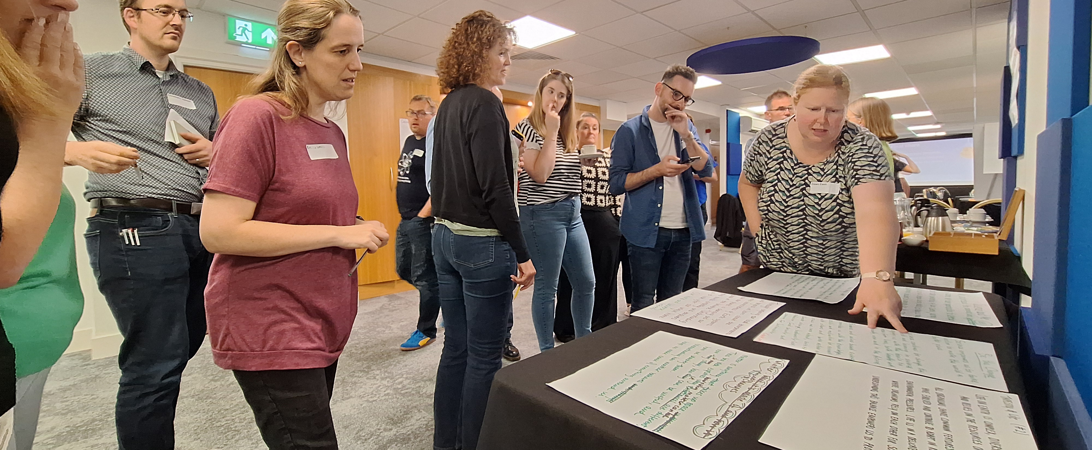
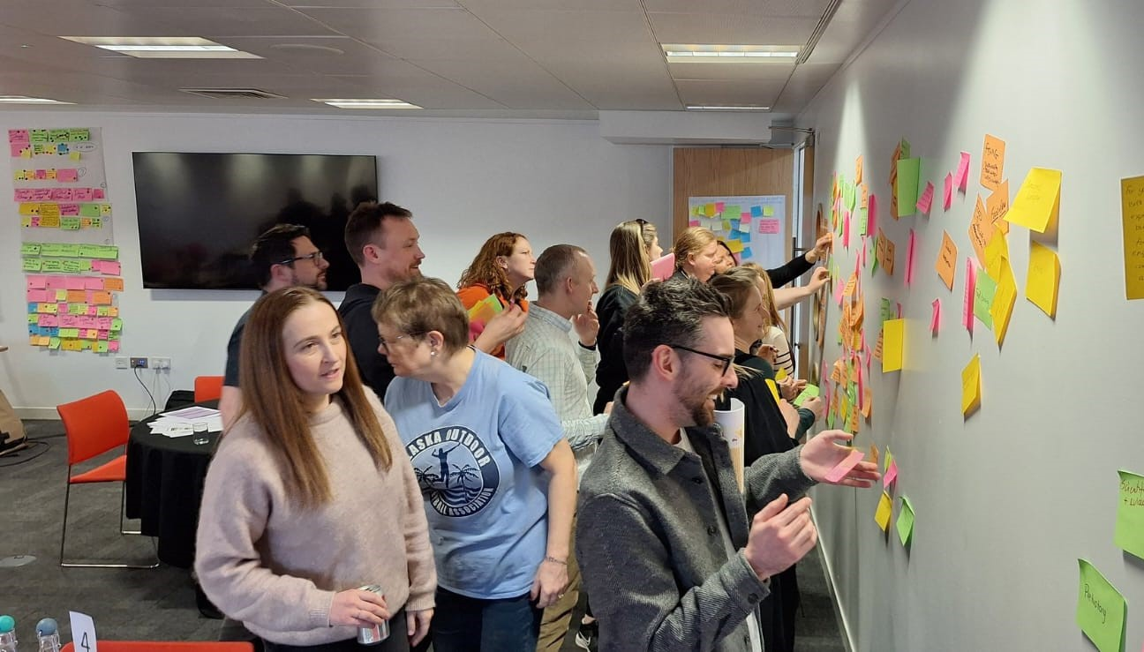
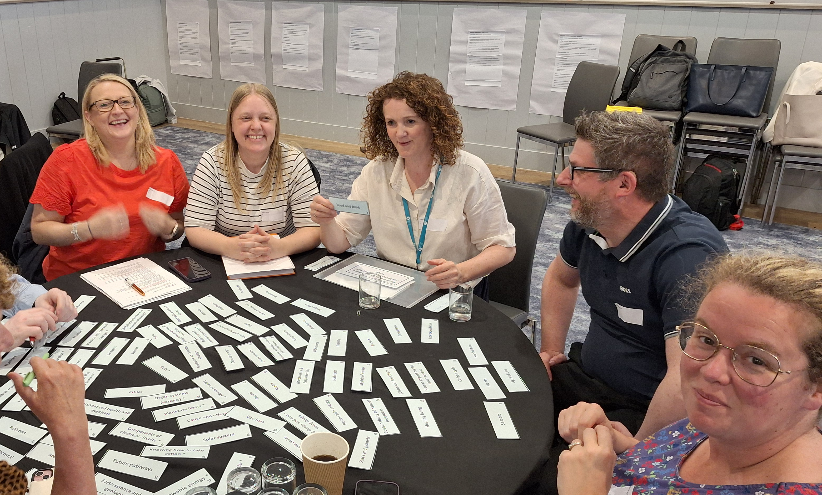
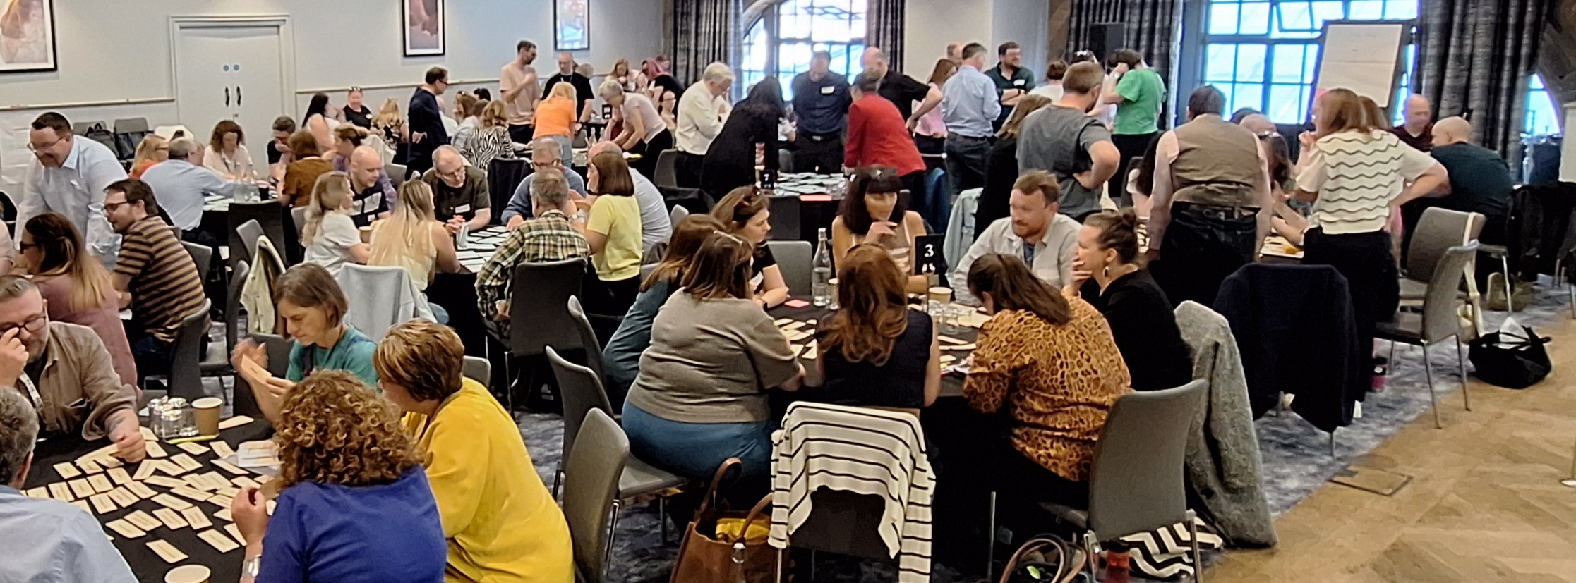
Notes:
But at the heart of this process is one key group — practitioners.
Education Scotland is taking a service design approach to curriculum review. This means that practicing teachers and practitioners are central to the work. At present we have over 1500 practitioners involved across all the CIC groups. These practitioners are helping to review and update the curriculum and are working alongside a range of stakeholder groups including academia, industry partners and ITE in the process.
Practitioner involvement is vital at every stage of the co-design process. Their insights, experiences, and perspectives ensure that the curriculum is practical, relevant, and meets the needs of children and young people across all sectors.
All eight curricular areas are now actively involved in the Curriculum Improvement Cycle.

Slide 7
Sciences CIC Groups
Steering
Group
Critical friends
The journey so far........
What's working/not working?
How does science support the four capacities?
What does a future-orientated science curriculum look/feel like?
Cross-curricular expectations
Curriculum rationale
Knowledge
Concepts
Big ideas
Senior Phase
Children and Young People
Technicians
Additional Support Needs
Early Learning and Childcare
Academia (HE/FE/ITE)
Industry
Core
Group
Collaboration
Group
Networks
Notes:
The Collaboration Group includes approximately 100 participants, 86 of whom are practitioners. Membership was determined through open recruitment using a set of criteria designed to ensure practitioner representation across all 32 local authorities, encompassing all sectors, roles, and levels of experience.
The role of the collaboration group is to:
▪ identify what works and what is not working in their area of focus;
▪ explore options and possible solutions to areas needing change or improvement;
▪ gather feedback on emerging proposals;
▪ sense check and test possible solutions;
▪ engage in sharing, learning, adopting; and
▪ be advocates for the overall CIC work.
The Sciences Core Group is made up of 30 participants drawn from the collaboration group. Of these 30 core group members, 21 are practitioners. The role of the core group is to:
• develop the options and possible solutions identified by the collaboration group;
• analyse and respond to feedback from collaboration, critical friends and steering groups; and
• comment and give feedback on relevant papers emerging from the overall CIC work.
The Collaboration Group and Core Group work in close alignment, with each informing and shaping the other’s activity. Insights and actions from one feed directly into the work of the other, creating a continuous cycle of learning, refinement, and impact.
The steering group is co-chaired by ADES, ES and SG and is made up of 10-15 participants from local and national government as well as representation from initial teacher education (ITE) (through the Scottish Council of Deans of Education). The role of the Steering group is to:
▪ create the enabling environment
▪ give /source strategic advice and direction
▪ provide support and challenge
▪ be advocates for the overall CIC, supporting and championing the work
▪ ensure a coherent response for each of the four phases of the CIC
▪ provide oversight and coordination of the overall work
▪ identify issues emerging from the overall work
▪ agree approaches to evaluation and monitoring
Critical friends support and complement the work of the Collaboration and Core Groups and they offer feedback and commentary as the work develops. Critical friends include practitioners, stakeholders and partners, employers and academics who volunteered or could not be involved directly in the Collaboration and Core Groups. At present, we have 97 active practitioners that make up the group of CFs. We have several focus groups that you can see on screen.
The role of the group is to:
▪ serve as a sounding board for ideas, proposals and approaches
▪ review and evaluate proposals, frameworks, and processes critically to identify areas for improvement
▪ provide an external lens to challenge assumptions and ensure innovative, evidence-based approaches
Via webinars such as this, our termly newsletters and the Science CIC blog, the science team are also connecting with wider networks to update and include their voices in the process at key points.
The work of all these key groups all feeds into the curriculum improvement cycle. A top line summary of the journey so far for the Science CIC process from our various events/workshops and online sessions can be seen on screen:
•What's working/not working
•How does science support the four capacities?
•What does a future-orientated science curriculum look/feel like?
•Cross-curricular expectations
•Curriculum rationale
•Knowledge
•Concepts
•Big ideas

Slide 8

Collaborative work between Maths and Science ES teams exploring alignment
Science CIC Core group has met online – reviewing the emerging big idea and concepts
Collaboration group has met online – reviewing curriculum rationale and the work emerging from the core group
Critical friends has met – update session on the progress of CIC, with a focus to the emerging big ideas and concepts.
Notes:
Update on the work that has progressed since our last webinar meeting
We held our first network webinar on 17 September 2025, and during that session we sought feedback from those in attendance on the emerging big ideas and concepts. Since then, the Core and Collaboration Groups, as well as the Critical Friends, have met online to reflect on this feedback and further develop the emerging ideas for the 3–18 sciences curriculum. The work coming from each of these groups will help to shape the focus for the next Core Group workshop due to take place mid-November
The Collaboration Group has also reviewed a draft curriculum rationale, which will be the focus of our next webinar in November 2025.
Finally, the Education Scotland Science team has been working closely with the Maths and Numeracy team to explore curriculum alignment. A number of joint actions are already underway.

Slide 9



https://blogs.glowscotland.org.uk/glowblogs/cices/
Notes:
For those of you interested in delving into the CIC journey a little deeper, you can find a range of materials on the Education Scotland CIC Web Hub
Curriculum Improvement Cycle – Education Scotland
On the blog you will find updates, publications, podcast links and an overview of the CIC process. You can also sign up for a termly newsletter, which will keep you abreast of all the current CIC updates.
You can access the three key CIC papers via the following links:
Paper 1: The background and a case for change: Findings of the pilot curriculum reviews
Paper 2: Towards an evolved technical framework.
Paper 3: ‘Working Together to Make Change Happen

Slide 10
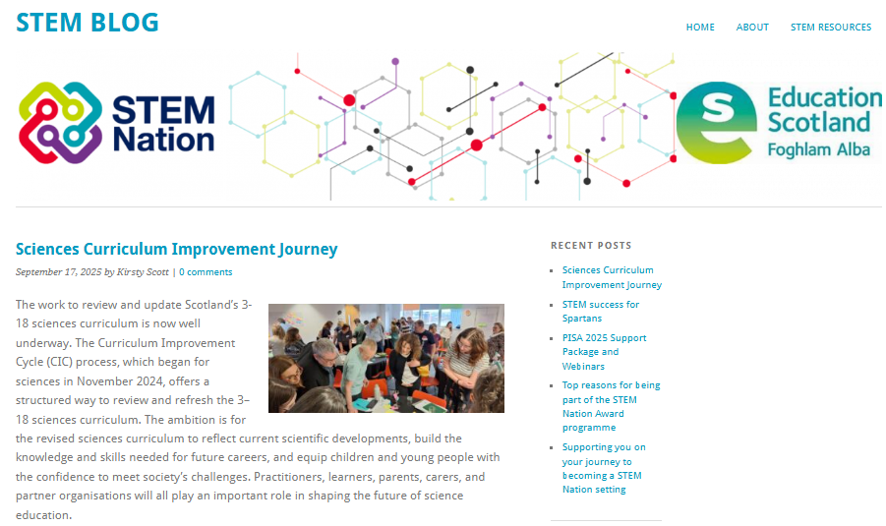
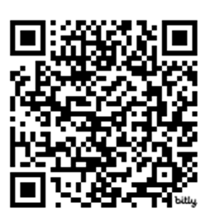
https://bit.ly/SciencesCICjourney
Notes:
As well as the general ES blog, we have our own – Science blog – which is our main portal for sharing all updates.
https://bit.ly/SciencesCICjourney
We’d encourage you to keep an eye on the blog for all things related to the science journey through the improvement cycle. We’ll be keeping it updated with outputs from the different CIC groups, as well as information about upcoming webinars.
We’ll also continue to share updates through the science and STEM networks, along with our termly science newsletter.
Our aim is to keep practitioners right up to date with the Sciences CIC process — so please do share the blog link with colleagues within your schools, settings and across your network where you can.

Slide 11


Photo: Kelly Siukkema, Unsplash
Language matters
Cross-cutting themes
Core competencies
Cross-curricular
expectations
Cross-curricular learning
Notes:
The language being used in the CIC continues to evolve based on feedback. The current term is cross curricular learning.

Slide 12
Key messages from the pilot reviews
Cross-curricular learning
Overly complex guidance
Reinforced their significance in future-oriented curriculum
Seen as an add on & only applied to BGE
Need clear and consistent approach
Often fragmented
Notes:
A series of pilot curriculum reviews were conducted to gather views and key messages on the CIC process and the aspects of the curriculum that needed to be addressed, as shown in the slide.
One of these areas was cross-curricular learning. The detailed feedback from these pilot reviews can be found in the three key ES publications (Background and Case for Change, Towards an Evolved Technical Framework and Working Together to Make Change Happen.

Slide 13
What has happened?
The process
Stakeholder group
sessions
Drafting of
big ideas
Paper will be published
Engagement with curricular areas via CIC groups
Engagement with critical friends
Children and young people engagement
1
2
3
4
5
6

Slide 14

Cross-curricular learning
Learning for Sustainability
Creativity
Democratic values
Digital
Entrepreneurship
Health and wellbeing
Language and Communication
Money and finance
Numeracy
Social justice, rights and equalities
Careers and pathways
Notes:
These are the 11 areas of cross-curricular learning

Slide 15

How?
We are decluttering the curriculum as a whole
Not doing everything – only those cross-curricular (CC) learning that sit naturally with science
Identifying the CC big ideas most relevant for sciences
Identifying core content for the sciences curriculum
A select group of others may be used as contexts for learning or themes for IDL projects
Purpose of this webinar
We need you to tell us your views! We want the CIC to be informed and shaped by practitioners. This is the service design approach.
Notes:
The slide shows some of the ways that cross-curricular learning can be embedded in the curriculum without increasing the amount of content that needs to be covered. Cross-curricular learning will be embedded in science where it makes most sense to do so and where there is strong alignment.
The key message coming from the pilot curriculum reviews is the need to declutter the curriculum. This bis a central aim of the Curriculum Improvement Cycle.

Slide 16
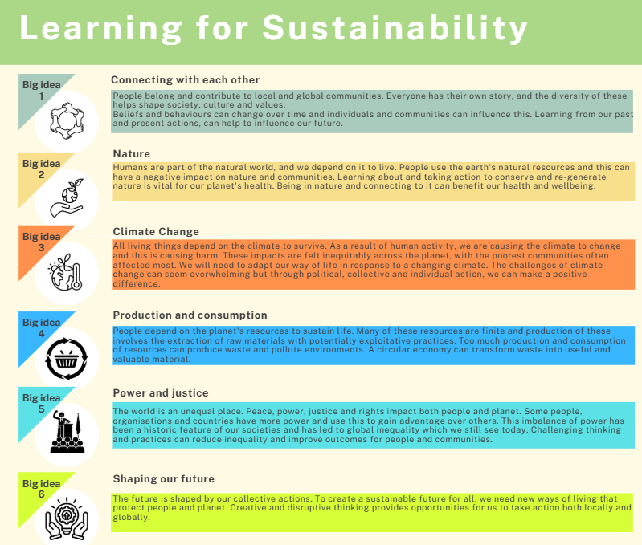

Notes:
Through 2024, a range of CIC stakeholder Core Groups met to develop the big ideas for each of the cross-curriculum learning themes. This slide shows the six big ideas for Learning for Sustainability.

Slide 17
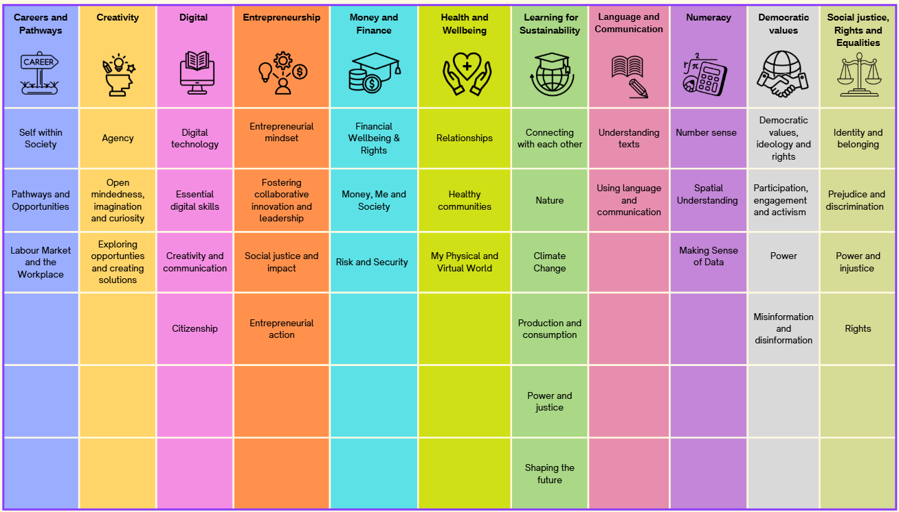
Cross-curricular expectations
Big ideas overview
Notes:
This slide shows the big ideas developed for all the cross-curricular learning themes.

Slide 18
Cross-curricular expectations
Big ideas overview
Notes:
This slide shows that similar big ideas emerged from some of the groups - showing areas of connection and where some of the big ideas could be merged or streamlined.

Slide 19

Future vision ˗ Learning for Sustainability
The current generation of learners see climate change as one of the most significant issues facing their futures and, as such, must be recognised as a key driver influencing the future of our education system.
All efforts, whether concerned with educational recovery post-pandemic or in terms of the future vision for Scottish education, must be directed to the purposes described in Article 29 of the UNCRC.
https://www.gov.scot/publications/putting-learners-centre-towards-future-vision-scottish-education/
For Scotland's learners, with Scotland's educators
Notes:
Let’s not forget the importance of the cross-curriculum themes within our curriculum. They have a central role to play in enriching and supporting our curriculum and preparing learners for life in the 21st century.
We are entering into a period of significant reform in Scottish education. This report by Prof Ken Muir makes clear that climate change, Learning for Sustainability and the United Nations Convention on the Rights of the Child must be recognised as key drivers influencing the future of our education system.
Why? The answer is simple – because that is what our learners are asking and demanding of us. This came out strongly in his extensive consultation with learners as he was preparing the report.

Slide 20
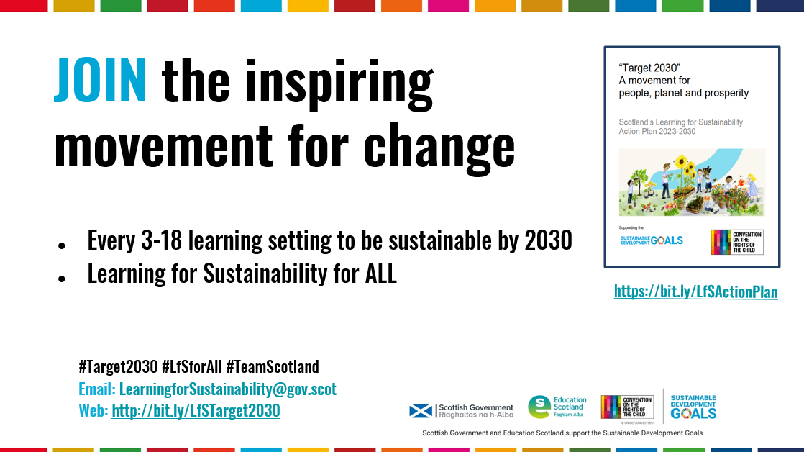
Notes:
Target 2030 is the national Scottish Government action plan for Learning for Sustainability. The Target is for all 3-18 education settings in Scotland to be sustainable by 2030 and for all learners to receive their curriculum entitlement to Learning for Sustainability. This is a key reason why Learning for Sustainability is one of the areas of cross-curriculum learning.

Slide 21

Space
Healthcare
Advanced manufacturing
Life and chemical sciences
engineering
Green economy
Energy
Fintech
Food and drink
Creative & digital media
Robotics
Land and nature
Photo: SpaceX, Unsplash
Notes:
These are some of the exciting economic sectors in Scotland which strong connections to science and STEM. It is important that our future-orientated curriculum equips learners with the skills, knowledge and capabilities to access these jobs and pathways. Curriculum for Excellence has always had Skills for Learning, Life and Work at its heart. Careers and pathways is, therefore, an important cross-curriculum theme for learning.

Slide 22
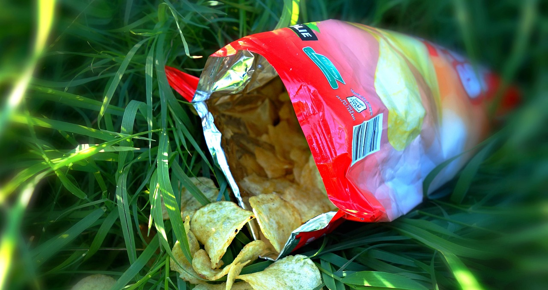


Health & wellbeing
Photos: StockSnap, PublicDomainPictures, Mabel Amber, Pixabay
Notes:
Health and wellbeing is also a valuable cross-curricular theme for learning and plays an important role in encouraging and supporting children and young people to make effective decisions to maintain good physical, emotional, mental and social health and wellbeing.

Slide 23

Are we ready?
Notes:
Digital innovation and developments will continue to shape our lives. Developments in relation to AI and robotics could have significant impact, hence the reason why Digital is an important cross-curricular theme for learning.
Other themes have not been covered here but play an equally valuable role in preparing learners for life in the modern world.

Slide 24
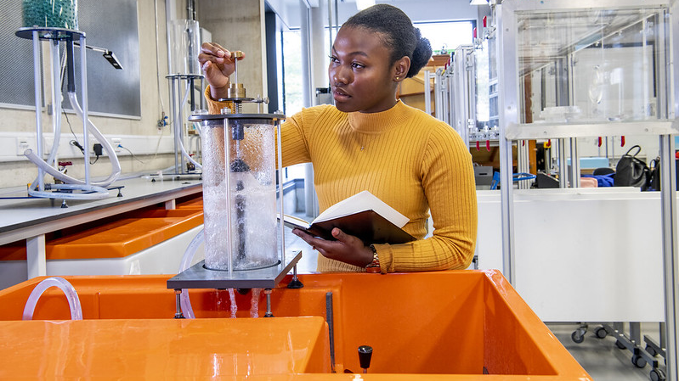

Photo: University of Southampton. Civil Engineering. This is Engineering
https://education.gov.scot/media/0skjinph/ekosgen-structural-barriers-to-stem-engagement-year-3-report-nov-2022.pdf
“There is a real need to ensure that STEM education being provided in schools is rooted in the real world, and of direct relevance not only for their future career choices, but accurately represents STEM-related enterprises and sectors of the economy. More and better information regarding STEM jobs is also required.”
Notes:
Education Scotland commission the research consultants, Ekosgen, to undertake an evaluation of Scotland’s STEM education and Training Strategy. As part of this, some 1300+ learners and 500 parents were consulted.
We asked them what more could be done to encourage children and young people to be engaged in science and STEM and to be encouraged to pursue these pathways. The slide highlights the central fining – connecting learning to real-life and the world of work.
Cross-curriculum learning plays a central role in connecting to real life and the world of work- again, highlighting its importance within our curriculum and underlining why it needs to be embedded, as opposed to be seeing to be ‘additional’.

Slide 25

The importance of project-based learning, inter-disciplinary learning and out-of-class activities in supporting STEM engagement should not be underestimated. Challenge- or project-based activities (often utilising externally-provided resources) with demonstrable real-world application will help to bridge the gap between the classroom and real life.
https://education.gov.scot/resources/a-summary-of-stem-resources/
Notes:
Again, this further evaluation report from Ekosgen highlights the importance of real-world application, project-based learning and interdisciplinary learning in the curriculum for engagement and motivation of learners. Cross-curriculum learning supports this approach to learning and can bring the curriculum to life.

Slide 26
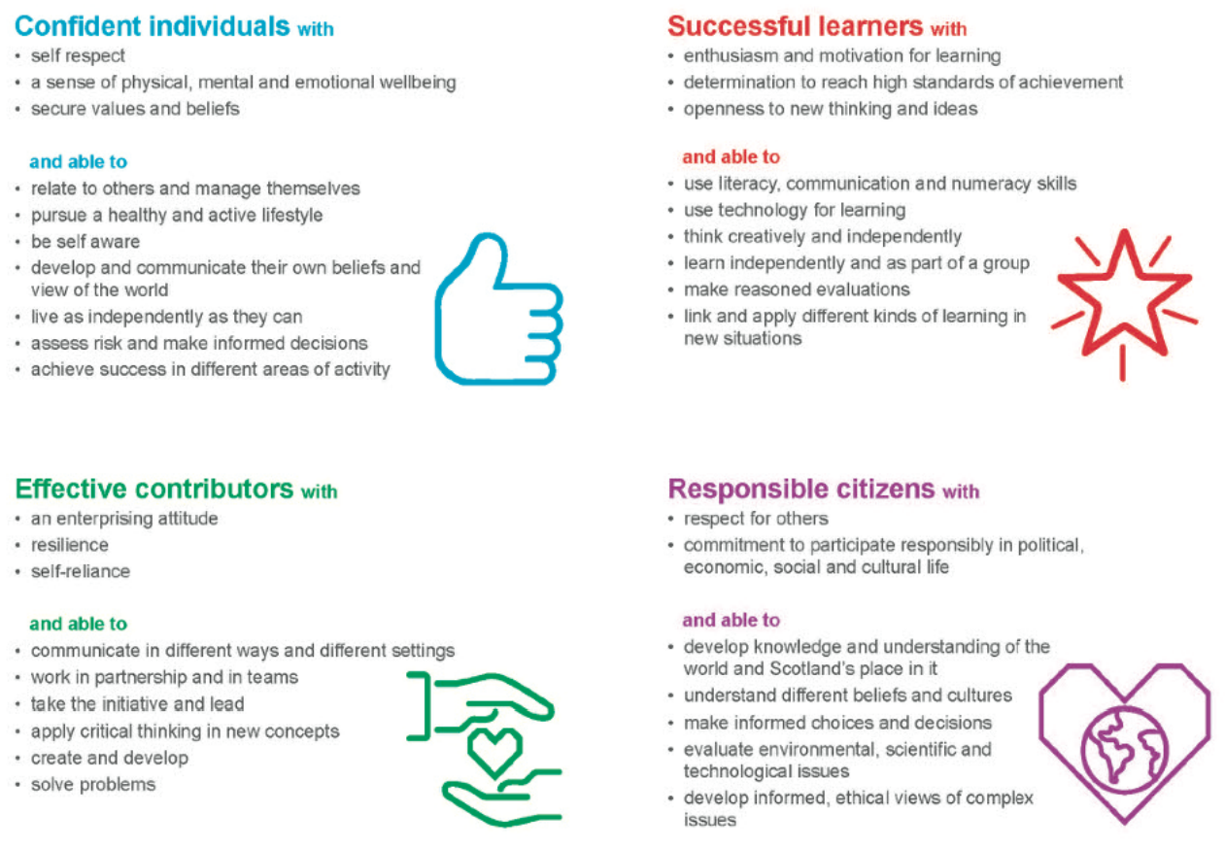
Notes:
Clear alignments can and should be made with the purposes of Scotland's curriculum as set out in the four capacities. All of the cross-curricular areas of learning contribute to the development of individuals, contributors, learners and citizens.
Work is also underway to integrate the cross-curricular learning, where natural alignment exists, into the four contexts for learning – opportunities for personal achievement, ethos and life of the school/setting, curriculum areas and interdisciplinary learning. As each of the curriculum areas develop their big ideas and work on the related layers to their technical framework there will be opportunities to make links to relevant cross-curricular asks.

Slide 27

How do these cross-curricular expectations align with science?
Notes:
This was the focus question for the Mentimeter poll which took place during this webinar.

Slide 28

Your views matter
Choose three or four cross curricular expectations that have ‘natural links’ to the sciences curriculum.
Core content
Contexts for learning
IDL/PBL opportunities
Notes:
This was the focus question for the Mentimeter poll which took place during this webinar.

Slide 29

Your views matter
Which of the cross curricular expectation big ideas are most relevant for the sciences curriculum?
Notes:
This was the focus question for the Mentimeter poll which took place during this webinar.

Slide 30
Cross-curricular expectations
Big ideas overview
Notes:
This slide was shown during the Mentimeter poll to support the voting process.

Slide 31
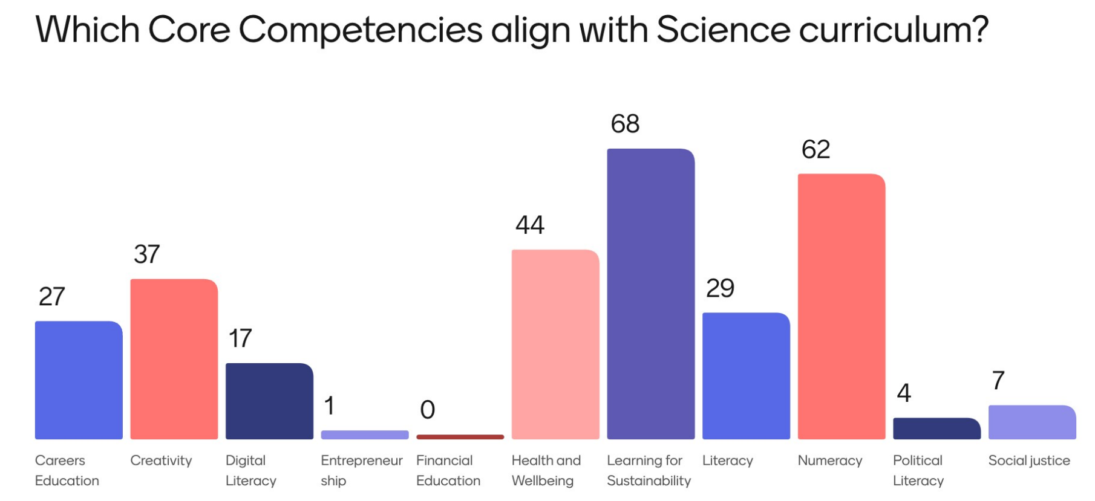
Money & finance
Language & communication
Democracy & values
Social justice, rights & equalities
Notes:
Note: This slide was shown after the live Mentimeter poll in the webinar had taken place.
In May 2025, the Sciences CIC Collaboration Group was asked to take part in the poll and their results are shown here in this slide for comparison.
Some of the names of the cross-curricular themes of learning have changed since this earlier poll was taken. The changes are noted at the bottom of the slide. The cross-curricular areas of learning were referred to as ‘core competencies’ when this earlier poll took place.

Slide 32

Cross-curricular big ideas ranked in May (Collaboration Group)
Climate Change (Sustainability) - 57
Making sense of data (Numeracy) - 56
Nature (Sustainability) - 52
Healthy Communities (Health and Wellbeing) - 30
Number Sense (Numeracy) - 28
Production and Consumption (Sustainability) - 27
Open-mindedness, imagination & curiosity (Creativity) - 25
Exploring opportunities & creating solutions (Creativity) - 25
Shaping our future (Learning for Sustainability) - 24
Pathways and Careers (Careers Education) - 21
My physical and virtual world (Health and Wellbeing) - 21
Critical Literacy (Literacy) - 20
Notes:
The Collaboration Group were also asked in May to identify which big ideas from their identified cross curricular areas of learning they thought were most relevant for the sciences curriculum.
Those big ideas voted for the most are shown.
Point to note that some of the titles for the big ideas have since changed.

Slide 33
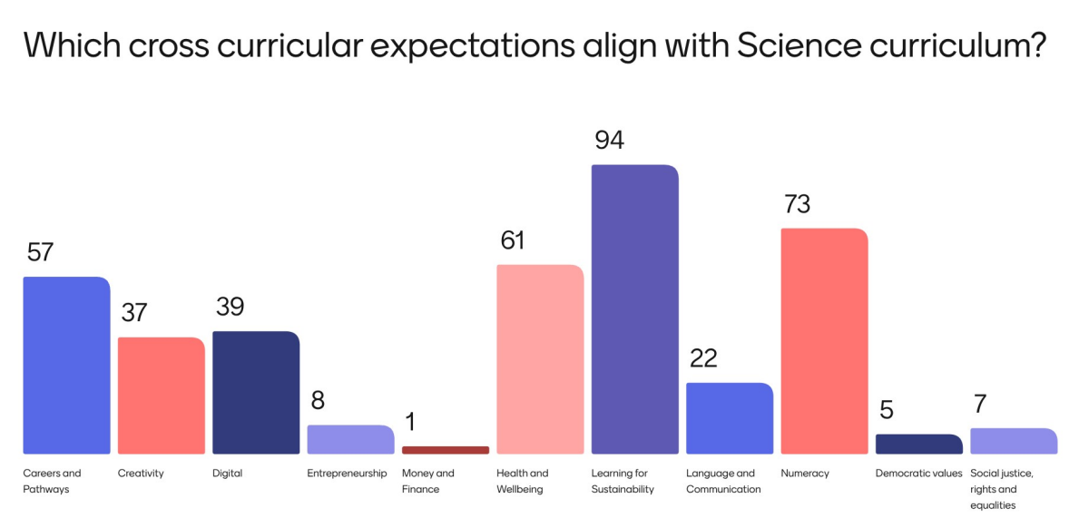
Notes:
For comparison, these are the results from the live Mentimeter poll carried out during this webinar

Slide 34

Cross-curricular big ideas ranked from the webinar
Cross cutting expectation | Big idea | Votes
Numeracy | Making sense of data | 93
Learning for Sustainability | Climate change | 92
Careers | Pathways and opportunities | 91
Learning for Sustainability | Nature | 91
Creativity | Exploring opportunities and creating solutions | 90
Health and wellbeing | Healthy communities | 87
Democratic values | Misinformation and disinformation | 85
Digital | Essential digital skills | 83
Learning for Sustainability | Shaping our future | 80
Numeracy | Number sense | 79
Notes:
These are the results from the live Mentimeter poll carried out during this webinar

Slide 35
In terms of cross-curriculum learning…
What do you consider to be the core knowledge for the sciences 3-18 curriculum for your sector?
Notes:
Attendees were then invited to complete a GLOW form to capture initial feedback on core science knowledge that was aligned (per sector) to the top ranked big ideas
Please note – this glow form is now closed

Slide 36

Next steps
Rationale - refining
Refine emerging big ideas and concepts
Alignment with cross curricular learning
Develop knowledge statements for each concept, aligned with the big ideas
AIM: June 2026, draft of the 3-18 science curriculum ready for consultation.
Engagement with children and young people
Notes:
Items one and two relate to the theme of our next webinar – registration details can be found on the next slide

Slide 37

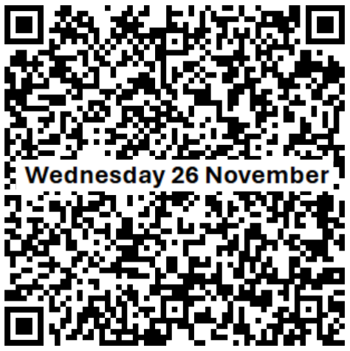
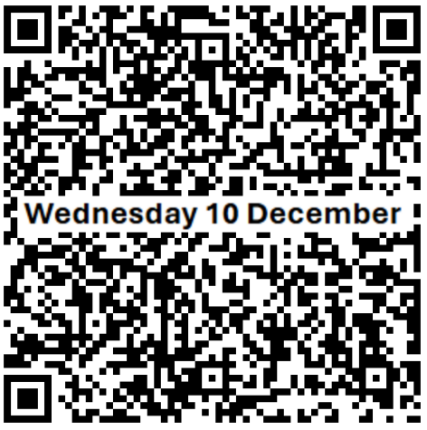
Future webinar dates
Wednesday 26 November 4:00 to 5:30pm
Curriculum rationale
Wednesday 10 December 4:00 to 5:30pm
Big ideas & concepts
Notes:
The next 2 webinars coincide with Core and Collaboration group events – so emerging updates from these events will be able to be shared at the webinars
Eventbrite registration
Webinar 3 – 26 November Sciences Network – Curriculum Improvement Cycle Webinar 3 Tickets, Wed, Nov 26, 2025 at 4:00 PM | Eventbrite
Webinar 4 – 10 December Sciences Network – Curriculum Improvement Cycle Webinar 4 Tickets, Wed, Dec 10, 2025 at 4:00 PM | Eventbrite

Slide 38
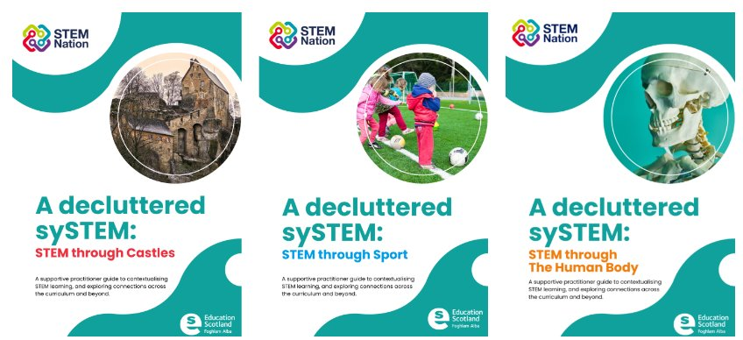
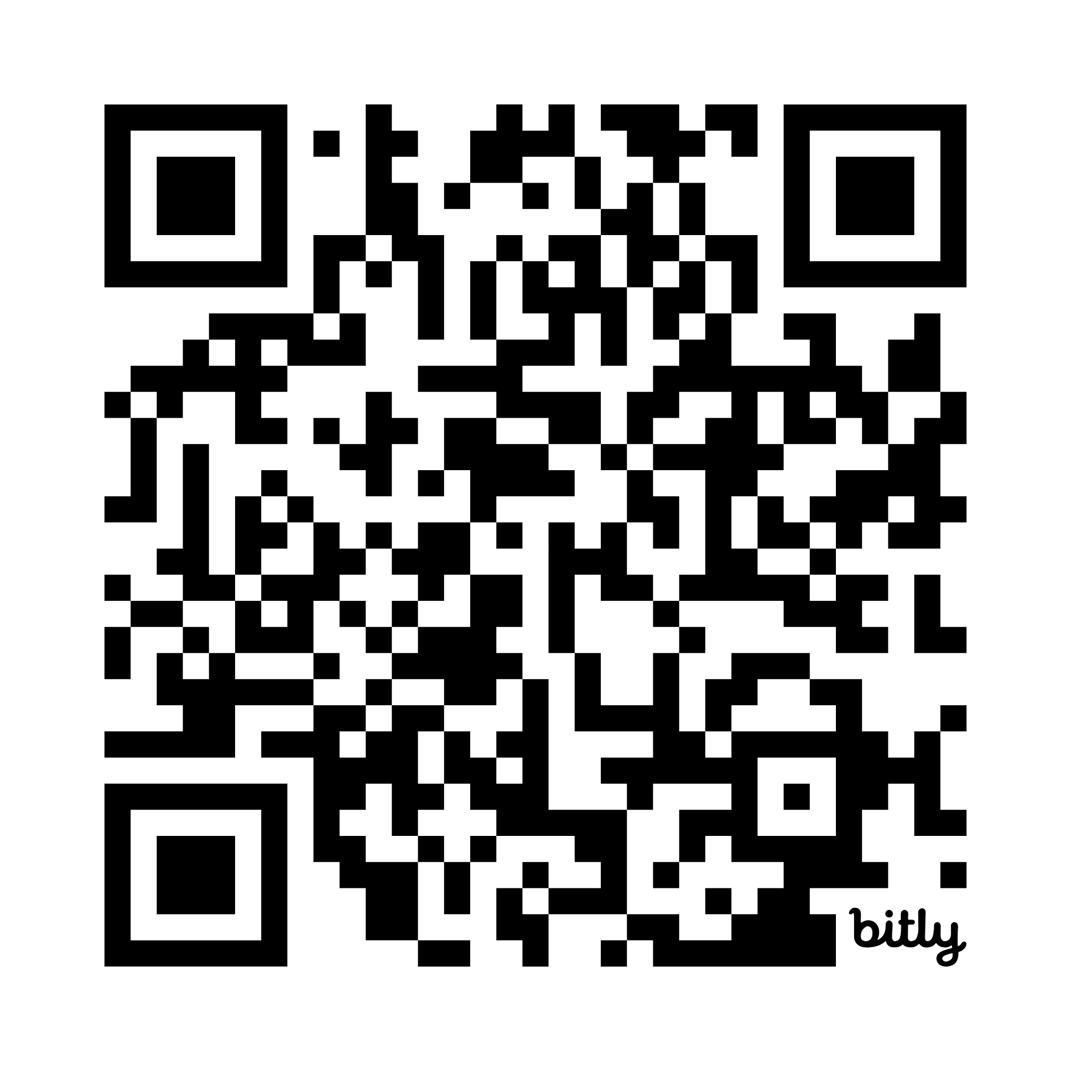
http://bit.ly/4nVYUnT
A Decluttered SySTEM
http://bit.ly/4nVYUnT
Notes:
We would also like to introduce you to some resources that the STEM team at Education Scotland have developed to help make connections across the curriculum using STEM as a context for learning and teaching.
It is a tool to support conversation, planning and discussion when looking towards a future-orientated curriculum and a streamlined approach to curriculum design. The resources and activities provide starting points and suggestions and they are in no way prescriptive or bound by level. You will find copies of these resources on your tables, which we will refer to during this workshop, but the QR code and link are also on the board for future reference.
There is an accompanying planning sheet.

Slide 39




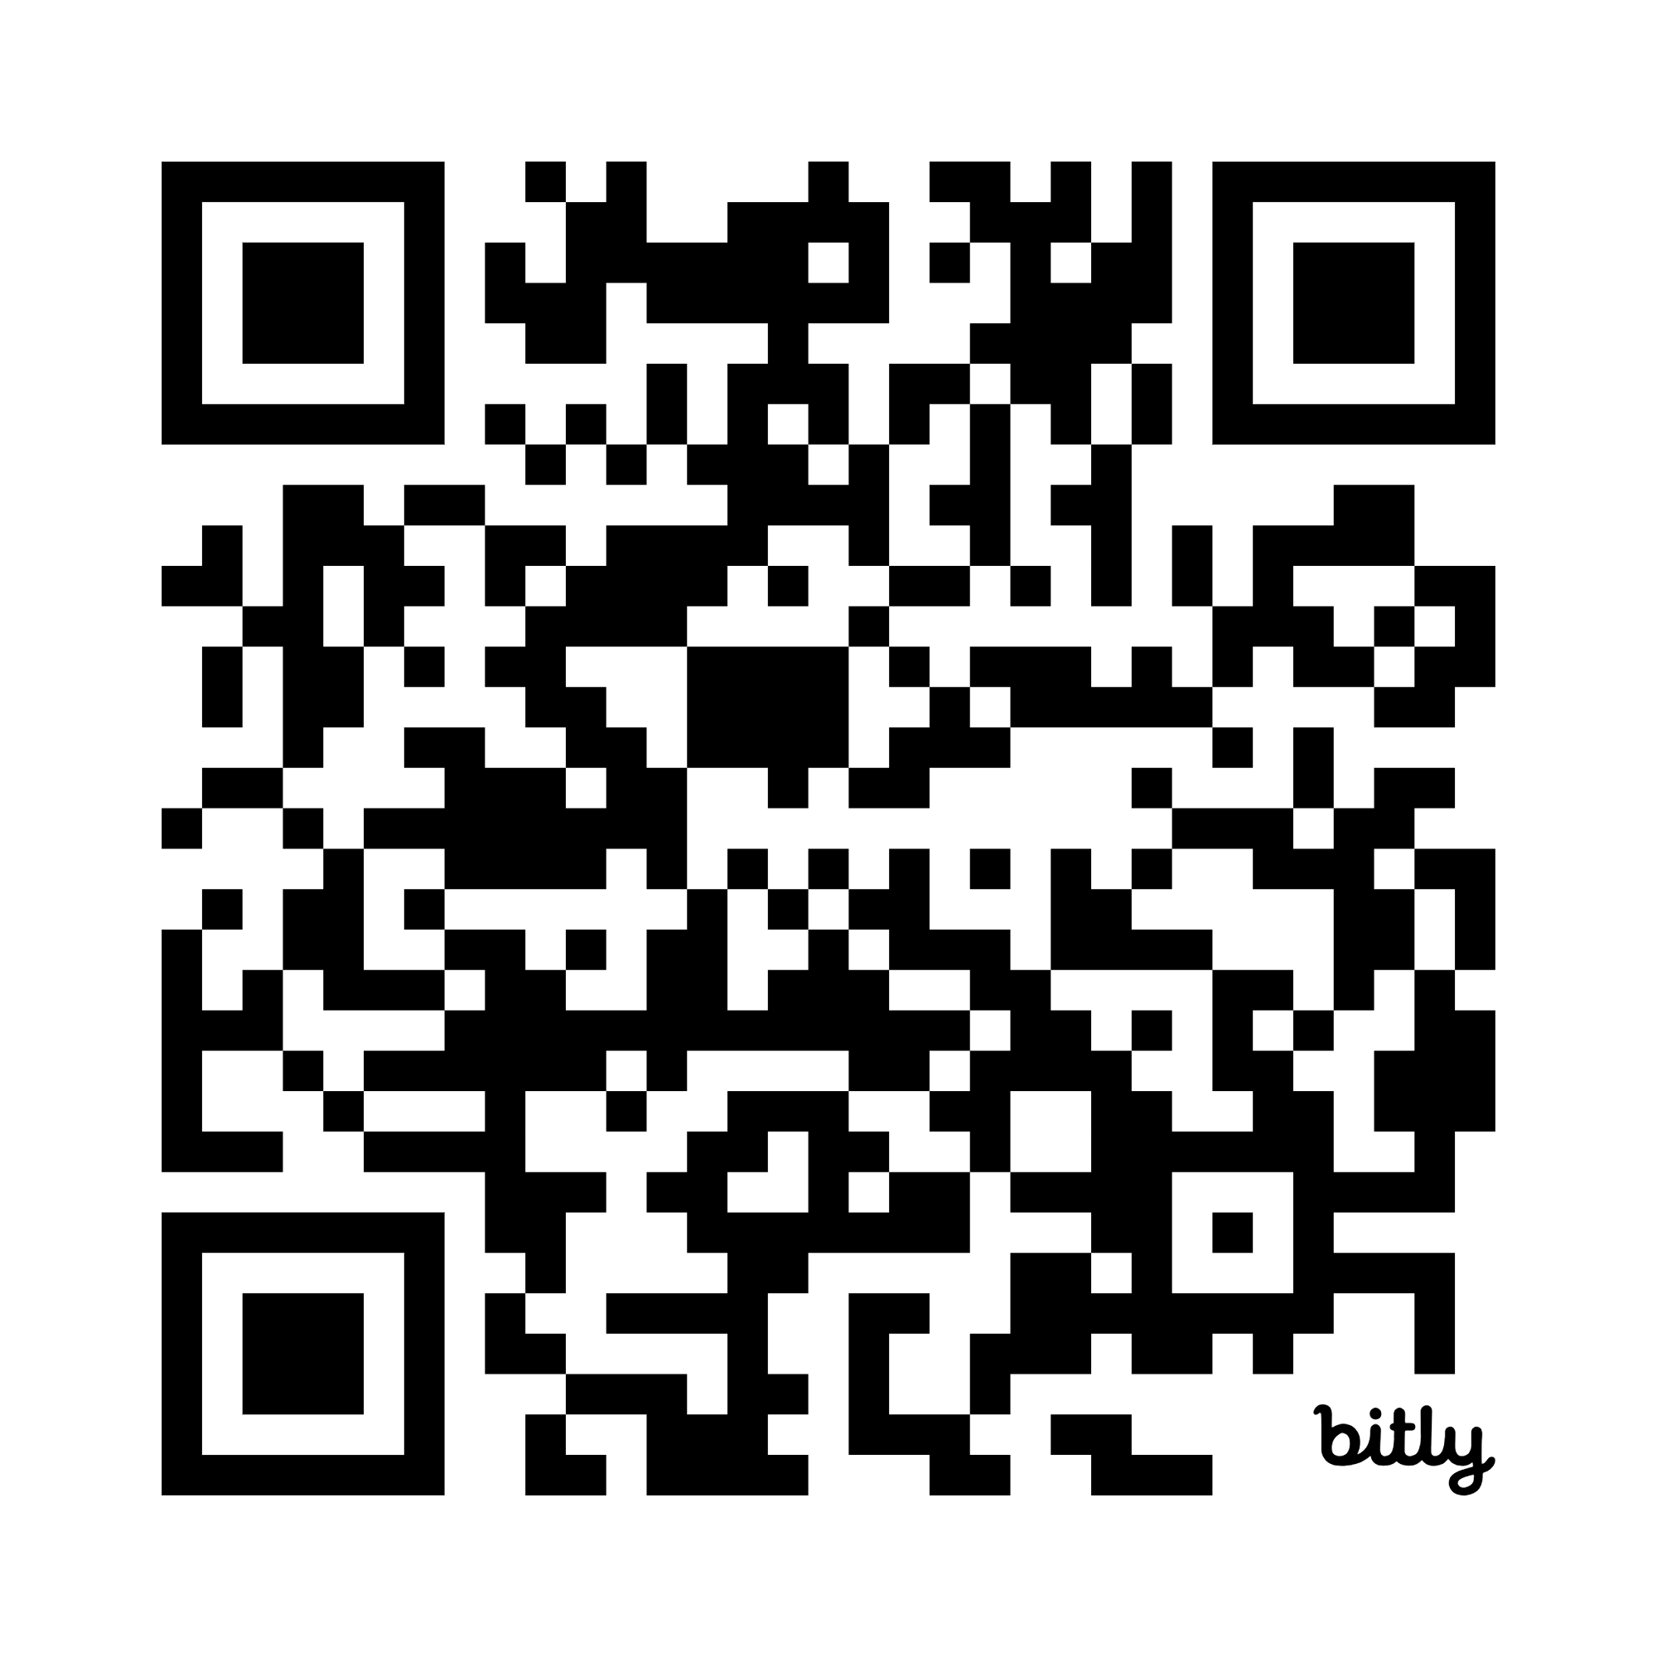


http://bit.ly/4nVYUnT
STEM Nation Award
http://bit.ly/4nY1slm
Notes:
Education Scotland’s STEM Nation Award programme recognises and celebrates the efforts of settings in relation to STEM learning. There are over 400 settings registered for the award, meaning over 130,000 learners are in settings committed to whole school approaches to STEM learning. The award is open to early learning and childcare, school and community learning and development settings.
Click on the links to find out more.

Slide 40
Science Newsletter – issued termly
Next issue – November
Sciences CIC Blog:
https://bit.ly/SciencesCICjourney
ES Science Network
Joining link https://bit.ly/3WfFnBl
Join code: uh9sf32
Email the science team at:
Science@educationscotland.gov.scot
Stay up to date
Notes:
Join our networks or visits these pages to stay up to date with the Curriculum Improvement Cycle.

