Slide 1

Notes for users
The slide scripts and links to documents / webpages can be found in the notes section of each slide
You are welcome to use these slides as suits your needs. Please ensure the information is conveyed accurately to avoid misunderstandings.
This is a presentation from a webinar held in September 2025. The Curriculum Improvement Process is underway and the information, including the sciences big ideas, are evolving and changing quickly. The information here is clearly labelled as draft and thinking has already moved on.
  Any questions, please get in touch:
  Science@educationscotland.gov.scot

Slide 2

Sciences Curriculum Improvement Cycle (CIC)
Science Network Webinar
Focus: Snapshot of evolving sciences big ideas
17 September 2025

Slide 3

Agenda
Welcome
Science CIC journey
Emerging Big Ideas
Staying connected

Slide 4

Education Scotland Science Team
Kirsty Scott and Jane Wilson National Advisors
Fiona Shaw, Margaret Craw and Laura McCafferty Education Officers
Ian Menzies Senior Education Officer
Contact us at:
Science@educationscotland.gov.scot

Slide 5

Notes:
Curriculum Improvement Cycle – Education Scotland
The Curriculum Improvement Cycle (CIC) Web Hub is easy to navigate – the QR code will link you to it but the weblink can also be found above if required.
If you are interested to learn more about the CIC process and how we got to where we are, then a good place to start exploring would be the About the CIC tab in the navigation at the top of this page. If you want to dive a bit deeper, you will find lots of information and links to a variety of publications in the Useful Reading section.
There’s now a termly e-Bulletin giving updates on progress with the CIC. You can sign up on the CIC Web Hub

Slide 6

Notes:
Curriculum Improvement Cycle – Journey
The Curriculum Improvement Cycle (CIC) journey for the sciences curriculum began in October 2024, with open recruitment for members to join the Collaboration group. Our first CIC event was held in Glasgow on 28 November 2024 with the Collaboration Group.

Slide 7

What will life be like in 2038/39?
How can our curriculum, learning and teaching best prepare our learners for this future?
What is the role of sciences education in this?
Photo: Drew Beamer, Unsplash
Notes:
As we review the 3–18 sciences curriculum it is important that we make sure the content of the curriculum continues to meet the needs of today’s learners and prepares them for the future.
Science and STEM are constantly evolving, and by taking a futures-focused approach, the CIC process allows us to ensure that what we teach remains relevant and inspiring. This will ensure we equip children and young people with the skills, knowledge, and curiosity they need in a rapidly changing world.
As we embark on this process, it is crucial that we take time to consider the future – the curriculum will be updated in ten-year cycles so the curriculum we are building now will still be experienced by learners in 2038/29. What will the world be like then? What will children and young people need from their science learning to thrive in society and succeed in the workplace?

Slide 8

Why?
3.4 Develop a systematic approach to curriculum review: Scotland could consider establishing a systematic curriculum review cycle with a planned timeframe and specific review agenda, led by the specialist stand-alone agency.
OECD
Review
M | J | J | A | S | O | N | D | J | F | M | A | M | J | J | A | S | O | N | D | J | F | M | A
2021 |  |  |  |  |  |  |  | 2022 |  |  |  |  |  |  |  |  |  |  |  | 2023
Notes:
The Organisation for Economic Cooperation and Development (OECD) was commissioned by the Scottish Government to review Curriculum for Excellence. The resulting report, Scotland’s Curriculum for Excellence: Into the Future, was published in June 2021.
One of the key recommendations was for Scotland to consider establishing a systematic curriculum review cycle with a planned timeframe and specific review agenda, led by the specialist stand-alone agency. This action had led to the establishment of the Curriculum Review Cycle in 2023/24.

Slide 9
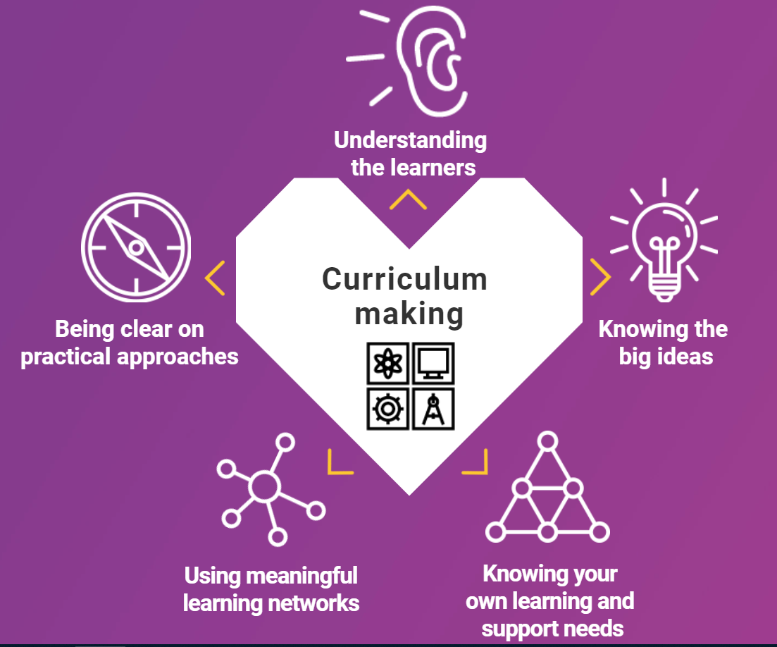
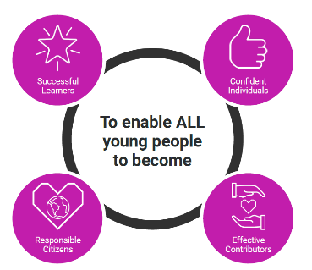

Scotland’s Curriculum Framework – not changing
why | what | how
 | + entitlements
www.scotlandscurriculum.scot
Notes:
The OECD report was supportive of the vision of Curriculum for Excellence, including the four capacities. The Why, What and How of CfE remain relevant and will continue to play a central role into the next phase of the curriculum.
The WHY: This is encapsulated by the four capacities
The WHAT: The four contexts for learning outline the totality of what we mean by ‘curriculum’ in Scotland
The HOW: These five aspects serve as the bridge between policy and what happens in settings.

Slide 10
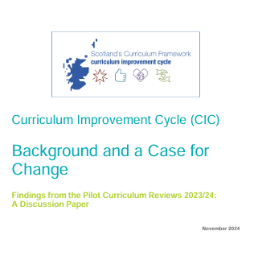
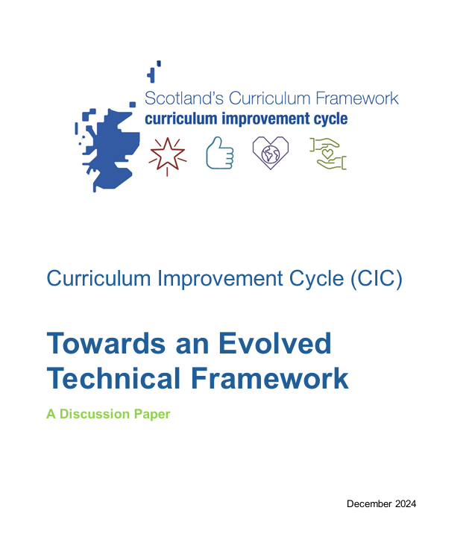

Curriculum improvement cycle
Discussion papers
Why?
What?
How?
Notes:
These are the three discussion papers which set out the 'why', 'what' and 'how' for changing the technical framework of the curriculum. The papers draw on the findings, key messages and learning from the pilot curriculum reviews.
The papers are available on the CIC Glow Blog - Curriculum Improvement Cycle – Education Scotland
The direct links are as follows:
Paper 1 CIC-A-CASE-FOR-CHANGE-PILOT-CURRICULUM-REVIEWS141124.pdf
Paper 2 CIC-Towards-an-Evolved-Technical-Framework-Discussion-Paper-FINAL-191224.pdf
Paper 3 020425-CIC-Working-Together-to-Make-Change-Happen-V1.0.pdf

Slide 11

Key findings from pilot curriculum reviews
Need to declutter the curriculum & streamline guidance
Clarify role of knowledge - This would support transitions and progression
Recognise difference between curriculum areas
Disconnect between BGE and senior phase
Lack of clear national standard for moderation decisions
Cross-curricular knowledge and skills
Notes:
In response to the OECD review, Education Scotland instigated a series of pilot curriculum reviews in a small number of curriculum areas to engage with practitioners and stakeholders. The discussions and feedback helped to develop early thinking around some of the key priorities that needed to be addressed through a process of curriculum review.
The sciences curriculum was not included in the pilot curriculum reviews as the Education Scotland Sciences Team was heavily committed to a series of 13 national events over this period.

Slide 12

Our current technical framework is defined as all documents used by educators to plan what young people learn, including guidance such as the Es and Os, benchmarks, progression frameworks, responsibilities for all, as well as approaches to moderation.
Notes:
Full paper: Towards an Evolved Technical Framework
Podcast: Towards an Evolved Technical Framework
This slide makes clear what we mean by the technical framework of the curriculum. Participants in the pilot reviews generally took the view that an evolved technical framework could address some of the challenges that had been experienced within the current technical framework.
Paper two was published in December 2024. This paper draws on and responds to the findings from the pilot curriculum reviews and other evidence to explain what the options might be to evolve the Technical Framework of Scotland’s Curriculum. It proposes a know, do, understand model based on Big Ideas.

Slide 13
Sciences CIC Groups
Steering
Group
Networks
Critical Friends Focus Groups
Senior Phase
Children and Young People
Technicians
Additional Support Needs
Early Learning and Childcare
Academia (HE/FE/ITE)
Industry
Critical friends
Core
Group
Networks
Collaboration
Group
Notes:
The Collaboration Group includes approximately 100 participants, 86 of whom are practitioners. Membership was determined through open recruitment using a set of criteria designed to ensure practitioner representation across all 32 local authorities, encompassing all sectors, roles, and levels of experience.
The role of the collaboration group is to:
▪ identify what works and what is not working in their area of focus;
▪ explore options and possible solutions to areas needing change or improvement;
▪ gather feedback on emerging proposals;
▪ sense check and test possible solutions;
▪ engage in sharing, learning, adopting; and
▪ be advocates for the overall CIC work.
The Sciences Core Group is made up of 30 participants drawn from the collaboration group. Of these 30 core group members, 21 are practitioners. The role of the core group is to:
• develop the options and possible solutions identified by the collaboration group;
• analyse and respond to feedback from collaboration, critical friends and steering groups; and
• comment and give feedback on relevant papers emerging from the overall CIC work.
The Collaboration Group and Core Group work in close alignment, with each informing and shaping the other’s activity. Insights and actions from one feed directly into the work of the other, creating a continuous cycle of learning, refinement, and impact.
The Steering Group is co-chaired by ADES (Association of Directors of Education in Scotland), Education Scotland and Scottish Government and is made up of 10-15 participants from local and national government as well as representation from initial teacher education (ITE) (through the Scottish Council of Deans of Education). The role of the Steering group is to:
▪ create the enabling environment
▪ give /source strategic advice and direction
▪ provide support and challenge
▪ be advocates for the overall CIC, supporting and championing the work
▪ ensure a coherent response for each of the four phases of the CIC
▪ provide oversight and coordination of the overall work
▪ identify issues emerging from the overall work
▪ agree approaches to evaluation and monitoring
Critical friends groups complement the work of our Collaboration and Core Groups and they offer feedback and commentary as the work develops. Critical friends include practitioners, stakeholders and partners, employers and academics who volunteered or could not be involved directly in the Collaboration and Core Groups. At present we have 97 active practitioners that make up the group of Critical Friends. The role of the Critical Friends are to:
▪ serve as a sounding board for ideas, proposals and approaches
▪ review and evaluate proposals, frameworks, and processes critically to identify areas for improvement
▪ provide an external lens to challenge assumptions and ensure innovative, evidence-based approaches
Via webinars such as this, our termly newsletters and the Science CIC blog, the science team are also connecting with wider networks to update and include their voices in the process at key points.

Slide 14
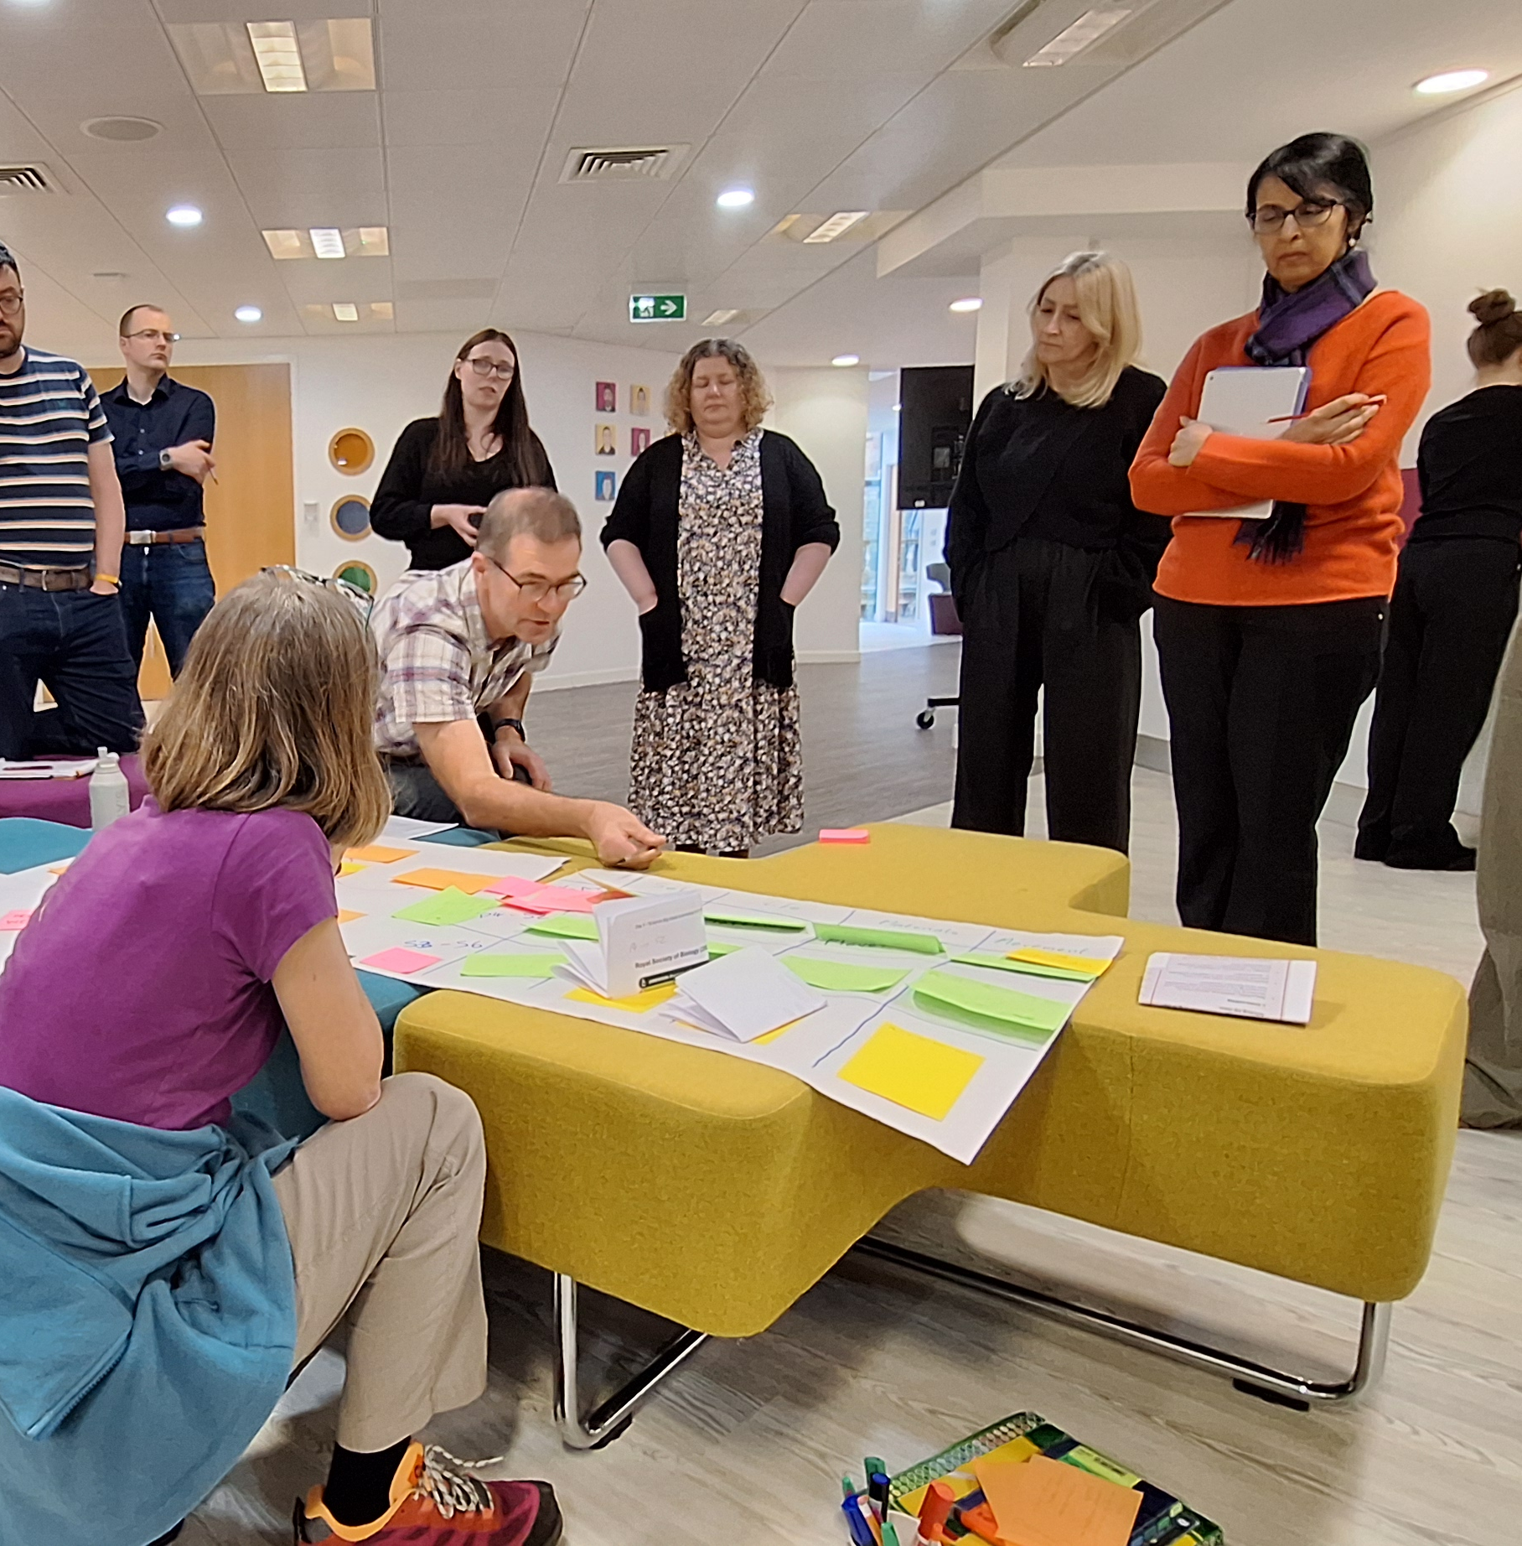
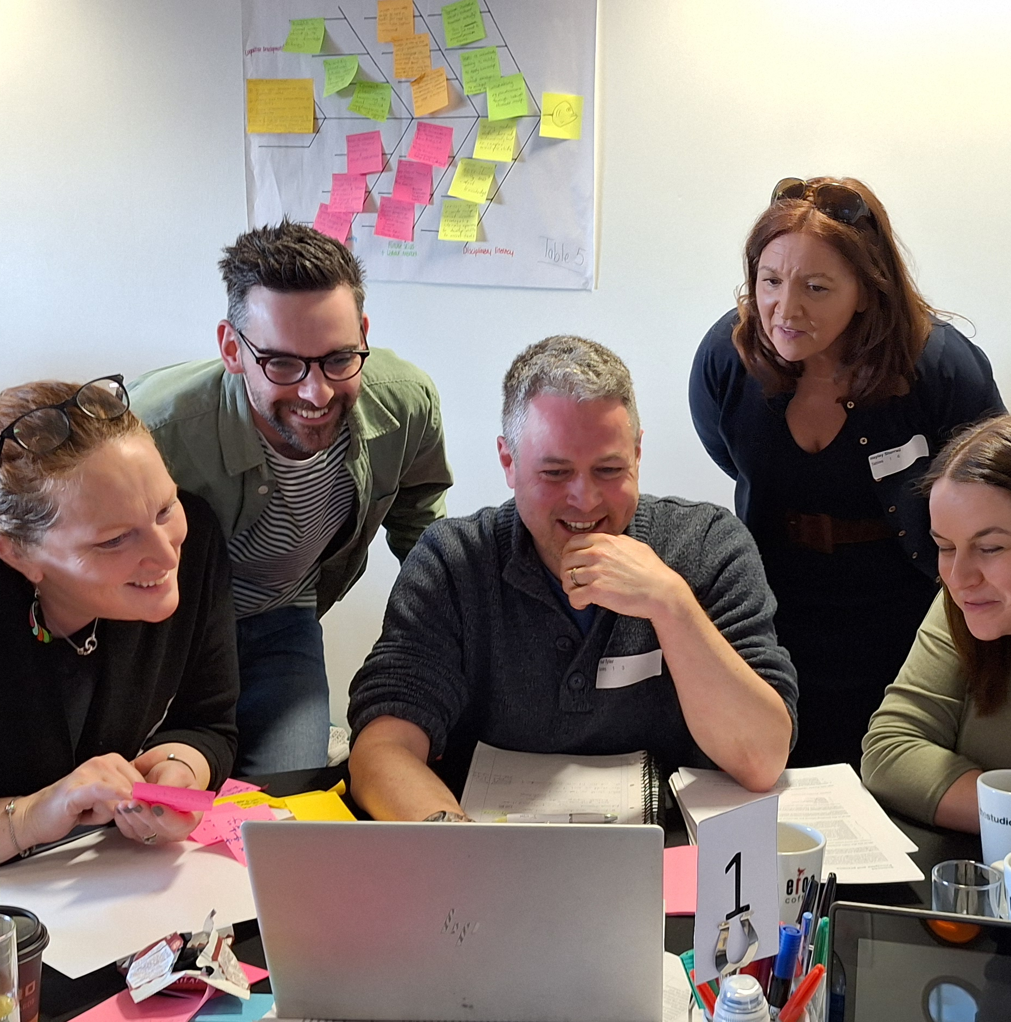
Sciences CIC Groups
Notes:
The sciences CIC groups are made up of practising educators from ELC, primary, ASN, secondary and community learning and development sectors. In the last year we have had a significant number of meetings, both online and in person, where people have had a chance to play an active role in shaping the future direction of the sciences curriculum.

Slide 15
The journey so far…
What’s working/not working?
How does science support the 4 capacities?
What does a future-oriented science curriculum look/feel like?
Cross-cutting themes
Curriculum rationale
Knowledge
Concepts
Big Ideas
Notes:
This slide summarises the work and focus of the CIC groups, drawing on activities from November 2024 to the present.
In November 2024, the Collaboration Group was tasked with exploring the following questions:
What’s working and what’s not?
How does science support the four capacities?
What does a future-oriented curriculum look and feel like?
In early 2025, both the Core and Collaboration Groups focused on cross-cutting themes (now referred to as cross-curricular learning strands) through an online session. As cross-curricular learning is the focus of Webinar 2, this presentation does not include detailed information on this area. For further details, please refer to the shared materials from Webinar 2 in the series.
In March 2025, the Core Group held a four-day workshop to refine outputs from the November Collaboration event and to begin developing the curriculum rationale and identifying relevant knowledge for the 3–18 curriculum.
In June 2025, the Collaboration Group reconvened to further refine the curriculum rationale developed by the Core Group. Participants also explored knowledge themes, emerging big ideas, and key concepts for the 3–18 science curriculum. (See slides 18-19 for more details.)
Since June 2025, all CIC groups have continued to focus on developing and refining these emerging big ideas and concepts, which remains their current priority.

Slide 16
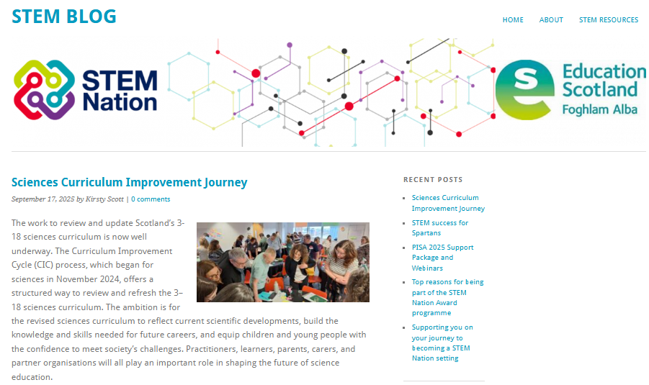
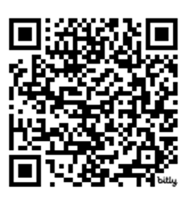
https://bit.ly/SciencesCICjourney
Notes:
https://bit.ly/SciencesCICjourney
In addition to the Education Scotland CIC blog, the Education Scotland Sciences Team has also set up a blog post to keep people updated on progress with the Sciences Curriculum Improvement Cycle.
We’d encourage you to keep an eye on the blog. We’ll be keeping it updated with outputs from the different groups involved in the process, as well as information about upcoming webinars.
We’ll also continue to share updates through national science and STEM networks, along with our termly science newsletter.
Our aim is to keep practitioners up to date with the sciences CIC process — so please do share the blog link with colleagues within your schools, settings and across your network where you can.

Slide 17
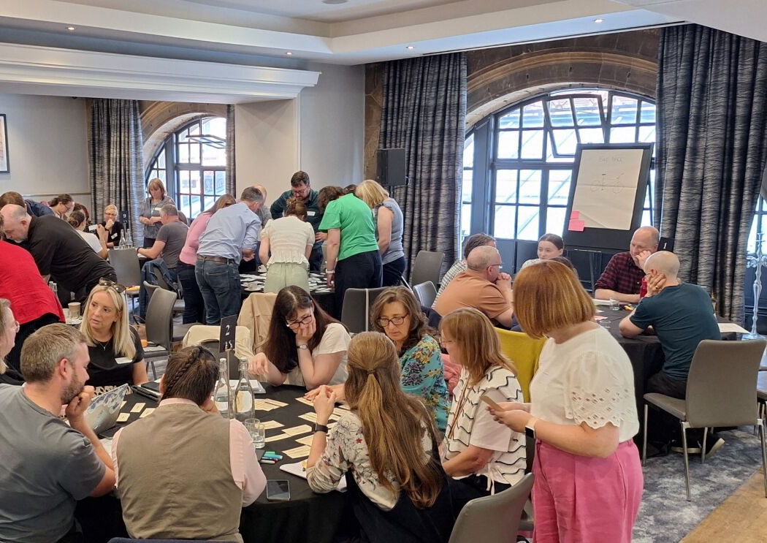
Sciences Collaboration
Day 2
About the day
12th June 2025
108 attendees
What was discussed?
Rationale for the new curriculum
Core knowledge & concepts across BGE science
Emerging big ideas of science
Notes:
The second face to face meeting of the Collaboration Group took place on 12th June 2025 in Glasgow.
Curriculum Rationale: The group gave feedback on a draft rationale statement for the new sciences curriculum. The feedback has been used to adapt the rationale and this will now go out for wider consultation across our science networks.
Core Knowledge: participants began to consider what core knowledge will be essential for learners, and grouped this to form core concepts for the sciences curriculum.
Emerging big ideas: Having considered the core concepts, participants began grouping these to start to form potential big ideas for the sciences curriculum.
These initial conversations from the collaboration group were developed further by the core group when they met again in August.

Slide 18
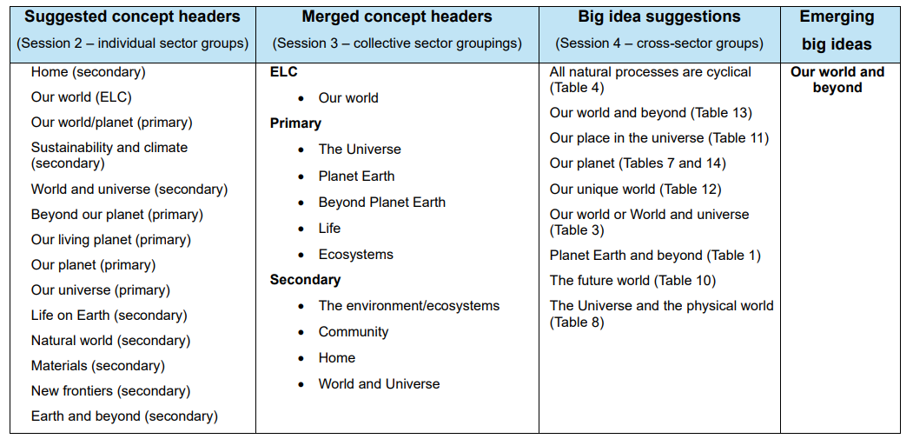
Output from Sciences Collaboration Day 2
(June 2025)
Notes:
The collaboration group considered some of the core knowledge which should be included in the evolved sciences curriculum, and then grouped this knowledge into CONCEPT headers. You can see the similarity in the wording from various groups for the themes they formed. This was a first step in considering what layer 2 of the technical framework (overview of what learners should know and be able to do) might look like for science, and the core group will be looking to refine this further throughout the academic year 2025-26.
The concepts were then grouped further into BIG IDEAS. Remember each curricular area will have between 3 and 6 big ideas – these are big overarching headings that group concepts together. Again, you can see similarities in the different wordings for big ideas that different groups came up with.

Slide 19

Big ideas
Please remember this webinar was held in Sept 2025. This is a snapshot of the emerging big ideas from that time. Developments are taking place quickly and thinking has already moved on and the big ideas and concepts have evolved.
Notes:
PLEASE NOTE:
The following slides contain information on the emerging big idea and concepts for science. They are not the final version and since this webinar they have changed.
The big ideas and concepts contained here are iterative and were shared during the webinar to get feedback on initial reactions
These are not the final big ideas and thinking has already moved on.

Slide 20

What is a big idea?
A big idea captures the core understanding children and young people will develop in a particular area of the curriculum from early learning and childcare onwards.
It will set out overarching ideas and concepts and have relevance and meaning for learners. It will support progression and guide the selection of content.
Notes:
What is a big idea?
A big idea captures the core understanding and sets out overarching ideas and concepts for a particular area of the curriculum
Harlen (2010) highlights that Big Ideas can promote greater coherence in learning by acting as conceptual “pegs” on which children and young people can organise and make sense of their educational experiences. This approach helps address the challenge of some learners struggling to see the relevance of studying topics that appear to them as isolated, disconnected facts. Shown are sample big ideas for Science taken from Harlen (2010).
In Scotland, our big ideas will run from 3-18, ensuring vertical coherence across the curriculum at all levels and stages.
Full paper: Towards an Evolved Technical Framework
Podcast: Towards an Evolved Technical Framework
Further Reading:
Harlen 2010
Royal Society of Chemistry 2020
Royal Society of Biology 2021
Primary Curriculum Advisory Group 2023
Institute of Physics 2024

Slide 21

Know Do Understand
‘Curriculum statements need to make clear what children should know factually, understand conceptually and be able to do in different disciplines’
(Erickson 2012)
Notes:
As proposed in the CIC paper, Towards an evolved technical framework, the revised curriculum will follow a know, do, understand model.
Full paper: Towards an Evolved Technical Framework
Podcast: Towards an Evolved Technical Framework

Slide 22
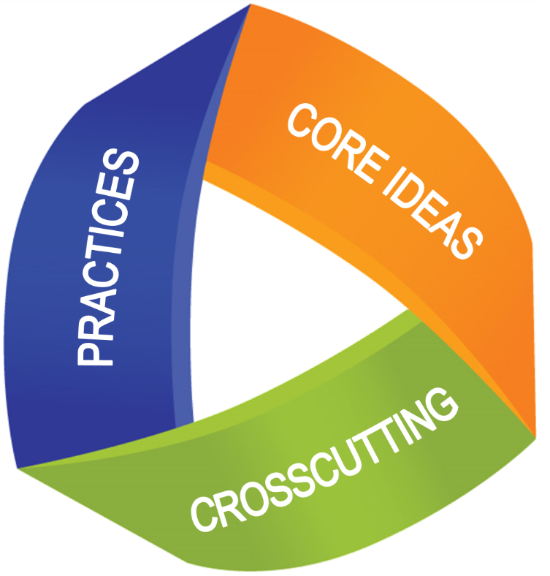
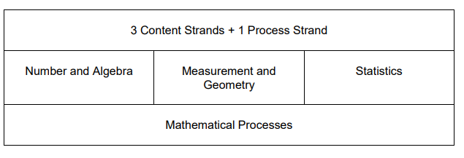
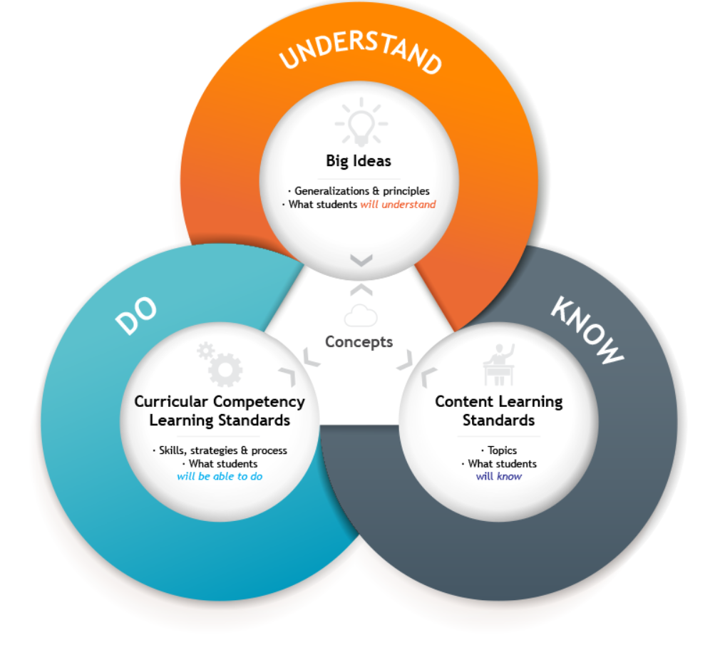
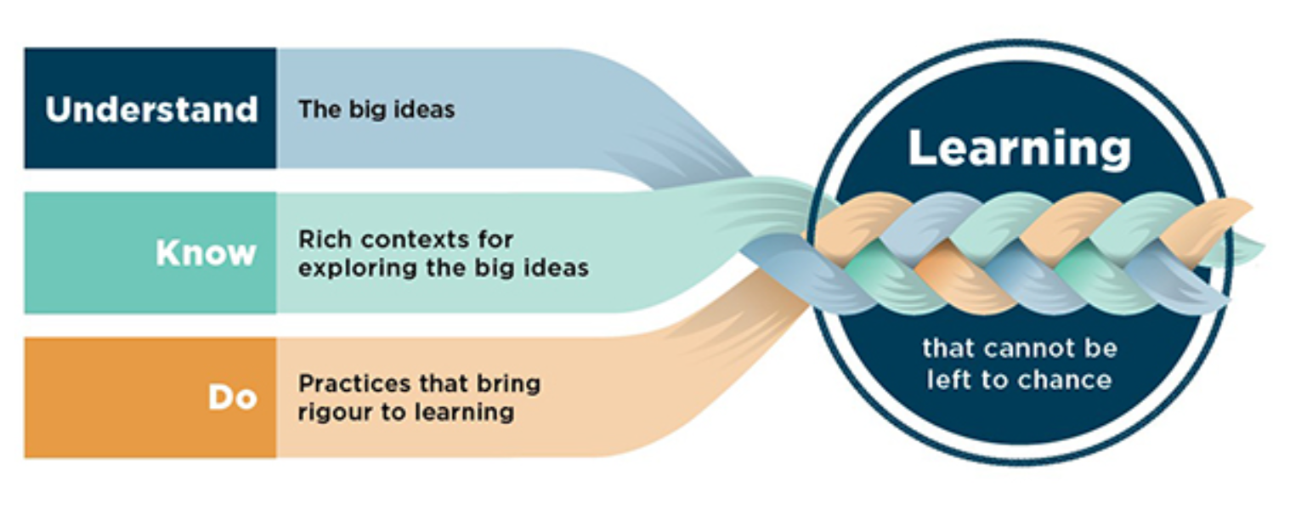
Big ideas approaches in other countries
Singapore
America
NGSS
British Columbia
New Zealand
Notes:
In British Columbia, Big Ideas are defined as generalisations and principles and the key concepts important in an area of learning. They reflect the “Understand” component of the Know-Do-Understand model of learning. The Big Ideas represent what learners will understand at the completion of the curriculum for their grade
Curriculum Overview | Building Student Success - B.C. Curriculum (gov.bc.ca)
In New Zealand, however, the Big Ideas remain the same across year levels and learners gradually deepen their understanding of them as they grow their knowledge of national and local contexts. They can be viewed as summations of conceptual understanding with key concepts embedded within them.
NZC - Mathematics and statistics (Years 0-8) (education.govt.nz)
In Singapore, the curriculum framework incorporates Big Ideas to help learners to develop a deeper understanding in individual subjects. They specifically identify Big Ideas relevant to individual subjects to help build a coherent understanding across different levels within a subject (Ministry of Education, Singapore, 2021).
USA - Next Generation Science Standards (NGSS)
About the model: Three Dimensional Learning | Next Generation Science Standards (nextgenscience.org)
Within the Next Generation Science Standards (NGSS), there are three distinct and equally important dimensions to learning science. These dimensions are combined to form each standard—or performance expectation—and each dimension works with the other two to help students build a cohesive understanding of science over time.
Practices describe behaviours that scientists engage in as they investigate and build models and theories about the natural world
Crosscutting concepts have application across all domains of science. As such, they are a way of linking the different domains of science. They include: Patterns, similarity, and diversity; Cause and effect; Scale, proportion and quantity; Systems and system models; Energy and matter; Structure and function; Stability and change.
Disciplinary ideas are grouped in four domains: the physical sciences; the life sciences; the earth and space sciences; and engineering, technology and applications of science.
NGSS Science example of practice, disciplinary core ideas and cross-cutting concepts
DCI Arrangements of the Next Generation Science Standards (nextgenscience.org)

Slide 23
Layer 1 : Big Ideas & Concepts
What do all children and young people need to understand across the curriculum to help them be individuals, contributors, citizens and learners?
Layer 2: Knowing and Doing
What key conceptual knowledge and skills do all children and young people need to help their understanding?
Layer 3: Progression in Knowledge and Skills
What is the expected knowledge and skills required to help all children and young people make progress at each stage?
Layer 4: Pedagogy
How should the interactions, experiences, spaces and time of learning environments be best organised and approached to allow all children and young people to flourish and develop their expected knowledge and skills?
Notes:
The new curriculum will have a number of layers to provide clarity about the what learners need to understand and what the core concepts will be (layer 1). Layer 1 helps to inform the key conceptual knowledge and skills which are articulated at layer 2. The detailed knowledge statements, at layer 3, will help to provide clarity in terms of knowledge and skills required to help all children and young people make progress at each stage.
Layer 4 will provide practical support, resources and guidance to help practitioners implement the new curriculum.

Slide 24

Implementation timeline
Curriculum
Formal adoption of the evolved technical framework in two stages from 2028.
Adoption of changes to Early, First, Second and Third Level from August 2028.
  Phased adoption of changes to fourth level and beyond from August 2029.
Qualifications
Start of new qualification development phase at subject level in 2028.
Introduction of Level 4 and Level 5 National Qualifications aligned to the evolved curriculum technical framework from 2031
Notes:
Scottish Government published the timeline for curriculum, qualification and assessment reform in June 2025: Supporting documents - Curriculum, Qualifications and Assessment Reform: progress to date and next steps - gov.scot

Slide 25
Science and me
The tapestry of life
How things work
Matter: Properties and Changes
Our world and the universe
Be the change
Core Group Event
28 & 29 August
Emerging
Sciences
big ideas
Note that thinking has already moved on since this webinar in September 25 and further changes have already been made to the big ideas.
Notes:
The Sciences CIC Core Group had a two-day workshop in August 2025. They spent time considering the thinking and output from the Collaboration Group Day 2 on 12 June. The main output was the identification of six big ideas for sciences.
A reminder - these are a first draft and iterative. Thinking has move don and the big ideas have already been changed. Please check our Sciences CIC blog for the latest developments.
On the slides that follow, each big idea is shown, with an accompanying draft rationale statement, to exemplify further the content of the big idea. There are also indicative concepts headers for each big idea, again they are draft.
Since this webinar the big idea titles and concept headers have changed as a result of feedback from a number of groups, including the feedback that emerged from this webinar in September.

Slide 26


SCIENCE AND ME
We understand the purposes, practices and applications of science. We have opportunities to develop and take ownership of our science journey. We can all develop science skills to help us make informed decisions in everyday life. We can all be truth seekers, using scientific skills to explore our future paths. ​
Being scientific
Science identity
Applications and contexts
Pathways and careers
Critical scientific literacy (or ethical literacy)
Note that thinking has already moved on since this webinar in September 2025 and further changes have already been made to the big ideas and concepts.

Slide 27

THE TAPESTRY OF LIFE
Life on Earth is complex, diverse and interconnected and relies on the resources of the natural world. All organisms share common features. Biological systems have evolved and continue to adapt in response to environmental pressures. Life is in a delicate balance where organisms rely on each other for survival. Understanding this balance empowers us to protect it.
Life science
Interdependence
Health
Our changing planet
Action for climate (or preserving our planet, or our future planet)
Note that thinking has already moved on since this webinar in September 2025 and further changes have already been made to the big ideas and concepts.

Slide 28

HOW THINGS WORK
Our world follows the laws of nature. We will learn how things interact through studying forces, electricity, waves, energy, and matter. By understanding these concepts, we can answer key questions about our world. We can also tackle important challenges in society. This knowledge will give us the skills and confidence to understand how things work.
Waves and radiation
Properties of matter
Quantum and nuclear physics
Energy (and thermal)
Electricity and magnetism
Forces
Note that thinking has already moved on since this webinar in September 2025 and further changes have already been made to the big ideas and concepts.

Slide 29

MATTER: PROPERTIES AND CHANGES
Matter is anything that takes up space. This big idea explores how and why matter can be different, how it may change, how it can be useful and how it can be identified. Understanding how matter behaves helps us make sense of everything around us.
Building blocks
Chemical changes
Physical changes
Analytical chemistry
Energy and change
Properties
Note that thinking has already moved on since this webinar in September 2025 and further changes have already been made to the big ideas and concepts.

Slide 30

OUR WORLD AND THE UNIVERSE
Through exploring our local environments and beyond, we learn about the interconnectedness of Earth systems, how our planet is changing and our place in the Universe. Understanding this builds empathy and empowers us to look after our unique home.
Earth’s systems
Weather systems
Earth in space
Earth’s structure and materials
Biomes / environments
Solar system
Moon and tides
Note that thinking has already moved on since this webinar in September 2025 and further changes have already been made to the big ideas and concepts.

Slide 31

BE THE CHANGE
Science empowers us to take action to make the world a better place. Science continues to change the world and learning in science equips us with the tools to transform lives, both locally and globally, now and in the future. Evidence and values-based science provide us with the knowledge, skills and motivation to connect with others and take action on issues we care about, such as climate change, biodiversity loss, pollution, food security and Learning for Sustainability. Crack on...
Action for climate
Or Preserving our planet
Or Our future planet
Our changing planet
Participating and contributing
Note that thinking has already moved on since this webinar in September 2025 and further changes have already been made to the big ideas and concepts.

Slide 32

Next steps
Rationale - refining
Draft Big Ideas and narrative
Refine draft concept headers and agree narrative
Develop knowledge statements for each concept header, aligned with the big ideas
AIM: June 2026, draft of the 3-18 science curriculum ready for consultation.
Engagement with Children and Young People
Notes:
Next steps for the CIC groups
Curriculum Rationale – Core and Collaboration group have agreed upon a draft of the curriculum rationale which will be taken to our next Science network webinar on 26th November for wider consultation. Details of how to register for the next two webinars appear on the next slide

Slide 33

Future webinar dates
Wednesday 29 October 4:00 to 5:30pm
Cross-cutting expectations
Wednesday 26 November 4:00 to 5:30pm
Curriculum Rationale
Wednesday 10 December 4:00 to 5:30pm
Concept Headers
Notes:
Webinar 3 – 26 November Sciences Network – Curriculum Improvement Cycle Webinar 3 Tickets, Wed, Nov 26, 2025 at 4:00 PM | Eventbrite
Webinar 4 – 10 December Sciences Network – Curriculum Improvement Cycle Webinar 4 Tickets, Wed, Dec 10, 2025 at 4:00 PM | Eventbrite

Slide 34
Science Newsletter – issued termly
Sciences CIC Blog
National Science Network in Glow
Joining link https://bit.ly/3WfFnBl
Join code: uh9sf32
Email the EdScot science team at:
Science@educationscotland.gov.scot
Stay up to date
Notes:
Link to access newsletters https://blogs.glowscotland.org.uk/glowblogs/STEMcentralinmotion/2025/11/04/science-newsletter/L
Link to the Science CIC blog https://bit.ly/SciencesCICjourney
National Science Network in Glow
Joining link https://bit.ly/3WfFnBl
Join code: uh9sf32

