Slide 1
Layer 1 : Big ideas & concepts What do all children and young people need to understand across the curriculum to help them be individuals, contributors, citizens and learners?
Layer 2: Knowing and doing What key conceptual knowledge and skills do all children and young people need to help their understanding?
Layer 3: Progression in knowledge and skills What is the expected knowledge and skills required to help all children and young people make progress at each stage?
Layer 4: Pedagogy How should the interactions, experiences, spaces and time of learning environments be best organised and approached to allow all children and young people to flourish and develop their expected knowledge and skills?
Notes:
The overarching concepts are very much part of layer 1, along with the big ideas.
This layer is our immediate focus.
Once these have been firmed up, we will start to progress development work on the other layers.
This next stage is due to commence from January 2026.

Slide 2

Energy
Interactions
Oceans
Life on land
Concepts ≠ topics/units of work
Notes:
When doing work around the concepts, some were emerging that felt more like topics or units of work eg oceans and life on land.
Our focus has been in identifying the overarching concepts, which are different from topic headers.

Slide 3
What is a concept?
Mary Myatt
Concepts:
provide the threads of a journey through the content matter.
signpost the underlying structures.
act as holding baskets for lots of information.
make learning more efficient for our pupils.
Support meaning and strengthen memory over time.
We cannot teach everything! If I understand a concept then new material relating to that concept becomes much stickier and is easier to make sense of.

Slide 4
What are overarching concepts?
Cut across all three big ideas
Coherence from 3–18 – not fragmented topics.
Support understanding across science disciplines.
They are NOT Big Ideas; they CONNECT the learning.

Slide 5
Review of international curricula
Benchmark Scotland against the highest performing science systems.
Universal overarching scientific concepts.
Ensure global credibility and future alignment.
Match international surveys - PISA/TIMSS expectations for scientific literacy.
Support readiness for emerging & complex scientific and societal challenges.

Slide 6


Overarching concepts give structure behind the scenes, guiding: • how learners build conceptual understanding and how learning connects across levels • how learning and assessment can build understanding, not memorisation.

Slide 7



Notes:
Example of how overarching concepts may be used to support learning:
Example: Early learning with ecosystems – even at early stages, learners can explore small-scale ecosystems, e.g., a garden or local green space.
Learners build on prior knowledge from previous experiences with other ecosystems.
Focus on key features and interdependencies within ecosystems, which can then be applied to new and unfamiliar contexts.
Polar bear habitats illustrate a different ecosystem, but learners can transfer understanding of systems and interdependencies across contexts.

Slide 8


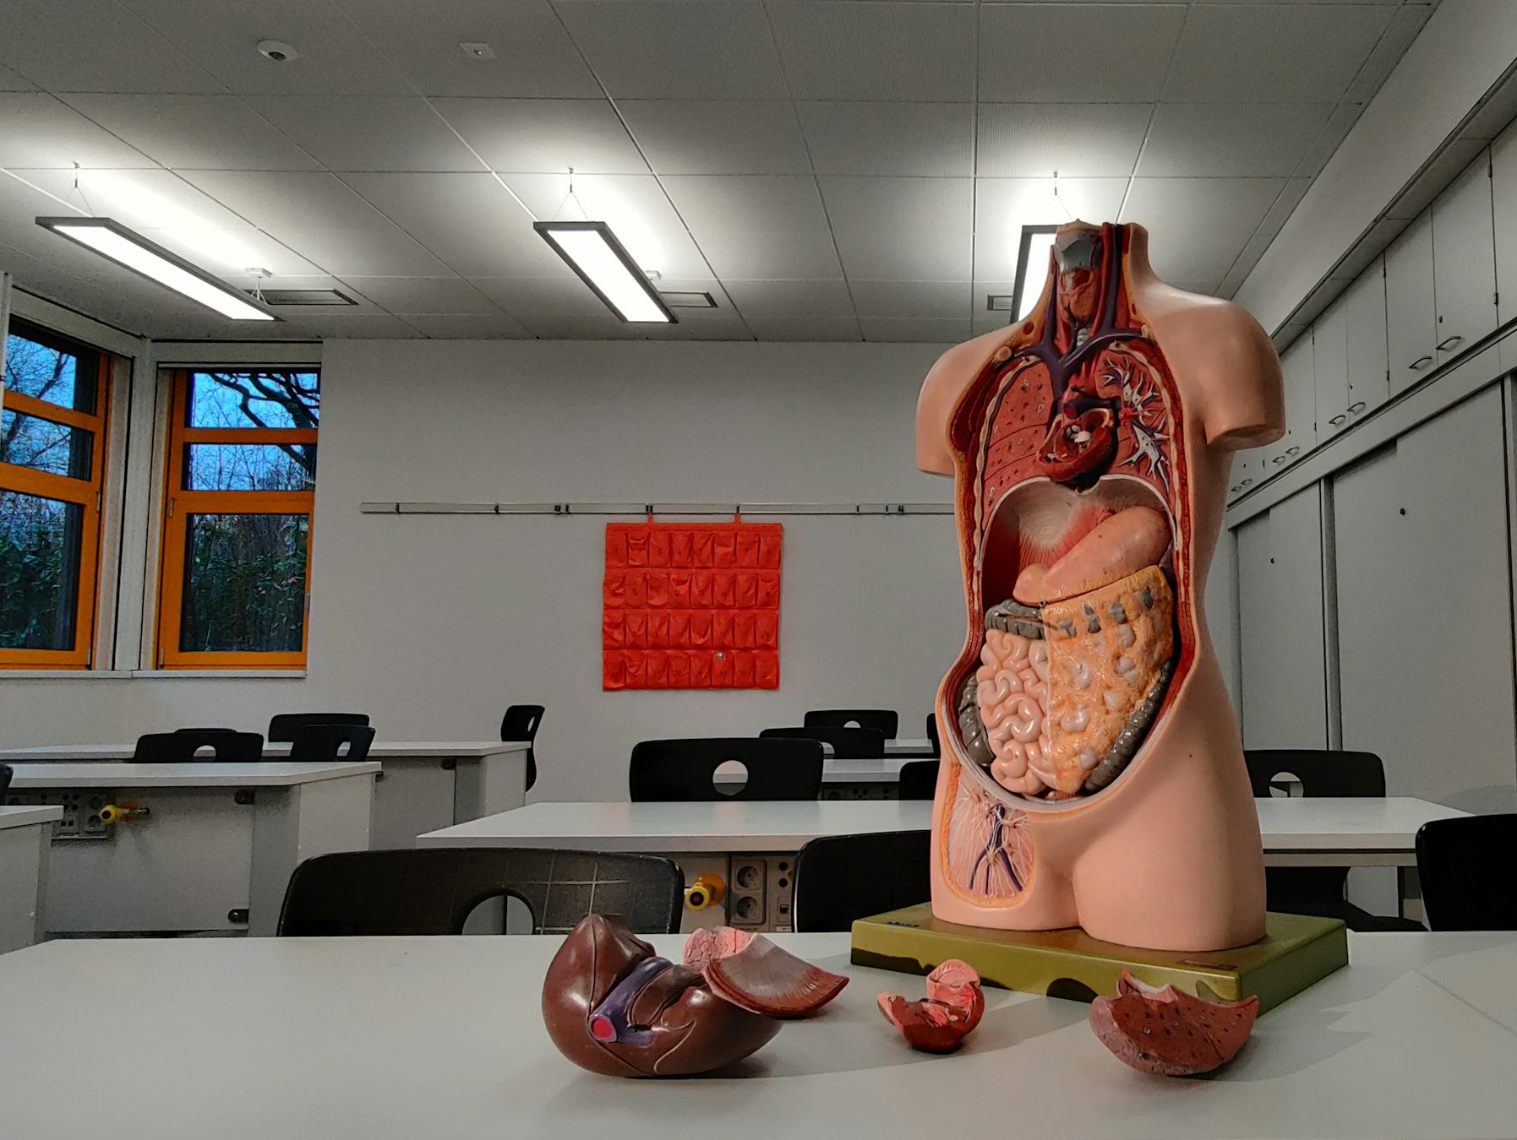

Notes:
Exploring systems contd.
Learners also explore different types of systems, e.g., organ systems, planetary systems, water and garden cycles.
Helps learners identify core features of systems and understand how these features apply across very different contexts.

Slide 9

Notes:
Idea/suggestion - “Concept Passports”:
As learners encounter new systems or cycles within the curriculum, they receive a “stamp” each time they encounter a concept.
This builds a progressive understanding of concepts from ages 3–18.
This also encourages learners to transfer knowledge to new and unfamiliar contexts, reinforcing conceptual understanding.

Slide 10

Over-arching concepts for 3–18 sciences curriculum
🔍 Relationships and interactions
📊 Patterns & trends
⚡ Energy
🔗 Systems and cycles
📏 Scale, proportion & quantity
🏗️ Shape, structure & function
🌱 Sustainability
⚖️ Ethics
Notes:
This slide shows the eight emerging overarching concepts the core and collaboration groups have identified as being relevant for the 3-18 sciences curriculum.

Slide 11
Scale, proportion & quantity | The sciences help us measure and compare the properties of the world, from the smallest of particles to the vastness of the Universe. Understanding scale, proportion and quantity helps us describe numerical relationships and undertake scientific calculations.
Systems & cycles | Many natural and human-made processes can be understood as a series of systems and cycles. Some operate in repeatable and predictable ways which help us make sense of our ourselves and the world around us.
Patterns & trends | Patterns and trends help us to notice what stays the same and what changes, so we can compare, explain and make predictions.
Relationships & interactions | Relationships and interactions help us make connections and explain the causes and effects we observe.
Shape, structure & function | The way something is shaped and structured determines its properties, how it works, and what it can be used for.
Energy | Energy is an indication that change can happen. Energy can be stored and transferred and helps us to describe and understand change.
Ethics | Ethics in the sciences are the principles that guide us to make informed and responsible decisions based on evidence, reasoning and values.
Sustainability | Sustainability is about using Earth’s resources responsibly so that people and nature can thrive now and in the future. Sustainability helps us to address local and global challenges.
Notes:
These are the descriptors that Core Group members have developed for the eight emerging overarching concepts.

Slide 12

Waterfall:
In the chat pane
Scale, proportion & quantity
Systems & cycles
Patterns & trends
Relationships & interactions
Shape, structure & function
Energy
Ethics
Sustainability
Notes:
During the meeting, attendees we asked the following for each concept
'Where might you encounter each overarching concept within the curriculum?'
Each concept was covered in turn, and feedback captured via the chat pane.
This activity can be repeated within settings and departments to build understanding of each of the overarching concepts and where they may connect to and support learning.

