Slide 1

Notes for users
The slide scripts and links to documents / webpages can be found in the notes section of each slide
You are welcome to use these slides to suit your needs. Please ensure the information is conveyed accurately to avoid misunderstandings.
This is a presentation from a webinar held in December 2025. The Curriculum Improvement Process is underway and thinking and drafts are evolving and changing quickly. The information in these slides may, therefore, be out of date.
This webinar session was recorded. Please refer to the recording for additional information Webinar Recording (the recording can also be accessed via our blog)
Any questions, please get in touch:
Science@educationscotland.gov.scot
Notes:
https://youtu.be/2nAr2CJVn8k

Slide 2
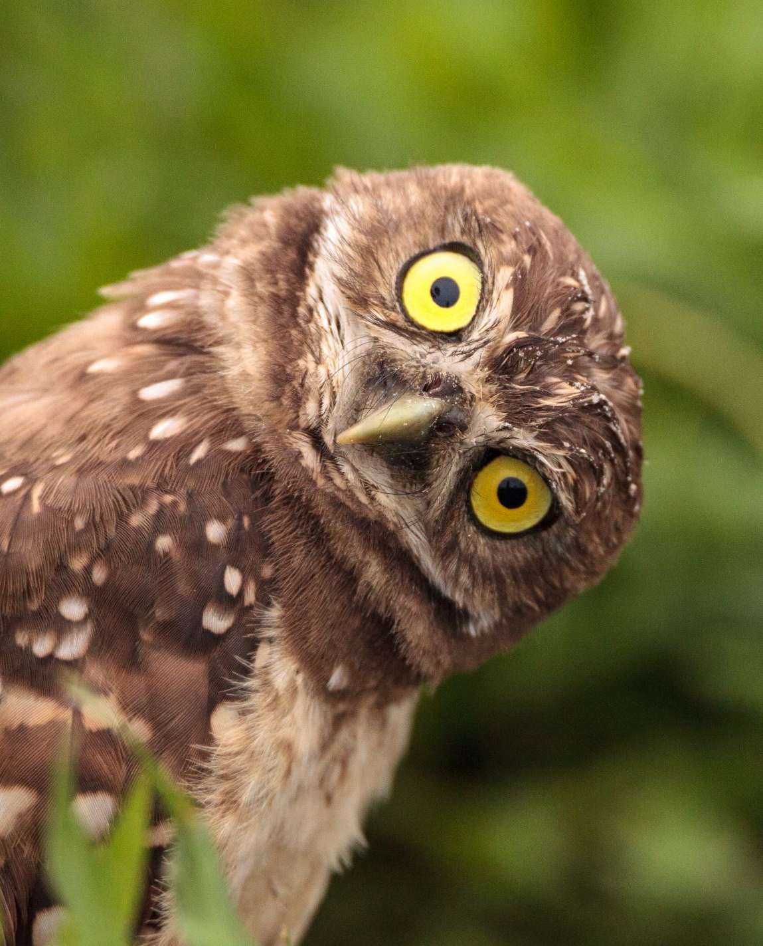
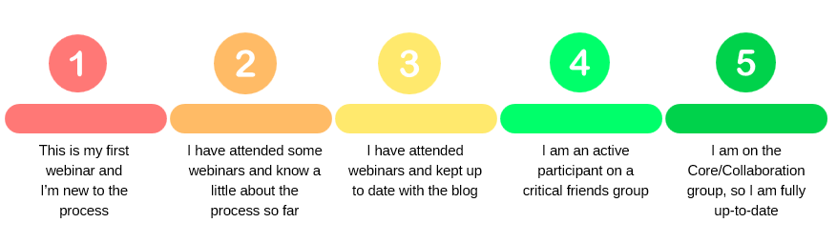
Welcome ☺
Thanks for joining us for this session. Here’s a wee connector activity to get us started whilst we wait for people to arrive.
Please introduce yourself in the chat
On a scale of 1 to 5, let us know how up to speed you are with the curriculum Improvement Cycle process
Write down one question you have about the CIC process.

Slide 3

Sciences Curriculum Improvement Cycle (CIC)
Focus: Big ideas and concepts
Science Network Webinar
10 December 2025
Notes:
Welcome to final webinar of 2025

Slide 4

Agenda
Welcome
Science CIC update
Emerging thinking
Big ideas
Concepts
Staying connected
Notes:
Welcome to our webinar this evening.
We’ll start with a brief update on the Curriculum Improvement Cycle.
We’ll then progress onto the main activity – looking at the emerging big ideas and concepts for the sciences curriculum
Before we finish, we’ll also explain ways you can stay connected and keep up to date with ongoing developments.

Slide 5

Education Scotland Sciences Team
Kirsty Scott and Jane Wilson National Advisors
Fiona Shaw, Margaret Craw and Laura McCafferty Education Officers
Ian Menzies Senior Education Officer
Contact us at:
Science@educationscotland.gov.scot
Notes:
These are the colleagues in our Education Scotland Sciences Team who are supporting the Curriculum Improvement Cycle.
Please get in touch with any of us or contact us through our sciences email inbox.

Slide 6


Notes:
The Sciences Curriculum entered the Curriculum Improvement Cycle (CIC) almost exactly a year ago – our first CIC event was our Collaboration Group event on 28 November 2024.
The process has been established in response to a review of Curriculum for Excellence by the Organisation of Economic Cooperation and Development (OECD).
One of the key recommendations from the 2021 OECD report was for Scotland to set up a process to support a cyclical process of curriculum reform.
Scotland has now decided to review the curriculum every 10 years.
This is the first cycle of improvement to take place.

Slide 7

Why?
3.4 Develop a systematic approach to curriculum review: Scotland could consider establishing a systematic curriculum review cycle with a planned timeframe and specific review agenda, led by the specialist stand-alone agency.
OECD
Review
M | J | J | A | S | O | N | D | J | F | M | A | M | J | J | A | S | O | N | D | J | F | M | A
2021 |  |  |  |  |  |  |  | 2022 |  |  |  |  |  |  |  |  |  |  |  | 2023
Notes:
In 2021, the Scottish Government commissioned the OECD to carry out an independent review of Scotland’s curriculum.
The resulting report provided a broad overview of where the curriculum currently stood and highlighted key areas we needed to consider for future improvement.
One of the most significant recommendations was the need for a systematic, planned curriculum review cycle—something with a clear timeframe and a structured agenda for ongoing review.
The OECD also suggested that this work should be led by a specialist, standalone agency to ensure consistency and long-term oversight.
In response, the Scottish Government asked Education Scotland to take on this role.
Our responsibility is to lead and manage the development of this new curriculum improvement cycle, ensuring that the review process is continuous, coherent, and sustainable going forward.

Slide 8
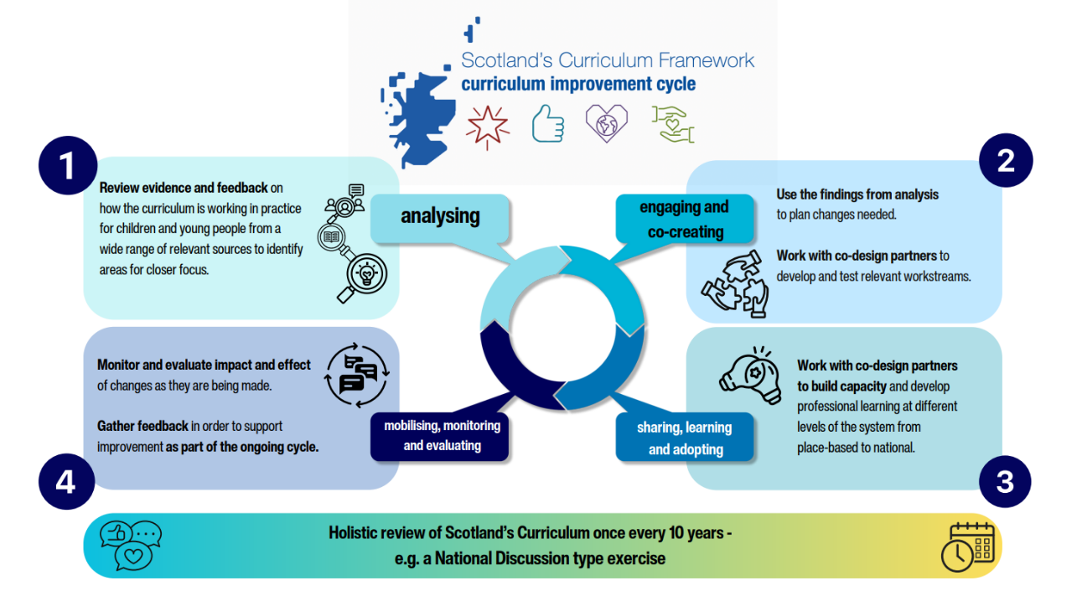
Notes:
We’ve designed this as a cycle in the fullest sense—a continuous, purposeful process rather than a one-off review.
To develop it, we looked internationally to understand how different countries approach curriculum review and renewal.
From that work, we identified four key phases in the cycle.
The first phase is the Analysing phase, which we’ve already completed.
This involved examining evidence, exploring international practice, and looking closely at data to understand what needed to change and why.
We are now firmly in the Engaging and co-creating phase.
This means working collaboratively with practitioners, learners, and partners across Scotland.
Together, we are shaping the direction of the curriculum and co-creating the next steps.
This webinar will share some of the emerging drafts that have come from this collaborative work.
After this CIC stage, we will move into the Sharing, learning and adopting phase.
This is where new approaches and ideas begin to be embedded into our practice and day-to-day work.
Then we enter the Monitoring, evaluation and mobilising phase.
This ensures we understand what’s working, what needs further refinement, and how learning from the process is shared and acted upon.
Once this phase is complete, the cycle begins again.
The intention is that this curriculum review cycle repeats every 10 years, ensuring Scotland’s curriculum remains current, relevant, and responsive to change.

Slide 9
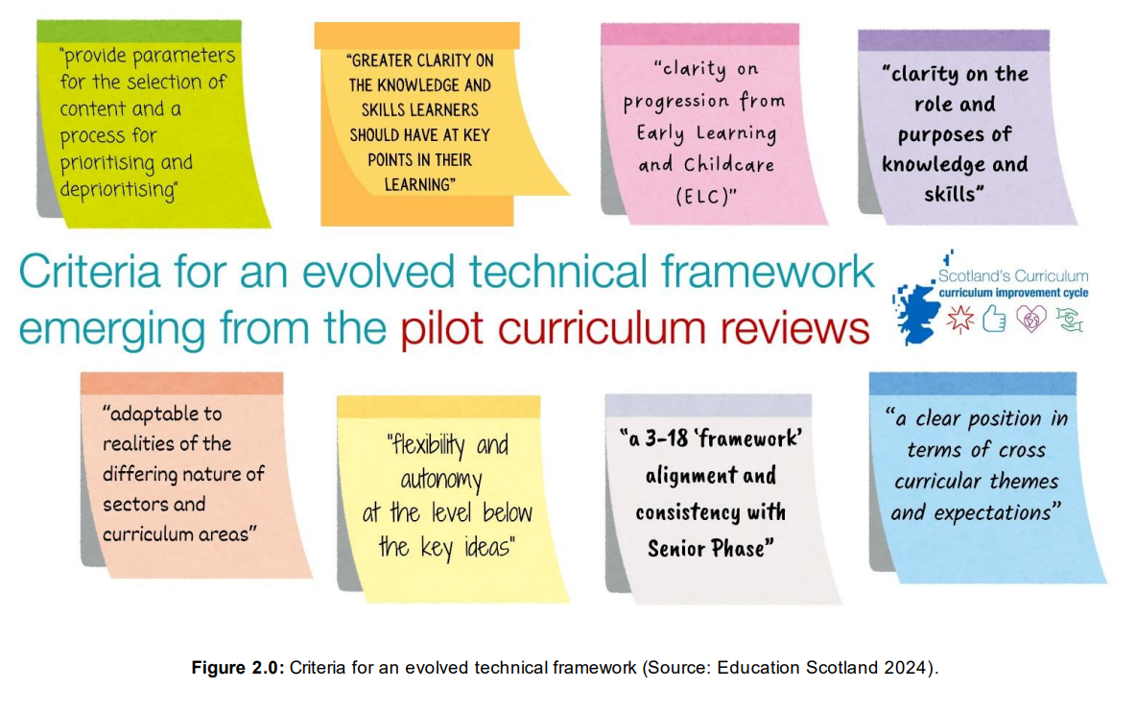
Notes:
Key messages from the pilot reviews
Education Scotland conducted pilot reviews across different curriculum areas in Scotland, engaging practitioners and stakeholders.
Key findings from pilots shaped our work over the past year:
Need to declutter the curriculum: prioritise essential content and know what to de-prioritise.
Provide clarity on knowledge and skills learners need at different stages.
Address challenges around progression across levels.
Recognise that different curriculum areas require different approaches
Aim to balance teacher autonomy with clear guidance.
Improve alignment between Broad General Education and Senior Phase, addressing OECD recommendations.
Strengthen cross-curricular themes and expectations to ensure they are embedded meaningfully.

Slide 10

What is a big idea?
It will set out overarching ideas and concepts and have relevance and meaning for learners. It will support progression and guide the selection of content.
A big idea captures the core understanding children and young people will develop in a particular area of the curriculum from early learning and childcare onwards.
Notes:
What is a big idea?
A big idea captures the core understanding and sets out overarching ideas and concepts for a particular area of the curriculum
Harlen (2010) highlights that big ideas can promote greater coherence in learning by acting as conceptual “pegs” on which children and young people can organise and make sense of their educational experiences. This approach helps address the challenge of some learners struggling to see the relevance of studying topics that appear to them as isolated, disconnected facts.
Full paper: Towards an Evolved Technical Framework
Podcast: Towards an Evolved Technical Framework
Further Reading:
Harlen 2010
Royal Society of Chemistry 2020
Royal Society of Biology 2021
Primary Curriculum Advisory Group 2023
Institute of Physics 2024

Slide 11

Know Do Understand
‘Curriculum statements need to make clear what children should know factually, understand conceptually and be able to do in different disciplines’
(Erickson 2012)
Notes:
As proposed in the CIC paper, Towards an evolved technical framework, the revised curriculum will follow a know, do, understand model.
Full paper: Towards an Evolved Technical Framework
Podcast: Towards an Evolved Technical Framework
In the revised curriculum, there will be an emphasis on ensuring curriculum statements clearly specify what learners should:
Know (factual knowledge)
Understand (conceptual understanding)
Do (practical or applied skills) across different disciplines.
Inspired by Ericsson’s principle: making curriculum expectations explicit in terms of knowledge, understanding, and action.

Slide 12
Layer 1 : Big ideas & concepts What do all children and young people need to understand across the curriculum to help them be individuals, contributors, citizens and learners?
Layer 2: Knowing and doing What key conceptual knowledge and skills do all children and young people need to help their understanding?
Layer 3: Progression in knowledge and skills What is the expected knowledge and skills required to help all children and young people make progress at each stage?
Layer 4: Pedagogy How should the interactions, experiences, spaces and time of learning environments be best organised and approached to allow all children and young people to flourish and develop their expected knowledge and skills?
Notes:
The new curriculum will have a number of layers
Layer 1: High-level, overarching structure – includes the big ideas and key concepts.
Layer 2: Focuses on knowing and doing – connecting knowledge to practical application.
Layer 3: Detailed knowledge and skills statements, including progression across stages.
Layer 4: Pedagogy – how the curriculum translates into classroom practice, teaching methods, and learning resources.

Slide 13


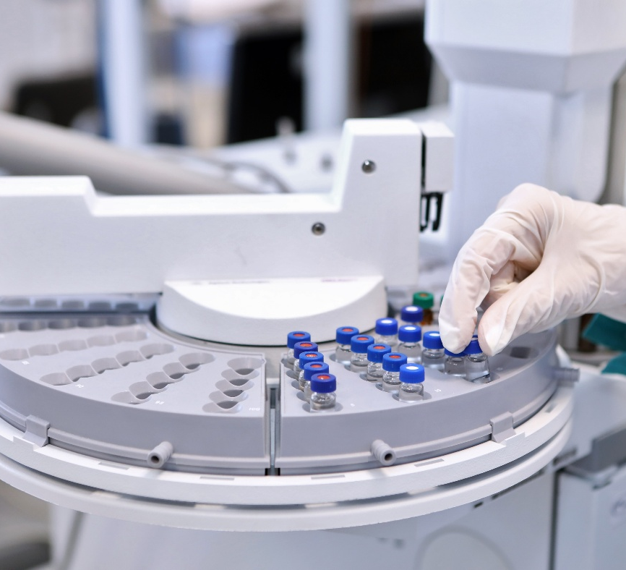
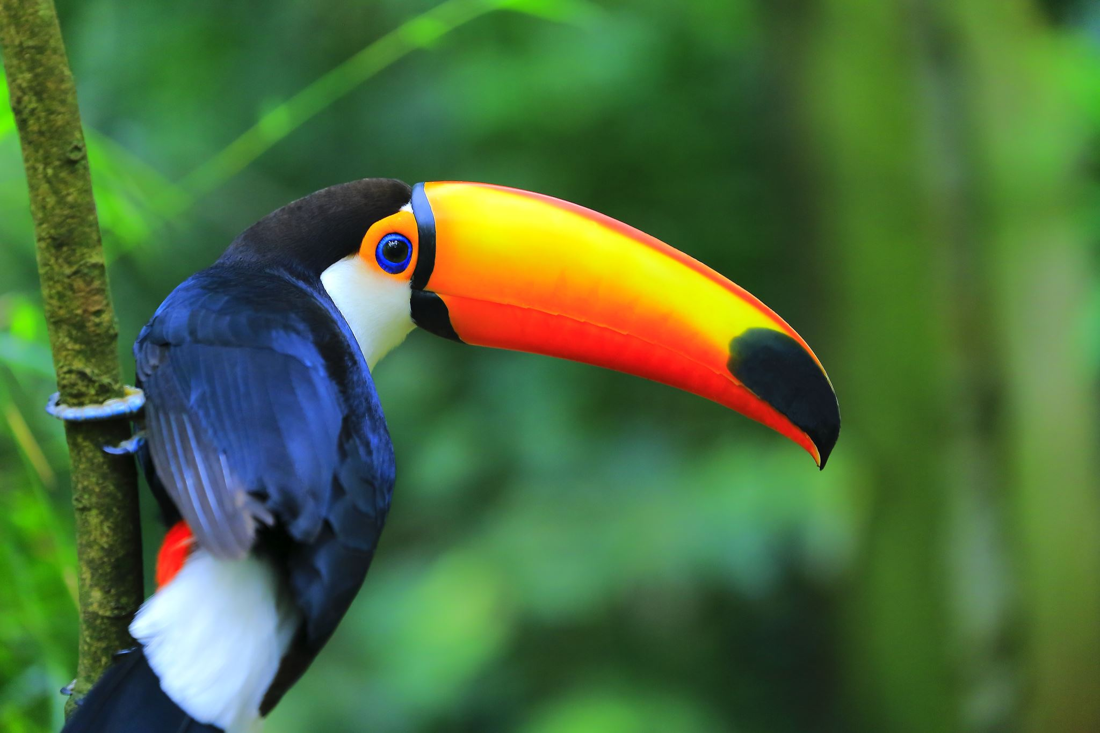

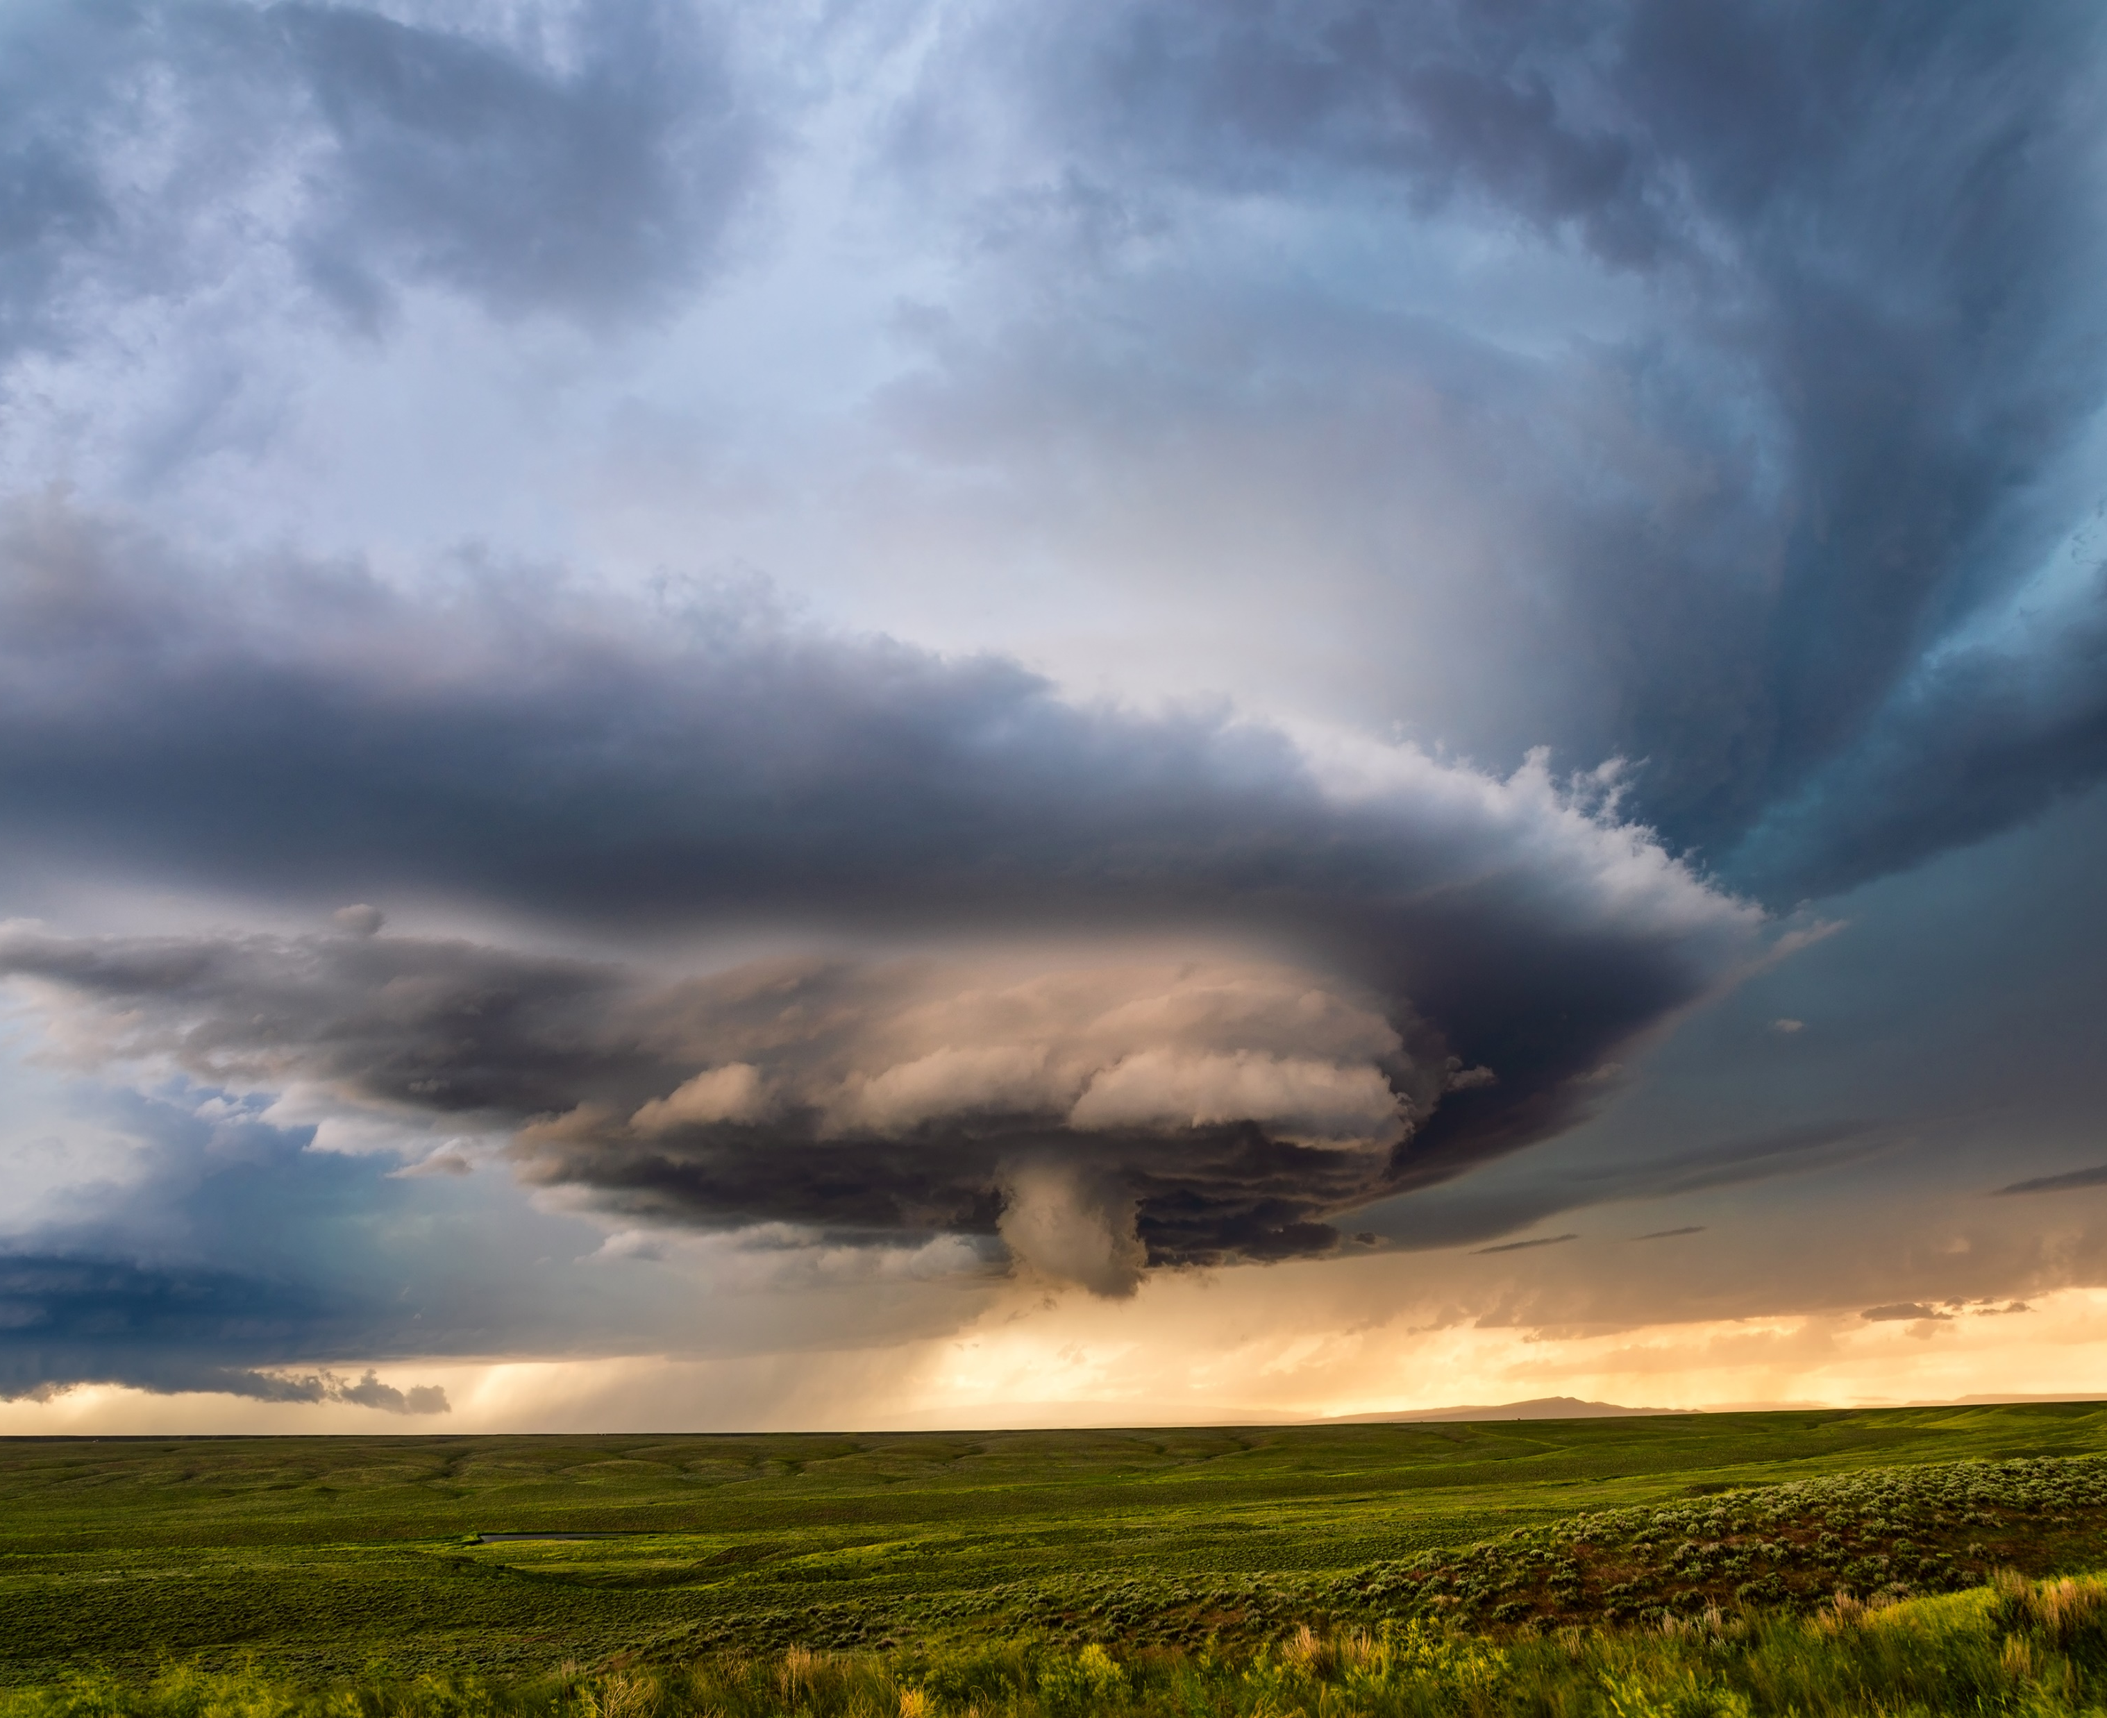
Magic happens at layer 4
The way the curriculum is presented, does not determine delivery
Notes:
The way the curriculum technical framework is presented does not determine teaching and pedagogy.
The three Big Ideas do not dictate pedagogy. They provide the high-level structure that guides progression, coherence and selection of content for the curriculum.
For example, the big ideas, knowledge and skills will not need to be taught in the order they are presented in the technical framework.
Our ambition in developing the big ideas, is to create an exciting curriculum that provides ample opportunities for engaging and future-orientated learning.
Our aim is to get the balance right between providing clarity and autonomy to practitioners.

Slide 14
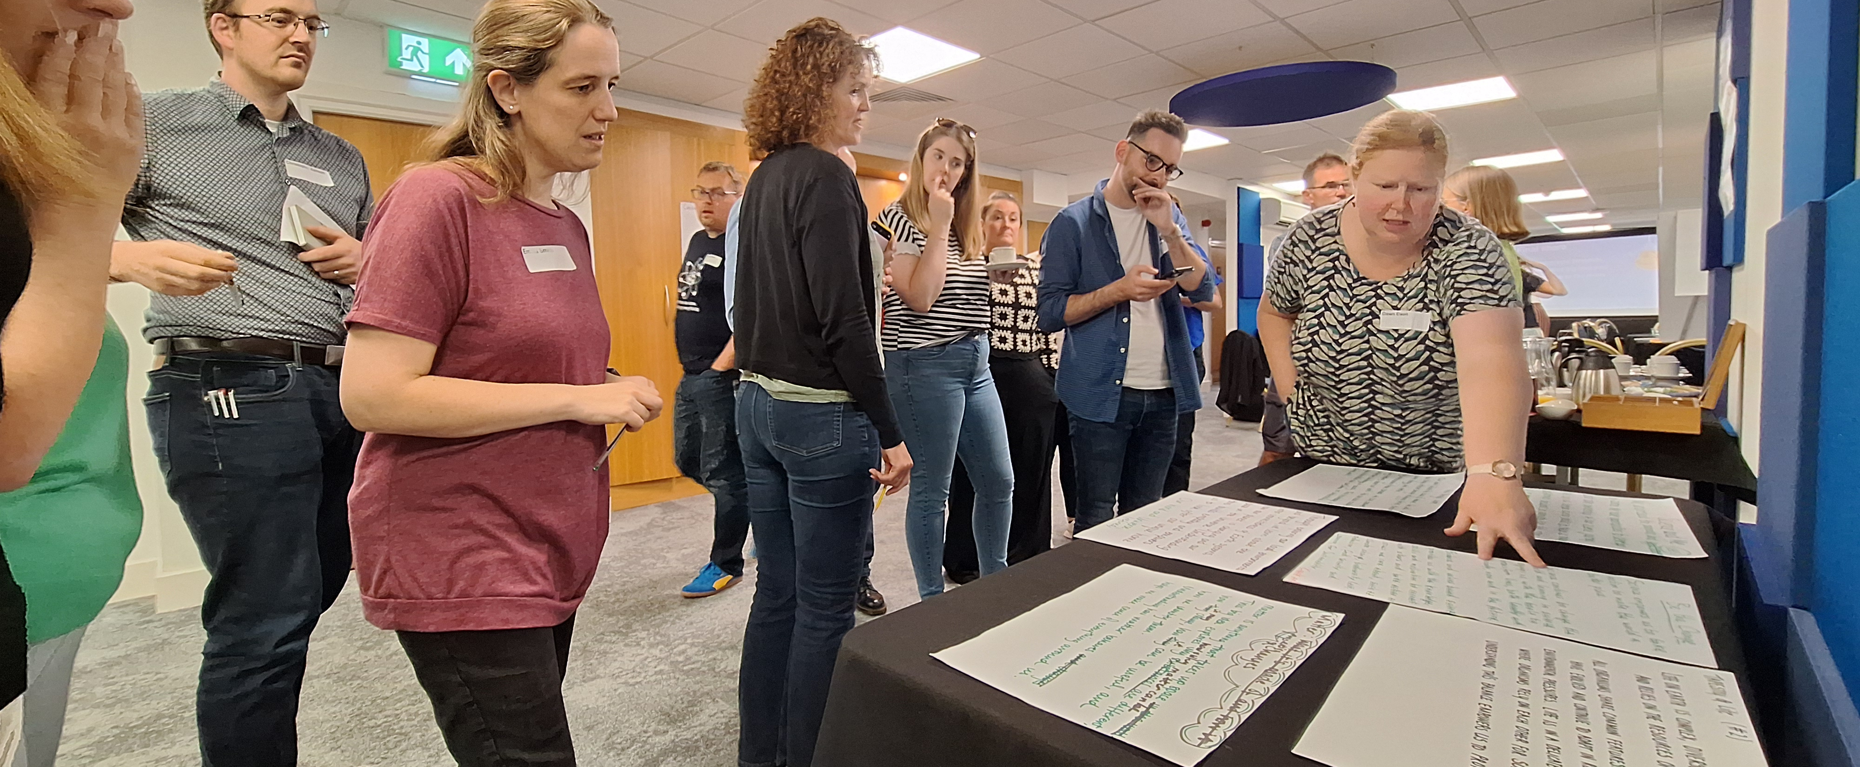
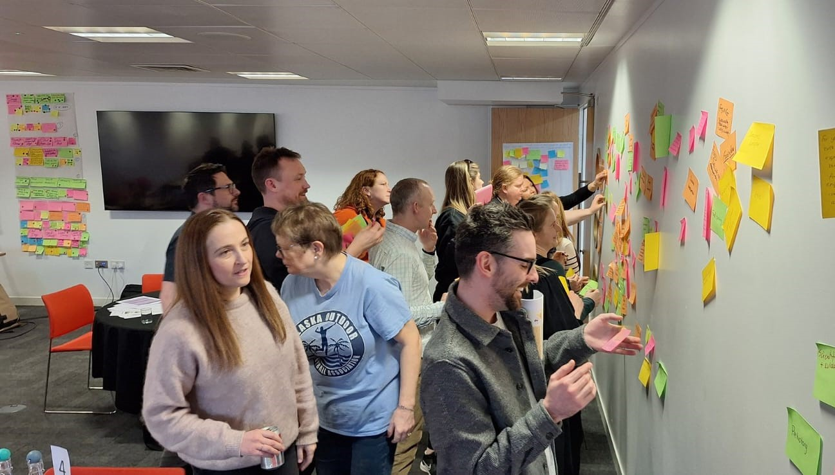
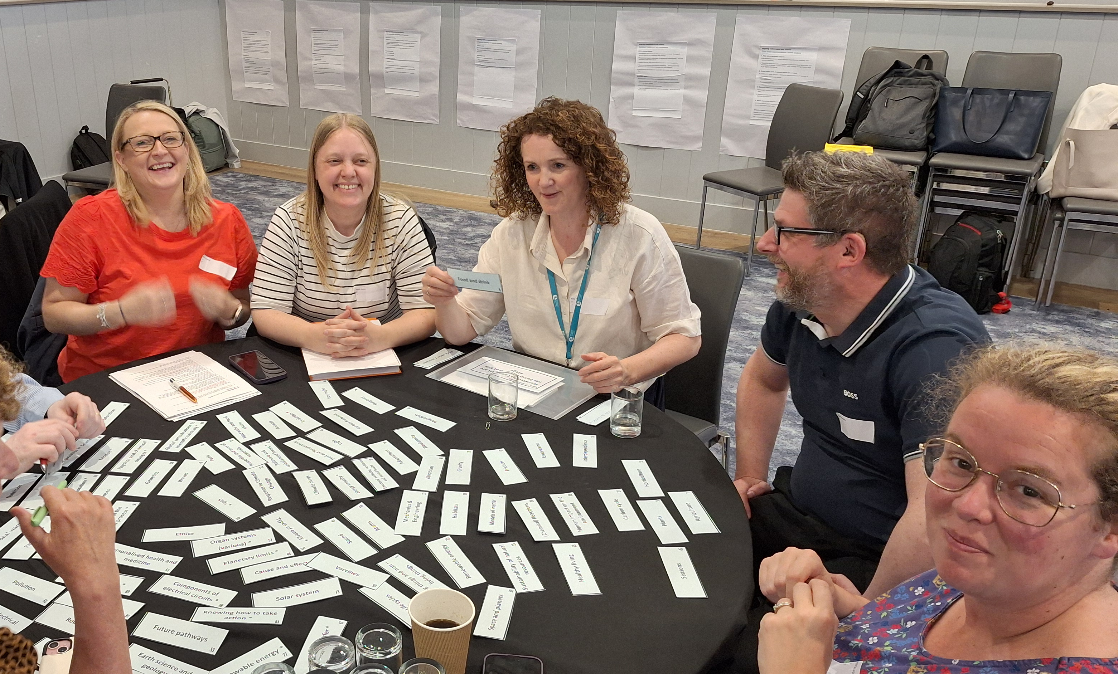
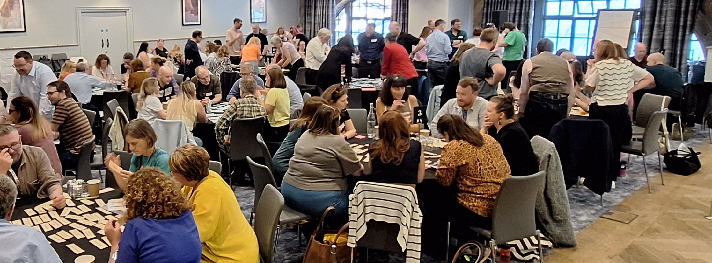
Sciences CIC Groups
70% practitioners – 30% organisations
Notes:
The Curriculum Improvement Cycle process is adopting a service design process. The Education Scotland science team have facilitated the process and worked alongside key groups, comprising predominantly of practitioners (70% of session/event attendees).
Valued partner organisations from around Scotland have also been part of the CIC groups (30% of CIC groups).

Slide 15
Sciences CIC Groups
Steering
Group
Critical friends
The journey so far........
What's working/not working?
How does science support the four capacities?
What does a future-orientated science curriculum look/feel like?
Cross-curricular expectations
Curriculum rationale
Knowledge
Concepts
Big ideas
Senior Phase
Children and Young People
Technicians
Additional Support Needs
Early Learning and Childcare
Academia (HE/FE/ITE)
Industry
Core
Group
Collaboration
Group
Networks
Notes:
Here as a reminder of the many CIC groups that are supporting the Sciences CIC process.
The Collaboration Group includes approximately 100 participants, 86 of whom are practitioners. Membership was determined through open recruitment using a set of criteria designed to ensure practitioner representation across all 32 local authorities, encompassing all sectors, roles, and levels of experience.
The role of the collaboration group is to:
▪ identify what works and what is not working in their area of focus;
▪ explore options and possible solutions to areas needing change or improvement;
▪ gather feedback on emerging proposals;
▪ sense check and test possible solutions;
▪ engage in sharing, learning, adopting; and
▪ be advocates for the overall CIC work.
The Sciences Core Group is made up of 30 participants drawn from the collaboration group. Of these 30 core group members, 21 are practitioners. The role of the core group is to:
• develop the options and possible solutions identified by the collaboration group;
• analyse and respond to feedback from collaboration, critical friends and steering groups; and
• comment and give feedback on relevant papers emerging from the overall CIC work.
The Collaboration Group and Core Group work in close alignment, with each informing and shaping the other’s activity. Insights and actions from one feed directly into the work of the other, creating a continuous cycle of learning, refinement, and impact.
The steering group is co-chaired by ADES, ES and SG and is made up of 10-15 participants from local and national government as well as representation from initial teacher education (ITE) (through the Scottish Council of Deans of Education). The role of the Steering group is to:
▪ create the enabling environment
▪ give /source strategic advice and direction
▪ provide support and challenge
▪ be advocates for the overall CIC, supporting and championing the work
▪ ensure a coherent response for each of the four phases of the CIC
▪ provide oversight and coordination of the overall work
▪ identify issues emerging from the overall work
▪ agree approaches to evaluation and monitoring
Critical friends support and complement the work of the Collaboration and Core Groups and they offer feedback and commentary as the work develops. Critical friends include practitioners, stakeholders and partners, employers and academics who volunteered or could not be involved directly in the Collaboration and Core Groups. At present, we have 97 active practitioners that make up the group of CFs. We have several focus groups that you can see on screen.
The role of the group is to:
▪ serve as a sounding board for ideas, proposals and approaches
▪ review and evaluate proposals, frameworks, and processes critically to identify areas for improvement
▪ provide an external lens to challenge assumptions and ensure innovative, evidence-based approaches
Via webinars such as this, our termly newsletters and the Science CIC blog, the science team are also connecting with wider networks to update and include their voices in the process at key points.
The work of all these key groups all feeds into the curriculum improvement cycle. A top line summary of the journey so far for the Science CIC process from our various events/workshops and online sessions can be seen on screen:
•What's working/not working
•How does science support the four capacities?
•What does a future-orientated science curriculum look/feel like?
•Cross-curricular expectations
•Curriculum rationale
•Knowledge
•Concepts
•Big ideas

Slide 16














3-18 SCIENCES BIG IDEAS
THE JOURNEY SO FAR
Core and Collaboration Groups
March - June 2025
Core Group
November 2025
Core Group
August 2025
Feedback considered resulting in merging of big ideas into 3 distinct themes with accompanying narratives
Exploring knowledge
Grouping of knowledge into concepts and big ideas -
49 distinct big ideas identified
6 themes refined into big ideas with accompanying narratives
Ed Scot sciences team refinement
Network feedback
Collaboration Group - December 2025
Big ideas and narratives shown to various stakeholder groups for feedback
Collaboration group output themed into 6 emerging big ideas
Changes supported by Collaboration Group
Narratives refined
Notes:
The big ideas have been developed through an iterative approach, which is typical of the service design approach.
They started to take shape between March and June through discussions in our Core and Collaboration Groups.
More detail of each stage of the journey will be shown in the slides to follow.

Slide 17
Science and me
The tapestry of life
How things work
Matter: Properties and Changes
Our world and the universe
Be the change
Core Group Event
28 & 29 August
Emerging
sciences
big ideas
Notes:
The Sciences CIC Core Group took part in a two-day workshop in August 2025. They spent time considering the thinking and output from the Collaboration Group Day 2 on 12 June. The main output was the identification of six emerging big ideas for sciences.

Slide 18
Big idea structure
Shared with Collaboration Group ̶ Webinar 02 October
Science and me | Tapestry of life | How things work | Matter: Properties and changes | Our world and the universe | Be the change
Being scientific | Life processes | Forces | Building blocks | Climate change | Science for life and society
Making decisions | Life science | Energy, waves and radiation | Chemical changes | Space | How science changes the world
Science in my community | Health | Electricity | Physical changes | Oceans | Sustainable futures
Pathways and careers |  |  | Properties of materials | Life on land
Energy & interactions
Notes:
The six big ideas and the emerging structure that sat beneath them were then shared with the Collaboration Group to gather feedback on the Core Group’s emerging work.

Slide 19






Science and me | Tapestry of Life | How things work | Matter: Properties & changes | Our world and the Universe | Be the change
I really like the big idea that looks at science skills and how these are useful in the wider world. The current curriculum misses this link to why and how science skills are useful to the world. | It seems to be quite biology heavy, would be better if it encompassed life in all three sciences. ‘The tapestry of life’ is not very accessible as a title. | The titles of the topics are very physics-based. Matter is a huge topic title too ˗ what about biology? | I am unsure about the Matter big idea. It is very similar to what we have in the E&O and too chemistry focused. It stands out as different to the others, more like a topic within a Big Idea than a Big Idea itself. | Much more exciting than the current E&Os and makes this area much more exciting ˗ also linking to how we look after our world . | A very important idea which is missing from the current curriculum. It shows the applications of learning under the other Big Ideas.
Notes:
A sciences network webinar was also held in October 2025 to gather further feedback on the emerging big ideas and to help shape decision-making of the CIC groups.
This slide outlines some of the themes emerging from this initial feedback.

Slide 20
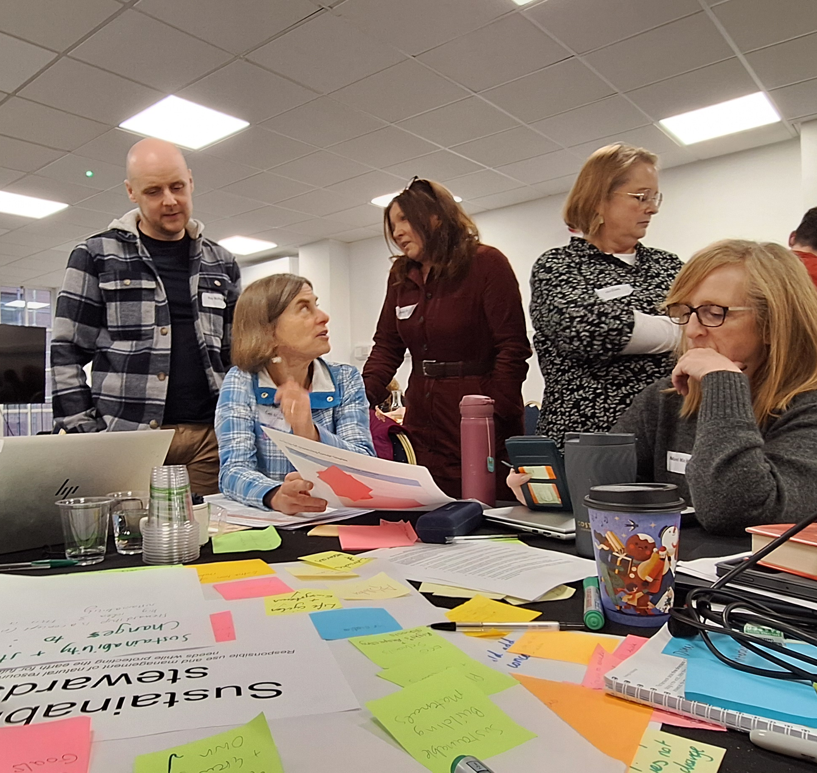
Core Group Workshop Activities
(20 – 21 Nov 2025)
Sorting knowledge bundles into big ideas
Reviewing big idea structure
Developing big idea narratives
Considering overarching concepts
Drafting overarching concepts statements
Notes:
In November 2025, we collated the evidence and presented it to our Core Group members at their two-day workshop. Activities included:
Sorting knowledge bundles into big ideas
Reviewing big idea structure
Developing big idea narratives
Considering overarching concepts
Drafting overarching concepts statements

Slide 21
Physics
Biology
Biology
Biology
Physics
Health physics?
Chemistry
Distribute your cards across at least two of the highlighted big ideas
Look for natural fits and opportunities
The big ideas still need to work as anchors
Physics
Chemistry
Chemistry
Notes:
Feedback from network webinars and Critical Friends focus groups suggested that the big ideas should be more integrated i.e. not take a discipline-specific approach.
We were keen to explore ways to achieve this.
One of the Core Group’s tasks was to develop an approach for the middle big ideas that worked across subjects, rather than being limited to chemistry, physics, or biology.

Slide 22
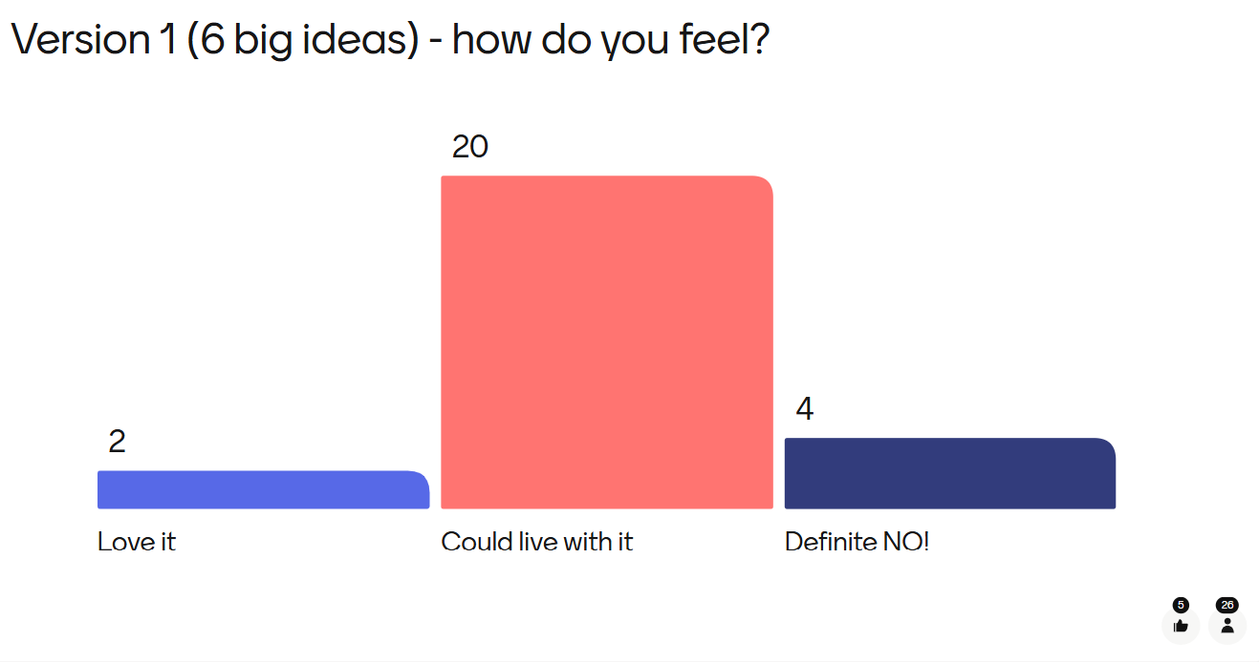
Notes:
This slide shows the Menti voting results from Core Group workshop 3 (20-21 November 2025) on the integrated (non-discipline specific) model for the 6 big ideas.
The Core Group feel it was workable and that they could live with the approaches they had identified.
However, for our new curriculum we wanted an approach that garnered a much more positive response.

Slide 23
Collapse?
Collapse?
Collapse?
Multiple ways to collapse big ideas were emerging
Realisation – is this telling us something? Do we need to take more strategic approach?
Notes:
When reflecting on the process and discussions that flowed from this task we began to realise that there were fundamental issues with using six big ideas. For example, group members were identifying a number of opportunities to merge different combinations of the big ideas. This suggested strongly that there was a need to rationalise the six big ideas into a smaller number of big ideas.

Slide 24
Disadvantages - Six big ideas
Challenging to place knowledge into big ideas
Bringing in complexities that didn’t need to be there
Could have caused confusion and duplication – encouraged discipline specific approach
Unclear where skills, energy fitted in – was becoming contrived
Looked like topic headings
Open to different interpretation by sectors
Difficult for progression into senior phase
Notes:
This slide shows the feedback from Core Group members when we reflected on the model with six big ideas.

Slide 25
Knowledge
Application
Three big ideas
Scientific knowledge: what we understand so far
Science in action:
be the change
Being scientific: building our skills toolkit
Skills
Doing science & being: application, innovation & impact
Learning science: curiosity, discovery & understanding
Learning about science: methods, processes & techniques
Notes:
The Core Group came to the collective realisation that the answer lay in reducing the six big ideas to three big ideas as outlined in the slide.

Slide 26
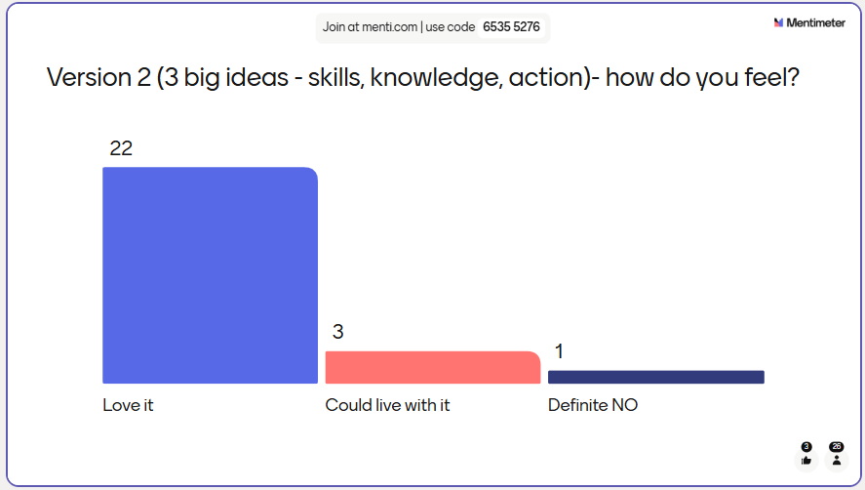
Notes:
This is the Menti voting results from Core Group workshop 3 (20-21 November 2025) in relation to the three big idea structure.
The Core Group were overwhelmingly positive about this approach.

Slide 27
Advantages - Three big ideas
Offers flexibility and more connected – true 3-18 curriculum
Easier to show progress, assess and support IDL
Clear focus on practical work – protects skills
Feels like true sciences big ideas and not organisers
Less scary for non-specialists
Feels different to what we have currently
Common language to other curriculum areas is positive for early learning and childcare and primary
Notes:
This slide details the reflections from Core Group members regarding the three big ideas.

Slide 28
Advantages - Three big ideas
More manageable number
Empowers learners to think differently
Lot more clarity
More likely to look at action part if only one of three big ideas
More equity of knowledge across three big ideas
Sciences disciplines are still clearly identifiable
Easier to align with myriad of sciences qualifications (+200)
Learners will feel like active players – here’s what I can do
Notes:
This slide details further reflections from Core Group members regarding the three big ideas.

Slide 29
Won’t knowledge big idea be too big?
Being scientific: building our
skills toolkit
Scientific knowledge:
what we understand so far
Science in action:
be the change
Remember
Each sector (ELC, primary, ASN and secondary) only works with a proportion of the knowledge
We are already exploring options for a digital platform which will help too
We will be decluttering the curriculum
Notes:
There was one initial concern from Core Group members: the Knowledge Big Idea might be too large if all content were included.
A discussion highlighted that each sector (Early years, primary, broad general education (secondary), and senior phase) only engages with a portion of the knowledge at a time.
It was felt that this would mean the content across each big idea would, therefore, be appropriately balanced.

Slide 30
What the feedback told us
people liked – this can still be there ♥
Being scientific: building our skills toolkit
Scientific knowledge: what we understand so far
Science in action:
be the change
What things are made of
Science around me
Practical skills
How things work
How science changes the world
Thinking scientifically
Life and health
Pathways and careers
Sustainability now and in the future
Our world and Universe
Action project
+ We will work with these more on a daily basis
Notes:
Some of the original headers under the Big Ideas have been highlighted as particularly strong and help create a clear narrative.
Conversations with the Curriculum Improvement Cycle groups are ongoing to review these headers.
Advantage: when placed at a lower level beneath the big ideas and concepts, these headers are used more frequently in day-to-day planning, teaching, and assessment.
If they work well at this level, it provides more opportunities for engagement with these headers in practice.

Slide 31
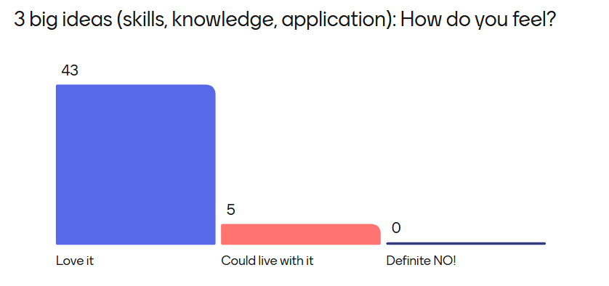
What did the Collaboration Group think?
Notes:
This slide shows the Menti voting results from the Collaboration Group members on the three big ideas model. This Menti vote was undertaken at the online session for Collaboration Group members held the week prior to their face-to-face event on 03 December 2025.
This shows overwhelming support from Collaboration Group members for the three big ideas model.

Slide 32
What did the Collaboration Group think?
I feel that the change to the 3 big ideas is huge progress.
There is clear progression based on prior sessions. There has been amendments made based on feedback (6 to 3 big ideas) which has been a bold decision to change quite far into the process. Shows it is still a fluid process which has the best intentions at core.
Really pleased to see the progression which has been made and the direction of travel, I feel that the big ideas have evolved nicely and am excited to take them back to school.
Notes:
Feedback from the Collaboration Group in-person event on 03 December – captured through the event evaluation.

Slide 33
Big idea
Collaboration Group Dec 2025
Being scientific: building our skills toolkit
We learn how to use scientific skills to answer big questions about our world.
Being scientific is about developing the skills to help us explore and understand the world. Through experiences that encourage curiosity, practical, enquiry, collaboration and critical thinking we begin to see ourselves in science and understand how it connects to our lives. By engaging with evidence, testing ideas and improving explanations, we develop confidence in scientific thinking and practices.
Notes:
Please note – the order the big ideas are presented in does not reflect a suggested teaching order or sense of prioritisation

Slide 34
Big Idea
Collaboration Group Dec 2025
Scientific knowledge: what we understand so far
Our scientific understanding is built on knowledge and evidence which develops over time.
Scientific knowledge helps us to make sense of the world around us and find our place within it. Our understanding of the sciences is refined over time as new evidence emerges. We can all contribute to the development of scientific knowledge.
Notes:
Please note – the order the big ideas are presented in does not reflect a suggested teaching order or sense of prioritisation

Slide 35
Big Idea
Collaboration Group Dec 2025
Science in action: be the change
Applying our scientific knowledge and skills empowers us to make informed and ethical choices, and to take action to build a better world and sustainable future for all.
Science is not only about understanding the world – it is about improving it. Applying our sciences knowledge and skills helps us to develop creative solutions to real-life challenges. We use evidence to make informed, ethical decisions, recognising that scientific discoveries can bring both benefits and risks. The sciences empower us to take action to help both people and the planet.
Notes:
Please note – the order the big ideas are presented in does not reflect a suggested teaching order or sense of prioritisation

Slide 36

Waterfall:
In the chat pane
Waterfall
What are your thoughts and
reflections on the three big ideas?
Notes:
During the webinar, we asked attendees to add their thoughts and reflections on the three big ideas to the chat pane.

Slide 37
Your views matter Title for Big idea 1: Do you prefer? OR simply
menti.com
Being scientific:
building our skills toolkit
Being scientific:
building our skills
Notes:
From the Collaboration Group event on 03 December, there were two discussion points raised around the titles of the big ideas.
During this webinar we consulted with attendees on their thoughts and conducted a Menti poll. The poll is now closed however you can view the results in the slide that follows.
We will undertake similar exercises with other Sciences Critical Friends Groups at the start of 2026 to help us reach a decision.

Slide 38
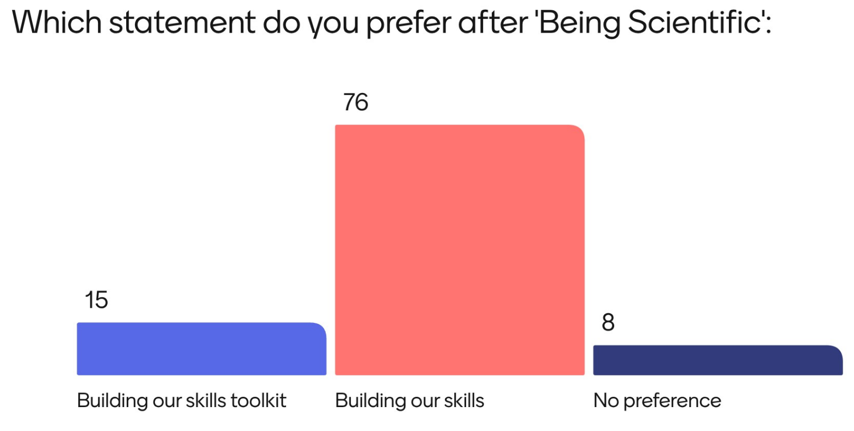
Notes:
The Menti results show strong support for dropping the word ‘toolkit’ from this big idea title.
The attendance at this webinar in December, however, was strongly skewed towards secondary.
Education Scotland will consult further with other groups including our early learning and childcare, primary and ASN critical friends to ensure each sector has a chance to express their views.

Slide 39
Your views matter Title for Big idea 3: Do you prefer? OR
menti.com
Science in action:
be the change
Science in action:
applying our learning
Notes:
From the Collaboration event, there were 2 discussion points raised around the titles of the big ideas.
During this webinar we consulted with attendees on their thoughts and conducted a menti poll. The poll is now closed however you can view the results in the slide that follows.

Slide 40
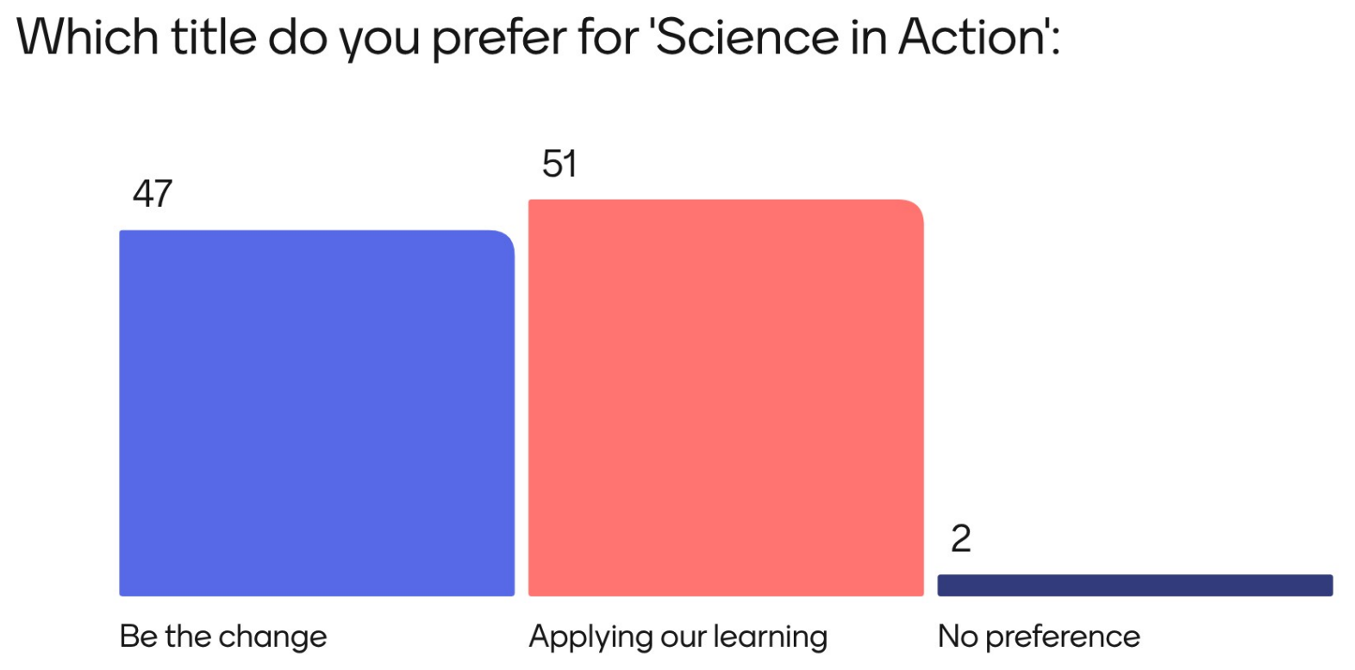
Notes:
The Menti results show no strong preference for other option for this big idea title.
The attendance at this webinar in December, however, was strongly skewed towards secondary.
Education Scotland will consult further with other groups including our early learning and childcare, primary and ASN critical friends to ensure each sector has a chance to express their views.

