Slide 1



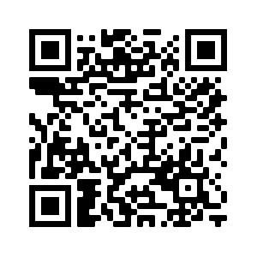

STEM Nation Award
Dumfries and Galloway
Lorraine Ross (Regional STEM Education Officer)
Ian Stewart – Development Officer (STEM Nation Award)
STEM@educationscotland.gov.scot
  STEM Nation
  Award

Slide 2
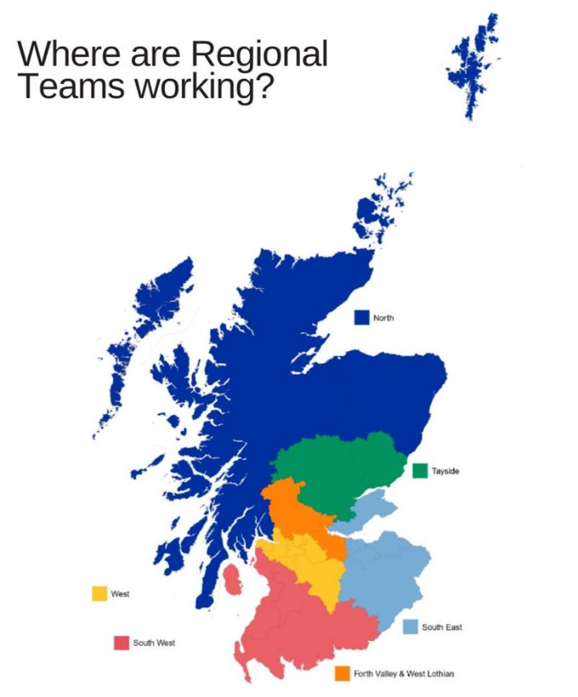

STEM and IGBE support
STEM Education Officer
  Lorraine Ross
STEM Education Officers are aligned to regions to support, develop and share good practice.
Our work also involves national priorities as outlined in the STEM strategy.
For Scotland’s learners with Scotland’s educators
Do luchd-ionnsachaidh na h-Alba, le luchd-foghlaim Alba

Slide 3


The STEM Nation Award and the Young STEM Leader Award Programmes have been developed with support and funding from the Scottish Government.
The STEM Nation Award Programme, led by Education Scotland, provides a focus for colleagues across a setting to work collegiately to identify, celebrate, promote and develop excellent STEM learning.
Notes:
The award has been developed to allow settings - ELCs, Schools and CLD settings. To celebrate, promote and build on effective practice in STEM.
Successful pilot programme with ELC settings and schools
Guidance documents are available in Gaelic for ELCs and schools
CLD guidance documents developed with practitioner working group
CLD documents have been co-developed with practitioners, with CLD exemplars prioritised for later this year

Slide 4
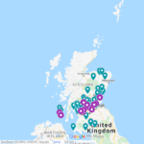
STEM Nation Award – Update
National Update :
Over 150 settings have registered from across all six regions;
44 settings have been awarded one or more elements.
23 settings have achieved the full STEM Nation Award.
Update for South East :
  18 settings are registered
  3 settings have been awarded one or more elements.
  3 settings have achieved the full STEM Nation Award.
Notes:
The successful pilot programme with ELC settings and schools led to 23 settings successfully achieving the full STEM Nation Award, with 44 other settings awarded for one or more elements, this is an impressive engagement when you consider this took place with the backdrop of lockdown.
In Glasgow – 10 settings are registered … 5 high schools, 3 primary school, 1 ELC setting and 2 CLD settings

Slide 5




Benefits
The STEM Nation Award Programme addresses the key aims of the STEM Strategy for Scotland, to deliver Excellence, Equity, Inspiration and Connection in STEM education and training. The structure of the Programme provides opportunities which allow settings to address many key priorities within the STEM context, including
Closing attainment gap Closing equity gap Social Justice Gender balance GIRFEC | Learning for Sustainability Green Skills STEM Skills UNCRC
Notes:
The Programme is designed to address the key aims of the STEM Strategy to deliver Excellence, Equity, Inspiration and Connection in STEM education and training. This provides opportunities for settings to engage in many key priorities such as closing attainment and equity gaps, social justice, gender balance and UNCRC goals

Slide 6





The five elements
For CLD settings, optionality built into STEM learning in the community element – CLD applicants can focus on adult learning, family learning or youth work.
Five key elements – evidence can be used across multiple elements
3 year window to submit evidence
Leadership in STEM
STEM family learning /
STEM learning in
the community
Employability and STEM partnerships
Curriculum and learner pathways
Equity and equality in STEM
Notes:
The structure of STEM Nation Award addresses the main aims of the STEM Education and Training Strategy, which are key to ensuring high quality STEM learning in all settings.
Five key elements …….
– evidence can be used across multiple elements
Depending on the needs of their learners CLD settings can focus of adult learning, family learning or youth work

Slide 7


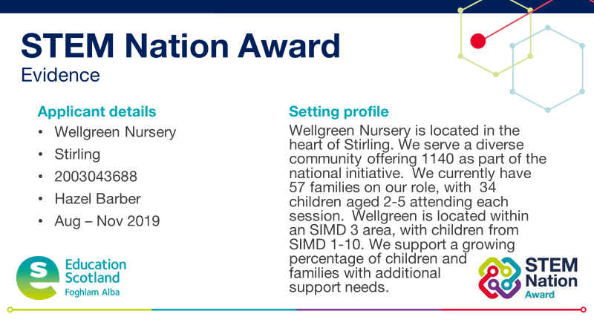
Programme Process
  Register and carry out self-evaluation
  Complete setting profile
  Collate and submit evidence using PowerPoint template
  For full award - Action Plan and Validation Conversation
Notes:
The process has been designed to be straightforward.....
Can apply for all five elements at once or work towards the award over a three year period
5 elements
3 year window
For settings who are embracing STEM learning
It's completely free!
Submission template is a PowerPoint and populated with extracts from improvement plans, photographs of learners, survey feedback from families, learner profiles, Tweets or newsletters
There is a maximum of 5 slides of evidence per element

Slide 8
Curriculum and Learner Pathways examples:
  STEM learning strongly supports Learning for Sustainability, the UN Sustainable Development Goals including learning about the climate emergency and threats to biodiversity.
  Engaging STEM contexts help us deliver literacy, numeracy and digital literacy.
  We are using creative approaches in STEM to promote curiosity, open-mindedness, imagination, problem solving and diversity.
  Collaboration with learning community colleagues is helping us to improve continuity and progression in STEM learning.
  We are helping learners develop a belief in their own abilities. The support we provide to learners and their families helps learners make informed choices about STEM learner pathways, not limited by stereotypes.
  We encourage all learners to develop a wide range of skills and take account of labour market needs when planning the curriculum to prepare learners for a variety of STEM careers, including green jobs.
Curriculum and learner pathways
Notes:
Further details on each element is given in the Application Guidance.
https://blogs.glowscotland.org.uk/glowblogs/public/stemnation/uploads/sites/8486/2022/10/03191711/01-STEM-Nation-Award-Application-guidance-ELC-and-schools.pdf
For Curriculum and Learner Pathways you may consider how curiosity, imagination and diversity is encourages.
or consider how improving collaboration is supporting progression
5

Slide 9
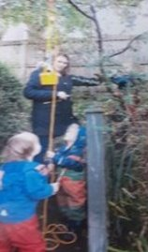
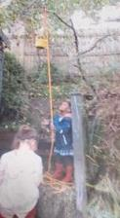
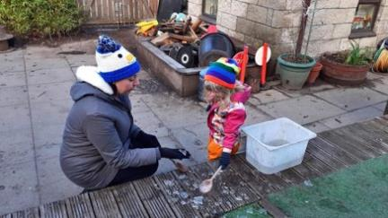
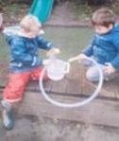
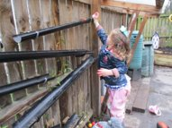
Increasing creativity and employability
Engineering and Science Exploration in the Garden.
Exploring Simple Machines
Through providing provocations such as pulley, syphons, wheels and levers children explore how simple machines work and what we can use them for. Developing creativity and innovation within children's play and learning. Giving children the skills to become computational thinkers, using problem solving skills to make the machines work. Children build resilience as they work through difficult tasks.
At Wellgreen Nursery we are responsive to the natural world. Exploring changing seasons with children as they occur. Allowing children to make sense of the world around them.
"It's (the pulley) for pulling stuff up, I put crab apples and stones in my bucket." S
"I was pulling on it so I could climb up and down." M
"The bucket is for catching things." M
"I don't know how to open the pulley. I did tie a knot; I think I need a hook." R
Properties
Exploration
Wellgreen Nursery, Stirling
Notes:
You may wish to use the notes area to provide a written narrative to support your evidence.

Slide 10
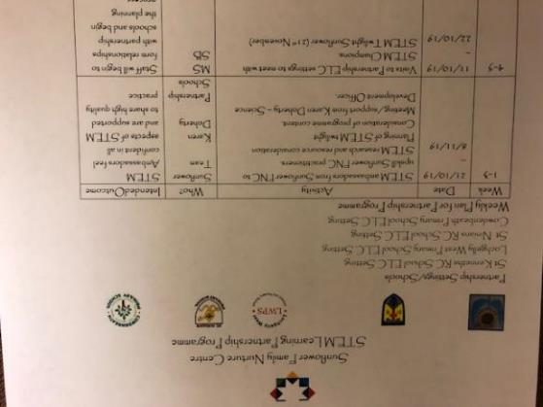
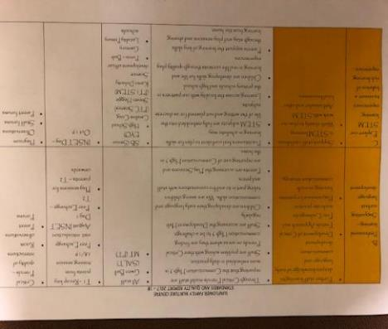
Leadership of change
We applied for STEM Funding through the Leadership and collegiate professional learning fund. We were successful in our bid. We now have 3 STEM ambassadors who are upskilling staff across 4 locality schools. This is a planned piece of work and data gathered so far is evidencing a positive impact on STEM outcomes for children. Within Sunflower FNC almost all staff are now confidently supporting and leading STEM across the setting.
Our Vision, Values and Aims have been developed in consultation with our children, staff, parents and partners. These are real, are lived and are re-visited regularly.
STEM has featured on our Improvement Plan for a number of years. STEM has been re-visited as we work to completely embed this in the life of the setting.
Sunflower Family Nurture Centre (ELC setting, Fife)

Slide 11
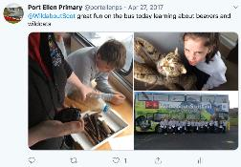
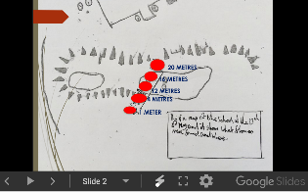
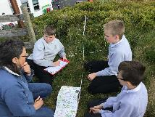
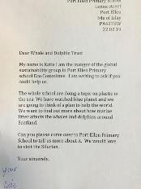
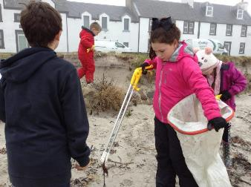
We worked with INHT on a cluster wide pollinators project.
The RSPB is a regular visitor and they support the ELCC in the annual great garden birdwatch.
ReJig helps us clean and survey our adopted local beach.
We learned about wild cats and whales and dolphins from visitors.
WILD ABOUT SCOTLAND VISIT
ISLAY NATURAL HISTORY TRUST
HEBRIDEAN WHALE AND DOLPHIN TRUST
RSPB
REJIG BEACH CLEAN
Port Ellen Primary School

Slide 12
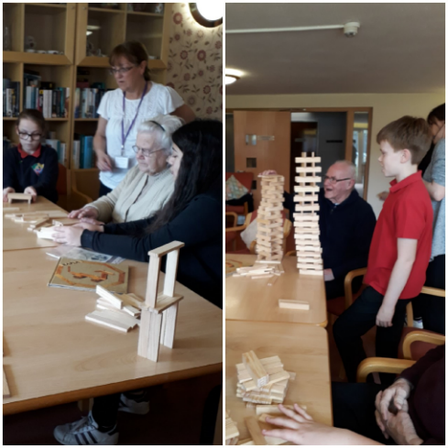
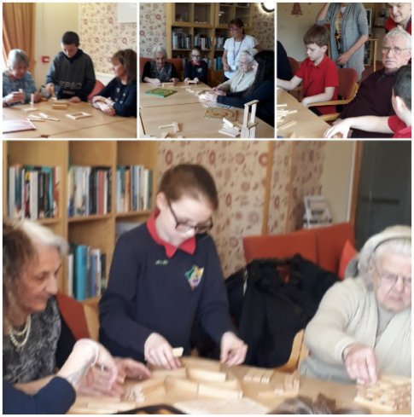
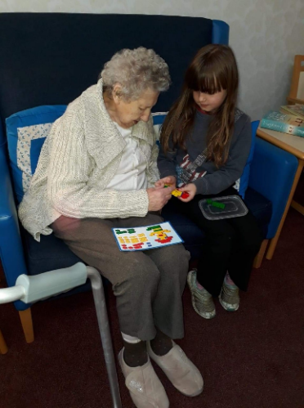
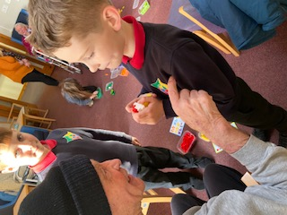
Community Engagement
Our community outreach groups regularly visit a neighbouring residential care home and engage in activities with the elderly residents.
STEM activities are often a focus for these visits, with learners engaging in construction challenges with resources such as Lego, Kapla and K'Nex. Pupils have also taught residents to use creative apps on iPads.
Pitteuchar East Primary School

Slide 13
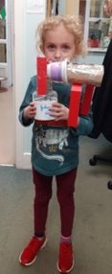

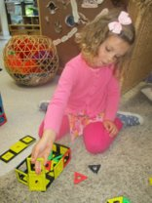
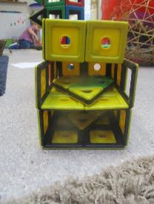
Improving wellbeing, equality and inclusion
Wellgreen staff consult "Gender Equal Play" to ensure we are creating a space that is inclusive for all children. Staff are aware of the statistics around STEM graduates. (around 26% are currently women) Children's interests are encouraged and supported, learning experiences are carefully and thoughtfully planned to be inclusive and differentiated for all learners.
Staff understand the importance of using appropriate language when discussing roles within society and we are non-judgemental of the choice's children make about where they want to play.
Resources are open-ended and appropriate for exploratory play. Choices are offered equally to all children.
O used junk modelling materials
"(I made) something for my toys, a little runaway train. They ran on it and it goes faster."
C has used the magnetic polygons to build an airport.
https://hub.careinspectorate.com/how-we-support-improvement/care-inspectorate-programmes-and-publications/gender-equal-play-in-early-learning-and-childcare/
Wellgreen Nursery, Stirling
Notes:
Could highlight gender balance, how you manage unconscious bias

Slide 14






Who can help?
children and young people
parents and wider community
Lorraine Ross Regional officer
STEM Nation network members
partners
community learning & development colleagues
practitioners
Ian Stewart DevelopmentOfficer
Notes:
There are many sources of support ...
STEM Nation Network – over 700 members

Slide 15
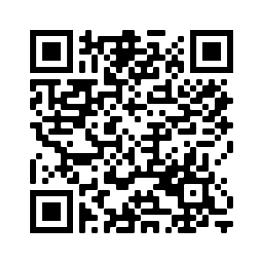
Support Structures / Opportunities
Initial Support within Scottish Borders: Lorraine Ross - Regional STEM Education Officer (Lorraine.ross@educationscotland.gov.scot)
Collegiate Support: STEM Leads, STEM Networks, colleagues, etc
Partners / Supporters : Science Centres, STEM Ambassadors, SSERC, Galloway and Southern Ayrshire Biosphere, Royal Society of Chemistry, The Royal Society, Institute of Physics, Royal Highland Educational Trust (RHET), D&G College, Universities and many more.
  Networks
Notes:
myself and Regional STEM EO can provide support prior to registration and during process.
Currently looking in to process of formalising relationship with Partners as STEM Nation Award Supporters.

Slide 16






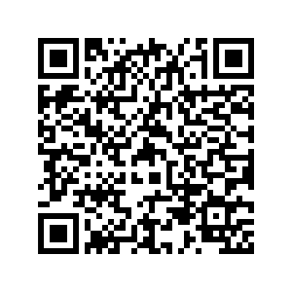

STEM Nation Update
154 Registered Settings
23 settings Full STEM Nation Award
44 settings one or more elements
Regular drop in sessions for interested and registered settings.
STEM Nation Network Sessions
  Upcoming STEM Events
Notes:
ES are also hosting drop in sessions for registered settings and those who are interested in registering
https://blogs.glowscotland.org.uk/glowblogs/STEMcentralinmotion/2022/10/06/stem-nation-award-drop-in-sessions/
… 5 high schools, 2 primary school, 1 ELC setting and 2 CLD settings

Slide 17


STEM Nation Network
MS Team (accessible through Glow) – with over 700 practitioners from across EY, Primary and ASN sector.
Regular sessions covering a range of themes
Sessions delivered nationally June 2021
Session 1 Resources: STEM Early Years - YouTube
Session 2 Grants: EY STEM network – YouTube
Session 3 STEM Nation Award: STEM Nation Awards - YouTube
Session 4 IGBE: Gender stereotypes / Unconscious bias ELC – YouTube
Session 5 Outdoor Ideas: Early Years Summer Tips - YouTube
For Scotland’s learners with Scotland’s educators
Do luchd-ionnsachaidh na h-Alba, le luchd-foghlaim Alba
Notes:
Some extra resources and support info for you!
We ran a series of recorded sessions in the run up to 2021 summer on Education Scotland Youtube channel

Slide 18
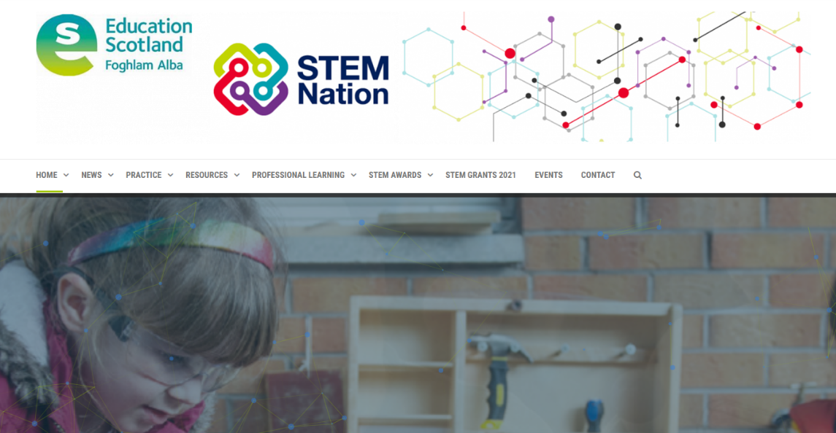
STEM online resource
STEM Nation – STEM Excellence, Equity, Inspiration and Connection (glowscotland.org.uk)
Case studies - Early learning and childcare – STEM Nation (glowscotland.org.uk)
IGBE Case Study - IGBE - early years whole setting approach - beginning - Cradlehall ELC.pdf
Stemnation.scot
For Scotland’s learners with Scotland’s educators
Do luchd-ionnsachaidh na h-Alba, le luchd-foghlaim Alba

Slide 19
STEM Resources
STEM Online resource: https://STEMnation.scot
Sciences STEM Wakelets: https://wakelet.com/@STEMES
STEM Resources page on National Improvement Hub: https://education.gov.scot/improvement/learning-resources/a-summary-of-stem-resources/
Family Learning and Parental Engagement: Education Scotland Parentzone: Supporting STEM at home
Outdoor Learning including webinar recordings: A summary of outdoor learning resources | Learning resources | National Improvement Hub (education.gov.scot)
Scottish Childminding Association: STEM (Science TechnologyEngineering andMaths)(childminding.org)
GLOW Sciences PLC including EY: https://glowscotland.sharepoint.com/sites/sciencesplc
For Scotland’s learners with Scotland’s educators​
Do luchd-ionnsachaidh na h-Alba, le luchd-foghlaim Alba
For Scotland’s learners with Scotland’s educators
Notes:
Resources – specifically with EY sections

Slide 20

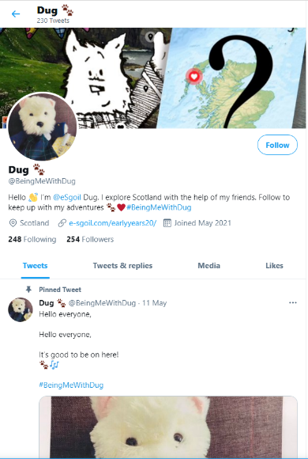
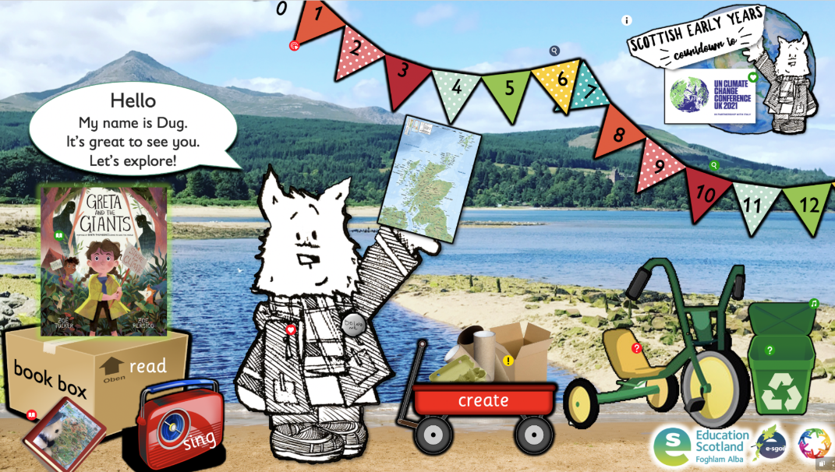

e-Sgoil Dug
Digital learning from Comhairle Nan Eilean Siar | e-Sgoil
Dug 🐾 (@BeingMeWithDug) / Twitter
For Scotland’s learners with Scotland’s educators
Do luchd-ionnsachaidh na h-Alba, le luchd-foghlaim Alba
Notes:
Has Dug visited you? What adventures have you had together?

Slide 21
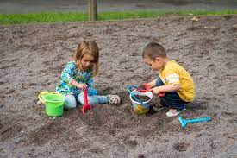
Outdoor Learning Resources
Outdoor learning with a focus on early years
Literacy in the outdoors
A Head Teacher's Journey Outdoor Learning
Outdoor Learning & Religious & Moral Education
Outdoor Learning with a focus on ASN
Using Digital Tools to capture, create and share outdoor learning experiences
Learning and teaching numeracy and maths outdoors
Outdoor Learning across the 4 contexts for learning
For Scotland’s learners with Scotland’s educators​
Do luchd-ionnsachaidh na h-Alba, le luchd-foghlaim Alba
For Scotland’s learners with Scotland’s educators
Notes:
Links to Outdoor webinar recordings from last year on ES Youtube

Slide 22



Lorraine.ross@educationscotland.gov.scot
Ian.stewart@educationscotland.gov.scot
STEM@educationscotland.gov.scot
@lorraineross20 @STEMedscot ​
For Scotland’s learners with Scotland’s educators​
Do luchd-ionnsachaidh na h-Alba, le luchd-foghlaim Alba
Notes:
Contacts

