Slide 1
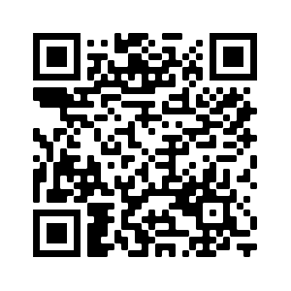
Resources available from Education Scotland
STEM@educationscotland.gov.scot
STEM Nation
Award

Slide 2
STEM Grants Programme
Round 3 Phase 2 Breakdown (59 Projects)
Round 4 Phase 1 Breakdown (59 Projects)
STEM | £167,533
Numeracy and Mathematics | £178,410
Total | £345,943
STEM | £194,605
Numeracy and Mathematics | £117,340
Total | £311,945
Since the inception of the grants programme over £4.3 million has been awarded to 307 STEM professional learning projects.
An estimated 58,161 practitioners have benefitted for the three funding rounds from over 9.5K establishments.
A further 29,000 practitioners are set to benefit from Round 4.
Notes:
STEM Evaluation Focus Groups - sign up:
https://forms.office.com/r/LvEAkQb85b

Slide 3
STEM Nation Online Resource
Resources
Professional Learning
Networks
Events
News
https://blogs.glowscotland.org.uk/glowblogs/stemnation/
Notes:
Lab Skills Sign Up
https://bit.ly/3KdT5i9
Put in chat
Other session will be advertised through Teams, social media, Synapse/Strontium/Sputnik

Slide 4
Events Calendar
Contains STEM and Learning for Sustainability professional learning opportunities, networks for dialogue and sharing practice and events from across a variety of STEM partners and also includes professional learning offered by Education Scotland.
Notes:
Lab Skills Sign Up
https://bit.ly/3KdT5i9
Put in chat
Other session will be advertised through Teams, social media, Synapse/Strontium/Sputnik

Slide 5
National e-Learning Offer (NeLO)
Approximately 24,000 resource links across 37 subjects
5000+ resource links for sciences NQs
All 3 strands of NeLO have content contained within NeLO micro-site on: e-Sgoil, West OS & ES (supported)
Supported element was developed by teachers for teachers by ES Curation groups. These groups collated and curated content which was mapped to the curriculum.
BBC, West OS, e-Sgoil & SCHOLAR resources
National e-Learning Offer | Education Scotland – https://education.gov.scot/nelo/
Notes:
This slide provides details of the support that Education Scotland and key partners have put in place for the National e-Learning Offer…
After presenting this slide a quick demo of the NeLO platform highlighting the following key points
•Two pages of the NeLO micro-site
•How to search the NeLO resources (page 2 of the site)
•Explain the filters on the left hand site
•Highlight that practitioners can suggest resources using the suggestion link
•Show the resource type collections
National e-Learning Offer: https://education.gov.scot/nelo/

Slide 6
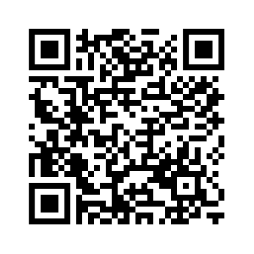
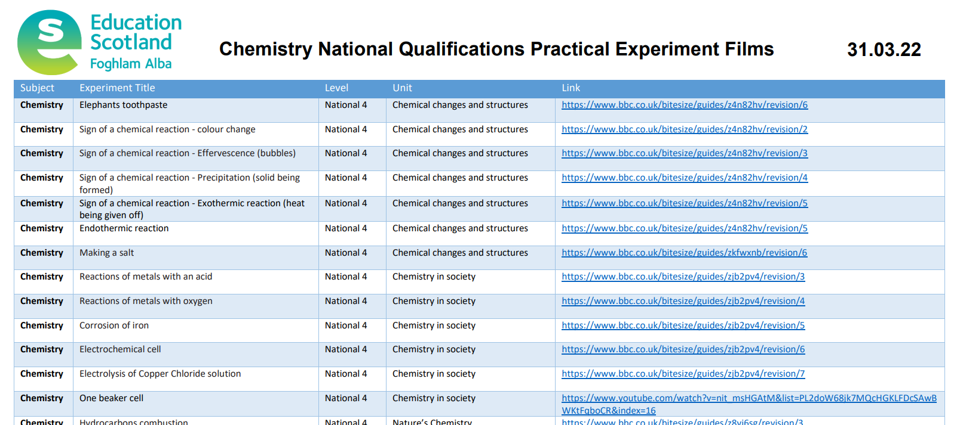
Practical Science Experiment Films
Ongoing filming with practitioners, BBC Bitesize and Universities.
Over 200 practical science experiment films, including:
Listings on STEM Nation Online Resource (https://www.bitlylinks.com/DUtrs8W7K)
All mandatory secondary experiments filmed for biology, chemistry and physics
Many Primary and BGE practical activities
Notes:
Lab Skills Sign Up
https://bit.ly/3KdT5i9
Put in chat
Other session will be advertised through Teams, social media, Synapse/Strontium/Sputnik

Slide 7
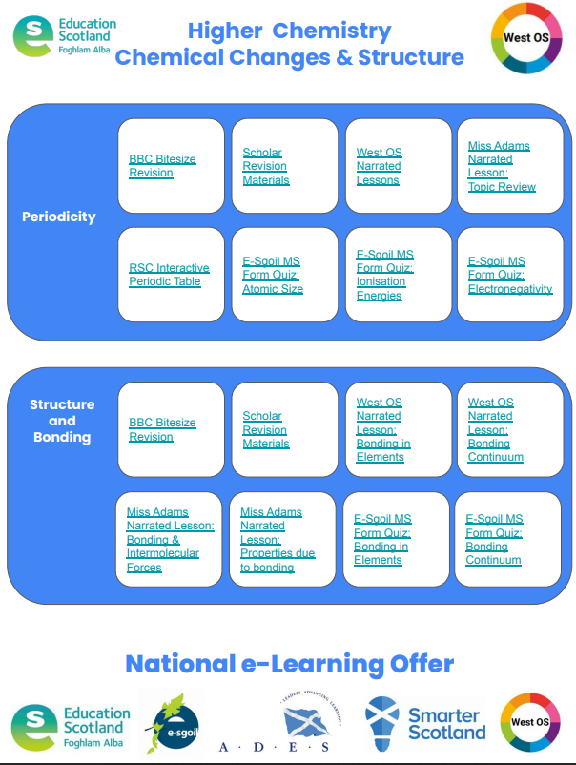

Slide 8
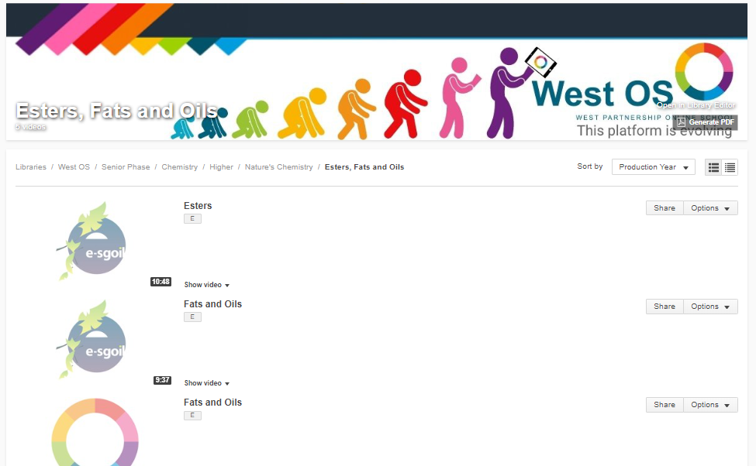

Slide 9
STEM Nation
Award
STEM@educationscotland.gov.scot
Notes:
https://jamboard.google.com/d/1pExlIa9vLNtJq-Mj5qIoFj0ShmA3cmSvh6EA8fYrw3I/edit?usp=sharing

