Slide 1
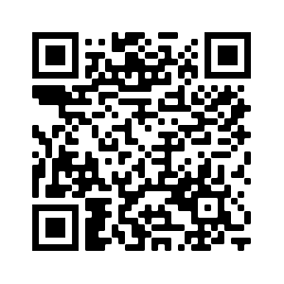
STEM Nation Award
Highland Inset – 22 Feb 2023
Ian Stewart – Development Officer (STEM Nation Award)
STEM@educationscotland.gov.scot
STEM Nation
Award

Slide 2
The STEM Nation Award and the Young STEM Leader Award Programmes have been developed with support and funding from the Scottish Government.
The STEM Nation Award Programme provides a focus for colleagues across a setting to work collegiately to identify, celebrate, promote and develop excellent STEM learning.
Notes:
The ….. Programmes have been developed as part of the STEM Strategy for Education and Training in Scotland. Both programmes were developed with support and funding from the Scottish Government. The YSL award is for individuals and is led by SSERC. the SNA is awarded to the setting and is led by Education Scotland.
SNAP provides a focus for colleagues across a setting to work together to firstly identify, celebrate and promote excellent STEM practice and learning, with the focus of further developing the practice.

Slide 3
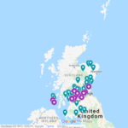
STEM Nation Award – National Update
Award available to ELC Settings, Schools and CLD Settings
Over 160 settings have registered from across all six regions;
45 settings have been awarded one or more elements.
24 settings have achieved the full STEM Nation Award.
Update for Northern Alliance:
18 settings are registered
3 settings have been awarded one or more elements.
2 settings have achieved the full STEM Nation Award.
Notes:
The successful pilot programme with ELC settings and schools led to 23 settings successfully achieving the full STEM Nation Award, with 44 other settings awarded for one or more elements, this is an impressive engagement when you consider this took place with the backdrop of lockdown.
In Falkirk – 11 settings are registered … 4 high schools, 4 primary school, 1 joint primary and ELC setting, 2 ELC setting

Slide 4
Benefits
The STEM Nation Award Programme addresses the key aims of the STEM Strategy for Scotland, to deliver Excellence, Equity, Inspiration and Connection in STEM education and training.
The structure of the Programme provides opportunities which allow settings to address many key priorities within the STEM context, including
Closing attainment gap Closing equity gap Social Justice Gender balance GIRFEC | Learning for Sustainability Green Skills STEM Skills UNCRC
Notes:
The Programme is designed to address the key aims of the STEM Strategy to deliver Excellence, Equity, Inspiration and Connection in STEM education and training. This provides opportunities for settings to engage in many key priorities such as closing attainment and equity gaps, social justice, gender balance and UNCRC goals

Slide 5
The five elements
For CLD settings, optionality built into STEM learning in the community element – CLD applicants can focus on adult learning, family learning or youth work.
Five key elements – evidence can be used across multiple elements
Three year window to submit evidence
Leadership in STEM
STEM family learning /
STEM learning in
the community
Employability and STEM partnerships
Curriculum and learner pathways
Equity and equality in STEM
Notes:
The structure of STEM Nation Award addresses the main aims of the STEM Education and Training Strategy, which are key to ensuring high quality STEM learning in all settings.
Five key elements …….
– evidence can be used across multiple elements
Depending on the needs of their learners CLD settings can focus of adult learning, family learning or youth work

Slide 6
Programme Process
Register and carry out self-evaluation
Complete setting profile
Collate and submit evidence using PowerPoint template
For full award - Action Plan and Validation Conversation
Notes:
The process has been designed to be straightforward.....
Can apply for all five elements at once or work towards the award over a three year period
5 elements
3 year window
For settings who are embracing STEM learning
It's completely free!
Submission template is a PowerPoint and populated with extracts from improvement plans, photographs of learners, survey feedback from families, learner profiles, Tweets or newsletters
There is a maximum of 5 slides of evidence per element

Slide 7
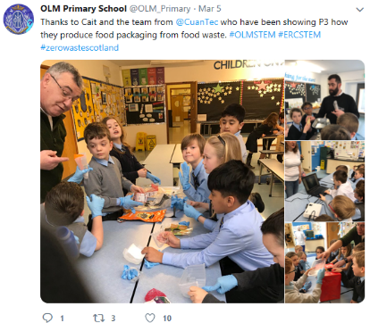
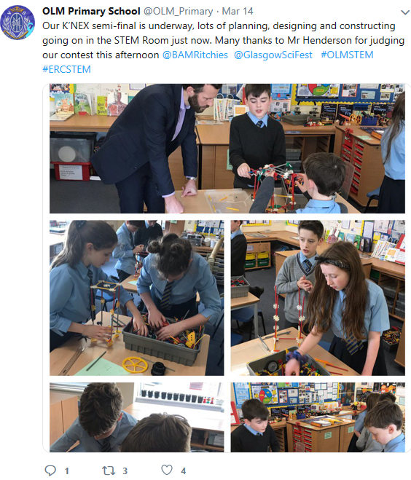
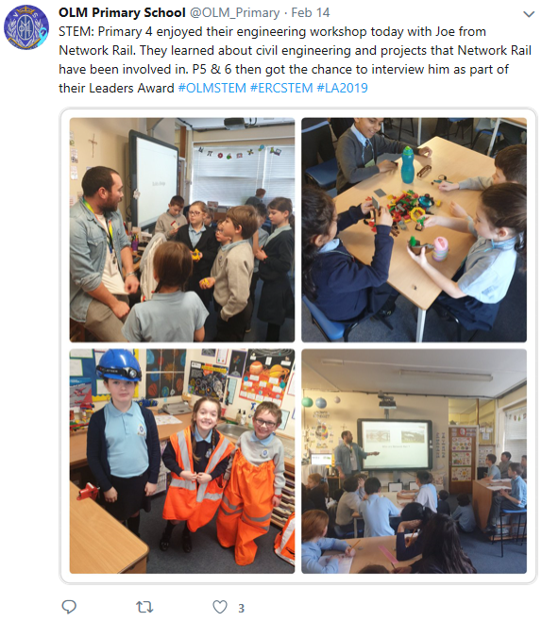
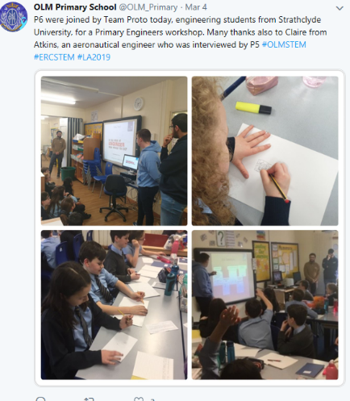
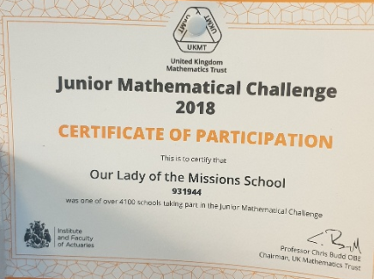
Our Lady of the Missions Primary School
Notes:
Over the next few slides we have some examples of evidence. On The STEM blog, there are complete examples of evidence to provide some guidance to your own submission. This example is from OLM PS highlights engagement with STEM professionals

Slide 8
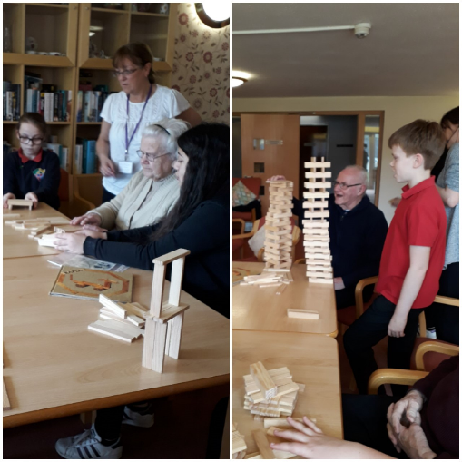
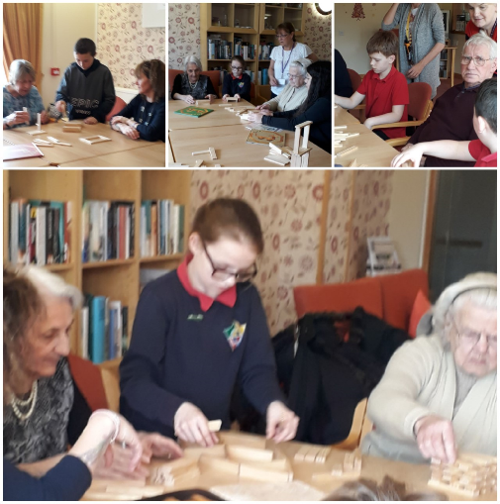
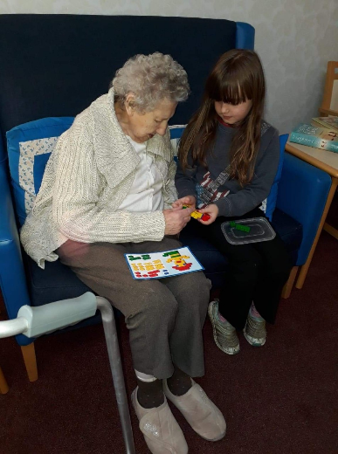
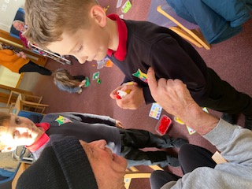
Community Engagement
Our community outreach groups regularly visit a neighbouring residential care home and engage in activities with the elderly residents.
STEM activities are often a focus for these visits, with learners engaging in construction challenges with resources such as Lego, Kapla and K'Nex. Pupils have also taught residents to use creative apps on iPads.
Pitteuchar East Primary School
Notes:
This example shows an example of community engagement from PEPS where they worked with residents in a care home on various challenges

Slide 9
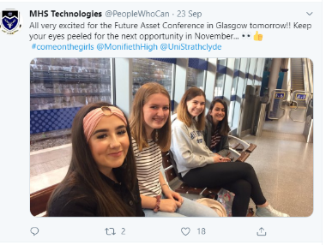
Monifieth High School
Notes:
In this example Monifieth HS show how they are IGBE

Slide 10
Who can help?
children and young people
parents and wider community
RAiSE STEM Lead
Regional STEM Education
Officer
partners
community learning & development colleagues
practitioners
Secondary Sciences network
Notes:
There are many sources of support ...

Slide 11
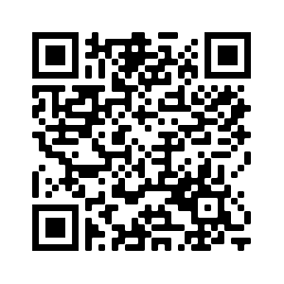
Support Structures / Opportunities
Regional STEM Education Officers:
Fiona Shaw (fiona.shaw@educationscotland.gov.scot)
Mark Irwin (mark.Irwin@educationscotland.gov.scot)
Collegiate Support:
UHI STEM Coordinators, colleagues, etc
Partners / Supporters :
STEM Ambassadors, SSERC, University of Highlands & Islands, Science Skills Academy, RHET, Royal Society of Chemistry, The Royal Society, Colleges, and many more
Networks
Notes:
myself and Regional STEM EO can provide support prior to registration and during process.
Currently looking in to process of formalising relationship with Partners as STEM Nation Award Supporters.

Slide 12
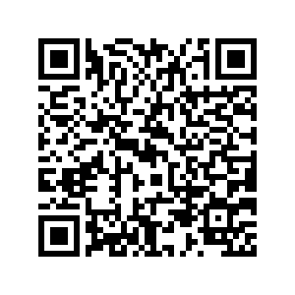
STEM Nation update
STEM Nation Network
Secondary Science Network
Award Drop-In Sessions
STEM Nation Network Sessions
Secondary Science Network Sessions
Regular drop in sessions for interested and registered settings.
Upcoming Events
Notes:
ES are also hosting drop in sessions for registered settings and those who are interested in registering
https://blogs.glowscotland.org.uk/glowblogs/STEMcentralinmotion/2022/10/06/stem-nation-award-drop-in-sessions/

Slide 13
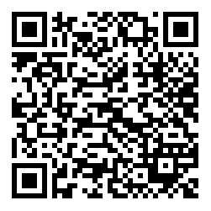
STEM Blog Post : WoS2023
(https://bit.ly/3GDlSN4)
STEM@educationscotland.gov.scot
Notes:
https://jamboard.google.com/d/1pExlIa9vLNtJq-Mj5qIoFj0ShmA3cmSvh6EA8fYrw3I/edit?usp=sharing

