Slide 1
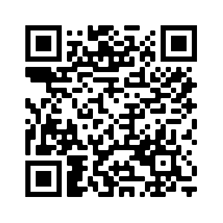
Resources available from Education Scotland
Ian Stewart – Development Officer (STEM Nation Award)
STEM@educationscotland.gov.scot
STEM Nation
Award

Slide 2
STEM Grants Programme
Round 3 Phase 2 Breakdown (59 Projects)
Round 4 Phase 1 Breakdown (59 Projects)
STEM | £167,533
Numeracy and Mathematics | £178,410
Total | £345,943
STEM | £194,605
Numeracy and Mathematics | £117,340
Total | £311,945
Since the inception of the grants programme over £4.3 million has been awarded to 307 STEM professional learning projects.
An estimated 58,161 practitioners have benefitted for the three funding rounds from over 9.5K establishments.
A further 29,000 practitioners are set to benefit from Round 4.
Notes:
STEM Evaluation Focus Groups - sign up:
https://forms.office.com/r/LvEAkQb85b

Slide 3
STEM Nation Online Resource
Resources
Professional Learning
Networks
Events
News
https://blogs.glowscotland.org.uk/glowblogs/stemnation/
Notes:
Lab Skills Sign Up
https://bit.ly/3KdT5i9
Put in chat
Other session will be advertised through Teams, social media, Synapse/Strontium/Sputnik

Slide 4
Events Calendar
Contains STEM and Learning for Sustainability professional learning opportunities, networks for dialogue and sharing practice and events from across a variety of STEM partners and also includes professional learning offered by Education Scotland.
Notes:
Lab Skills Sign Up
https://bit.ly/3KdT5i9
Put in chat
Other session will be advertised through Teams, social media, Synapse/Strontium/Sputnik

Slide 5
National e-Learning Offer (NeLO)
Approximately 24,000 resource links across 37 subjects
5000+ resource links for sciences NQs
All 3 strands of NeLO have content contained within NeLO micro-site on: e-Sgoil, West OS & ES (supported)
Supported element was developed by teachers for teachers by ES Curation groups. These groups collated and curated content which was mapped to the curriculum.
BBC, West OS, e-Sgoil & SCHOLAR resources
National e-Learning Offer | Education Scotland – https://education.gov.scot/nelo/
Notes:
This slide provides details of the support that Education Scotland and key partners have put in place for the National e-Learning Offer…
After presenting this slide a quick demo of the NeLO platform highlighting the following key points
•Two pages of the NeLO micro-site
•How to search the NeLO resources (page 2 of the site)
•Explain the filters on the left hand site
•Highlight that practitioners can suggest resources using the suggestion link
•Show the resource type collections
National e-Learning Offer: https://education.gov.scot/nelo/

Slide 6
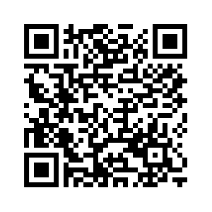
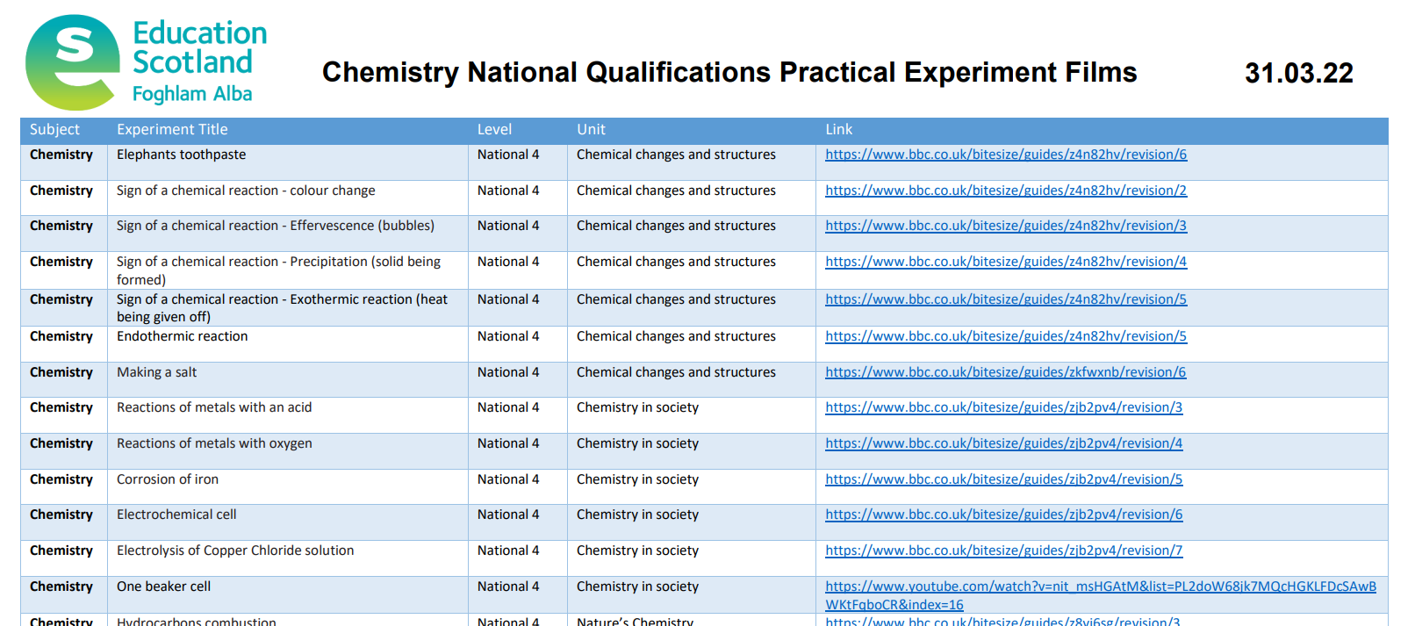
Practical Science Experiment Films
Ongoing filming with practitioners, BBC Bitesize and Universities.
Over 200 practical science experiment films, including:
Listings on STEM Nation Online Resource (https://www.bitlylinks.com/DUtrs8W7K)
All mandatory secondary experiments filmed for biology, chemistry and physics
Many Primary and BGE practical activities
Notes:
Lab Skills Sign Up
https://bit.ly/3KdT5i9
Put in chat
Other session will be advertised through Teams, social media, Synapse/Strontium/Sputnik

Slide 7
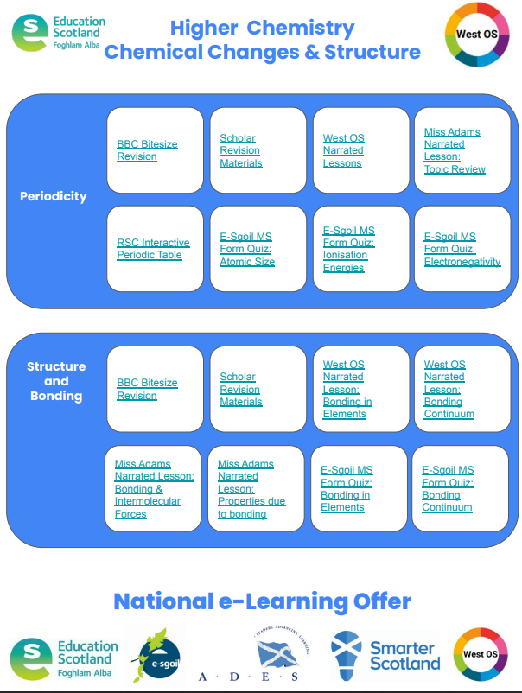

Slide 8
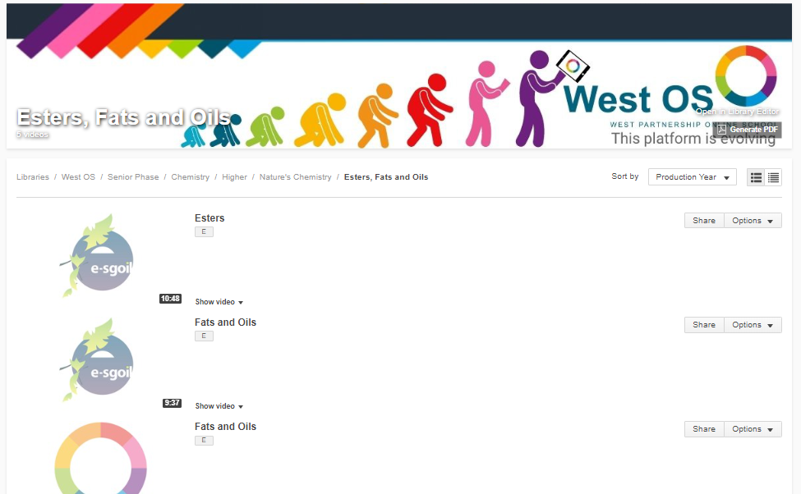

Slide 9
STEM Nation Award
Ian Stewart – Development Officer (STEM Nation Award)
STEM@educationscotland.gov.scot
STEM Nation
Award

Slide 10
The STEM Nation Award and the Young STEM Leader Award Programmes have been developed with support and funding from the Scottish Government.
The STEM Nation Award Programme provides a focus for colleagues across a setting to work collegiately to identify, celebrate, promote and develop excellent STEM learning.
Notes:
The ….. Programmes have been developed as part of the STEM Strategy for Education and Training in Scotland. Both programmes were developed with support and funding from the Scottish Government. The YSL award is for individuals and is led by SSERC. the SNA is awarded to the setting and is led by Education Scotland.
SNAP provides a focus for colleagues across a setting to work together to firstly identify, celebrate and promote excellent STEM practice and learning, with the focus of further developing the practice.

Slide 11
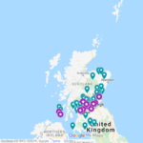
STEM Nation Award – National Update
Award available to ELC Settings, Schools and CLD Settings
Over 150 settings have registered from across all six regions;
44 settings have been awarded one or more elements.
23 settings have achieved the full STEM Nation Award.
Notes:
The successful pilot programme with ELC settings and schools led to 23 settings successfully achieving the full STEM Nation Award, with 44 other settings awarded for one or more elements, this is an impressive engagement when you consider this took place with the backdrop of lockdown.
In Falkirk – 11 settings are registered … 4 high schools, 4 primary school, 1 joint primary and ELC setting, 2 ELC setting

Slide 12
Benefits
The STEM Nation Award Programme addresses the key aims of the STEM Strategy for Scotland, to deliver Excellence, Equity, Inspiration and Connection in STEM education and training.
The structure of the Programme provides opportunities which allow settings to address many key priorities within the STEM context, including
Closing attainment gap Closing equity gap Social Justice Gender balance GIRFEC | Learning for Sustainability Green Skills STEM Skills UNCRC
Notes:
The Programme is designed to address the key aims of the STEM Strategy to deliver Excellence, Equity, Inspiration and Connection in STEM education and training. This provides opportunities for settings to engage in many key priorities such as closing attainment and equity gaps, social justice, gender balance and UNCRC goals

Slide 13
The five elements
For CLD settings, optionality built into STEM learning in the community element – CLD applicants can focus on adult learning, family learning or youth work.
Five key elements – evidence can be used across multiple elements
Three year window to submit evidence
Leadership in STEM
STEM family learning /
STEM learning in
the community
Employability and STEM partnerships
Curriculum and learner pathways
Equity and equality in STEM
Notes:
The structure of STEM Nation Award addresses the main aims of the STEM Education and Training Strategy, which are key to ensuring high quality STEM learning in all settings.
Five key elements …….
– evidence can be used across multiple elements
Depending on the needs of their learners CLD settings can focus of adult learning, family learning or youth work

Slide 14
Programme Process
Register and carry out self-evaluation
Complete setting profile
Collate and submit evidence using PowerPoint template
For full award - Action Plan and Validation Conversation
Notes:
The process has been designed to be straightforward.....
Can apply for all five elements at once or work towards the award over a three year period
5 elements
3 year window
For settings who are embracing STEM learning
It's completely free!
Submission template is a PowerPoint and populated with extracts from improvement plans, photographs of learners, survey feedback from families, learner profiles, Tweets or newsletters
There is a maximum of 5 slides of evidence per element

Slide 15
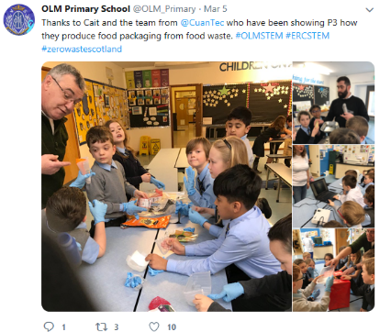
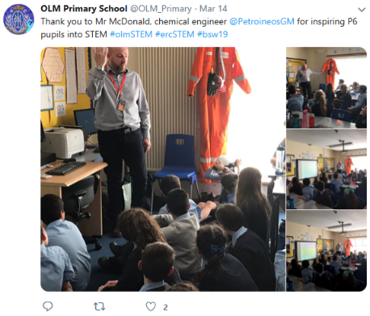
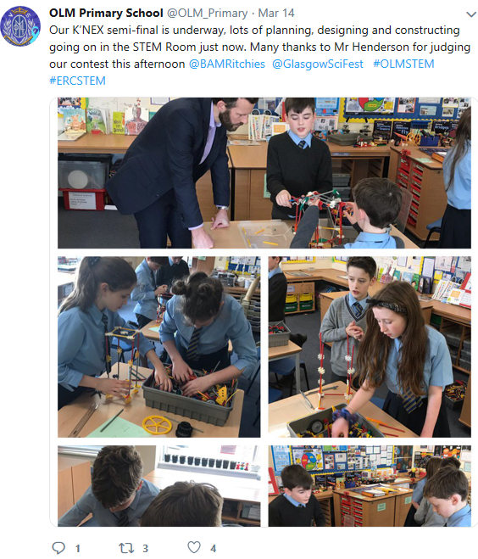
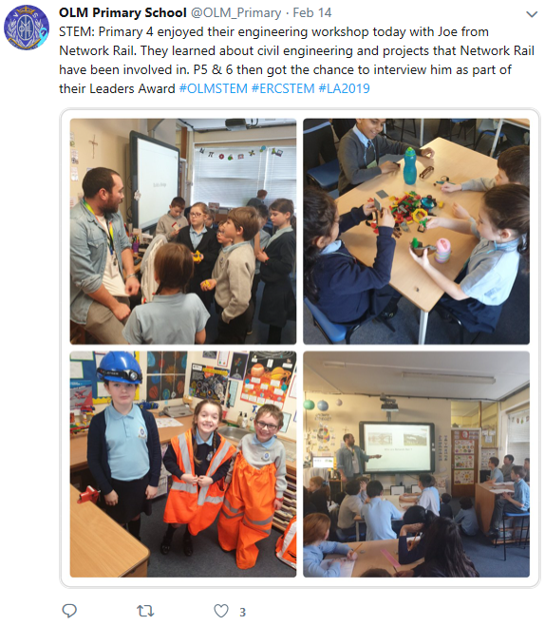
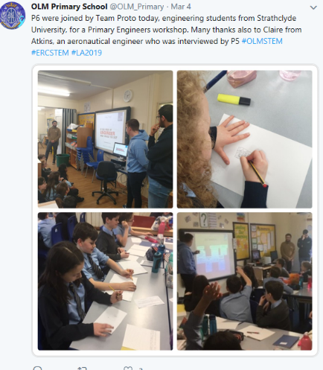
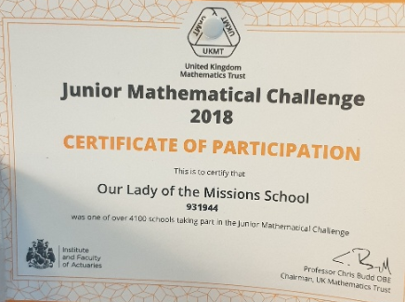
Our Lady of the Missions Primary School
Notes:
Over the next few slides we have some examples of evidence. On The STEM blog, there are complete examples of evidence to provide some guidance to your own submission. This example is from OLM PS highlights engagement with STEM professionals

Slide 16
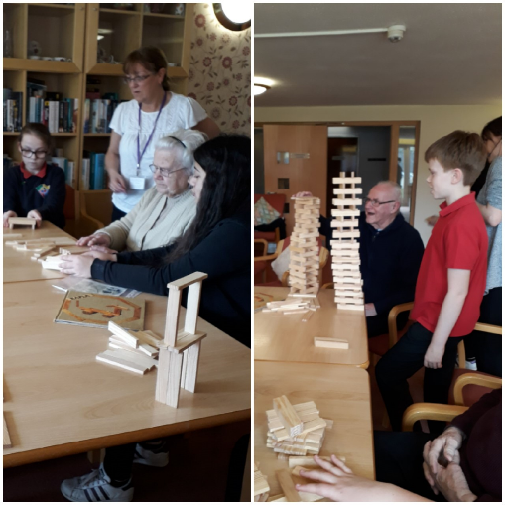
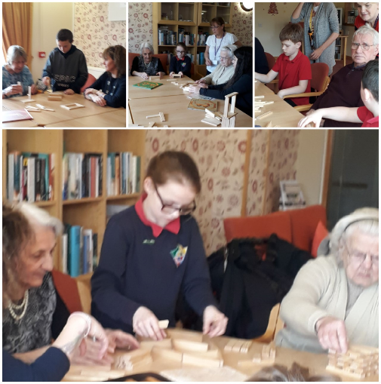
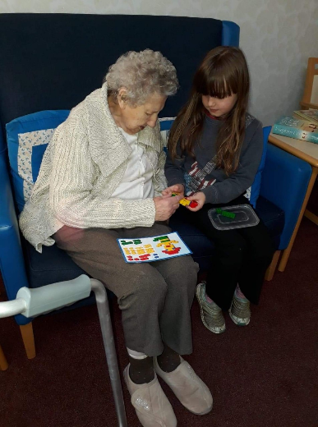
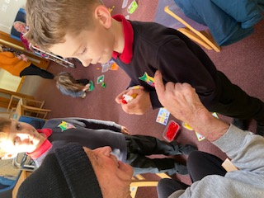
Community Engagement
Our community outreach groups regularly visit a neighbouring residential care home and engage in activities with the elderly residents.
STEM activities are often a focus for these visits, with learners engaging in construction challenges with resources such as Lego, Kapla and K'Nex. Pupils have also taught residents to use creative apps on iPads.
Pitteuchar East Primary School
Notes:
This example shows an example of community engagement from PEPS where they worked with residents in a care home on various challenges

Slide 17
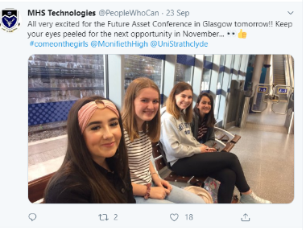
Monifieth High School
Notes:
In this example Monifieth HS show how they are IGBE

Slide 18
Who can help?
children and young people
parents and wider community
RAiSE PSDO / STEM Lead
Regional STEM Education
Officer
partners
community learning & development colleagues
practitioners
STEM Nation network members
Notes:
There are many sources of support ...

Slide 19
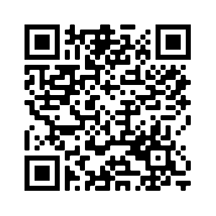
Support Structures / Opportunities
Initial Regional Support:
Regional STEM Education Officer
Collegiate Support:
STEM Leads, STEM Networks, RAiSE PSDOs, colleagues, etc
Partners / Supporters :
STEM Ambassadors, SSERC, Science Centres, The Royal Zoological Society of Scotland, Royal Society of Chemistry, The Royal Society, Colleges, Universities and many more
Networks
Notes:
myself and Regional STEM EO can provide support prior to registration and during process.
Currently looking in to process of formalising relationship with Partners as STEM Nation Award Supporters.

Slide 20
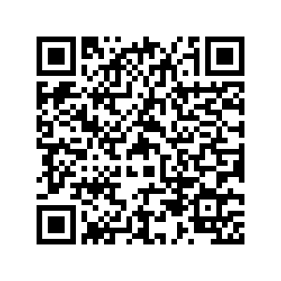
STEM Nation update
STEM Nation Network
Secondary Science Network
Award Drop-In Sessions
STEM Nation Network Sessions
Secondary Science Network Sessions
Regular drop in sessions for interested and registered settings.
Upcoming STEM Events
Notes:
ES are also hosting drop in sessions for registered settings and those who are interested in registering
https://blogs.glowscotland.org.uk/glowblogs/STEMcentralinmotion/2022/10/06/stem-nation-award-drop-in-sessions/

Slide 21
STEM Nation
Award
STEM@educationscotland.gov.scot
Notes:
https://jamboard.google.com/d/1pExlIa9vLNtJq-Mj5qIoFj0ShmA3cmSvh6EA8fYrw3I/edit?usp=sharing

