Slide 1
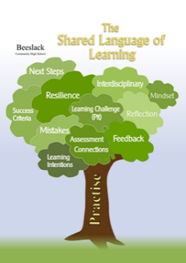
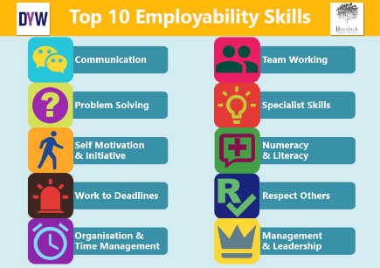
Work Across the Years
Learning Intentions:
To reflect how the job market has changed over the years
Success Criteria:
Work together to discuss how jobs continue to change.
Skills:
Team working Respect others
At Beeslack we #strivetobe successful, curious,
responsible, resilient and respectful to allow us all to flourish,
grow and achieve.

Slide 2
Task: Work Across the Years
Use your general knowledge to group the blue job cards by when they first existed on the table.
Are there any of these jobs which have disappeared from the job market.

Slide 3
Before 1800 | 1800-1889 | 1890-1950 | 1951-Now

Slide 4
Electronic
Engineer
CGI Animator
Car Mechanic
Teacher
Physiotherapist
Before 1800 | 1800-1889 | 1890-1950 | 1951-Now
Electronic
Engineer
Teacher
Physiotherapist
CGI Animator
Car Mechanic

Slide 5
Town Planner
Professional Rugby
Union Player
Police Officer
Pilot
Midwife
Before 1800 | 1800-1889 | 1890-1950 | 1951-Now
Teacher | Physiotherapist | Electronic Engineer | CGI Animator
 |  | Car Mechanic
Professional Rugby Union Player
Midwife
Police Officer
Town Planner
Pilot

Slide 6
Financial
Regulator
Audio Mixing Engineer
Sewing Machine Operator
Triage Nurse
Journalist
Before 1800 | 1800-1889 | 1890-1950 | 1951-Now
Teacher | Physiotherapist | Electronic Engineer | CGI Animator
Midwife | Police Officer | Car Mechanic | Professional Rugby Player
Town Planner |  | Pilot
Sewing Machine Operator
Financial
Regulator
Journalist
Audio Mixing Engineer
Triage Nurse

Slide 7
Forensic Scientist
Professional Footballer
Video Game Developer
Architect
Electrician
Before 1800 | 1800-1889 | 1890-1950 | 1951-Now
Teacher | Physiotherapist | Electronic Engineer | CGI Animator
Midwife | Police Officer | Car Mechanic | Professional Rugby Player
Town Planner |  | Pilot | Financial Regulator
Journalist |  | Audio Mixing Engineer | Triage Nurse
Sewing Machine Operator
Forensic
Scientist
Professional Footballer
Video Game Developer
Architect
Electrician

Slide 8
Think, Pair & Discuss
Are there any surprises?
Are there any unusual things that you have found out?
Are there other jobs which have disappeared from the job market?

Slide 9
Work and Skills
Learning Intentions:
To identify how employability skills link to various jobs.
Success Criteria:
Work together to discuss how different skills link to jobs.
Skills:
Team working Respect others
At Beeslack we #strivetobe successful, curious,
responsible, resilient and respectful to allow us all to flourish,
grow and achieve.

Slide 10
Task: Skills for Work
Choose 3 of the jobs (blue cards) and link the employability skills (yellow cards) to the jobs
You can arrange as you wish
Which job needs the most skills
Which skill links to the most jobs
If finished, complete task with another 3 jobs.
Discuss findings with whole class.

Slide 11
Work Across My Community
Learning Intentions:
To identify the range of jobs that you are aware within your network
Success Criteria:
To identify a wider community to seek advice from.
Skills:
Team working Respect others
At Beeslack we #strivetobe successful, curious,
responsible, resilient and respectful to allow us all to flourish,
grow and achieve.

Slide 12
Task: Work Across My Community
As a group, complete the sheet to identify the range of jobs carried out by family, friends and the wider community.
Focus on the people you would be willing to approach for support / information.
If time, discuss findings with whole class.

Slide 13
Work Across My Community
As a group list the range of jobs that people you know do.
Who? | How you know them? | Job

Slide 14
Curriculum to Work
Learning Intentions:
To research the range of jobs that link to various areas of the curriculum
Success Criteria:
To identify how various jobs and careers link to the school curriculum.
Skills:
Team working Respect others
At Beeslack we #strivetobe successful, curious,
responsible, resilient and respectful to allow us all to flourish,
grow and achieve.

Slide 15
Task: Curriculum to Work
In your group, identify what you think is important to know about a job / career, list as many questions as you wish. (If needed your teacher has suggestions.)
Individually, reflect on school subjects which interest you and find out about related jobs using the range of resources provided.

Slide 16
Planning
Learning Intentions:
To plan a resource which allows you to share your findings about job(s) which interest you
Success Criteria:
To plan a suitable resources.
Skills:
Respect others Time Management
At Beeslack we #strivetobe successful, curious,
responsible, resilient and respectful to allow us all to flourish,
grow and achieve.

Slide 17
Task: Planning
In your group, discuss how you could share you research about job(s) or career(s) which interest you.

Slide 18
My Wider Skills
Learning Intentions:
Use appropriate tool to identify your skills and strengths.
Success Criteria:
To identify how my skills / strength suit different jobs.
Skills:
Team working Respect others
At Beeslack we #strivetobe successful, curious,
responsible, resilient and respectful to allow us all to flourish,
grow and achieve.

Slide 19
Task: My Wider Skills
Log in to the My World of Work website. Open “Personalise your Account” and carry out the Skills/Strengths tools.
Identify how your strengths /skills fit with jobs you are interested in and how you could further develop these. Include this in your resource.

Slide 20
Resource
Learning Intentions:
To create suitable resource to share findings about job(s) or career(s)
Success Criteria:
To create high quality resource to share with others.
Skills:
Time Management Respect others Task Management
At Beeslack we #strivetobe successful, curious,
responsible, resilient and respectful to allow us all to flourish,
grow and achieve.

Slide 21
Task: Resource
Continue creating high quality informative resource to share your findings about your chosen job(s) or career(s)
Regularly monitor your progress on page 4 of your booklet.

