Slide 1
Science Careers
START
Acknowledgements
This resource has been compiled to allow students to find out information about jobs & careers related to the BGE Science Curriculum.
This PowerPoint can be used in a variety of ways, which include :
Slides or linked video/audio clips can be embedded in lessons,
As a research or home-learning activity for students.
I am extremely appreciative for the support of the organisations listed in the Acknowledgements which greatly enhances the resource.
I must also thank many friends and family for permission to use photographs.
This resource will continue to evolve with more jobs / careers and more links.
Please e-mail STEM@educationscotland.gov.scot with any suggestions.
Education Scotland STEM Team, January 2023
STEM >> STEM resources, STEM blog, Twitter: @EdScotSciences @STEMedscot #STEMNation
SCN 3-20a
Careers Education Standard (3-18)
SCN 4-20a

Slide 2
Acknowledgements
START
Introduction
This resource has been produced with support from the following organisations and the use of their links is greatly appreciated:
BBC Radio Scotland British Geological Survey (BGS) British Pest Control Association (BCPA) Centre for Process Innovation (CPI) Education Scotland Historic Environment Scotland (HES) Institute of Physics (IOP) Lantra Scotland NHS Education for Scotland National Environment Research Council (NERC) National Trust for Scotland (NTS) Openreach Limited | RenewableUK (Faces of Wind Energy) Royal Botanic Gardens Edinburgh The Royal (Dick) School of Veterinary Studies Royal Society of Chemistry (RSC) Royal Zoological Society of Scotland (RZSS) / Edinburgh Zoo Skills Development Scotland / My World of Work Scottish Natural Heritage (SNH) Scottish Water UK Research and Innovation (UKRI) UKSEDS (spacecareers.uk)
SCN 3-20a
Careers Education Standard (3-18)
SCN 4-20a

Slide 3
From BGE Science to Careers
Introduction
Acknowledgements
Planet Earth
Electricity, Forces and Waves
Biological Systems
Materials
Level 3 Benchmarks
Level 4 Benchmarks

Slide 4
Planet Earth
HOME
Biodiversity & Interdependence
Energy Sources & Sustainability
Processes of the Planet
Space
Level 3 Benchmarks
Level 4 Benchmarks

Slide 5
Biodiversity & Interdependence
HOME
Planet Earth
Animal Care Worker
Gardener
Botanist
Horticulture Worker
Marine Biologist
Countryside Officer / Countryside Ranger
Pest Control Officer
Environmental Scientist
Zoologist
Forestry Worker
Zookeeper
Level 3 Benchmarks
Level 4 Benchmarks

Slide 6
Energy Sources & Sustainability
HOME
Planet Earth
Architect
Engineering Apprenticeships
Design Engineer
Environmental Consultant
Electrician
Heating Engineer
Energy Engineer
Insulation Installer
Energy Researcher
Plumber
Level 3 Benchmarks
Level 4 Benchmarks

Slide 7
Processes of the Planet
Planet Earth
HOME
S3 Chemistry
Architect
Environmental Scientist
Biotechnologist
Fermentation Scientist
Brewer
Gas Service Technician
Chemical Engineer
Laboratory Technician
Chemist
Leakage Operative
Design Engineer
Materials Scientist
Energy Engineer
Mechanical Engineer
Energy Researcher
Hydrologist / Oceanographer
Engineering Apprenticeships
Plumber
Environmental Consultant
Level 3 Benchmarks
Level 4 Benchmarks

Slide 8
Space
HOME
Planet Earth
Astrochemist (RSC)
Materials Scientist
Astronomer
Science Public
Relations Officer
Astrophysicist (IOP)
Design Engineer
Level 3 Benchmarks
Level 4 Benchmarks

Slide 9
Forces, Electricity and Waves
HOME
Forces
Electricity
Waves
Level 3 Benchmarks
Level 4 Benchmarks

Slide 10
Forces
HOME
Forces, Electricity and Waves
Air Traffic Controller
Mechanical Engineer
Architect
Orthotist
Civil Engineer
Pilot
Design Engineer
Physiotherapist
Engineering Apprenticeships
Prosthetist
Materials Scientist
Sports and Exercise Scientist
Level 3 Benchmarks
Level 4 Benchmarks

Slide 11
Electricity
HOME
Forces, Electricity and Waves
Construction Manager
Engineering Apprenticeships
Electrician
Energy Engineer
Electricity Distribution Worker
Energy Researcher
Electronic Engineering Technician
Level 3 Benchmarks
Level 4 Benchmarks

Slide 12
Waves
HOME
Forces, Electricity and Waves
Astronomer
Photographer
Astrophysicist (IOP)
Radiographer
Audiologist
Radiologist
Dispensing Optician
Studio Sound Engineer
Lighting technician
Telecommunications
Engineer
Optometrist
Level 3 Benchmarks
Level 4 Benchmarks

Slide 13
Biological Systems
HOME
Body Systems
Cells
Inheritance
Level 3 Benchmarks
Level 4 Benchmarks

Slide 14
Body Systems
Biological Systems
HOME
S1 Science
Audiologist
Pathologist
Chemical Engineer
Pharmacist
Dentist / Orthodontist
Physiotherapist
Dental Hygienist
Prosthetist
Dental Nurse
Radiographer
Doctor
Speech and Language Therapist
Nurse
Orthotist
Vet
Paramedic
Veterinary Nurse
Level 3 Benchmarks
Level 4 Benchmarks

Slide 15
Cells
HOME
Biological Systems
Baker
Forensic Scientist
Biomedical Scientist
Geneticist / Clinical Scientist
Biotechnologist
Microbiologist
Brewer
Nurse
Doctor
Pathologist
Environmental Health Officer
Pharmacist
Fermentation Scientist
Pharmacologist
Food Technologist
Water Treatment Worker
Level 3 Benchmarks
Level 4 Benchmarks

Slide 16
Inheritance
HOME
Biological Systems
Botanist
Midwife
Farm Worker
Vet
Geneticist / Clinical Scientist
Veterinary Nurse
Health Visitor
Zoologist
Level 3 Benchmarks
Level 4 Benchmarks

Slide 17
Materials
HOME
Properties & Uses of Substances
Earth’s Materials
Chemical Changes
Level 3 Benchmarks
Level 4 Benchmarks

Slide 18
Properties & Uses of Substances
HOME
Materials
Architect
Laundry Worker
Archaeologist
Materials Scientist
Chemical Engineer
Orthotist
Chemist
Painter & Decorator
Conservation Officer
Printer
Energy Engineer
Prosthetist
Hairdresser
Quality Control Technician
Health & Safety Officer
Water Treatment Worker
Laboratory Technician
Level 3 Benchmarks
Level 4 Benchmarks

Slide 19
Earth’s Materials
HOME
Materials
Architect
Energy Researcher
Archaeologist
Environmental Scientist
Civil Engineer
Geoscientist / Geologist
Chemical Engineer
Laboratory Technician
Chemist
Materials Scientist
Conservation Officer
Quarry Engineer
Energy Engineer
Stone Mason
Level 3 Benchmarks
Level 4 Benchmarks

Slide 20
Chemical Changes
HOME
Materials
Chemical Engineer
Environmental Consultant
Chemist
Environmental Scientist
Electrician
Laboratory Technician
Electronic Engineering Technician
Mechanical Engineer
Hydrologist / Oceanographer
Energy Engineer
Energy Researcher
Level 3 Benchmarks
Level 4 Benchmarks

Slide 21
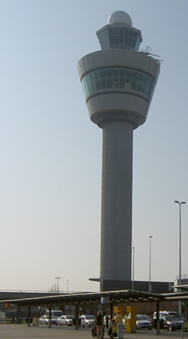
Air Traffic Controller
HOME
You would calmly and carefully guide aircraft pilots during their take off, their flight and landing.
You'd help them avoid other aircraft and deal with difficult weather conditions so the crew and passengers arrive safely and on time.
You'd be responsible for giving clear instructions to make sure that aircraft travelling through UK airspace are kept a safe distance apart.
You'd also respond to emergency distress calls, working under pressure to help the aircraft land safely.
Ian Stewart
Forces
My World of Work Link

Slide 22
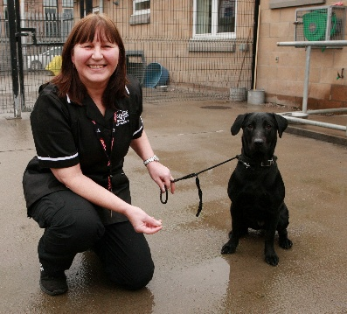
Animal Care Worker
HOME
You would look after animals living in kennels, catteries or rescue centres and keep them healthy and happy.
You could care for dogs and cats, or other animals such as rabbits, hamsters and guinea pigs. You might care for donkeys, horses or even parrots.
You would:
Prepare food and feed the animals
Keep animals clean and groom them
Clean out kennels, pens and cages, and change bedding
Look after animals who become ill or distressed
Answer queries from colleagues and visitors
Maintain the animal enclosures
Reproduced with the permission of
©The Skills Development Scotland Co. Ltd.
My World of Work Link
Including video
Biodiversity & Interdependence

Slide 23
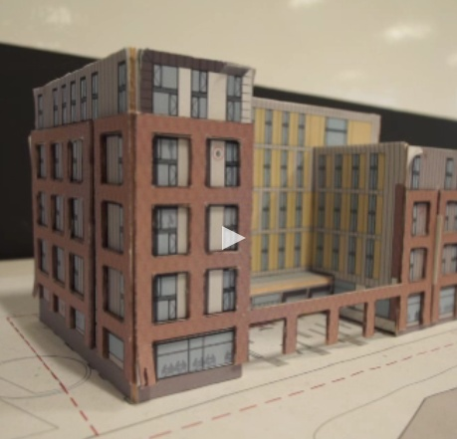
Architect
HOME
You would design new buildings so that people have practical, attractive, safe places in which to live and work.
You might also restore old buildings so they can be used for a new purpose.
You'd be responsible for a building project from the earliest stages through to completion, including designing the land around the building.
You'd talk with clients about their needs and expectations and draw designs for them to see and approve.
Energy Sources & Sustainability
Reproduced with the permission of
©The Skills Development Scotland Co. Ltd.
Processes of the Planet
Properties & Uses of Substances
IOP Video
Forces
Earth’s Materials
My World of Work Link

Slide 24
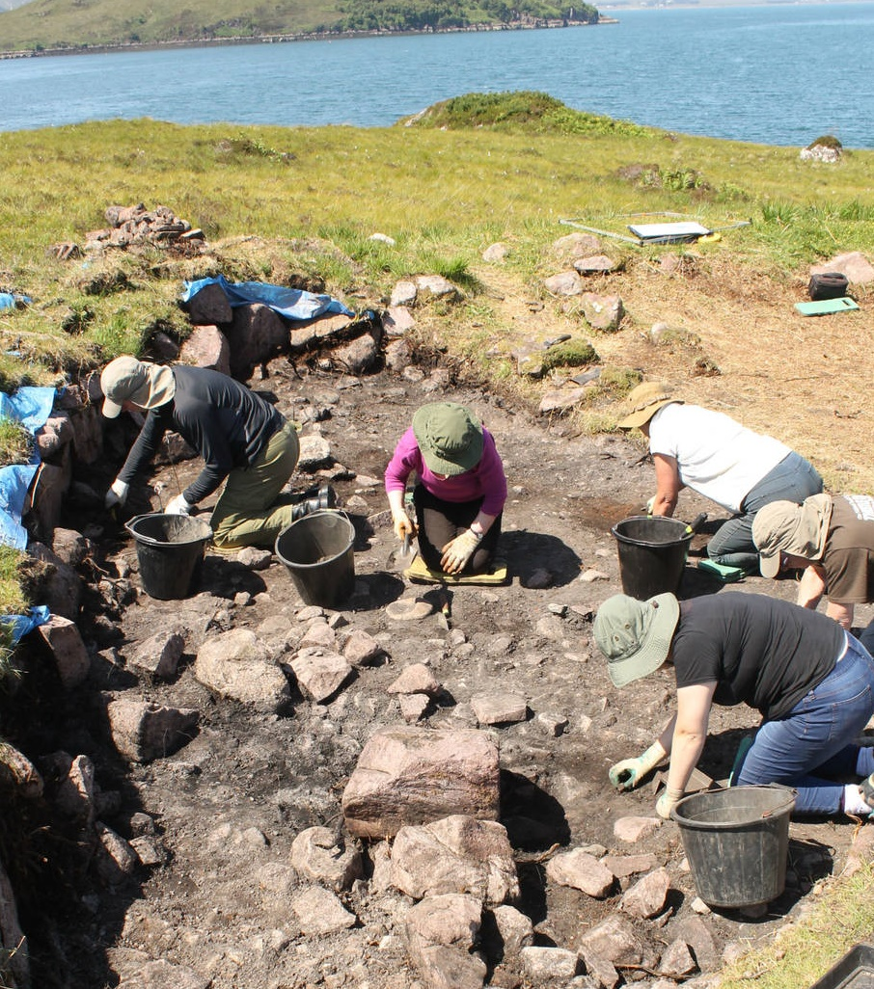
Archaeologist
HOME
You would dig up buildings and objects from the past and share what you learn from them so people can learn more about the past.
You'd carefully uncover old buried buildings, settlements and objects in archaeological digs. You'd look for traces of the people who lived there - things like pottery, jewellery, bones, coins, seeds and animal remains.
Your discoveries would help people understand more about how the past influences our lives today. You'd help to preserve the past by assessing what impact new developments will have on historic sites.
Reproduced with the permission of
the National Trust for Scotland
Historic Environment Scotland
Properties & Uses of Substances
National Trust for Scotland
Earth’s Materials
My World of Work Link

Slide 25
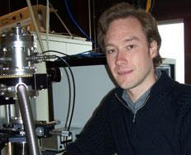
Astrochemist (RSC)
HOME
This research is directed to investigating the chemistry and physics of the regions of space between the stars, known as interstellar medium.
To do this I use a range of experimental techniques including laser and light based approaches which help us understand the conditions in the interstellar medium.
Using the results that we obtain I write articles and prepare materials and talks for presenting at scientific conferences, where researchers meet to share their work and get new ideas.
Reproduced with the permission of The Royal Society of Chemistry.
Reproduced with the permission of The Royal Society of Chemistry.
SpaceCareers Link
Space
RSC Profile

Slide 26
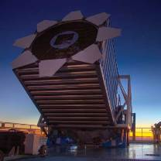
Astronomer
HOME
You would observe and study huge stars and planets or tiny particles in space to help us understand more about how the universe works.
You'd take part in big research projects to look at objects and events in space. You'd collect data from the research and work out what it tells us about the origin and structure of the universe.
You'd use computers, optical and radio telescopes, spectroscopes, satellites, spacecraft and space probes to collect and analyse information.
©Institute of Physics.
IOP Video
Space
SpaceCareers Link
Waves
My World of Work Link

Slide 27
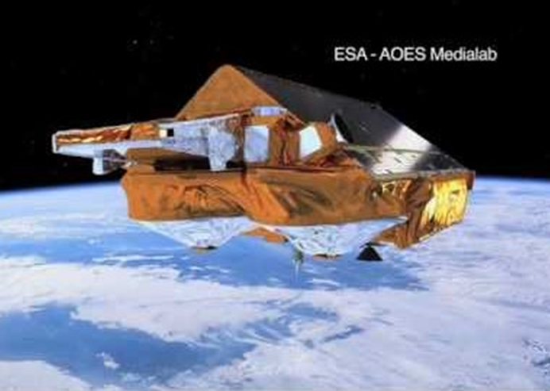
Astrophysicist
HOME
Catherine studied an MPhys degree in Astrophysics at Edinburgh University.
She then went on to do a PhD at Oxford.
Catherine uses NASA's famous Hubble Telescope, as well as several large telescopes in Hawaii, to try and understand some of the mysteries of the universe.
"At the moment we're trying to get funding to build telescopes up in space that are bigger and better than Hubble," says Catherine.
Reproduced with the permission of
UKRI / Natural Environment Research Council. ©NERC
©Institute of Physics.
NERC / UKRI : Physicist Video
Space
My World of Work Video
Waves
IOP Profile

Slide 28
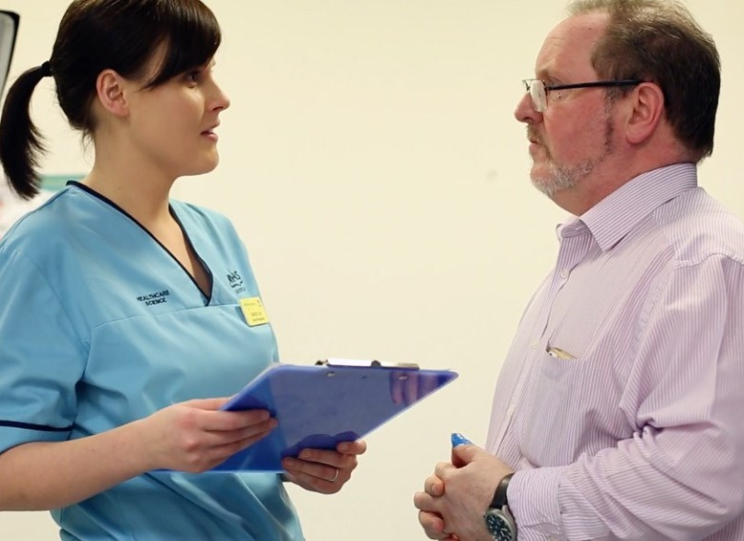
Audiologist
HOME
You would help people to hear better by testing their hearing and finding the right solution for each individual.
You would test children and adults' hearing and find out how to help each individual so their hearing improves.
You'd support people who have lost their hearing and people who have medical conditions that affect their hearing or balance.
Reproduced with the permission of
© NHS Education for Scotland
Radio Scotland - Dream Job
Waves
NHS Profiles
Body Systems
My World of Work Link

Slide 29
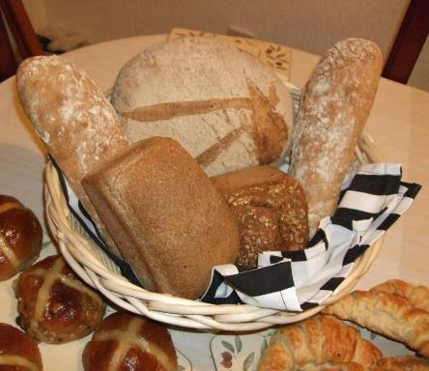
Baker
HOME
You would make baked goods for customers in shops and supermarkets. Or you’d bake and sell your hand-made products in a small craft bakery or delicatessen.
As well as bread and rolls, you’d make other items such as pastries, pies, cakes and biscuits. You’d also decorate and fill them with cream, fruit, jam or icing so they look appetising and taste delicious.
You would:
•Weigh out the ingredients
•Mix the ingredients according to the recipe
•Work out cooking times
•Shape the individual products
•Bake the goods in ovens
Reproduced with the permission of Gordon Johnston
Radio Scotland - Dream Job
Cells
My World of Work Link

Slide 30
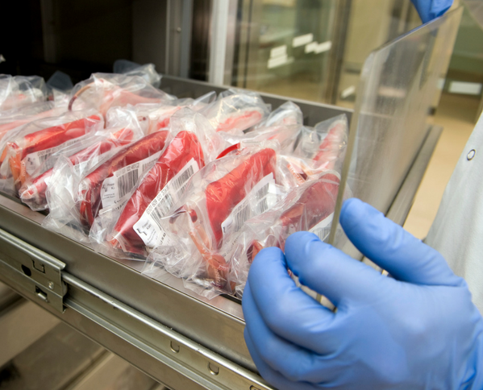
Biomedical Scientist
HOME
You would test blood, tissue and fluid samples from ill people so they can be diagnosed and treated as soon as possible.
You’d use computers and hi-tech equipment to test and analyse biological samples in a laboratory and identify a patient’s disease or condition. Your findings will help doctors and healthcare professionals to decide what medical treatment to give.
Sometimes you’d meet patients, who may be anxious and upset, to discuss their condition and get samples.
Reproduced with the permission of
© NHS Education for Scotland
NHS Profiles
My World of Work Link
Including video
Cells

Slide 31
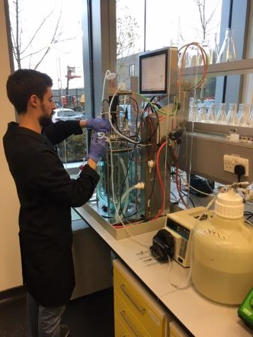
Biotechnologist
HOME
You would use your biology knowledge to come up with products and processes that improve our health, our food and our world.
In medical biotechnology and biotherapeutics you might:
• Research genetics, proteins, antibodies, viruses, plants, fungi, bacteria and diseases
• Develop treatments for genetic causes of disease
• Produce medicines using techniques such as cell culture and genetic modification
In industrial biotechnology, you might:
• Produce enzymes for use in food and drink
• Create biological detergents and dyes
• Improve animal feed
• Genetically modify crops
Reproduced with the permission of Dennis Goevert
Cells
CPI Apprentice Interview
Processes of the Planet
My World of Work Link

Slide 32
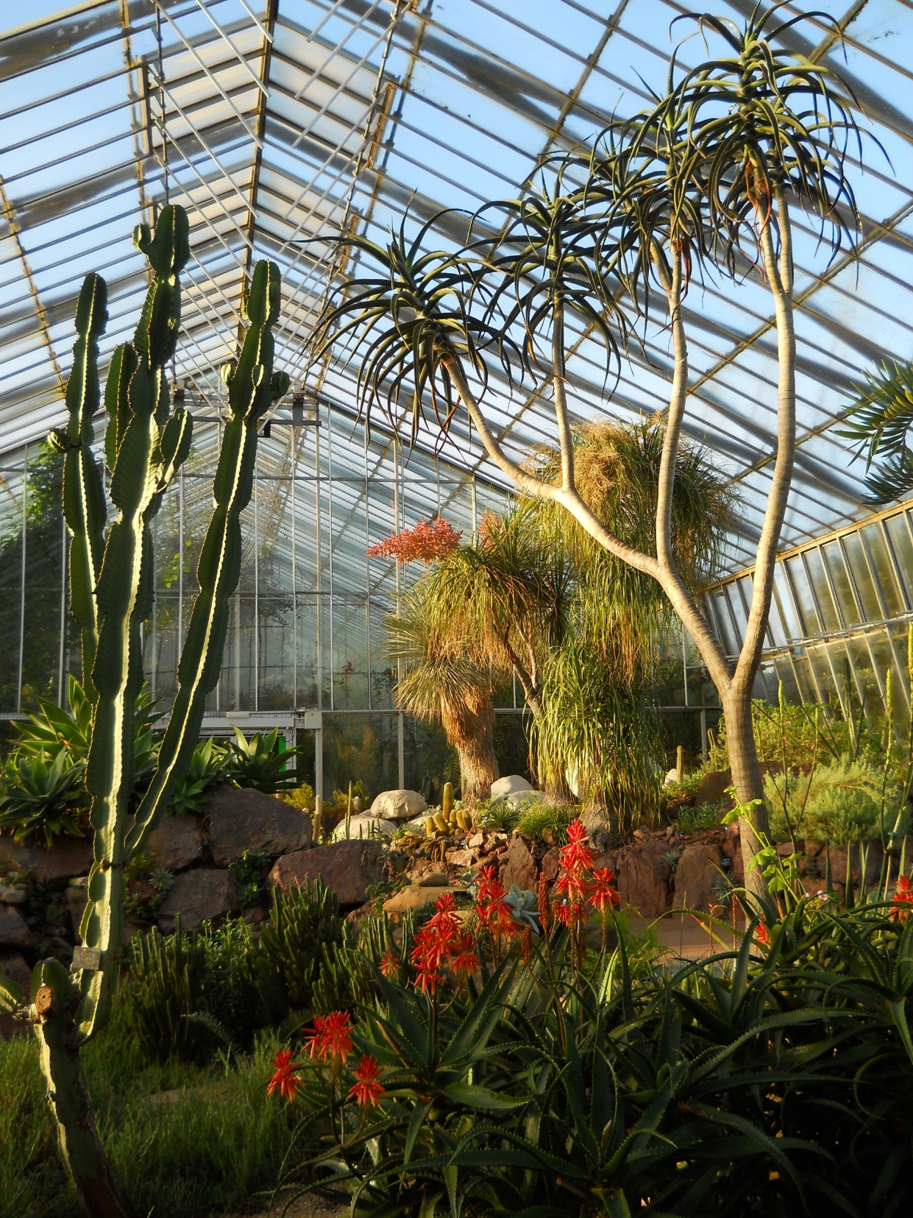
Botanist
HOME
You would study plants so we can use them to make food, drugs and different materials.
You’d discover more about how plants thrive so we can protect them and keep our surroundings pleasant and healthy.
You would analyse, interpret and report on data. You’d examine all types of plants including fungi and algae, either in the laboratory or in their natural environment.
Reproduced with the permission of
©The Royal Botanic Garden Edinburgh.
Biodiversity & Interdependence
Royal Botanic Garden
Inheritance
My World of Work Link

Slide 33
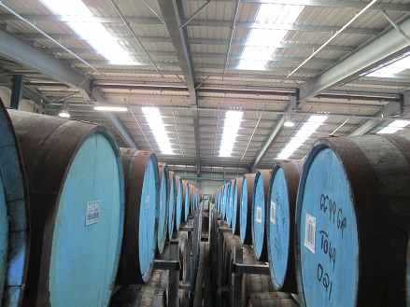
Brewer
HOME
You would be in charge of the beer production process in a brewery.
Typically, you would:
•Check brewing conditions and beer quality
•Keep records of production
•Work with suppliers
•Make sure ingredients meet high standards
•Oversee updates or repairs to machinery
•Look after stock
•Manage the packaging process
•Develop, test and produce new beers
•Manage staff
In a large brewery, you may look after just one area, such as fermentation, packaging or quality control. In a small or micro-brewery, you are likely to be involved in all stages of the brewing process.
Reproduced with the permission of Mark Patterson
Cells
Processes of the Planet
My World of Work Link

Slide 34
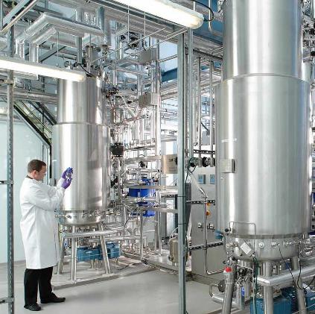
Chemical Engineer
HOME
You would work out how to use chemicals and materials to make new medicines, create better food and protect the environment.
You would study the make-up of chemicals and materials. You’d investigate how they interact and behave under different conditions, using complex procedures and hi-tech equipment.
You’d use your findings to find better ways to do things and create new products in a wide range of industries.
Body Systems
Processes of the Planet
Reproduced with the permission of
©Centre for Process Innovation Limited (CPI)
Properties & Uses of Substances
CPI Interview
Earth’s Materials
My World of Work Link
including video
Chemical Changes

Slide 35
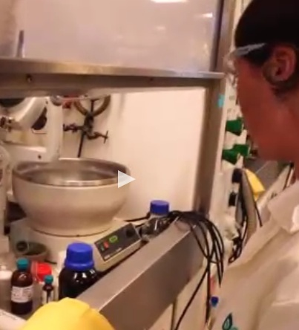
Chemist
HOME
You would work out how to use chemicals and materials to make new medicines, create better food and protect the environment.
You would study the make-up of chemicals and materials. You’d investigate how they interact and behave under different conditions, using complex procedures and hi-tech equipment.
You’d use your findings to find better ways to do things and create new products in a wide range of industries.
Reproduced with the permission of
©The Skills Development Scotland Co. Ltd.
Processes of the Planet
Properties & Uses of Substances
RSC Profiles
Earth’s Materials
My World of Work Link
including video
Chemical Changes

Slide 36
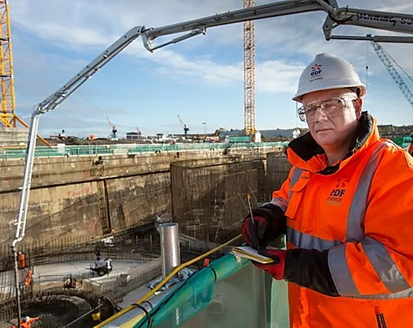
Civil Engineer
HOME
You would plan, design and manage construction projects for large buildings, transport links and major structures.
You’d explain your ideas to the client and make sure that the project is finished on time and to budget.
You could work in one of these specialist areas:
Structural - dams, buildings, offshore platforms and pipelines
Transportation – roads, railways, etc.
Environmental – water supply networks, drainage and flood barriers
Maritime – ports, harbours and sea defences
Geotechnical – mining, earthworks and construction foundations.
Reproduced with the permission of
©RenewablesUK / Faces of Wind Energy
Faces of Wind Energy Profile
Earth’s Materials
IOP Profile
Forces
My World of Work Link

Slide 37
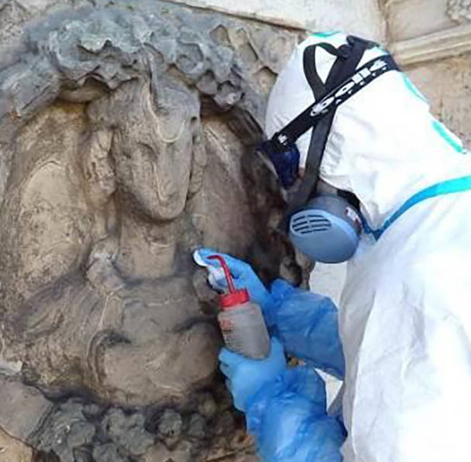
Conservation Officer
HOME
You would save works of art and historic objects which are in danger of disintegrating so future generations can enjoy them.
You’d apply scientific and artistic techniques to preserve and restore the objects. You need to pay careful attention to the smallest details. You would also make sure the objects are stored and displayed in the right way.
Reproduced with the permission of
the National Trust for Scotland
Historic Environment Scotland
National Trust for Scotland
Properties & Uses of Substances
My World of Work Link

Slide 38
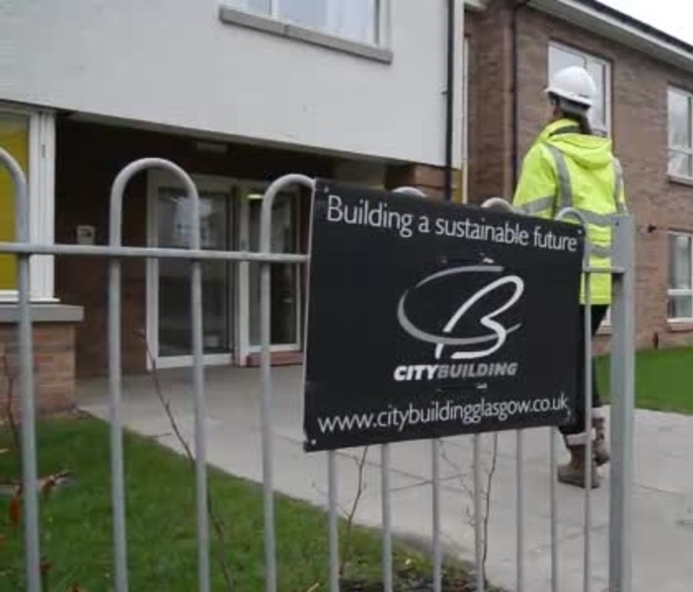
Construction Manager
HOME
You would supervise and direct operations on a construction project to make sure the building or structure is completed safely, on time and within the budget.
You’d manage the project on behalf of another company, your client. You’d lead and motivate the construction team and sort out any problems that arise during the project.
On small sites you might have full responsibility for the whole project. On larger sites you may be in charge of a particular section and report to a senior site manager.
Reproduced with the permission of
©The Skills Development Scotland Co. Ltd.
My World of Work Link
Including Video
Electricity

Slide 39
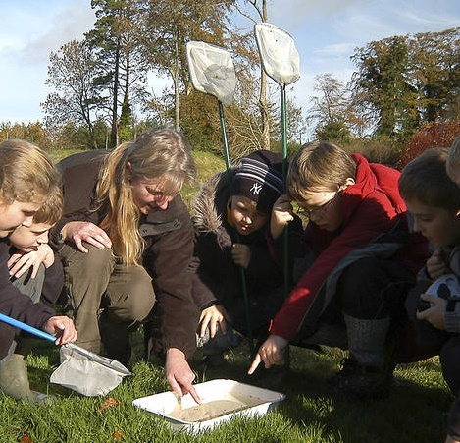
Countryside Officer
HOME
You would try to make it easy for people to enjoy spending time in the countryside. You’d improve access to interesting and beautiful places they’d enjoy visiting.
You’d explain scientific knowledge and facts in a way that’s easy to understand so they can learn more about nature and wildlife.
Your work would help to protect Scotland’s natural heritage - including woodlands, moors, rivers, hills, lochs and coastlines - for future generations.
Reproduced with the permission of the
National Trust for Scotland
Historic Environment Scotland
National Trust for Scotland
Biodiversity & Interdependence
My World of Work Link

Slide 40
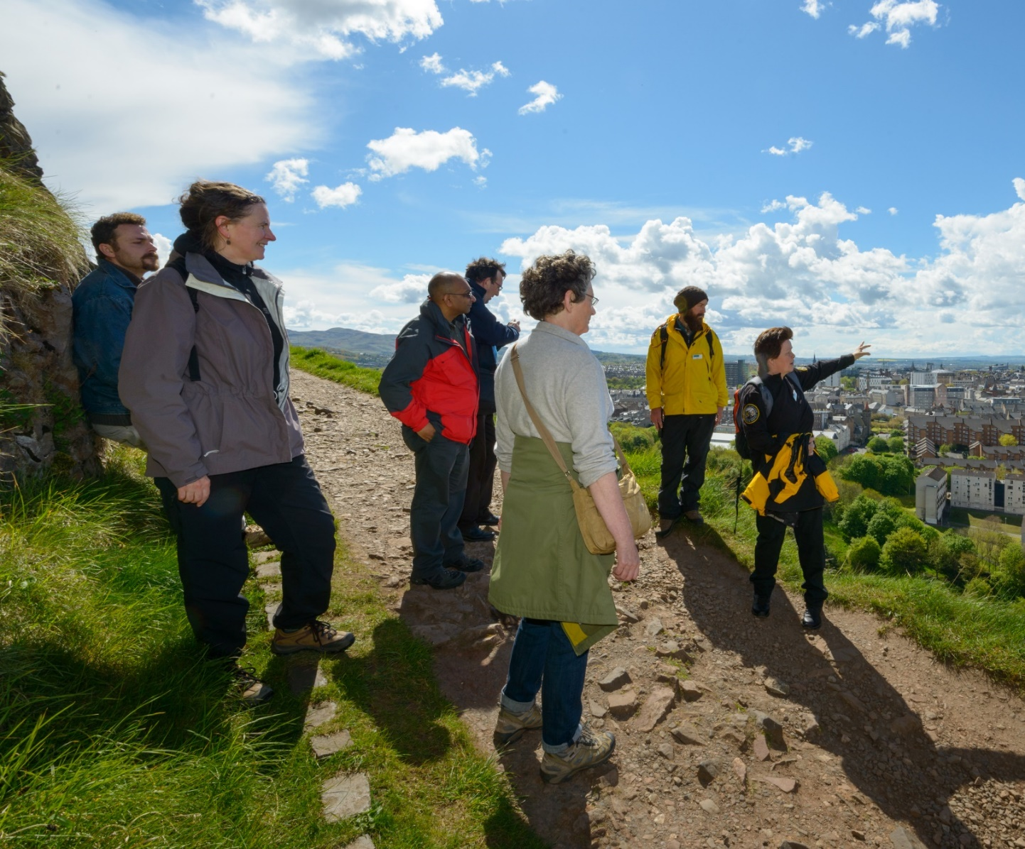
Countryside Ranger
HOME
You would do practical work to look after the countryside and conserve wildlife and habitats.
You’d repair paths, fences and signs to assist people who visit the countryside. When you speak with the public and answer questions about the wildlife and landscapes you’d be able to convey your enthusiasm about the natural environment.
© Crown Copyright HES
Historic Environment Scotland
National Trust for Scotland
Biodiversity & Interdependence
My World of Work Link

Slide 41
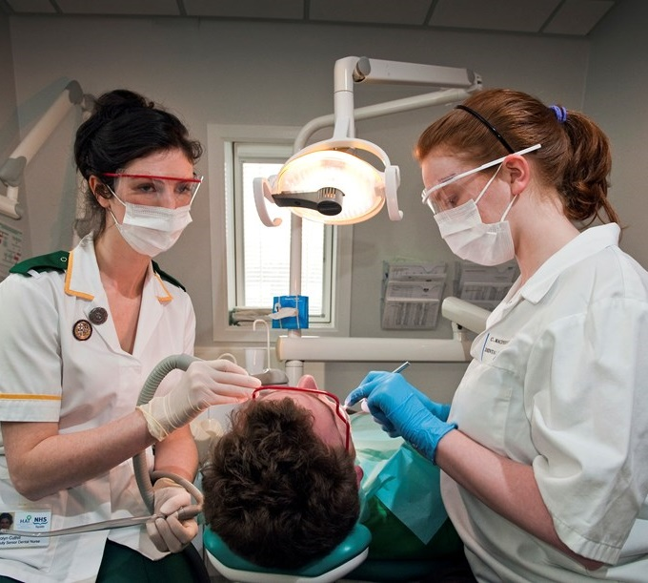
Dental Nurse
HOME
You would look after people when they visit the dentist and make them feel comfortable. You’d assist the dentist as they give treatments and help with other aspects of patient care.
You’d look after patients who are coming for a simple check-up or having advanced specialist treatment.
Patients may be nervous so you’d need to be calm and reassuring. You’d try to make sure that they are relaxed and comfortable at all times.
Reproduced with the permission of
© NHS Education for Scotland
NHS Profile
Body Systems
My World of Work Link with clip

Slide 42
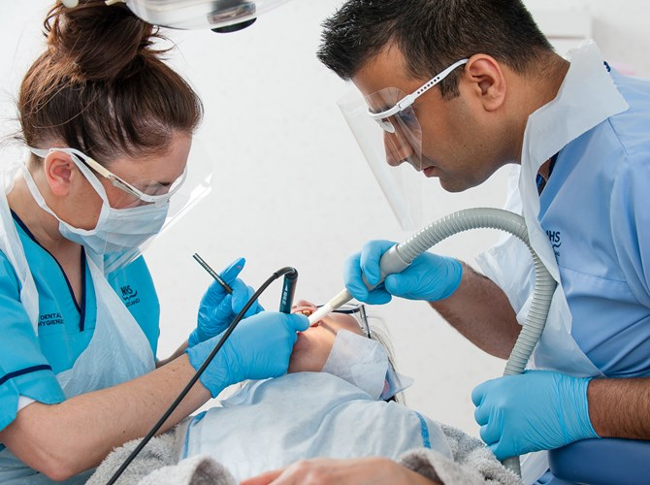
Dental Hygienist
HOME
You would look after people when they visit the dentist and make them feel comfortable. You’d assist the dentist as they give treatments and help with other aspects of patient care.
You’d look after patients who are coming for a simple check-up or having advanced specialist treatment.
Patients may be nervous so you’d need to be calm and reassuring. You’d try to make sure that they are relaxed and comfortable at all times.
Reproduced with the permission of
© NHS Education for Scotland
My World of Work Video
Body Systems
My World of Work Link

Slide 43
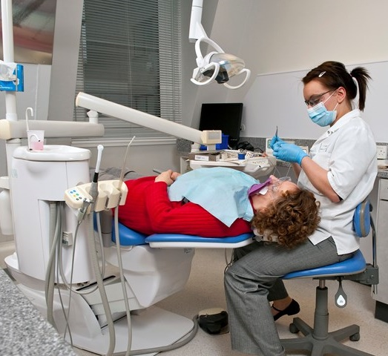
Dentist / Orthodontist
HOME
You would help people keep their teeth and gums healthy and strong. You’d explain to patients how to care for their teeth and gums. You’d check their mouths and treat any problems.
You’d carry out delicate procedures using medical instruments. You’d need to deal with anxious patients and people who may be upset because they are in pain.
Many dentists work as general dental practitioners (GDPs) in the community, looking after private and NHS patients.
Reproduced with the permission of
© NHS Education for Scotland
NHS Profile
Body Systems
My World of Work Link (2 clips)

Slide 44
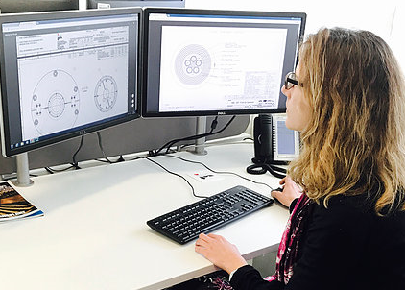
Design Engineer
HOME
You would research and develop ideas for new products and the systems used to make them. You’d improve the performance and efficiency of existing products.
You will need to understand engineering and design principles. You’d use your knowledge of the qualities of materials and of methods of construction and manufacturing to create products that a company can sell and make a profit.
You could work in a wide range of industries, from electronics to synthetic textiles.
Reproduced with the permission of
©RenewablesUK / Faces of Wind Energy
Faces of Wind Energy Link
IOP – Spacecraft Designer
My World of Work Link
Design Engineer
Processes of the Planet
Energy Sources & Sustainability
My World of Work Link
Aerospace Engineer
Forces
Space

Slide 45
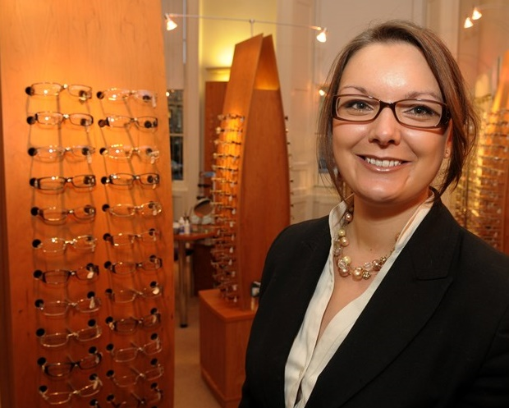
Dispensing Optician
HOME
You would help customers choose glasses and contact lenses that suit and fit them and meet their needs. You’d order the spectacles and contact lenses and make sure they fit.
You would create orders for glasses and lenses using the prescriptions from an optometrist, who examines and tests eyes or an ophthalmologist, an eye surgeon.
You’d work with each individual customer to select the right spectacles or contact lenses for them
Reproduced with the permission of
© NHS Education for Scotland
NHS Profiles
Waves
My World of Work Link

Slide 46
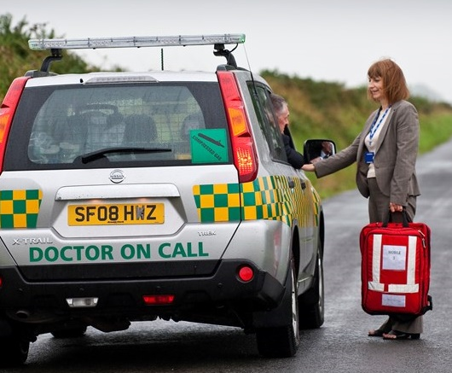
Doctor (GP)
HOME
You would provide medical care for people in the local community. The patients will trust you to help them by quickly diagnosing and treating their illness.
You’d be the first point of contact for patients, seeing them either in your surgery or visiting them at home. You would need to listen to them and put them at ease.
You’d ask the person questions about their health and do physical checks if necessary. You’d make a diagnosis, explain the options for treatment to the patient and decide what action to take.
Reproduced with the permission of
© NHS Education for Scotland
Body Systems
NHS Profiles
Cells
My World of Work Link (with clip)

Slide 47
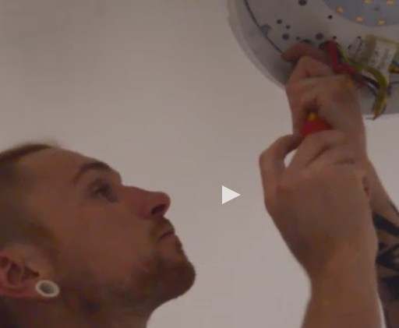
Electrician
HOME
You would make sure that electrical systems in people’s homes and businesses work safely. You’d fix faults and install new systems.
You might set up and maintain power systems for engineering projects and buildings or ensure that street lights work.
You could also work on renewable technology, such as wind turbines, 'smart' heating systems and photovoltaic systems that produce solar power.
Reproduced with the permission of
©The Skills Development Scotland Co. Ltd.
Chemical Changes
My World of Work Link
With Video
Electricity

Slide 48
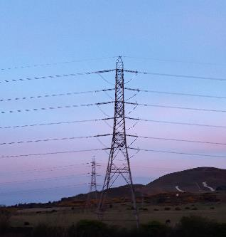
Electricity Distribution Worker
HOME
You would look after and fix the power lines that get electricity from power stations to homes, industries and businesses.
You could work in one of three main areas of electricity transmission.
In overhead transmission or lines work, you’d maintain and repair overhead power lines.
As a cable jointer you’d join and repair underground cables. You’d connect customers to the electricity supply network.
Working in electrical fitting you’d install, repair and maintain the high voltage equipment which controls electricity flow.
Ian Stewart
Electricity
My World of Work Link

Slide 49
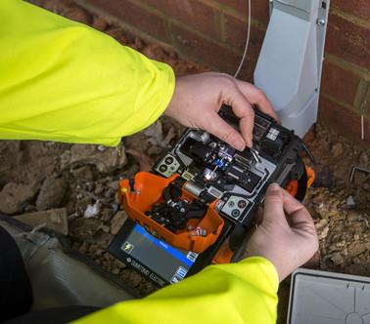
Electronic Engineer Technician
HOME
You would design, make and fix the systems and components used in all sorts of equipment such as mobile phones, computers and medical instruments.
You could work on the electronic components used in:
Telecommunications
Medical scientific instruments
Programmable control systems –
Data communications
Control systems
Reproduced with the permission of ©Openreach Limited
Chemical Changes
Electricity
My World of Work Link

Slide 50
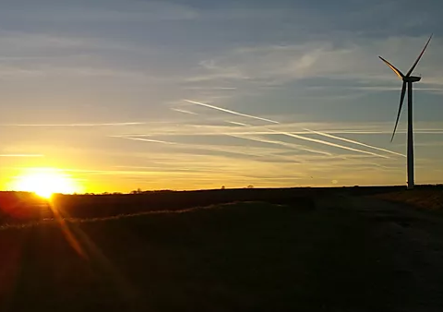
Energy Engineer
HOME
You would design and construct sites to generate energy from the wind, sun and water. You could also drill for and extract gas and oil.
You would research, design and oversee construction of power generation plants that use renewable and sustainable natural resources.
Reproduced with the permission of
©RenewablesUK / Faces of Wind Energy
Faces of Wind Energy Profile
Processes of the Planet
Energy Sources & Sustainability
Field Engineer - IOP Profile
Earth’s Materials
My World of Work Link

Slide 51
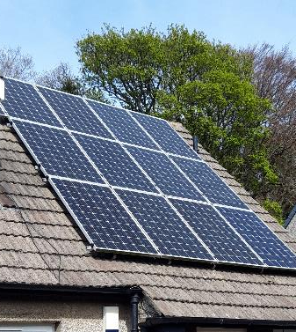
Energy Researcher
HOME
You would research new and improved ways of generate energy.
This may include improving efficiency of fossil fuels.
Or may include research and design of power generation plants that use renewable and sustainable natural resources.
IOP Profile – Solar Energy
Sean Fallon / Ian Stewart
RSC Profile - Batteries
Processes of the Planet
RSC Profile – Solar Energy
Energy Sources & Sustainability
RSC Profile (with video clip)
Earth’s Materials

Slide 52
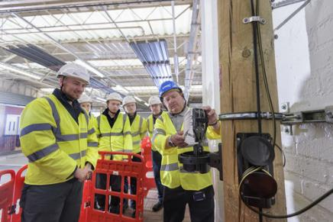
Engineering Apprenticeships
HOME
Start your career in engineering with this apprenticeship.
You could go into a huge range of fields including aerospace, automotive, bioscience, communication, electrical, electronics, fabrication and welding, mechanical, maintenance marine, and measurement and control engineering.
Reproduced with the permission of ©Openreach Limited
MyWOW Apprenticeship VIdeo
Openreach Trainee Engineers
Processes of the Planet
CPI Apprentice Interview
Energy Sources & Sustainability
Faces of Wind Energy Profile
Forces
Electricity
My World of Work Link

Slide 53
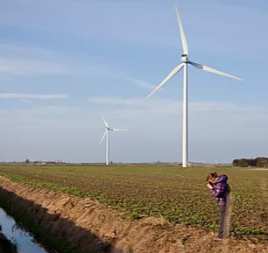
Environmental Consultant
HOME
You would give advice to businesses and organisations about environmental issues.
You would assess the environmental impact of new developments or industries. You’d help businesses to be greener.
Reproduced with the permission of
©RenewablesUK / Faces of Wind Energy
RSC Profile
Chemical Changes
IOP Profile
Processes of the Planet
Faces of Wind Energy clip
Energy Sources & Sustainability
My World of Work Link with clip

Slide 54
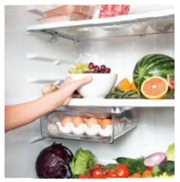
Environmental Health Officer
HOME
You would make sure that the places where people live, work and go for leisure and sport are safe, healthy and hygienic.
Your work would protect people from dangers like pollution, unsafe food and pests.
© Crown Copyright FFS
Food Standards Scotland
Cells
My World of Work Link

Slide 55
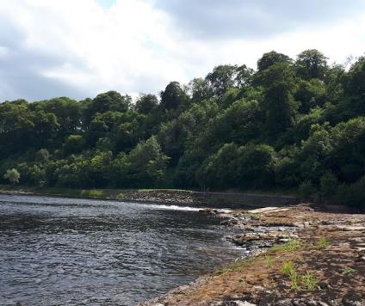
Environmental Scientist
HOME
You would analyse water, soil and other substances checking for signs of pollution.
You may work in a laboratory where samples are brought in or you may do field work to collect samples.
NERC / UKRI : Ecologist Video
River Tay, Ian Stewart
NERC / UKRI : Physicist Video
Processes of the Planet
RSC : Atmospheric Chemist
Chemical Changes
Earth’s Materials
RSC : Environmental Chemist
Biodiversity & Interdependence
My World of Work Link

Slide 56
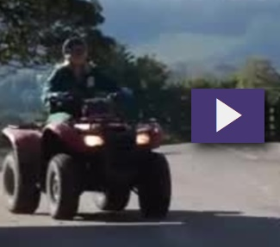
Farm Worker
HOME
You would do practical and manual work on a farm. You could look after animals like cows, chickens or pigs or grow and harvest crops.
You’d operate farm machinery and do general repairs.
You could work on any of the three main types of farm:
•Farms that only have animals – livestock
•Farms that only have crops – arable
•Farms that have both – mixed
Your work would vary depending on the type of farm and the time of year.
Reproduced with the permission of
©The Skills Development Scotland Co. Ltd.
Lantra Scotland Profile
Inheritance
My World of Work Link
Including Video

Slide 57
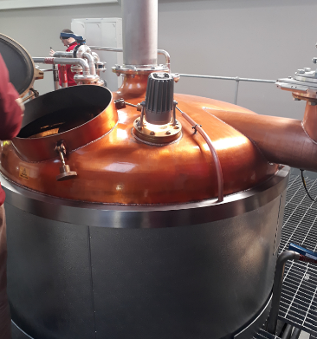
Fermentation Scientist
HOME
You would be in charge of the production process in a biotechnology facility.
Typically, you would:
•Check brewing conditions / product quality
•Keep records of production
•Work with suppliers
•Make sure ingredients meet high standards
•Oversee updates or repairs to machinery
•Look after stock
•Develop, test and produce new products
•Manage staff
In a large facility, you may look after just one area, such as fermentation, packaging or quality control. In a small facility, you are likely to be involved in all stages of the fermentation process.
Reproduced with the permission of Mark Patterson
CPI Link
Cells
CPI Apprentice Video
Processes of the Planet
My World of Work Link

Slide 58
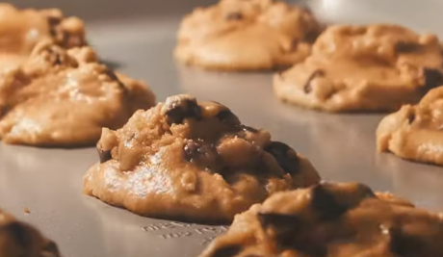
Food Technologist
HOME
You would test food for safety and quality and find ways to keep food fresh for longer. Or you would invent new processes and products, such as fat-free food.
You’d help to develop a wide range of products in the food and drink industry and make sure they are safe for consumers.
As a food scientist, you would use scientific techniques to:
• Get accurate nutritional information for food labels
• Investigate ways to keep food fresh, safe and attractive
• Find ways of producing food more quickly and cheaply
• Test the safety and quality of food
Reproduced with the permission of
The Royal Society of Chemistry.
RSC – Food Scientist (with clip)
RSC – Flavourist (with clip)
Cells
My World of Work Link

Slide 59
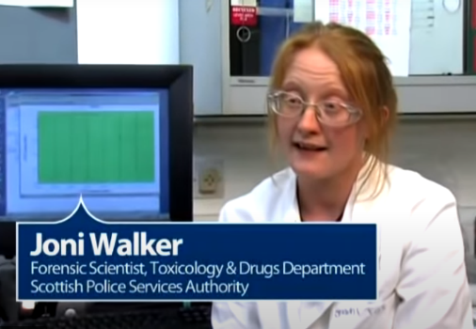
Forensic Scientist
HOME
You would help to solve crimes by finding evidence that links a suspect to a crime scene.
You’d obtain and analyse evidence from a variety of sources - including blood and other body fluids, hairs, textile fibres, glass fragments and tyre marks - using forensic techniques and scientific principles.
You might go to crime scenes, which may be unpleasant, and methodically examine them to collect potential evidence. It’s very important to objectively analyse all the traces of physical evidence and prepare them for use in court cases.
Reproduced with the permission of The Royal Society of Chemistry.
Properties & Uses of Substances
RSC Profile (with clip)
Cells
My World of Work Link

Slide 60
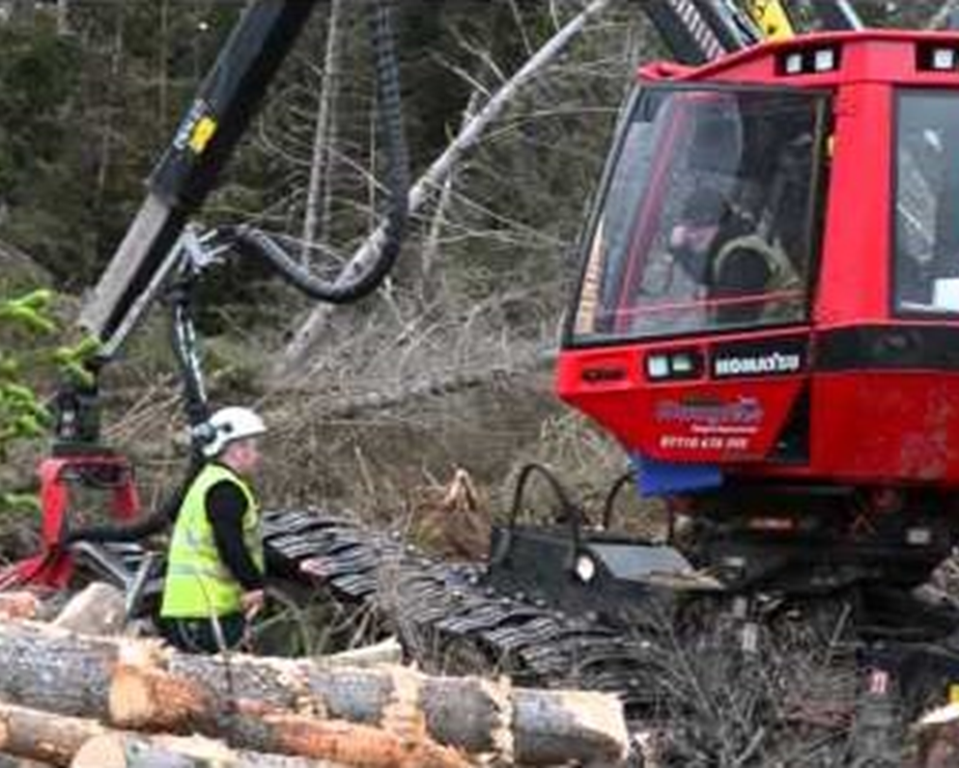
Forestry Worker
HOME
You would carry out practical tasks in forests and woodlands to help care for and protect the environment. You’d plant, prune, and fell trees. You’d also protect trees from pests and disease.
You’d need to be safety-conscious, responsible and have a good head for heights.
You would:
•Mark and measure trees to be cut down
•Prepare the ground for planting by clearing undergrowth
•Trim and cut back shrubs and other ground cover to promote the healthy growth of trees
•Harvest trees, strip branches and cut felled tree trunks into specific lengths
Reproduced with the permission of
©The Skills Development Scotland Co. Ltd.
Lantra Scotland Profile
Biodiversity & Interdependence
My World of Work Link (2 clips)

Slide 61
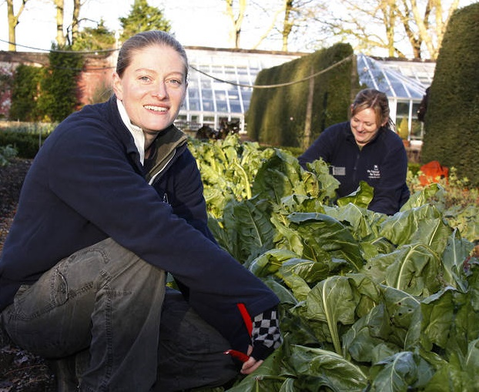
Gardener
HOME
You would look after a garden or other green spaces like parks and sports grounds so people can enjoy them all year round.
You’d grow and care for all types of plants like flowers, trees, shrubs and lawns.
You would:
• Raise plants from seeds or cuttings
• Dig, plant and weed flower beds and borders
• Maintain high levels of presentation in public parks and gardens
Reproduced with the permission of the
National Trust for Scotland
Lantra Scotland Profile
National Trust for Scotland
Training Opportunities
Royal Botanic Garden
Biodiversity & Interdependence
My World of Work Link (with clip)

Slide 62
Gas Service Technician
HOME
You would safely install and repair gas heating and hot water systems. You’d maintain and repair the pipes, appliances and meters.
You would work in people’s homes and in businesses like cafes and hotels.
You’d need to check systems carefully to make sure they work or find any problems. You’d follow technical layouts and diagrams.
Reproduced with the permission of
©The Skills Development Scotland Co. Ltd.
My World of Work Link
Including Video
Processes of the Planet

Slide 63
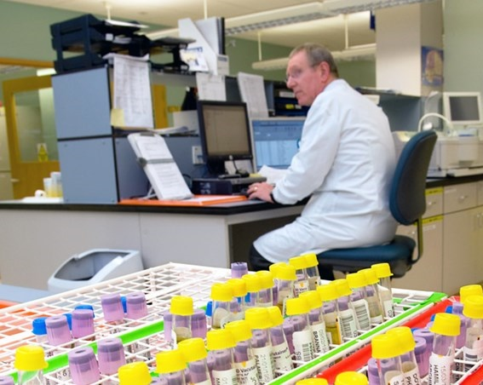
Geneticist / Clinical Scientist
HOME
You would do scientific research to understand and treat diseases in people, animals and plants.
Genes contain the information that controls a living organism’s appearance, how it survives and how it behaves in its environment.
You’d use this information to make discoveries in a wide range of fields from medicine to agriculture. You could work in research, teaching, industry or the NHS.
Reproduced with the permission of
© NHS Education for Scotland
NHS Profile – Clinical Scientist
Inheritance
Cells
My World of Work Link

Slide 64
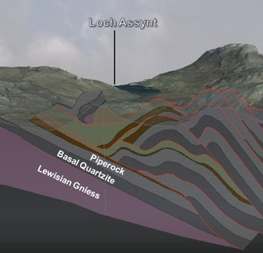
Geoscientist / Geologist
HOME
You would study the structure of the Earth and investigate mineral and energy resources.
You’d do research to find ways to protect people who live in places with volcanoes and earthquakes.
You’d research how the planet was formed and shaped over time.
NERC/BGS Volcanologist Video
Reproduced with the permission of the
British Geological Survey ©UKRI. All rights Reserved
NERC/BGS Geologist Video
British Geological Survey
Earth’s Materials
My World of Work Link with clip

Slide 65
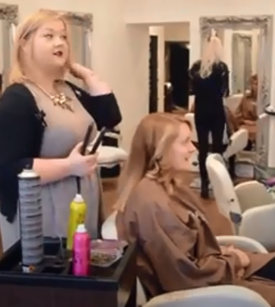
Hairdresser
HOME
You would cut, colour and shape clients' hair to create the look they want.
As a junior hairdresser, you would:
Greet customers
Shampoo their hair
Do simple cutting
Make sure towels and supplies are ready for use
Keep the salon clean and tidy
Reproduced with the permission of
©The Skills Development Scotland Co. Ltd.
Properties & Uses of Substances
My World of Work Link with clip

Slide 66
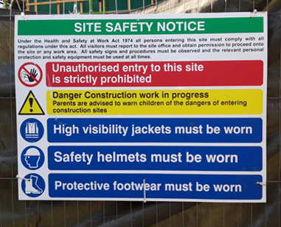
Health & Safety Officer
HOME
You would keep people safe from accidents, injuries and health problems in the workplace.
You’d create health and safety policies and make sure employers and workers follow them.
Depending on your employer, your work could cover areas such as:
Fire safety
Occupational health
Noise
Safe use of machinery
Control of hazardous substances
Ian Stewart
Health & Safety Executive
Properties & Uses of Substances
My World of Work Link

Slide 67
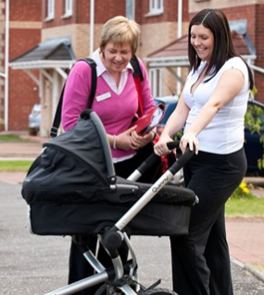
Health Visitor
HOME
You would visit people in their homes and give them information, practical care and support to help them stay healthy.
Health visitors are experienced and qualified registered nurses or midwives.
You’d visit people of all ages and backgrounds. You’d focus on people who need special help, such as new mothers and their babies.
Reproduced with the permission of
© NHS Education for Scotland
Body Systems
NHS Profiles
Inheritance
My World of Work Link

Slide 68
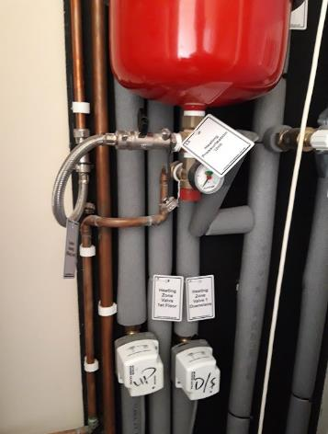
Heating Engineer
HOME
You would install and service heating and air conditioning systems. You’d help people and organisations save energy by making the systems as efficient as possible.
You’d work on systems in large buildings like office blocks, factories, schools and hospitals. You would make sure that systems work as efficiently as possible to reduce fossil fuel consumption, carbon emissions and help people to save energy.
Ian Stewart
Energy Sources & Sustainability
My World of Work Link

Slide 69
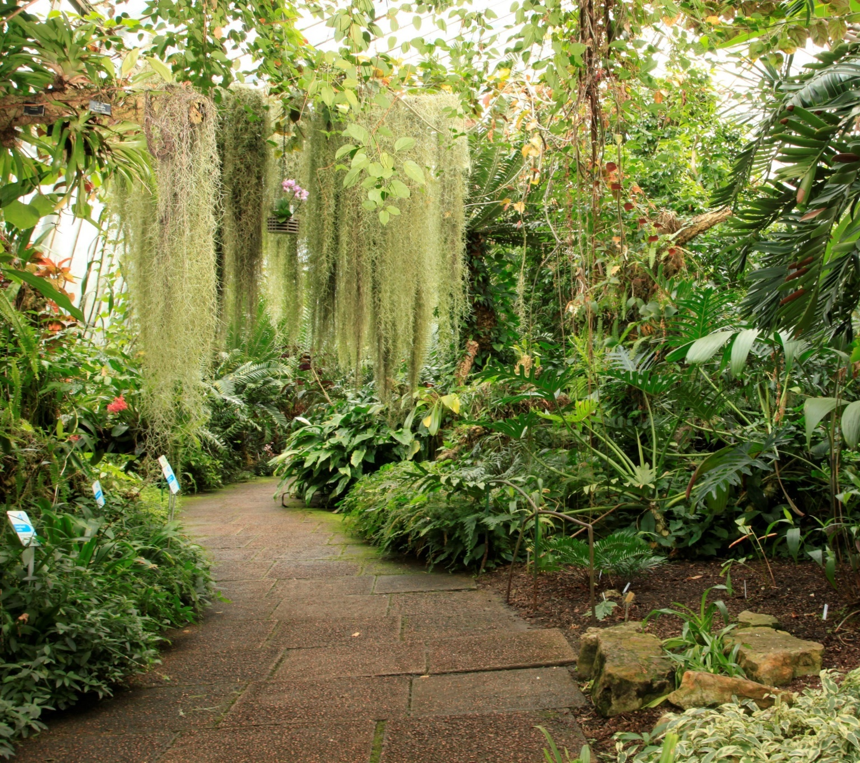
Horticulture Worker
HOME
You would grow plants for decoration or to produce food, sell plants in a garden centre or look after plants in parks and gardens.
You could grow plants for:
Production horticulture, where you’d produce and sell plants either for food or decoration
Garden centres where you’d sell plants to the public
Parks and gardens where you’d look after plants in private gardens, public parks and green spaces, historic gardens or botanic gardens
Lantra Scotland Profile
Reproduced with the permission of
©The Royal Botanic Garden Edinburgh.
Royal Botanic Garden
Biodiversity & Interdependence
My World of Work Link

Slide 70
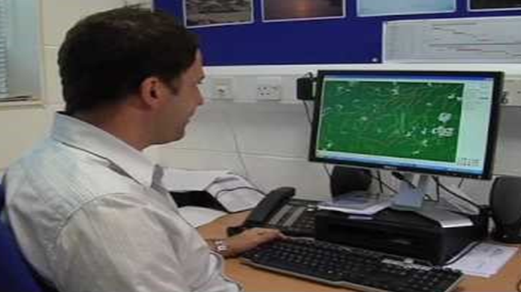
Hydrologist / Oceanographer
HOME
You would study the seas and oceans to help us learn more about the marine environment, plants and animals.
You’d do research, for example, on the effects of climate change or the impact of pollution and offshore engineering on marine life.
Four branches of oceanography are :
Biological – studying marine plants and animals
Physical – exploring water temperature, density, wave motion, tides and currents
Geological – examining the structure and make-up of the ocean floor
Chemical – analysing the chemicals in sea water and the impact of pollutants
Reproduced with the permission of
UKRI / Natural Environment Research Council. ©NERC
Scottish Water Hydrologist Video
NERC – Ice Modeller Video
NERC – Hydrologist Video
Processes of the Planet
SpaceCareers Link
Chemical Changes
My World of Work Link

Slide 71
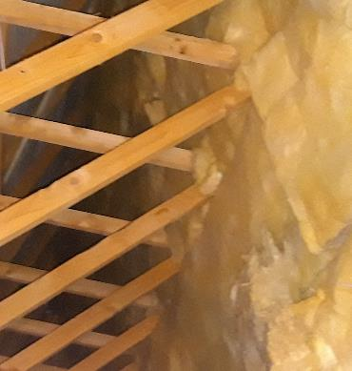
Insulation Installer
HOME
You would inject insulation materials into the space in walls, roofs and lofts so people’s homes and other buildings are warmer and cheaper to heat.
You’d make the buildings more fuel-efficient so they’d use less energy.
You’d do a survey before the installation to work out which methods and materials to use. You’d write a report for the customer and your manager.
You’d work out the volume of space that needs to be filled and calculate how much insulation will be needed.
Ian Stewart
Energy Sources & Sustainability
My World of Work Link

Slide 72
Laboratory Technician
HOME
You would do tests, research and investigations and support scientists and their research. You could work in different areas such as forensic science, scientific analysis, the health service, and in education.
You might work to diagnose diseases, measure levels of pollution or help to develop new products. You might work with specialised techniques such as ways of treating infertility.
Reproduced with the permission of
©The Skills Development Scotland Co. Ltd.
Processes of the Planet
Properties & Uses of Substances
Earth’s Materials
Apprentice Interview (CPI)
Chemical Changes
My World of Work Link with clip

Slide 73
Laundry Worker
HOME
You would make sure hospitals, care homes and hotels have clean bedclothes and towels every day for the people who stay there.
You’d operate washing machines and tumble dryers to clean and dry items like clothes, bed linen, towels, sportswear and uniforms.
You could work in the laundry department of organisations like hospitals, universities and hotels, or for companies and shops that provide specialist laundry cleaning services.
Reproduced with the permission of
©The Skills Development Scotland Co. Ltd.
Properties & Uses of Substances

Slide 74
Leakage Operative
HOME
You would use specialist equipment to find leaks in water pipes and then arrange repairs to save water. People would depend on you to quickly get their water running again whenever there was a problem.
You would carry out planned surveys and also respond to emergencies, making sure that the water supply is disrupted as little as possible.
Because there is often no visible sign of a leak, you would use specialist equipment to examine water flowing in and out of an area to find out where any leaks are.
Reproduced with the permission of ©Scottish Water.
Scottish Water – Modern Apprentice Video
Processes of the Planet
My World of Work Link

Slide 75
Lighting Technician
HOME
You would set up the lights for TV shows and films or live events like concerts and plays. You’d operate the lights during the shows and events and create amazing special lighting effects.
Your work could range from basic spotlighting for conferences or presentations to operating strobes, lasers and pyrotechnics at massive live concerts. You would normally specialise in film and TV, including working on location, or focus on theatre and live events, as the techniques and equipment are different
Reproduced with the permission of
©The Skills Development Scotland Co. Ltd.
Waves
My World of Work Link with clip

Slide 76
Marine Biologist
HOME
You would study ocean animals, plants and ecosystems to increase our knowledge and understanding of the environment, genetics, and animal or plant biology.
The ocean covers more than 70% of the Earth’s surface and is the habitat of 230,000 known species, although much of the ocean’s depths remain unexplored. You could work on research projects to observe and better understand ocean animals, plants and ecosystems, projects to protect and conserve sealife or to develop and manage marine resources.
NERC / UKRI Video
Scottish Natural Heritage
Reproduced with the permission of
Scottish Natural Heritage. ©SNH. All rights reserved
Radio Scotland - Dream Job
Biodiversity & Interdependence
My World of Work Link

Slide 77
Materials Scientist
HOME
You would run tests on materials to see how they can be used to improve products people use every day. Your work would mean a higher standard of goods could be produced more quickly, and people could buy them in the shops more cheaply.
The materials you work on could be used to make anything from computers and mobile phones to cars, clothes and furniture.
©Institute of Physics.
Processes of the Planet
Properties & Uses of Substances
Earth’s Materials
RSC Profile with clip
Forces
Space
My World of Work Link

Slide 78
Mechanical Engineer
HOME
You would design and test components and machines like wind turbines, pumps for clean water and medical prosthetics to help people who have mobility difficulties.
You’d oversee the set-up of the machines and check that they work properly.
Reproduced with the permission of
©The Skills Development Scotland Co. Ltd.
Processes of the Planet
MyWOW Apprenticeship Video
Chemical Changes
My World of Work Link with clip
Forces

Slide 79
Microbiologist
HOME
You would study micro-organisms such as bacteria, viruses, fungi and algae. Your work could be used to prevent diseases, make new medicines or grow more food.
You could work in a variety of different areas.
If you work in healthcare as a clinical microbiologist you would identify pathogens – which produce diseases – and work out how to protect communities from the spread of infection.
Reproduced with the permission of
UKRI / Natural Environment Research Council. ©NERC
NERC / UKRI Video
Cells
My World of Work Link

Slide 80
Midwife
HOME
You would guide a mother to bring her baby safely into the world. You’d help her through this emotionally and physically demanding experience at all stages - before, during and after the birth.
You would care for and support pregnant women and their babies. Each woman will trust you to do your best to keep their baby healthy and safe.
Reproduced with the permission of
© NHS Education for Scotland
NHS Profile
Inheritance
My World of Work Link

Slide 81
Nurse
HOME
You would care for people who are sick, injured or disabled and support them and their families when they are anxious and upset.
You'd work with doctors to give the patients practical medical care. You'd respond sensitively to the person's needs so they feel safe and looked after.
Reproduced with the permission of
© NHS Education for Scotland
NHS Profile
Body Systems
My World of Work Link
Cells

Slide 82
Optometrist
HOME
You would examine people’s eyes to check their vision and decide if they need glasses or contact lenses. You’d also look for defects, injuries and ill health.
You would:
• Test and measure a person’s vision using instruments and traditional tools like reading charts
• Make a diagnosis and advise what they should do
• Prescribe, fit and supply glasses or contact lenses
• Discuss the suitability and shape of frames for glasses
Reproduced with the permission of
© NHS Education for Scotland
NHS Profiles
Waves
My World of Work Link

Slide 83
Orthotist
HOME
You would help people who need a device to support or control part of their body. You would create devices which would give them greater independence and could hugely improve their quality of life,
Your work would assist people who find it physically difficult to move.
As an orthotist, you would design and fit surgical appliances (orthoses) such as braces, callipers, neck collars and splints.
Reproduced with the permission of
© NHS Education for Scotland
Properties & Uses of Substances
Body Systems
NHS Profiles
Forces
My World of Work Link with clip

Slide 84
Painter & Decorator
HOME
You would decorate and protect surfaces such as plaster, metal and wood to create pleasant spaces for people to live and work in.
You could work on everything from redecorating living rooms to painting large structures like bridges.
When working in a home, you would use paint, varnishes and wallpaper to decorate rooms. You would follow instructions about colours, textures and wallpaper patterns.
Ian Stewart
Properties & Uses of Substances
My World of Work Link

Slide 85
Paramedic
HOME
You would respond rapidly to emergency calls and give immediate medical care to injured people in potentially life-threatening situations.
You'd deal with anything from minor wounds to serious injuries caused by a major accident. You'd treat shocked and traumatised people who will rely on you to help them and ease their pain.
You would often transfer critically ill patients from one hospital to another.
You'd check the patient's condition and quickly decide what action to take.
Reproduced with the permission of
© NHS Education for Scotland
NHS Profiles
Body Systems
My World of Work Link with clip

Slide 86
Pathologist
HOME
You would diagnose, prevent, treat and study illness by looking at cells and tissue samples from patients and dead bodies.
There are five main areas you could work in:
Chemical pathology/clinical biochemistry - study of chemicals in the blood
Haematology - study of disorders of the blood
Histopathology - study of disease in human tissue
Medical microbiology and virology - study of infection
Immunology - study of the immune system
Reproduced with the permission of
©The Skills Development Scotland Co. Ltd.
Body Systems
Cells
My World of Work Link with clip

Slide 87
Pest Control Officer
HOME
You would identify, control and get rid of pests so they don’t live in people’s homes or workplaces.
You would deal with infestations including:
• Rats or mice
• Wasps
• Ants
• Cockroaches
Using a range of chemicals and equipment, you’d remove infestations in homes, restaurants, sewers and other places.
“Wasp Nest” Reproduced with the permission of
George Buchan, Pestforce Edinburgh.
British Pest Control Association
Biodiversity & Interdependence
My World of Work Link

Slide 88
Pharmacist
HOME
You would help people get the right medicines and drugs and use them safely to treat illnesses and disease.
You’d check prescriptions, dispense medicines and make sure that the laws to control medicines are met.
You could work as a community pharmacist, for example in a high street shop, or in a hospital pharmacy either in the NHS or in a private hospital.
Reproduced with the permission of
© NHS Education for Scotland
Body Systems
NHS Profiles
Cells
My World of Work Link

Slide 89
Pharmacologist
HOME
You would do research to discover and develop new drugs and medicines, and to make sure they are used safely.
You’d study the effects of drugs and other chemical substances on cells, animals, humans and the environment. You would work in a research team with scientists and other staff.
You might specialise in:
Clinical pharmacology, looking at the effects of medicine on people in clinical trials
Neuropharmacology, examining the effects of drugs on the nervous system
Ron Stewart
RSC Profile with video clip
Cells
My World of Work Link

Slide 90
Photographer
HOME
You would use your artistic and technical skills to take still photographs at special events or to be used in magazines, books or adverts.
You would normally specialise in one area of photography, such as:
General or social, like weddings and portraits
Advertising and editorial, for adverts, magazines and photo libraries
Press and photojournalism, for newspapers and other news publications
Fashion - photographing models and clothing for magazines and catalogues
Corporate, producing promotional material for industrial and commercial companies
Reproduced with the permission of
© NHS Education for Scotland
NHS Profile – Medical Illustrator
Waves
My World of Work Link with clip

Slide 91
Physiotherapist
HOME
You would guide people though exercise programmes that make it easier for them to walk or move without pain. It would be up to you to work out what kind of treatment would be best for them.
You would help:
• People with spine and joint problems,
• Patients recovering from accidents, sports injuries and strokes
• Children who have mental or physical disabilities
• Older people with physical problems who want to become more mobile
Reproduced with the permission of
© NHS Education for Scotland
Body Systems
NHS Profiles
Forces
My World of Work Link (2 clips)

Slide 92
Pilot
HOME
You could fly helicopters or aeroplanes for airlines.
As a helicopter pilot you would transport passengers for business, leisure or to respond to an emergency.
As an airline pilot you would fly people and cargoes thousands of miles around the world.
It’s a responsible job; the crew and passengers will rely on you for a safe journey. They’d expect you to remain calm and act decisively if there was a crisis.
Reproduced with the permission of Julia Barnes (SCAA)
My World of Work Link – Helicopter Pilot
My World of Work Link –
Airline Pilot
Forces

Slide 93
Plumber
HOME
You would fit and repair water and heating systems and appliances in homes and businesses. People who were having problems would rely on you to get these systems up and running again as soon as possible.
You would:
Set up and service water supplies, heating systems and drainage
Find faults in equipment and repair them
Install and fix home appliances like showers, cookers, gas fires and washing machines
Attend emergency call-outs to fix leaks, for example during cold weather
Ian Stewart
Energy Sources & Sustainability
Radio Scotland - Dream Job
Processes of the Planet
My World of Work Link with clip

Slide 94
Printer
HOME
You would operate machines to print books, leaflets, posters, magazines and other items. You’d set up the printing presses with the right materials and fix any problems.
You’d follow the instructions from the pre-press operator about the requirements for the production run.
Reproduced with the permission of Colin Deacon (Deacon Bros.)
RSC Profile with Video Clip
Properties & Uses of Substances
My World of Work Link

Slide 95
Prosthetist
HOME
You would help people who need an artificial limb. You would create devices which would give them greater independence and could hugely improve their quality of life,
Your work would assist people who find it physically difficult to move.
As a prosthetist, you would design and fit artificial limbs (prostheses) to replace limbs lost through amputation or which are missing at birth.
Reproduced with the permission of
© NHS Education for Scotland
NHS Profiles - Prosthetist
Properties & Uses of Substances
Body Systems
NHS Profiles – Prosthetic Support
Forces
My World of Work Link

Slide 96
Quality Control Technician
HOME
You would check that products meet quality standards and are safe for customers to buy.
You would also help to set up and manage quality control systems.
For example, if you worked in food and drink production, you would:
Find and remove faults in the production process
Test microbiological, chemical and physical samples
Check labels
Check that methods are in line with legislation
Reproduced with the permission of ©Scottish Water
RSC Profile with Video Clip
Scottish Water Video
Properties & Uses of Substances
My World of Work Link

Slide 97
Quarry Engineer
HOME
You would help to decide if a site is suitable for a mine or quarry and safely set up and run the operations.
You would find the best way to extract raw materials from the ground. You’d also plan how to restore a site that has come to the end of its commercial life to a condition that fits in with the surrounding environment.
You could also work in the processing plants that refine raw materials such as china clay, slate and stone (known as aggregates) for use in industries like construction.
Working with minerals surveyors, you’d explore a new site to see if it has the potential to be a commercially viable operation.
Reproduced with the permission of the
British Geological Survey ©UKRI. All rights Reserved
Earth’s Materials
BGS - Minerals UK Link
My World of Work Link

Slide 98
Radiographer
HOME
You would use different kinds of radiation to help diagnose or treat people who are ill or injured.
You would use highly technical, computerised equipment. There are two types :
As a diagnostic radiographer, you would:
• Produce and interpret high quality images of the body for diagnosis
• Take part in surgical procedures, such as biopsies (examining tissues to find the cause of disease)
As a therapeutic radiographer, you would:
• Plan and deliver treatment using x-rays and other radioactive sources
• Assess and monitor patients throughout treatment and follow up
Reproduced with the permission of
© NHS Education for Scotland
NHS Profiles - Diagnostic
Body Systems
NHS Profiles - Therapeutic
Waves
My World of Work Link

Slide 99
Radiologist / Medical Physicist
HOME
You would research new techniques and develop new medical equipment for treatments in hospitals. You’d make sure specialist equipment is safe and works properly.
You’d work with equipment, like MRI scanners, ultrasounds and x-rays, which are used to investigate patients' conditions.
Reproduced with the permission of
© NHS Education for Scotland
Body Systems
NHS Profiles
Waves
My World of Work Link

Slide 100
Science Public Relations Officer
HOME
You would create and maintain a good public image for a business or organisation. You’d make sure that it has a good reputation with the public and the media.
You could work for one company or organisation in its communications department. Or you could work as an account executive at a public relations consultancy which provides services to a number of clients.
First of all you would find out how the organisation would like to be seen. Then you would come up with ideas to create that image and maintain the reputation in the future.
© Rob MacDougall
IOP Video
Historic Environment Scotland
Science Curriculum
My World of Work Link with clip

Slide 101
Speech and Language Therapist
HOME
You would assess, support and treat adults and children who have communication problems.
Your work would be important in helping people who have:
• Difficulties in speaking clearly
• Problems understanding language
• Problems using language
• A stammer
• Difficulties with feeding, chewing or swallowing
These issues may be a result of injury, stroke, cancer, Parkinson’s disease, a mental health problem or learning difficulty.
Reproduced with the permission of
© NHS Education for Scotland
NHS Profiles
Body Systems
My World of Work Link

Slide 102
Sports and Exercise Scientist
HOME
You would look at the human body, its shape, how it works and moves, and how people think about physical activity. You would work with athletes and sports people and help them to become better at what they do.
You might also work with the public to help them to improve their health through exercise, or recover from injury or illness through physical activity.
You could work with staff such as sports coaches and sports therapists to assess sports people and help to improve their performance.
Reproduced with the permission of
the Royal Society of Chemistry
RSC Profile with video clip
Forces
My World of Work Link

Slide 103
Stone Mason
HOME
You would use your manual skills to carve blocks of stone, or lay and fit stonework into place on building projects.
You would normally work as either a banker mason or a fixer mason.
As a banker mason, in a workshop, you would:
Follow design instructions
Carve and shape stone
give stone a textured or polished finish (known as dressing)
Use hand and power tools
As a fixer mason, on site, you would:
Build walls
Fit cladding using specialised materials and methods
Repair stonework
Reproduced with the permission of the
National Trust for Scotland
Historic Environment Scotland
National Trust for Scotland
Earth’s Materials
My World of Work Link with clip

Slide 104
Studio Sound Engineer
HOME
You would make high quality recordings of music, speech and sound effects. You would use electronic equipment to record sound.
You would:
• Plan recording sessions with producers and artists
• Set up microphones and equipment in the studio
• Make sure the recording levels are set correctly
• Use recording equipment and add effects
• Record each instrument or item onto a separate track
• Mix tracks to produce a final version
• Log tapes and other details of the session
Reproduced with the permission of
©The Skills Development Scotland Co. Ltd.
Waves
My World of Work Link with clip

Slide 105
Telecommunications Engineer
HOME
Reproduced with the permission of © Openreach Limited.
You would set up and look after broadband, mobile phone and landline telephone networks.
You would also work on satellite, digital TV and fibre optic systems.
The size of each job would vary. You might set up a large corporate network one day and a home satellite system the next.
Reproduced with the permission of © Openreach Limited.
Openreach Careers Link
Waves
My World of Work Link

Slide 106
Vet
HOME
You would diagnose and treat sick animals. You would probably work in general practice, with pets, farm and zoo animals. You may work with all of these types of animals, or specialise in just one.
Many of the owners you talk to may be upset or anxious about their pets, so it would be important to have a kind and reassuring manner. You would also have to be very gentle with the animals you work with, as many of them will be fragile.
Image Credit: University of Edinburgh - Royal (Dick) School of Veterinary Studies
The Royal (Dick) School of Veterinary Studies
Body Systems
Inheritance
My World of Work Link with clip

Slide 107
Veterinary Nurse
HOME
You would give nursing care to sick and injured animals.
Your work would support a veterinary surgeon (vet). You would also play an important role in educating owners on good standards of animal care and welfare.
Many of the owners you talk to may be upset or anxious about their pets, so it would be important to have a kind and reassuring manner. You would also have to be very gentle with the animals you work with, as many of them will be fragile.
Reproduced with the permission of
©The Skills Development Scotland Co. Ltd.
Body Systems
Radio Scotland - Dream Job
Inheritance
My World of Work Link with clip

Slide 108
Water Treatment Worker
HOME
You would use the equipment in a water treatment plant to make water clean and safe for people to drink.
You could also process sewage, chemicals and other waste to make it safe.
You would:
• Use equipment such as sludge processing and pumping stations
• Clean and look after septic tanks, filters and other equipment
• Make small repairs and report major problems to engineers
• Add chemicals to treat the water
• Check and record water and gas levels
Ian Stewart
Scottish Water - Modern Apprentice Video
Properties & Uses of Substances
Cells
My World of Work Link

Slide 109
Zoologist
HOME
You would study animals, their habits and the places they live.
You would:
• Study animals in the wild or in a zoo or laboratory
• Collect, record and study information
• Use manual and computerised methods to look at cells, fertilise eggs and more
• Give presentations and publish information in journals and books
You could become an expert in one area, for example reptiles, insects, fossils, or the environment.
Reproduced with the permission of
©The Royal Zoological Society of Scotland.
Biodiversity & Interdependence
Edinburgh Zoo
Inheritance
My World of Work Link

Slide 110
Zookeeper
HOME
You would look after all types of animals in zoos, safari parks and aquariums or in the wild.
This job comes with a lot of responsibility, as the animals in your care would depend on you completely to make sure they have a good life.
You would:
Order and prepare food, water and bedding Check and clean out pens and cages
Check for signs of distress, disease or injury in animals
Help the vet to care for sick animals
Answer visitors’ questions and sometimes give talks or lectures
Keep an eye on conditions
Keep healthcare records, normally on a compute
Reproduced with the permission of
©The Royal Zoological Society of Scotland.
Edinburgh Zoo
Biodiversity & Interdependence
My World of Work Link with clip

Slide 111
Level 3 Science Benchmarks
HOME
Planet Earth
Electricity, Forces and Waves
Biological Systems
Materials
Topic Science

Slide 112
Planet Earth
Biodiversity & Interdepence
Energy Sources & Sustainability
Processes of the Planet
Space
Careers
Level 3 Science

Slide 113
Biodiversity and Interdependence
I can sample and identify living things from different habitats to compare their biodiversity and can suggest reasons for their distribution.
SCN 3-01a
Identifies living things using biological keys.
Collects and analyses increasingly complex data and information, for example, temperature and light intensity, to suggest reasons for the distribution of organisms within different habitats.
Careers
1
2
3
Planet Earth

Slide 114
Biodiversity and Interdependence
I have collaborated on investigations into the process of photosynthesis and I can demonstrate my understanding of why plants are vital to sustaining life on Earth.
SCN 3-02a
Describes the process of photosynthesis (using the word equation) in terms of reactants (raw materials) and products.
Applies knowledge gained from practical investigations to explain how green plants make their own food in the form of sugars and store this as starch.
Investigates and presents information on how plants help to sustain life, for example, by providing oxygen, food, habitat, raw materials and medicines.
Careers
1
2
3
Planet Earth

Slide 115
Biodiversity and Interdependence
Through investigations and based on experimental evidence, I can explain the use of different types of chemicals in agriculture and their alternatives and can evaluate their potential impact on the world’s food production. SCN 3-03a
Interprets data and information to establish a link between the use of fertilisers and plant yield and nutrient levels in the soil.
Researches an agricultural method, for example, chemical fertilisers, herbicides, pesticides, organic methods, genetic modification (GM) and biological control and evaluates their impact on food production.
Careers
1
2
3
Planet Earth

Slide 116
Energy Sources and Sustainability
I can use my knowledge of the different ways in which heat is transferred between hot and cold objects and the thermal conductivity of materials to improve energy efficiency in buildings or other systems. SCN 3-04a
Applies knowledge from practical investigations to explain how heat is transferred by conduction, convection and radiation.
Establishes a link between heat loss in buildings and the temperature difference between the inside and outside of the building.
Applies understanding of thermal energy efficiency, conductors and insulators to explain how materials can be used in building design to reduce heat loss, for example, in double and triple glazing.
Careers
1
2
Planet Earth

Slide 117
Energy Sources and Sustainability
By investigating renewable energy sources and taking part in practical activities to harness them, I can discuss their benefits and potential problems.
SCN 3-04b
Presents research findings on the advantages and disadvantages associated with the use of renewable energy sources and their impact on society, demonstrating an informed view based on evidence.
Careers
1
2
Planet Earth

Slide 118
Processes of the planet
By contributing to experiments and investigations, I can develop my understanding of models of matter and can apply this to changes of state and the energy involved as they occur in nature.
SCN 3-05a
Describes, using particle models and diagrams, the properties of solids, liquids and gases and applies this knowledge to identify and classify unknown substances.
Applies understanding of models of matter to explain changes of state in terms of energy being gained or lost by a substance.
Careers
1
2
Planet Earth

Slide 119
Processes of the planet
I can explain some of the processes which contribute to climate change and discuss the possible impact of atmospheric change on the survival of living things.
SCN 3-05b
Explains how the levels of carbon dioxide in the atmosphere have increased over time, for example, through respiration of organisms, deforestation and increased combustion of fuels.
Draws on supporting evidence, quotes and sources to demonstrate an association between carbon dioxide in the atmosphere and increasing global temperatures as a result of the greenhouse effect.
Careers
1
2
Planet Earth

Slide 120
Space
By using my knowledge of our solar system and the basic needs of living things, I can produce a reasoned argument on the likelihood of life existing elsewhere in the universe.
SCN 3-06a
Presents a reasoned argument on the likelihood of life existing elsewhere in the universe including factors such as: the distance of planets from their stars, the number of stars.
Careers
Planet Earth

Slide 121
Forces, Electricity and Waves
Forces
Electricity
Vibrations & Waves
Careers
Level 3 Science

Slide 122
Forces
By contributing to investigations of energy loss due to friction, I can suggest ways of improving the efficiency of moving systems.
SCN 3-07a
Draws on findings from investigations to explain how lubrication, streamlining and other methods can be used to reduce friction, reducing the energy lost and improving efficiency.
Careers
1
2
Forces, Electricity and Waves

Slide 123
Forces
I have collaborated in investigations into the effects of gravity on objects and I can predict what might happen to their weight in different situations on Earth and in space. SCN 3-08a
Knows that weight is a force caused by the Earth’s (or other planet’s) gravitational pull on an object, measured in newtons (N), and uses the formula W = mg to calculate weight.
Predicts the effects on the weight of an object due to the gravitational field strength in different positions in the universe, for example, at different altitudes on Earth, on different planets and in deep space.
Careers
1
2
Forces, Electricity and Waves

Slide 124
Electricity
Having measured the current and voltage in series and parallel circuits, I can design a circuit to show the advantages of parallel circuits in an everyday application.
SCN 3-09a
Applies knowledge from practical investigations to describe the similarities and differences between series and parallel circuits and explain the advantages of parallel circuits in an everyday application.
Careers
1
2
Forces, Electricity and Waves

Slide 125
Electricity
I can help to design simple chemical cells and use them to investigate the factors which affect the voltage produced. SCN 3-10a
Investigates and explains how electricity can be produced when different metals are used as electrodes, with an electrolyte between them.
Investigates and discusses the relationship between a range of factors (for example, the combination of metal electrodes used, the electrolyte used, the electrolyte concentration, the distance between electrodes and surface area of electrodes) and the voltage produced by a simple chemical.
Careers
1
2
Forces, Electricity and Waves

Slide 126
Vibrations & Waves
By exploring the refraction of light when passed through different materials, lenses and prisms, I can explain how light can be used in a variety of applications. SCN 3-11a
Demonstrates through practical investigation how refraction can cause a change of direction of light as it passes from one material to another.
Describes the practical applications of refraction in everyday situations, for example, in corrective lenses in glasses, and in magnifying glasses and optical instruments.
Explains how a visible spectrum is produced as light passes through a prism.
Careers
1
2
Forces, Electricity and Waves

Slide 127
Vibrations & Waves
By exploring radiations beyond the visible, I can describe a selected application, discussing the advantages and limitations. SCN 3-11b
Describes the electromagnetic spectrum as a family of waves including Gamma Rays, X-Rays, Ultraviolet, Visible Light, Infrared, Microwaves, Television and Radio.
Researches at least one application of an electromagnetic wave beyond the visible in everyday life, giving advantages and limitations of that application.
Careers
1
2
Forces, Electricity and Waves

Slide 128
Biological Systems
Body Systems
Cells
Inheritance
Careers
Level 3 Science

Slide 129
Body Systems
I have explored the structure and function of organs and organ systems and can relate this to the basic biological processes required to sustain life.
SCN 3-12a
Explores and explains the structure and function of at least three of the major organ systems, for example, Respiratory, Circulatory, Digestive, Excretory, Reproductive and Skeletal, and relates this to the basic biological processes required to sustain life.
Careers
1
2
Biological
Systems

Slide 130
Body Systems
I have explored the role of technology in monitoring health and improving the quality of life.
SCN 3-12b
Uses a variety of instruments to monitor and record aspects of health, for example, pulse rate, blood pressure and recovery rate and gives examples of other aspects of health that may be monitored, for example, cholesterol and BMI.
Researches one condition that is screened for (for example, bowel cancer, macular degeneration and diabetes) and describes the symptoms of the condition.
Careers
1
2
Biological
Systems

Slide 131
Cells
Using a microscope, I have developed my understanding of the structure and variety of cells and of their functions. SCN 3-13a
Identifies the structures found in plant and animal cells and describes their functions.
Describes the main similarities and differences between plant and animal cells.
Researches and describes the structure and function of some specialised cells, for example, nerve, root hair, red blood cell, sperm and egg.
Careers
1
2
3
Biological
Systems

Slide 132
Cells
I have contributed to investigations into the different types of microorganisms and can explain how their growth can be controlled.
SCN 3-13b
Applies knowledge from investigations to describe the essential resources that micro-organisms need to grow and reproduce, for example, food, water, warm temperature and a suitable pH.
Draws conclusions from investigations to describe how conditions and chemicals can promote and restrict growth, including temperature, antibiotics and antifungals.
Careers
1
2
3
Biological
Systems

Slide 133
Cells
I have explored how the body defends itself against disease and can describe how vaccines can provide protection. SCN 3-13c
Describes how microbes (for example, bacteria and viruses) can cause disease and infection and how barriers to infection provide a first line of defence, for example, skin, mucus and stomach acids.
Describes how the immune system protects the body against disease if the first line of defence is breached, for example, through the action of white blood cells and production of antibodies.
Applies knowledge of body defence mechanisms to explain how vaccinations can protect individuals and populations from disease.
Careers
1
2
3
Biological
Systems

Slide 134
Inheritance
I understand the processes of fertilisation and embryonic development and can discuss possible risks to the embryo. SCN 3-14a
Knows that a sex cell (gamete) contains half the genetic information needed to a make a complete individual.
Explains how the nuclei of an egg and a sperm (sex cells) fuse through the process of fertilisation and how the fertilised egg divides repeatedly to form an embryo.
Identifies the main structures within the pregnant womb (for example, placenta, amniotic fluid and umbilical cord) and describes their function.
Gives examples of substances, including toxins, which can cross the placenta from the mother to the embryo and demonstrates understanding of the potential damage to the embryo.
Careers
1
2
Biological
Systems

Slide 135
Inheritance
I have extracted DNA and understand its function. I can express an informed view of the risks and benefits of DNA profiling. SCN 3-14b
Knows that DNA is found in the nucleus of most cells and that it contains the instructions for the development and function of living things (genetic code).
Describes a gene as a piece of DNA which controls specific characteristics in an individual and demonstrates understanding that every individual has a unique combination of genes.
Describes DNA profiling as a way of using technology to analyse DNA to see a unique pattern for an individual and gives examples of practical applications (paternity tests and forensics).
Presents reasoned arguments on the ethical implications of collection, processing, storage and ownership of genetic information or DNA profiles.
Careers
1
2
Biological
Systems

Slide 136
Materials
Properties & Uses of Substances
Earth’s Materials
Chemical Changes
Careers
Level 3 Science

Slide 137
Properties & Uses of Substances
I have developed my knowledge of the Periodic Table by considering the properties and uses of a variety of elements relative to their positions. SCN 3-15a
Investigates and describes properties of metals and non-metals, for example, appearance, conductivity of electricity, position in the Periodic Table and their uses linked to their properties.
Knows that elements are organised in the Periodic Table by atomic number, each with its own unique symbol, and that elements with similar chemical properties are placed together in vertical groups.
Identifies and names the groups ‘alkali metals’, ‘halogens’ and ‘noble gases’ and describes their reactivity.
Careers
1
2
3
4
Materials

Slide 138
Properties & Uses of Substances
Having contributed to a variety of practical activities to make and break down compounds, I can describe examples of how the properties of compounds are different from their constituent elements. SCN 3-15b
Investigates and describes at least two examples of compounds with properties that are different from their constituent elements, for example, hydrogen explosion and electrolysis of water.
Constructs names of two-element compounds which are derived from the names of the elements, from which it is formed, with a suffix of -ide.
Constructs word equations for simple reactions, for example, carbon reacting with oxygen:
carbon + oxygen → carbon dioxide.
Careers
1
2
3
4
Materials

Slide 139
Properties & Uses of Substances
I can differentiate between pure substances and mixtures in common use and can select appropriate physical methods for separating mixtures into their components. SCN 3-16a
Identifies elements present from simple molecular formulae.
Gives examples of pure substances and mixtures from everyday life.
Selects appropriate physical methods to separate mixtures into their components, for example, distillation, filtration and chromatography and justifies their choices.
Careers
1
2
3
4
Materials

Slide 140
Properties & Uses of Substances
I have taken part in practical investigations into solubility using different solvents and can apply what I have learned to solve everyday practical problems. SCN 3-16b
Investigates and describes the solubility of substances in different solvents, for example, water and acetone/propanone.
Explains the link between the relative quantity of solute or solvent and changes in the concentration of a solution.
Careers
1
2
3
4
Materials

Slide 141
Earth’s Materials
Through evaluation of a range of data, I can describe the formation, characteristics and uses of soils, minerals and basic types of rocks. SCN 3-17a
Applies knowledge of the rock cycle to describe the formation and characteristics of sedimentary, igneous and metamorphic rocks and gives at least one example of how each is used.
Describes the formation and characteristics of loam, sand and clay soil types, providing examples of their uses, for example, in agriculture, building and beauty products.
Researches the formation, characteristics and uses of at least two common minerals, for example, quartz or gypsum and communicates their findings to others using a range of media.
Careers
1
2
Materials

Slide 142
Earth’s Materials
I can participate in practical activities to extract useful substances from natural resources.
SCN 3-17b
Investigates and describes how at least two useful substances can be extracted from natural resources, for example, metal from mineral ores, dyes from plants and oils from plants.
Careers
1
2
Materials

Slide 143
Chemical Changes
Having taken part in practical activities to compare the properties of acids and bases, I have demonstrated ways of measuring and adjusting pH and can describe the significance of pH in everyday life. SCN 3-18a
Knows that indicators, such as universal indicator, are chemicals which produce different colours when placed in acid and alkali/bases.
Investigates and describes the colour changes of indicators when added to acid/bases.
Investigates and describes the pH of some everyday substances.
Identifies substances as acidic (pH of less than 7), alkaline/basic (pH greater than 7) or neutral (equal to 7).
Investigates and describes what happens to the pH when an acid is added to an alkali/basic.
Careers
1
2
3
Materials

Slide 144
Chemical Changes
Through experimentation, I can identify indicators of chemical reactions having occurred. I can describe ways of controlling the rate of reactions and can relate my findings to the world around me. SCN 3-19a
Identifies indicators of chemical reactions such as colour change, precipitate formation, release of gas, and/or a detectable energy change.
Finds the relationship between particle size, concentration temperature and catalysts and the rate of a reaction.
Explains how catalysts, including enzymes, can be used to speed up chemical reactions, and provides at least two everyday examples of reactions involving a catalyst.
Careers
1
2
3
Materials

Slide 145
Chemical Changes
I have helped to design and carry out practical activities to develop my understanding of chemical reactions involving the Earth’s materials. I can explain how we apply knowledge of these reactions in practical ways.
SCN 3-19b
Describes chemical reactions involving the Earth’s materials, for example, combustion of fossil fuels, carbonate rocks reacting with acid and the formation and impact of acid rain.
Careers
1
2
3
Materials

Slide 146
Topical Science
I have collaborated with others to find and present information on how scientists from Scotland and beyond have contributed to innovative research and development.
SCN 3-20a
Collaborates with others to research how scientists, and those who use science in their jobs, have contributed to the development of scientific ideas.
Communicates findings in a suitable way to give an example of how scientists contribute to innovative research and development.
Gives examples of how skills developed through science are used in a wide variety of jobs and careers including science, technology, engineering and mathematics (STEM) careers.
LINK
1
2
Level 3 Science

Slide 147
Topical Science
Through research and discussion, I have contributed to evaluations of media items with regard to scientific content and ethical implications.
SCN 3-20b
Demonstrates understanding of bias and separates fact from opinion taking into account a range of reasons for bias, for example, selective sampling and political views.
Analyses the scientific content in media items and presents a reasoned argument on the ethical implications of the scientific issue being explored.
1
2
Level 3 Science

Slide 148
Level 4 Science Benchmarks
HOME
Planet Earth
Electricity, Forces and Waves
Biological Systems
Materials
Topic Science

Slide 149
Planet Earth
Biodiversity & Interdepence
Energy Sources & Sustainability
Processes of the Planet
Space
Careers
Level 4 Science

Slide 150
Biodiversity and Interdependence
I understand how animal and plant species depend on each other and how living things are adapted for survival. I can predict the impact of population growth and natural hazards on biodiversity. SCN 4-01a
Describes how plants and animals depend on each other for food, shelter and pollination, using scientific vocabulary such as ‘population’, ‘community’ and ‘species’.
Explains the possible effects of removal or addition of species on food webs and biodiversity.
Summarises research findings to provide examples of structural, physiological and behavioural adaptations which lead to species survival.
Careers
1
2
3
4
Planet Earth

Slide 151
Biodiversity and Interdependence
I have propagated and grown plants using a variety of different methods. I can compare these methods and develop my understanding of their commercial use.
SCN 4-02a
Compares natural and artificial techniques to propagate plants, for example, seeds, bulbs and cuttings, and suggests commercial uses such as food production and food security.
Careers
1
2
3
4
Planet Earth

Slide 152
Biodiversity and Interdependence
I can contribute to the design of an investigation to show the effects of different factors on the rate of aerobic respiration and explain my findings.
SCN 4-02b
Explains, using experimental findings, the effect of different factors on the rate of aerobic respiration.
Uses the word equation to describe the process of aerobic respiration.
Careers
1
2
3
4
Planet Earth

Slide 153
Biodiversity and Interdependence
I Through investigating the nitrogen cycle and evaluating results from practical experiments, I can suggest a design for a fertiliser, taking account of its environmental impact.
SCN 4-03a
Describes the nitrogen cycle and explains the importance of each stage.
Explores and explains the possible impact of the use of fertilisers, for example, algal blooms.
Careers
1
2
3
4
Planet Earth

Slide 154
Energy Sources and Sustainability
By contributing to an investigation on different ways of meeting society’s energy needs, I can express an informed view on the risks and benefits of different energy sources, including those produced from plants.
SCN 4-04a
Applies knowledge and understanding from different areas of the curriculum to express an informed view of the risks and benefits of different energy sources, including at least one energy source derived from plants.
Careers
1
2
Planet Earth

Slide 155
Energy Sources and Sustainability
Through investigation, I can explain the formation and use of fossil fuels and contribute to discussions on the responsible use and conservation of finite resources.
SCN 4-04b
Discusses, following research, the formation and use of fossil fuels and the need to use remaining fossil fuel resources responsibly, for example, to preserve finite supplies, limit pollution and reduce emissions of greenhouse gases.
Careers
1
2
Planet Earth

Slide 156
Processes of the planet
I have developed my understanding of the kinetic model of a gas. I can describe the qualitative relationships between pressure, volume and temperature of gases.
SCN 4-05a
Calculates the pressure exerted by a force over an area using the relationship P = F / A.
Describes, from experimental observation, the relationships between pressure, volume and temperature for a fixed mass of gas.
Careers
1
2
Planet Earth

Slide 157
Processes of the planet
Through exploring the carbon cycle, I can describe the processes involved in maintaining the balance of gases in the air, considering causes and implications of changes in the balance.
SCN 4-05b
Describes the steps in the carbon cycle and explains how processes such as respiration, photosynthesis and burning carbon-based fuels affect the balance of gases in the air.
Researches the effects of changes in the balance of gases in the air and shares their scientific findings in an appropriate manner.
Careers
1
2
Planet Earth

Slide 158
Space
By researching developments used to observe or explore space, I can illustrate how our knowledge of the universe has evolved over time. SCN 4-06a
Describes the operation of an optical telescope, for example, reflecting or refracting telescopes, and explains the advantages of placing optical telescopes in orbit, for example, larger range due to less absorption and less atmospheric distortion.
Researches and describes advances in techniques for viewing the universe, for example, using radio telescopes, emission spectra or through gravitational wave detection.
Discusses how discoveries made through observations have improved our knowledge of the universe and provides supporting evidence.
Careers
Planet Earth

Slide 159
Forces, Electricity and Waves
Forces
Electricity
Vibrations & Waves
Careers
Level 4 Science

Slide 160
Forces
I can use appropriate methods to measure, calculate and display graphically the speed of an object, and show how these methods can be used in a selected application.
SCN 4-07a
Measures and records data from experiments to produce speed-time graphs and interprets speed-time graphs to accurately describe motion.
Calculates acceleration and distance travelled from a speed-time graph.
Careers
1
2
3
4
Forces, Electricity and Waves

Slide 161
Forces
By making accurate measurements of speed and acceleration, I can relate the motion of an object to the forces acting on it and apply this knowledge to transport safety.
SCN 4-07b
Explains the motion of objects in situations involving constant acceleration, using Newton’s Second Law, and applies knowledge to the context of transport safety, for example, braking distances, seatbelts, airbags and other design features.
Careers
1
2
3
4
Forces, Electricity and Waves

Slide 162
Forces
I can help to design and carry out investigations into the strength of magnets and electromagnets. From investigations, I can compare the properties, uses and commercial applications of electromagnets and super magnets. SCN 4-08a
Interprets and analyses data to establish a relationship between the strength of electromagnets and, for example, the number of coils, size of current, core material or dimensions.
Compares model electromagnets with those used in real-life applications, looking for similarities and differences.
Shares scientific findings about the uses of super magnets, for example, in MRI machines, computer hard drives, electric and hybrid motors, audio speakers, electric guitars and race car engines.
Careers
1
2
3
4
Forces, Electricity and Waves

Slide 163
Forces
Through experimentation, I can explain floating and sinking in terms of the relative densities of different materials.
SCN 4-08b
Calculates the density of a range of materials using the relationship Density = mass / volume.
Careers
1
2
3
4
Forces, Electricity and Waves

Slide 164
Electricity
Through investigation, I understand the relationship between current, voltage and resistance. I can apply this knowledge to solve practical problems.
SCN 4-09a
Investigates the electrical properties of at least one fixed resistor to determine the relationship R = V / I and applies this to solve practical problems in circuits.
Careers
1
2
3
4
5
Forces, Electricity and Waves

Slide 165
Electricity
By contributing to investigations into the properties of a range of electronic components, I can select and use them as input and output devices in practical electronic circuits.
SCN 4-09b
Demonstrates understanding of the properties of input devices (for example, variable and light dependent resistors, thermistors and switches) and the operation of output devices (for example, bulbs, LEDs, motors and relays).
Careers
1
2
3
4
5
Forces, Electricity and Waves

Slide 166
Electricity
Using my knowledge of electronic components and switching devices, I can help to engineer an electronic system to provide a practical solution to a real-life situation.
SCN 4-09c
Applies knowledge and understanding of the properties of switching devices, for example, transistors and logic gates, to design and construct an electronic circuit which solves a practical problem.
Careers
1
2
3
4
5
Forces, Electricity and Waves

Slide 167
Electricity
Using experimental evidence, I can place metals in an electrochemical series and can use this information to make predictions about their use in chemical cells.
SCN 4-10a
Draws on findings from experiments to construct an electrochemical series using the voltage difference between pairs of metals.
Demonstrates an understanding of the use of different metals in electrochemical cells for different applications.
Careers
1
2
3
4
5
Forces, Electricity and Waves

Slide 168
Electricity
Careers
Using a variety of sources, I have explored the latest developments in chemical cells technology and can evaluate their impact on society.
SCN 4-10b
Researches and demonstrates awareness of the developments in cell technology, for example, in relation to fuel cells.
Researches an application of chemical cells and its impact on society, communicating findings to others and acknowledging sources appropriately.
Careers
1
2
3
4
5
Forces, Electricity and Waves

Slide 169
Vibrations & Waves
By recording and analysing sound signals, I can describe how they can be manipulated and used in sound engineering.
SCN 4-11a
Interprets sound wave traces to describe changes in amplitude and frequency.
Careers
1
2
Forces, Electricity and Waves

Slide 170
Vibrations & Waves
By carrying out a comparison of the properties of parts of the electromagnetic spectrum beyond the visible, I can explain the use of radiation and discuss how this has impacted upon society and our quality of life.
SCN 4-11b
Compares non-visible parts of the electromagnetic spectrum, finding their common properties (speed, propagation), individual properties (range of frequencies, wavelengths) and discusses their uses.
Careers
1
2
Forces, Electricity and Waves

Slide 171
Biological Systems
Body Systems
Cells
Inheritance
Careers
Level 4 Science

Slide 172
Body Systems
I can explain how biological actions which take place in response to external and internal changes work to maintain stable body conditions.
SCN 4-12a
Describes the changes in the body in response to an external stimulus (for example, change in temperature) and an internal change (for example, water balance and the kidneys or the action of insulin in relation to the regulation of glucose).
Explains the importance of these changes in relation to the normal working conditions of the body (homeostasis).
Careers
1
2
Biological
Systems

Slide 173
Body Systems
Through investigation, I can explain how changes in learned behaviour due to internal and external stimuli are of benefit to the survival of species.
SCN 4-12b
Describes methods of learned behaviour in organisms, for example, the effect of light on the behaviour of woodlice, and explains how this behaviour contributes to their survival.
Careers
1
2
Biological
Systems

Slide 174
Cells
By researching cell division, I can explain its role in growth and repair and can discuss how some cells can be used therapeutically.
SCN 4-13a
Summarises data and information from research to explain why cell division is required for growth and repair in organisms.
Researches and describes at least one therapeutic use of stem cells.
Careers
1
2
3
Biological
Systems

Slide 175
Cells
I have taken part in practical activities which involve the use of enzymes and microorganisms to develop my understanding of their properties and their use in industries.
SCN 4-13b
Describes the properties and industrial uses of at least one microorganism, for example, the use of yeast in brewing and bacteria in yogurt production.
Describes the properties of at least one enzyme used in industry, for example, enzymes within biological detergents and stain removers or pectinase in the breakdown of plant material to release juice.
Careers
1
2
3
Biological
Systems

Slide 176
Cells
I can debate the moral and ethical issues associated with some controversial biological procedures.
SCN 4-13c
Formulates a reasoned argument, based on evidence and using correct scientific vocabulary, to debate moral and ethical issues of the chosen controversial biological procedure, for example, the collection and use of stem cells and DNA profiling.
Careers
1
2
3
Biological
Systems

Slide 177
Inheritance
Through investigation, I can compare and contrast how different organisms grow and develop.
SCN 4-14a
Investigates and researches the life cycles of at least two organisms and compares and contrast their related growth and development.
Careers
1
2
3
Biological
Systems

Slide 178
Inheritance
Through evaluation of a range of data, I can compare sexual and asexual reproduction and explain their importance for survival of species. SCN 4-14b
Evaluates and compares data and information on sexual and asexual reproduction, for example, rate of reproduction and numbers of organisms, and explains the importance of both methods for survival of species.
Careers
1
2
3
Biological
Systems

Slide 179
Inheritance
I can use my understanding of how characteristics are inherited to solve simple genetic problems and relate this to my understanding of DNA, genes and chromosomes.
SCN 4-14c
Describes how the genetic information received from parent(s) determines some of our physical characteristics and demonstrates understanding that some genes have dominant and recessive versions called ‘alleles’.
Produces a worked example to solve a simple genetic problem, for example, a monohybrid cross to show the passage of genes from parents to offspring.
Careers
1
2
3
Biological
Systems

Slide 180
Materials
Properties & Uses of Substances
Earth’s Materials
Chemical Changes
Careers
Level 4 Science

Slide 181
Properties & Uses of Substances
Through gaining an understanding of the structure of atoms and how they join, I can begin to connect the properties of substances with their possible structures. SCN 4-15a
Constructs diagrams and models to illustrate the sharing of outer electrons in covalent bonds between non-metal atoms when forming molecules and to illustrate how ionic compounds exist as a crystal lattice.
Identifies, from temperature data, the relationship between melting and boiling points and the state at room temperature for covalent and ionic compounds.
Investigates and describes electrical conductivity for covalent and ionic compounds.
Identifies the most likely type of bonding in a compound based on its properties, for example, melting and boiling points and electrical conductivity.
Careers
1
2
3
Materials

Slide 182
Properties & Uses of Substances
I have carried out research into novel materials and can begin to explain the scientific basis of their properties and discuss the possible impacts they may have on society.
SCN 4-16a
Summarises data and information from research to explain the properties, practical application and potential impact of a novel material.
Careers
1
2
3
Materials

Slide 183
Properties & Uses of Substances
Through evaluation of experimental results, I can demonstrate my understanding of conservation of mass.
SCN 4-16b
Demonstrates understanding of conservation of mass by evaluating experimental results relating to the mass of reactants and products of at least two chemical reactions, for example, burning iron wool, making magnesium oxide or precipitation of ionic salts.
Careers
1
2
3
Materials

Slide 184
Earth’s Materials
I have explored how different materials can be derived from crude oil and their uses. I can explain the importance of carbon compounds in our lives.
SCN 4-17a
Explains how fractional distillation can be used to separate crude oil into ‘fractions’ (groups of compounds with similar boiling points).
Identifies and describes the importance of at least three everyday substances that are made from hydrocarbons, for example, petrol for fuel, camping gas or plastics.
Careers
Materials

Slide 185
Chemical Changes
I can monitor the environment by collecting and analysing samples. I can interpret the results to inform others about levels of pollution and express a considered opinion on how science can help to protect our environment.
SCN 4-18a
Analyses and interprets findings from environmental sample data to identify the quantities of pollutants present.
Gives at least one reason for the presence of a pollutant in an environmental sample and describes the environmental change which may occur as a result of the presence of the pollutant.
Careers
1
2
3
Materials

Slide 186
Chemical Changes
I can collect and analyse experimental data on chemical reactions that result in an obvious change in energy. I can apply my findings to explain the significance of the energy changes associated with chemical reactions.
SCN 4-19a
Collects and analyses temperature data to identify, on at least two occasions, where a chemical reaction is either exothermic or endothermic.
Careers
1
2
3
Materials

Slide 187
Chemical Changes
Having carried out a range of experiments using different chemicals, I can place metals in an order of reactivity, and relate my findings to their everyday uses. SCN 4-19b
Uses data from experiments to list metals in order of reactivity, for example, involving metals reacting with oxygen (to produce oxides), metals reacting with water (to produce hydroxides) and metals reacting with a dilute acid (to produce hydrogen gas and aqueous salts).
Constructs simple formulae equations describing reactions of metals with oxygen, water and a dilute acid.
Investigates and describes three methods of extracting metals from their compound ores as:
o Heating alone o Heating with carbon o Electrolysis
Identifies the appropriate extraction method for a metal depending on the position of the metal in the reactivity series.
Draws on findings from investigations to explain how metals above iron in the reactivity series can be used to sacrificially protect iron from corrosion.
Careers
1
2
3
Materials

Slide 188
Topical Science
I have researched new developments in science and can explain how their current or future applications might impact on modern life.
SCN 4-20a
Researches and communicates developments in science, explaining how current and future applications might impact on life.
Demonstrates increasing understanding of how the transferrable skills developed through the sciences are used in a wide variety of jobs including science, technology, engineering and mathematics (STEM) careers.
LINK
1
2
Level 4 Science

Slide 189
Topical Science
Having selected scientific themes of topical interest, I can critically analyse the issues, and use relevant information to develop an informed argument.
SCN 4-20b
Selects and analyses scientific content of topical interest from a range of sources, including the media.
Identifies examples of bias in sources and justifies decisions in separating fact from opinion.
Critically analyses a scientific issue and gives consideration to the ethical, moral, environmental, social or political implications of the scientific theme selected to develop an informed argument.
1
2
Level 4 Science

