Slide 1
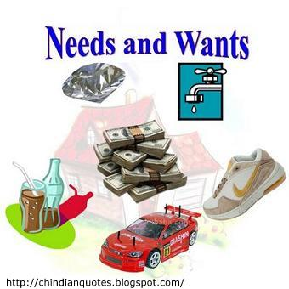

Slide 2
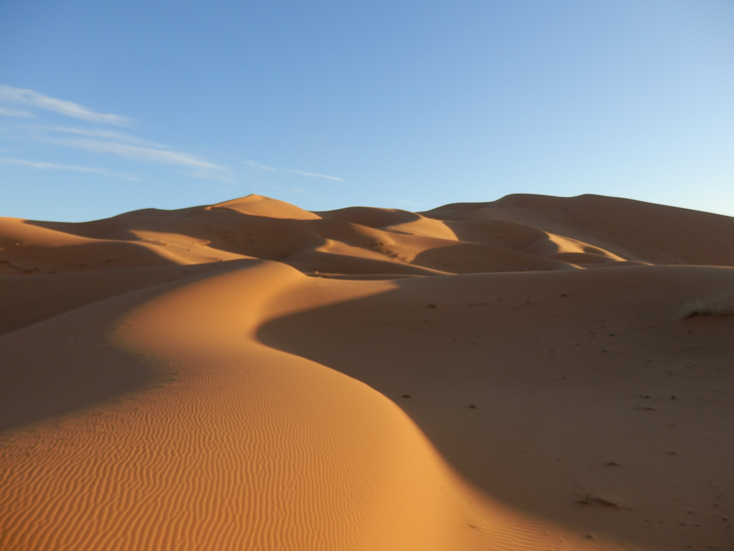
During the Easter break I took a trip
to Morocco. While I was there I went
on a camel trek.

Slide 3
I rode my camel into the Sahara
desert

Slide 4
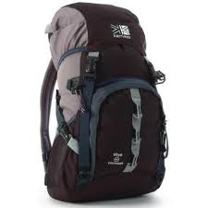
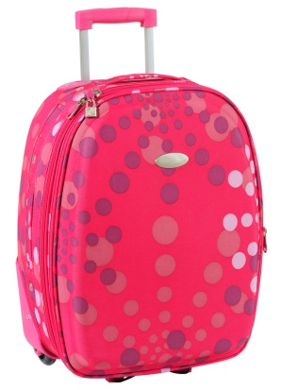
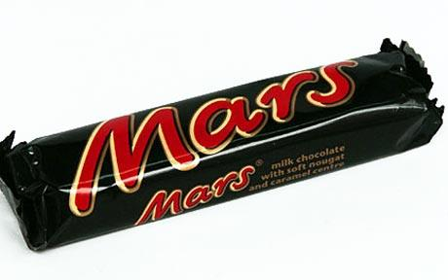
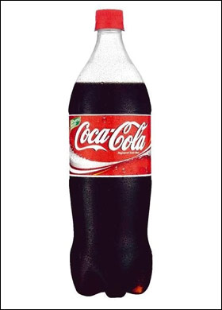
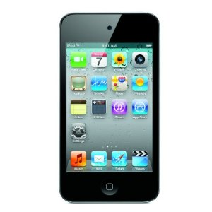
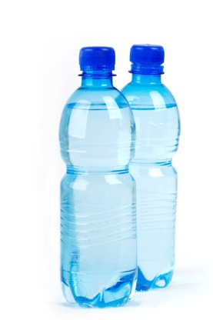
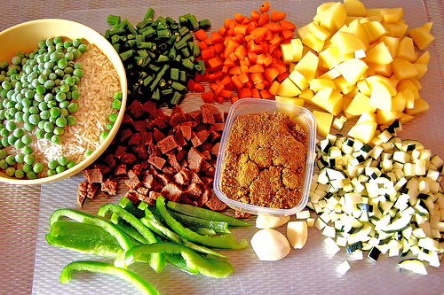
What did I need?

Slide 5
Some of the things you need are
called rights.
But what are your rights?
Children’s Rights:
The things you need to survive and
grow to your full potential.

Slide 7
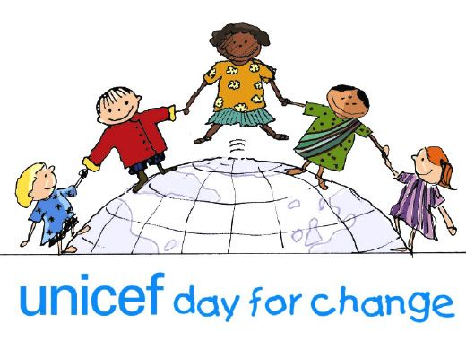
UNICEF raises money for global work for children and their rights worldwide.

Slide 8
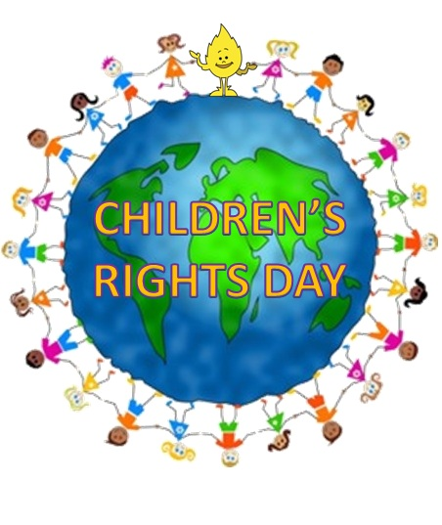
UNICEF work is based on the UNCRC –
United Nations Convention on the Rights of the Child.
United Nations Convention on Righst of the Child

Slide 9
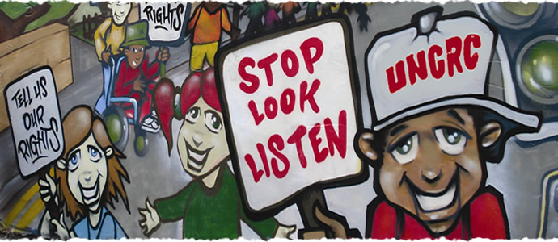
There are 42 articles in the UNCRC which are your rights – together, as a school, we are going to learn about these rights and begin our journey to becoming a Rights Respecting School.

Slide 10
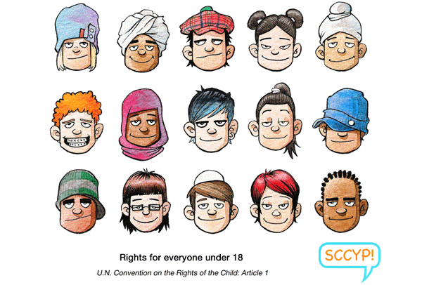

Slide 12
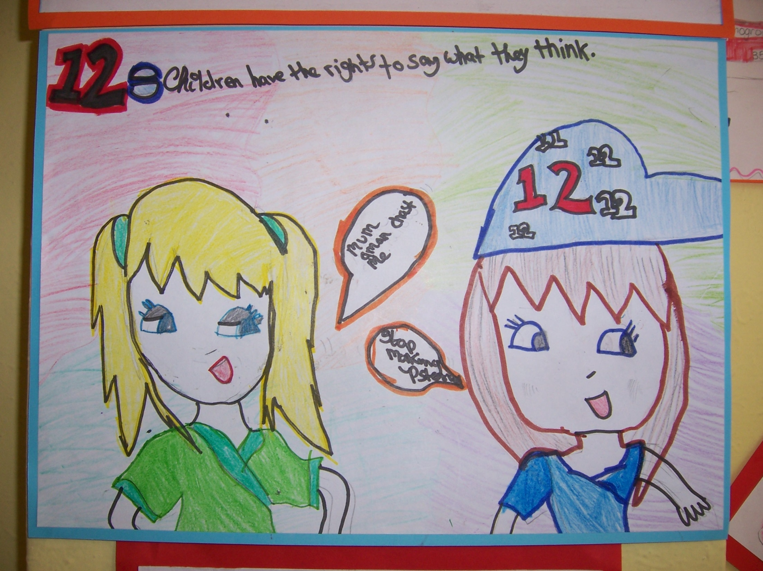

Slide 13
