Slide 1
St John Bosco Primary School and Nursery Class
Renfrewshire Council : Education and Leisure Services
Developing CFE through a Rights Respecting School Approach

Slide 2
Aims
Help participants become more familiar with UNICEF Rights Respecting School
Demonstrate how UNICEF’s Rights Respecting School can be a successful vehicle to develop Global Citizenship
Identify how RRSA can link to the totality of experiences planned for children and young people.
Give practical examples of how schools can use a Rights Respecting approach.

Slide 3
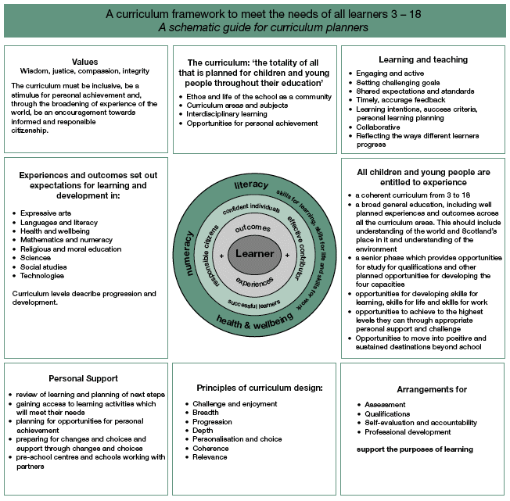

Slide 4
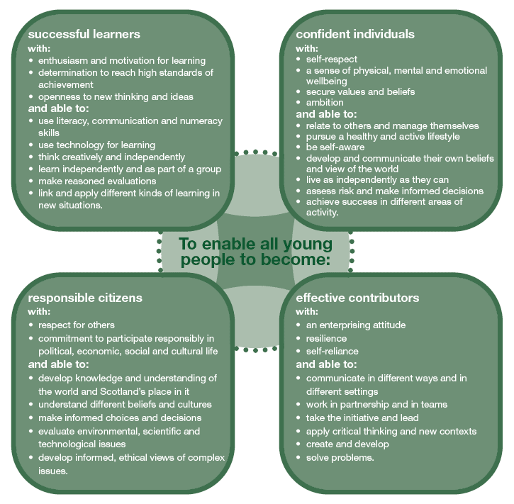
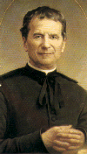
CfE Values = School Gospel Values
Values – Wisdom, Justice, Compassion, Integrity
The curriculum must be inclusive, be a stimulus for personal achievement and, through the broadening of experience of the world, be an encouragement towards informed and responsible citizenship.
“We want our children to be good Christians and upright Citizens”
St John Bosco
Love – Respect
Justice – Fairness
Trust – Faith
Forgiveness
Compassion - Kindness

Slide 5
Part 2 Active Task
Values – Wisdom, justice, compassion, integrity
The curriculum must be inclusive, be a stimulus for personal achievement and , through the broadening of experience of the world, be an encouragement towards informed and responsible citizenship.
TASK
In groups discuss the term “Global Citizenship”
What does this mean?
What would this look like and sound like in children and young people?

Slide 6
Part 3
“The curriculum: The totality of all that is planned for children and young people throughout their education:
Ethos and life of the school
Curriculum areas and subjects
Interdisciplinary learning
Opportunities for personal achievement.
TASK
Within your group you have a large sheet with one of the areas identified.
Discuss how RRSA links to this area? How could RRSA be developed further in this area?

Slide 7
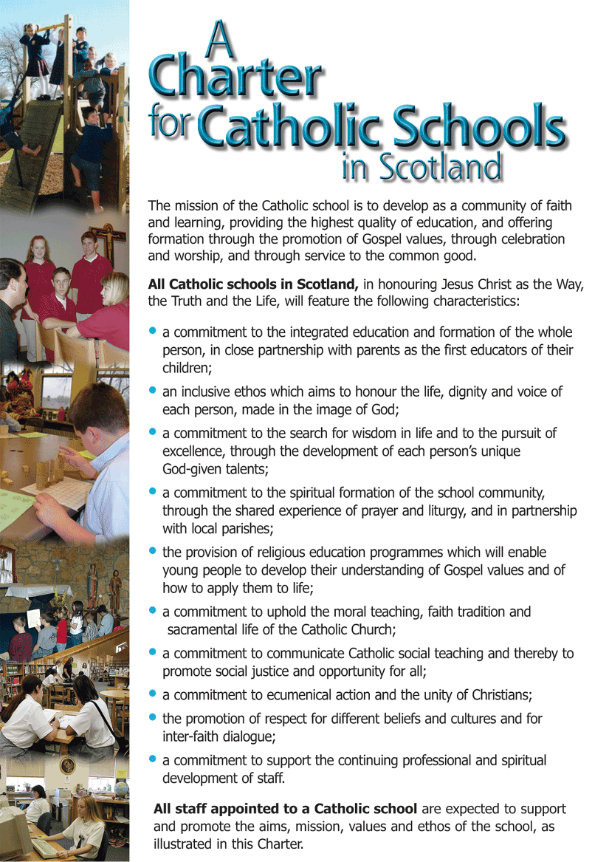

Slide 8
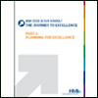
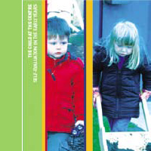
Self Evaluation

Slide 9
RERC/RME
“Catholic Schools aim to help all students to develop their fullest potential, preparing them for life, informing their minds and forming their characters so that they can contribute with others, and above all with God, to the transformation of their world”
This Is Our Faith page 3
“Through developing awareness and appreciaiton of the value of each individual in a diverse society, religious and moral education engenders responsible attitudes to other people.”
Curriculum for Excellence, RME Principles and Practices page 1

Slide 10
RERC/RME
“Catholic schools are communities which are open, welcoming and inclusive. The Church expects that Catholic schools, working with parents and families, will seek to prepare pupils to find happiness and to lead lives of goodness, built upon Christian values, personal integrity and moral courage.”
This Is Our Faith page 3
“Children and young people must become aware that beliefs and values are fundamental to the fabric of society in communities, local and global.”
Curriculum for Excellence, RME Principles and Practices page 1

Slide 11
Health and Well Being
“The statements of experiences and outcomes in Health and Well Being reflect a holistic approach to promoting health and well being of all children and young people. They are consistent with the United Nations Convention on the Rights of the Child, which sets out the right for all children and young people to have access to appropriate health services and to have their health and wellbeing promoted.”
Curricululm for Excellence, Health and Well Being Principles and Practices page 1

