Slide 1
Global Citizenship

Slide 3
What is Global Citizenship
To be aware of Rights and Responsibilities, your own and others, how society works and how we can make society a better place.

Slide 4
UNCRC
Article 12
All children and young people have the right to have a say in decisions that affect them, to access relevant information and to express their feelings. This statement includes all children in the world.

Slide 5
Global Citizens
Tackle discrimination and inequality and want to work to do so.
Respect and value diversity in our multi cultural society.
Are aware that we have to look after the world we live in safeguarding it for future generations.
Believe that everyone can make a difference.
Get involved and contribute to the community locally and globally.
Take responsibility for their actions.

Slide 6
We Are Doing this by
Organising events in school.
Thinking of others.
Have charity days; Yorkhill Hospital and Marys Meals.
Looking after the environment and recycling though the Eco Group.
Being involved in the local community.
Following the School Charter

Slide 7
Examples
Giving to Charity Shops
Behaving
Volunteering in and Out of School
Not Getting in Fights
Being Involved in Clean up Litter Campaign
Not Bullying
Not Contributing to Cyber Bullying
Buddying

Slide 9
Advantages
Accepting people are different
Gain Respect
Being Fair
Being Democratic
Participating
Releasing your potential as an adult of the future
Influence others
Acting with others
Confidence

Slide 10
Ongoing issues
Child Poverty
Locally
Nationally
Globally
Article 6
Children and young people have a right to survive and develop and the government should give as much help as is needed.

Slide 11
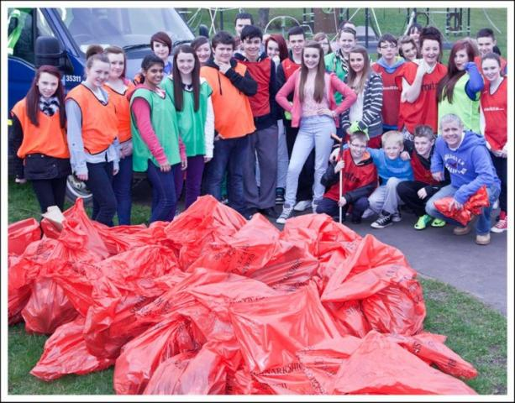
Finally
In some countries it is more difficult for children to get out off the poverty trap.
Paper bag game
Give idea of how some children in developing countries have to deal with poverty.

