Slide 1
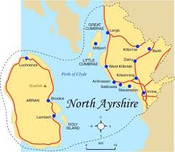

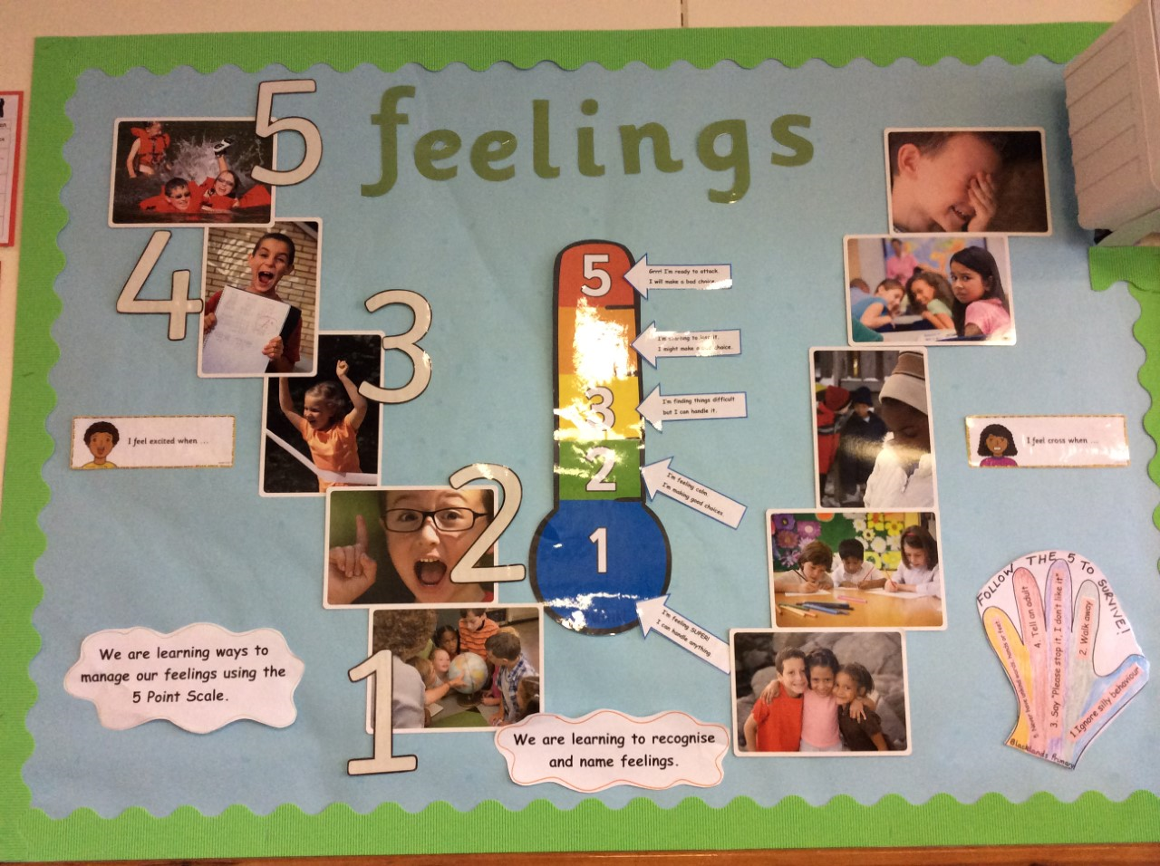


Nurturing North Ayrshire
Supporting Health and Wellbeing at Local Authority Level
Sam March, Principal Psychologist
Philip Gosnay, Senior Manager
Morven McLean, PT Nurture
Notes:
To replace photos right click on image and select ‘Format Picture’ – a new panel will appear on right hand side of page, click on paint bucket, then click on Fill and then select ‘Picture or texture fill’. Then click ‘file’ under select insert picture from . You can then select the photo you want to use from your photo library. It will automatically appear in the circle

Slide 2

North Ayrshire’s approach to closing the poverty related attainment gap.
North Ayrshire Council have established 6 workstreams which supply schools with interventions, programmes, staff and resources to reduce the gap.
There are also a number of other partnership projects funded through the attainment challenge.
This work is governed by an Attainment Challenge Programme Board which monitors performance and impact.
Attainment Challenge
Leadership
Mental Health and Wellbeing
Family Learning
Professional Learning Academy
Data Analysis
Nurture

Slide 3
What is a Nurturing Approach?
A nurturing approach recognises that positive relationships are central to both learning and wellbeing. A key aspect of a nurturing approach is an understanding of attachment theory and how early experiences can have a significant impact on development.
It recognises that all staff have a role to play in establishing the positive relationships that are required to promote healthy social and emotional development and that these relationships should be reliable, predictable and consistent where possible. A nurturing approach has a key focus on the school environment and emphasises the balance between care and challenge which incorporates attunement, warmth and connection alongside structure, high expectations and a focus on achievement and attainment. It is based on the understanding of 6 Nurturing Principles.
A nurturing approach can be applied at both the universal and targeted level and promotes inclusive, respectful relationships across the whole school community, including learners, staff, parents/carers and partners.
Notes:
Good Afternoon, I am Morven, I am the PT for nurture - I’m going to talk you through a little bit of our specific nurture approach, and how it was set up - IN order to communicate to staff what Nurturing North Ayrshire would like we had to communicate what a nurturing approach was.
And for many staff these were values that they already had and practices that they already had. IT was about bringing to the front and focusing on particular aspects of practice. That’s not to say there weren’t also changes to be made – but what we understood a nurturing approach to be was on that had relationships at its core. And an understanding that in order for children to successfully learn we had to focus on health and wellbeing as the starting point. We had to ensure that all our learning environments, classes, school dinner halls, early years setting were reliable, predictable combined with staff who were warm, empathetic and who want ot learn with children.
We also had to communicate very clearly that nurture was still about structure and high expectations – it wasn’t an easy approach or soft, it isn’t “letting them away with it” it is about recognising that some children were in distress, some pupils struggle to self regulate and as an educator you have a role to support children to manage strong emotions. It is the criticism that was levelled against nurture early on and one that we need to acknowledge and still discuss with staff – and not just secondary staff.
Central to developing Nurturing North Ayrshire was sharing and communicating the 6 principles of nurture and the extended 6 principles of nurture and providing learning opportunities to all staff to consider what they already did, what they could tweak and what they could change.

Slide 4
The 6 Nurture Principles
Learning is understood developmentally
Nurture is important for wellbeing
Language is a vital means of communication
All behaviour is communication
Transitions are important in children’s lives
Environment offers a safe base
Notes:
Is everyone familiar with these – these form the foundation of nurture not just in North Ayrshire but nationally – they come from the Nurture Group Network.

Slide 5
Nurturing North Ayrshire
Nurture Groups 9 Early Years 20 Primary 8 Secondary PEF funded groups Education Support Resources | Wellbeing Interventions School Counsellors SMHFA Place to Be See Me
Whole School Nurturing Approaches and Restorative Approaches

Slide 6
Our Nurture Story
Existing foundations of nurture work
Education directorate committed to “Nurturing North Ayrshire”
Looking outwards phase- Education Scotland
Attainment Challenge launched
Professional learning for school SMT
Primary nurture groups established
Secondary and early years groups established
Primary nurture groups expanded to include 5 new groups
Notes:
Co-exists alongside Health and wellbeing strand of attainment challenge and the work being done in it.

Slide 7
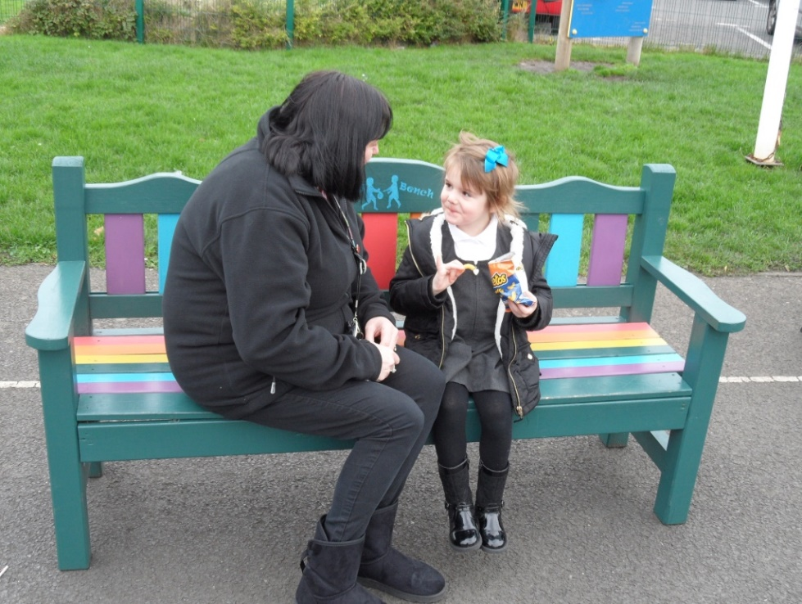
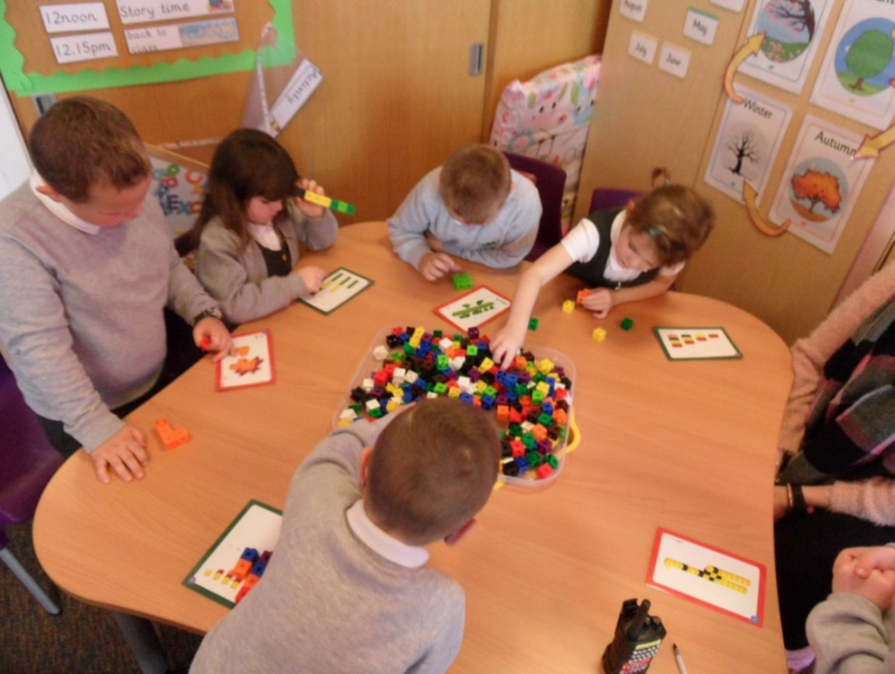
Nurture Groups - Purpose
To meet the social and emotional needs of identified children so that they can develop the skills for life and learning and have the confidence, self-efficacy, and emotional resilience to access the curriculum and attain. In addition to building emotional resilience, this workstream aims to support universal approaches to nurture across the school estate.

Slide 8
“Sometimes the work is too hard and its too long and I’m tired and its too boring so I just want to go home…
…I like the nurture room and playtime. I even like it when it’s somebody’s birthday.”
“School is boring and I want to stay in my house…
..I like nurture room and the cool stuff we do there.”
Notes:
Here are a couple of comments from kids… heartbreaking aren’t they
But there is a positive … and that’s what I want to share with you today..
Nurture groups aren’t new and we are not first LA to use them they are proving to be a successful part of a wider approach to

Slide 9
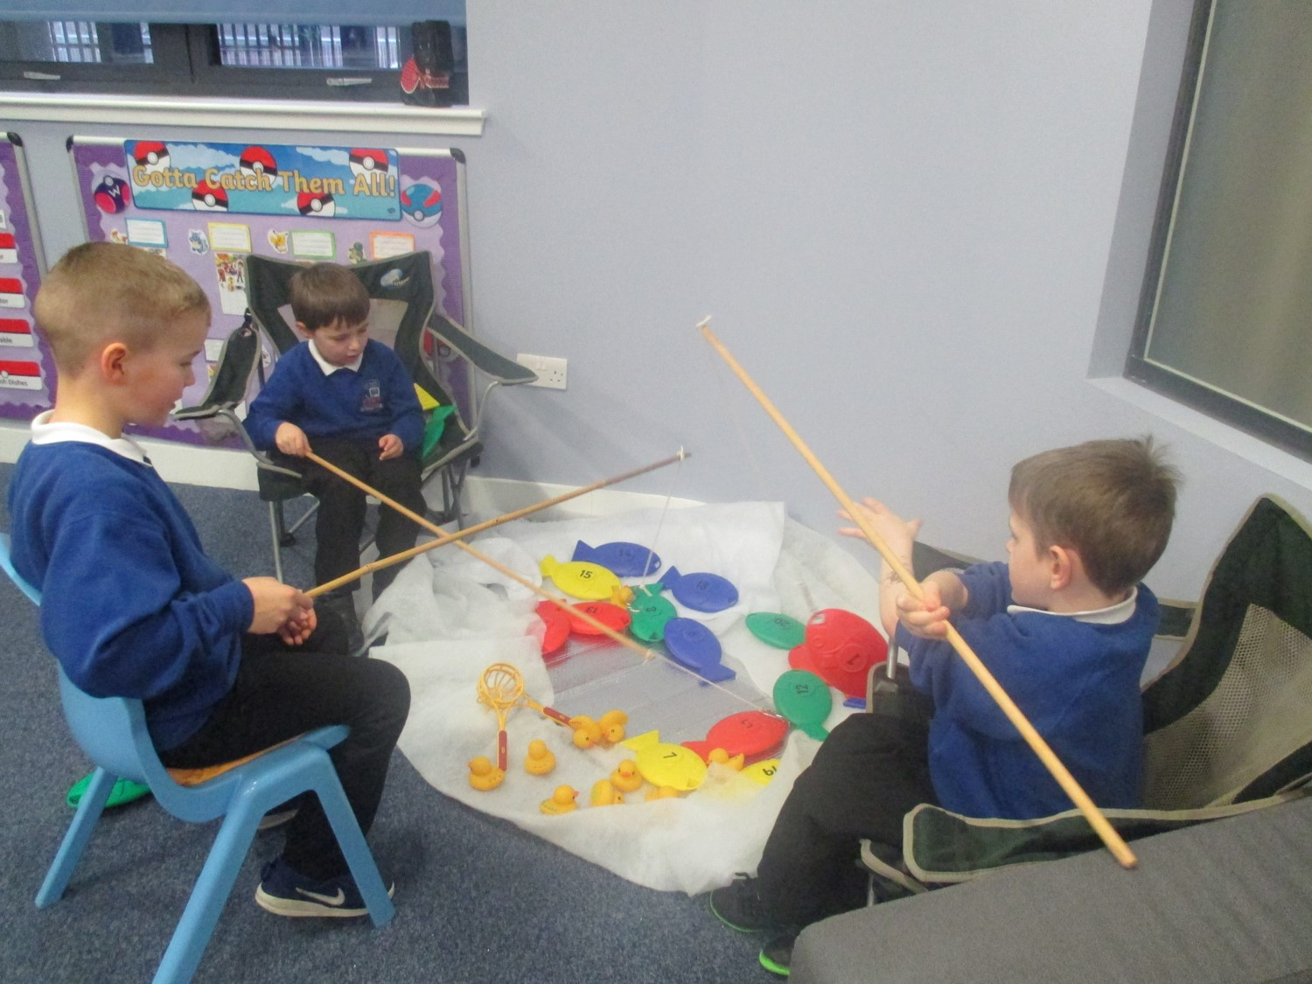
Nurture group model
Environment that links home and school
Small group teaching
Wellbeing curriculum delivered through play and activities
Informed by the 6 principles of nurture
Notes:
Identification of children – Boxall, presentation in class, knowledge of family and home
Small group max 6 children, children attend for 4 terms – build close relationships with the 2 adults in the room adults act as safe base/ attachment figure from which children can begin to feel safe and explore learning.
Learning is developmentally appropriate, slow pace, focused on learning the language of emotions, developing base language skills, sharing, turn taking, caring for themselves and others, and attention and listening skills
Recognise that these skills are essential for pupils to learn and thrive in the classroom – develop these skills children will be ready to learn, ready to attain.. And through this we will be better able to close attainment gap

Slide 10
Professional Learning that Challenges
Every child who is struggling with their reading
should be given support.
It is the responsibility of every teacher
to help all pupils to read.
Teaching pupils to read fluently
requires time and patience.
Pupils should not be deprived of their education
simply because they cannot read.
Schools should work in partnership
with parents to improve a pupil’s reading.
self-regulation
behaviour
self-regulate
behave.
behave
self-regulate
self-regulate.
behave.
self-regulation.
behaviour.
Notes:
Our staff’s Professional Learning, their understanding of attachment and trauma, and how this effects brain development.
WE also needed staff to think about their values and how they viewed behaviour and how they understood their role in the classroom in relation to these factors.
Slides like this were a launch point for discussion around nurture values.

Slide 11
Underpinning Skills and Values of Nurturing Practice
Attunement
Empathy
Body
language
Questioning / statements
Re-framing
Active listening
Skills
Para-linguistics
Connection before correction
Values
Pro-social/ Relational
Notes:
Maybe not an exhaustive list but again a tool to start to think about what teachers already do, what do we think about, what as individuals and teams did we need to develop.

Slide 12
Nurture – Impact
One measure of the impact of primary nurture groups is the Boxall Profile, which provides a framework for assessing children who have social, emotional and behavioural difficulties.
The Boxall Profile below shows the positive impact on the 95 children who have completed this intervention to date.
The graphs show significant improvements to Boxall Profiles which were recorded at entry and exit to Nurture provision.
Evidence now reported across all sectors, early years, primary and secondary
Notes:
What has the impact of this workstream been? What can we report as a result of our interventions? Qualitative and quantitative are both good.

Slide 13
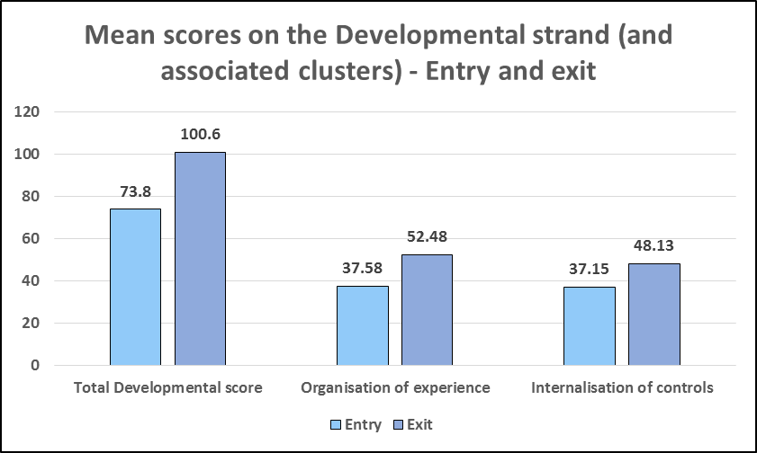
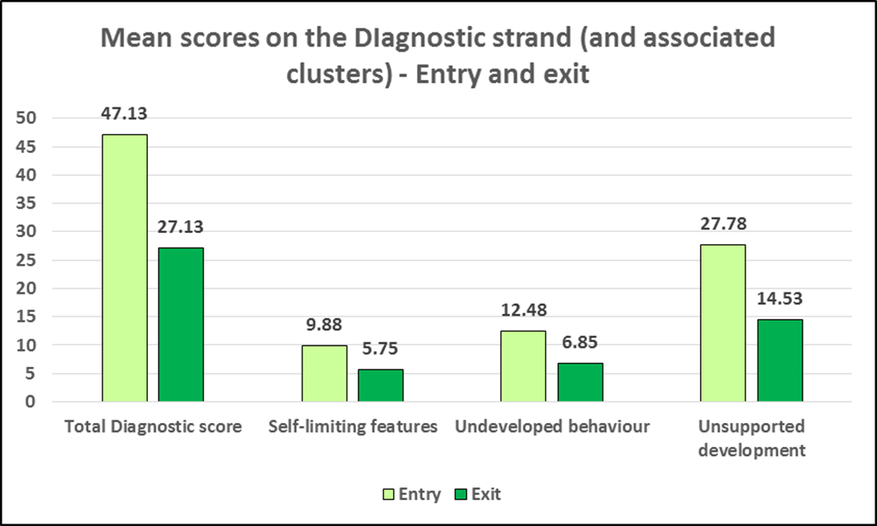
Early Years
Notes:
Based on 40 children
All shifts are significant

Slide 14
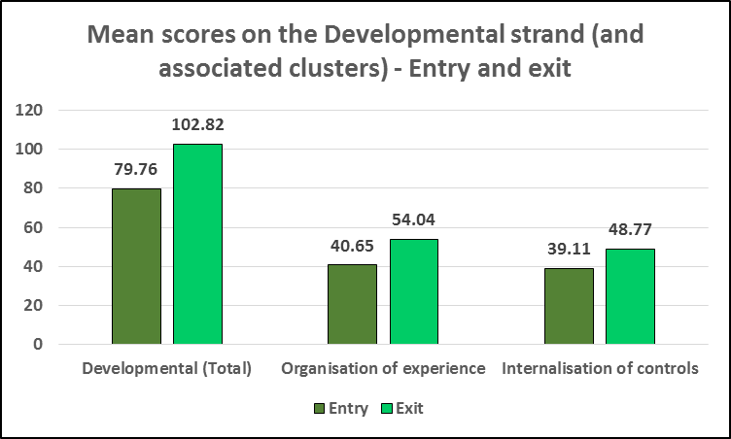
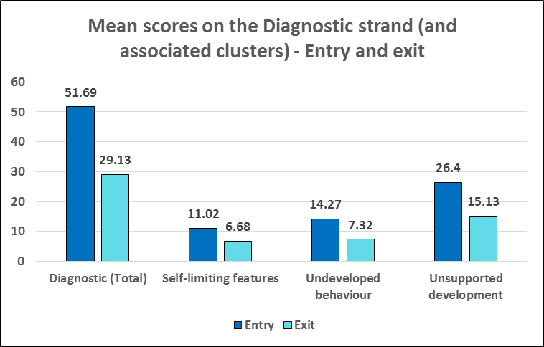
Secondary
Notes:
N=114
Again all shifts are significant

Slide 15
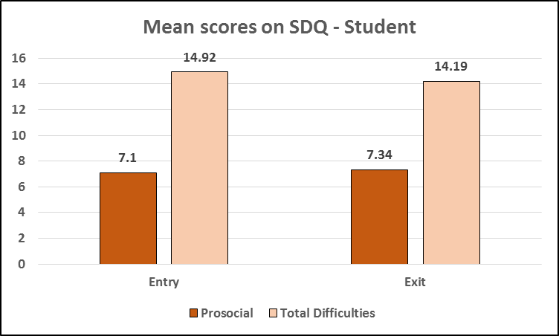
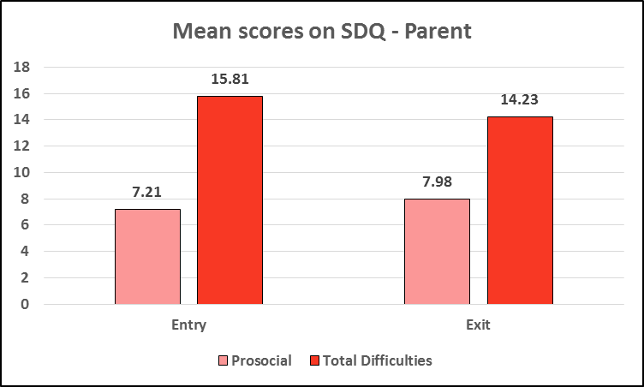
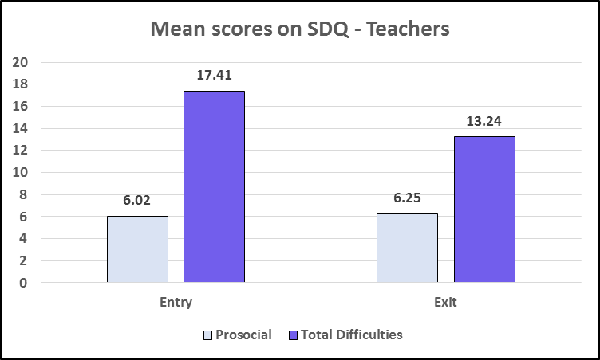
Secondary SDQs
Notes:
SDQ Teachers and Parents show significant shift.
Pupil data shows there is not.

Slide 16
Nurture Teacher
“I love my job. I love the children who attend nurture. They are all individuals with different requirements. They make me so happy to be part of their lives. They also teach me things which I am truly grateful for.”
Notes:
Who doesn’t want to feel like this about their work…
“Seeing a lovely smile on a child’s face instead of a glower or a frown. Watching interaction between children who find it difficult to play with others.”

Slide 17

“Nurture is making a significant contribution to the narrowing of the poverty related attainment gap.”
The inspection team recognised the, “strong culture of collaborative professional learning… with a high engagement and focus on improvement.”
“There was recognition of the strong commitment and value placed on professional learning in North Ayrshire.”
Inspection of North Ayrshire Council’s Attainment Challenge -HMIe 2018
Notes:
A recent HMIE inspection of North Ayrshire’s approaches to raising attainment stated that there has been a wide range of interventions and supports to promote health and wellbeing. The inspection team recognised the, “Strong culture of collaborative professional learning… with a high engagement and focus on improvement.” There was recognition of the strong commitment and value placed on professional learning in North Ayrshire.

Slide 18

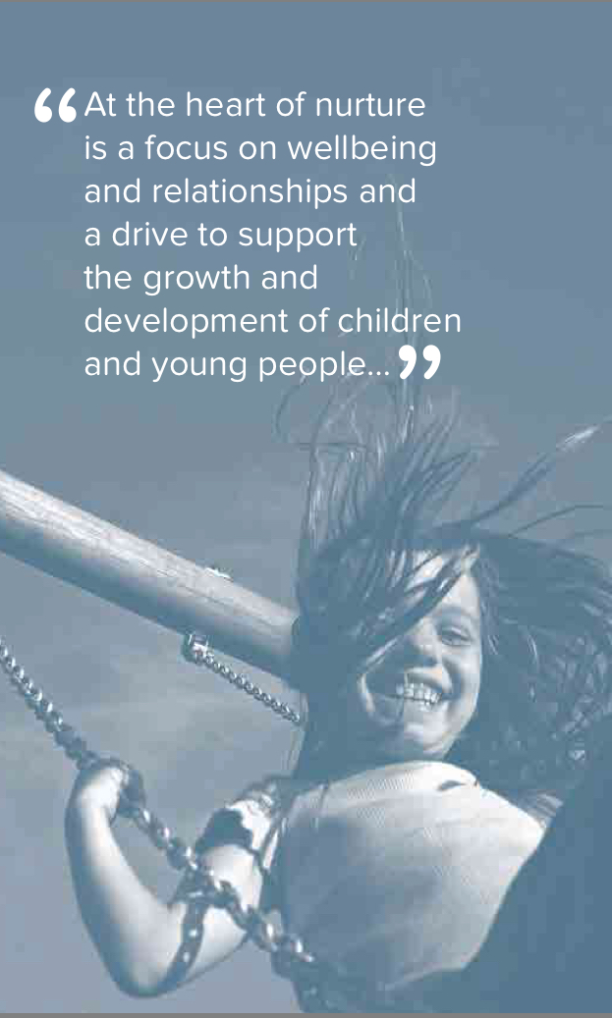
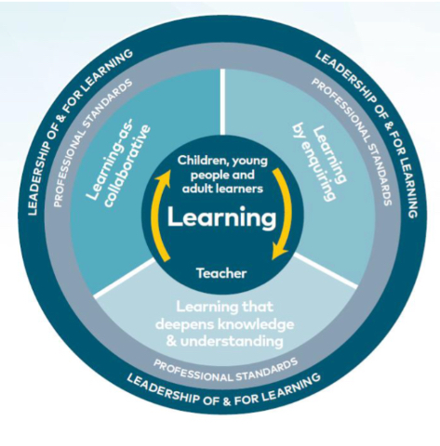
Professional Learning
North Ayrshire Council: Education and Youth Employment
Professional Learning in
Nurture and Restorative
Practice
informed professional staff in support of
Children and Young People

Slide 19
Professional Learning
Initial nurture training – 2 day training for whole school , 4 day training for groups
On-going programme of learning for early years, primary and secondary nurture practitioners
Annual Nurture Conference
Nurture co-ordinator twilights

Slide 20

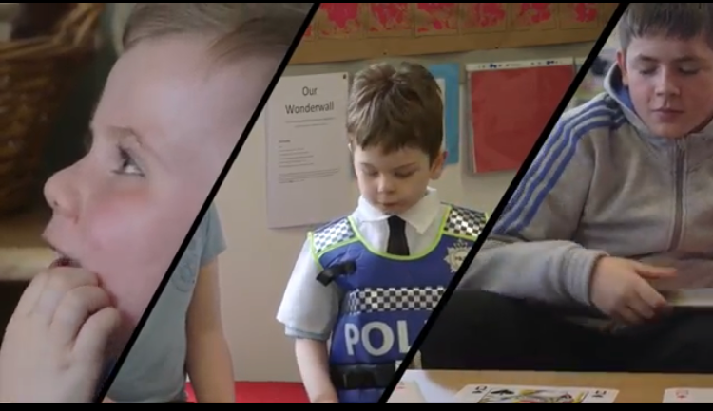
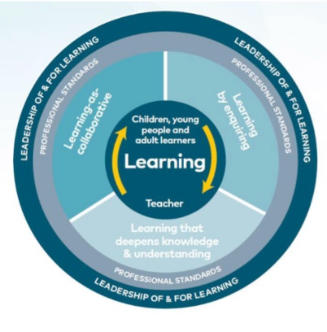
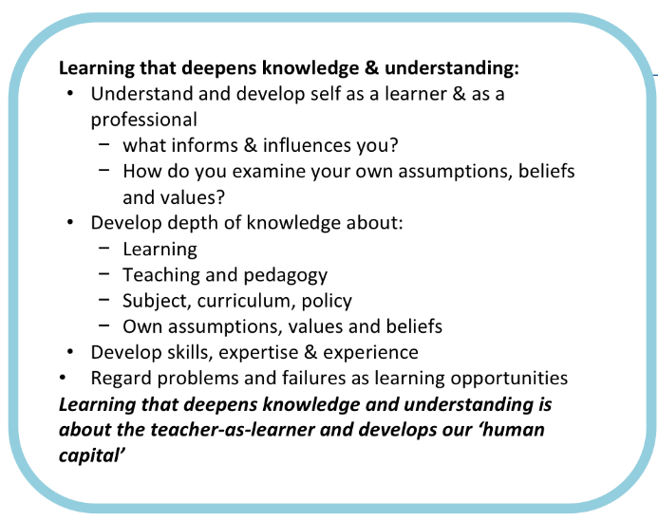
Learning that deepens knowledge & understanding
The team’s commitment to Professional Learning influences change and improvement to our own professional learning programmes for nurture staff. We teach best as learners.
Nurture heads, teachers and “early adopter CTs” cascade learning to ensure every child feels safe, welcome and valued. We teach best as learners.
Notes:
Welcome
Intro
From the outset let’s be clear ...... today is not just about what is done to people to fix them it is about what is do with people to fundamentally change the basis and culture of what we strive to do to support the life chances of our young people . It is about recognising that relationships are key at all levels to enhance the wellbeing of our YP ....
THE NIF DRIVERS SUPPORTED BY SE THROUGH HGIOS
DESCRIBES the need to:
n Recognise that outcomes for children and young people can be improved by improving practice at different levels of the system;
Recognise Professional responsibilities and ensure everyone involved has the capacity to play their part effectively;
Use evidence to inform practice and share innovation;
The self-evaluation of nurturing approaches based on nif drivers and our hgios informed QIF can also helps schools determine to what extent their culture and ethos impacts on overall attainment and achievement.
Our approach to professional learning in nurture and restorative practice is the same approach we take when undertaking nurturing approaches with children
Professional learning advocated by NORTH AYRSHIRE AND THE GTCS IS in itself nurture based ..... in professional learning in north Ayrshire within NRP we really do get to practice what we preach .....
Nurture Work stream’s Professional Learning
The nurture work stream are committed to their own professional learning. There is a commitment in the team to bringing learning back to the authority and sharing new learning with partners.
Highlights have included:
Morven McLean and Jennifer Johnstone participated in Nurture Group Network’s Scottish Conference and Summer School. The summer school used a workshop format and modified versions of the workshops have been shared with the nurture team. This year practitioners from our secondary nurture groups are hoping to attend summer school and will bring back and share their experiences.
Diane Ferguson, Catherine Paterson and Sam March attended Bruce Perry’s seminar in Edinburgh on 3 October 2016. Following the seminar nurture training has been adapted to reflect the learning gained.
Sam March attended the Division of Child and Educational Psychology Conference, 11-12 January 2018
Taryn Moir and Sue McLeod attended a 6 day course, ‘Foundations in Restorative Practices’ led by Tim Chapman, chair of the European Forum for Restorative Justice. This training has informed advanced training currently being undertaken with senior school leaders and pastoral support teachers. This training aims to give support staff the skills needed to use conferencing in more challenging and complex situations.
Taryn Moir and Sue MacLeod attended a one day Restorative Conference “Moving forward with restorative justice in Scotland; Why?” This was a useful networking event showcasing how Restorative Approaches are being used across Scotland in a variety of settings and provided the opportunity to discuss what could promote the approach further. The event also launched the publication ‘Guidance for the Delivery of Restorative Justice in Scotland, (Scottish Government, 2017) which has informed our own practice guidelines. Following on from this an initial link has been made with the Community Justice team in North Ayrshire which will provide a multi-agency perspective on the approach within the Authority and a possible opportunity for joint training.
Taryn Moir attended public dialogues on Restorative Justice which added a further perspective to knowledge and understanding of the approach using real life case studies.
Taryn and Sue attend the National Scottish Restorative Policy Forum which aims to inform policy decision making regarding the approach in various contexts.
Taryn and Sue attend the Restorative practitioner’s network in Scotland which has provided a Scotland wide perspective on how the approach is being implemented in a variety of contexts. This further informs our own training and implementation.
An article entitled “What impact has the Educational Psychology Service had on the implementation of restorative approaches activities within schools across a Scottish local Authority?” is to be published within a national psychology journal. (appendix 7)
All members of the team use the enhanced professional learning developed at events and conferences and through reading and reflection to improve and develop the learning opportunities they share with teachers across North Ayrshire.

Slide 21
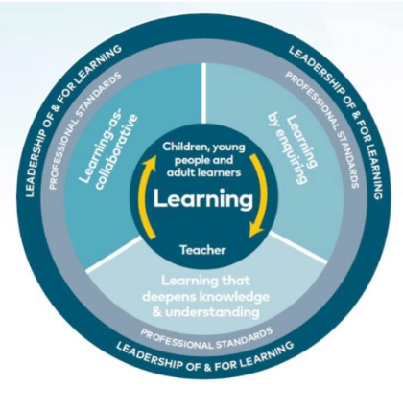
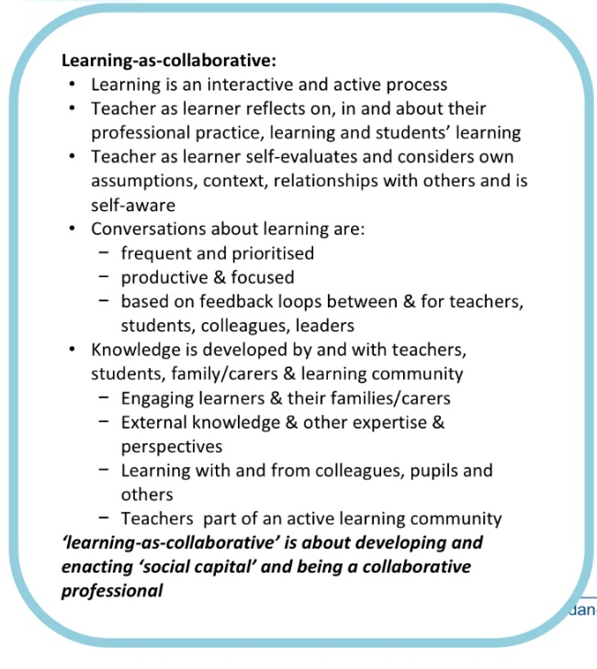
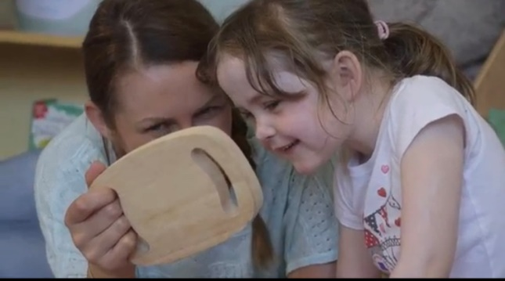
Learning as Collaboration
Secondary pathfinders for de escalation
Nurture practitioners are supported to share their experiences and to develop a collaborative approach.
The team strengthen and develop and deepen knowledge of wellbeing
Professional learning has been described as helpful, thought provoking and stimulating.
Excellent discussion around children’s emotional development.
New Nurture practitioners professional learning is delivered in mixed groups of EY , Primary and secondary, results in rich discussion and in sharing of best practice.
Learning used to coach colleagues and improve their practice and affirm nurture practice.
Notes:
“I will use knowledge gained in training to improve my own practice in terms of nurture and to support nurture staff through my role as nurture co-ordinator for the school.”
“Having the knowledge of the nurture principles and the reasons why, will hopefully enable me to help set up the nurture room, including the children in this process will hopefully prove to be beneficial.”
“I have a better knowledge and understanding about nurture and the impact that poor attachment and trauma can have on children. I feel more equipped to work in a nurture room.”
“Learning from this course will be applied within my mainstream class as well as in the nurture room.”

Slide 22
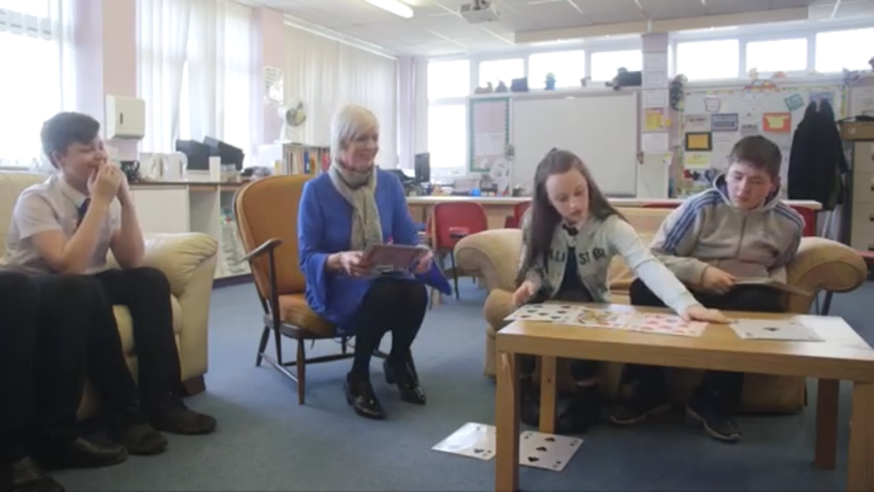
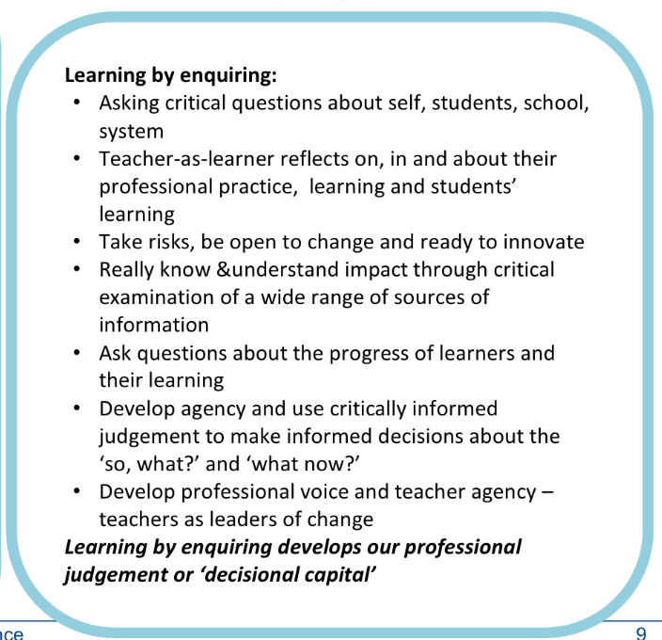

Learning by enquiring……………..
Assessment and information
is used to take decisions
about pathways for children
and Young people (So, what?
And what now?)
QI Visits based on directed self evaluation tasks ensure practice is challenged and leads to improved outcomes for children.
Moderation groups- practice reflection, and peer learning. These opportunities allow space for critical thinking, affirmation of practice and reassurance.
Notes:
“Meeting regularly makes me feel nurtured and supported”
“It is vitally important to meet with others. It keeps us learning and sharing strategies, keeping each other reassured.”
“Valuable tool for self-evaluation through collegiate conversations. Positive to help create plans to implement nurture across the whole school.”
“We are very happy with the fortnightly meetings and like the structure of the planned discussion topics/ visitors / sharing good practice.”

Slide 23

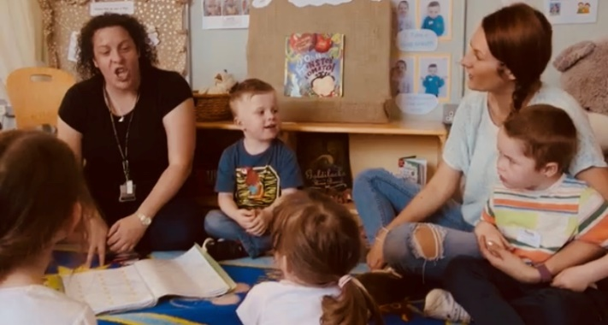
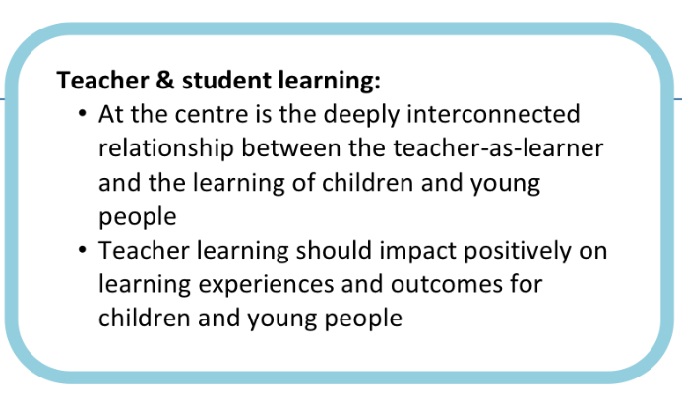
Teacher and Student Learning
Children’s learning is understood developmentally.
Independence develops through dependence and trust in a key adult. “connectedness”, “attunement” and “claiming”
The environment offers a safe base
The importance of nurture for the development of wellbeing, with children and young people given the support to challenge negative beliefs about themselves and build resilience
Language is a vital means of communication and all behaviour is communication
The importance of transition / routine in children’s lives
Wellbeing is understood by staff and increasingly by young people links to both GIRFEC and HGIOS?4 /HGIOELC
Staff fully understand the impact of trauma, attachment and Adverse Childhood Experiences (ACES) on whole child development;
Moving away from behaviourist models to more relational ones- a major cultural shift in NAC.
Notes:
Student learning
Children’s learning is understood developmentally. Independence develops through dependence – staff should respond to children at their emotional/developmental level, thus enabling them to progress;
The environment offers a safe base; importance of structure and predictability with firm, clear boundaries and adults working together supportively;
The importance of nurture for the development of wellbeing, with children and young people given the support to challenge negative beliefs about themselves and build resilience;
Language is a vital means of communication; staff listen and respond to children in ways that show the children are valued and thought about or kept in mind;
All behaviour is communication; children are helped to understand and thus to express their feelings and given opportunities for extended conversations;
The importance of transition in children’s lives; staff acknowledge the feelings aroused by transitions and understand that even small changes in routine can be overwhelming and unsettling for some children.

Slide 24
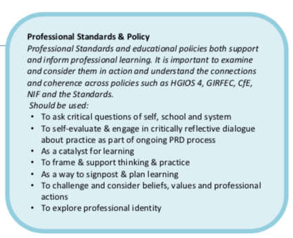
Professional Standards and Policy
Teachers
develop and apply their knowledge,
skills and expertise
deepen and apply pedagogic knowledge in nurture ,restorative and de escalation
Inclusion is deepened and supported through nurture for all , ACES and attachment theory .
staff in all settings contribute to establishment improvement planning in hwb and to PL
Senior managers measure impact of this learning in action through classroom visits to schools under their QIF visits with schools .
Through the QIF and moderation process ,question, develop and account for practice in critically informed ways and provide an informed rationale for professional actions based on assessment and professional observation leading to support for yp experiencing trauma and changing the culture of learning and teaching to one based on positive relationships .
systematically investigate, analyse and evaluate the impact of practice through the QIF , challenge questions , nurture questionnaires and undertaking commitments that are enacted followed up by subsequent learning sessions .
critically question and challenge educational assumptions, beliefs and values of self and system - self analysis of nurturing and restorative approaches pre and post learning.
critically engage with a range of educational literature, research and policy to make meaningful links to inform and change practice. At all levels all engage in professional reading and research .
Through the PL approach to nurture and weekly nurture learning opportunities nurture heads staff and early adopters
work to create, contribute to, and lead a collegiate culture, promoting collaborative enquiry, peer moderation with constructive feedback, and effective professional dialogue and debate.
Nurture PL ensures staff from primary and secondary work and develop collaboratively , with other agencies and with parents in their communities.
Notes:
Professional Skills and Abilities
Teachers develop and apply their knowledge, skills and expertise through enquiry and sustained professional
learning
to deepen and apply pedagogic knowledge in nurture ,restorative and de escalation to lead learners and the learning of colleagues in order that their understanding of wellbeing and inclusion is deepened and supported through nurture for all , ACES and attachment theory . All nurture staff in all settings contribute to establishment improvement planning in hwb and to PL cascade sessions . Senior managers gain a measure of this success of this learning in action through classroom visits to schools under their QIF visits with schools .
Through the QIF and moderation process ,question, develop and account for practice in critically informed ways and provide an informed rationale for professional actions based on assessment and professional observation leading to support for yp experiencing trauma and changing the culture of learning and teaching to one based on positive relationships .
systematically investigate, analyse and evaluate the impact of practice through the QIF , challenge questions , nurture questionnaires and undertaking commitments that are enacted followed up by subsequent learning sessions .
critically question and challenge educational assumptions, beliefs and values of self and system - self analysis of nurturing and restorative approaches pre and post learning.
critically engage with a range of educational literature, research and policy to make meaningful links to inform and change practice. At all levels all engage in professional reading and research .
Through the PL approach to nurture and weekly nurture learning opportunities nurture heads staff and early adopters
work to create, contribute to, and lead a collegiate culture, promoting collaborative enquiry, peer moderation with constructive feedback, and effective professional dialogue and debate.
Nurture PL ensures staff from primary and secondary work and develop collaboratively , with other agencies and with parents in their communities.

Slide 25
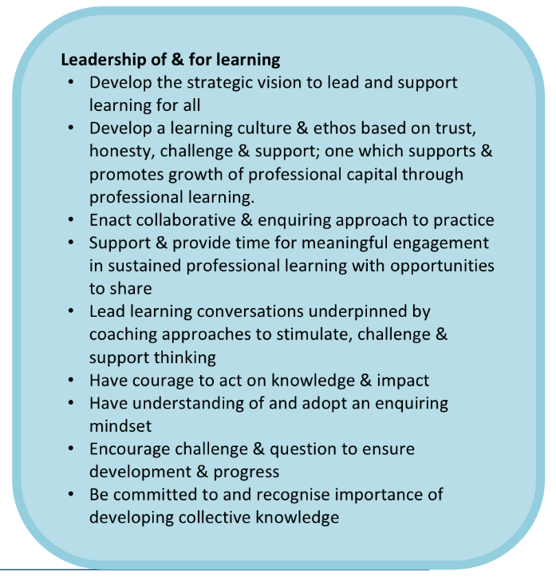
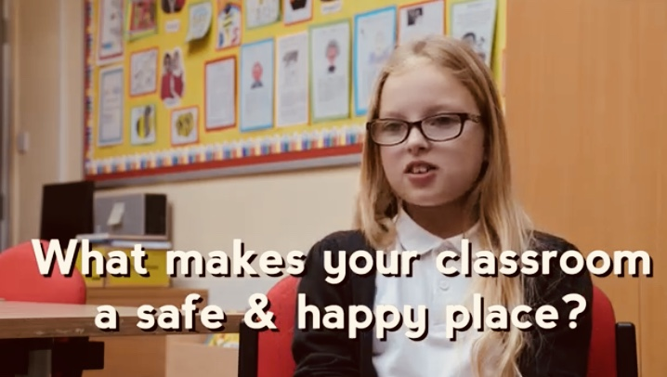
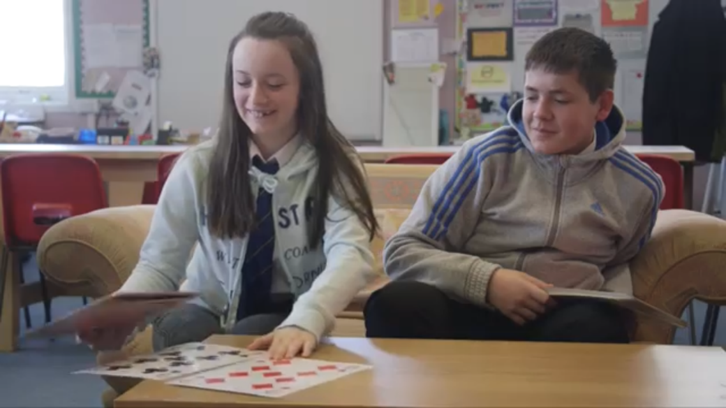
Leadership of and for learning
Notes:
Nurture is establishing it self as an essential basis on which to build the most effective learning and teaching. It is a commitment within the council’s integrated children’s services plan. Professional learning sessions facilitate examination of own practice and to reflect on the journey required towards deepening nurture. Time crucially is given to this self analysis – vital if nurture is to take root. Scenarios in nurture stimulate discussion andchallenge and support thinking. Learning in nurture is further enhanced by QIF challenging and supporting practice whilst weekly sessions allow time for staff to reflect on YP needs and staff needs to support Wellbeing. Moderation sessions and recall learning sessions build clollective knowledge and help in the evolution and personalisation of future professional learning sessions in nurture and restorative approaches. No one is in a fixed mindset – professional learning like nurture evolves to meet the needs of its audience.
Professional learning is ceding into classroom practice- in the words of our corporate director it is singularly the most important improvement we have to embrace over the next 5-10 years. If social justice is to be truly at our heart then it is through a commitment to nurture at al levels and across all sectors – EYC, Primary, Secondary and into further education. Professional learning is firmly focussed on changing mindset and attuning staff to a deeper understanding of trauma and attachment and its practical application to educational settings.

Slide 26
Health and Wellbeing
Counselling service
SMHFA
See Me
Place to Be

Slide 27
Mental Health and Wellbeing – Secondary Counselling Service
School counsellors in all 9 of our secondary schools
350 pupils have used the service to date (since June 2017)
More pupils referred by Pastoral staff (61%) but also high number of self-referrals (39%)
Low mood (65.1%), stress (61.7%) and anxiety (58%) are the three most common reasons for young people to attend counselling
Significant positive shift on SDQ – Prosocial skills have increased and total difficulties decreased after counselling sessions end
Significant positive shift on YP-CORE assessment after counselling sessions end
Notes:
What interventions, programmes, resources, training are funded through this workstream? (e.g. )

Slide 28
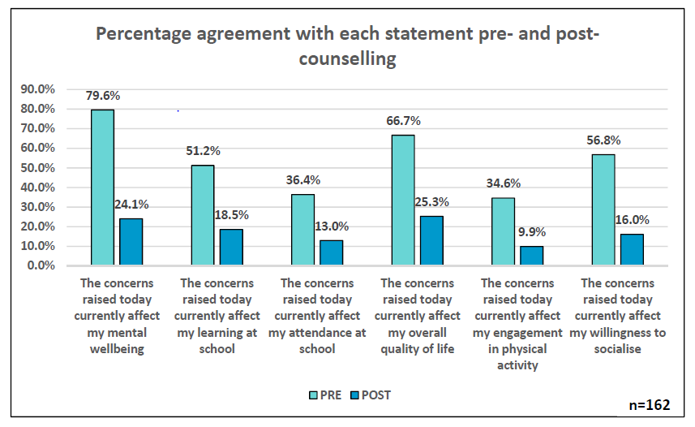
Mental Health and Wellbeing – Secondary Counselling Service Impact
All pupils are asked to rate their agreement with the following statements before and after counselling – the results can be seen below:
Notes:
What has the impact of this workstream been? What can we report as a result of our interventions? Qualitative and quantitative are both good.

Slide 29
Mental Health and Wellbeing – Secondary Counselling Service Impact
“Having someone to talk to that was understanding and that I trusted. Also, someone that I knew was on my side and wanted me to be better.” (S6 pupil)
“Talking about issues that I didn’t want to keep secret. Having someone reliable to talk to.” (S1 pupil)
What are the best things about counselling?
“Having someone to talk with and understand my thoughts.” (S5 pupil)
“Having someone that isn’t at home all the time to talk to, taking the stress off my family, getting help from someone who properly knew how to help me.” (S2 pupil)
Notes:
What is the purpose of this workstream?
What is the long term outcome?

Slide 30
Mental Health and Wellbeing – Secondary Counselling Service Impact
“It’s brilliant because I feel supported and understood – without a counsellor I would have really struggled.” (S5 pupil)
“It’s good because people don’t get to talk to people sometimes.” (S2 pupil)
What do you think about having a counsellor in your school?
“I think it’s a good thing because you can get stuff off your chest that’s annoying you or making you sad.” (S5 pupil)
“I think it’s good as it has helped me out with problems and I have felt more comfortable about coming to school.” (S4 pupil)
Notes:
What is the purpose of this workstream?
What is the long term outcome?

Slide 31
What’s next for Nurturing North Ayrshire?
Expand targeted nurture provisions
Deepen whole school work to support distressed behaviour through professional learning (De-escalation, Self Regulation)
Supervision for school leaders
Extend SMFHA and tiered support for mental health
Develop coherent sustainable long term counselling approach as part of whole school approach
Kilwinning Wellness Model- Linking with Mental Health National Taskforce

