Slide 1
Blue Whale’s
Children’s university
By Niamh Connolly

Slide 2
What is a Blue Whale?
The blue whale is the largest animal on the planet.
They weigh as much as 200 tons (approximately 33 elephants).
The blue whale has a heart the size of a Volkswagen beetle.
Its stomach can hold one ton of krill and it needs to eat about four tons of krill each day.
They are the loudest mammal on earth and are even louder than a jet engine.
Their calls reach 188 decibels, while a jet reaches 140 decibels.

Slide 3
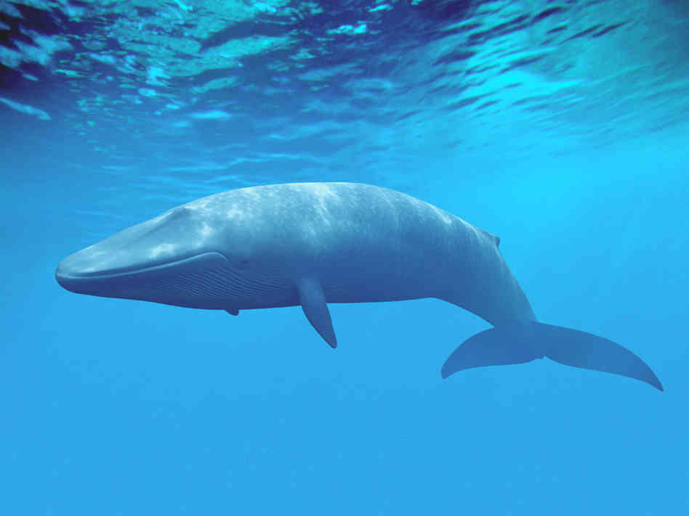
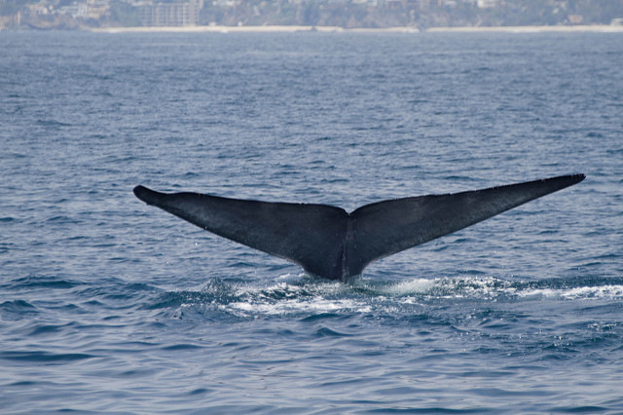
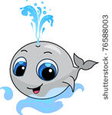
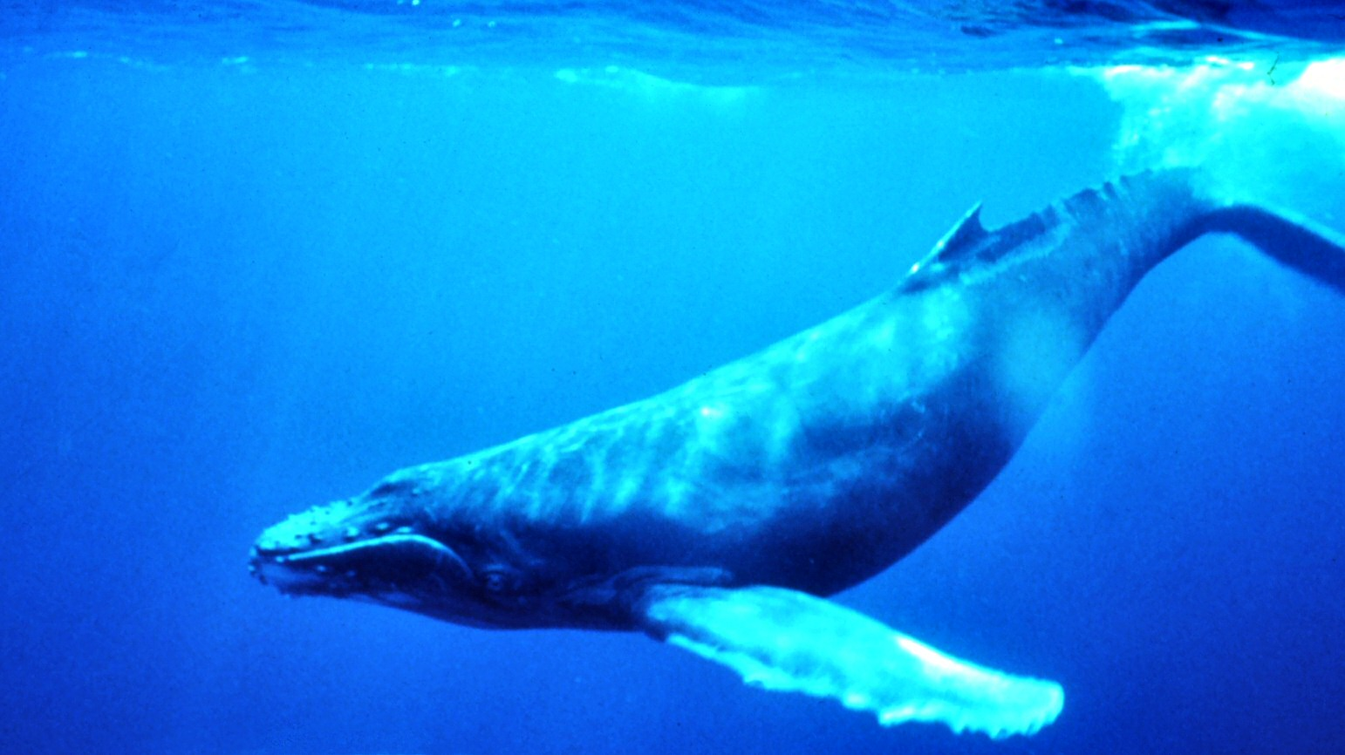
pictures

Slide 4
What are the similarities between a human and a blue whale?
Blue Whales are mammals and so are we.
Both Humans and Blue Whales are “warm-blooded”
We both breathe through our lungs.
We both give birth to live young and nurse them.
Whales even have hair!

Slide 5
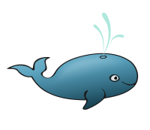
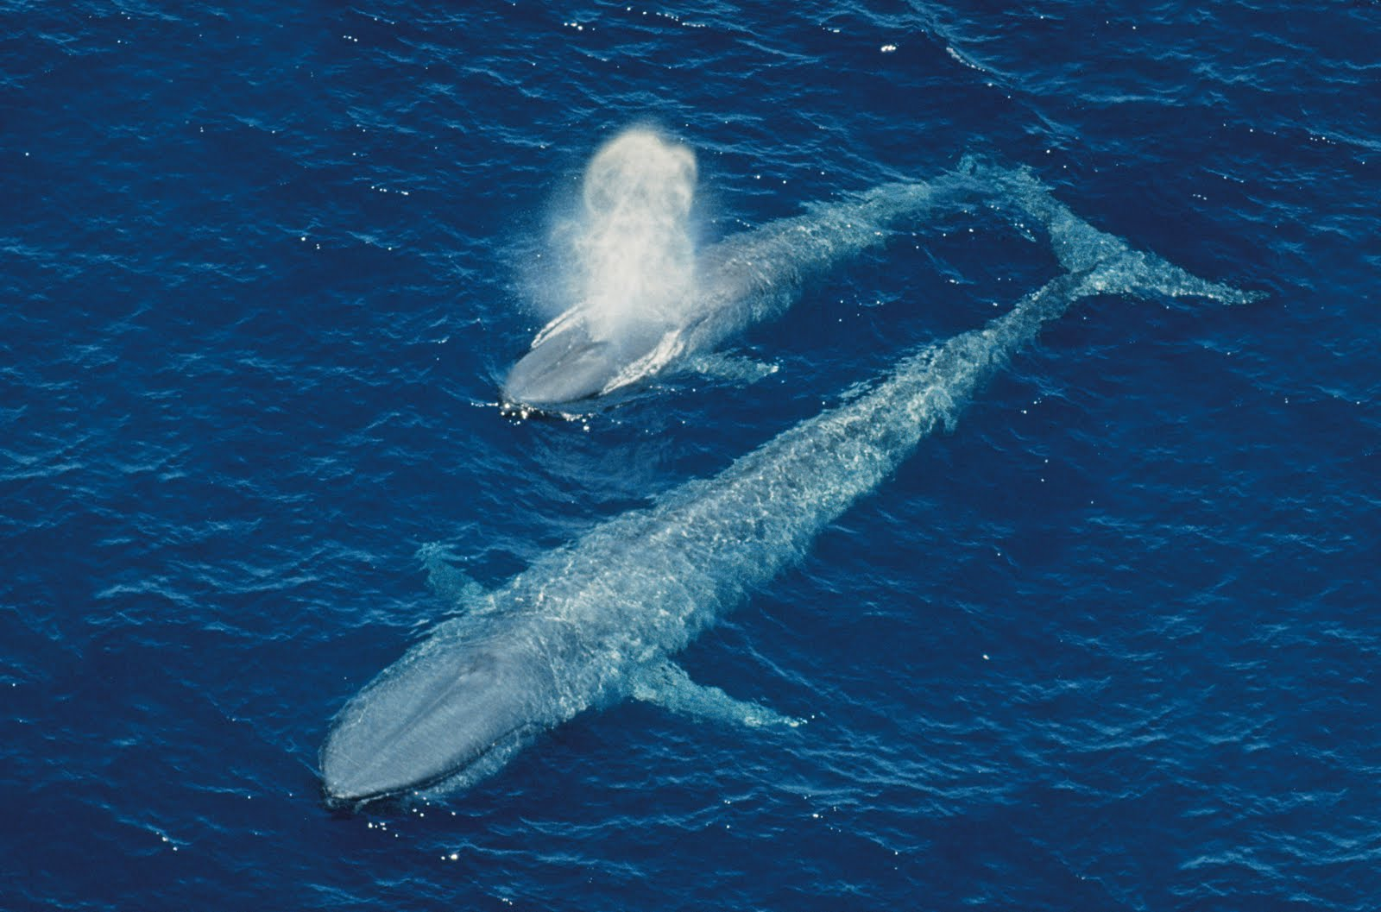
Picture’s

Slide 6
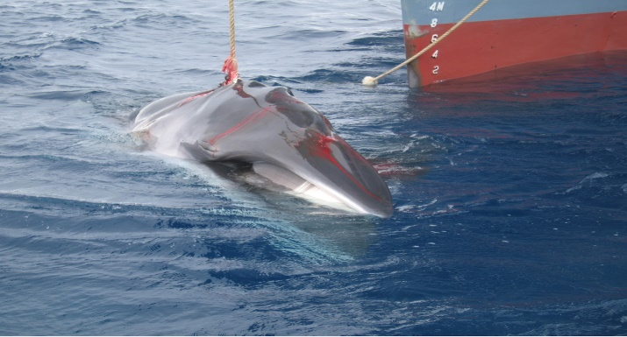
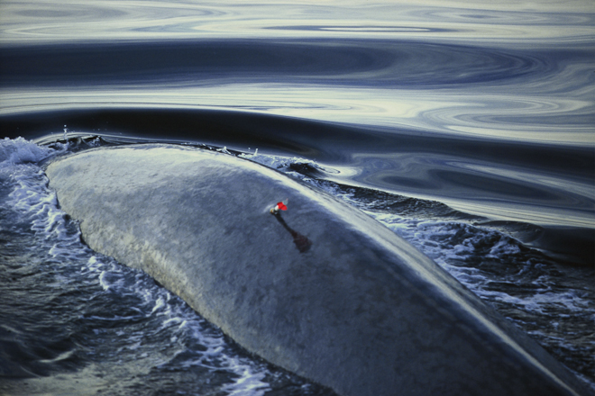
Why are they endangered?
Blue whales are threatened by environmental change including habitat loss and toxics.
Blue whales can also be harmed by ship strikes by becoming entangled in fishing gear.
Climate change and its impact on Krill (shrimp-like crustaceans).
Commercial whaling which is conducted by countries such as Japan and Iceland.

Slide 7
Thank's for watching

