Slide 1
Welcome to
Whiteinch
Primary
School
A Great Place to Learn

Slide 2
This is my
Head Teacher,
Mrs McLaughlin.
.

Slide 3
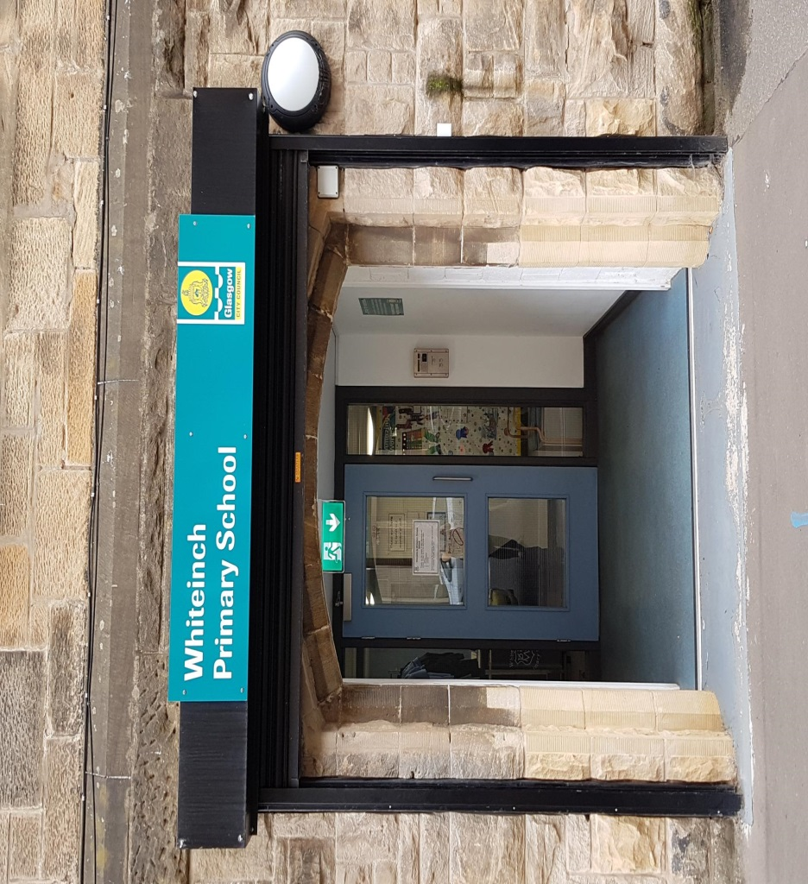
This is my
Main Entrance.

Slide 4
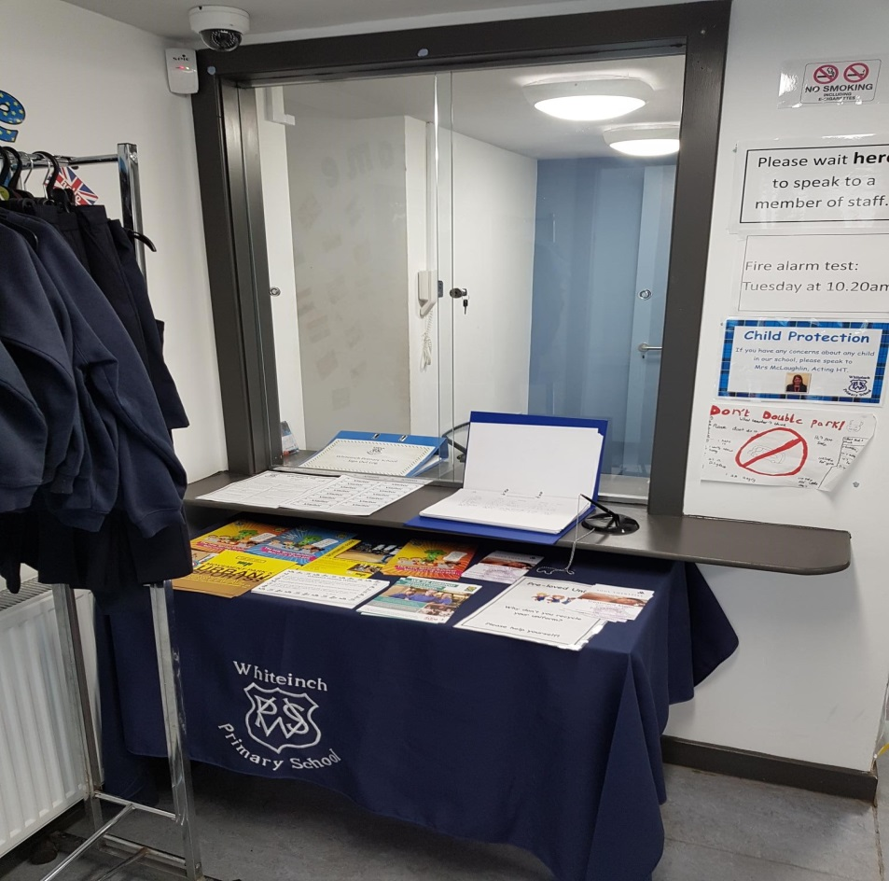
This is my
School Office.

Slide 5
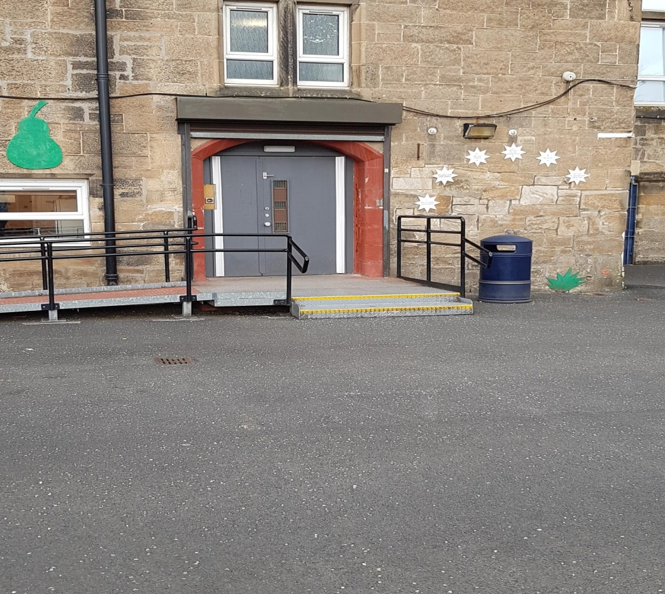
This is my P1-3
door.

Slide 6
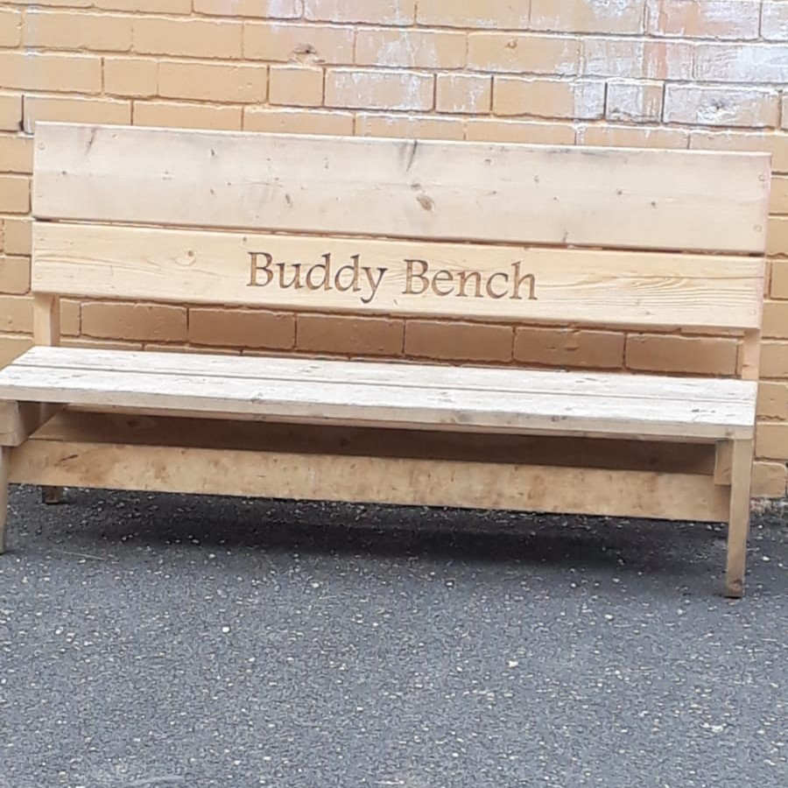
This is in my P1-3 playground.

Slide 7
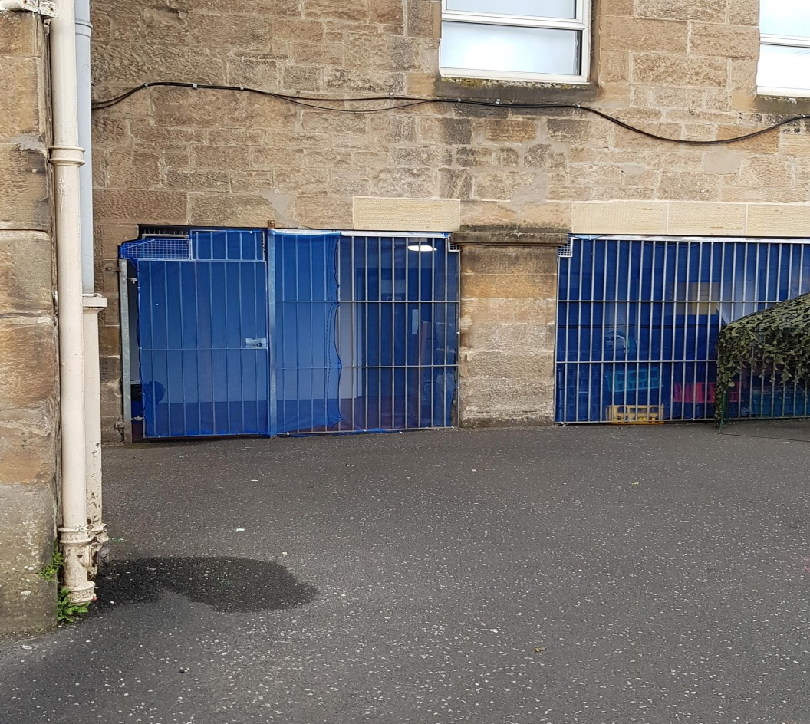
This is the gate to my P1-3 playground toilets.

Slide 8
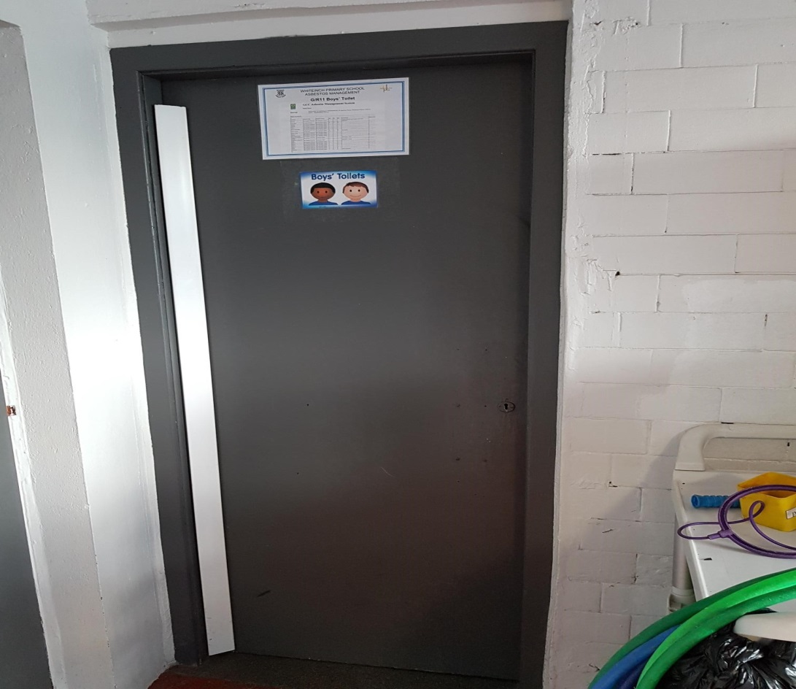
These are my P1-3 playground toilets.

Slide 9
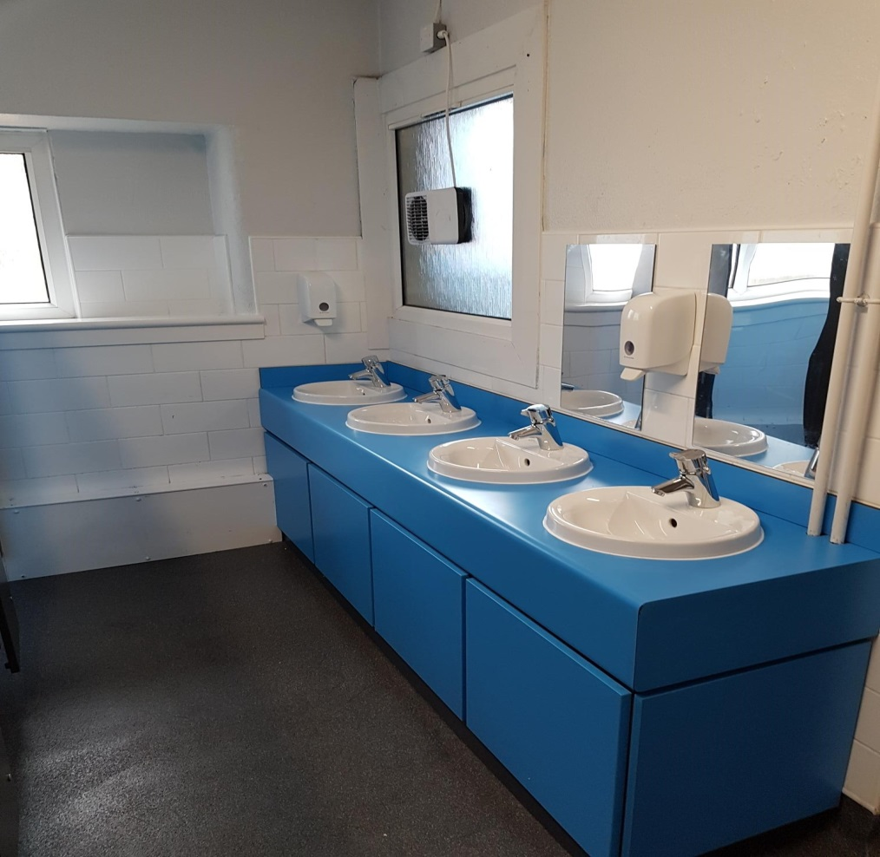
This is inside my P1-3 playground toilets.

Slide 10
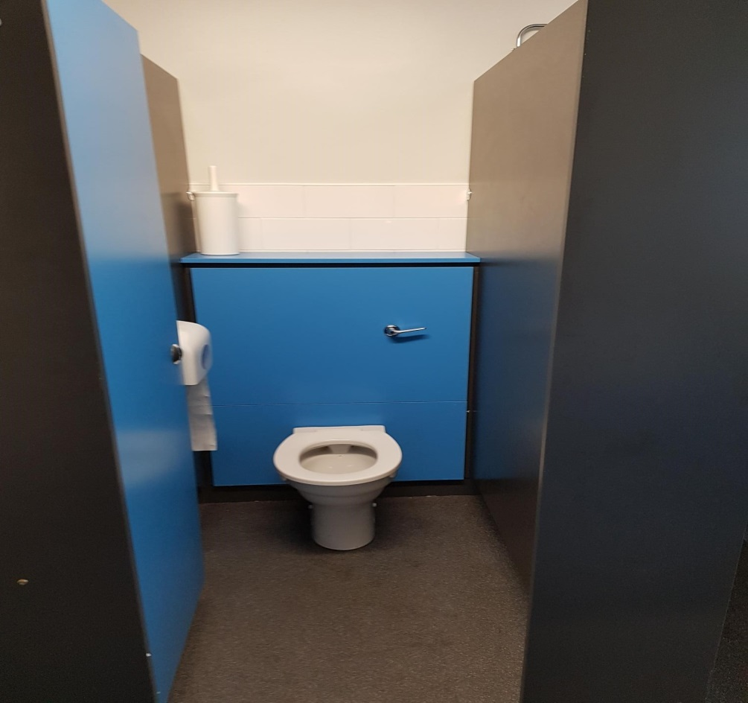
This is inside my P1-3 playground toilets.

Slide 11
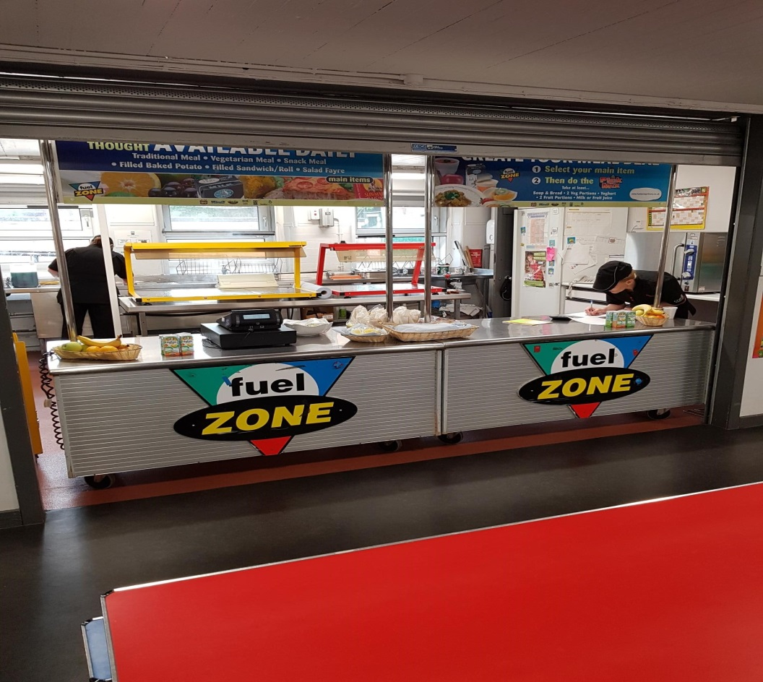
This is my dinner hall.

Slide 12
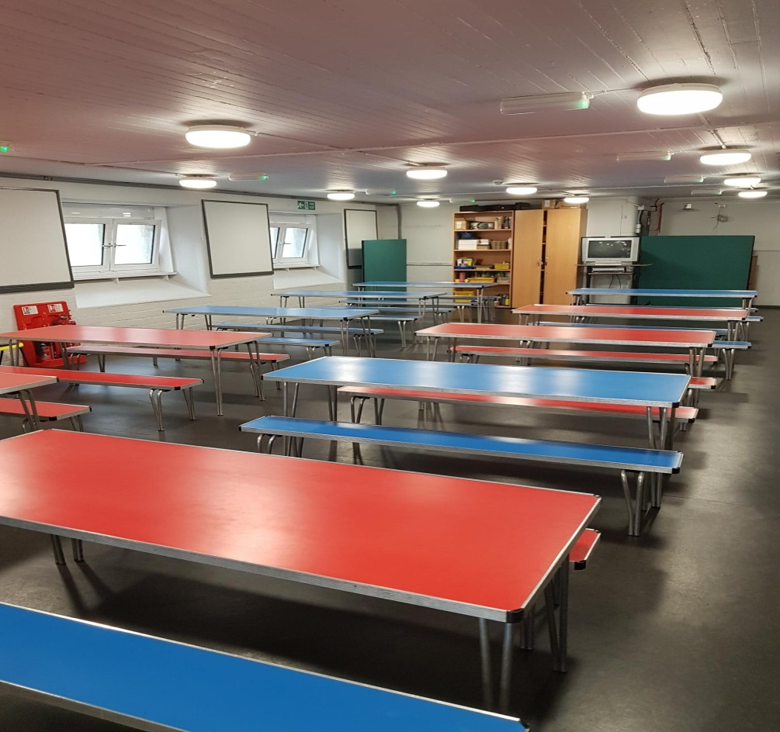
This is where I sit for lunch.

Slide 13
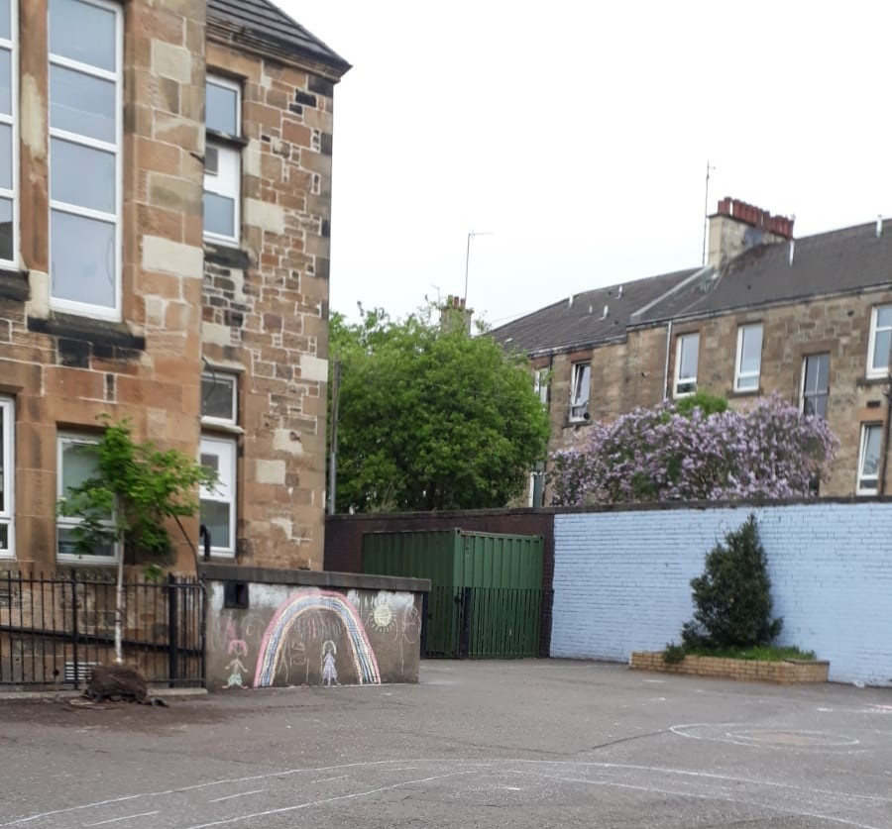
This is my P4-7 playground.

Slide 14
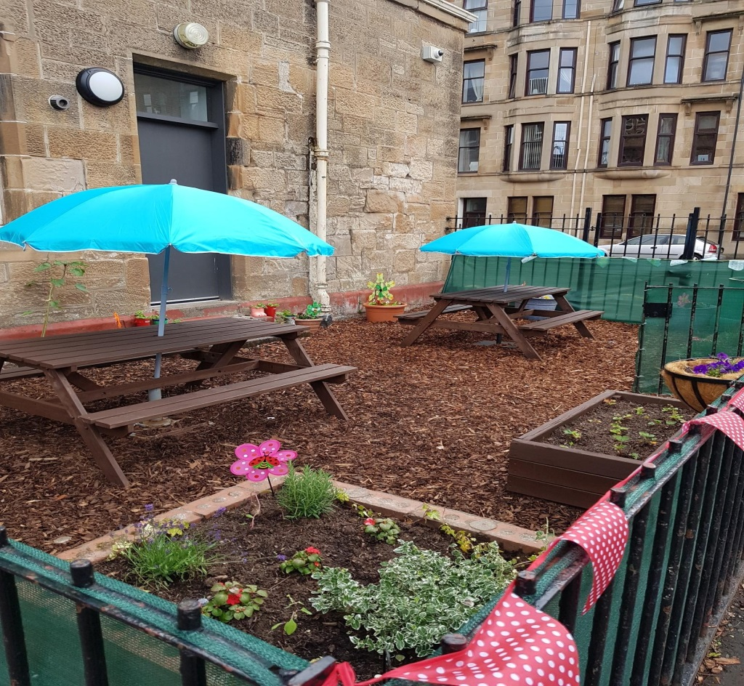
This is my school garden.

Slide 15
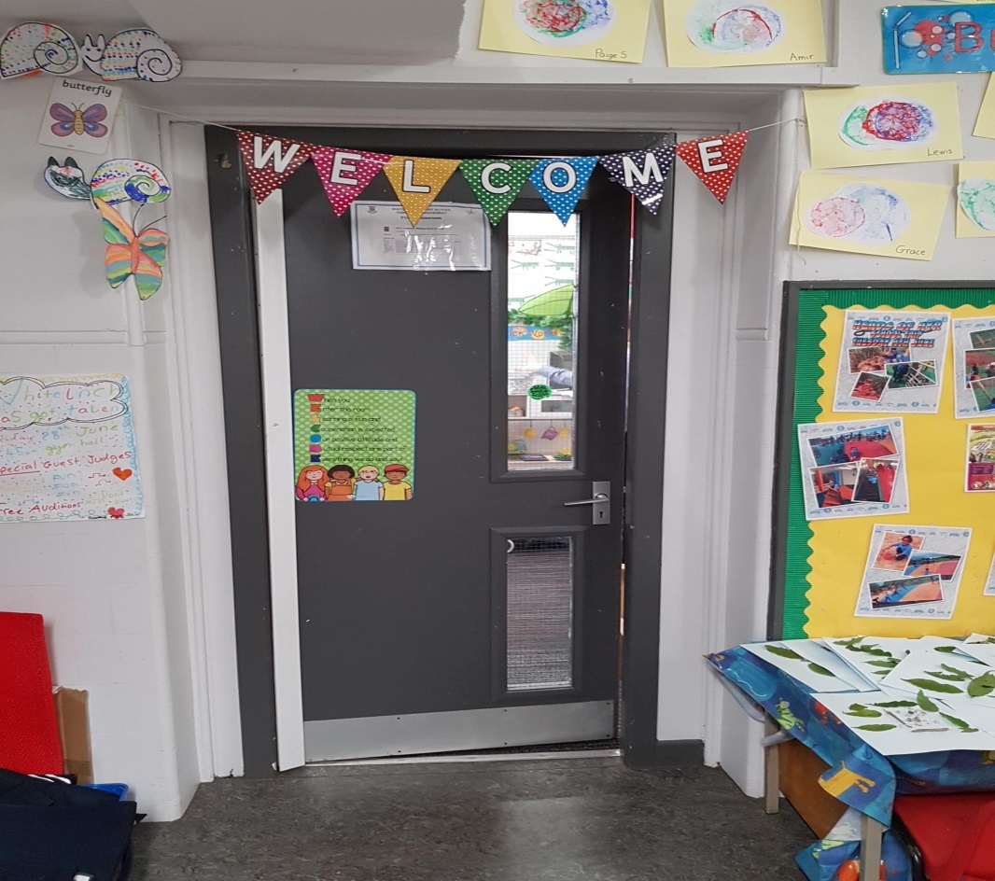
This is my
P1 classroom.

Slide 16
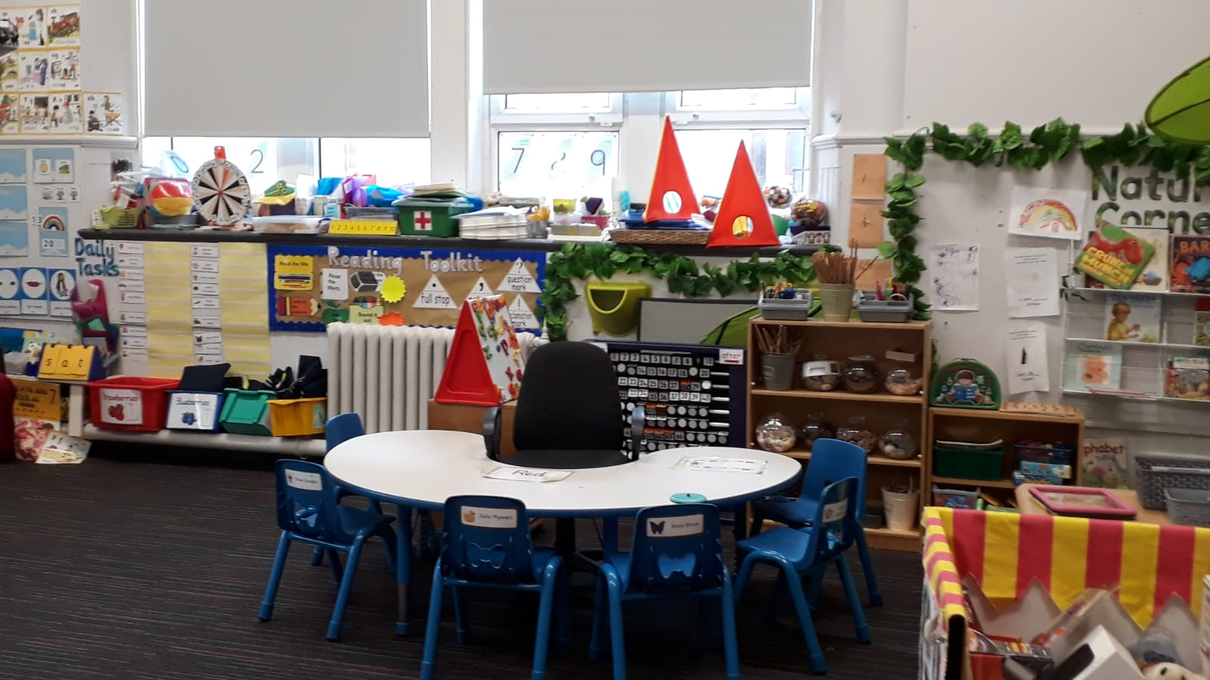
This is inside my P1 classroom.

Slide 17
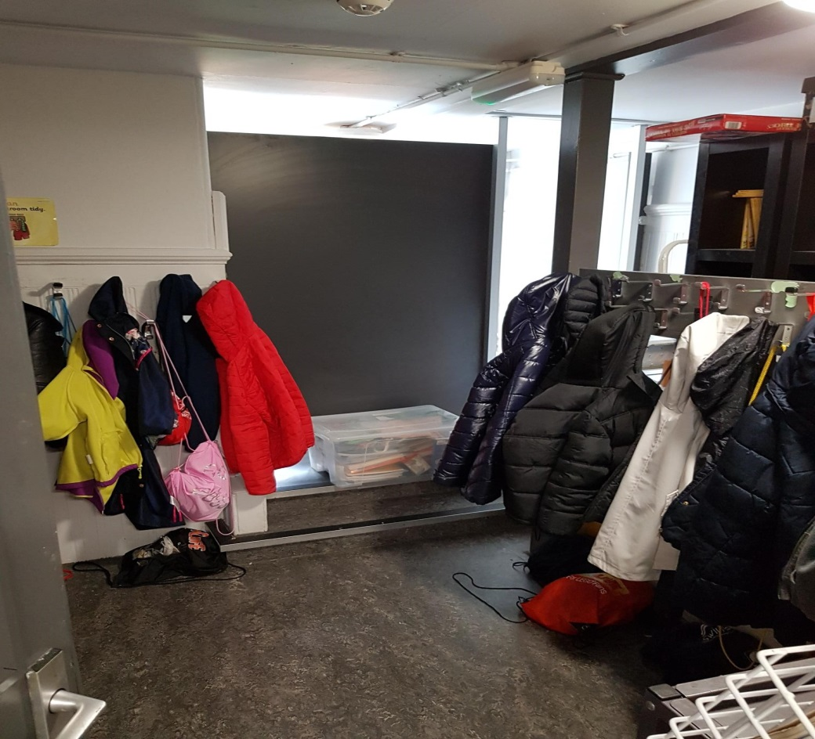
This is my P1 Cloakroom.

Slide 18
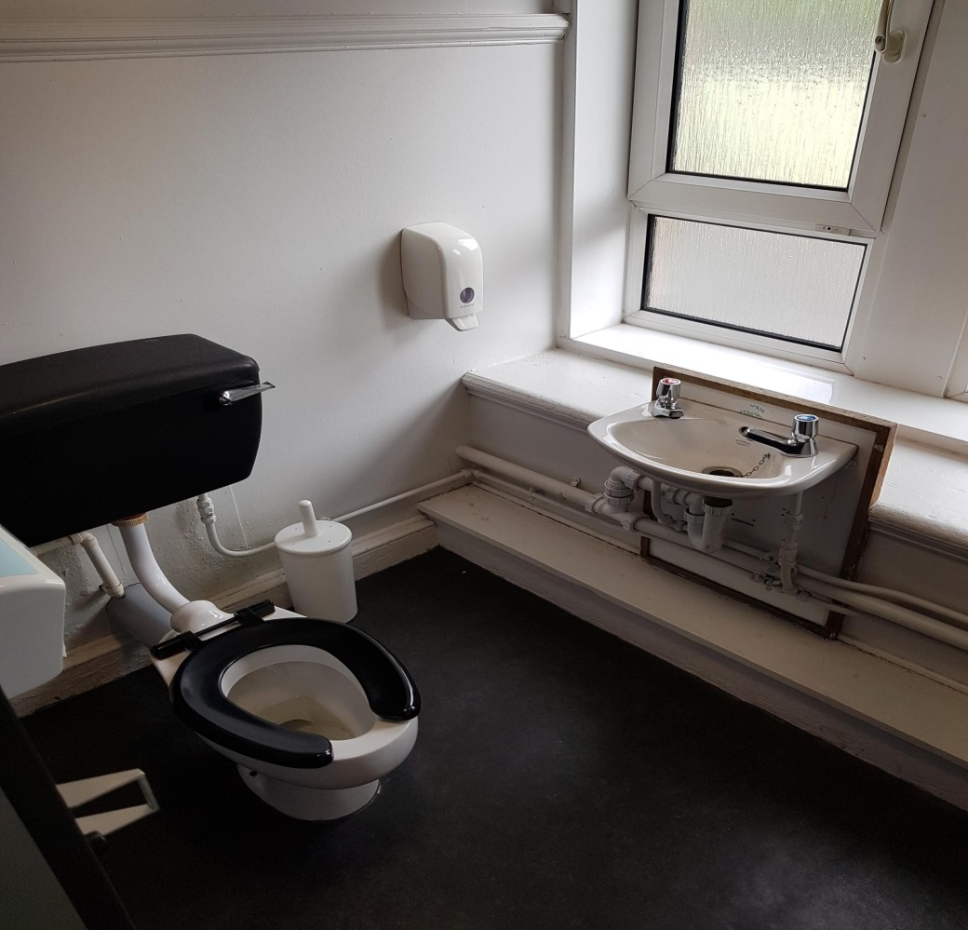
This is my P1 toilet.

Slide 19
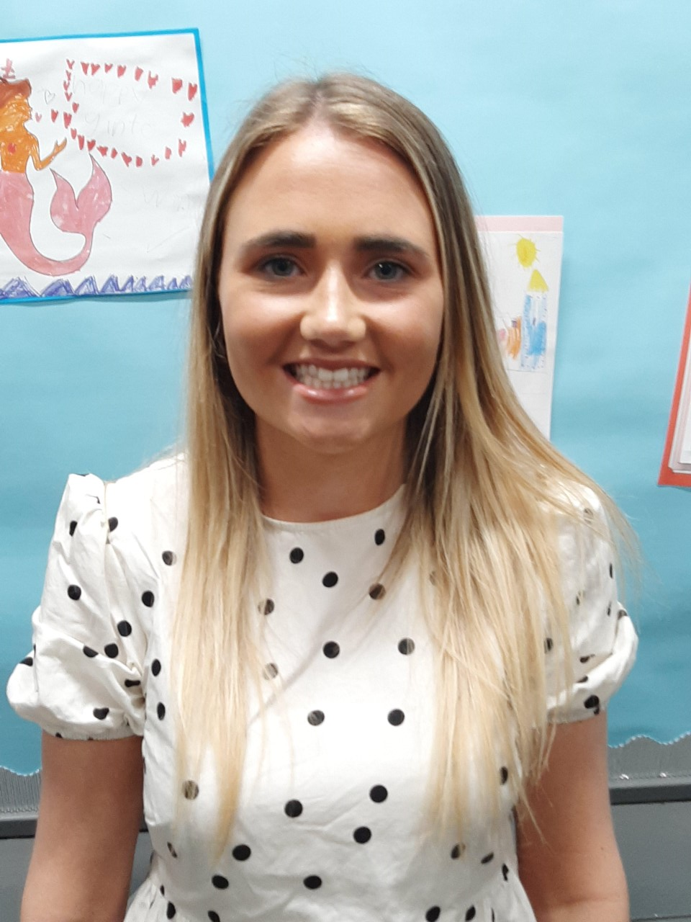
Miss MacDonald will be one of my Primary 1 teachers.

Slide 20
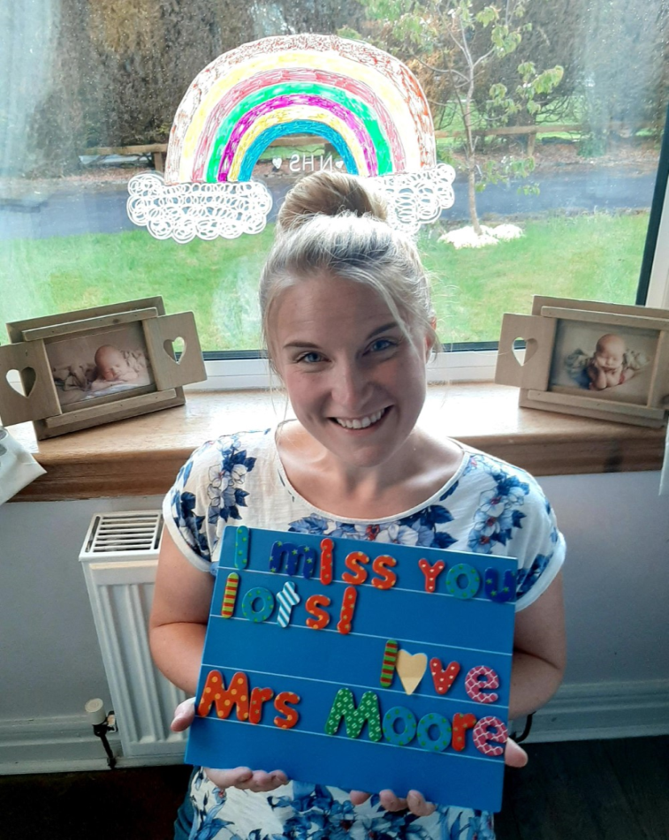
Mrs Moore might also teach me some days.

Slide 21
I will meet my P7
buddy soon.

Slide 22
In Primary 1 I will learn through a Play based approach.

Slide 23
All of the staff and pupils are excited to meet you soon.
A Great Place to Learn!

