Slide 2
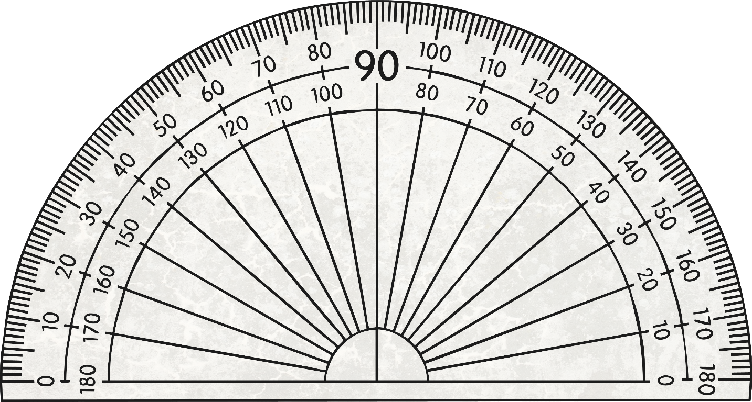
Right Angle
A right angle is 90⁰.

Slide 3
Acute Angle
An acute angle is less than 90⁰.

Slide 4
Obtuse Angle
An obtuse angle is more than 90⁰ and less than 180⁰.

Slide 5
Straight Angle
A straight angle is exactly 180⁰.

Slide 6
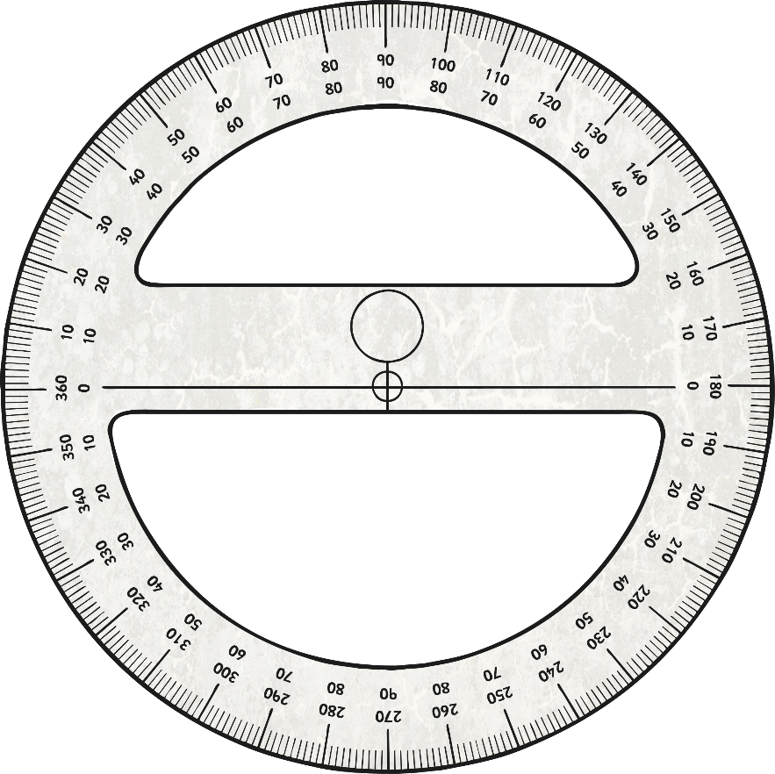
Reflex Angle
A reflex angle is greater than 180⁰ and less than 360⁰.

Slide 7
What kind of angle is this?
Right
Acute
Obtuse
Straight
Reflex

Slide 8
What kind of angle is this?
Right
Acute
Obtuse
Straight
Reflex

Slide 9
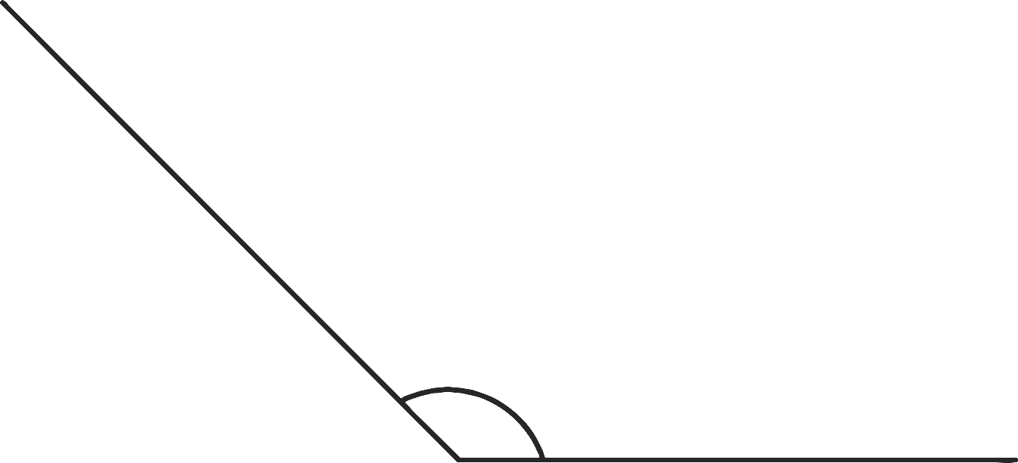
What kind of angle is this?
Right
Acute
Obtuse
Straight
Reflex

Slide 10
What kind of angle is this?
Right
Acute
Obtuse
Straight
Reflex

Slide 11
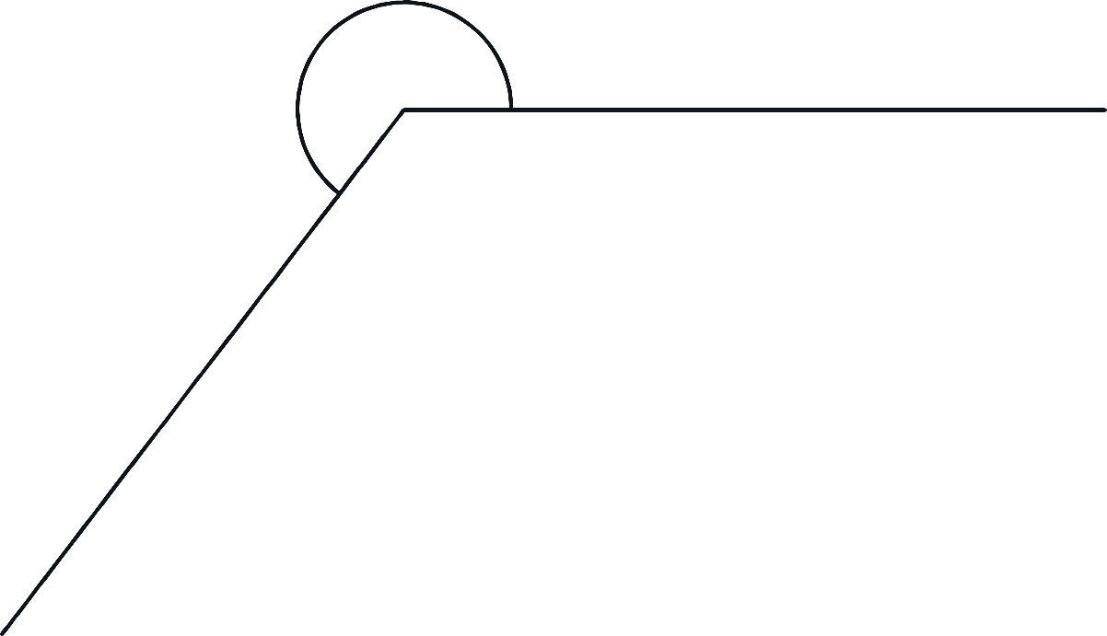
What kind of angle is this?
Right
Acute
Obtuse
Straight
Reflex

