Slide 1
Customer Service
Nat 4/5 Travel and Tourism

Slide 2
What is customer service?
Any contact with the customer
Face to face
Telephone
E-mail
Letter

Slide 3
Why is customer service important?
Many travel and tourism organisations state their aim is not just to meet customer expectations but to exceed them!
£££££ It costs 5X as much to attract a new customer as retain an existing one!!

Slide 4




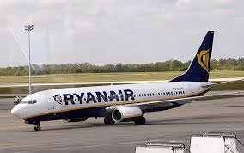
Why is customer service important? continued
“Excellent customer service is vital to give an organisation the edge over its rivals in this competitive industry”

Slide 5
THINK ABOUT IT
When did you last go shopping?
Where did you go?
Was it enjoyable?
If so why?
If not, why not?
Now complete Lesson 1 Activities

Slide 6
First Impressions
It takes customers just 10 seconds to form their first impressions
First impressions count!
Which statement makes the best impression?
A a queue of customers
B being served immediately
A customer greeted with a smile
B staff chatting, customer ignored

Slide 7
First Impressions
Which statement makes the best impression?
A Scruffy staff, chewing gum
B Well dressed staff, professional looking
A Clear, tidy desks
B Coke can and snack on desk
A Positive behaviour and body language
B Staff slouched over desks

Slide 8
Why so important?
Organisations need to ensure they retain their customers.
Staff must be aware of importance of making a good first impression
Personal presentation and non- verbal communications are important elements of a first impression.
In which scenario, is the rep most likely to be able to sell tours and activities?
Now complete lesson 2 activities

Slide 9
Good customer service behaviours
In a small group or pair, brainstorm as many words and phrases as you can to describe good customer service.
Do the same exercise for bad customer service.

Slide 10
What makes good customer service?
Which words/phrases did you think of:
Friendly
Attentive
Helpful, knowledgeable
Making customer feel good
Concerned
Patient
Efficient
Meeting needs every time
Exceeding the customer’s needs

Slide 11
Benefits of excellent customer service
Customers will keep returning to you (repeat business)
You will get more recommendations from satisfied customers
Better public image
You will have “the edge” over competition
Your sales will go up- more profit for company
Benefits to staff
Happier staff, happier managers
Better bonuses for staff/Reward system?
Increased job satisfaction
Better job security and chances of promotion

Slide 12
Poster task (lesson 4)
Refer to slide 11
Design an A4 sized poster that could be displayed in a staff room to remind staff about the benefits of excellent customer service
Plan in jotter first
Get plan checked
Make bright attractive poster. Best will be displayed in our “office”

Slide 13
Main types of communication
Face to face
Eg resort rep, travel agent, hotel receptionist
Telephone
Eg. Call centre worker, receptionist at attraction
Written
Eg Marketing assistant sending letters, e-mails, flyers

Slide 14
Effective communication
All communication contributes to overall image customer will have of a company
The design of a web site may attract customers to explore it further or look elsewhere for a holiday
If an e-mail has spelling errors, a customer will have a poor impression of service levels

Slide 15
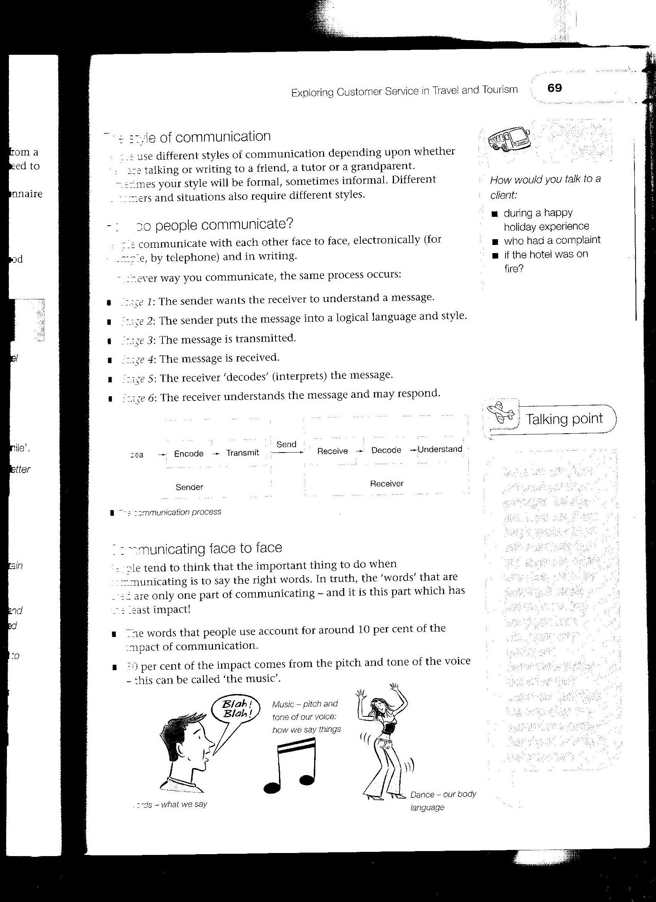
Communicating face to face
The words that people use account for only 10% of the impact of communication
30% comes for the tone or the pitch – this can be called the music or the vocal
The part which makes most impact -60%- is the body language!
Tone or vocal
Body language
words

Slide 16
Non- verbal communication
The importance of body language
This is all about the way we present ourselves to others and transmit messages, either intentionally or unintentionally.
Banging the table to make a point, making eye contact, shrugging our shoulders or creating a particular facial expression are all examples of body language.
Task: In pairs: Use a gesture (make sure it is appropriate for school!!) to express a feeling/emotion – ask partner to guess what you are showing.

Slide 17
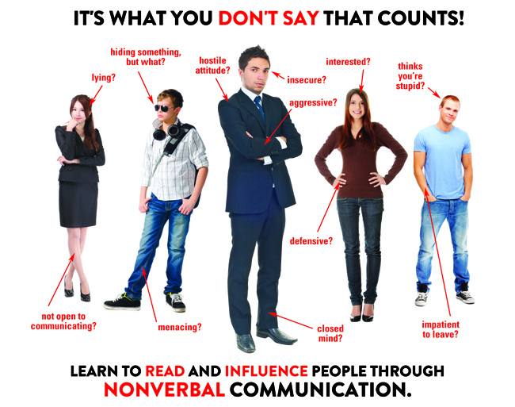

Slide 18


Positive and negative body language
Customers should be made to feel welcome from the first moment they meet a member of staff, who should always smile and greet the customer in a friendly and polite manner.

Slide 19


Positive and negative body language
Negative body language, such as crossed arms, lack of eye contact or a surly facial expression should be avoided at all times when dealing with customers in travel and tourism.
Complete lesson 5 tasks

Slide 20
Effective listening skills
How good are you at listening?
Do you interrupt when your friends are talking?
Do you interrupt?
Do you look away?
Do you think about something else?

Slide 21
Active listening
Face the speaker
Maintain eye contact (not staring though!)
Nod and smile when appropriate
Look for body language and tone of voice (to give more understanding)
Look interested or even concerned (if appropriate)
Demonstrate that you understand what is being said by making appropriate responses (Wow! Oh dear!)
Ask questions to check understanding (so, are you saying that he shouted at you...?)

Slide 22
Lesson 6 task
Pair up. Tell your partner about your day out in Largs or Millport (or another attraction visit, day out or holiday or even a holiday situation or problem)
As you listen, make sure you are doing so in an effective way. Get partner to complete a checklist and evaluate your skills.
(Use a copy of slide 21 – previous slide- and highlight as appropriate)

Slide 23
Visit Scotland Star Grading
VisitScotland uses a five-level star-grading system to indicate the standard of customer care and range of facilities on offer at assessed establishments.
The awards focus on the standard of the welcome, hospitality and service they provide, as well as presentation and the standard of toilets, shop or café if they have them. The number of stars awarded to a property indicate the levels visitors can expect of the establishment:

Slide 24
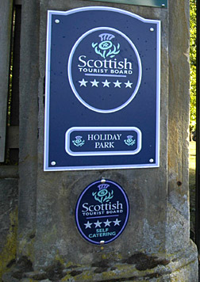
Star grading system
1 star: clean and tidy, a fair and acceptable, if basic, standard
2 stars: a good overall standard
3 stars: a very good standard
4 stars: an excellent standard
5 stars: an exceptional standard

Slide 25
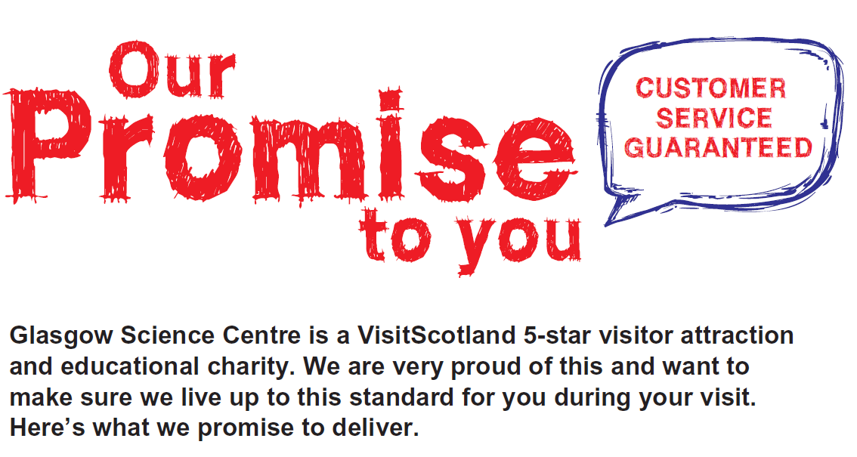

Slide 26
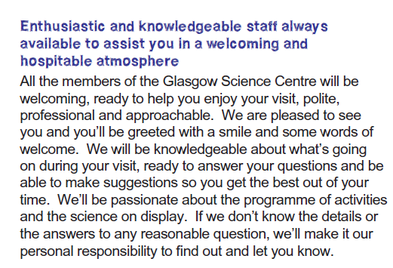
Extract from customer charter

