Slide 1
Trends in Tourism
Use the Visit Scotland web site to investigate different types of holidays in Scotland.

Slide 2
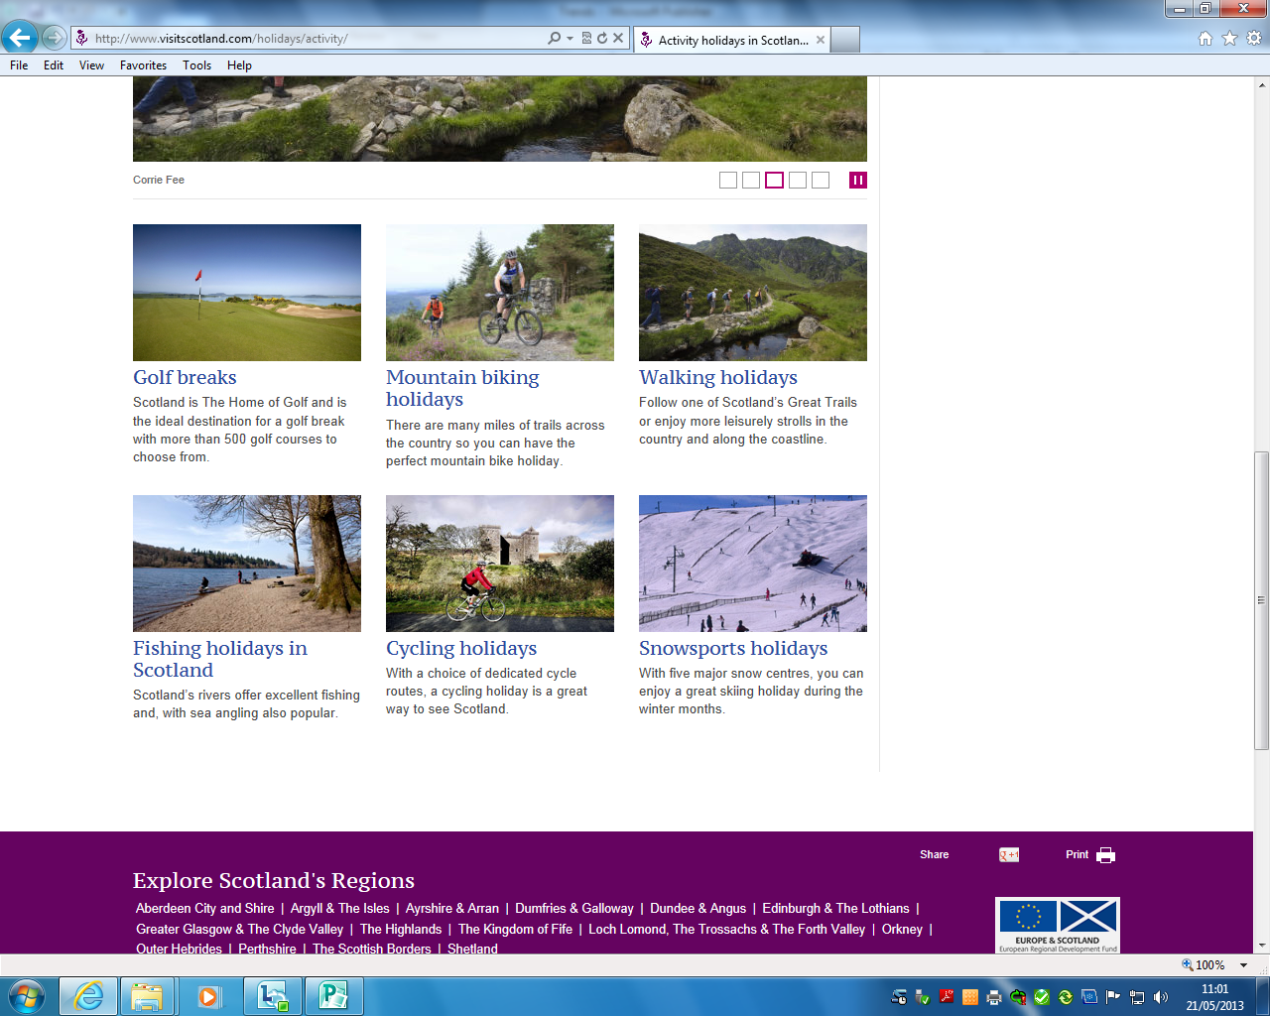
Activity Holidays
Can you provide at least one example of a destination in Scotland that could be used for each of the following activities

Slide 3
Mini Investigation
Can you create a powerpoint/ Prezi/ Brochure highlighting the attractions of a city break
You are using Scotland as your example so you have SEVEN to choose from
You can use Publisher/ Word/Powerpoint or if you prefer you can complete a written copy
Please avoid cutting and pasting from the internet
Make it YOUR PERSONAL RECOMMENDATIONS

