Slide 1


SENIOR PHASE INFORMATION EVENING
ST THOMAS AQUINAS SECONDARY SCHOOL
#beCLEAR

Slide 2

School prayer
As we come together as the family of St Thomas Aquinas Secondary, we pray and give thanks for our community. Lord, we ask that you encourage us to reach our goals. May you bless the work of staff and pupils and foster in us the will to live in the way the gospels have taught us each and every day.
Amen
St Thomas Aquinas- Pray for us
Notes:
As we come together as the family of St Thomas Aquinas Secondary, we pray and give thanks for our community. Lord, we ask that you encourage us to reach our goals. May you bless the work of staff and pupils and foster in us the will to live in the way the gospels have taught us each and every day.
Amen St Thomas Aquinas- Pray for us

Slide 3

S4
READY FOR THE CHALLENGE
ST THOMAS AQUINAS SECONDARY SCHOOL
#beCLEAR
Thursday 3rd September 2026 | 6pm
Year Head: Mr Young
Notes:
Good evening and welcome to our S4 Senior Phase Information evening. For those who don’t know me my name is Mr Young and I’m delighted to continue as Year Head for this group of young people following through from S3 and the end of the Broad General Education.
This evening I intend to share important information with you about what to expect as your child starts the Senior Phase at Saint Thomas Aquinas Secondary.

Slide 4
S4 Year Group
Time | Input | Presenter | Location
6.00pm | S4: Ready for the Challenge (Overview of the Year, Expectations, Key Dates) | Mr Young S4 Year Head | Social Area (seating)
6.10pm | SCQF Pathways From Level 3 to Level 7 other qualifications at STA | SCQF Staff Mrs Cohen & Mrs Morrison | Social Area (seating)
6.20pm | Study Skills How to access our Study Skills sessions on MS Teams | Mr Howe PT Raising Attainment | Social Area (seating)
6.30pm | Positive Pathways Key information and advice for post-school, including college, apprenticeships and UCAS information. | Jackie O’Hare SDS Careers Advisor Evonne McHendry SDS Careers Advisor Kathleen Cusick DYW Co-ordinator | Social Area (seating)
6.40pm | Parental Engagement Strengthening parental and family engagement and building positive partnerships between home and school. | Miss MacLure PT Parental Engagement | Social Area (seating)
6.50pm | Optional Drop-In for Pathways Queries Support for Learning, Pastoral Care, DYW and Careers Advisor | Various | Social Area (seating)
7.00pm | End of Event
ST THOMAS AQUINAS SECONDARY SCHOOL
#beCLEAR
Notes:
I am hugely grateful for your support thus far and for attending this evening.
We hope, that by working in partnership with you, our parents and carers, that your child will thrive in S4 as this year is so important in their learner journey.
This could be the last year at Saint Thomas Aquinas Secondary school for some of our young people and I have been keen to stress that at assemblies.
On the screen is the format of this evening.

Slide 5
STA: S4 ATTAINMENT
By the end of S4, no. of young people achieving:
5+ Award @ SCQF Level 3 | 20/21 | 21/22 | 22/23 | 23/24 | 24/25* | 25/26*
 | 98% | 95% | 99% | 93% | 89% | 97%
ST THOMAS AQUINAS SECONDARY SCHOOL
#beCLEAR
5+ Award @ SCQF Level 4 | 20/21 | 21/22 | 22/23 | 23/24 | 24/25* | 25/26*
 | 89% | 82% | 92% | 86% | 83% | 85%
5+ Awards @ SCQF Level 5 | 19/20 | 20/21 | 21/22 | 22/23 | 23/24 | 24/25*
 | 44% | 47% | 50% | 44% | 47% | 41%
*Not yet including SQCF Level 4/5/6 qualifications
Notes:
I would like to begin this evening by highlighting year group attainment from last year’s S4.
This data does not yet include Skills for Life or National Progression Awards or other qualifications that we deliver here at Saint Thomas Aquinas Secondary to meet the needs of our learners.
There is an element of competition between us year heads and I am determined that we will come out on top and beat last year’s attainment. Mrs McInally has tasked me with this year’s S4 achieving the highest and best attainment at first time of asking! Not pressure then. When chatting through with Miss Meehan the presentation – she said you know you want to give the parents some of your experience from school – but on second thoughts they probably wouldn’t understand that you wrote on slate! Appreciated and noted Miss Meehan.
Here at Saint Thomas Aquinas Secondary, we have high hopes for all our learners. We are always aspirational and strive to support all young people to maximise their attainment and achieve their potential.

Slide 6
POSITIVE DESTINATIONS
2025-26 | Total % Positive
STA | 99.5%
Scotland | 91%
ST THOMAS AQUINAS SECONDARY SCHOOL
#beCLEAR
3 Careers Advisors from Skills Development Scotland
1 Developing the Young Workforce Co-ordinator
1 Work Experience Co-ordinator
Monthly Positive Destination Meetings
Track young people for 12 months post-school
Notes:
Although most learners return to school for S5, some leave at the end of S4 or when they turn 16. We support these young people to find an appropriate pathway, such as college or an apprenticeship.
We work hard to ensure all learners move on to a positive and sustainable destination after leaving Saint Thomas Aquinas Secondary. As you can see, our current destination figures for recent leavers are very strong.
I currently have responsibility for work experience and encourage all pupils to take advantage of opportunities that enhance their experience and CV. Please encourage your child to look out for suitable opportunities, provided these do not affect school attendance or attainment. We hold monthly meetings to review the progression pathways of pupils planning to leave school. This allows us to provide appropriate support to those considering an alternative pathway.
Learners returning for S5 will receive advice on choosing the most appropriate subjects based on their S4 attainment. They will normally select their best five subjects from the seven studied in S4. We discourage pupils from “crashing” new subjects in S5 and recommend building on their existing knowledge and attainment. It is therefore essential that S4 learners perform to the best of their ability and achieve the strongest possible results when they first sit each subject at a particular level.

Slide 7

STA : FACTORS THAT LEAD TO HIGH ATTAINMENT
  High Expectations and Standards
  High Quality of Learning & Teaching
  Rigorous Monitoring and Tracking of pupil Progress
  Student Support Programme
ST THOMAS AQUINAS SECONDARY SCHOOL
#beCLEAR
Notes:
As you know, positive attainment figures are because of high expectations and standards across the school. We appreciate the support that you as parents and carers give us! As year head of S4, I have very high expectations of your child.
The teachers of Saint Thomas Aquinas work extremely hard and go above and beyond to deliver high-quality learning and teaching to support your child to achieve their potential. We track and monitor progress closely and will communicate your child’s progress through 3 reports (October which is post Autumn assessments; January which is post interim assessments and March with your child’s estimate grade for each qualification they are sitting). We also have two progress and achievement meetings which offers an opportunity to communicate your child’s progress and what they need to do to improve. Finally, we have a very strong student support programme which we feel helps our learners when the pressure is really on when sitting National Qualifications.

Slide 8

S4 STANDARDS AND EXPECTATIONS
Attendance & timekeeping
Effort
Attitude
Behaviour
Uniform
Preparation
ST THOMAS AQUINAS SECONDARY SCHOOL
#beCLEAR
Notes:
Now that your child is in S4, our expectations of them have increased. They are regarded as senior pupils who will set an excellent example for our younger learners. The increased expectations we have include all the things on the screen.
We know that attendance impacts attainment. If your child is not in class due to late coming or non-attendance, then they are not learning which will impact their attainment. Furthermore, they will be under increased pressure to catch up with any work missed due to absence. Your support to ensure that your child is in school and on time is gratefully appreciated. In class, we want your child to be active participants and to be fully focused. We know that mobile phones are a huge distraction and can affect your child’s focus and concentration. If your child brings their iPad to school, they will have no need to use their phones during class time. We would really appreciate your support with this.
Furthermore, your child is expected to come to school fully prepared with a charged iPad, homework planner and any books they need for the classes they attend.

Slide 9

S4 STANDARDS AND EXPECTATIONS
Student Support Programme
PT Raising Attainment
Supported Study
Metacognition and Study Skills
Targeted HWB groups (e.g. Coping with Exam Stress Workshops)
Easter School
Pastoral Care Support
Year Head
ST THOMAS AQUINAS SECONDARY SCHOOL
#beCLEAR
Notes:
We are very fortunate to have a brilliant student support programme. Our Pastoral Care PTs are proactive in dealing with any emerging concerns and communicating with you.
Our staff are great at volunteering their own time to run supported study classes – not an entitlement nor a replacement for classes – outwith the formal supported study diet.
We also offer a one-to-one mentoring programme, and Easter school revision classes.
We also deliver study skills workshops during PSE and offer Health & wellbeing groups to help and support pupils to cope with exam stress.
Following tracking reports, we use a variety of interventions for pupils who require additional help and support to keep them on track. These are carried out by your child’s PSE teacher, Pastoral care teacher or me, their year head.
It’s not often we get something for free – but this is – so please take it.

Slide 10

SUPPORTING YOUR CHILD
Study environment (space, materials and distractions)
Time management & study planner
Attendance & timekeeping
Hard-work and effort
Prepared to learn
Homework &
assessment deadlines
Support STA’s high
expectations & standards
ST THOMAS AQUINAS SECONDARY SCHOOL
#beCLEAR
Notes:
We have a diverse audience tonight in relation to some will be in or delivering education, this might be your first child or your 4th child going through the senior phase. Regardless as a parent/ carer, there are some key ways in which you can support your child at home during the year ahead.
Ensuring your child has somewhere quiet to complete home learning and to study is key. As I have already said, mobile phones can be a huge distraction. Muting notifications and snap chat messages can certainly help – the best solution would be to not to have their phone with them when studying,
We will offer advice through PSE about time management and using a study planner. Helping your child to produce a study planner to ensure they focus on all subjects, not just on their favourite or best subjects is a way to support your them.

Slide 11


WORKING IN PARTNERSHIP
ST THOMAS AQUINAS SECONDARY SCHOOL
#beCLEAR
Notes:
We know that the year ahead will be challenging and pressurised for your child – and for you as parents and carers!
We know it is important to instil resilience in our young people.
We are very keen to work closely with you in partnership to support our young people during the year ahead, to build that resilience and to ensure they achieve the qualifications which they deserve this year.

Slide 12



S4 NATIONAL QUALIFICATIONS
SCQF Level 3
Internal Unit Assessments
Graded Pass or Fail
SCQF Level 4
Internal Unit Assessments including an Added Value Unit (AVU)
Graded Pass or Fail
SCQF Level 5
Exam and Assignments/ Performances etc
Graded A-D
ST THOMAS AQUINAS SECONDARY SCHOOL
#beCLEAR
Notes:
In case you are unaware, the Qualifications Scotland National qualifications we deliver in S4 are mainly National 3, National 4 and National 5 qualifications.
National 3 and National 4 qualifications are internally assessed – and Qualifications Scotland verify the assessment evidence to ensure we uphold national standards- and these qualifications are graded as a pass or a fail.
Learners must pass each unit to achieve the full qualification.
National 5 is the most challenging of these three national qualifications. Learners sit the course assessment during the Qualifications Scotland exam diet and may also be required to complete assignments or performances depending on the subject. National 5 qualifications are graded A-D.
Achieving a National 5 pass may lead to sitting the Higher qualification in S5.

Slide 13
S4 NATIONAL QUALIFICATIONS
Presentation levels depend on BGE attainment evidence
Levels communicated in tracking reports
Levels may change
Aspirational and realistic
Other qualifications & pathways
Final presentation levels and attainment will impact choices in S5
ST THOMAS AQUINAS SECONDARY SCHOOL
#beCLEAR
Notes:
The level at which your child is presented for a qualification in S4 depends on their attainment and evidence gathered in the Broad General Education. Your child’s levels will be communicated through tracking reports and at progress and achievement evenings. Please be aware that presentation levels may change depending on how well your child copes with the level of challenge and difficulty of a certain course. We strive to be aspirational for what your child can achieve but we are also aware of the importance of being realistic in terms of ability and the likelihood of a learner successfully achieving a qualification. Please be assured that we would never want to set a learner up to fail so a change in level or the recommendation to specialise in another pathway is intended to ensure each child successfully achieves appropriate qualifications. Mrs Cohen and Mrs Stewart will give you more information on other qualifications and pathways available at Saint Thomas Aquinas shortly as they are the experts. What learners achieve in S4 will influence their progression pathways and subject choices in S5 and S6. It can also influence their destination pathway when they leave school.
For this reason, we strongly encourage all learners to achieve the best set of results the first time of asking.

Slide 14
S4 NATIONAL QUALIFICATIONS
Increase in candidate malpractice
Use of AI
Thorough investigation - final decision made by SQA
Support to monitor this at home
ST THOMAS AQUINAS SECONDARY SCHOOL
#beCLEAR
Notes:
Qualification Scotland have highlighted that there was a notable increase in candidate malpractice in May’s exam diet. Many of the malpractice investigations were due to the use of AI by candidates claiming to have produced their own work.
Candidate malpractice results in a thorough investigation being carried out and Qualifications Scotland make the final decision regarding the qualifications a candidate can or cannot achieve depending on the outcome.
We would ask you to please try to monitor this at home. We understand the many benefits of AI but Qualifications Scotland are clear about its use in National qualifications. Further information is shared through the learners’ ‘My Qualifications’ information which also includes information about coursework and assignments – the link to which is included in your information pack.

Slide 15
KEY DATES TERM 1
MONTH | ACTIVITY
August - October | Class tests On-going assessments Senior Phase Information Evening Positive Destinations Evening S4 Tracking Opens S4 Tracking Issued
ST THOMAS AQUINAS SECONDARY SCHOOL
#beCLEAR
Notes:
I would now like to highlight some key dates with you.
In term 1, between August to October, all pupils will sit class tests and assessments in each of their subjects.
Following on from that there will be a Positive Destinations Evening on the 22nd of September 2026. Please try your best to come along to this evening as it has proven very successful and influential for pupils in the past.
Pupils will be tracked with regards to behaviour, effort and homework and if they have been on track or not on track in each subject at their current level and this will be shared with you.

Slide 16
KEY DATES TERM 2
MONTH | ACTIVITY
November - December | S4 Progress and Achievement Evening 1 (12.11.26) Interim Assessments
ST THOMAS AQUINAS SECONDARY SCHOOL
#beCLEAR
Notes:
Term 2 is from October to December.
You will be able to discuss reports, tracking and your child’s progress at our S4 Progress and Achievement evening on the 12th of November.
Interim assessments will take place in December. This will be an opportunity for teachers to gather evidence in each subject about a pupil’s progress and to ensure each child is sitting at the right level. It also helps to identify areas of strength and areas which the pupil needs to focus on to successfully achieve the qualification.

Slide 17
KEY DATES TERM 3
MONTH | ACTIVITY
January - March | Class tests On-going assessments Staff Moderation of Interim Assessments Interim Assessment Results (21.01.26) S4 Progress & Achievement Evening 2 (28.01.26) Post-Interim Assessment Interventions Additional Assessment Arrangements Supported Study S4 Tracking (including estimates) opens (08.03.27) S4 Tracking (including estimates) issued Final SQA Presentation levels and Estimates
ST THOMAS AQUINAS SECONDARY SCHOOL
#beCLEAR
Notes:
Term 3 is from January to March - very much the busiest – so much so that teachers call it ‘mad March’.
During this term, pupils will be issued with results from their December Interim Assessments.
Intervention interviews with class teachers, Principal teachers of subjects, pastoral care teachers and deputy head teachers will take place with pupils who are not on track. The purpose of these interventions is to ensure that your child receives appropriate support if they are underperforming in certain subjects.
Presentation levels will be finalised depending on a pupil’s progress and the evidence gathered.
Meetings about Assessment Arrangements requests will take place. Mrs Quinn and Mrs Cassidy work extremely hard to ensure every child who is entitled to additional assessment arrangements gets the support they need. Further information about Assessment Arrangements can be found on parental information leaflets issued this evening.
It is a busy term for learners who will continue to produce evidence and complete assignments which will be submitted to Qualifications Scotland.
Your child will receive a final tracking letter indicating their estimate grade and final presentation level in March.

Slide 18
KEY DATES TERM 4
MONTH | ACTIVITY
April - June | Easter School SQA Exam Diet begins (26.04.27) SQA Exam Diet ends (03.06.27) S5 Induction day (1.6.26) SQA Results Day 10.08.26
ST THOMAS AQUINAS SECONDARY SCHOOL
#beCLEAR
Notes:
The SQA exams will begin on the 26th of April 2027 and they will end on the 3rd June 2027.
For those pupils who wish to return for S5, there will be an induction day at the start of June.
The SQA results will be issued to all candidates on the 10th of August 2027.
Please ensure your child signs up to Qualifications Scotland so they can receive their results by text. This also allows them to check that their information held by Qualifications Scotland, such as their address, is accurate so that their Qualifications Scotland certificate can be posted to the correct address with the correct information.
I hope that following all the hard work and effort which your child – and you – puts into the year ahead, that they will be happy and proud of those results on the 10th of August.

Slide 19


INFORMATION SHARING
All presentations and resources will be available on our school website
You should have a hard copy of the key dates/ FAQs document
Digital copy of Key Dates/ FAQs document emailed to you
ST THOMAS AQUINAS SECONDARY SCHOOL
#beCLEAR
Notes:
I hope you find the information this evening useful.
All presentations will be available on our website and please take a copy of our information pack.
A digital copy will be emailed to all S4 parents and carers.
Finally, if you would like to about your child’s pathway staff will e available here in the Social Area.
If you need to speak to your child’s pastoral care teacher about anything else, please follow the usual procedures by going through the school office.
I will now pass you over to Mrs Cohen and Mrs Morrison for the next part of the evening.

Slide 20

Pathways at STA
Senior Phase Information Evening
GO!

Slide 21
SCQF!
The Scottish and Credit Qualifications Framework.
Helps us to measure the value of all of our qualifications.

Slide 22
SCQF Information
Language
Credit Points
Positive
Destinations
Nat 4 = SCQF level 4
Nat 5 = SCQF level 5
Higher = SCQF level 6
Advanced Higher = SCQF level 7
1 credit point per ten hours of learning
All credit points go towards our learner’s futures.

Slide 23
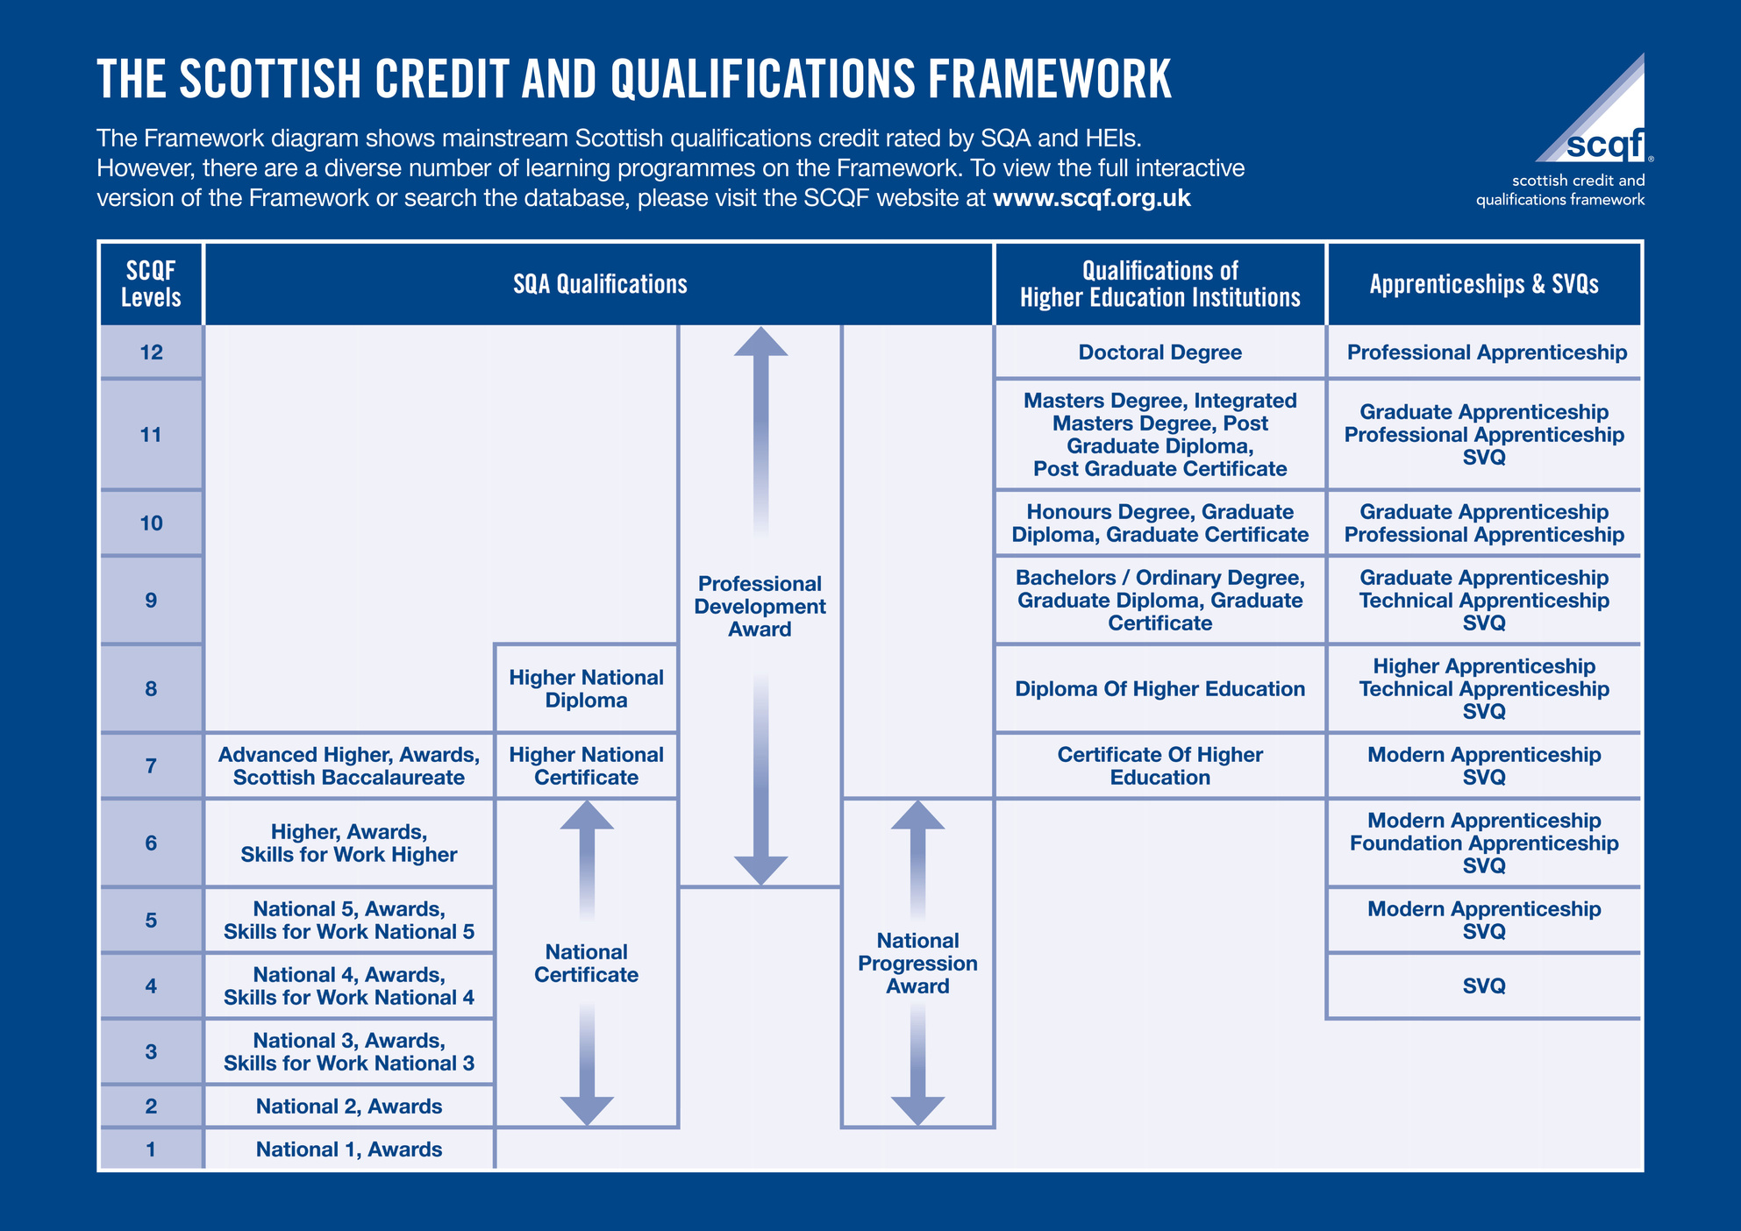

Slide 24
NPAs
Level 4, 5 and 6
Areas of specialism
Skills based
Real life experience
No external assessment in May
Same credit points as NQ

Slide 25
SCQF at STA
Marketing
Health & Wellbeing
Scottish Studies
Early Learning Childcare
Creative Industries & Event Planning
Lab Science
Sports Development & Leadership
Business & IT
Skills for Work Hospitality
Skills for Life & Work
Cyber Security
Creative Thinking
Personal Development
Criminology
Health Sector Skills
Digital Media
Web Design
Events Management

Slide 26
A significant cultural shift is needed to support young people's diverse talents and learning pathways.
We as educators must recognise that academic and vocational education are not separate worlds but that all young people need a blend of both to become fully educated citizens.
—Prof. Louise Hayward

Slide 27
Goals for STA
01
02
03
Parental Engagement
Learner Engagement
Sharing updates with parents and carers about the pathways we offer.
Educating our learners about their choices and making sure they feel supported to take the right path for them.
Growth
Equal Value
Our goal is to grow our Senior Phase pathways across the curriculum.
Ensuring that vocational and academic qualifications are viewed equally.

Slide 28
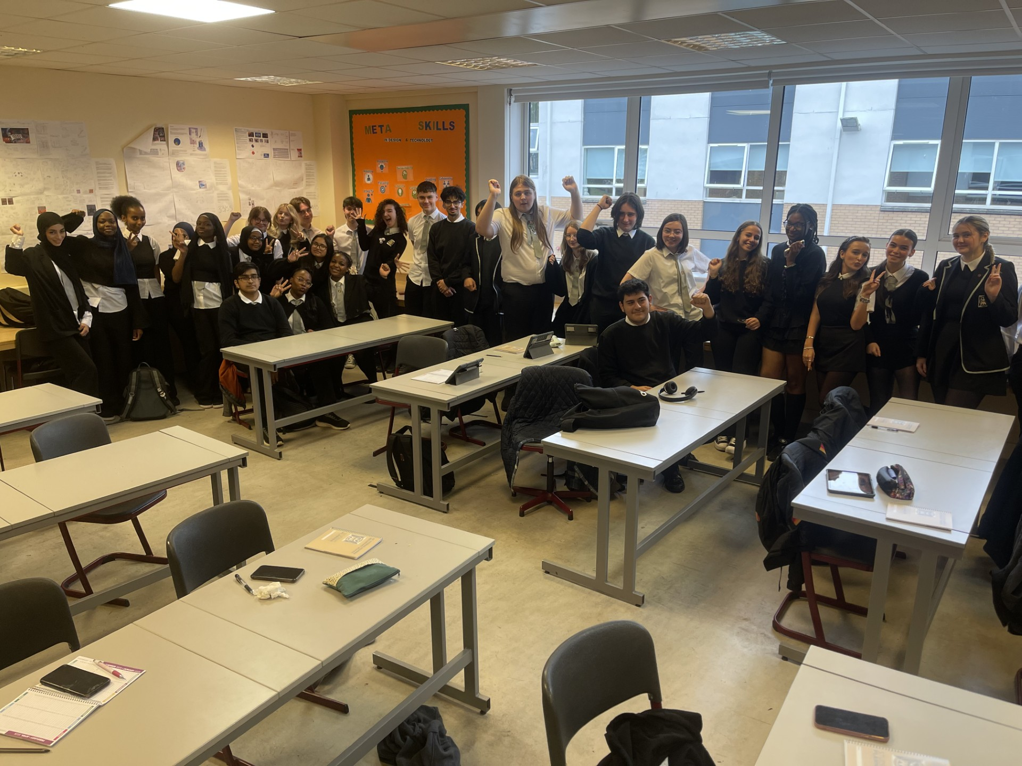
SCQF Ambassador Team
01
02
03

Slide 29
SCQF Ambassador Role
  THEIR MISSION: Help parents, carers, employers and fellow pupils to better understand qualifications and their value!
  The ambassadors will be at school events going forward with information to share with pupils and parents from S1 – S6.
  When you see them, go and speak to them and ask them any questions you may have!

Slide 30

Thanks for listening
01
02
@StThomasAquinasSec
@SCQFPartnership
03

Slide 31

Study Skills And Effective Habits
PT Raising Attainment
Gary Howe
Teacher of modern studies, history & criminology

Slide 32
Tonight’s Session
Stepping up a gear as we enter a new year group
Online sessions for study skills+
Science of Learning
Supported Study
Raising Attainment Resources

Slide 33
Stepping up to S4
At least 2 hours per subject per week
Success in S3 exams is no guarantee of success in S4.
N5 Modern Studies Case Study, 2025/26 cohort:
66 pupils in the cohort
76% passed the S3 exam (24% failed)
32% became N4
4% sat the N5 exam but did not pass
So, 36% of the cohort did not achieve N5
What did the successful pupils do?

Slide 34
Step and match the challenge (N5→Higher)
Progression Tables are data made by the SQA which show progression from N4 to N5; N5 to Higher; Higher to Adv Higher within a subject.
E.g. What do pupils that get a B at N5 English go on to get at Higher?
30% (7% + 23%) go on to get a B or better at Higher, 70% do worse...
Success at N5 is no guarantee of success at Higher. Higher is considerably harder.
How did the 30% who matched or bettered their N5 result do it?
 | English
 | Percentage of Learners Gaining Higher
National 5 in 2023 | Result | A | B | C | D | No Award
 | A | 48% | 30% | 16% | 5% | 1%
 | B | 7% | 23% | 34% | 26% | 9%
 | C | 1% | 7% | 21% | 37% | 33%
 | D | 1% | 4% | 12% | 29% | 54%
Notes:
Progression data for all subjects here - https://www.sqa.org.uk/sqa/91419.html
2018-19 data is the most recent due to lockdown. What can pupils do… growth mindset… get organised… use effective strategies – flashcards/past papers… go to supported study… That is what it takes to have positive progression.

Slide 35
N4 to N5 is an even bigger challenge
 | Percentage of Learners Gaining National 5
Qualification | A | B | C | D | No Award
Application of Mathematics | 5% | 9% | 16% | 21% | 48%
Biology | 4% | 6% | 15% | 30% | 45%
Chemistry | 10% | 10% | 21% | 24% | 35%
English | 9% | 21% | 31% | 23% | 16%
English for Speakers of Other Languages | 10% | 25% | 21% | 25% | 19%
Geography | 6% | 11% | 18% | 27% | 38%
Graphic Communication | 2% | 5% | 21% | 27% | 46%
History | 4% | 9% | 14% | 21% | 52%
Mathematics | 11% | 13% | 15% | 18% | 43%
Modern Studies | 5% | 10% | 19% | 25% | 41%
Physics | 5% | 11% | 23% | 23% | 38%

Slide 36
Science of Learning
Multi-store model of memory
Fighting forgetting by spacing reminders
Top 3 retrieval strategies to close gaps in knowledge

Slide 37
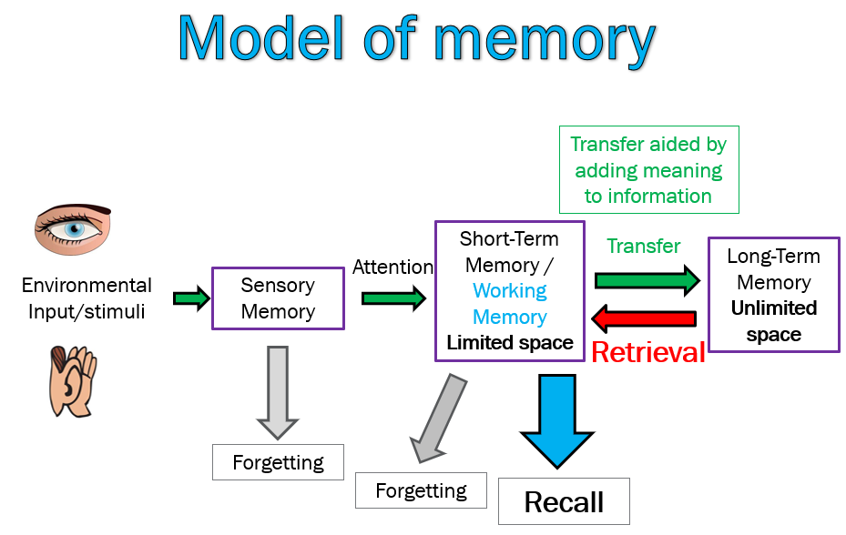
Notes:
Talk about cognitive load theory

Slide 38
The Forgetting curve in action
Look carefully at the 10 words
Apple
Chair
River
Library
Haggis
Amber
Mountain
Window
Tartan
Candle

Slide 39
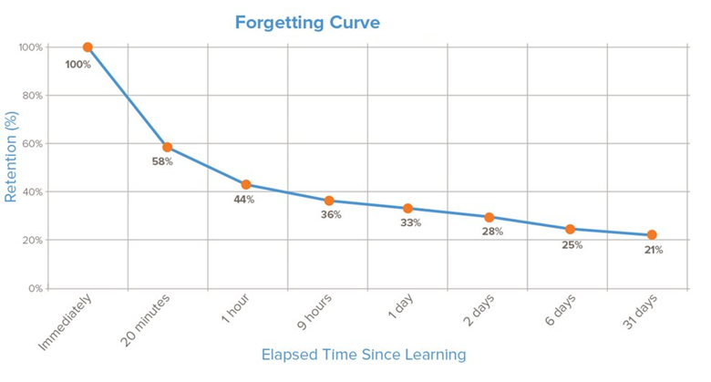
Forgetting

Slide 40
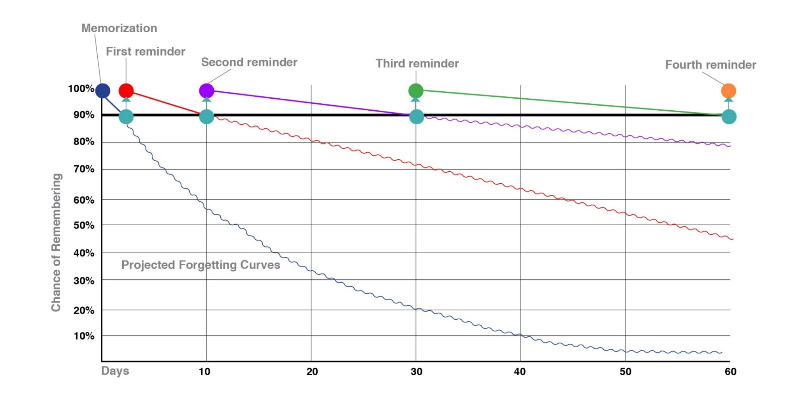
Fighting against forgetting

Slide 41
Recall time
Now Recall the 10 words that were shown a few slides back.
Debrief
What we would expect is most people will remember most of the words, but not all.
Usually recall is better for first and last words.
This shows how memory naturally fades quickly without reinforcement.
Forgetting is normal – but practice fights forgetting.

Slide 42
What is Retrieval Practice?
Quizzing - by going into your long term memory to retrieve information and bringing it into your working memory to answer questions/problem solve/perform.
It is vital that quizzing is done without notes.
This makes studying more stimulating, more effective but more challenging.
Challenge is part of learning.

Slide 43
Top 3 Retrieval Practice Strategies
Do QS past paper questions
Flashcards
Brain-dumps A.K.A. Free Recall

Slide 44
Practical takeaways
Encourage recall, not just rereading
Ask "Tell me what you learned today" rather than "Did you revise?"
Promote short, regular study blocks instead of last-minute marathons
25 Mins study & 5 mins break
Most people's optimal focus window is 30-50 mins before attention and recall start dropping.
Support Routines
Same time/place for study helps habits stick.

Slide 45
Supported Study Programme
Extremely important intervention!
Attendance is monitored
Pupils must explain to their class teacher if they cannot attend supported study, attending is expected.

Slide 46
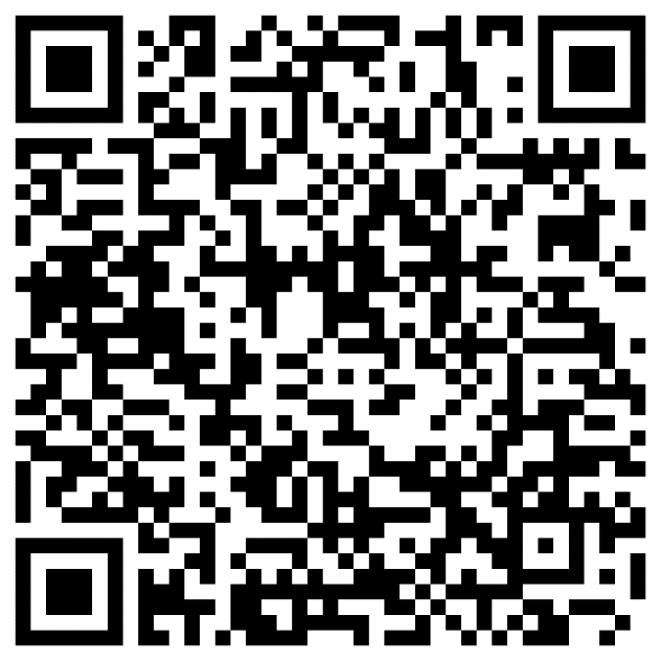
Resources
Where? You can find these resources on the ‘STA Pupil Site’ on OneDrive.
What resources?
Template study plan
PSE lessons
PowerPoints from study skills sessions
Supported Study Timetables (when available)

Slide 47
Challenge
As well as asking 'Do you have homework?’
Ask 'Show me what you remember from class today'

Slide 48
Senior Phase Information Evening 2026
Careers Advisers
Jackie O’Hare
Evonne McHendry

Slide 49
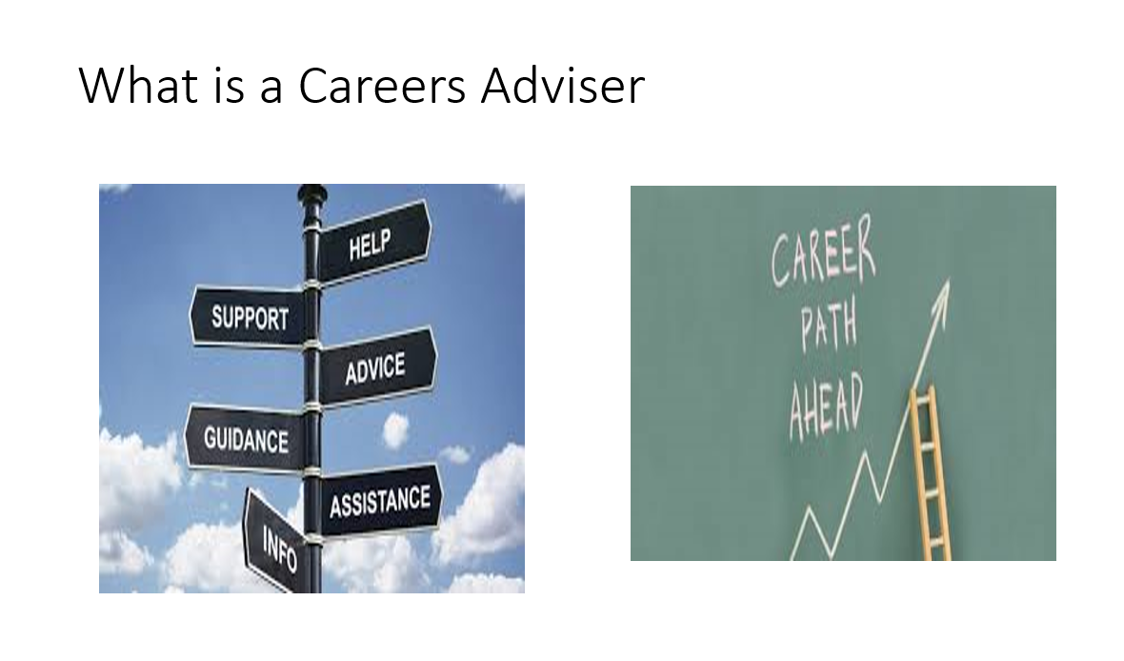
Notes:
49

Slide 50



CHOICE

Slide 51

Career Management Skills

Slide 52

Routes & Pathways
University
Apply for
a Modern
Apprenticeship
Apply for
Further Education
Return to school/
Plan for University/
Senior Phase Opportunities
Employment/
Training for Work

Slide 53
06.08.26
UCAS Support
05.08.26
LNAT Support
05.08.26
UCAT Support
Oct. 2026
College Support
College Support
College Support
Apr. 2027
Modern Apprenticeship
Jan. 2027
Dec. 2026
Notes:
As Careers Advisers we are based here in school every day to support and help students, however we also offer additional support during main transitional times, i.e summer holidays – we offer workshops to support pupils who are thinking about applying to university, looking at completing UCAS applications down to what information should be included within personal statements
During the October break we offer support for anyone thinking of going to college, again supporting them to identify suitable courses and writing PS, support applications. This is a very competitive pathway which opens in Jan so being prepared to submit applications is crucial. We also encourage those who are unsure about leaving school to submit application as this then gives options of choice for the end of the school year
During Easter we offer the same support for anyone who is interested in apply for Graduate or Modern Apprenticeships.

Slide 54


Get in touch!
Jackie O’Hare
Careers Adviser
0141 468 7089
Jacqueline.ohare@sds.co.uk
Evonne McHendry
Careers Adviser
0141 468 6886
Evonne.mchendry@sds.co.uk

Slide 55

Anna Maclure
PT parental engagement
August 2026

Slide 56
Anna Maclure – PT Parental Engagement
Teacher of Social Subjects
Principal Teacher of Parental Engagement

Slide 57


Slide 58
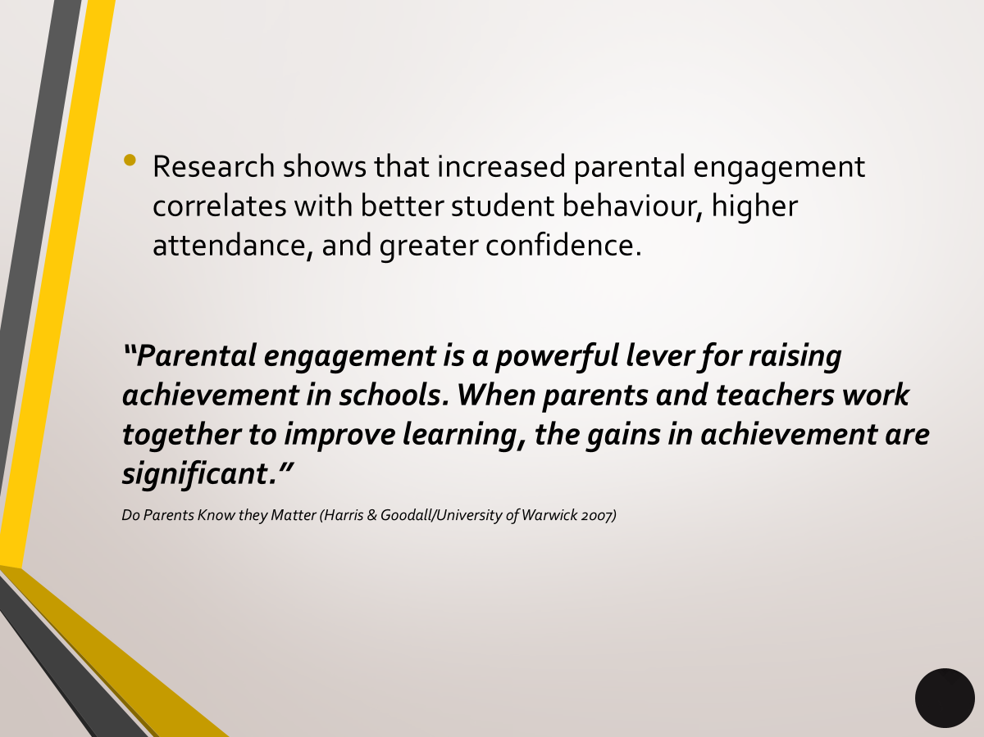

Slide 59

​COMMUNICATION DURING ACADEMIC TERM
Pastoral care are the first point of contact with parents in Secondary school.
Please contact your son or daughter’s pastoral care teacher if you wish to discuss attendance, learning or any other concerns that you have.
Please call the school number and ask for pastoral care and you will be put through.
Pastoral Care will return your call if they are teaching or in a meeting.

Slide 60
​COMMUNICATION DURING ACADEMIC TERM
You will receive formal communication from the school at the following stages in the year:​
Tracking Points​
Parents Evening​

Slide 61
In addition to the formal communication, you will receive termly newsletters to keep you up to date with what each department is doing within the school.
We also send out praise postcards throughout the year for pupils who have been nominated by teachers for exemplifying the school values.

Slide 62
Focus groups
Throughout the year we host various coffee mornings and events for our parents.
Each event has a specific focus.
EAL and ASN events have run in the last year.
Work with outside agencies- FISO.
P7 STArs family event.

Slide 63

Parent council
Parent council meetings take place throughout the year.
A chance to have your voice heard.
Meetings take place in person, in school.
All are welcome- please come along!
Contact- @gw21maclureanna@glow.sch.uk
Follow us on Instagram:
@StThomasAquinasSec​
@sta_parentalengagement

