Slide 1


Pathways at STA
Senior Phase Information Evening
GO!
Notes:
Year Head for S5 and Lead teacher of SCQF Ambassador Program alongside Mrs Morrison
Good evening everyone, and thank you for taking the time to listen.
I’m going to talk briefly about the different Senior Phase pathways available at STA, and particularly about how we are continuing to develop the range of qualifications and opportunities available to our young people.
One of the key messages I want you to take away is that success in the Senior Phase will look different for different young people. Our job is to help every pupil find the pathway that is right for them and that will help them move on to a positive destination when they leave school.

Slide 2
SCQF!
The Scottish and Credit Qualifications Framework.
Helps us to measure the value of all of our qualifications.
Notes:
Before looking at our pathways, it’s important to understand the SCQF – the Scottish Credit and Qualifications Framework.
Essentially, the SCQF gives us a common language for understanding and comparing qualifications in Scotland.
It helps pupils, parents, schools, colleges, universities and employers understand both the level of a qualification and the amount of learning involved.
This is particularly important because our young people now have access to a much wider range of qualifications than simply National 5s and Highers.

Slide 3
SCQF Information
Language
Credit Points
Positive
Destinations
Nat 4 = SCQF level 4
Nat 5 = SCQF level 5
Higher = SCQF level 6
Advanced Higher = SCQF level 7
1 credit point per ten hours of learning
All credit points go towards our learner’s futures.
Notes:
There are two important things to understand when looking at the SCQF: levels and credit points.
The level tells us about the difficulty and complexity of the learning. For example, National 4 is SCQF Level 4, National 5 is Level 5, Higher is Level 6 and Advanced Higher is Level 7.
Credit points are slightly different. They represent the amount of learning involved, with one SCQF credit point representing approximately ten hours of learning.
The important message for our young people is that all of these qualifications contribute towards their learner journey. It is about building a profile of qualifications, skills and experiences that will ultimately help them progress to a positive destination.

Slide 4
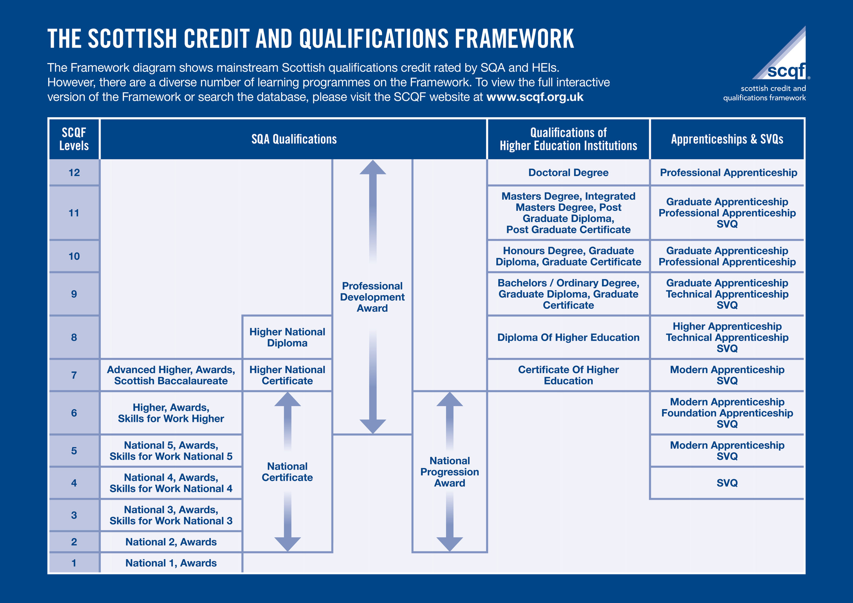
Notes:
When we talk about Senior Phase pathways, therefore, we need to move away from thinking that there is only one definition of success.
For some pupils, a traditional pathway involving National Qualifications and Highers will absolutely be the right route.

Slide 5

NPAs
Level 4, 5 and 6
Areas of specialism
Skills based
Real life experience
No external assessment in May
Same credit points as NQ
Notes:
One way we have broadened our pathways is through National Progression Awards, or NPAs.
NPAs are available at different SCQF levels and allow pupils to develop knowledge and skills within a particular area of specialism.
They are often very practical and skills-based, giving pupils opportunities to apply their learning in contexts that can feel more relevant to real life.
Another important difference is that NPAs do not have an external examination in May. Instead, pupils build evidence and complete assessments throughout the course.
Most importantly, these qualifications carry SCQF credit points just as National Qualifications do. They are valuable qualifications and can form an important part of a young person’s overall Senior Phase pathway.

Slide 6
SCQF at STA
Marketing
Health & Wellbeing
Scottish Studies
Early Learning Childcare
Creative Industries & Event Planning
Lab Science
Sports Development & Leadership
Business & IT
Skills for Work Hospitality
Skills for Life & Work
Cyber Security
Creative Thinking
Personal Development
Criminology
Health Sector Skills
Digital Media
Web Design
Events Management
Notes:
This slide gives you an idea of just how much our curriculum has developed.
We now offer pathways across a wide range of areas – from Marketing, Business and IT and Cyber Security, to Lab Science, Early Learning and Childcare, Sports Development, Hospitality, Criminology and Digital Media, amongst many others.
The important thing here isn't necessarily remembering every course on this slide.
It's recognising that we are trying to create a Senior Phase curriculum that reflects the different strengths, interests and aspirations of our young people.
Not every young person learns in the same way, and not every young person wants to progress to the same destination. Our curriculum needs to reflect that.

Slide 7
A significant cultural shift is needed to support young people's diverse talents and learning pathways.
We as educators must recognise that academic and vocational education are not separate worlds but that all young people need a blend of both to become fully educated citizens.
—Prof. Louise Hayward
Notes:
I think this quote from Professor Louise Hayward captures really well what we are trying to achieve.
We need to move away from seeing academic and vocational learning as two completely separate things, or assuming that one has greater value than the other.
Our young people need a combination of knowledge, qualifications, practical skills and experiences that will prepare them for whatever comes next.
That might be university, college, an apprenticeship, training or employment.
The question we should be asking isn't simply, “How many Highers does this pupil have?” It should be, “Does this young person have the right qualifications, skills and experiences to take them where they want to go?”

Slide 8
Goals for STA
01
02
03
Parental Engagement
Learner Engagement
Educating our learners about their choices and making sure they feel supported to take the right path for them.
Sharing updates with parents and carers about the pathways we offer.
Growth
Equal Value
Our goal is to grow our Senior Phase pathways across the curriculum.
Ensuring that vocational and academic qualifications are viewed equally.
Notes:
So, where do we go from here?
We have several key priorities.
Firstly, growth. We want to continue developing and expanding the pathways available across our Senior Phase curriculum.
Secondly, learner engagement. We need our pupils to understand the choices available to them and feel confident choosing the pathway that is right for them – rather than simply following what their friends are doing or feeling that one type of qualification is somehow better than another.
Parental engagement is equally important. We want parents and carers to understand these qualifications too, so that you can have informed conversations with your child about their choices.
And underpinning all of this is equal value. We want to build a culture where academic, vocational and skills-based qualifications are all recognised and celebrated for the opportunities they provide.

Slide 9
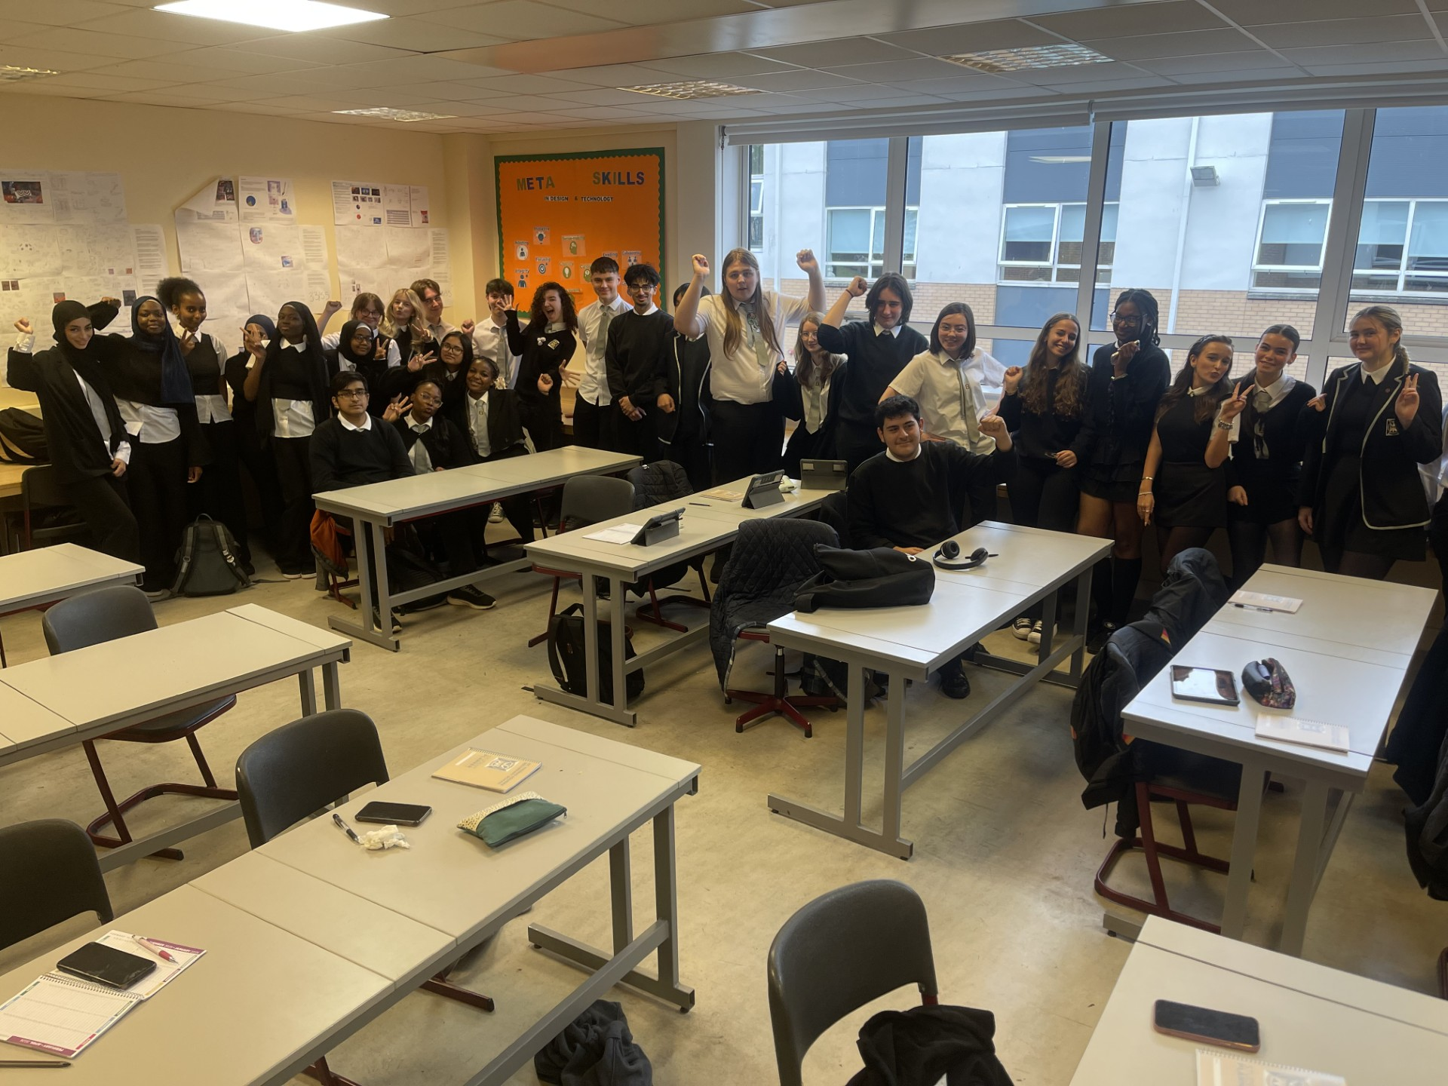
SCQF Ambassador Team
01
02
03
Notes:
One of the ways we are going to help develop that understanding is through our SCQF Ambassador Team.
Our ambassadors will play an important role in helping us communicate the message about pathways and qualifications – not only to other pupils, but also to parents, carers and our wider school community.

Slide 10
SCQF Ambassador Role
  THEIR MISSION: Help parents, carers, employers and fellow pupils to better understand qualifications and their value!
  The ambassadors will be at school events going forward with information to share with pupils and parents from S1 – S6.
  When you see them, go and speak to them and ask them any questions you may have!
Notes:
The mission of our ambassadors is quite simple: to help pupils, parents, carers and employers better understand qualifications and their value.
You will begin to see our ambassadors at school events, where they will be able to share information and talk to pupils and families from S1 right through to S6.
We want conversations about pathways to start early. We don't want pupils reaching the Senior Phase without understanding the choices available to them.
So, when you see our ambassadors at future events, please speak to them, ask questions and find out more about the different opportunities available.

Slide 11

Thanks for listening
01
02
03
@StThomasAqSec (SCQF)
@StThomasAquinasSec
Notes:
So, the main message I would like to finish with is that there is no single pathway to success.
Our ambition is to build a Senior Phase curriculum where every young person can find a pathway that matches their strengths, interests and future aspirations.
Whether that pathway includes Highers, National Qualifications, NPAs, vocational learning or – as will increasingly be the case – a combination of these, each pathway should be valued.
Ultimately, it isn't about every young person following the same route.
It's about ensuring that every young person leaves us with the qualifications, skills, experiences and confidence they need to take their own next step successfully.
Follow us on INSTAGRAM for any updates
Thank you for listening.

