Slide 1
Senior Phase Information Evening 2026
Careers Advisers
Jackie O’Hare
Evonne McHendry

Slide 2
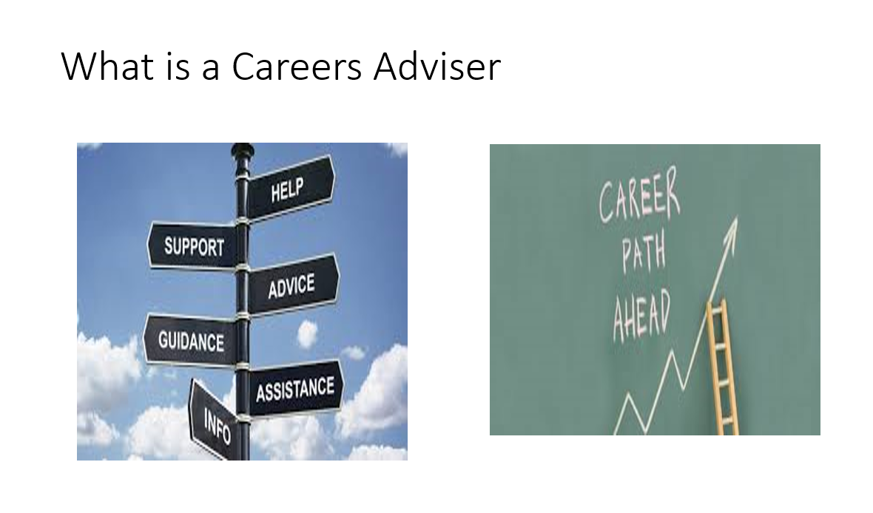
Notes:
2

Slide 3



CHOICE

Slide 4

Career Management Skills

Slide 5

Routes & Pathways
University
Apply for
a Modern
Apprenticeship
Apply for
Further Education
Return to school/
Plan for University/
Senior Phase Opportunities
Employment/
Training for Work

Slide 6
06.08.26
UCAS Support
05.08.26
LNAT Support
05.08.26
UCAT Support
Oct. 2026
College Support
College Support
College Support
Apr. 2027
Modern Apprenticeship
Jan. 2027
Dec. 2026

Slide 7


Get in touch!
Jackie O’Hare
Careers Adviser
0141 468 7089
Jacqueline.ohare@sds.co.uk
Evonne McHendry
Careers Adviser
0141 468 6886
Evonne.mchendry@sds.co.uk

