Slide 1

Study Skills And Effective Habits
PT Raising Attainment
Gary Howe
Teacher of modern studies, history & criminology

Slide 2
Tonight’s Session
Stepping up a gear as we enter a new year group
Online sessions for study skills+
Science of Learning
Supported Study
Raising Attainment Resources

Slide 3
Stepping up to S4
At least 2 hours per subject per week
Success in S3 exams is no guarantee of success in S4.
N5 Modern Studies Case Study, 2025/26 cohort:
66 pupils in the cohort
76% passed the S3 exam (24% failed)
35% became N4
4% sat the N5 exam but did not pass
So, 39% of the cohort did not achieve N5
What did the successful pupils do?

Slide 4
Step and match the challenge (N5→Higher)
Progression Tables are data made by the SQA which show progression from N4 to N5; N5 to Higher; Higher to Adv Higher within a subject.
E.g. What do pupils that get a B at N5 English go on to get at Higher?
30% (7% + 23%) go on to get a B or better at Higher, 70% do worse...
Success at N5 is no guarantee of success at Higher. Higher is considerably harder.
How did the 30% who matched or bettered their N5 result do it?
 | English
 | Percentage of Learners Gaining Higher
National 5 in 2023 | Result | A | B | C | D | No Award
 | A | 48% | 30% | 16% | 5% | 1%
 | B | 7% | 23% | 34% | 26% | 9%
 | C | 1% | 7% | 21% | 37% | 33%
 | D | 1% | 4% | 12% | 29% | 54%
Notes:
Progression data for all subjects here - https://www.sqa.org.uk/sqa/91419.html
2018-19 data is the most recent due to lockdown. What can pupils do… growth mindset… get organised… use effective strategies – flashcards/past papers… go to supported study… That is what it takes to have positive progression.

Slide 5
N4 to N5 is an even bigger challenge
 | Percentage of Learners Gaining National 5
Qualification | A | B | C | D | No Award
Application of Mathematics | 5% | 9% | 16% | 21% | 48%
Biology | 4% | 6% | 15% | 30% | 45%
Chemistry | 10% | 10% | 21% | 24% | 35%
English | 9% | 21% | 31% | 23% | 16%
English for Speakers of Other Languages | 10% | 25% | 21% | 25% | 19%
Geography | 6% | 11% | 18% | 27% | 38%
Graphic Communication | 2% | 5% | 21% | 27% | 46%
History | 4% | 9% | 14% | 21% | 52%
Mathematics | 11% | 13% | 15% | 18% | 43%
Modern Studies | 5% | 10% | 19% | 25% | 41%
Physics | 5% | 11% | 23% | 23% | 38%

Slide 6
Science of Learning
Multi-store model of memory
Fighting forgetting by spacing reminders
Top 3 retrieval strategies to close gaps in knowledge

Slide 7
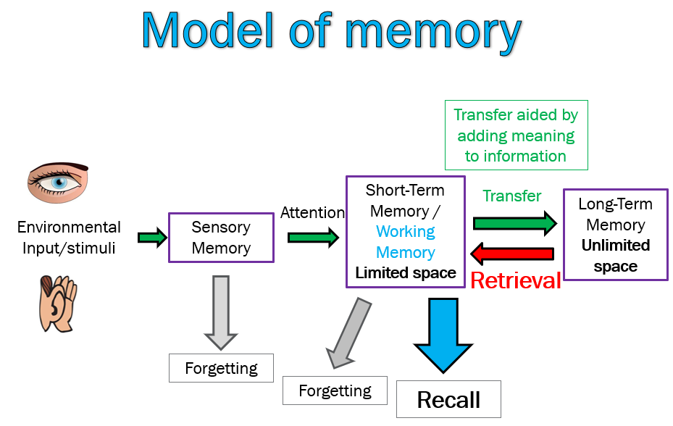
Notes:
Talk about cognitive load theory

Slide 8
The Forgetting curve in action
Look carefully at the 10 words
Apple
Chair
River
Library
Haggis
Amber
Mountain
Window
Tartan
Candle

Slide 9
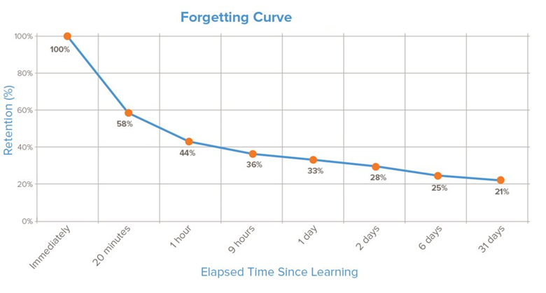
Forgetting

Slide 10
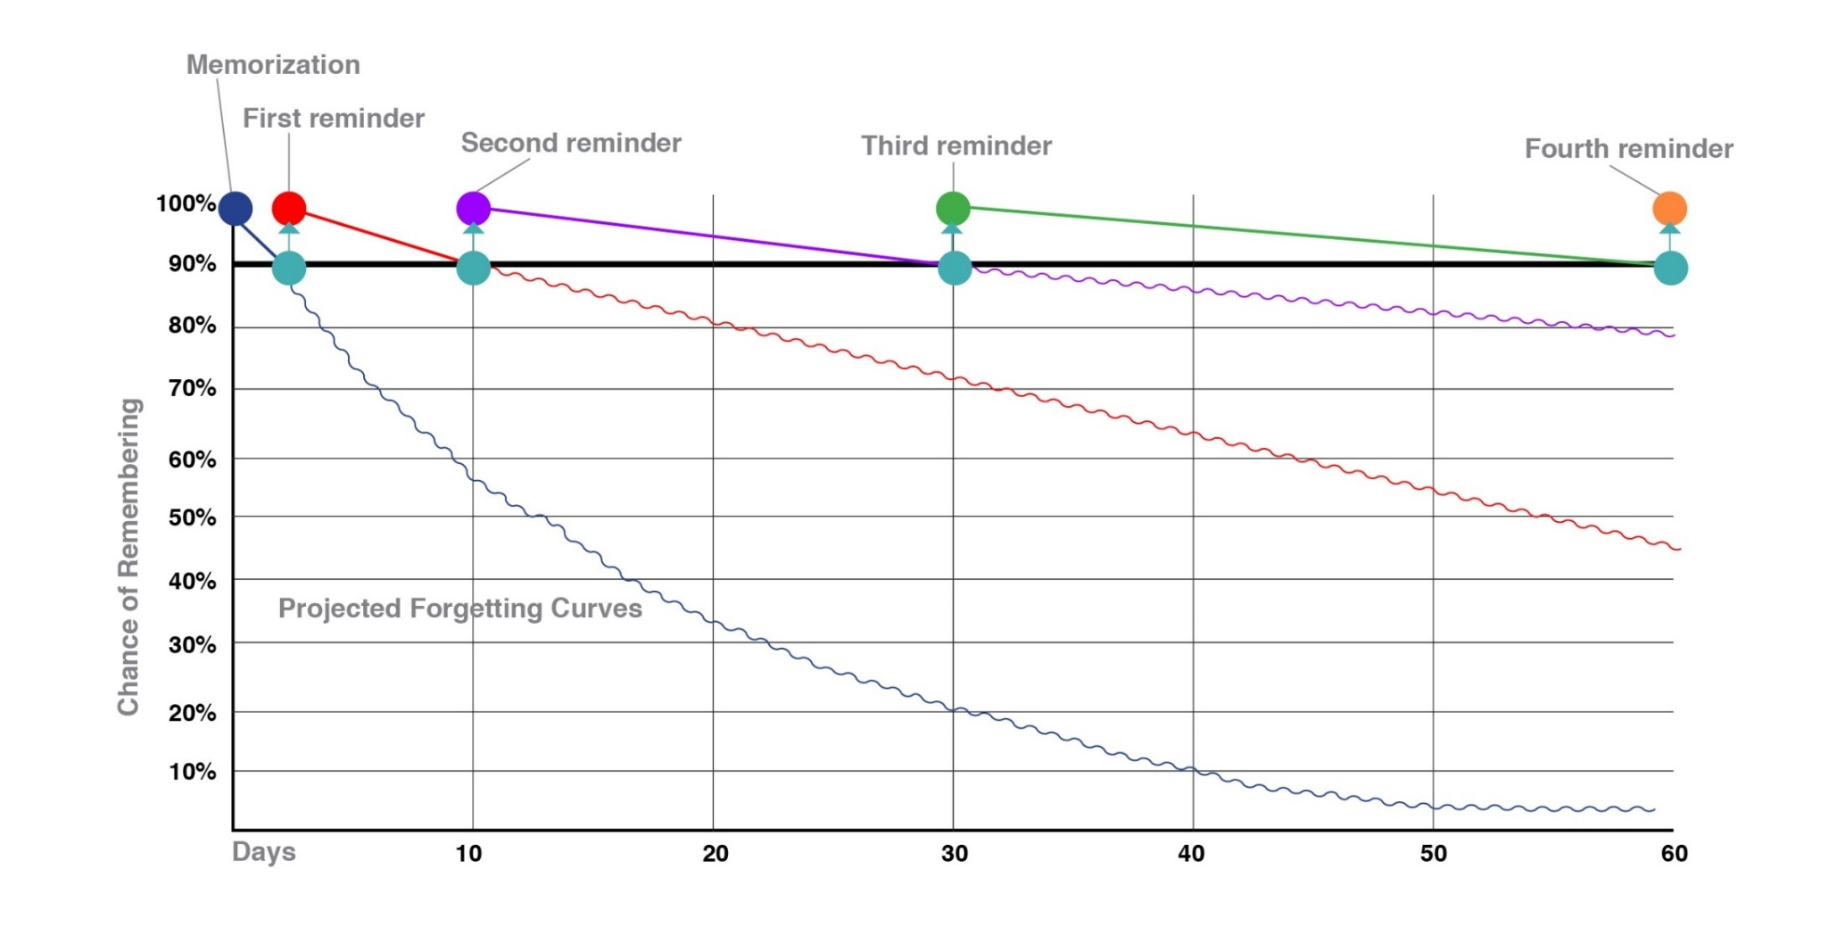
Fighting against forgetting

Slide 11
Recall time
Now Recall the 10 words that were shown a few slides back.
Debrief
What we would expect is most people will remember most of the words, but not all.
Usually recall is better for first and last words.
This shows how memory naturally fades quickly without reinforcement.
Forgetting is normal – but practice fights forgetting.

Slide 12
What is Retrieval Practice?
Quizzing - by going into your long term memory to retrieve information and bringing it into your working memory to answer questions/problem solve/perform.
It is vital that quizzing is done without notes.
This makes studying more stimulating, more effective but more challenging.
Challenge is part of learning.

Slide 13
Top 3 Retrieval Practice Strategies
Do SQA past paper questions
Flashcards
Brain-dumps A.K.A. Free Recall

Slide 14
Practical takeaways
Encourage recall, not just rereading
Ask "Tell me what you learned today" rather than "Did you revise?"
Promote short, regular study blocks instead of last-minute marathons
25 Mins study & 5 mins break
Most people's optimal focus window is 30-50 mins before attention and recall start dropping.
Support Routines
Same time/place for study helps habits stick.

Slide 15
Supported Study Programme
Extremely important intervention!
Attendance is monitored
Pupils must explain to their class teacher if they cannot attend supported study, attending is expected.

Slide 16
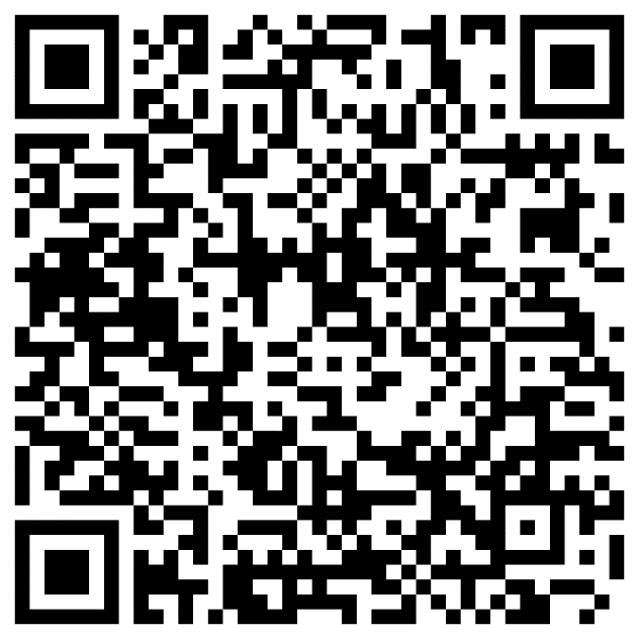
Resources
Where? You can find these resources on the ‘STA Pupil Site’ on OneDrive.
What resources?
Template study plan
PSE lessons
PowerPoints from study skills sessions
Supported Study Timetables (when available)

Slide 17
Challenge
As well as asking 'Do you have homework?’
Ask 'Show me what you remember from class today'

