Slide 1
Parental Engagement Update

Slide 2
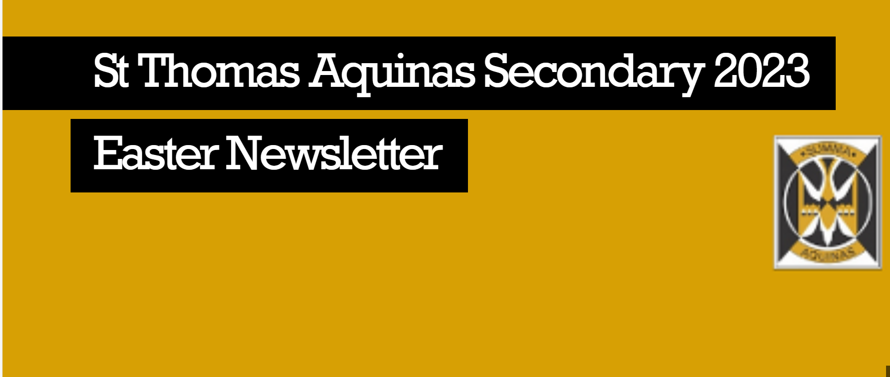
Celebrating Success
Newsletter
1 per term
Interactive & easy to access
All departments & groups within the school invited to contribute
1500-2200 views per newsletter
Praise Postcards
Sent out for different reasons during the year (positive start, wider achievement, demonstrating school values etc.)
Signed by year head and posted home
Over 1200 pupils nominated last school year
Notes:
Parents wanted more positive communication regarding pupil progress and success.

Slide 3
P7-S1 Transition Programme
Series of online sessions for new STA parents & carers
Sessions have been updated each year using parent & carer feedback
Held online to make sessions more accessible
40-60 parents on each session on average
Next steps:
Focus group with S1 parents to gather feedback on the transition process and the support they have received.
Update the transition sessions for 2023-2024

Slide 4
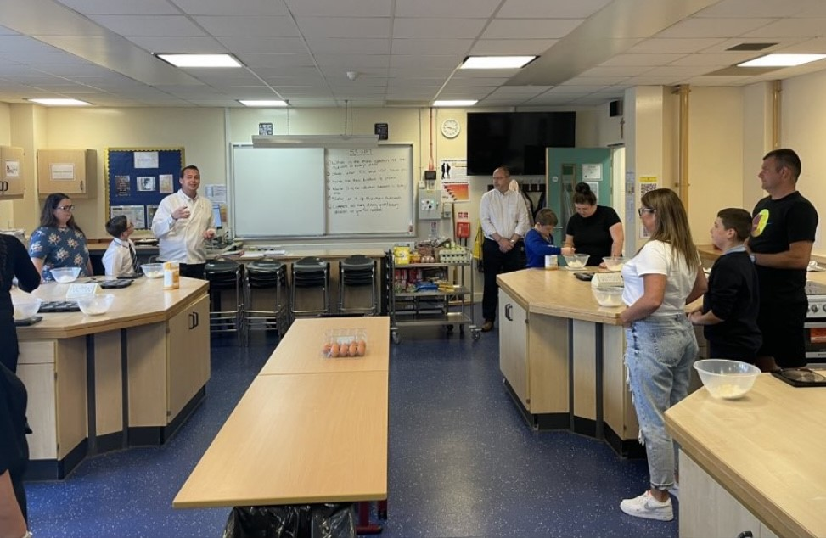
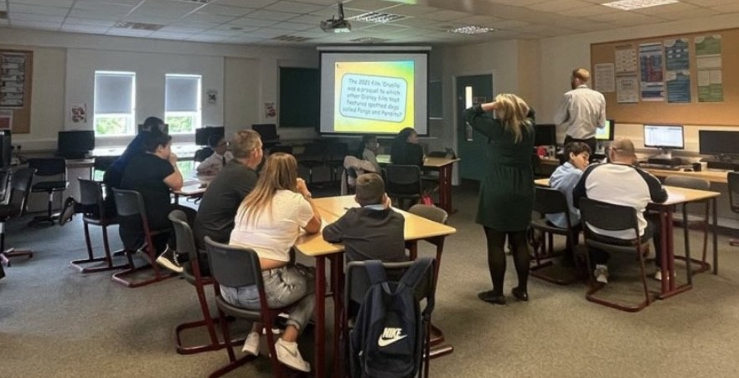
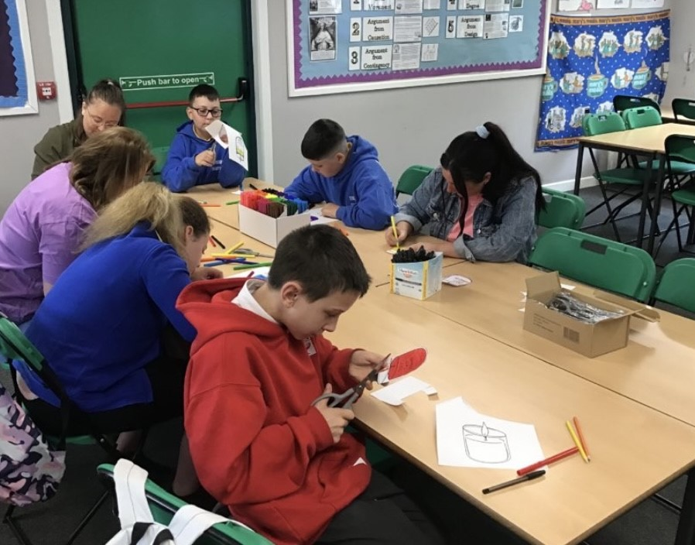
P7-S1 Transition Programme STArs
Family Cooking
Family Quiz
RE Reflection
Notes:
25 family members attended this year.

Slide 5
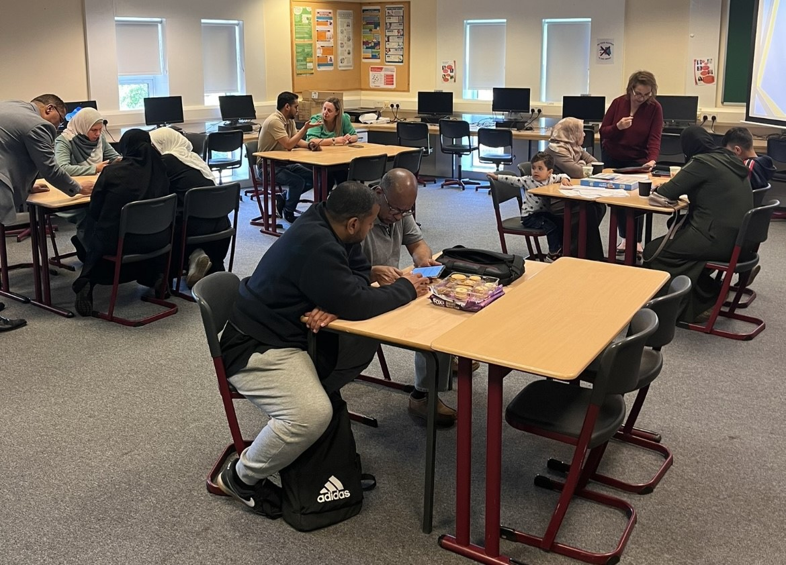
EAL Parents & Carers
Termly coffee mornings for EAL parents & carers
Session such as SfL, Raising Attainment and Financial Support.
Sessions and all support materials are translated
Feedback:
4.83/5 Stars
100% of participants asked us to continue with the coffee mornings this year

Slide 6
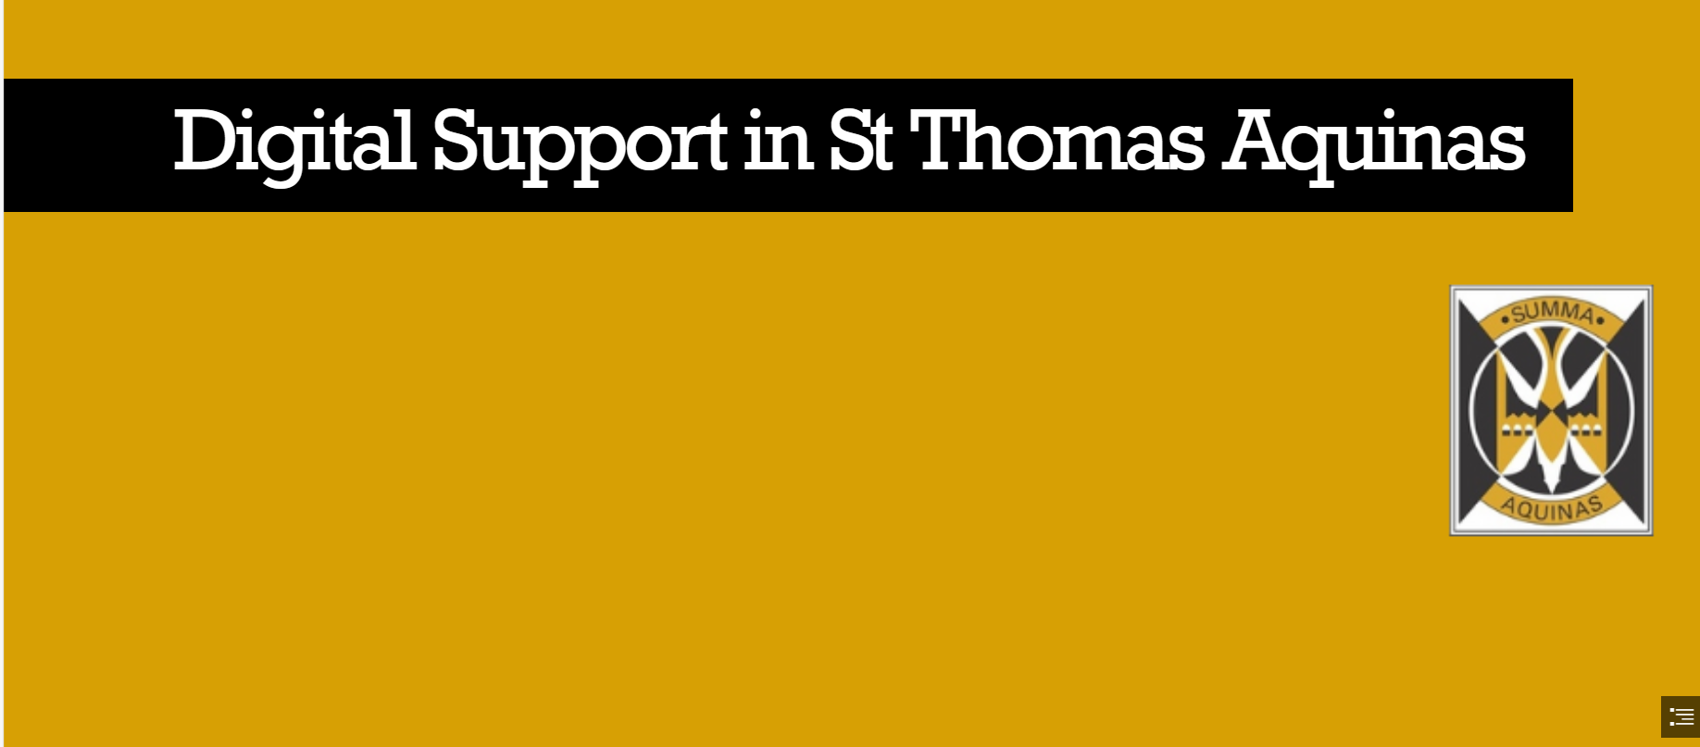
Online Support (home learning)
Online support sessions on Microsoft Team
Online support sessions on SMHW
Recorded tutorials to support families in using OneDrive & iPads for home learning
Microsoft Sway with digital support links for families
Notes:
Lockdown learning survey highlighted parents digital literacy as a barrier to supporting pupils in their learning.

Slide 7
Study Skills
Online sessions for S4 and S5/6 parents & carers
Led by PT Raising Attainment
Roughly 200 parents & carers have attended the sessions over the last two years
Power point slides are shared with all parents & carers regardless of attendance at the session

Slide 8
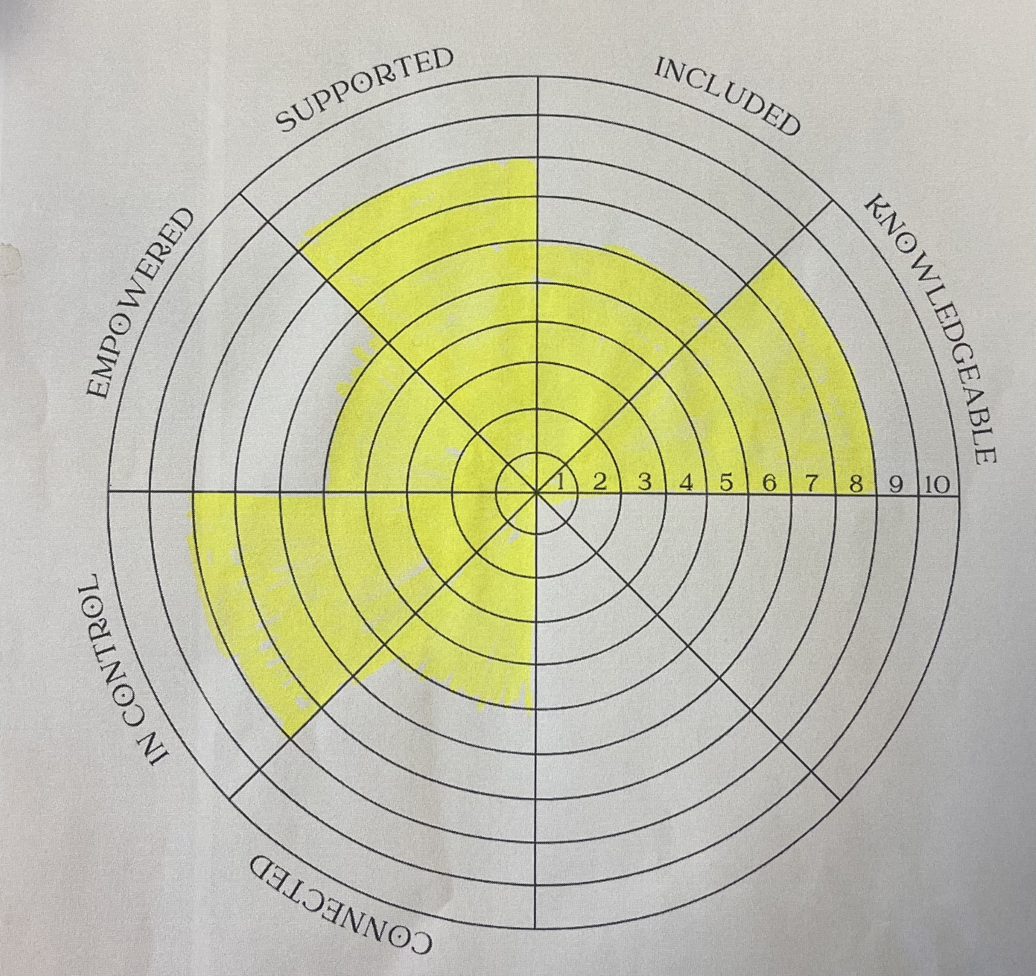
Parents & Carers of ASN pupils
Next steps:
Continue to gather feedback to enhance how we support this group (empowered)
Termly coffee mornings led by parents (connected)
Expert speakers to develop knowledge
Notes:
Parents and primary caregivers of young people diagnosed with ASD are found to experience increased levels of stress and overall poorer physical and mental health when compared with parents of typically developing children and children with other neurodevelopmental disabilities.
Supported 8.5/10
Included 7/10
Empowered & in control 4/10
Connected 6/10
Knowledgeable 6/10

Slide 9
Mental Health & Wellbeing Fund
£3500 grant to support the health & wellbeing of adults in the community
Money has been spent in consultation with the parent council
So far, has funded 1 year of English classes for EAL parents
1 block of Yoga for STA parents & carers
12 parents/carers will be completing the FARE Emergency First Aid at work qualification

Slide 10
School Policies
We are currently creating ‘parent friendly’ versions of STA and GCC policies such as attendance & late coming, home learning & anti bullying.
Notes:
Policies to be updates:
Attendance/late coming
HWB
Home Learning

Slide 11
Parent Council
We have a very active, supportive parent council.
Finance (breakfast club, prom, discos, s6 leavers gifts)
Raising awareness
Applying for and spending grants on our behalf
Supporting other parents

Slide 12
Leading Parent Partnership Award
If we are successful then we will be the first secondary in Scotland to achieve this award
We have been working towards engaging our hardest to reach parents by tweaking what we already do (targeting specific parents for events, translating information, providing high quality information on the website)
We are aiming to reduce any barriers that parents face when engaging with the school
If you have any suggestions then please let me know!

Slide 13
Next Steps
Leading Parent Partnership Award – Verification Day
Targeted support for ASN parents & carers
Continue to celebrate success with families
Support working groups and departments to develop parent friendly approaches

