Slide 1
Raising Attainment Supporting our young people to succeed
27-10-2022
Principal Teachers of Raising Attainment
Hoyvee Wong and David Houston

Slide 2
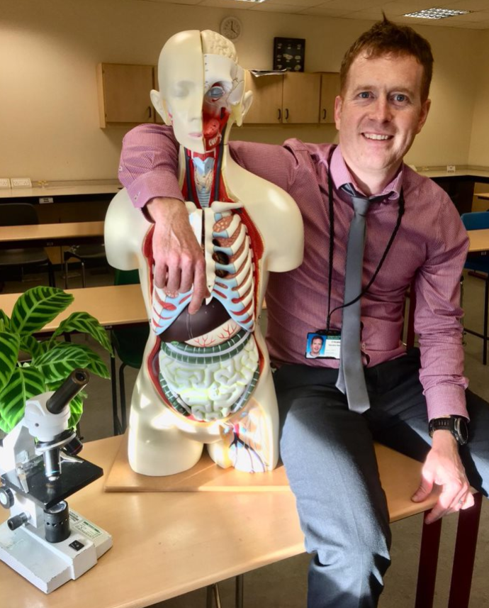
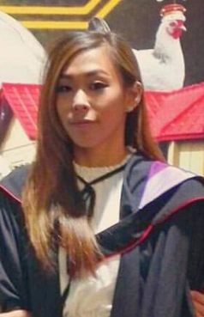
PTs Raising Attainment
Mr David Houston
Miss Hovyee Wong

Slide 3
Tonight’s Session
The countdown and other key dates
Science of learning & retrieval strategies
The study environment
Step up S5s – realising progression
Study Planning
Supports and resources
Take home messages

Slide 4
Countdown and Key Dates
5 weeks in the classroom until the (5th December) Interim Assessments
19 weeks in the classroom until the main SQA exam diet - https://www.sqa.org.uk/sqa/files_ccc/nq-2023-exam-timetable.pdf
E-sgoil supported study recommences on Monday 31-10-22
STA supported study starts on Monday 31-10-22
Parents night #1 - S4: Thursday 17-11-22
- S5/6: Wednesday 09-11-22

Slide 5
Science of Learning
Multi-store model of memory
Fighting forgetting by spacing reminders
Top 3 retrieval strategies to close gaps in knowledge

Slide 7
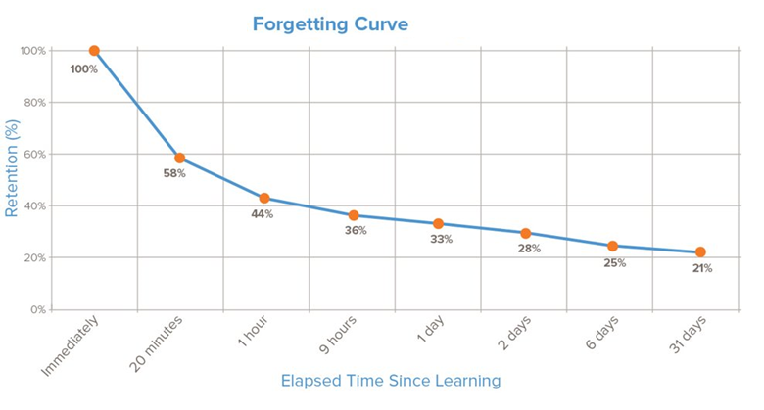
Forgetting

Slide 8
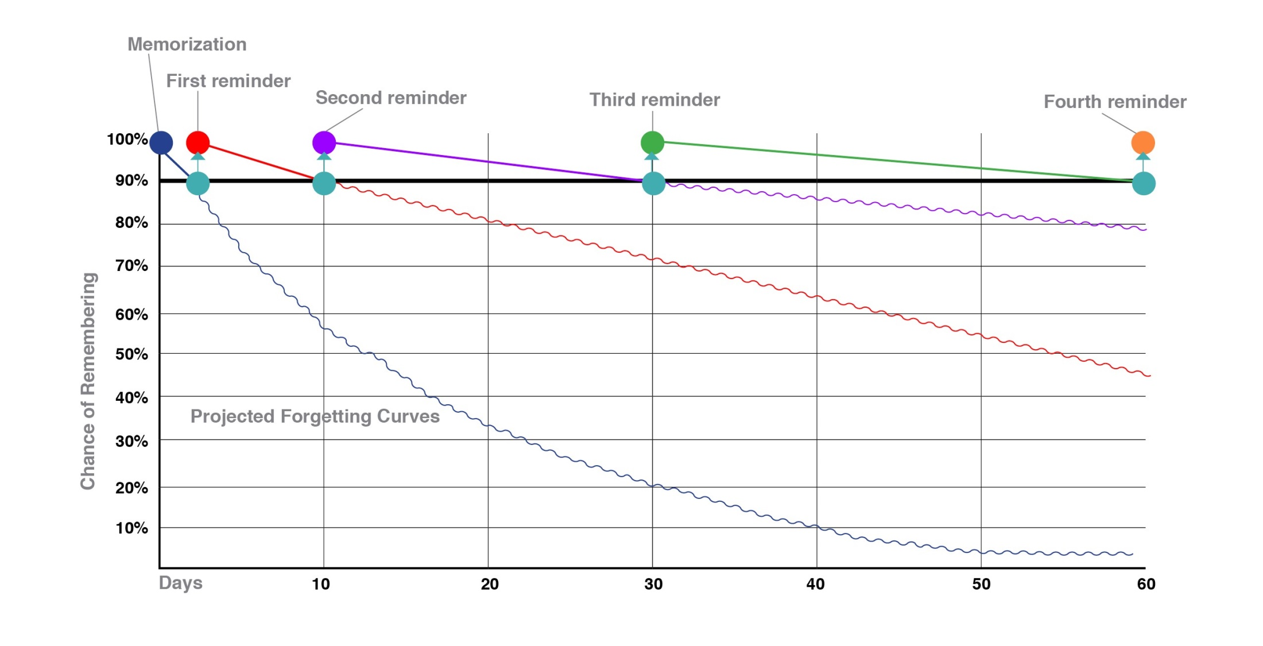
Fighting against forgetting

Slide 9
What is Retrieval Practice?
Quizzing - by going into your long term memory to retrieve information and bringing it into your working memory to answer questions/problem solve/perform.
It is vital that quizzing is done without notes.
This makes studying more stimulating, more effective but more challenging.
Challenge is part of learning.

Slide 10
Top 3 Retrieval Practice Strategies
Do SQA past paper questions
Flashcards
Brain-dumps A.K.A. Free Recall

Slide 11
SQA Past Paper Questions
https://www.sqa.org.uk/pastpapers/findpastpaper.htm
Can access 2018-19 & 2021-22 papers
Teachers no where to find earlier papers so can advise pupils
It is crucial to do the SQA past papers without notes and try to complete in the same time restrictions as the final exam.
Self mark using the marking scheme. Pay close attention to it.
The wrong answers show the gaps in knowledge.

Slide 12
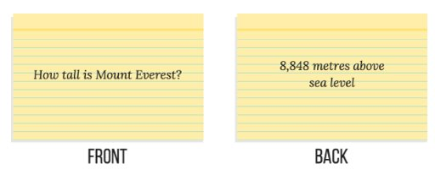
What is a Flashcard?
A small two-sided card which has a question or a definition on one side and the answer or defined term on the other side.
They can also have dates, equations, and quotes on them.
See the example below:

Slide 13
What a Flashcard is NOT
A flashcard is not a rewrite of your notes crammed onto a small card:

Slide 14
Why use Flashcards?
A gold standard of retrieval practice supported by an enormous evidence base.
Quickly identifies gaps in your knowledge.
Pupils can use independently for revision at home.
Can use with friends, siblings and parents/guardians.
Flashcards are FUN!

Slide 15
Brain-dumps A.K.A. Free Recall
Pupils select a subject
Select a topic within that subject
Write us much as they can remember about that topic
Write ideas a bullet points, use diagrams where necessary
Check against notes / revision guide / textbook
The information not recalled shows the gaps in knowledge

Slide 16
Keep repeating retrieval
SQA past paper questions, flashcards, free recall are key, keep doing them, this is how to close gaps in knowledge.
Any time pupils re-read notes or watch teaching videos, they should turn that activity into retrieval by summarising what they have learned.
That is the only way to make re-reading effective.

Slide 17
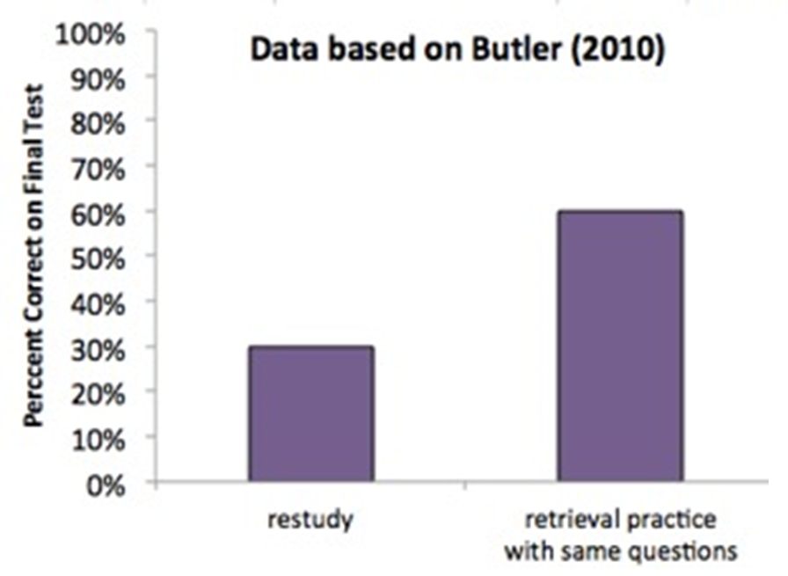
The Power of Retrieval

Slide 18
Study Environment
Effective study space
Data on music
Breaks and sleep are key, a good plan will help in this – more on this later.

Slide 19
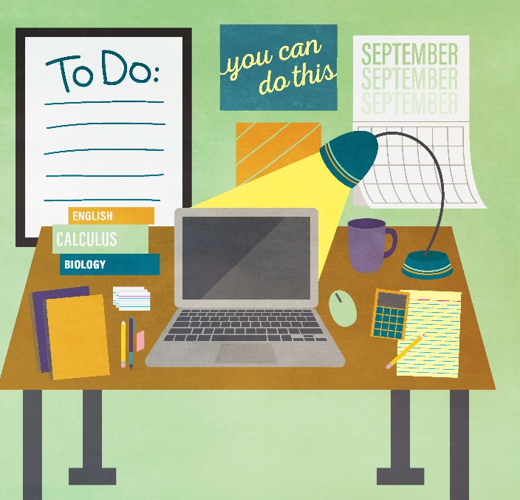
Effective Study Space
Students must know what they need to study, why they need it and how to use it.
Get rid of everything else, especially their phone
Note data shows a 20% drop in performance comparing children with / without mobile phone during studying.

Slide 20
Notes:
#17 - Perham and Currie 2014

Slide 21
Step Up S5
Progression Tables are data made by the SQA which show progression from N4 to N5; N5 to Higher; Higher to Adv Higher within a subject.
E.g. What do pupils that get a B at N5 English go on to get at Higher?
31% (7% + 24%) go on to get a B or better at Higher, 69% do worse...
Success at N5 is no guarantee of success at Higher. Higher is considerably harder.
How did the 31% who matched or bettered their N5 result do it?
Notes:
Progression data for all subjects here - https://www.sqa.org.uk/sqa/91419.html
2018-19 data is the most recent due to lockdown. What can they do… growth mindset… get organised… use effective strategies – flashcards/past papers… go to supported study… That is what it takes to have positive progression.

Slide 22
Study Plan
All S4-6 Pupils have been supplied with a study plan template for November 2022
This was given in PSE this week where they started to fill it in
They should complete this before Monday 31st October 2022
Pupils should reflect on their plan each week and adjust it if required
Pupils should try to complete at least two study sessions per subject per week for S4s and three for S5/6s
Model plan on next slide. Pupil template attached in this team

Slide 23
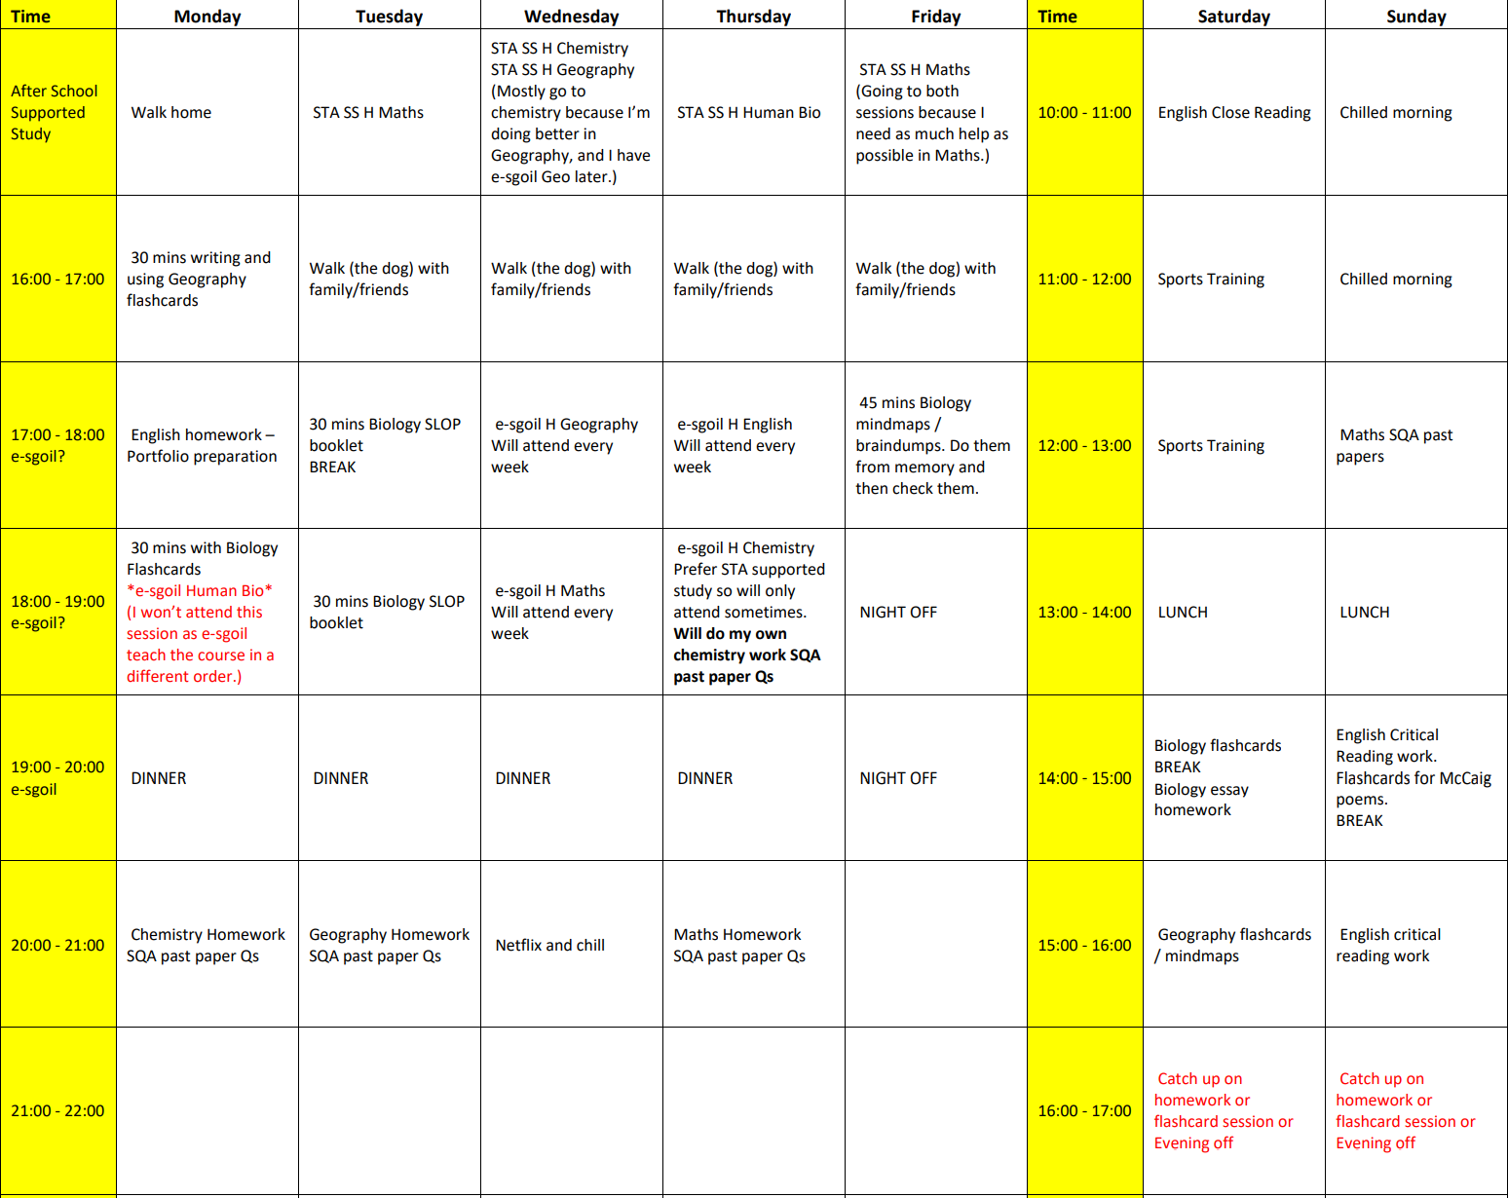

Slide 24
Supports and resources
Day in day out, committed teachers
STA supported study
e-sgoil supported study
PSE inserts from RA PTs
Supply of flashcards
Teams / OneDrive for all resources
Show my homework
West OS which should be on pupils Glow Launch Pad
BBC Bitesize revision App and website
Quizlet – digital flashcards
Scottish teacher YouTube channels

Slide 25
Raising Attainment PSE inserts
12th October – Autumn assessment reflection and target setting
26th October – Supported Study and Study Planning
2nd November – Effective studying and flashcard handout
9th November – Study environment
16th November – Further retrieval practice strategies
23rd November – Managing exam stress
30th November – December assessment timetable and plan
Above is subject to changes as required

Slide 26
Take home messages
Promote a growth mindset:
‘We are but the product of our thoughts, what we think, we become.’
A growth mindset means awareness of the science of learning and using effective retrieval strategies to close gaps in knowledge.
You can do flashcards with them.
Study Environment:
Help your child set up an effective study space – no phone.
Study Plan:
Support your child with their study plan. It needs to space learning, have breaks, allow for homework. Help them prioritise the supported study sessions they will attend based on their recent results.
Praise, encourage, motivate and forgive

Slide 27
Tonight’s Session
The countdown and other key dates
Science of learning & retrieval strategies
The study environment
Step up S5s – realising progression
Study Planning
Supports and resources
Take home messages

