Slide 1
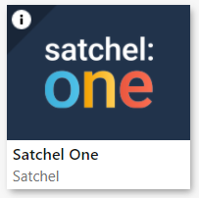
Introduction to SMHW: Parent/Carer Guide

Slide 2
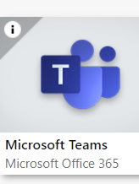
Show My Homework (SMHW)
St Thomas Aquinas are introducing a new way for pupils to do homework and submit to their teacher.
Assign and monitor homework online with the market-leading homework solution that integrates with Microsoft Teams and Google Classroom, engages students, involves parents, facilitates distance learning and saves teachers time.
Although we currently use Teams, SMHW will be used for HW submission ONLY.
Both apps will be used by staff interchangeably.
After submission, parents/carers can clearly see what grade their child has been given and any feedback the teacher has given

Slide 3
These slides will help you to...
Download
1
Download the SMHW (Satchel One) app
Log on
2
Log into SMHW using your unique Parent Code
Understand
3
Understand the app
View
4
View grades and feedback from teachers

Slide 4
Step 1 – Download the app
Download SMHW to your device of choice. This can be found on Apple and Android devices through the App store.
It will look like this icon >>
Open the app

Slide 5
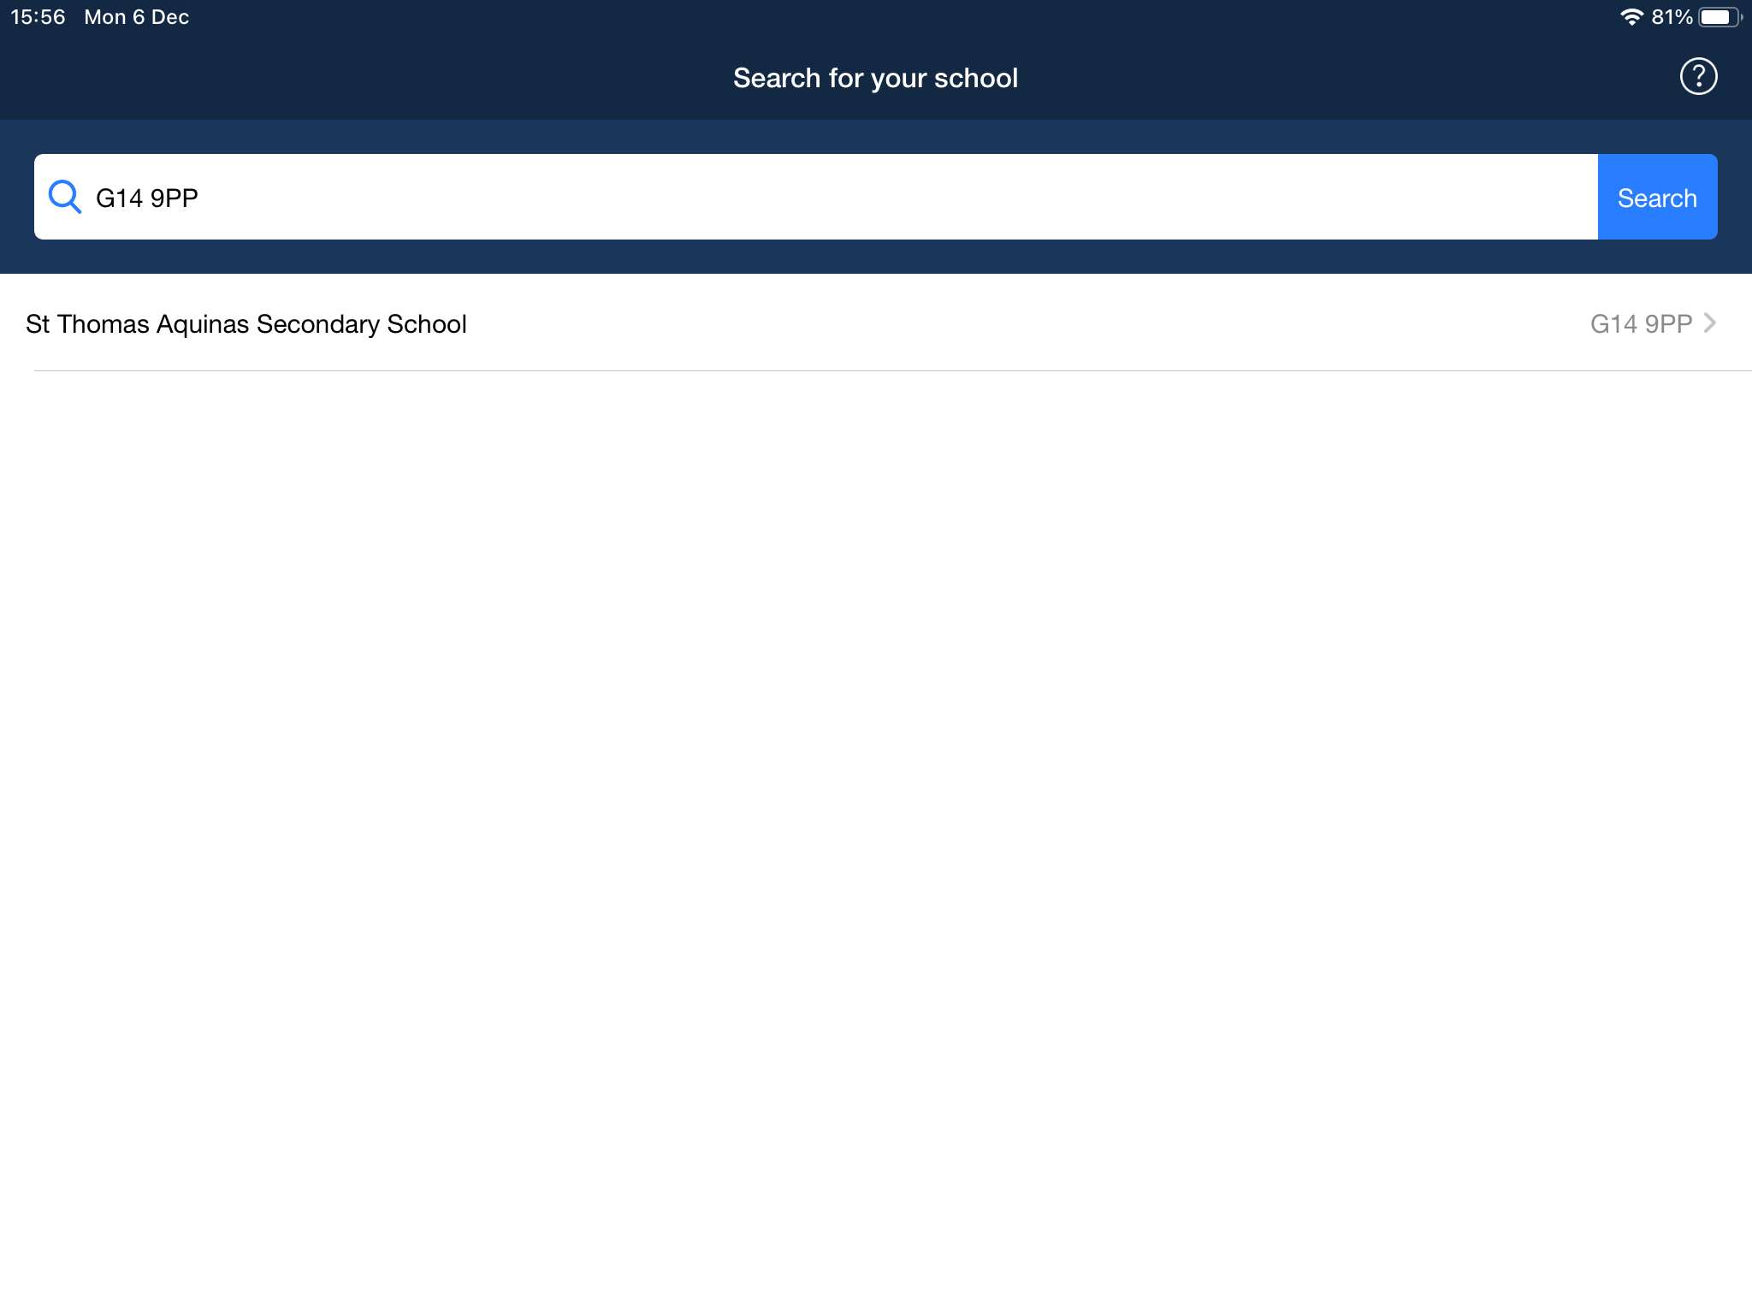
Step 2 – Finding our school
Type in the school’s postcode
G14 9PP

Slide 6
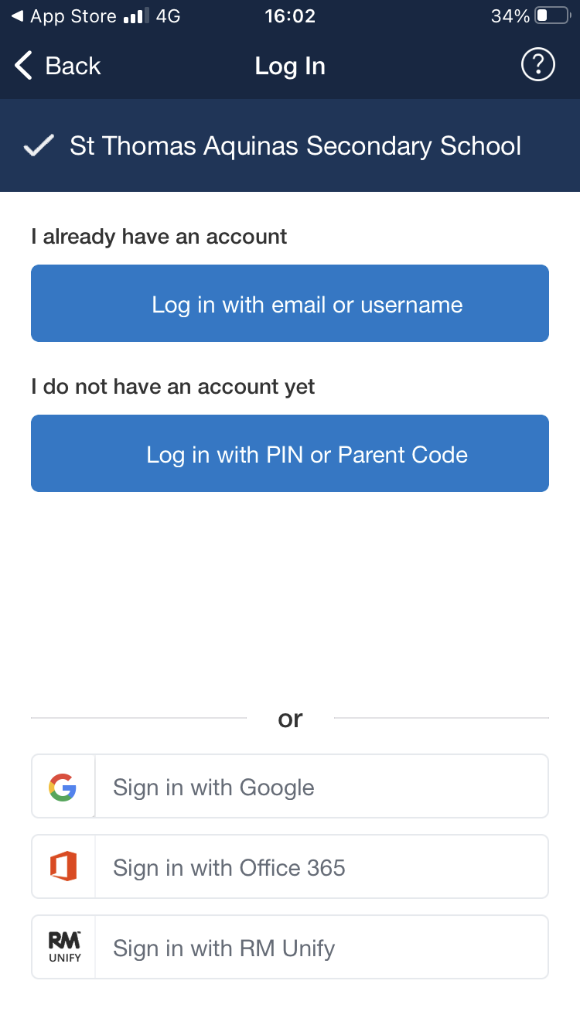
Step 3 – Parental Code
Your child will have received a letter during PSE time with your SMHW log in details
Please find your Parent Code
Click ‘I do not have an account yet’
Please enter your Parent Code
Misplaced your parent code?

Slide 7
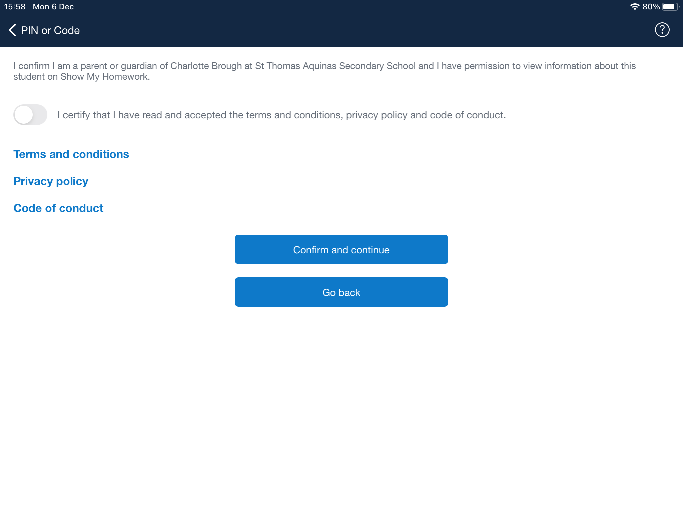
Step 4 – Accept Terms & Conditions

Slide 8
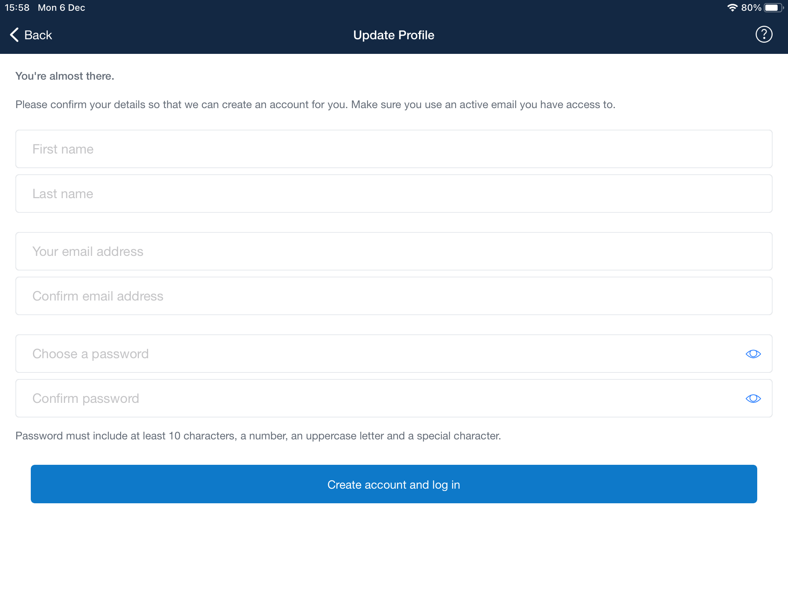
Step 5 - Creating a log in and password
Please type in the important information
SMHW will ask you to create a password
Your password needs to be secure and must have:
At least 10 characters
An uppercase letter
A number
A symbol (&*!)
Please take note of this
You will be able to use your email and password next time you log into the app

Slide 9
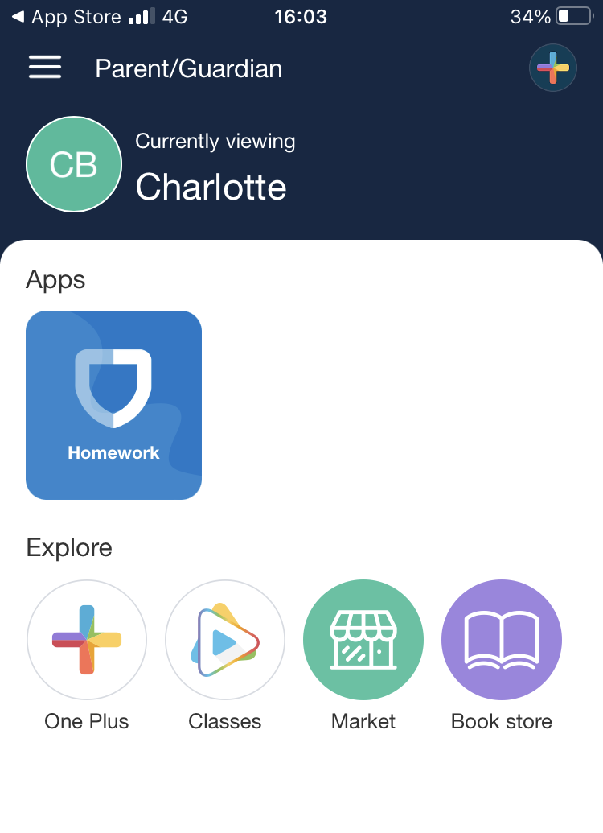
Step 6 – Parental Dashboard
The SHMW dashboard allows parents/carers to access a variety of areas within SMHW
The ‘SMHW’ section will be the most frequently used part of the app. This will allow you to see your childs homework tasks
Click on the blue shield icon ‘SMHW’

Slide 10
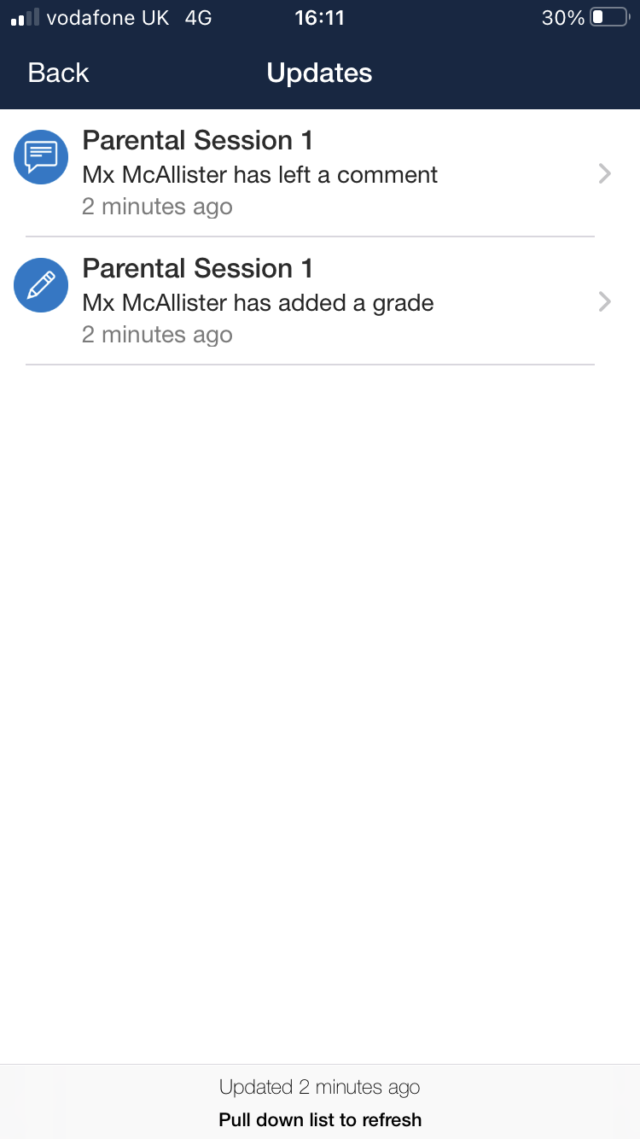
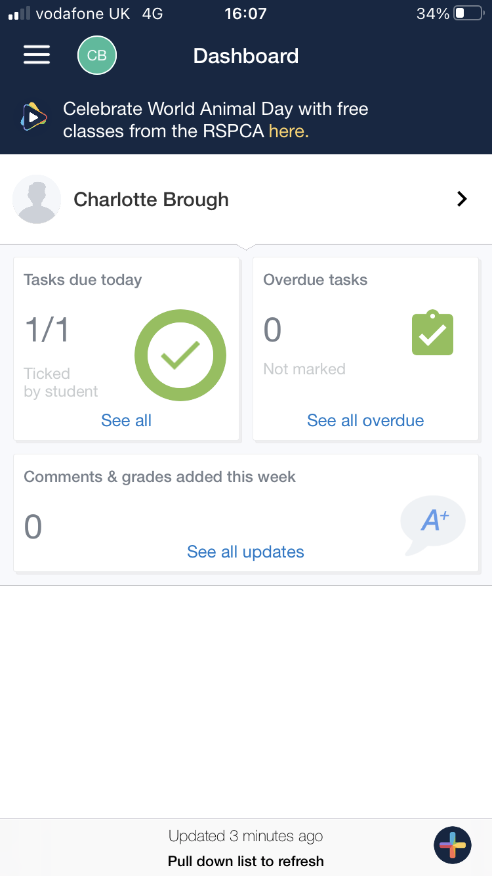
Step 7 - Notifications
Parent/Carers and pupils will all receive a notification when a teacher posts a task on SMHW
There will also be a reminder message the day before the due date on the assignment
Once your child has completed a task and uploaded a document, parents/carers will receive a notification that this has been uploaded
Parents/carers will receive another notification when the teacher has marked their HW task, graded this and given feedback.

Slide 11
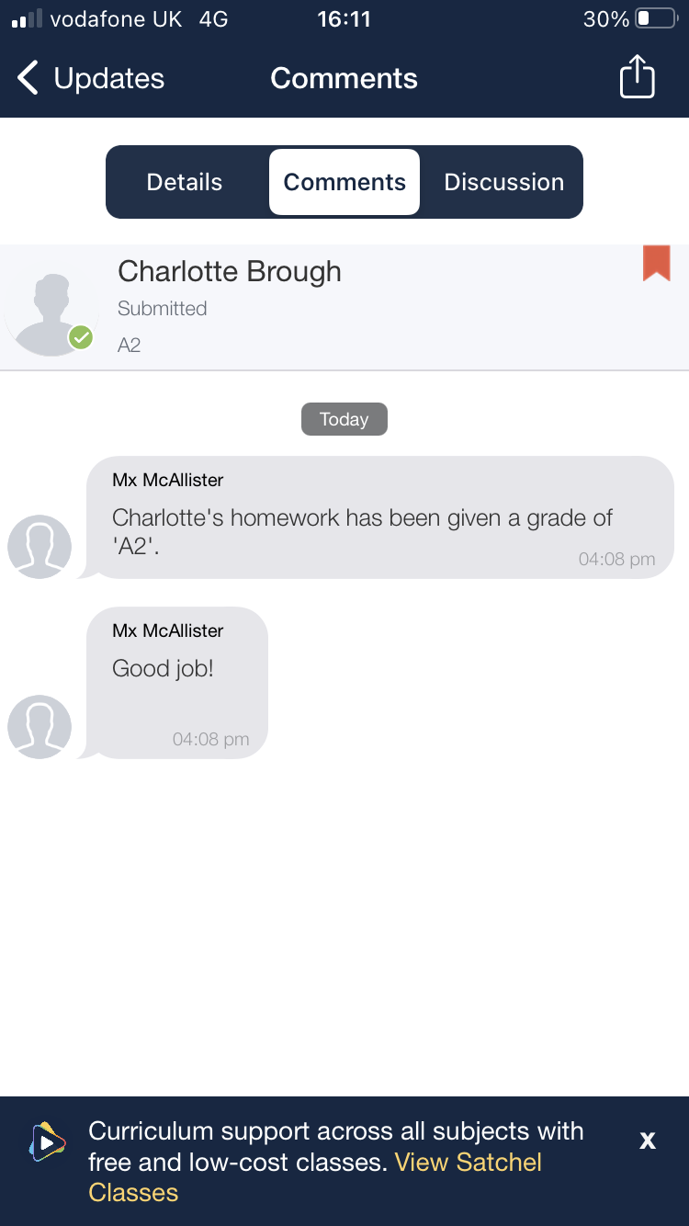
Step 8 - Feedback
Parents/carers can see the feedback & grade from the teacher
Parents/carers can also see any further dialogue between their child and teacher (e.g. further questions on a task)

Slide 12
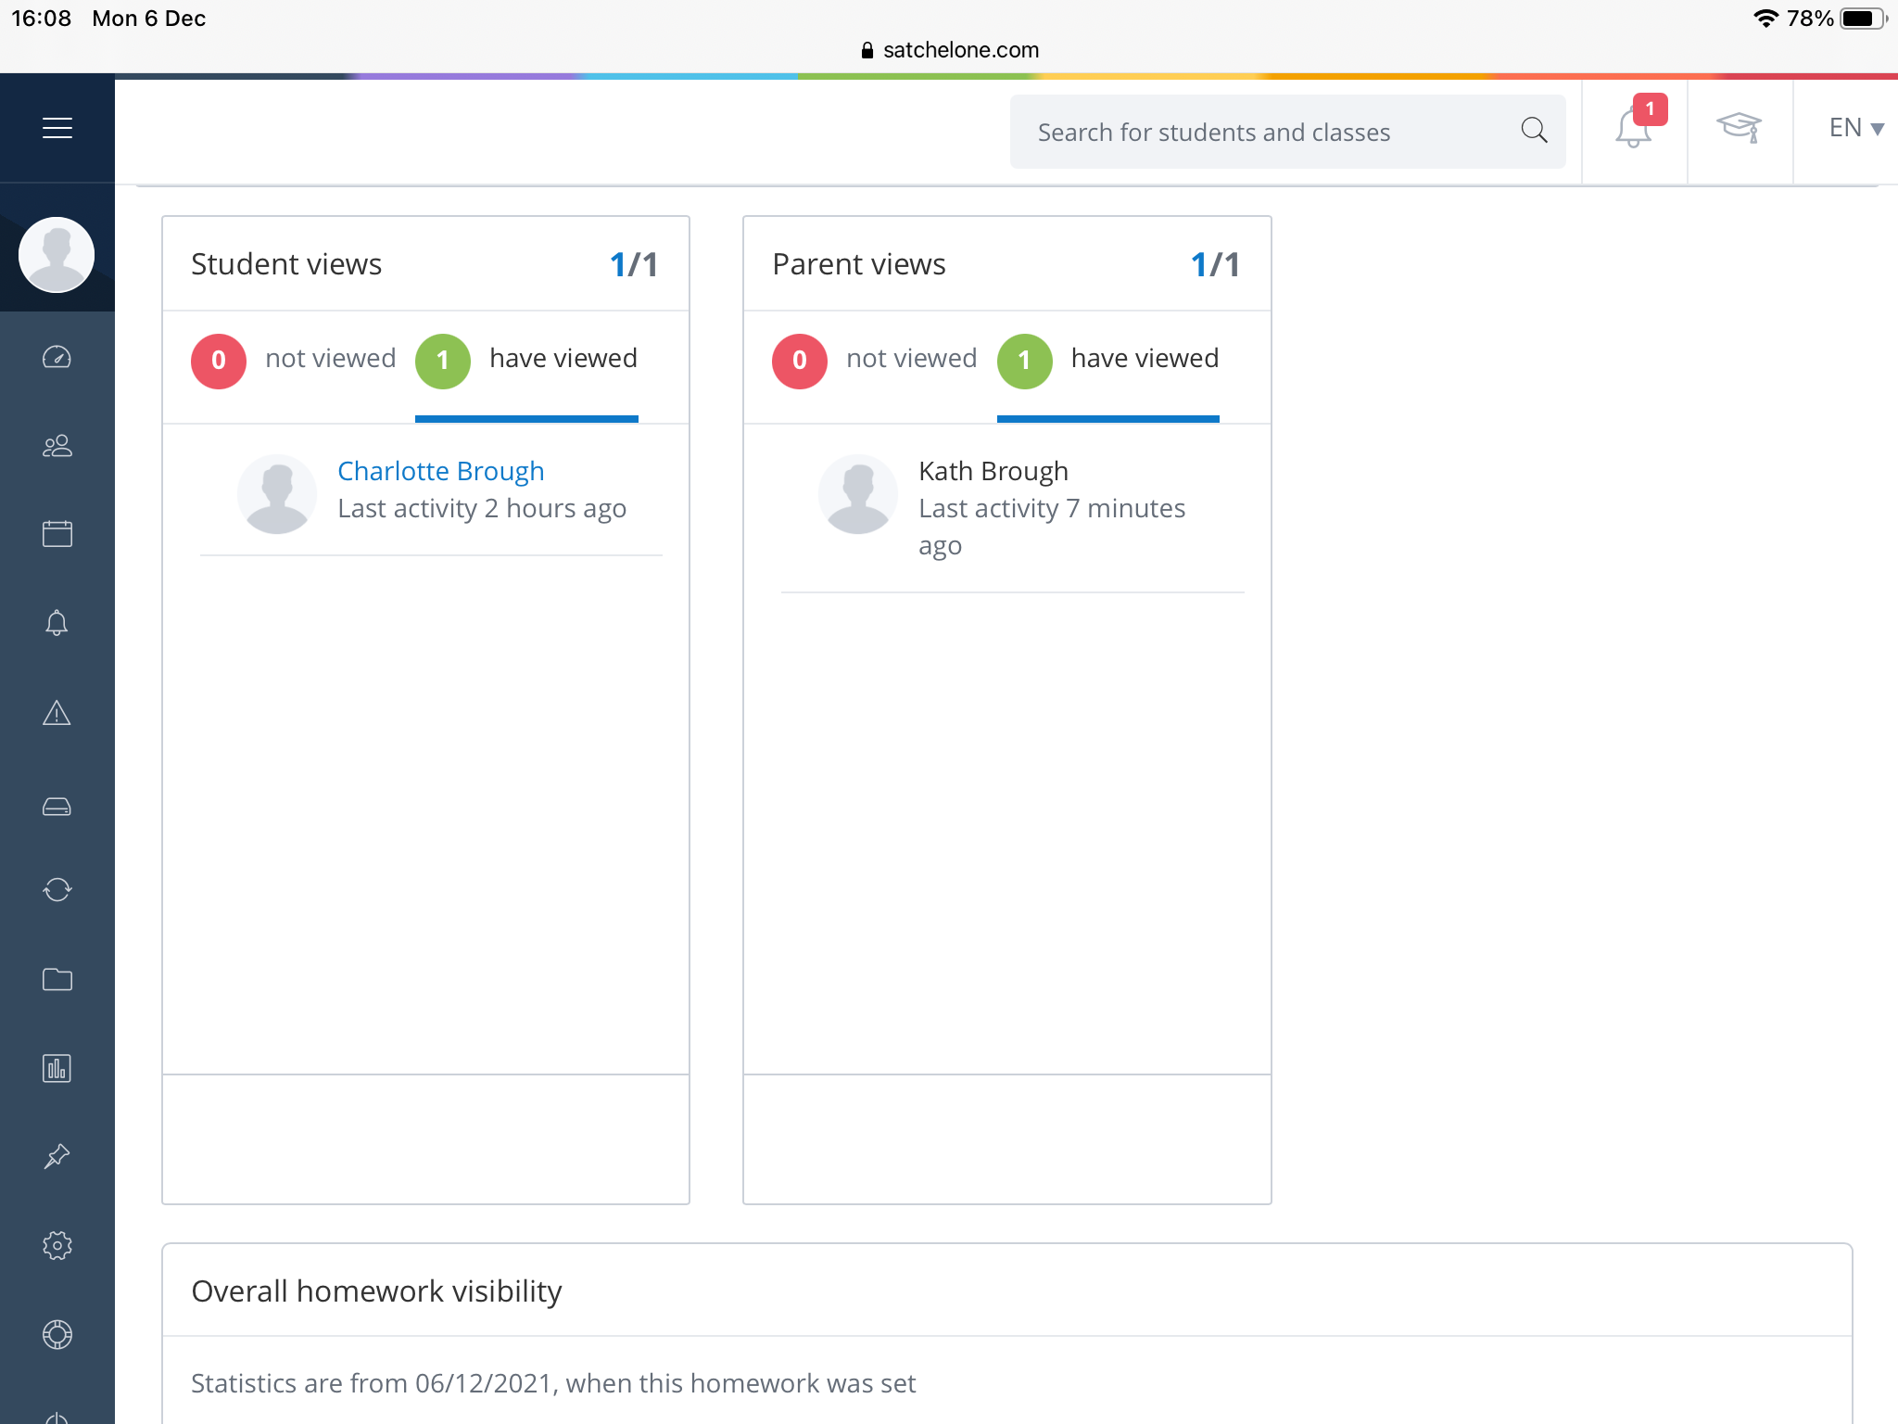
What teachers see…
Teachers can see engagement from both parents and pupils on HW assignments

Slide 13
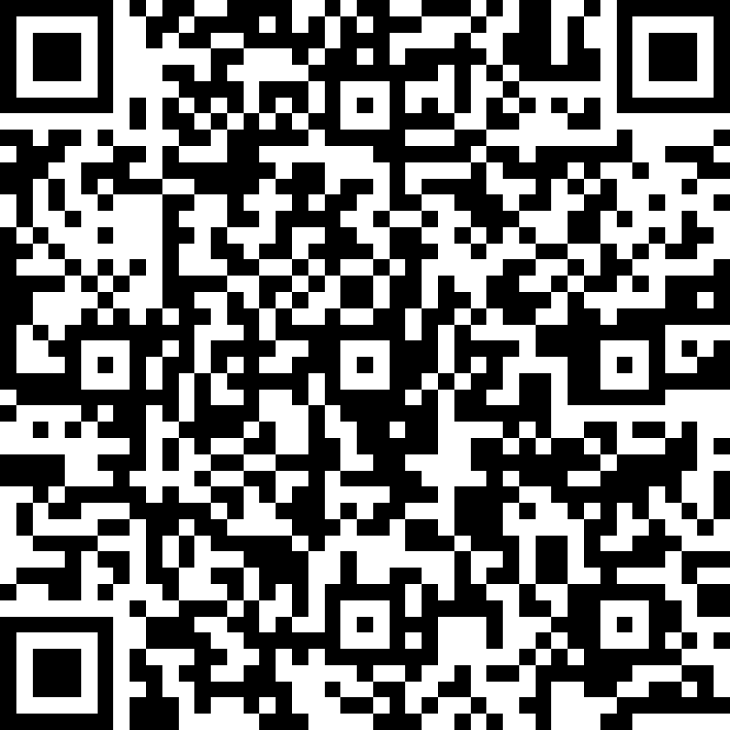
Needing more support…
Please familiarise yourself with the app
We ask that you can support and encourage your child with the app
If your child has forgotten their code, their class teacher can access this for them
Please complete this Microsoft Form if you do not have a Parent Code, or scan the QR code
Other year groups will follow in the near future
The link below will support you with any further questions on SMHW. Also we would recommend watching the helpful video at the bottom of the page:-
Logging in as a parent | Satchel Help Center (satchelone.com)

