Slide 1
PARENTS EVENINGS
Joining an appointment on Teams

Slide 2
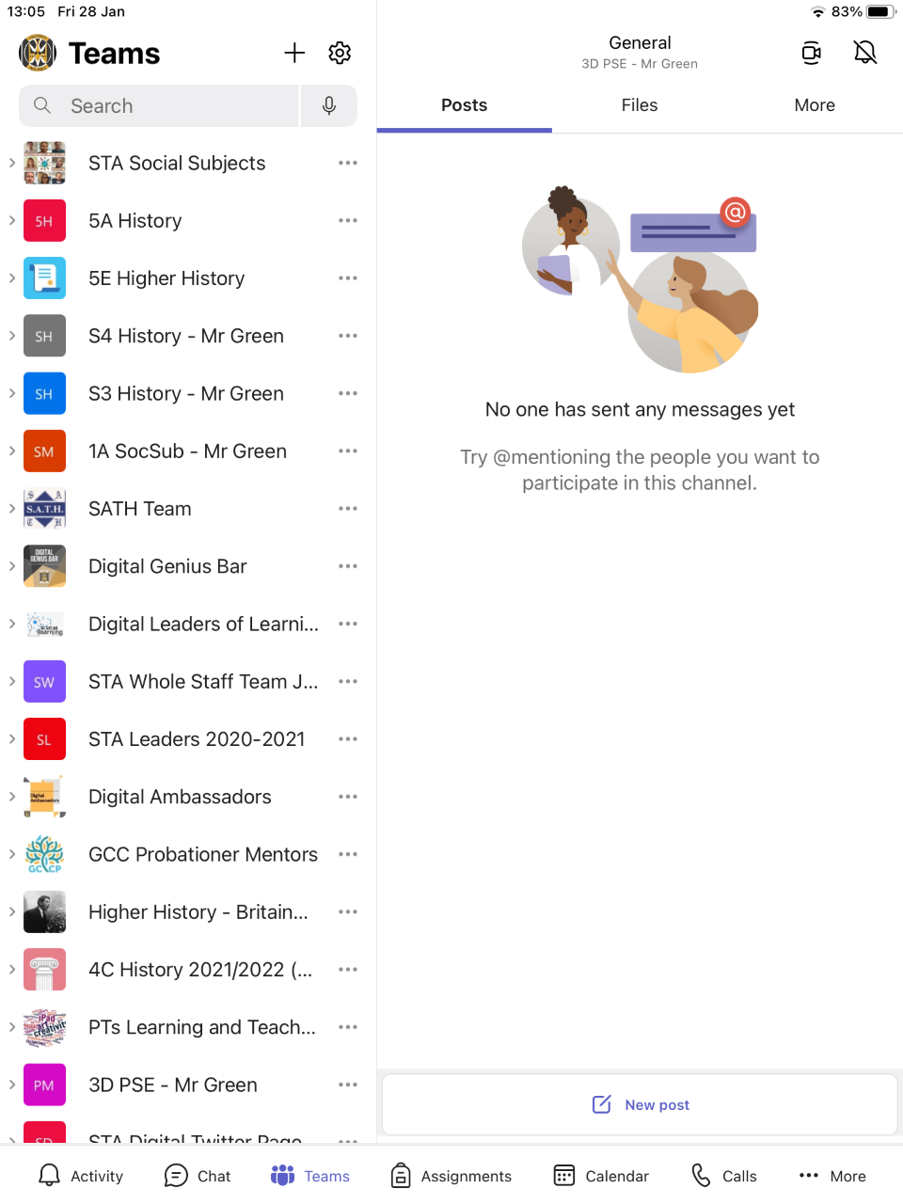
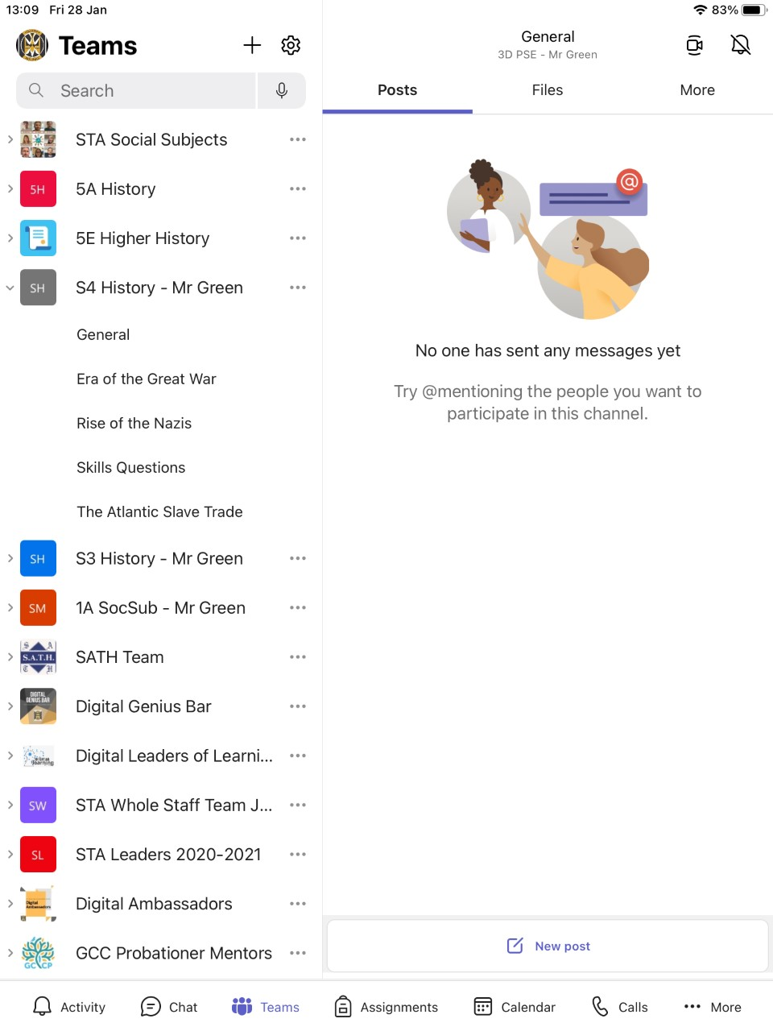
STEP 1:FIND THE CORRECT TEAM
On the left hand side, find the appropriate Team for your next appointment
Press the name of the Team on the left to open channels
Select ‘General’

Slide 3
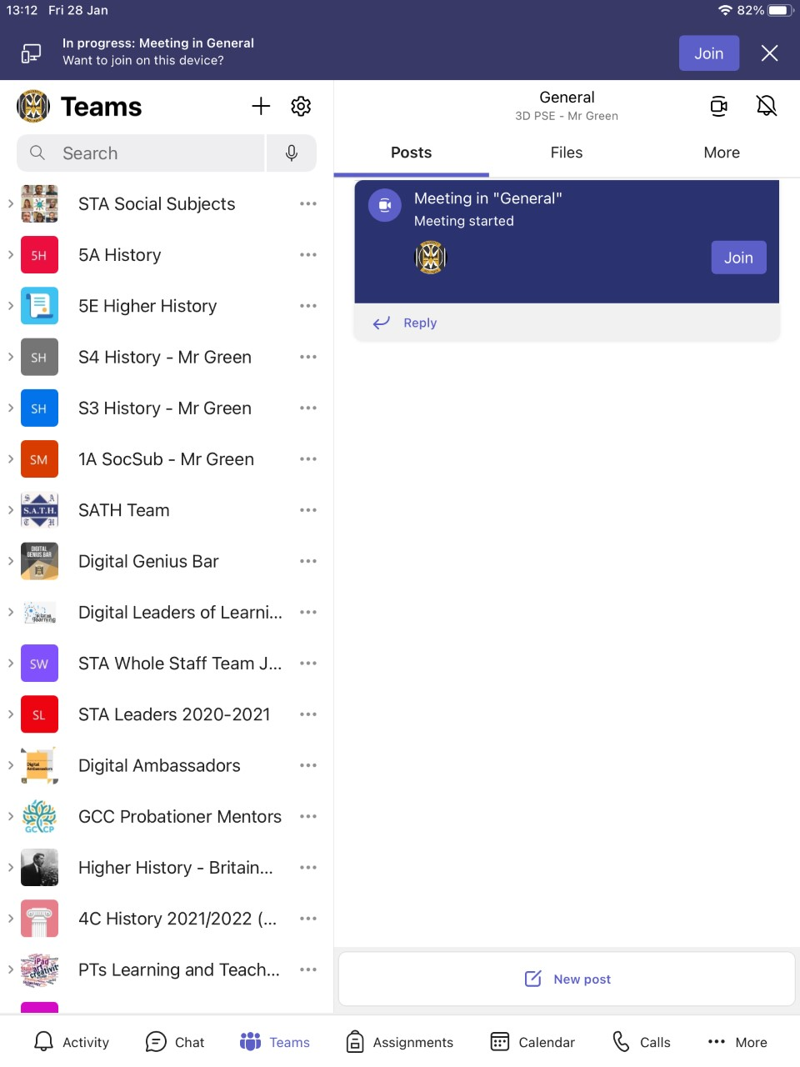
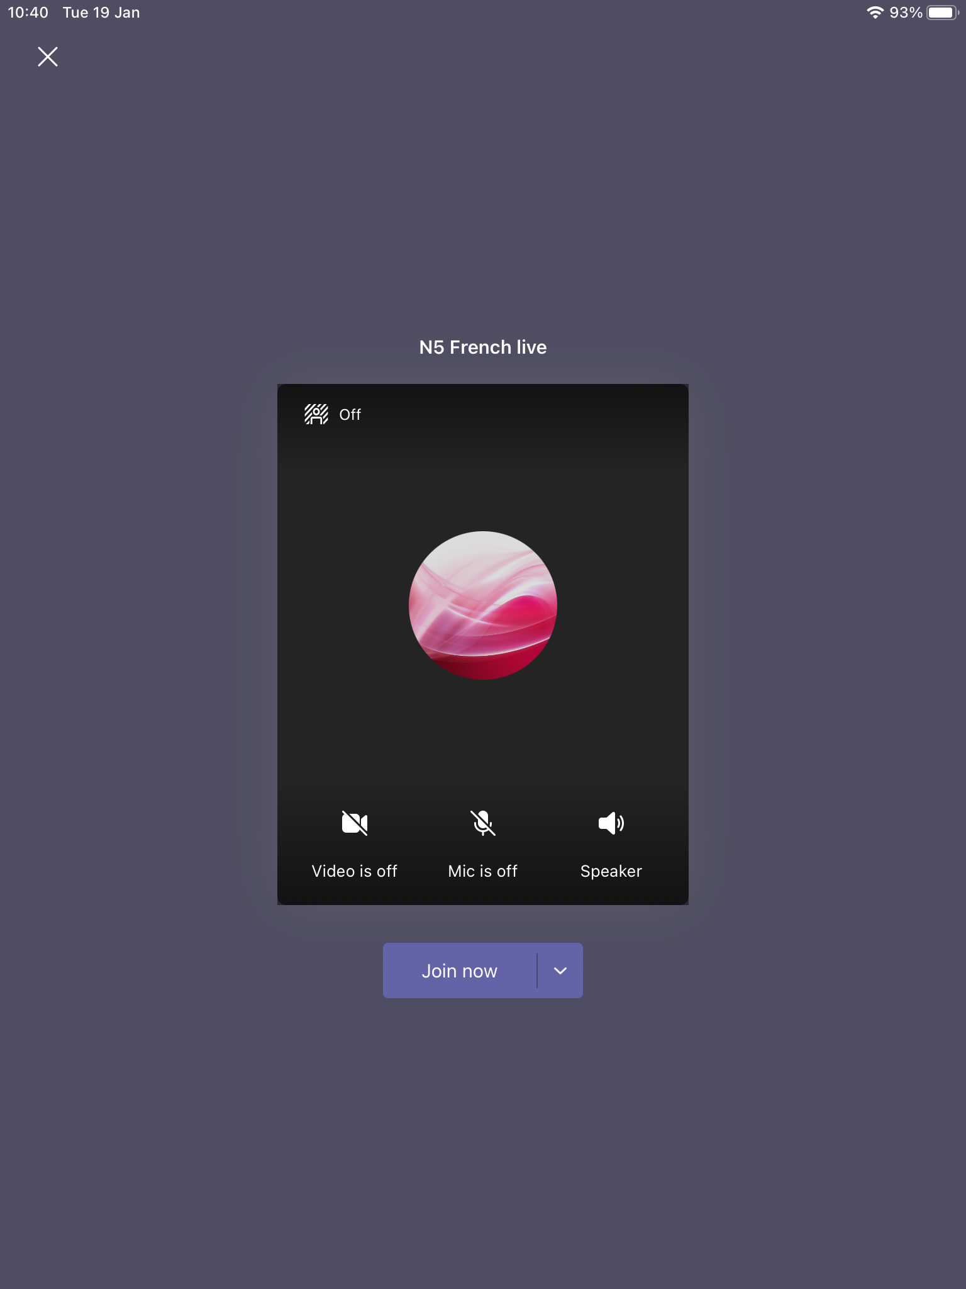
STEP 2: JOIN MEETING
When it’s time for your meeting tap ‘Join’
Your screen should now look like the one on the right
Now make sure your video and mic are on.
After doing all of this, hit ‘Join now’

Slide 4
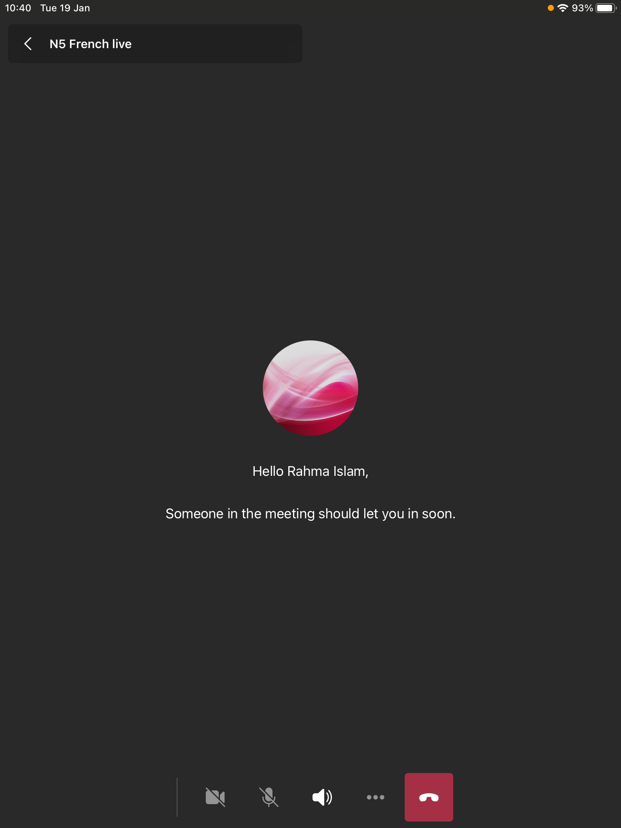
NOW ALL THAT’S LEFT TO DO IS WAIT!
This is the ‘lobby’
Once you’re here, your teacher will be notified, and they will let you into the meeting at your appointment time

Slide 5
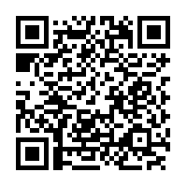
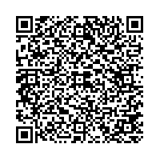
Any questions?
Feel free to:
Speak to one of our Digital Ambassadors
Post in the Digital Ambassadors Team
email Miss McAllister: gw16mcallistersarah@glow.sch.uk
or Mr Green:
gw17greentimothy@glow.sch.uk
Don’t forget to check out our help guides on the school website:
St Thomas Aquinas Secondary School
Or on our Digital Help Folder:
STA Pupil Site

