Slide 1
How to access Microsoft Teams

Slide 2
Open Safari (or another internet browser)

Slide 3
Search “GLOW login”

Slide 5
Click here

Slide 6
Pupils sign in here

Slide 7
Pupil Login
Your child’s login details can be found on a sticker inside their homework jotters or on their SeeSaw accounts.
P6 and P7 children will be asked to change their passwords when they first login (they may have already done this in class).

Slide 9
This is the Launch Pad Scroll down

Slide 10
On the Launch Pad you will find Outlook – the email app

Slide 11
This is the Teams app (it is at the very bottom of the Launch Pad)

Slide 12
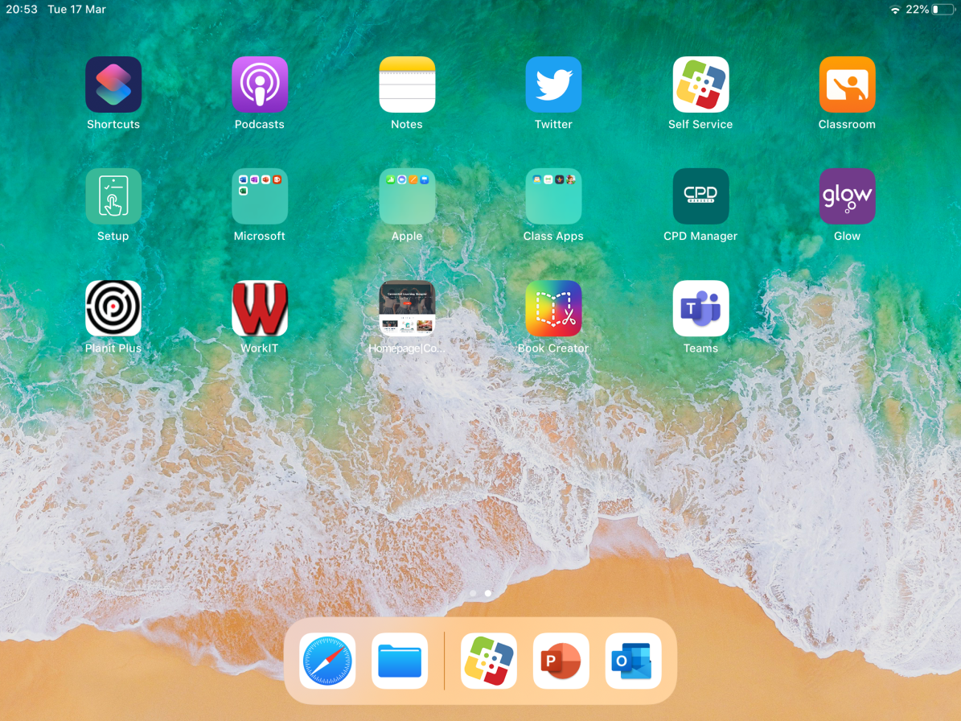
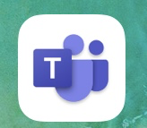
The Teams app can also be downloaded from Self Service/App Store

Slide 13
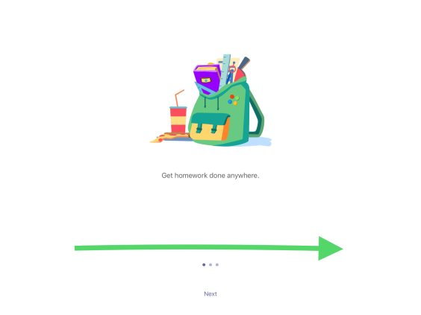
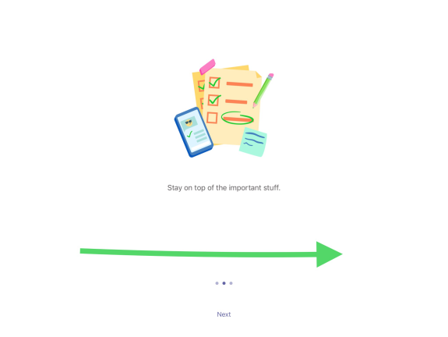
To find work you will have to go through these steps…

Slide 14
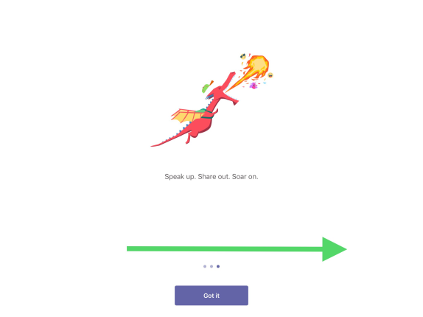
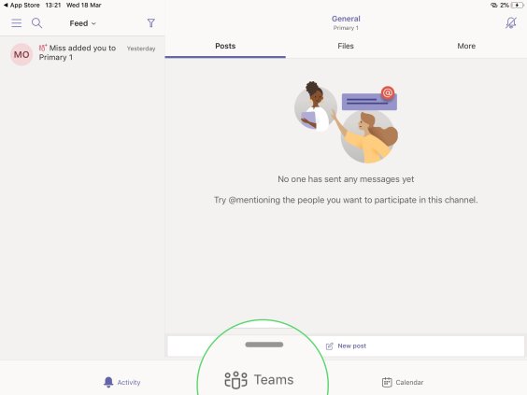
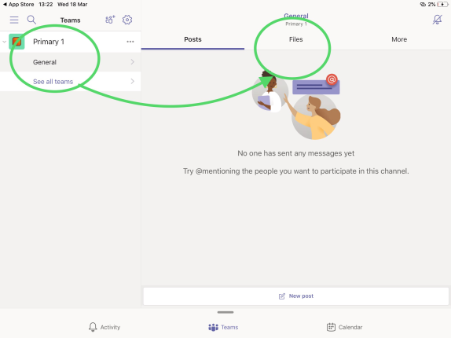

Slide 15
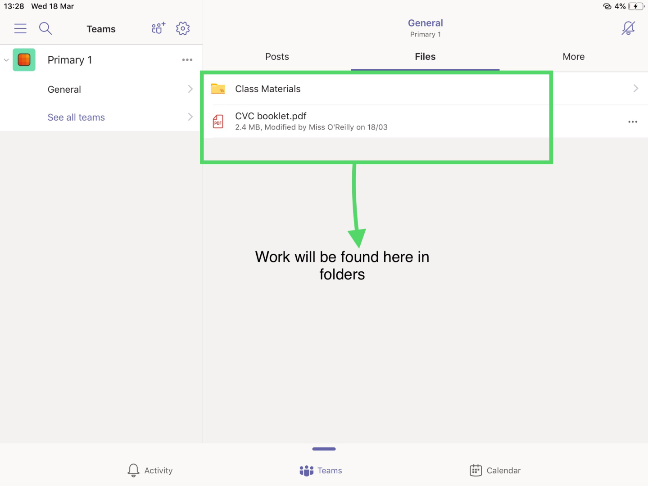
Work will be uploaded by the Class Teacher into folders in the Files section

Slide 16
Thank you for your continued support!

