Slide 1




P7 Valencia Trip
22^{nd -} 26th February 2026

Slide 2
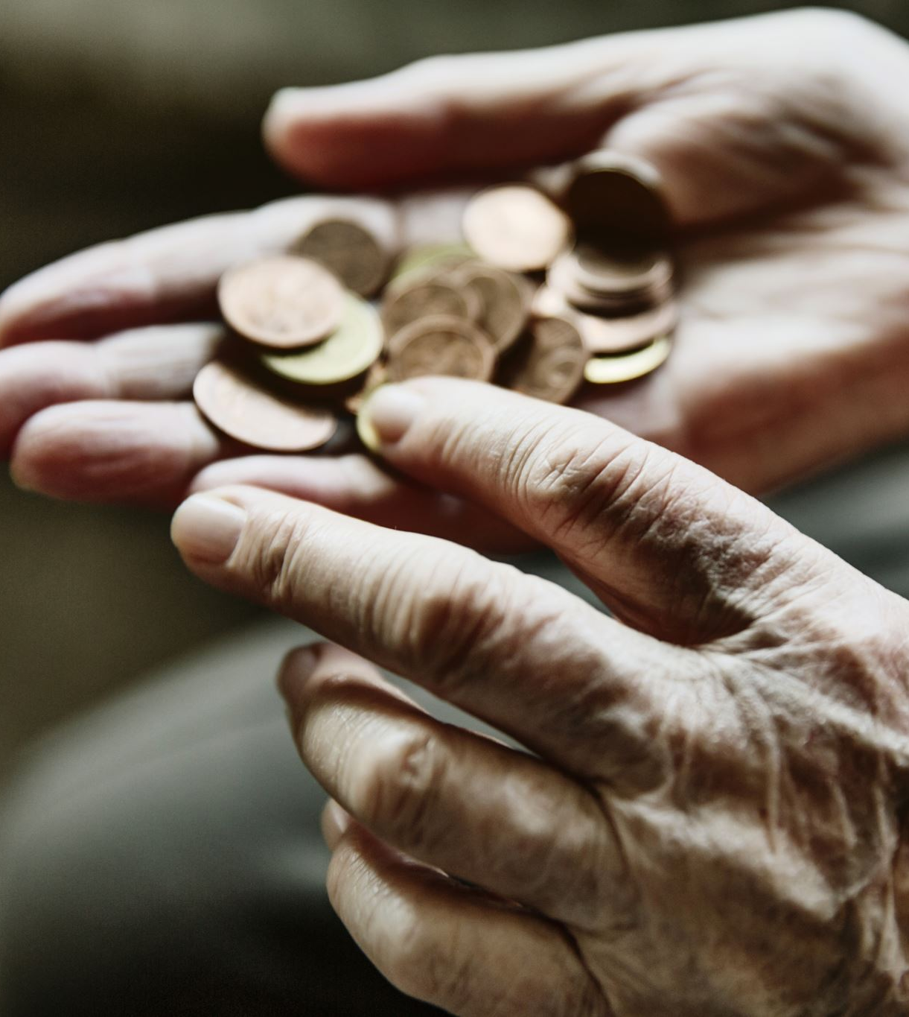
Funding, Costs and Spending Money

Slide 3
Turing Fund
Grant application; initial grant was successful but for lesser amount than we had initially applied.
Pots of money are ring fenced for specific costings; money cannot be moved from one budget line to another.
£70 per child towards travel and accommodation costs.
Children will require spending money, min £50-max £70 this must be in euros and handed into school the week before travel.

Slide 4
Staff Team
7 staff travelling with children
Lead SLT; Mrs Rutherford HT and Mrs McLaughlin PT
Accompanied by:
Mr Curran, Mrs Balloch, Miss McKirgan, Dave Kelly, Ms McNamara.

Slide 5
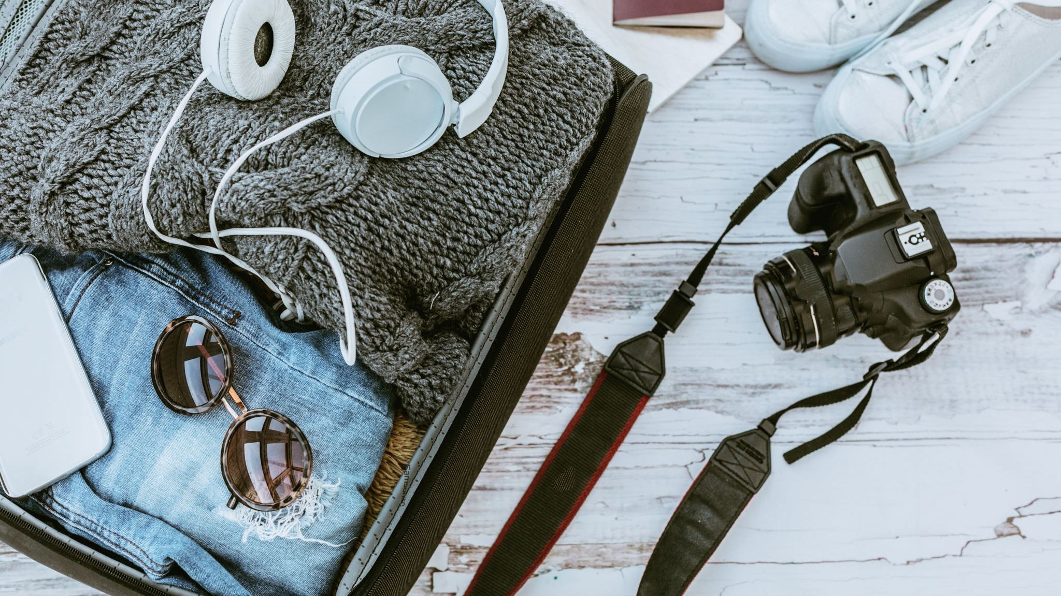
Travel

Slide 6
Flights and Coach transfers
Coach pick up at 4am on 22/2 from St Francis Primary.
NO ACCESS to school therefore all children MUST be on time.
Flying Easyjet Glasgow-Alicante at 7.10am on Sunday 22nd February.
Alicante-Valencia coach transfer.
Return travel: Easyjet flight on 26th Feb Alicante-Glasgow at 20.10pm. Due to land in Glasgow at 22.25pm. Coach transfer back to St Francis.
11.15pm Pick up at school.

Slide 7
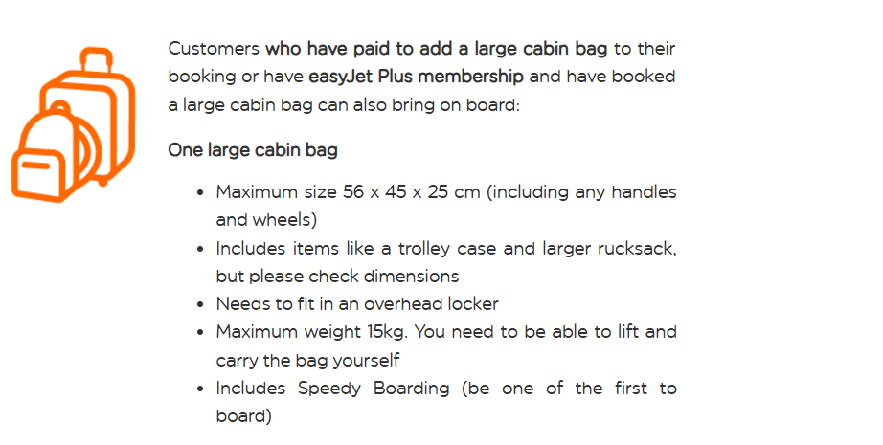
Luggage MAX 15KG

Slide 8
Bag check…
Week 9-13th February, children must bring their (empty) luggage to school for staff to check it meets the airline requirements.

Slide 9
Passports, Visas, Sharecodes and GHIC Cards
Passports and GHIC cards will be collected from children on Thu 18th February to allow staff to check all documentation is in place.
GHIC Cards will be held by staff for the duration of the trip.
Children will be issued with passports at the airport, they will then be collected and stored safely for the duration of the trip.
They will be used at the airport on the return journey, collected by staff and re-issued to children on their return to school after the trip.

Slide 10
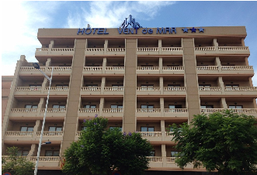
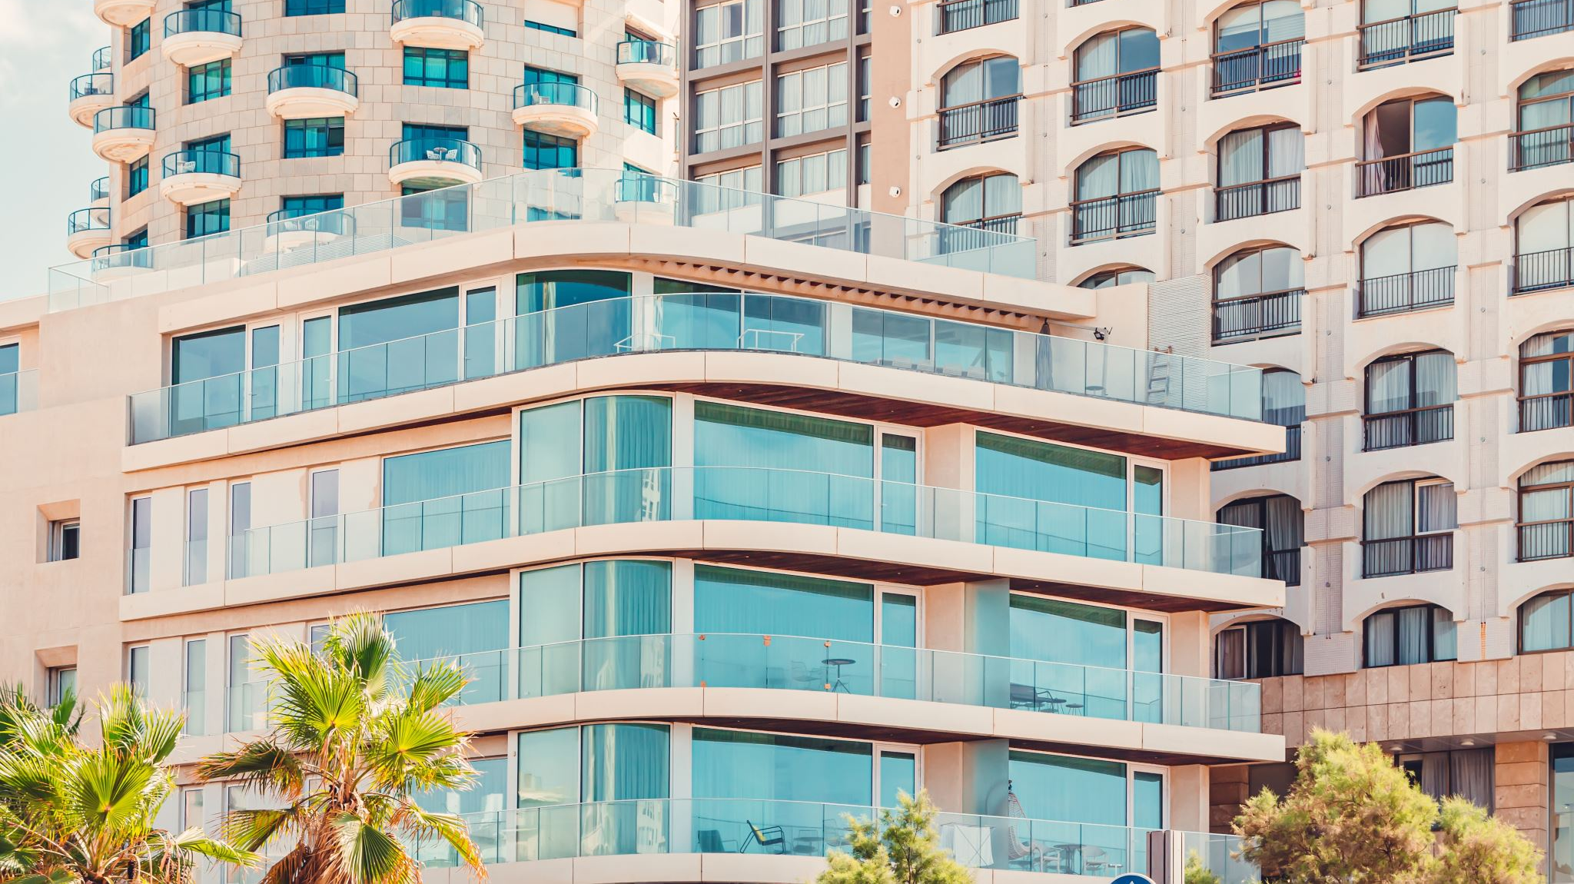
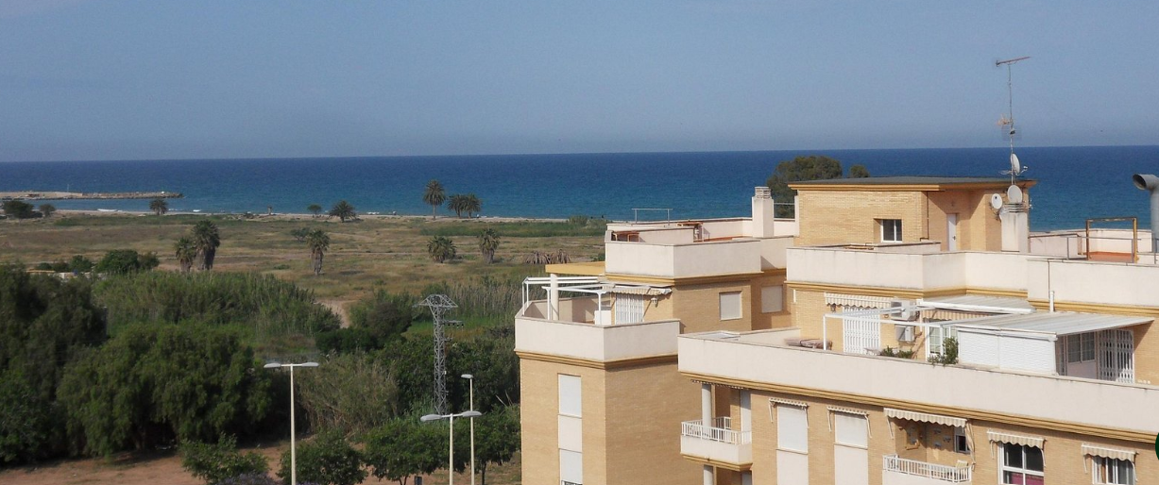
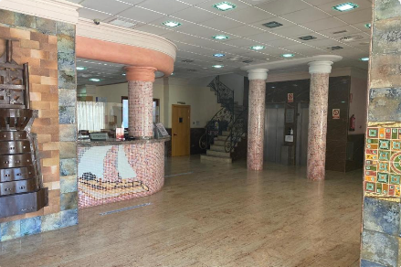
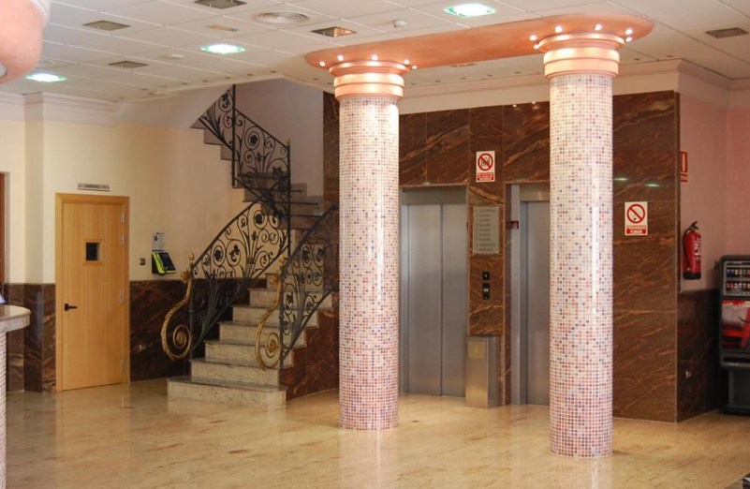
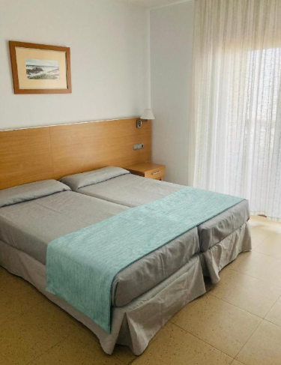
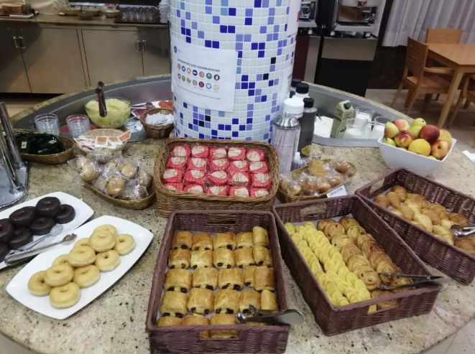
Hotel Vent de Mar

Slide 11
Four-night stay
Half board basis; Breakfast and Dinner provided.
Twin rooms; two single beds. Shower/bathroom in each room.
Rooms allocated on ground and first floor; staff rooms will be located next to children’s rooms.
Near to beach/ green area

Slide 12
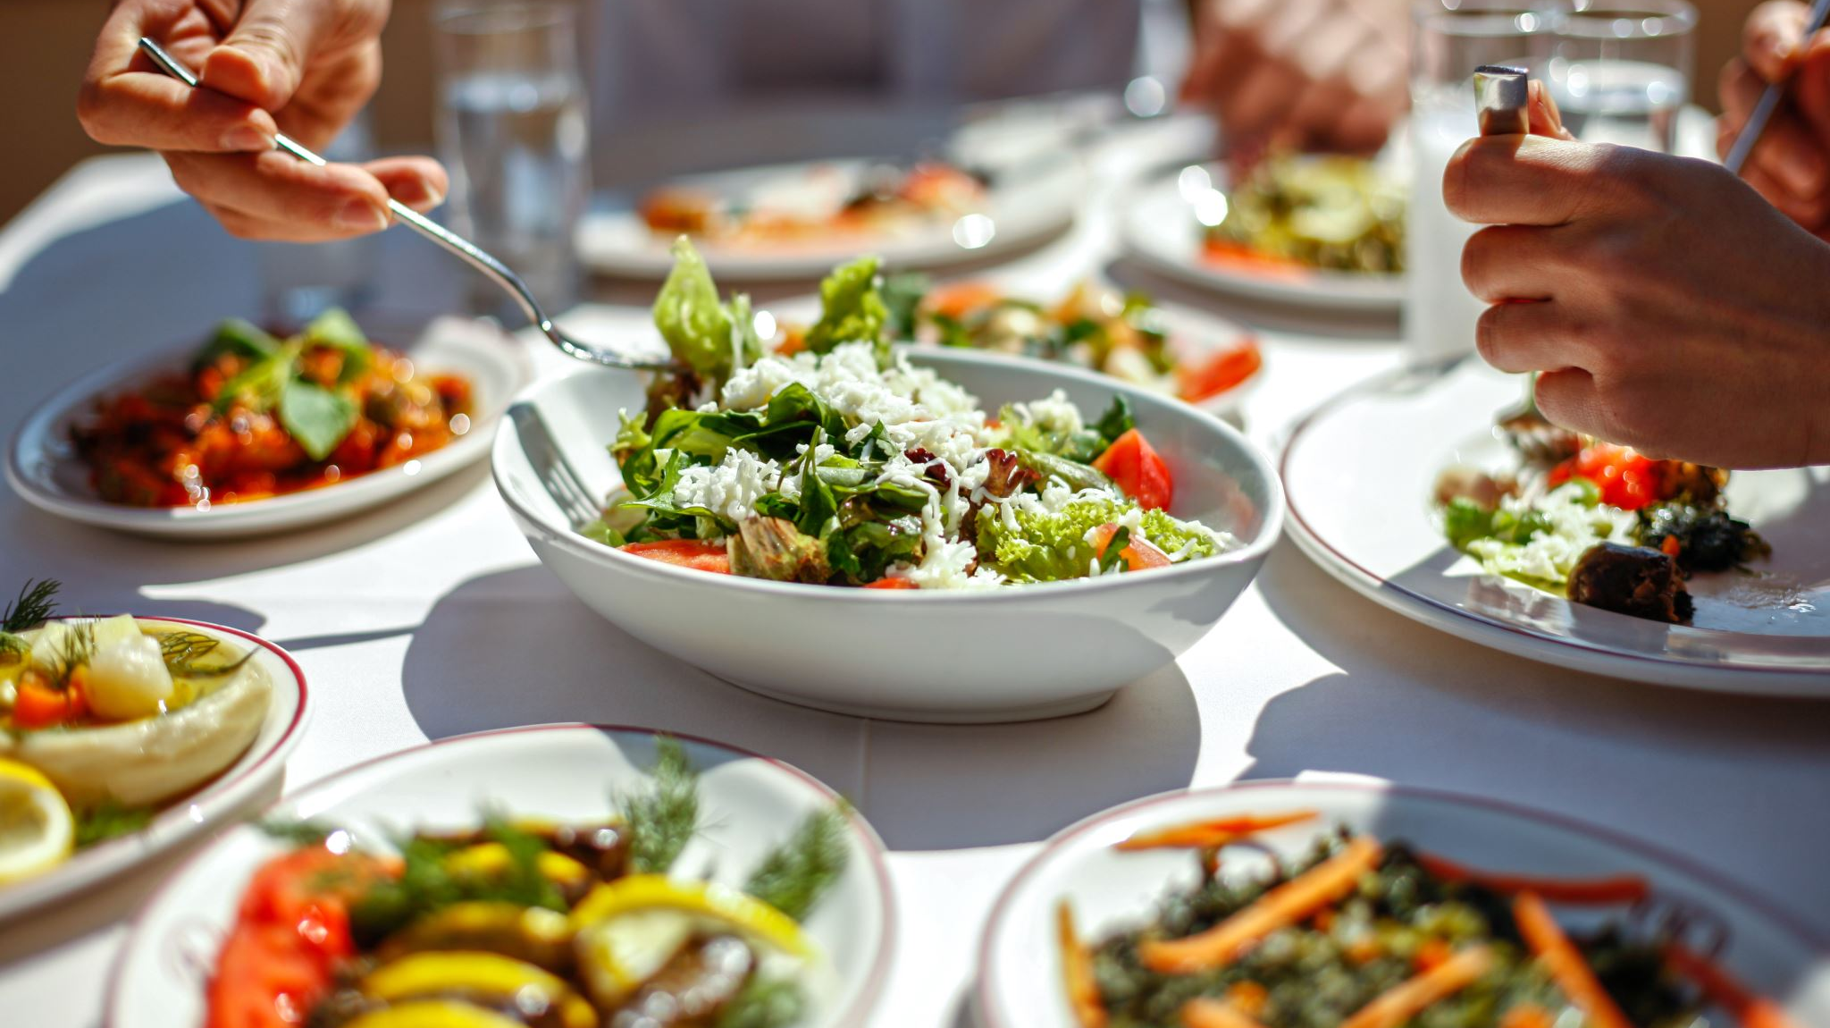
Food

Slide 13
Our meal plan is buffet style. Meat/ fish options. Salad bar, side dishes, fruit, and dessert.
Breakfast buffet style, with eggs, cold meat cuts, various pastries, cereal, bread, jam, juice/water tea and coffee.
Lunch; in school Mon/Tuesday
Lunch: out during trip on Wed
Lunch provided by hotel on Thu

Slide 14
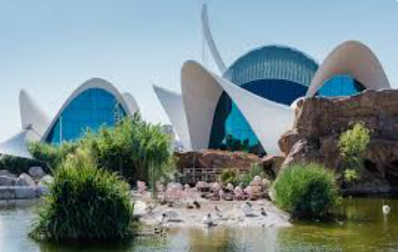

Itinerary
Sunday 22nd: Travelling to Valencia/ arrive at hotel, familiarise with local area.
Mon 23rd: Visit Spanish schools
Tue 24th: Visit Spanish schools, activity with all schools together.
Wed 25th: Valencia Trip: Oceanografico/ Science Park
Thu 26th: Check out and travel back to Glasgow

Slide 15
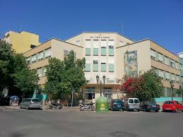
Schools
Colegio Dominicos San Vicente Ferrer Valencia

Slide 16
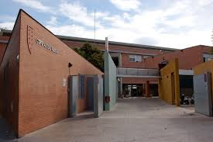
Ausias March

Slide 17
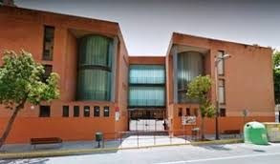
Ceip Mediterraneo

Slide 18
Weather
In February, Valencia experiences mild, pleasant winter weather that often feels like early spring, with average daytime high temperatures of around 16°C (61°F) and cooler nights. It is generally a dry, sunny month with minimal rainfall.

Slide 19
Kit List
Remember 15kg baggage allowance!
Liquids must be bagged separately and no more than 100ml (they do not need to be removed from hand luggage at security!)
Liquids include:
all drinks, including water
liquid or semi-liquid foods, for example soup, jam, honey and syrups
cosmetics and toiletries, including creams, lotions, oils, perfumes, mascara and lip gloss
sprays, including shaving foam, hairspray and spray deodorants
pastes, including toothpaste
gels, including hair and shower gel
contact lens solution
any other solutions and items of similar consistency

Slide 20
Clothing for four days (light layers, the evening can be cooler)
Waterproof jacket
Comfortable shoes for walking
Underwear
Pyjamas / slipper socks/ slippers
Toiletries (remember it is only four nights!)

Slide 21
Medication
ONLY prescription medication can be taken. Any medication being carried must have a pharmacy issued label on it with child’s name etc.
Medication forms will be issued and must be completed for each medication required, we will then collate an overview of this.
Children should NOT hand medication into school, it will be carried in child’s bag and handed over to staff on arrival at the hotel.
Children must NOT carry any medication that school staff are unaware of.
Ideally all medicines must be under 100ml, if this is not possible we will require a doctor’s letter to accompany children on the trip.

Slide 22
Risk Assessment
Mrs Mc Laughlin travelled to Valencia last week, she has visited schools, stayed in the hotel etc and a full risk assessment has been undertaken.
No mobile phones.
No electronic device; tablets, i-pads, smart watches etc.

Slide 23
We have emergency procedures in place and parents will be issued with a number they can contact on a 24-hour basis (this will be to speak to school staff here in the UK, if we need to contact staff in Valencia, we will do this. )
Communication: Updates re travel times etc will be shared via Twitter/X
Daily images and updates shared on Showbie platform

Slide 24

Questions?

