Slide 1
Welcome to our class blog! We have had a very busy start to the year and have been learning lots of new things. Please click on to find out more!

Slide 2
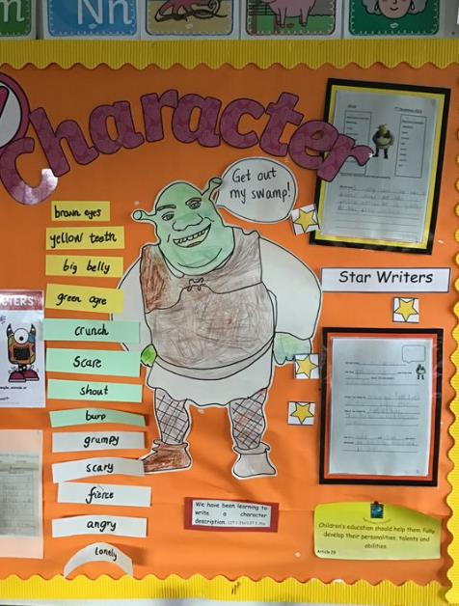
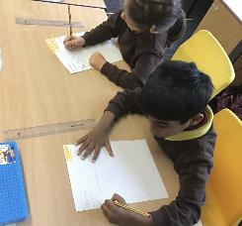
Literacy
This term we have been learning:
New sounds to help us spell new words.
To read and say the sounds and listen for the word themselves.
We have been learning about fairy tales. We have used adjectives to describe characters.
We have used our 5 senses to describe different settings.
To create compound sentences using ‘and’.

Slide 3
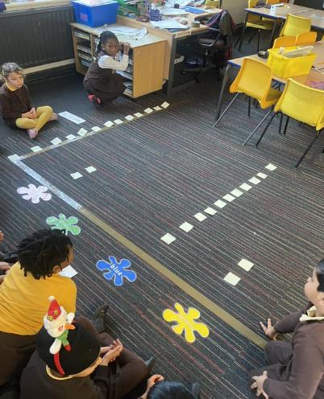
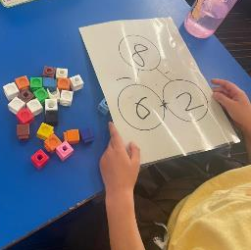
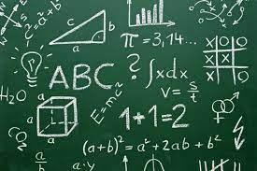
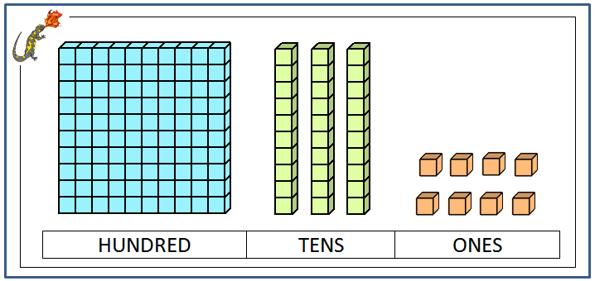
Numeracy
This term we have been learning:
To count up to 100.
To use different subtraction strategies (counting back using a number line).
We have been learning about place value.
We have been learning to partition numbers within 30.
We have been learning about different ways to record data such as bar charts.

Slide 4
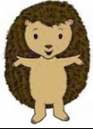
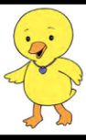
Health & Wellbeing
This term we have been learning:
How to give and receive compliments.
To recognise different emotions such as excited, tired and frustrated.
To solve problems using restorative conversations.
We have been learning different ball skills. We have also been learning to work as team by playing different games.

Slide 5
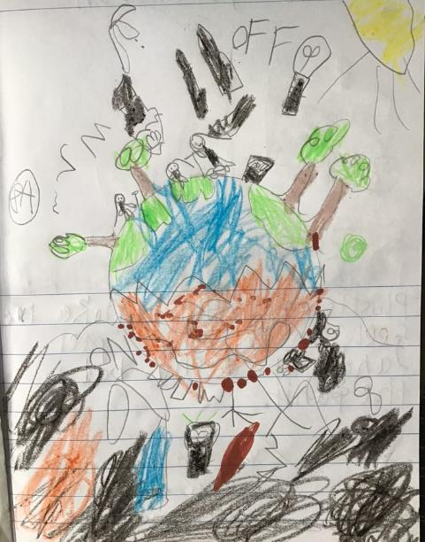
Sustainability
This term we have been learning about our planet and how to look after it.
We discussed good choices and bad choices for the environment.
We discussed the impact of our choices on the planet.
We have made positive choices in our classroom and assigned class jobs such as ‘light monitor’ and ‘recycle monitor’.
We learned about the sun and how we can use it to create energy.

Slide 6
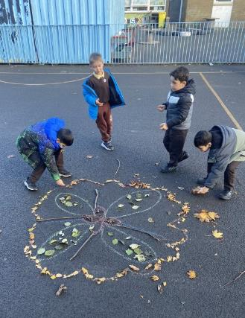
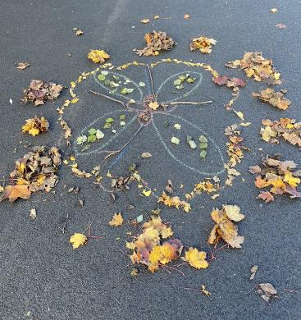
Outdoor Learning
This term we have been exploring our natural environment with Miss McEneny.
We explored Rangoli patterns and created our own using natural materials.

Slide 7
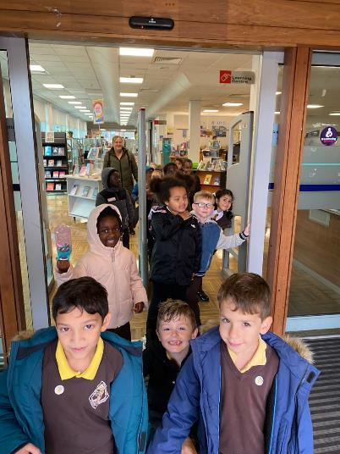
Some more pictures of learning in other areas of the curriculum!

Slide 8
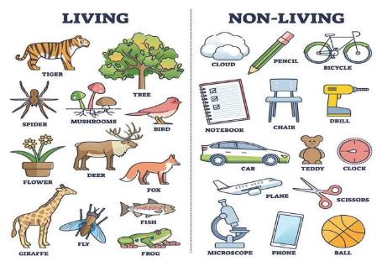
Next term we will be learning…
We will continue to learn new sounds in phonics!
We will explore procedural writing and how to write instructions. We will be able to tell you how to make a jam sandwich!
We will be learning to read with expression.
We will learn to apply our skills in addition and subtraction to word problems.
We will learn how to use directional language.
We will explore our planet Earth, the solar system and living and non-living things.

Slide 9
Website links that you might want to check out!
Family Learning website – how to videos and information to help children with learning at home
https://blogs.glowscotland.org.uk/gc/stfrancisfamilylearning/
St Francis Primary and Nursery Class website – latest news and information about our school
https://blogs.glowscotland.org.uk/gc/stfrancisprimaryandnurseryclass/
St Francis Primary and Nursery Class Twitter page
https://twitter.com/StFrancis_PS?ref_src=twsrc%5Etfw

