Slide 1
Welcome to our class blog! P5 Term 2 Please click on to find out more!

Slide 2
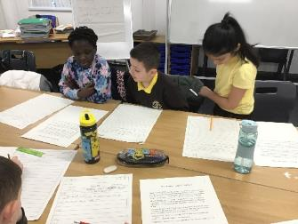
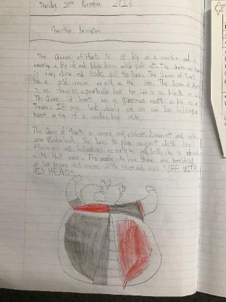
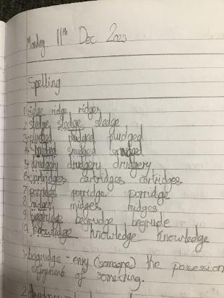
Literacy
This term we have:
Developed our reading strategies – focusing on understanding words and finding information
Learned to develop our use of punctuation, nouns, connectives,
adverbs and coordinating adjectives
Learned to develop our handwriting style
Learned to create setting and character descriptions including good imagery
to diacritically mark our spelling words

Slide 3
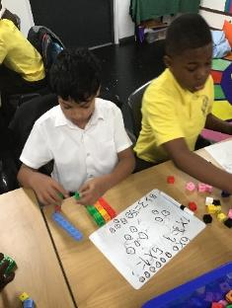
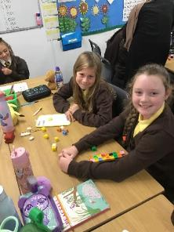
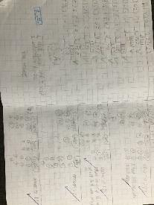
Numeracy
This term we have:
Learned to multiply and divide numbers using a range of strategies
Learned to carry out money calculations involving the four operations
Learned to tell the time
Learned about different 2D and 3D shapes and their properties
Learned to understand the term coordinates and be able to identify and plot coordinates on a graph

Slide 4
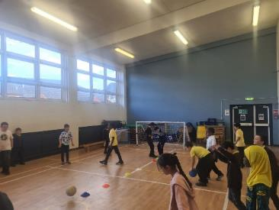
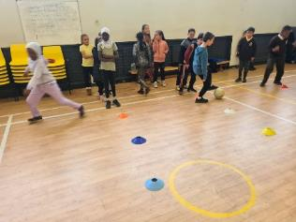
Health & Wellbeing
This term we have been learning:
how to make healthy choices
the dangers of fireworks
all about road safety
to talk about the problems we might have in class
how to use the PATHS control signals
to develop our football skills; dribbling, passing and shooting
how to perform Scottish Ceilidh Dancing for our WAG show
our Christmas show performance

Slide 5
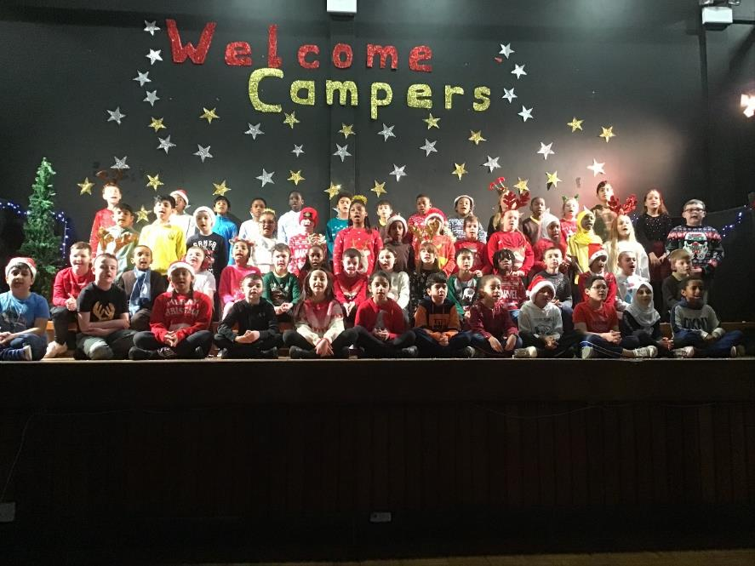
Our Christmas Show Performance

Slide 6
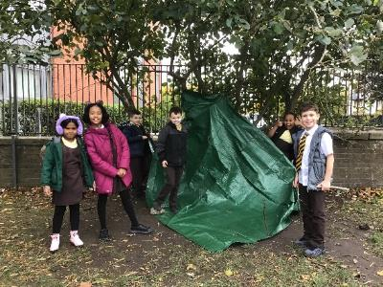
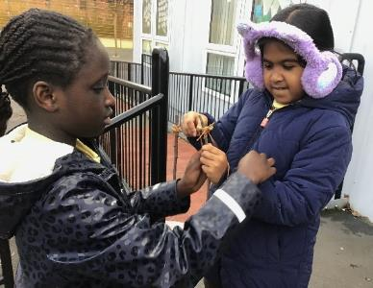
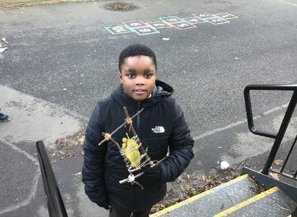
Outdoor Learning
We took our learning outside to build on our teambuilding skills. We created dens using tarpaulin, pegs and ropes.

Slide 7
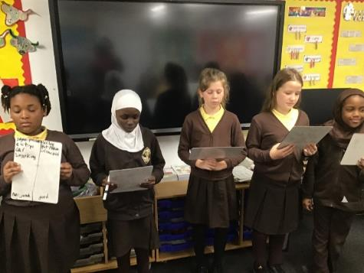
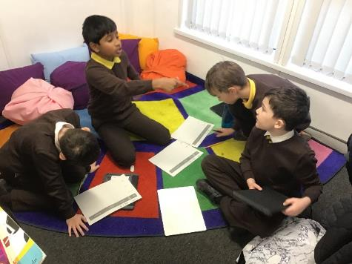
IDL During Term 2, we have been learning what it means to be self-sustainable and all about Renewable and Non-renewable Energy. We have also been learning to select and use applications and software to capture, create and modify text, images, sound and video.

Slide 8
Coming up in Term 3…
Maths/Numeracy – We will be exploring angles and fractions.
Literacy – We will be learning to develop our understanding of how complex sentences are constructed and explore report and explanation writing genres.
Health and Wellbeing – We will be examining nutritional value of foods; packaging and interpreting data. We will also be developing our team work skills.

Slide 9
Website links that you might want to check out!
Family Learning website – how to videos and information to help children with learning at home
https://blogs.glowscotland.org.uk/gc/stfrancisfamilylearning/
St Francis Primary and Nursery Class website – latest news and information about our school
https://blogs.glowscotland.org.uk/gc/stfrancisprimaryandnurseryclass/
St Francis Primary and Nursery Class Twitter page
https://twitter.com/StFrancis_PS?ref_src=twsrc%5Etfw

