Slide 1
Welcome to our class blog! P4 Term 2 Please click on to find out more!

Slide 2
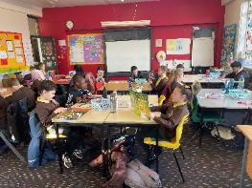
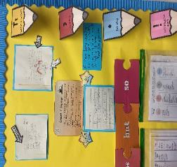
Literacy
This term we have been learning:
new sounds
reading strategies – questioning, prediction
to develop our use of punctuation, nouns, adverbs, adjectives and speech marks
to use cursive handwriting
to describe character within a spooky setting
to describe setting within a spooky setting
our class novel this term is called ‘Bill’s New Frock’ which will be continued into term 3

Slide 3
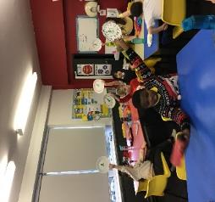
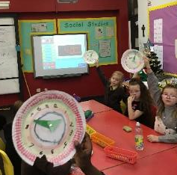
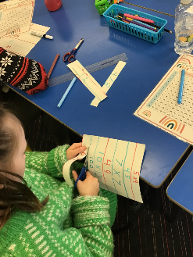
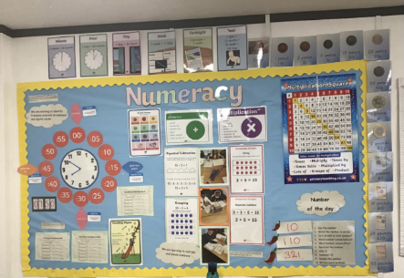
Numeracy
This term we have been learning:
the 2, 5, 10, 7, 8 and 9 times tables
strategies for multiplying including arrays, groups, skip counting and repeated addition
to tessellate and make patterns
Digital and analogue clocks
Telling the time in 5 minute increments

Slide 4
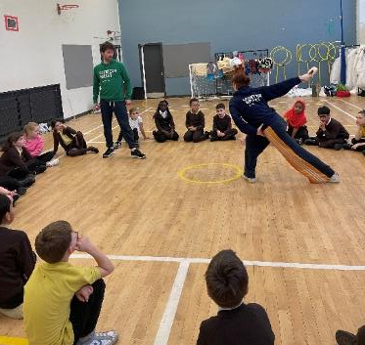
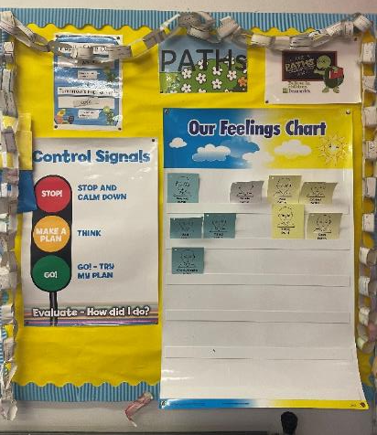
Health & Wellbeing
This term we have been learning:
to talk about the problems we might have in class
how to use the PATHS control signals
sports coaches for football
sports coaches for handball

Slide 5
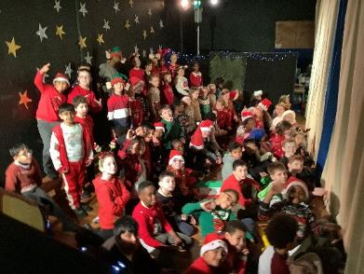
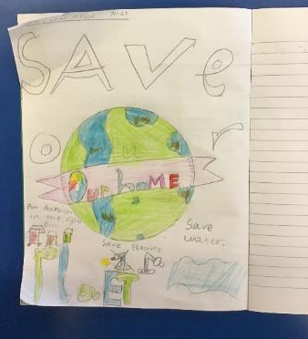
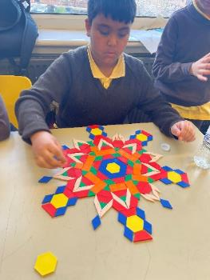
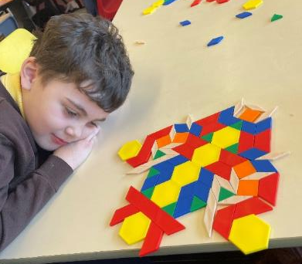
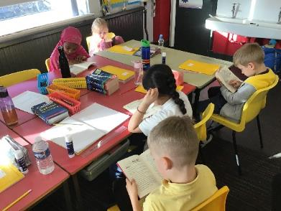
Some more pictures of learning in other areas of the curriculum!
Our houses for the future generation

Slide 6
Coming up in Term 3…
Maths/Numeracy – division, fractions, area and volume
Literacy – new sounds, reading strategies and persuasive writing
Health and Wellbeing – PATHS, feelings, athletics and healthy lifestyles
Science – The Human Body

Slide 7
Website links that you might want to check out!
Family Learning website – how to videos and information to help children with learning at home
https://blogs.glowscotland.org.uk/gc/stfrancisfamilylearning/
St Francis Primary and Nursery Class website – latest news and information about our school
https://blogs.glowscotland.org.uk/gc/stfrancisprimaryandnurseryclass/
St Francis Primary and Nursery Class Twitter page
https://twitter.com/StFrancis_PS?ref_src=twsrc%5Etfw

