Slide 1
Primary 1a Welcome to our class blog! Please click on to find out what we’ve been learning this term!

Slide 2
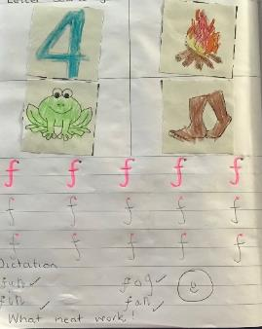
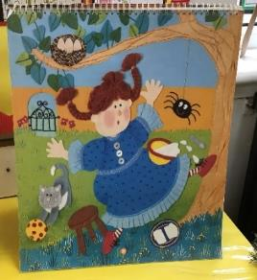
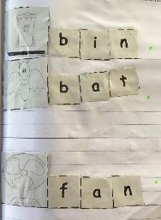
Literacy
This term we have been learning to:
Blend our letter sounds to help us read harder words
Use our letter sounds to write words
Contribute to shared writing lessons when we work together to write sentences
Use our letter sounds to ‘have a go’ at writing our own words and sentences independently
Clarify words.
We have been very busy!

Slide 3
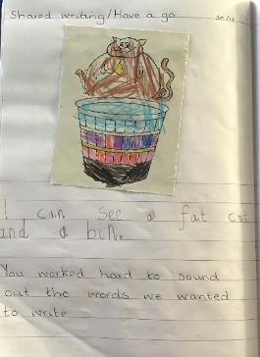
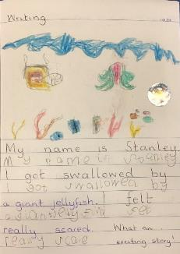
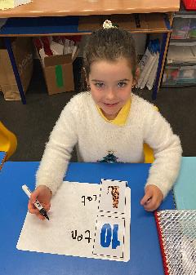
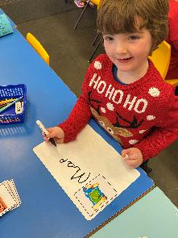
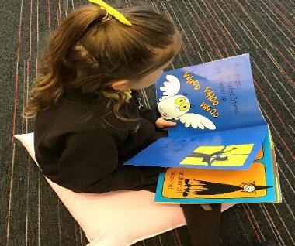
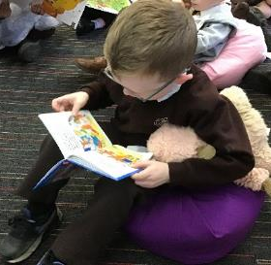
We have continued to learn even more sounds. We can use these sounds to ‘have a go’ at writing words and sentences all by ourselves.
We can use the letter sounds we know to help us read words.
We enjoy listening to stories and having the opportunity to choose our own favourite book.
We can clarify words and show our understanding of what these words mean.

Slide 4
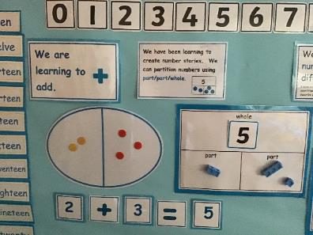
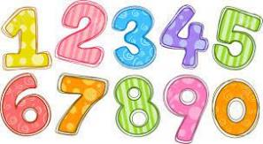
Numeracy and Mathematics
This term we have been learning to:
Count forwards and backwards from a given number
Add using a range of strategies
Represent numbers in different ways e.g. dots, fingers, ten frames,
Partition numbers (split numbers) using the part, part, whole model
Read and set o'clock times
Recognise and discuss 3D shapes.

Slide 5
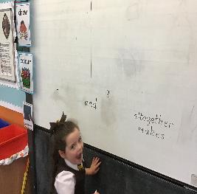
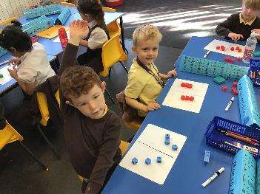
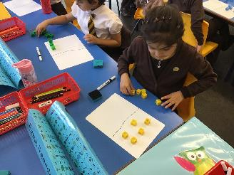
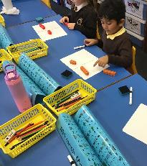
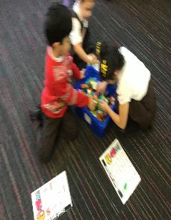
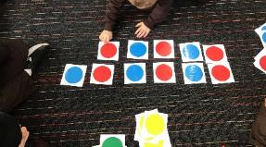
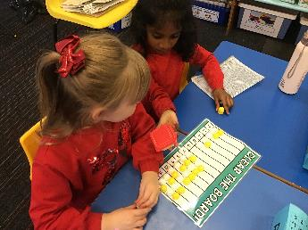
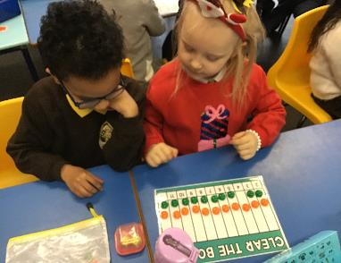
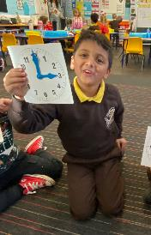
Numeracy and Mathematics
We can partition numbers using the part, part, whole model.
We can represent numbers in different ways
We are learning to
copy, continue
and create patterns.
We enjoy playing our number games.

Slide 6
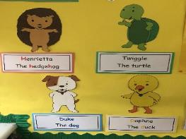
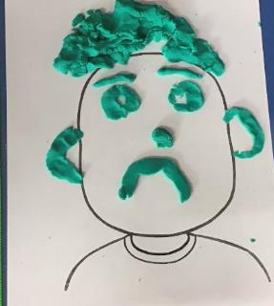
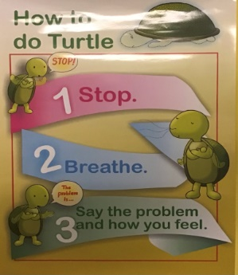
Health & Wellbeing
This term we have been learning:
To recognise the emotions of ‘sad’ and ‘cross’
About the qualities of a good friend
To explore the ways in which we can be responsible and respectful
About the ways in which we can help to stop the spread of germs.

Slide 7
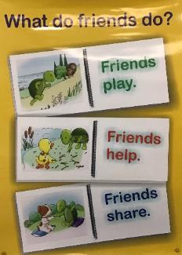
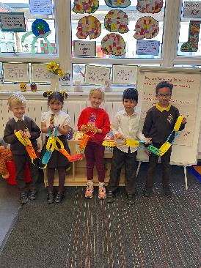
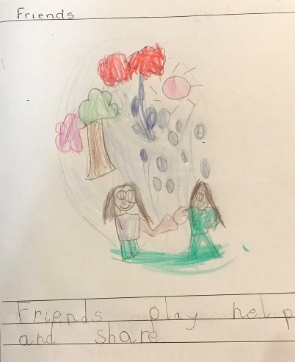
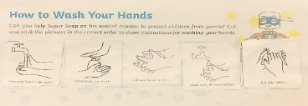
Health & Wellbeing
We made a friendship chain with the names of everyone in our class.
We can talk about the qualities of a good friend.
We know how to wash our hands carefully to help stop germs from spreading.
We learned about healthy food choices.

Slide 8
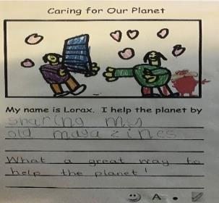
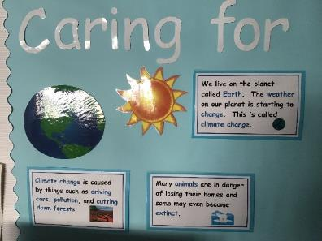
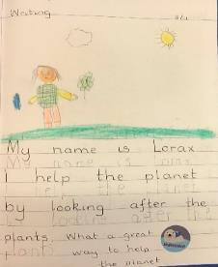
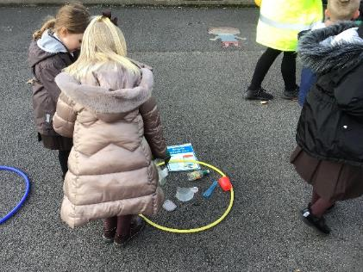
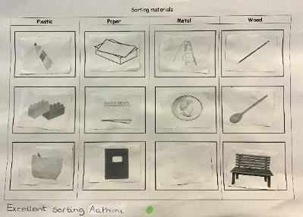
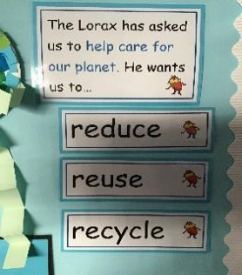
Other Curricular Areas
This term our IDL topic was ‘Caring For Our Planet’. We explored the changes we can make to our behaviour to help care for our planet.
We learned about the dangers, sea creatures face from pollution.
We know that we can help our planet by trying to reduce, reuse and recycle.
We explored the different materials used to make a range of items and sorted them into groups.

Slide 9
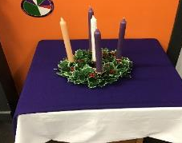
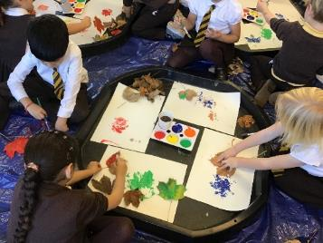
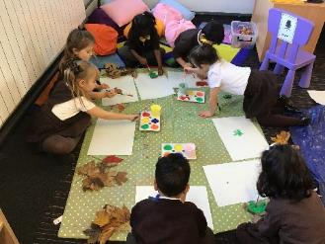
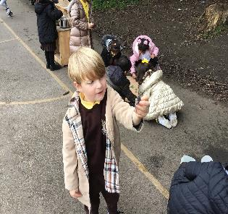
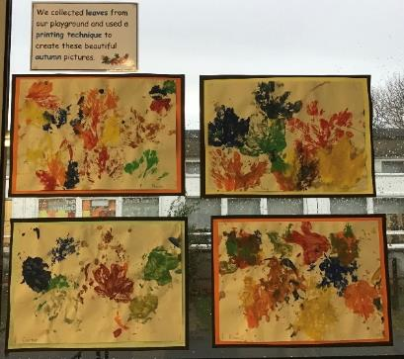
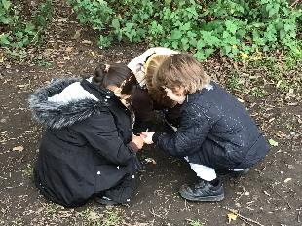
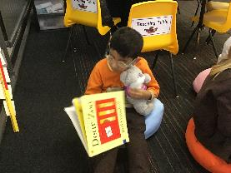
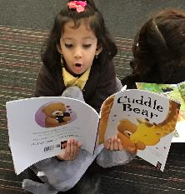
Other Curricular Areas
In Art we collected leaves and used a printing technique to create these beautiful paintings
In R.E. we learned about Advent and explored the story of Christmas.
We explored living things as part of our outdoor learning activities.
Thank you so much to everyone for supporting our readathon fundraiser!

Slide 10
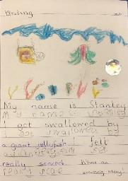
Term 3
Here a some of the things we will be learning about next term.
Literacy and English
We will:
Continue to build on our knowledge of letter sounds. Our new sounds will include vowel digraphs such as ‘ai’ and ‘oa’
Read and write more complex words and sentences
Participate in shared writing sessions where we will work together to build increasingly complex sentences
Continue to have opportunities to write independently
Continue to build on our knowledge of the tricky words.
Health and Well-being
We will continue to look at strategies we can use to help us control our emotions in a positive way.

Slide 11
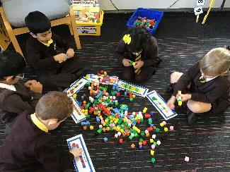
Numeracy and Mathematics
We will be:
Continuing to explore different ways of solving addition and subtraction calculations
Learning to skip count in 2s, 5s and 10s
Using tally marks, bar charts and graphs to display different information
Reading and recording o’clock and half past times on analogue and digital clocks
Social Studies/Science
Next term our topics will be Toys and On the Farm. Within the toys topic we will explore different power sources and friction. Our farm topic will look at the different types of farms we have and the produce we get from these. We will look at the journey our food makes from the farm to our plates. We will also investigate the different food groups.

Slide 12
Website links that you might want to check out!
Family Learning website – how to videos and information to help children with learning at home
https://blogs.glowscotland.org.uk/gc/stfrancisfamilylearning/
St Francis Primary and Nursery Class website – latest news and information about our school
https://blogs.glowscotland.org.uk/gc/stfrancisprimaryandnurseryclass/
St Francis Primary and Nursery Class Twitter page
https://twitter.com/StFrancis_PS?ref_src=twsrc%5Etfw

