Slide 1
Welcome to our class blog! We have had a very busy Term 2, learning lots of new things and performing in our Nativity. Please click on to find out more!

Slide 2
Literacy
This term we have been learning:
Phonics including digraphs.
To read and say the sounds and listen for the word themselves.
To write character and setting descriptions using different language techniques.
To carefully read and answer comprehension questions about a text.
Use our reading skills to read and understanding fiction and non-fiction texts.
A range of reflective reading strategies.

Slide 3
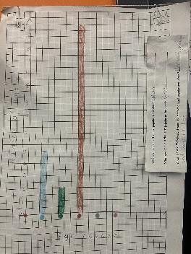
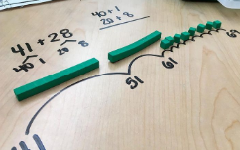
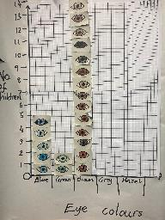
Numeracy
This term we have been learning:
Different strategies to solve addition and subtraction number sentences – open number lines, expanded form, partitioning and place value
To recognise and use greater than and less than symbols
Skip counting in 3s and 4s
To recognise 2D and 3D shape and their properties
How to gather, analyse, interpret and record data using frequency charts, pictographs and bar graphs

Slide 4
Health & Wellbeing
This term we have been learning:
To continue to learn about PATHS feelings and strategies to regulate our emotions
To identify our emotions through daily check ins
Continuing to learn about our rights
How to stay active and healthy
Laudato Si - the importance of goods and services, and why people should be paid and treated fairly

Slide 5
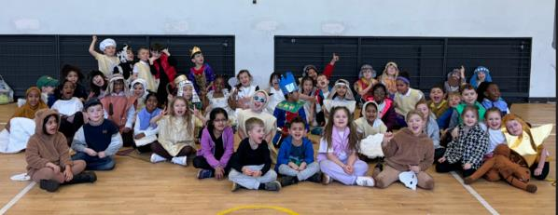
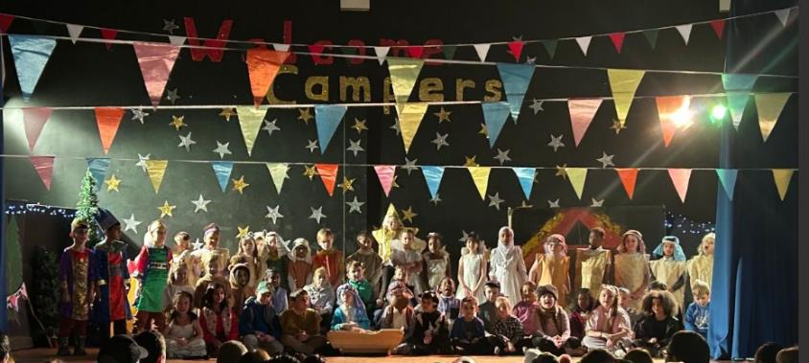
Nativity!

Slide 6
Learning for Term 3
Literacy
Novel study – Reflective Reading strategies
Writing – Procedural/Explanation and Report writing
Phonics International- Weekly spelling words
Numeracy
Multiplication – Using concrete, pictorial and abstract method to learn times tables
Division – Using concrete and pictorial representations to share and group quantities
Measure – distance, volume, weight
Angles, Symmetry and Transformation
Health and Wellbeing
PATHS- Continuing to learn about feelings and use strategies to manage these.
Dance – Workshops with D2D
SHANARRI – Focusing on Respect and Reasonability
Healthy – Food hygiene

Slide 7
Website links that you might want to check out!
Family Learning website – how to videos and information to help children with learning at home
https://blogs.glowscotland.org.uk/gc/stfrancisfamilylearning/
St Francis Primary and Nursery Class website – latest news and information about our school
https://blogs.glowscotland.org.uk/gc/stfrancisprimaryandnurseryclass/
St Francis Primary and Nursery Class Twitter page
https://twitter.com/StFrancis_PS?ref_src=twsrc%5Etfw

