Slide 1
Primary 1b Welcome to our class blog! Please click on to find out what we’ve been learning this term!

Slide 2
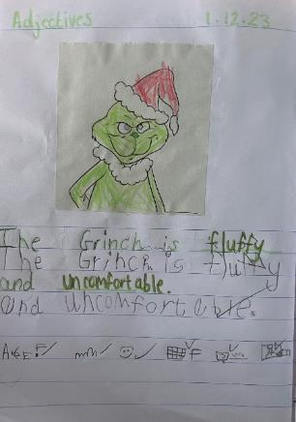
Literacy
This term we have been learning to:
Blend our letter sounds to help us read harder words
Use our letter sounds to write words
Contribute to shared writing lessons when we work together to write sentences
Use our letter sounds to ‘have a go’ at writing our own sentences independently
Clarify words.

Slide 3
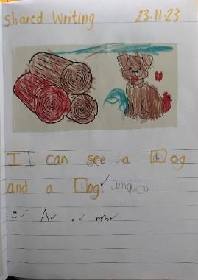
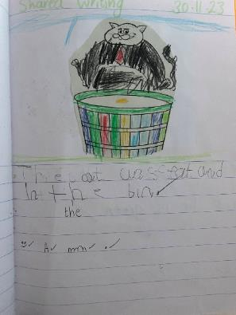
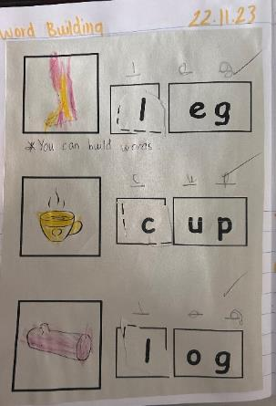
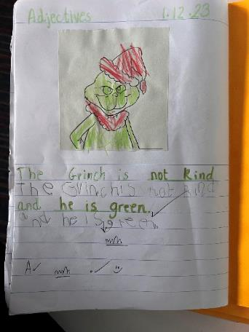
We have continued to learn even more sounds. We can use these sounds to ‘have a go’ at writing words and sentences all by ourselves.
We can use the letter sounds we know to help us read words.
We can recognise word families.
We can clarify words and show our understanding of what these words mean.
We enjoy listening to stories and having the opportunity to choose our own favourite book.

Slide 4
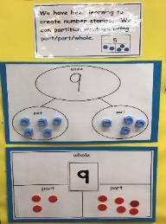
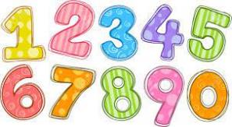
Numeracy and Mathematics
This term we have been learning to:
Count forwards and backwards from a given number
Add using a range of strategies
Represent numbers in different ways e.g. dots, fingers, ten frames,
Partition numbers (split numbers) using the part, part, whole model
Read and set o'clock times
Recognise and discuss 3D shapes.

Slide 5
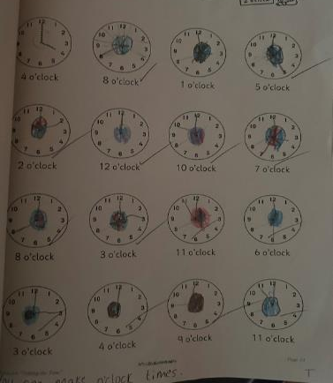
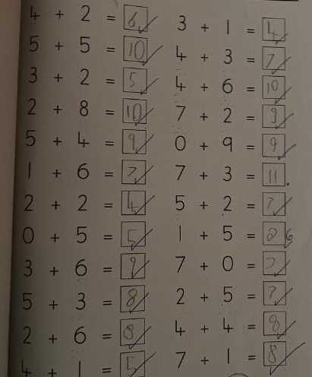
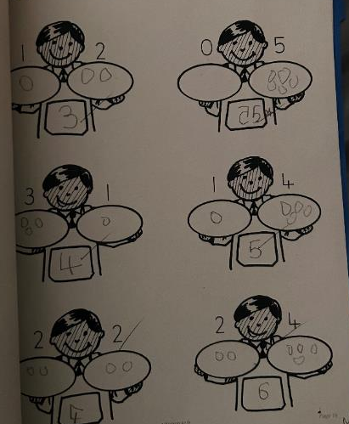
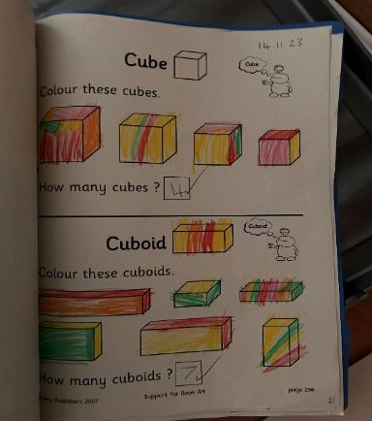
Numeracy and Mathematics
We can use strategies to add numbers e.g. number line, cubes.
We can read o’clock times!
We are learning to
identify 3D shapes.

Slide 6
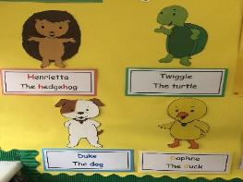
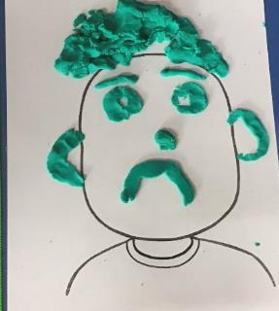
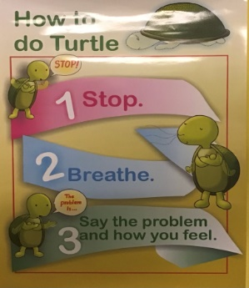
Health & Wellbeing
This term we have been learning:
To recognise the emotions of ‘sad’ and ‘cross’
About the qualities of a good friend
To explore the ways in which we can be responsible and respectful
About the ways in which we can help to stop the spread of germs.

Slide 7
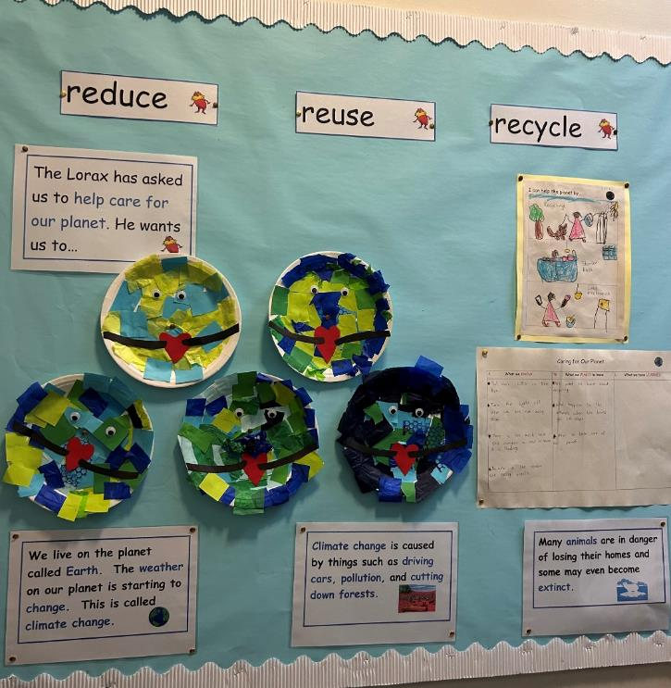
Other Curricular Areas
This term our IDL topic was ‘Caring For Our Planet’. We explored the changes we can make to our behaviour to help care for our planet.
We learned about the dangers, sea creatures face from pollution.
We know that we can help our planet by trying to reduce, reuse and recycle.
We explored the different materials used to make a range of items and sorted them into groups.

Slide 8
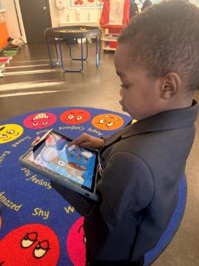
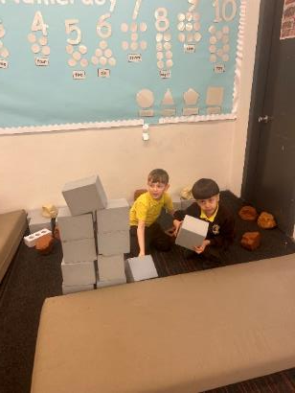
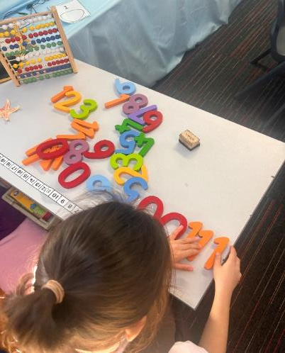
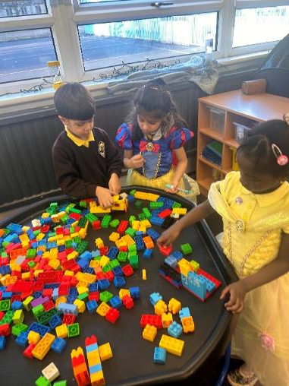
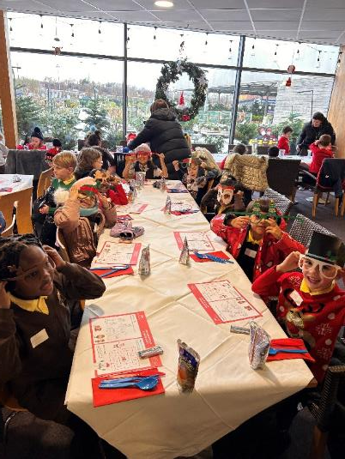
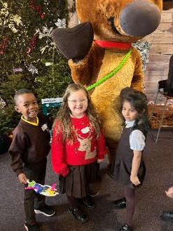
STEAM Room

Slide 9
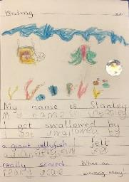
Term 3
Here a some of the things we will be learning about next term.
Literacy and English
We will:
Continue to build on our knowledge of letter sounds. Our new sounds will include vowel digraphs such as ‘ai’ and ‘oa’
Read and write more complex words and sentences
Participate in shared writing sessions where we will work together to build increasingly complex sentences
Continue to have opportunities to write independently
Continue to build on our knowledge of the tricky words.
Health and Well-being
We will continue to look at strategies we can use to help us control our emotions in a positive way.

Slide 10
Numeracy and Mathematics
We will be:
Continuing to explore different ways of solving addition and subtraction calculations
Learning to skip count in 2s, 5s and 10s
Using tally marks, bar charts and graphs to display different information
Reading and recording o’clock and half past times on analogue and digital clocks
Social Studies/Science
Next term our topics will be Toys and On the Farm. Within the toys topic we will explore different power sources and friction. Our farm topic will look at the different types of farms we have and the produce we get from these. We will look at the journey our food makes from the farm to our plates. We will also investigate the different food groups.

Slide 11
Website links that you might want to check out!
Family Learning website – how to videos and information to help children with learning at home
https://blogs.glowscotland.org.uk/gc/stfrancisfamilylearning/
St Francis Primary and Nursery Class website – latest news and information about our school
https://blogs.glowscotland.org.uk/gc/stfrancisprimaryandnurseryclass/
St Francis Primary and Nursery Class Twitter page
https://twitter.com/StFrancis_PS?ref_src=twsrc%5Etfw

