Slide 1
Welcome to our class blog! We have had a very busy start to the year and have been learning lots of new things. Please click on to find out more!
P6

Slide 2
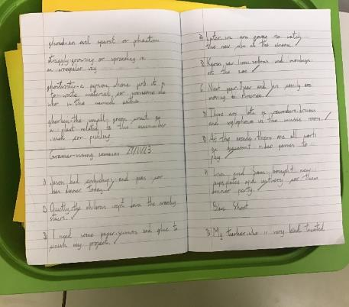
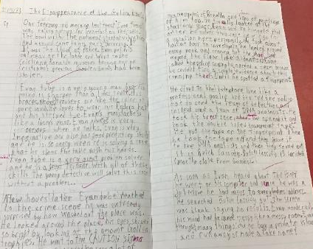
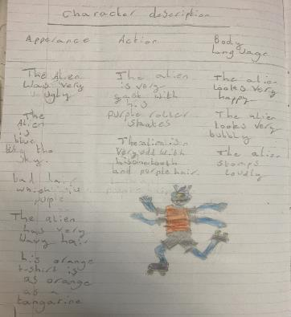
Literacy
This term we have been learning:
In reading we have focussed on reading strategies. We have been learning to find information within a text and identifying the main idea of a text.
In spelling we have been following the Phonics International programme, focusing on letter sounds, building vocabulary, spelling rules and using Active Spelling activities.
This term in Writing, P6/5 and P6a have started to look at Sci-fi writing and describing a ‘out of this world’ setting and character. P6/7 have been writing crime/mystery stories.
In Grammar, we have been improving our knowledge of punctuation and how to use it correctly.

Slide 3
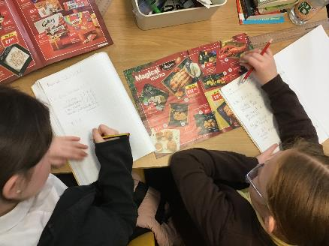
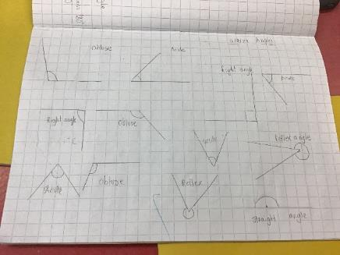
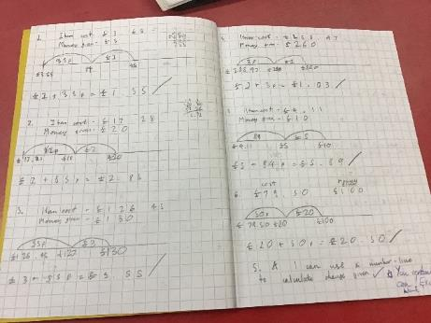
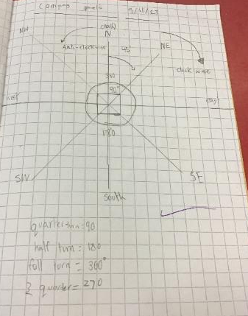
Numeracy
This term we have been learning:
To extend our multiplication knowledge by learning how to use a range of strategies and choosing the one that works best for us.
How to add, subtract, multiply and divide using Money. We even created our own Christmas menu using Lidl magazines and keeping to a budget.
P6/5 have been focusing on 2D and 3D shapes. They were able to create different 3D shapes and give the shape properties.
P6a and P7/6 have been focusing on angles and compass points.
We also participated in Sumdog Competition to represent our school.

Slide 4
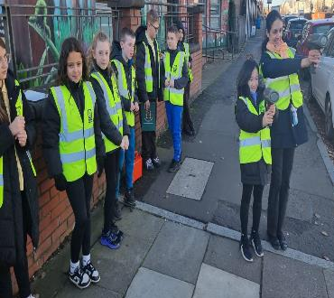
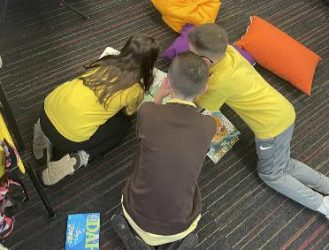
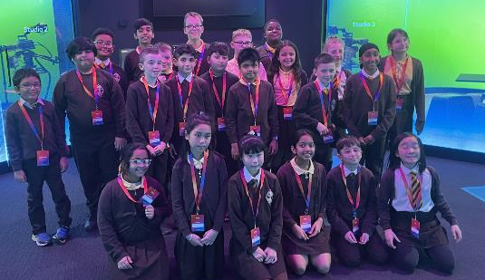
Health & Wellbeing
This term we have had visiting coaches to help us to improve our PE skills.
The Road Safety Officers visited our school and each class took part in several events.
We really enjoyed getting ready for the W.A.G (We are Gorbals) show and creating some art to be enjoyed at the event.
We also took part in a whole school Read-athon.
P7/6 were invited to the Sky Academy.

Slide 5
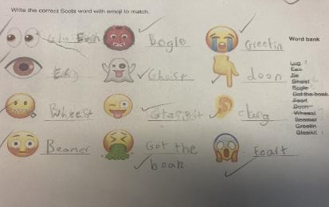
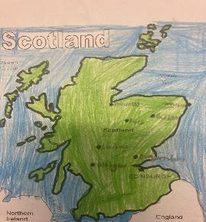
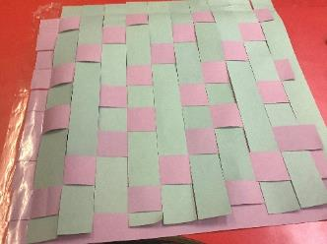
Topic
As part of our topic we have been learning different aspects about Scotland. We have been learning about the 8 cities, creating PowerPoints, listening to different Scottish musicians and bands, learning different Scot words, creating timelines of Scottish history and created multiplication patterned inspired tartan.

Slide 6
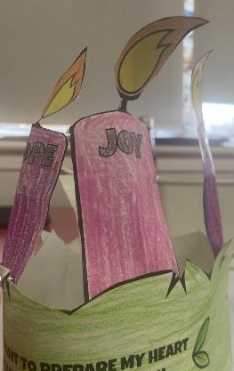
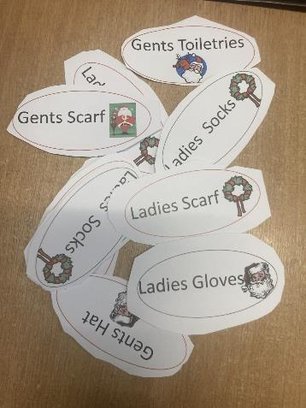
RE
Primary 6’s have started their Pope Francis Faith Award (P.F.F.A) journey. Fr Eddie came to the school and we celebrated with a Mass. As part of P.F.F.A, P6a have created thank you cards to their adult.
P6/5, P6a and P7/6 have been creating Christmas labels for Blessed John Duns Scotus to help others.
For St Andrew’s Day, P6a and P7/6 created a Powerpoint about St Andrew’s life.
P6/5 have been creating Advent Wreath and learning about the importance of each candle during Advent.

Slide 7
Website links that you might want to check out!
Family Learning website – how to videos and information to help children with learning at home
https://blogs.glowscotland.org.uk/gc/stfrancisfamilylearning/
St Francis Primary and Nursery Class website – latest news and information about our school
https://blogs.glowscotland.org.uk/gc/stfrancisprimaryandnurseryclass/
St Francis Primary and Nursery Class Twitter page
https://twitter.com/StFrancis_PS?ref_src=twsrc%5Etfw

