Slide 1
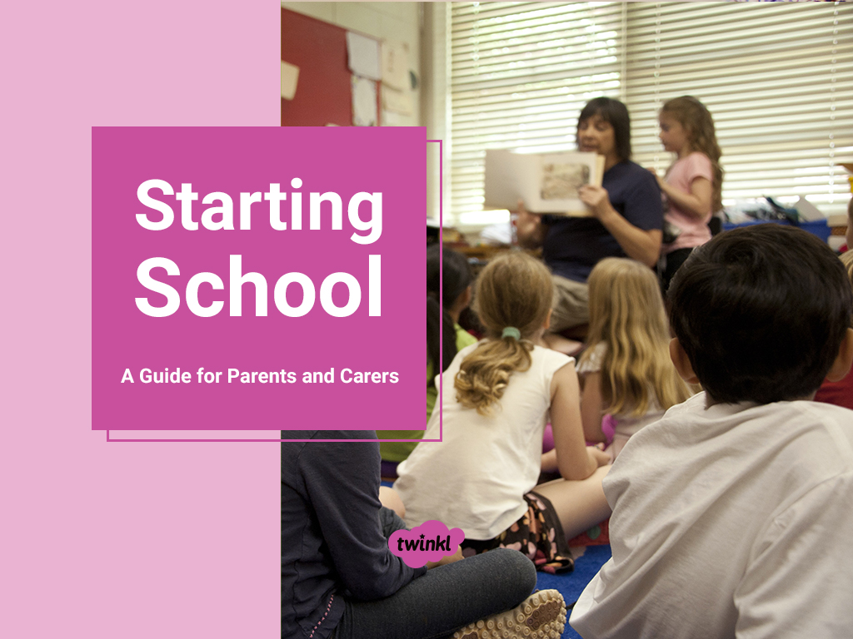


Slide 2
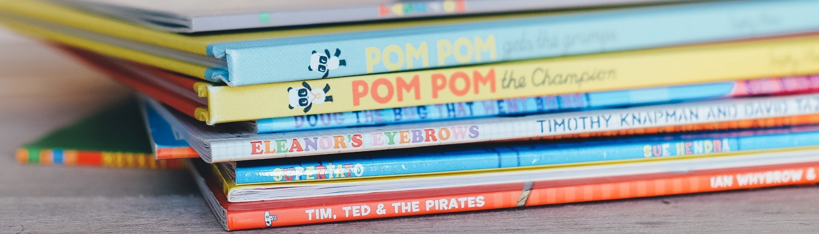

Starting school is an important step in your child’s life.
Although this is an exciting time for you and your child, it is normal to feel nervous.
There are many ways to support your child as they start Primary 1.

Slide 3


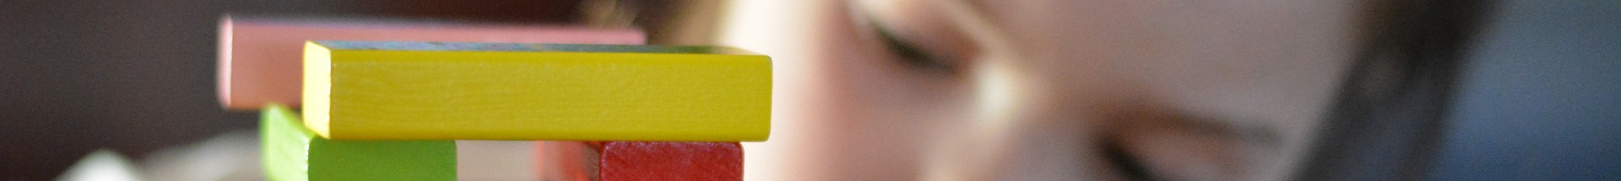
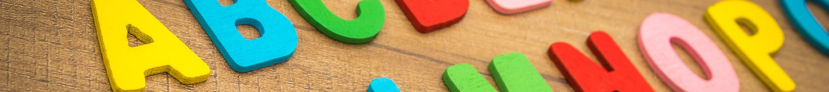
Children all learn and develop at their own pace. Just as babies and toddlers vary in the age that they learn to walk, children will develop literacy and numeracy skills at different ages.
Try not to compare your child to their peers. Remember that learning is a journey rather than a race.
We are a school family who are here to help support each other the best we can. Communication is key to help this.

Slide 4

Teachers will not expect your child to be able to write or count accurately when they start school.
It is more important that your child is able to listen, follow instructions, share, take turns, communicate their needs and be independent than it is for them to be able to write their name or count to 20.

Slide 5
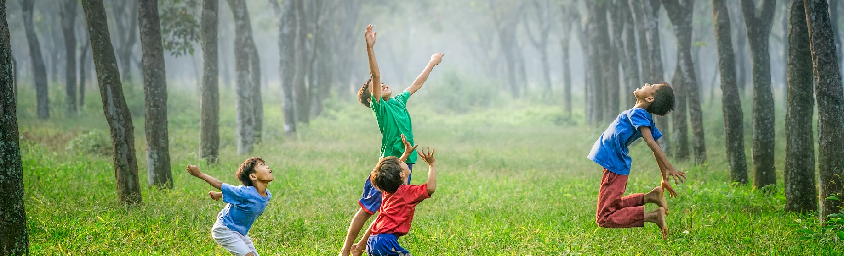
To effectively support your child starting school, you can help them to develop their self-help skills, social skills, communication skills and motor skills.
This will enable your child to be independent in class and ready
to learn.
*Singing nursery rhymes and reading to you child are wonderful ways to spark a love of learning and develop important skills*

Slide 6


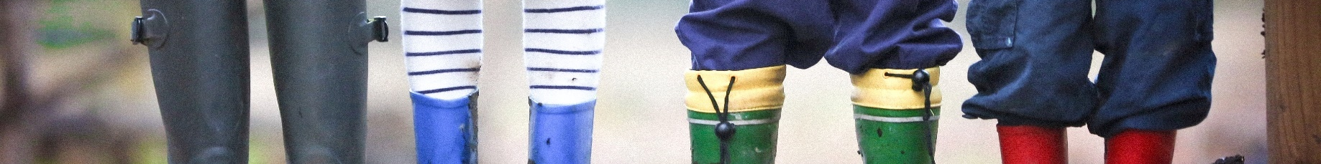
Self-Help Skills
Self-help skills are things like feeding and dressing independently.
You can support your child by practising:
putting on, zipping up and taking off coats;
putting on shoes;
changing clothes for PE;
using cutlery to eat independently;
opening bottles and packets to eat snacks and packed lunches independently.
*Also knowing that their teachers are in school to help and they should speak to us if they are upset. *

Slide 7

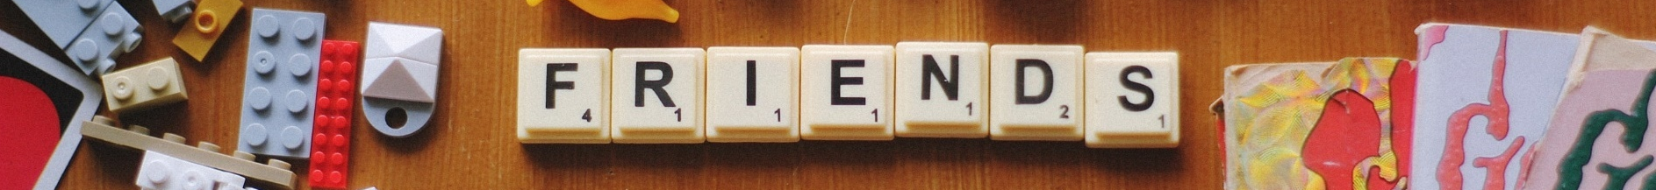
Social Skills
Social skills are the skills we need to be able to communicate and interact effectively.
You can support your child by practising their ability to:
share;
take turns;
work co-operatively;
listen;
follow instructions;
use kind hands;
resolve conflicts.

Slide 8
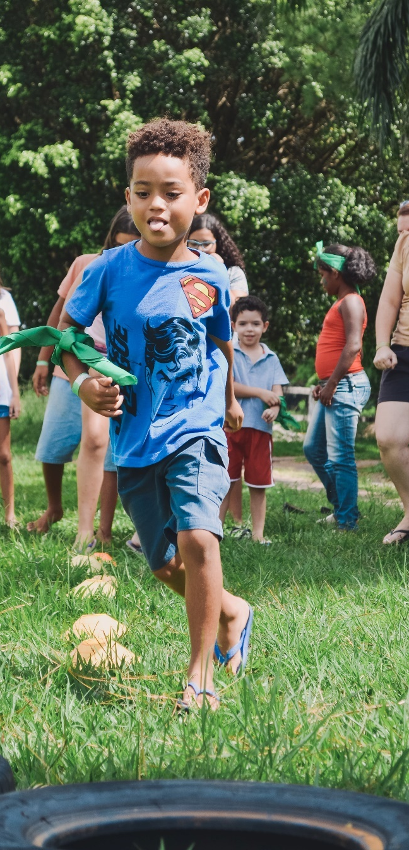
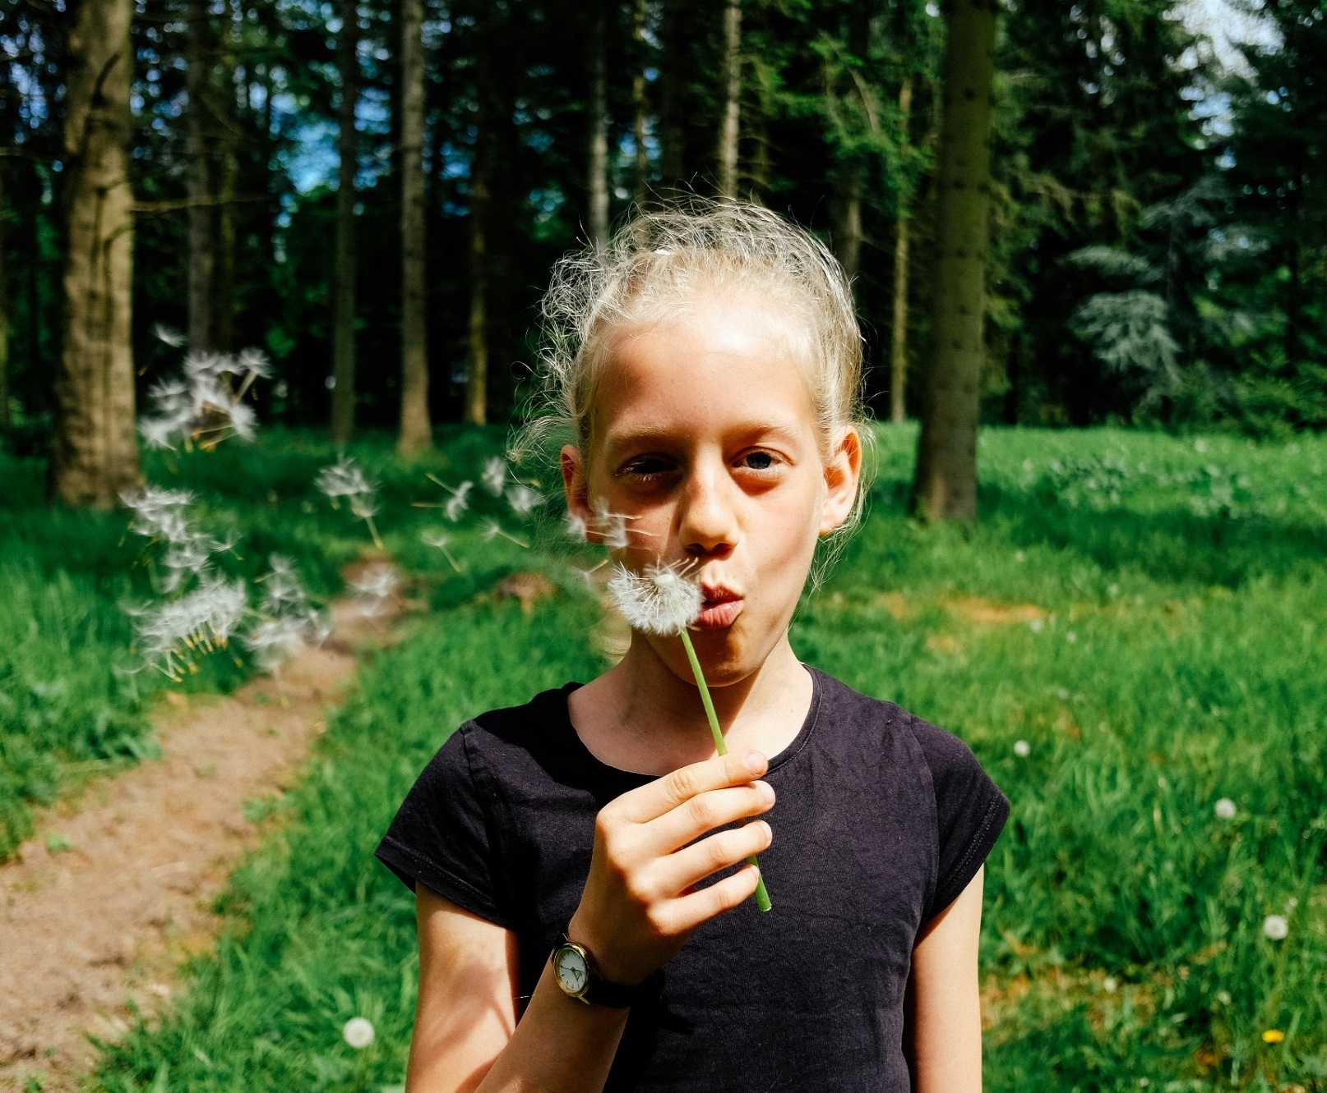
Communication Skills
Communication skills are the skills we need to interact both verbally and non-verbally.
You can support your child by encouraging them to:
make eye contact;
listen attentively;
develop their vocabulary by introducing new words;
take turns in conversations;
express their feelings appropriately;
understand facial expressions and body language;
speak clearly;
speak to adults and peers.

Slide 9
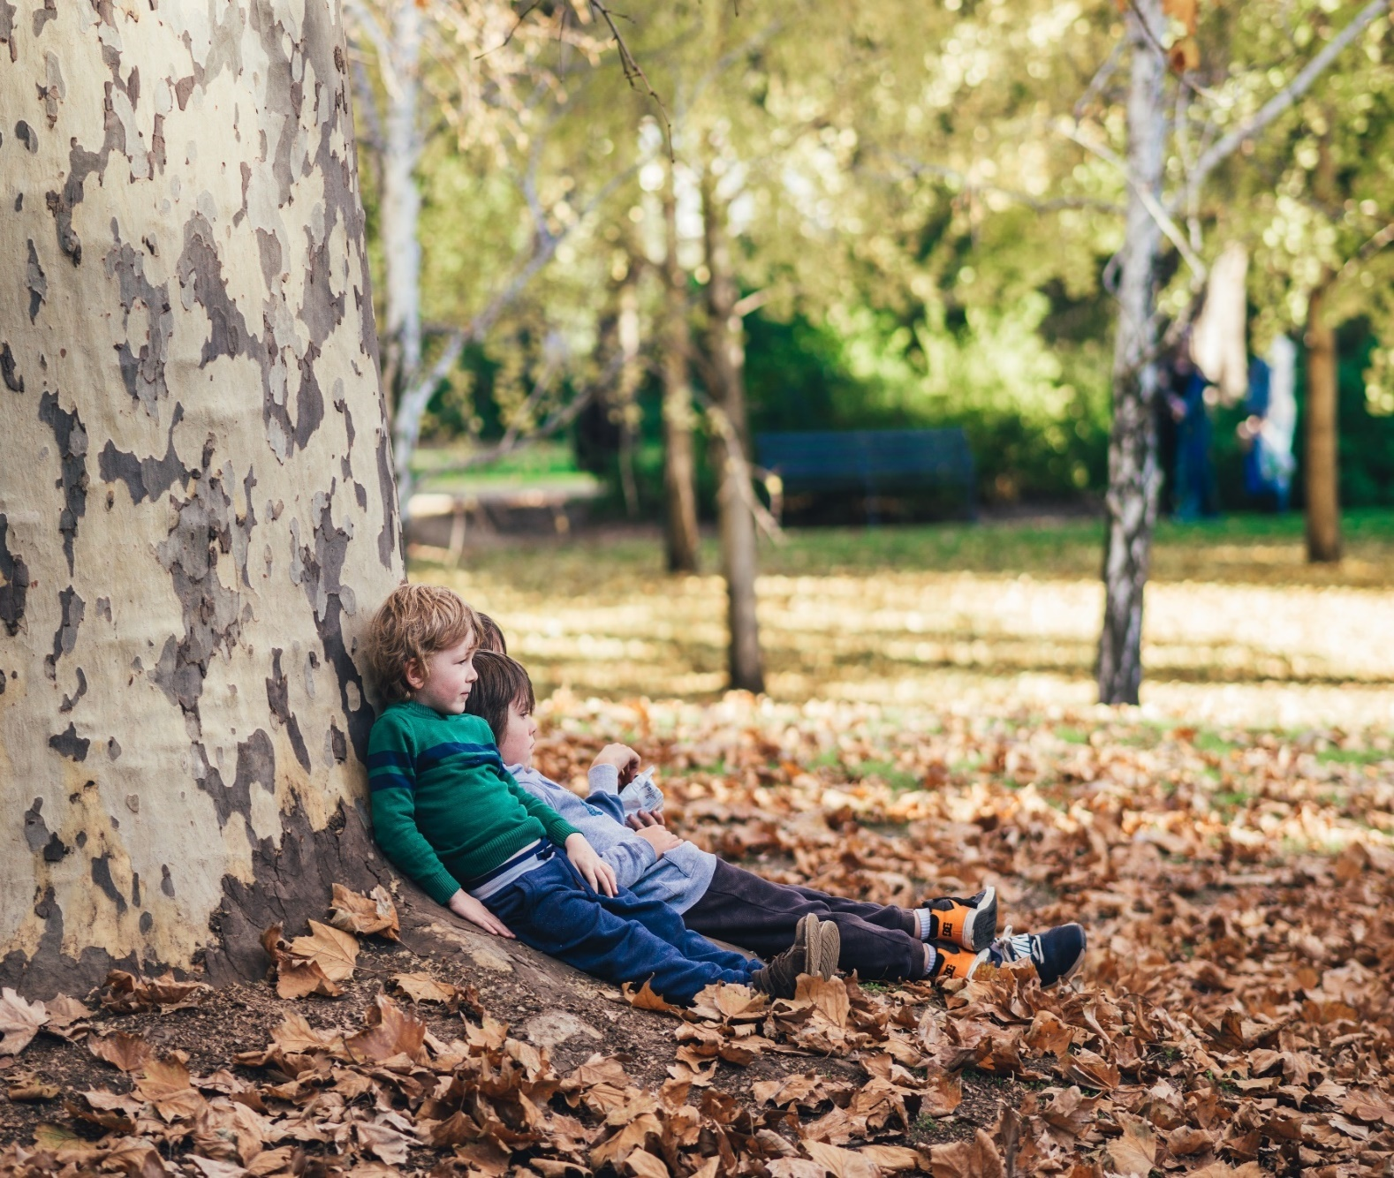
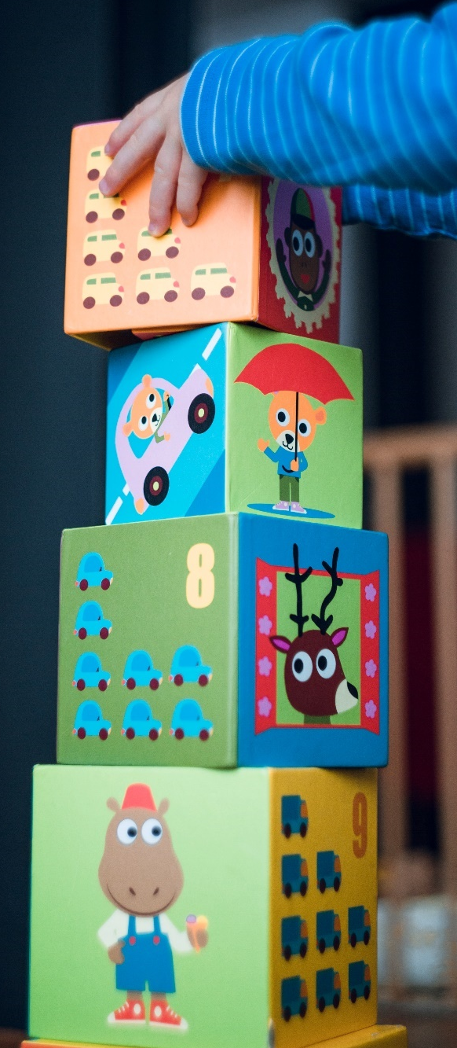
Motor Skills
Fine motor skills involve using the muscles in fingers, hands and forearms to make precise movements.
Gross motor skills involve using the large muscles of the arms, legs and body.
taking them to play in the park;
playing catch with a ball;
doing a jigsaw puzzle;
threading beads;
playing with playdough.
Click here for more ideas:
https://theimaginationtree.com/40-fine-motor-skills-activities-for-kids/
You can support your child by:

Slide 10
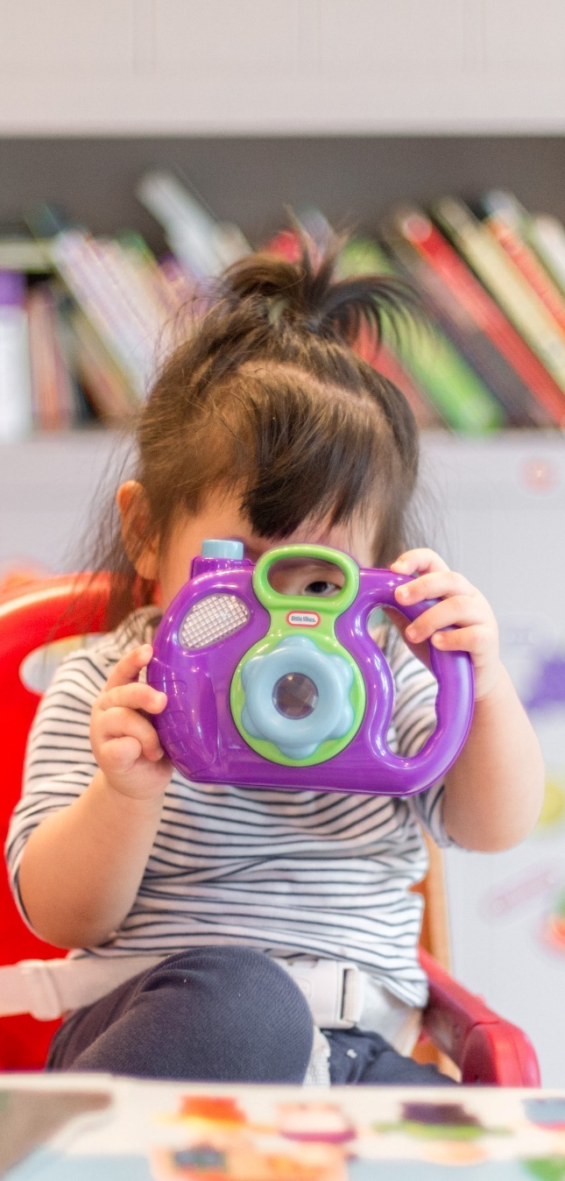

Experiences
Spending time having fun experiences with your child is a fantastic way to develop their skills. Here are some easy ideas to try:
Join the online library and share books with your child.
Play games like dominoes or snap to develop counting and matching skills.
Get your child to help you write a shopping list and take them to buy the items at the shops.
Make your own book using cut-outs from old magazines and catalogues.
Make playdough by following a simple recipe.

Slide 11
If you have any questions relating to your child starting school, please contact the Head Teacher who will be happy to speak with you and answer any questions.
Mrs Isobel Padden
@stfrancisoa
headteacher@st-francisofassisi-pri.glasgow.sch.uk
0141 773 2052

Slide 12
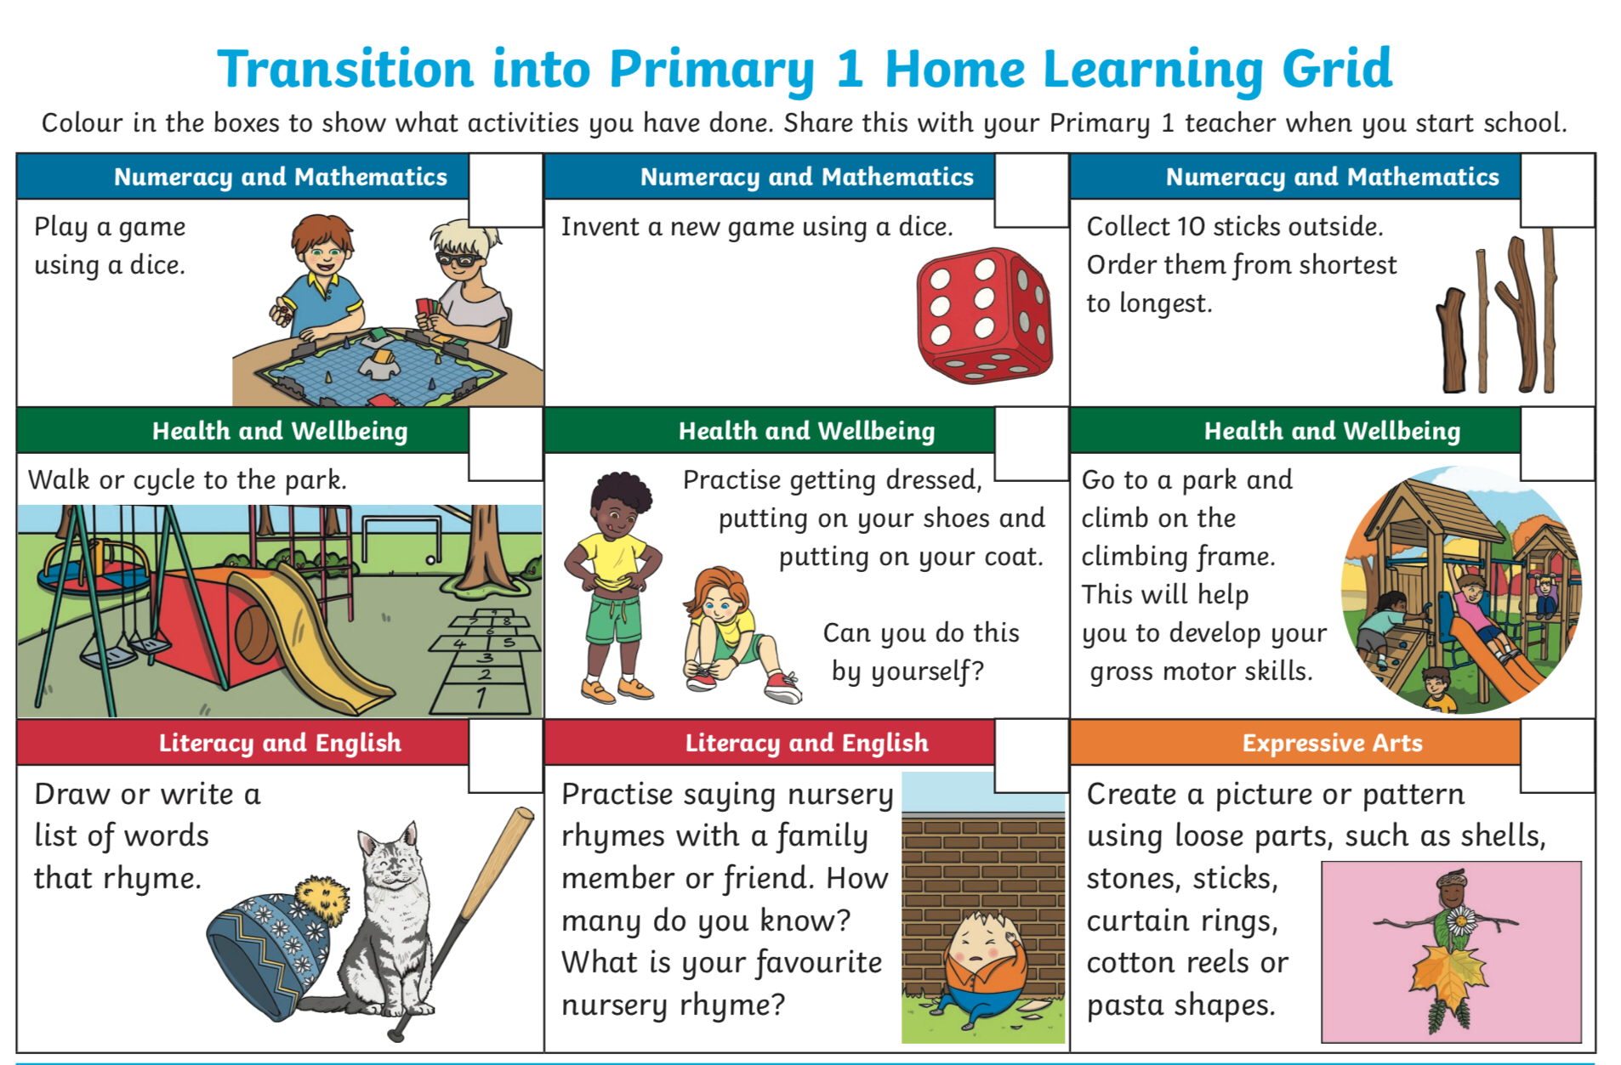

Slide 13
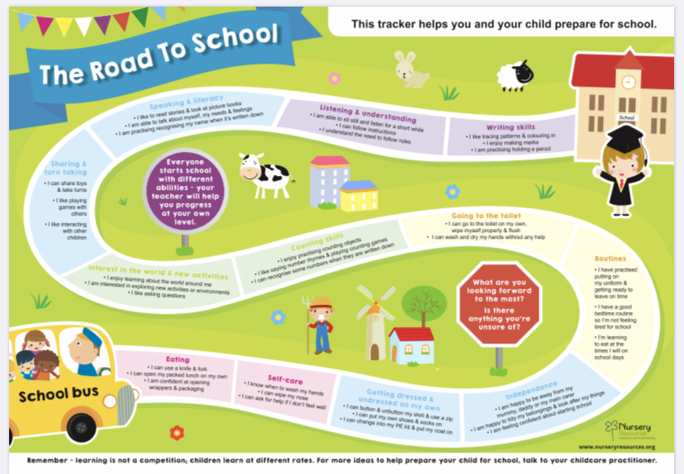

Slide 14
