Slide 1
The Home Front
Lesson starter:
How did the government protect people during World War II?
Write as many points as you can.

Slide 2
Learning Intention
Understand how the government tried to protect the people of Britain during the war.
Evaluate the success of these measures.

Slide 3
Success Criteria…
I can describe how the government tried to protect the people of Britain.
I can evaluate how successful these measures were by completing a table with details, plus the positives and negatives of each point.

Slide 4
Task One
Take a whole page in your jotter and copy the following table:
Method of protection | Positives | Negatives
Rationing . .
Propaganda . .
Black Out . .
Evacuation . .

Slide 5
Task One
As we go through the following slides, you need to do the following:
Add 2 points of information for each section
Add at least 1 positive aspect of the protection method
Add at least 1 negative aspect of the protection method
Method of protection | Positive | Negative
Rationing Rationing introduced because of submarine campaign. | Food was shared out equally so everyone had the same | People could buy things on the black market if they had money.

Slide 6
Rationing
One person’s weekly allowance
4oz (113g) | lard or butter
12oz (340g) | sugar
4oz (113g) | bacon
2 | eggs
6oz (170g) | meat
2oz (57g) | tea
Hitler’s submarines surrounding Britain meant food could no longer be shipped in
Rations were introduced to make sure everyone had a fair share
Fruit and vegetables were not rationed but were in short supply

Slide 7
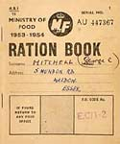
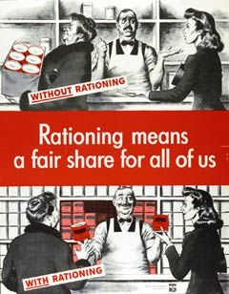
Rationing games

Slide 8
Propaganda
The government tried to control the British population through powerful propaganda
An example was the ‘Dig for Victory’ campaign
It convinced people to use any free space to grow fruit and veg so there would be no food shortages

Slide 9
The Blackout
The Blackout was introduced to try and confuse German Luftwaffe bombers
House lights, street lights and car headlamps, all had to be invisible after dark

Slide 10
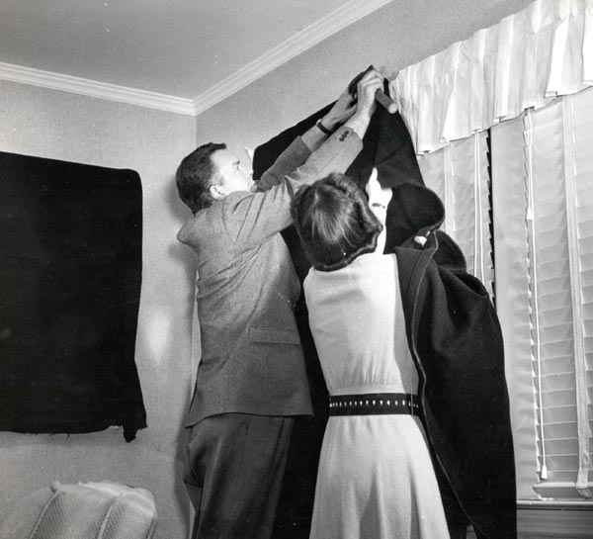
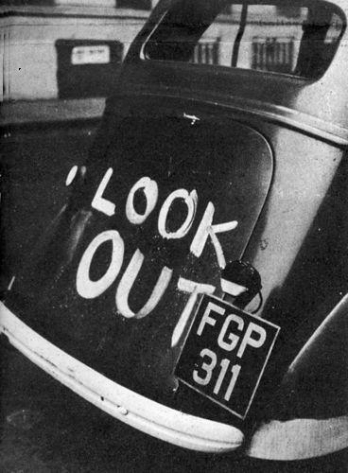
Blackout curtains
Car accidents increased during WWII
The Blackout video

Slide 11
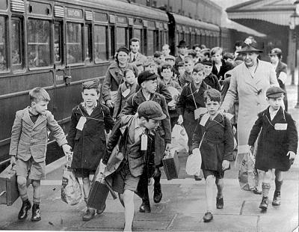
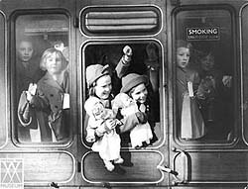
Evacuation
On 1st September 1939, Prime Minister Chamberlain ordered evacuation to begin
When bombing of cities didn’t start immediately, many parents brought their children back to the cities
Most of those evacuated had no idea what their life as an evacuee would be like nor when they would see their parents again

Slide 12
Learning Intention
Understand how the government tried to protect the people of Britain during the war.
Evaluate the success of these measures.

Slide 13
Success Criteria…
I can describe how the government tried to protect the people of Britain.
I can evaluate how successful these measures were by completing a table with details, plus the positives and negatives of each point.

