Slide 1

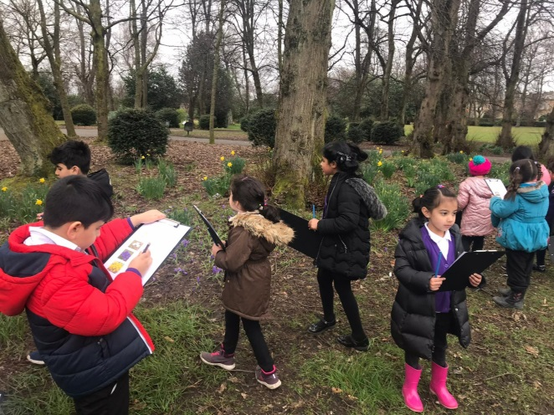
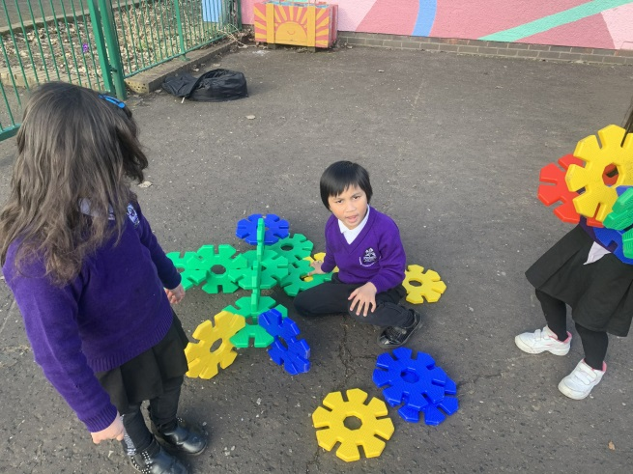
Welcome to Saint Albert’s Primary
Helpful Hints and Information for the Parents of our new P1 children

Slide 2
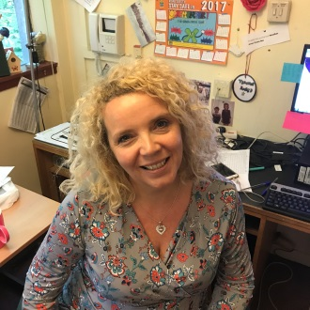
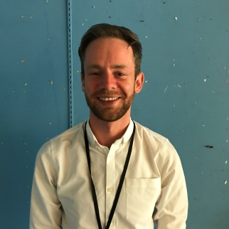
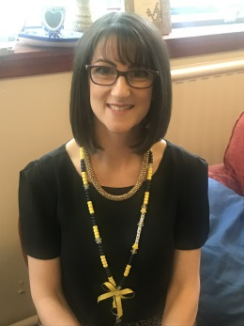
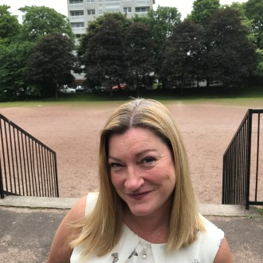
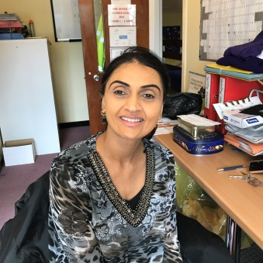
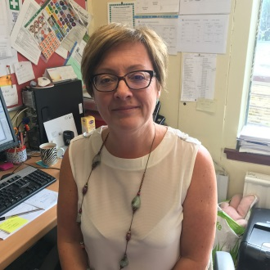
St. Albert’s Team
Mrs Harker
Head Teacher
Mr Stewart
Depute Head Teacher
Mrs Rodger
Depute Head Teacher
Mrs Kelly
Principal Teacher
Mrs Ali
Office
Mrs Connell
Office

Slide 3
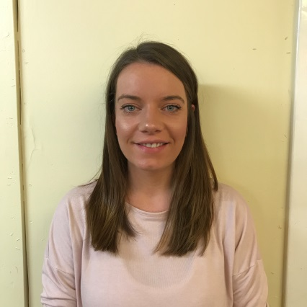
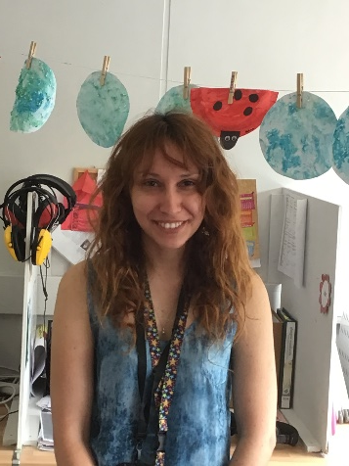
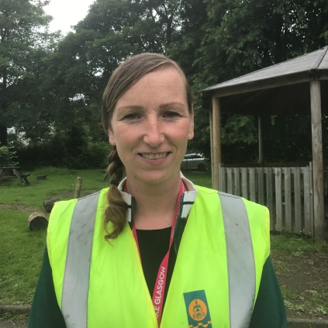
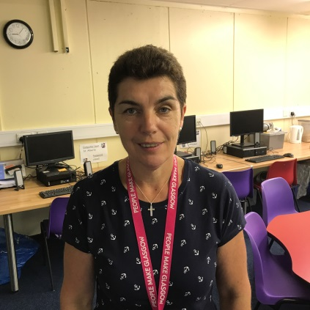
Class 1 Staff
Mrs Creevy
Miss Symeonidou
Miss Forteath
Marie Rooney

Slide 4

Important Dates
First day
Monday 16th August 9:00am – 3:00pm

Slide 5

School Uniform
Black trousers/skirt/pinafore/Summer dress
White shirt & school tie
White/purple polo shirt with logo
Purple jumper/cardigan with logo
Dark coloured shoes & jacket
P. E. days
White/purple polo shirt with logo
Black jogging trousers/leggings
Soft shoes

Slide 6
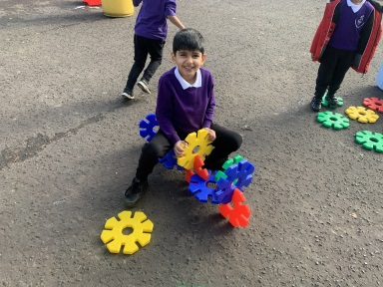
School Uniform
Ties, jumpers, cardigans & polo shirts will be available to buy from the school. (Date to be confirmed)
Everything else can be purchased from your chosen store.

Slide 7
General Information for August
P1 children will enter in the infant playground
P1 children dismissed from the gate at the infant playground. Adults wait outside the gate please.
Teaching staff will hand over each child to their parent / carer
Please inform school if someone different is collecting your child
If you are late collecting your child please let the office know and you will need to collect them from the school office

Slide 8



Communication
Group Call Xpression- download the app
Email
Check your child’s bag for letters
We will text and you can respond to these
We will have contact details from nursery
Please view your class blog for information & updates on learning

Slide 9
APPOINTMENTS
If your child has a Doctor / Dentist / Hospital appointment please phone the school office and give the date and time of the appointment.
Always report to the school office
(not to your child’s class)
Medicines must be labelled and consent forms signed at school office – parent MUST give first dose of medication to child.

Slide 10
Absences
Please phone school before 9:30am
Text or contact the Hub
Send a letter to your child’s class teacher when they return to school

Slide 11
Children will have their own tray of resources. Please do not send in pencil cases, toys etc for H & S reasons
Most learning will take place outdoors so please wrap up
Home learning will be given on a Monday to be completed by Friday starting in September 2021
Label ALL clothes, bags, lunch boxes with name and surname. Please!

Slide 12

Practice with your child
Opening and closing bags and lunch boxes
Putting on and taking off school uniforms.
Fastening and unfastening shoes – we recommend velcro shoes for P1

Slide 13

Health Promoting School
Encourage your child to bring only ONE healthy snack for play time.
No nut products due to allergies (including nutella)
No sweets, chocolate, crisps, fizzy juice, cans or glass bottles.

Slide 14
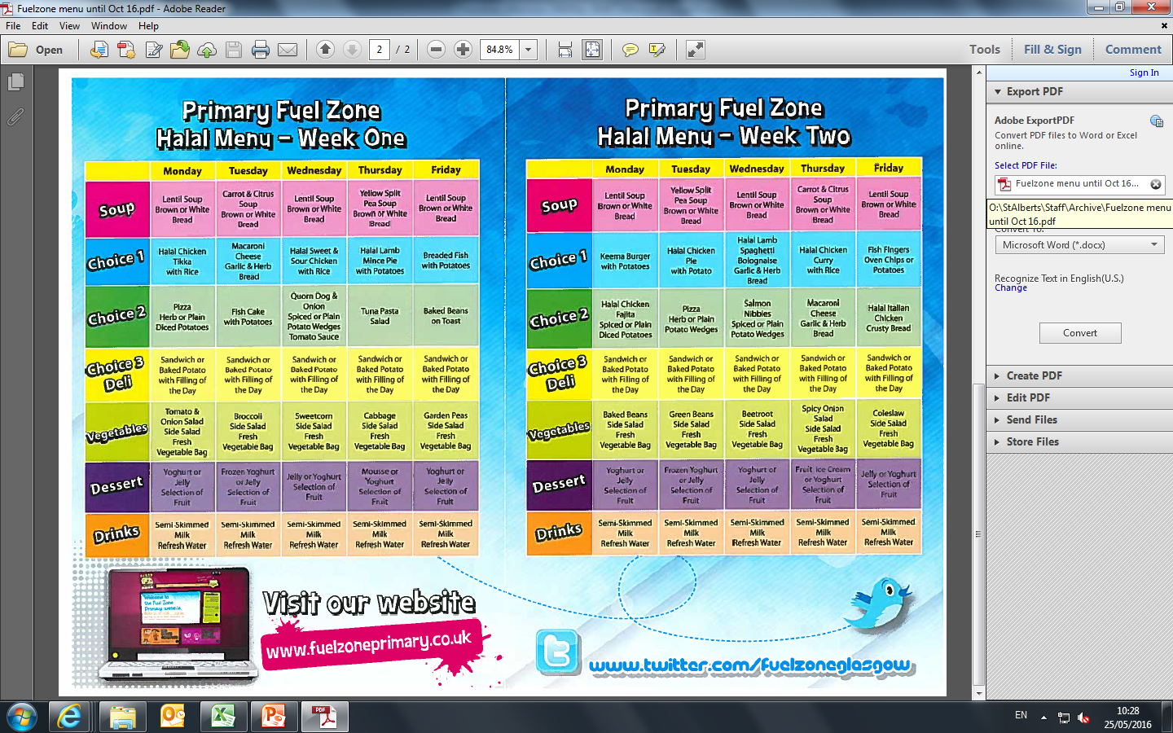

Slide 15
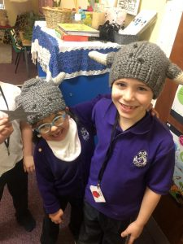
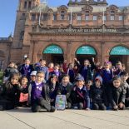
P1 & Class One
Inclusion
Expertise and benefits of having Class One provision
Always working together

Slide 16

Outdoor Learning & Play
Play and outdoor learning form a huge part of our learning experiences in P1 in St Albert’s.
Expect your child to be:
Singing, rhymes, games, story telling, counting, turn taking and lots more.
The learning is very active with a play based approach.

Slide 17

Please send a light waterproof jacket to leave in school for outdoor learning and wellies if you can. We have spare wellies and waterproofs for extended outdoor activities

Slide 18
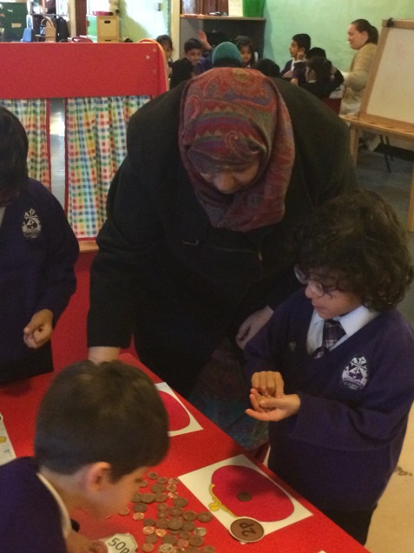
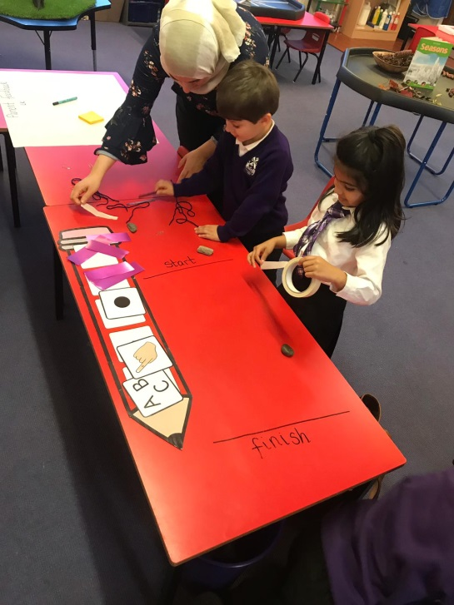
Parent Workshops
Workshops will provide opportunities to see how your child learns
Provide guidance for parents on how to support your child’s learning at home
Dates to follow!

Slide 19


Over the summer
Read to your child (encourage a love of books!!)
Read /teach them nursery rhymes
www.bbc.co.uk/schoolradio/subjects/earlylearning/nurserysongs
Draw circles in an anti clockwise direction
http://www.smartappsforkids.com/handwriting/
Colour in (encourage to stay in the lines)
Encourage your child to talk to you

Slide 20
FIND MATHS IN EVERY DAY
Asking your child to talk about or name the number of things in their picture story books
Going on a number hunt with your child; for example, get them to look for and identify cars with a number plate that has the number 2, or to look for and identify house or unit numbers with a 4
Collecting a selection of different coloured everyday objects
Sort them into groups of the same colour

Slide 21

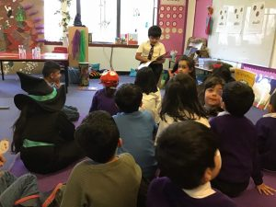

LITERACY EVERY DAY
What you can do:
Read to your child as much as you can.
Your local library is a great source of books and information
You might want to consider electronic books too
If your child’s first language is not English, learning words and reading in their first language is beneficial and should be encouraged
iPad or similar tablets – can display colourful, animated stories with a narrator to read the story to your child. You need to have an iTunes account before you’re able to search for and download books from the Apps store

Slide 22

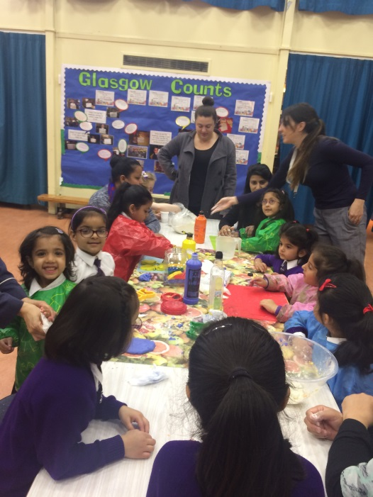
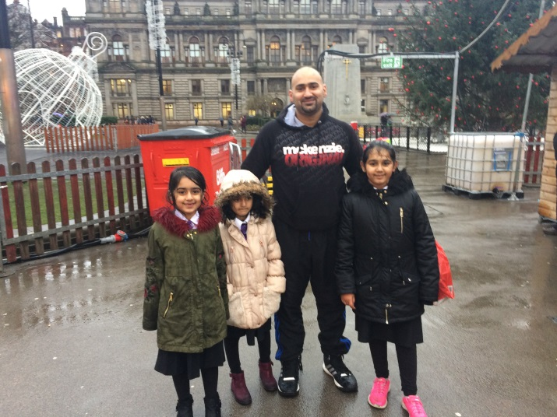
Parent Council
We have a very active and supportive
Parent Council and Parent Teacher Group who are very eager to welcome new members

Slide 23

Please contact the office with your email address if you wish this information sent out to you.
Please contact me, Karen Kelly for any further information or help. We hope to meet you all soon in small groups.
Thank you! Enjoy your holiday!

