Slide 1
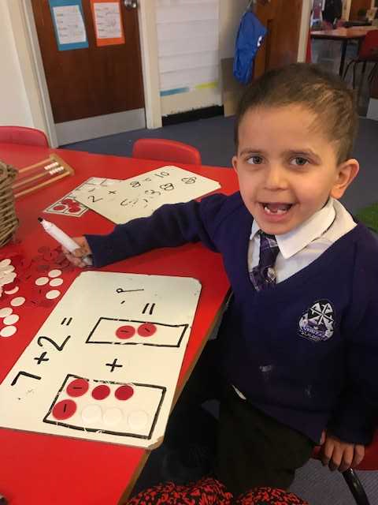

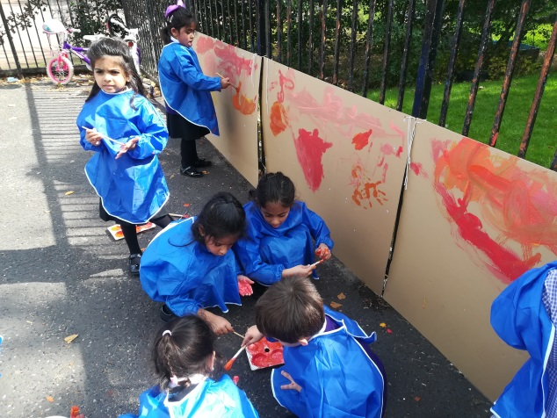
Welcome to Saint Albert’s Primary
Information for Parents & Carers

Slide 2
First day information
First 3 days
12th, 13th & 14th August
P1 9.15am – 12 noon
P2 – P7 9.30 – 2pm
P1 – P3 enter via infant playground
P4, 4/5, 5 enter via top gate into upper playground
P6, 6/7, 7 enter via car park
Pupils will be directed straight to class

Slide 3
Your child will attend school as stated for the first three days then normal school hours will resume on Monday 17th August
Pupils will have their own tray of resources. If pencil case etc brought from home these must be kept in pupils own tray
Most learning will take place outdoors
Home learning will be given when appropriate to be completed at home (online)
Label ALL clothes, bags, lunch boxes with name and surname. Please!

Slide 4

School Uniform
Uniforms have changed because…..
Most learning will be outdoors so warm comfortable clothing is required
School t-shirt – Available to buy from the office (further info on this soon)
Black jogging trousers/leggings – Buy from any store
Cardigan/jumper – School wear not necessary but can purchased from BE school wear, Argyle Street
Black Plimsoles – For wearing inside school (Can be
stored in school)
Outdoor shoes
Wellies (can be stored in school)
Outdoor jackets
Normal uniform can be worn if preferred & appropriate

Slide 5


Communication
Parents/carers are not allowed to enter the school building. Please phone the office for information
Group Call Xpression- download the app
We will text and you can respond to these
Twitter, Facebook & Blogs

Slide 6
APPOINTMENTS
If your child has a Doctor / Dentist / Hospital appointment please avoid school hours
Medicines must be labelled and consent forms signed at school office – parent MUST give first dose of medication to child.

Slide 7
Absences
Please phone school before 9:30am
Text or contact the Hub
Send a letter to your child’s class teacher when they return to school

Slide 8

Practice with your child
Opening and closing bags and lunch boxes
Putting on and taking off school uniforms.
Fastening and unfastening shoes – we recommend velcro shoes for P1

Slide 9

Health Promoting School
Encourage your child to bring only ONE healthy snack for play time.
Pupils should provide their own water bottles
No nut products due to allergies (including nutella)
no sweets, chocolate, crisps, fizzy juice, cans or glass bottles.c

Slide 10
Illness during school hours
If your child becomes unwell during school hours and are showing symptoms of Covid-19, they will be isolated in a designated room.
They will be supervised by a member of staff until they are collected.
Please ensure your contact details (new mobile phone numbers, email etc) in the school office are up-to-date
We would advise your child is tested and in better health before returning to school.

