Slide 1
Home Learning
2020

Slide 2
What have our parents said…
Home Learning for Maths and Literacy
More opportunities for presentation of work
Consistent home learning across the school
Work that is appropriate – high expectations for all

Slide 3
Home Learning
Aim
For Home Learning to have biggest impact:
Action (two strands):
Practising basic skills through repetition.
Children taking ownership.
What this could look like
Practice skills linked to learning in school
Develop pride and excitement
Cross curricular opportunities *
Open ended and flexible *

Slide 4
Home Learning every week
Curricular Area | What should be there
Spelling / Phonics | Weekly Spelling/ Phonics - Jolly Spelling & Grammar book
Reading | Learning to read/ developing phonics/ alphabetic code etc. One levelled book and one choice book (P1-P3/4) Competent in reading One levelled and one or two choice texts depending on length (P3/4-P7) Tailored to the individual child
Numeracy | Sumdog/ Number Bonds/ Time Table Bonds

Slide 5
Home Learning over a term
Creative Home Learning
To encourage creativity and children’s ownership of learning
Children will use new and develop existing skills in completing the task
Children have a choice of three activities to complete
Children can complete one, two or three activities
They can bring activities in whenever they are completed
There will be a showcase of creativity each term

Slide 6
Home Learning Jotters (A4)

Slide 7
Home Learning Jotters (A4)
Sumdog password / Bug Club password
Spelling words
Number bonds / Time tables
If sheet required, trimmed and children can stick in
Term Grid stuck into jotter
Creative Curriculum options when appropriate
All placed inside A4 plastic Home Learning Folder

Slide 8
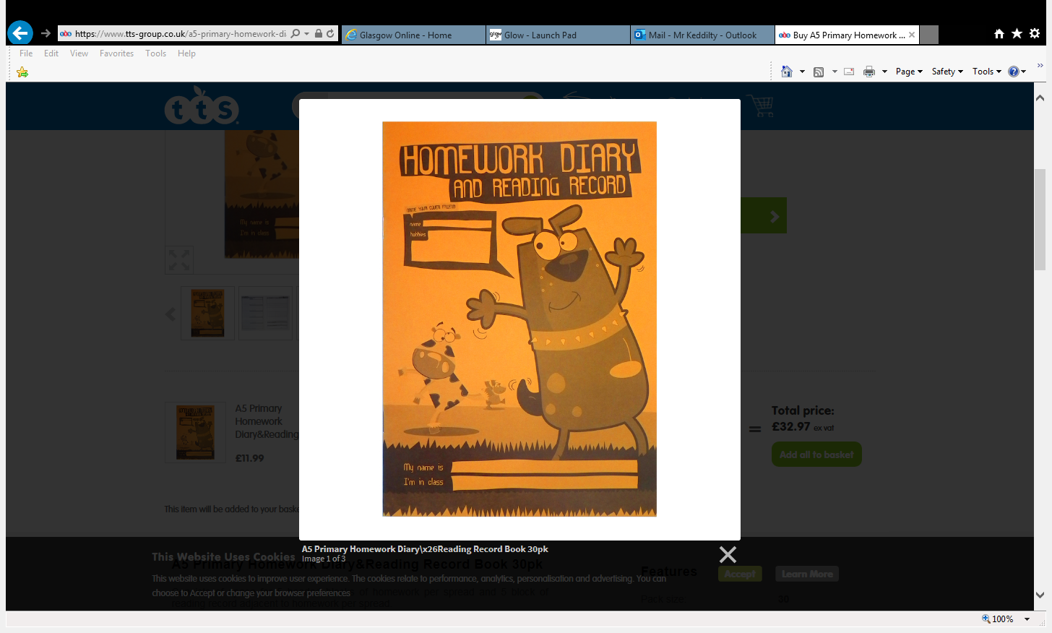
Home Learning Diary?

Slide 9
Thoughts…

