Slide 1
Glasgow Counts Workshop
Primary 2 Focus
23rd October 2019
Early Level moving onto First Level 1
by end of Primary 2

Slide 2
Aims for today’s workshop
Understand some of the strategies and resources your child will be using in class.
See example questions to ask your child to support understanding of number.
Work with your child to solve problems using Glasgow Counts concrete resources.

Slide 3
Counting
P2 Skip Counting is an important part of early numeracy. Skip counting used in telling the time, dealing with money.
Counting forwards and backwards in 1s, 2s, 5s 10s form the basis of solving problems in addition, subtraction.
P3 Pupils should be beginning to start counting from a number that is not a multiple.
Example if you can count in 10s (10,20,30) can you count in 10s starting at 12? (12,22,32).
A hundred square is helpful here to notice number patterns!
Pupils should have regular opportunities for skip counting “can you count in 2s starting from 15?

Slide 6
Hundred Square Splat
Ask your child to count in multiples using the hundred square splat game. Visual patterns make it easier for children to make sense of skip counting!
Sometimes, children can ‘remember’ a counting pattern eg. 2,4,6,8.
Using a visual support helps to make sense of that pattern

Slide 7
Numerals P2
Being able to recite numerals is not an indication of number sense being developed; simply a list with no understanding.
Pupils must recognise and identify numerals 0-9 at the start and be able to match the correct number name.
Pupils then develop the understanding of the amount each number represents.
The following concrete resources help develop number sense.

Slide 9
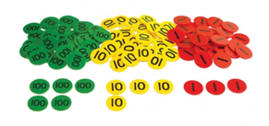
Numerals P3
Pupils should have an understanding of place value to recognise and understand numbers. Children should begin to ‘see’ how numbers are made up.
Arrow cards and place value counters are useful tools to promote place value understanding.
For this particular picture, the number being represented is
5 hundreds 4 tens and 3 units
so
543.

Slide 10
Numerals
Numicon is also a very helpful resource which allows children to see a visual picture of a number.
Questions to ask your child…
What do you notice about number 32 and number 33?
“They both have 3 tens”.

Slide 11
Place Value P2
Questions for your child:
What is the value of the digit 2 in these numbers? 32, 27, 92 Explain how you know.
What is the same and what is different in these two numbers 16 and 61?
Barriers to Learning:
Children write 13 as 30, muddling the “teen” and “ty” numbers.
Use the units digit before the tens digit. Teens numbers can confuse as child hears the units digit first- lead to reversing numbers- concrete materials allow child to visualise the number increasing number sense.
Lack of understanding that the position of a digit gives its value.
Language of numbers can cause confusion e.g. the word eleven does not make it clear that it is actually ten and one.

Slide 12
Place Value P2

Slide 13
Place Value P3

Slide 14
Questions to ask your child about numbers…P3
Can you show/write me a 3 digit number with 6 units?
Yousaf writes ‘three hundred and six’ as ‘3006’. Do you agree with Yousaf? Why/Why not?
Is 24 odd or even? Prove it.
Asking children to show their thinking, prove their working and justify their answers allows for a deeper understanding of number and can also point out common misconceptions (like Yousaf’s 3006) which them allow teachers and parents to correct the child.

Slide 15
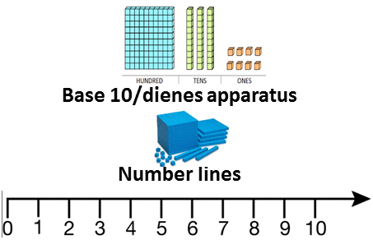
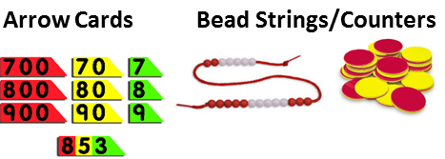
Resources to support understanding of number and place value

Slide 16
Helpful Websites
www.kangaroomaths.com
www.ncetm.org.uk
https://mathsframe.co.uk/en/resources/category/10/ordering-comparing-and-reading
https://nrich.maths.org/6343

Slide 17
Groups
Group 1 Group 3
Muhammad Abdullah Subhan Imran
Ajwa Ahmad Innaayah Iqbal
Arham Ahmed Zayn Irfan
Armaan Ahmed M. Talha Javed
Amer Al Ghazawi Inayah Kamran
Group 2 Group 4
Abdulahadi Al Zoubi Zainab Ahmed
Alizah Ali Deen Malik
Rida Ali Shahmir Malik
Lulu Gadder Abdullah Qureshi
Aleena Ihsan Ismaeel Sahail

Slide 18
Groups (continued)
Group 5 Group 7
Rayvaan Sangray Eshaal Khan
Jibraeel Shehbaz Waris Ali Naqvi
Ranvir Singh Alina Nisar
Issa Tayyub Mano Saeed
Aarv Battu Rayyan Sarwar
Group 6 Musa Yasin
Alvina Yasser
Amna Zahra
Fatima Adeel
Aila Afzal
Maleeha Amir
Muhammed Hasnain

