Slide 1
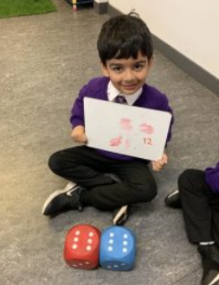
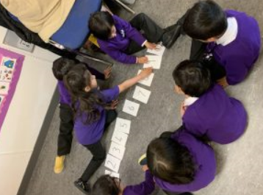
Parent Workshop Early Level
Wednesday
2nd October 2019

Slide 2
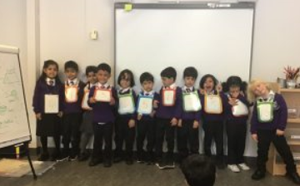
Number Word Sequences
Children need lots of practice when learning the meaning of “before” and “after”.
Use the pre number concept of before, between and after in daily living situations such as:
Lining the children up and asking them who comes before the others in the line.
Using the children as a human number line and asking the following:
Who has the number before…?
Who has the number after…?
Who has the number between…?
Children will be introduced to forward and backward number word sequences.
We were each given a number vest. We had to put ourselves in order!

Slide 3
Number word sequences
Forward Number Word Sequences (FNWSs)
Copying and saying short forward number sequences (start from all different numbers)
Saying alternate numbers 1,2,3,4,5,6
Saying the next number 6,7,8,9
Saying the next 1, 2 or 3 number words forwards 1 2 3 4 5 6
Saying the number after 17 18
Backward Number Word Sequences
As above but counting backwards
Notes:
Put on clip of Jack Hartmann https://www.youtube.com/watch?v=7stosHbZZZg
Counting choir
Counting with the turtle in 6s.

Slide 4
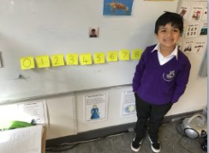
Numerals
Children need to be immersed in number- numbers associated number names and corresponding values for each number. Activities could include the following:
Numbers on a number line- which numbers are missing?
Which is greater, smaller?
Can you find examples of numbers, number names in our class, school environment, home?
Look at car number plates, what numbers can you see?
I’m going to start counting from 6 and I’m going to count to this number( show number and number name), can you tell me when to stop?
Danny put all the mixed up post it notes in the right order! He had to recognise numerals and know about number order to be successful!

Slide 5
How many?
How do you see it?

Slide 6
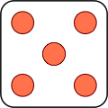
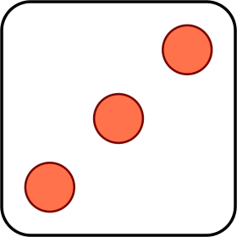
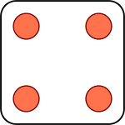
Subitising
Subitising is an essential part of developing Number Sense. By looking at a group of items, children can start to develop an understanding of how a number is made up.
Perceptual Subitising- is the amount you can instantly recognise without counting, usually up to 5 or 6.
Conceptual Subitising-chunks a larger amount into smaller values eg. 7 as 5 and 2 or 3 and 4.
Children should be introduced to rectangular arrangements first ( show 10 s frames) then linear, circular and scrambled or random patterns.
What do you see, how did you see it?
Ibrahim recognised 6 straight away on the dice! Using a dice is a good way to develop our subitising skills at home.

Slide 7
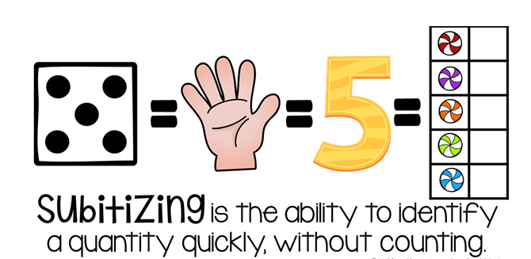
Subitising
Notes:
Crucial to number development – builds on visual representation/conceptual understanding

Slide 8
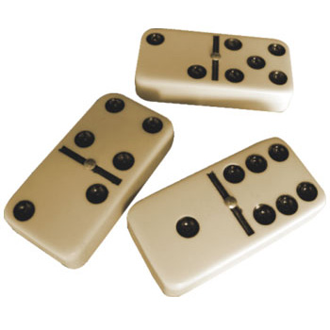
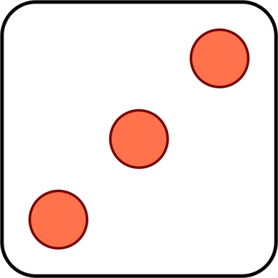
How to subitise
Notes:
Step by step instructions with different resources

Slide 9
Regular / Domino Patterns
Start with patterns In order
1
Notes:
9

Slide 10
Regular / Domino Patterns
2
How do you
see it?
What do
you see?
Notes:
10

Slide 11
Regular / Domino Patterns
3
Notes:
11

Slide 12
Regular / Domino Patterns
4
Notes:
12

Slide 13
Regular / Domino Patterns
5
Notes:
13

Slide 14
Regular / Domino Patterns
6
Notes:
14

Slide 15
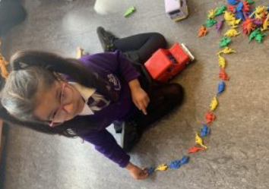
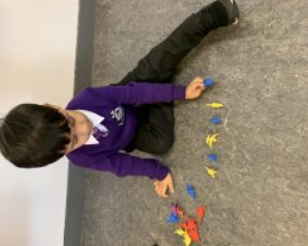
Counting
Counting activities should form part of daily maths warm up activities.
When counting objects, each object must be counted and given just one number name.
The objects counted should be counted in a fixed order (1,2,3,4…)
Children need to be aware that the last number used gives the number of objects in that set. (cardinality)
The arrangement of the objects does not affect how many in the set. (conservation of number)
Aiza and Shahzain know to count each object once!

Slide 16
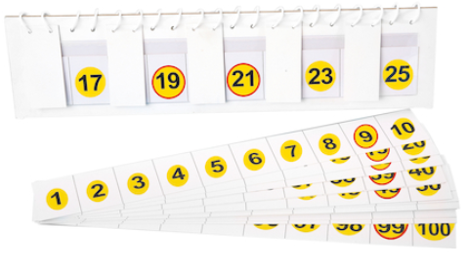
Daily counting activities and resources

Slide 17
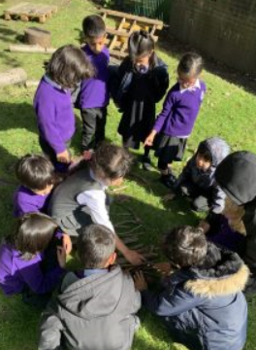
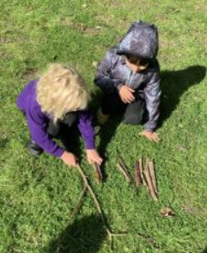
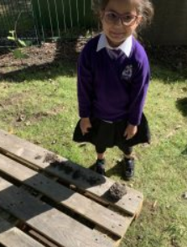
We can count anywhere!
Here are some photographs of us counting sticks and leaves outside!

Slide 18
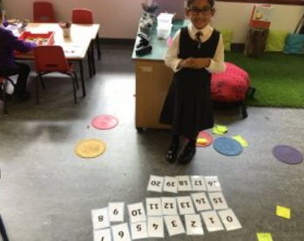
Place Value
Important to develop a strong sense of 10 and provide lots of opportunities to partition numbers in different ways.
Children should have a solid foundation of the “fiveness of 5” before moving on to partitioning within 10.
The concept of zero is usually harder than counting and other early number concepts.

Slide 19
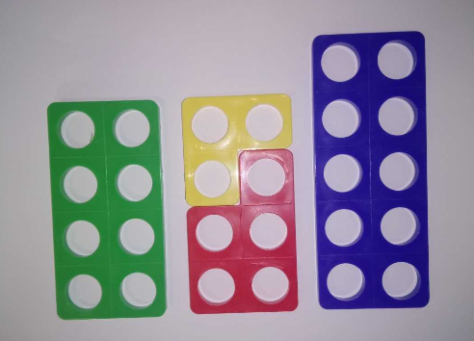
Building number sense
Notes:
What can you see ?
How do you know it’s an 8 (5 + 3 or 10 - 2)

Slide 20
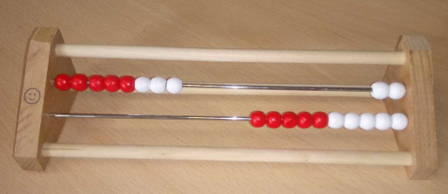
Building number sense
Notes:
What can you see ?
How do you know it’s an 8 (5 + 3 or 10 - 2)

Slide 21
Useful Websites
https://www.topmarks.co.uk/learning-to-count/teddy-numbers
http://www.crickweb.co.uk/ks1numeracy.html
https://www.topmarks.co.uk/learning-to-count/blast-off
https://www.topmarks.co.uk/learning-to-count/gingerbread-man-game
https://www.topmarks.co.uk/learning-to-count/blast-off
https://www.topmarks.co.uk/learning-to-count/ladybird-spots

Slide 22
Activity Groups
Group 1
Rohaan Ahmed
Naba Akhtar
Maaz Aslam
Shahzain Imran
Ibrahim Shahzad
Group 2
Alaiyna Bilal
Shayan Farrukh
Saif Ali Hussain
Seher Ul Haq
Rohan Singh
Group 3
Ibraheem Javaid
Shanzay Malik
Shahin Salah
Mohammed Nawaz
Group 4
Zainab Shahzad
Hassan Tahir
Sami Usman
Daanyal Zamir
Sahar Javed
Group 5
Aiza Afzal
Eesa Ahmed
Hassan Ahmed
Ayman Al Obaid
Pip Gaizley-Gardiner
Group 6
Hishaam Alam
Ibrahim Ali
Qailah Ali
Ibrahim Amin
Mohammed Ibrahim

