Slide 1
FAMILIES CONNECT

Slide 2
Families Connect
Every child should have the best start at school so they can reach their full potential, but big school can be daunting. Families Connect helps to make it less daunting.
Parents are the first and most important teacher for their children and schools are keen to work together with parents
Children whose parents are involved in school life enjoy school and learning more and tend to do better at school.

Slide 3
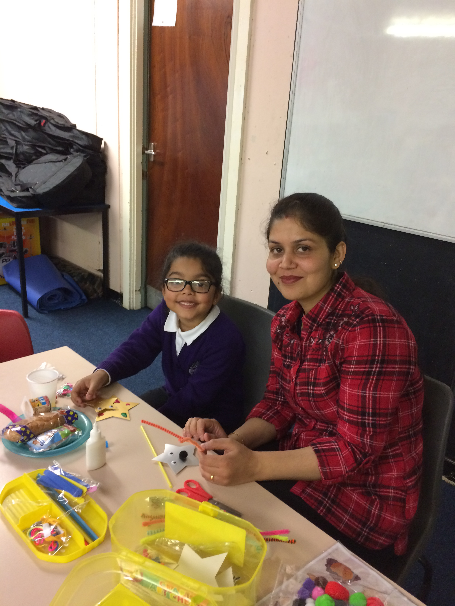

Slide 4
Why Families Connect?
Start of primary school is an important time for a child
Parents have told us they want to best support their child’s learning at home
Families Connect gives an opportunity to exchange ideas between parents and to connect with other parents
Parents can find out what happens in the classroom
Parents get to know teachers and teachers get to know parents!

Slide 5
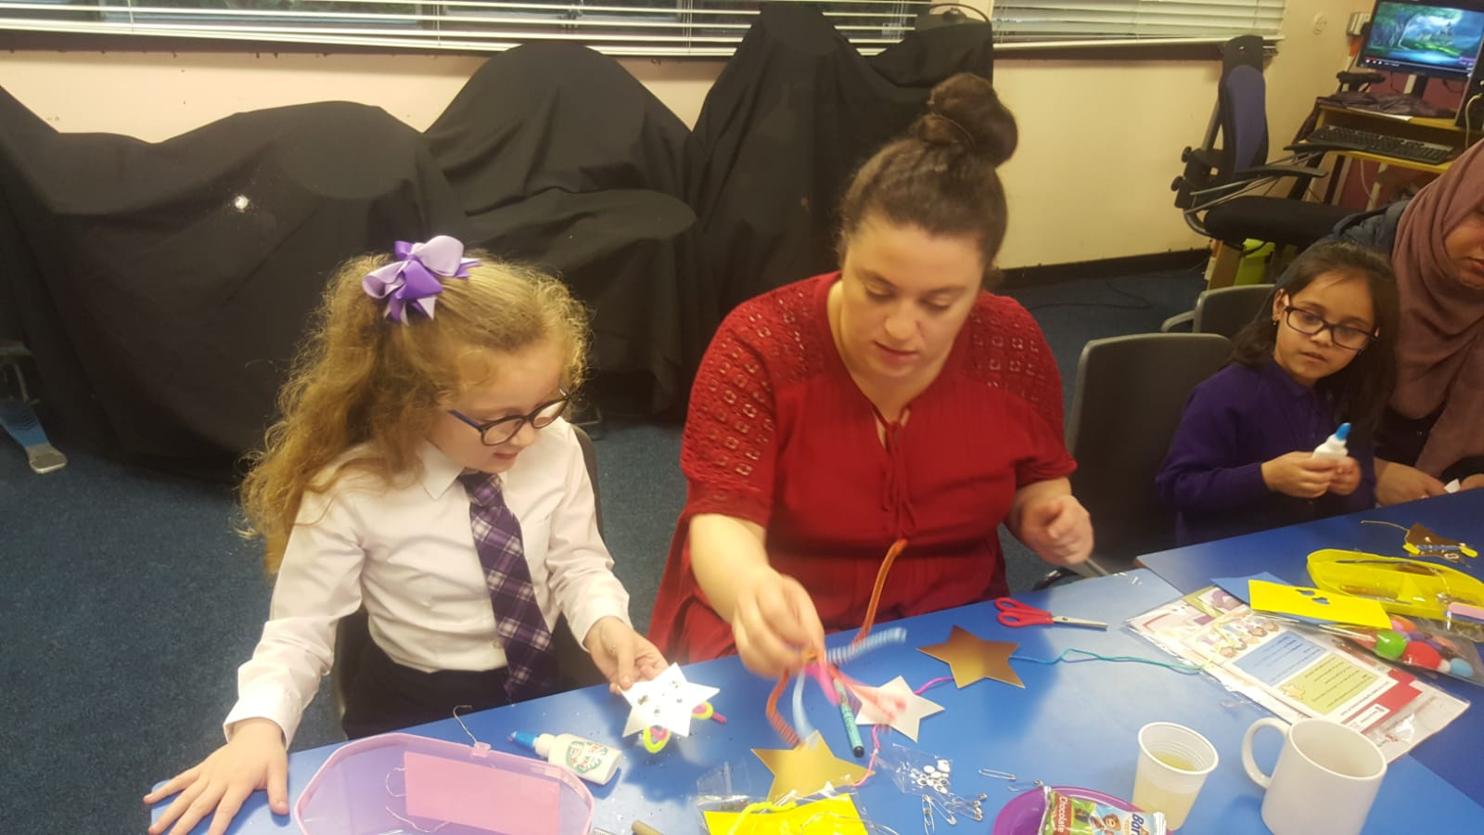

Slide 6
A New Programme
Families Connect:
8 weekly 1.5 hour workshops
1 hour for parents only
1hour trying out activities with the focus child (age 4-6)
After school snack for children and plenty of tea/coffee/cake
YOU can help us test the programme and help us make it better!
It’s all FREE

Slide 7
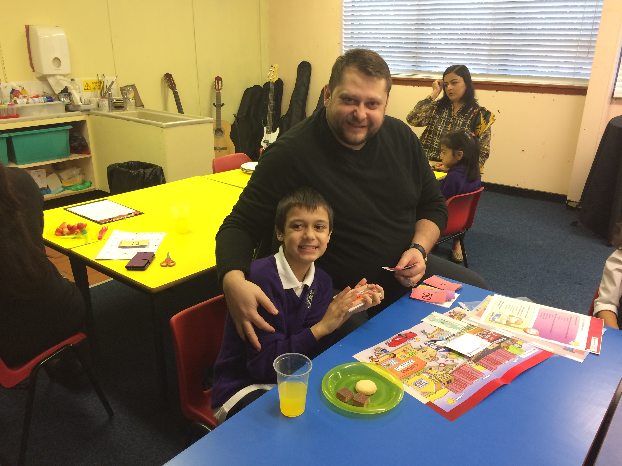

Slide 8
8 Workshops
Topics
Week |  | Topic
Week 1 | Social and emotional development | Focus on Feelings
Week 2 | Social and emotional development | The Importance of Praise
Week 3 | Social and emotional development | The Importance of Listening
Week 4 | Literacy | Book Talk
Week 5 | Literacy | Beyond the Page
Week 6 | Numeracy | Number Names
Week 7 | Numeracy | The Importance of Counting
Week 8 | Celebration and evaluation

Slide 9
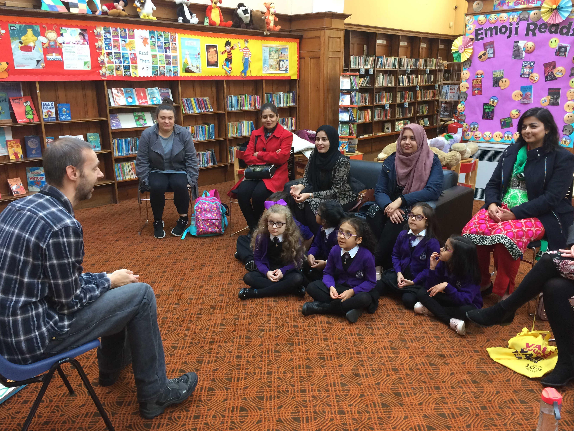

Slide 10
What happens at Families Connect?
Each workshop is 1.5 hours long and will run from 9am – 10.30
Parents arrive, cup of tea. Time to exchange ideas, get to know one another
The Science Bit: Topic of the week and why this helps children’s learning
Fun activity/game to try out and take away home to play at home.
: Children join. Snack and catch up with mum/dad/carer about their day
Trying out the game/activity together.
.

Slide 11
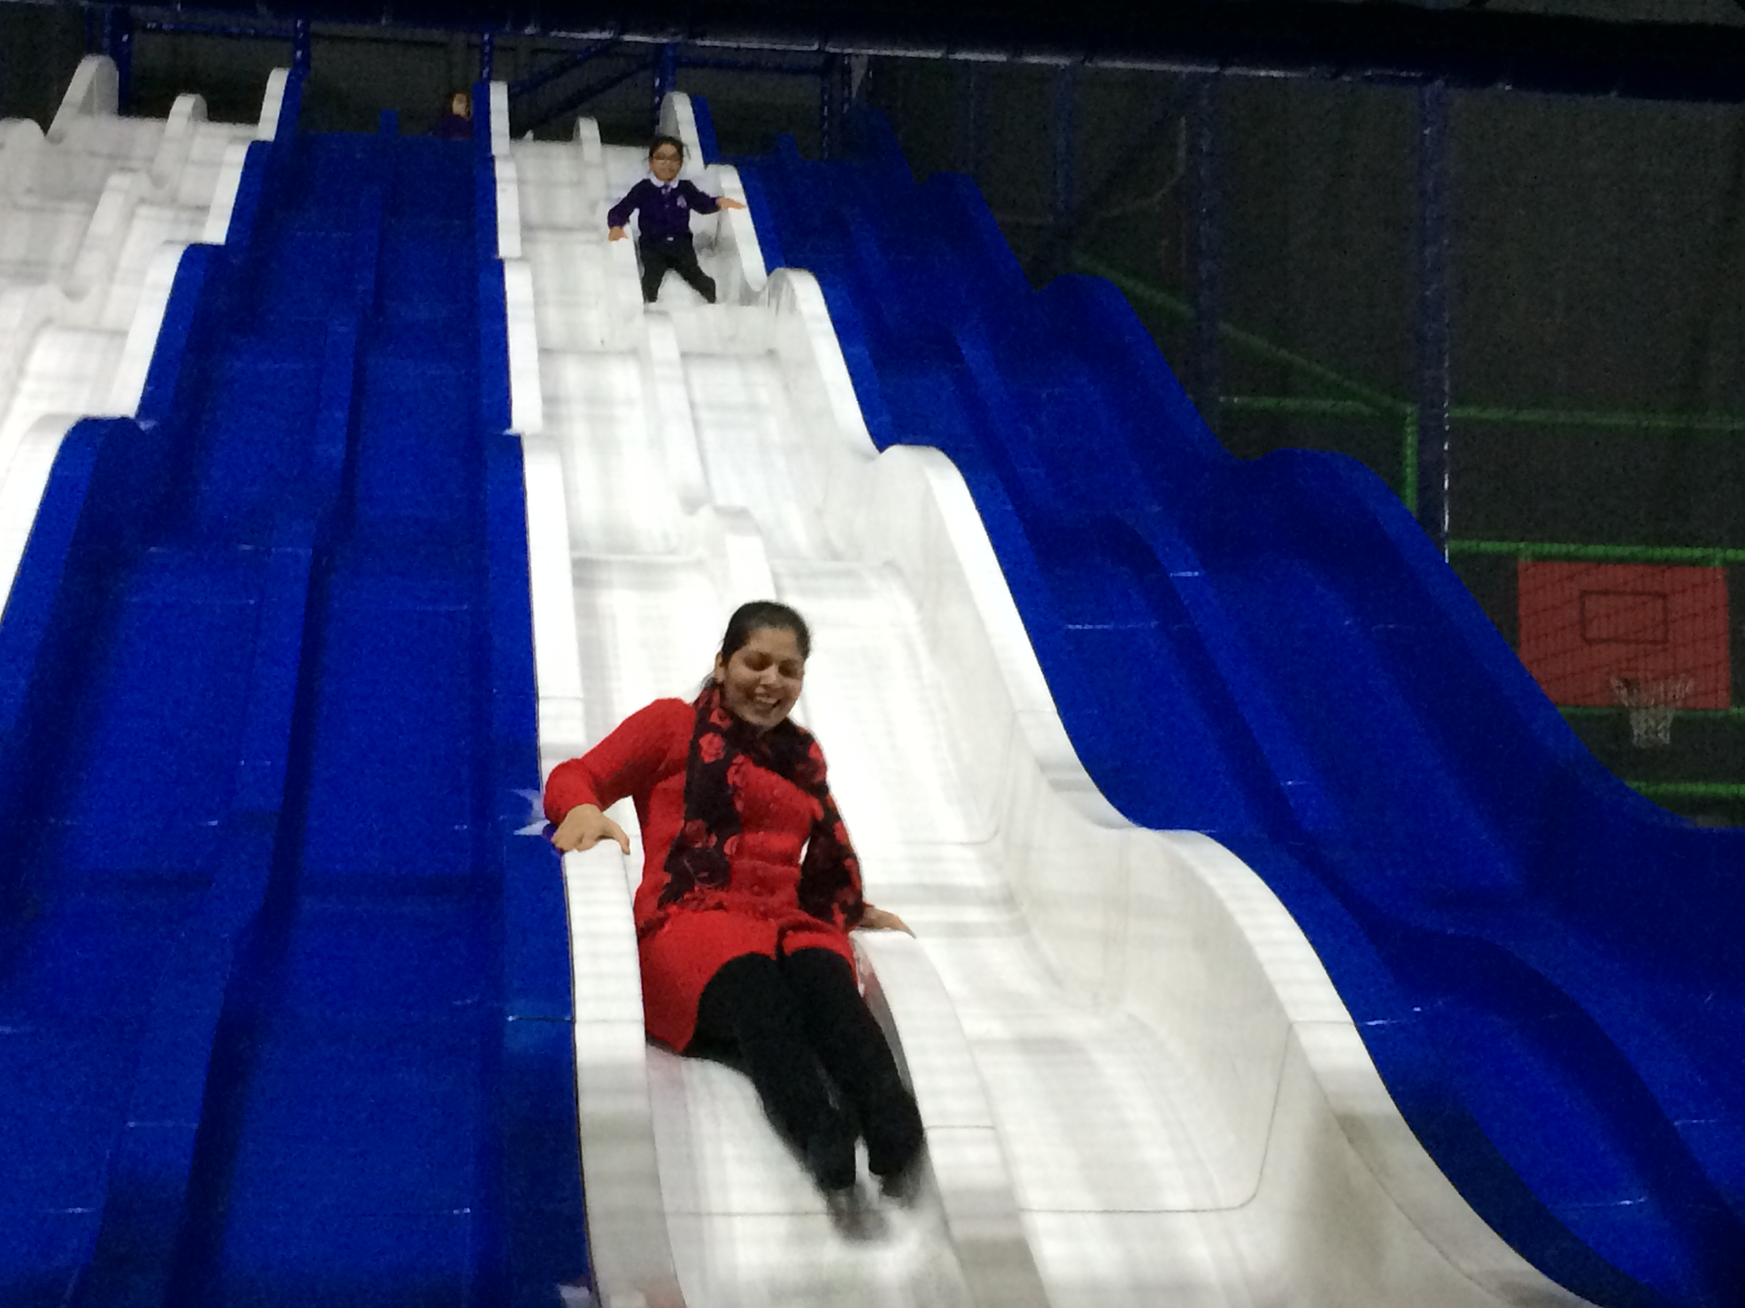

Slide 12
Families Connect
What Families Connect offers:
At least one fun activity/game to take home every week to try out with your child
Tips and ideas sheet to take home, with a fridge magnet bull clip to keep it handy
Snack for the children
A chance to get to know other parents and the school staff
Some time without the children to relax and recharge
Quality 1 on 1 time with one child,
Lots of fun!
Feelings Fan

Slide 13
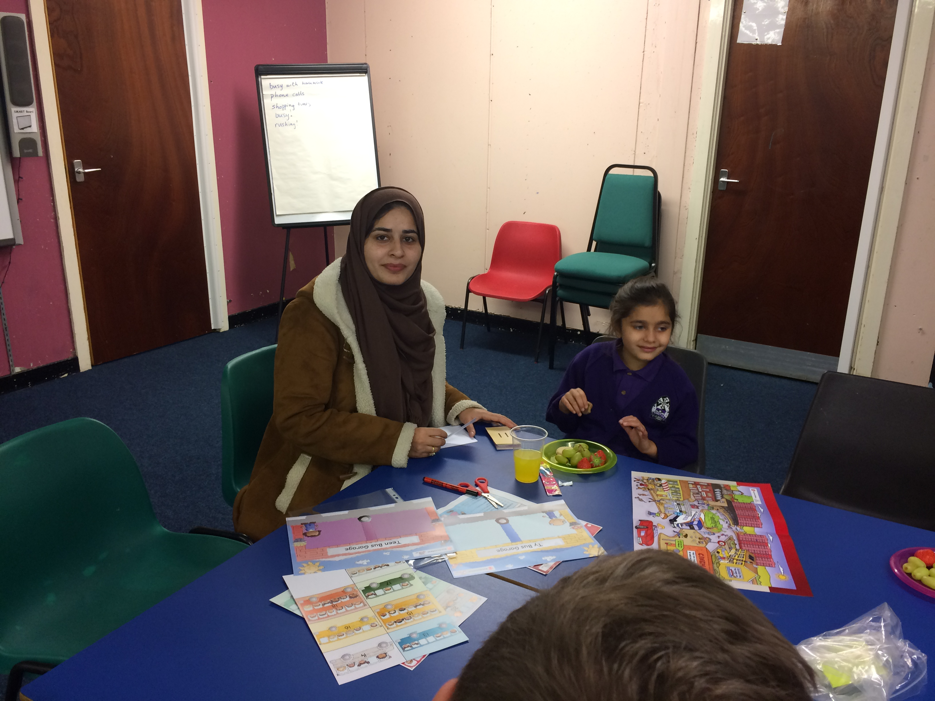

Slide 14
How to be part of Families Connect
Places are limited to 10 families.
If oversubscribed, families with a 5 year old are given a place, and it’s first come first served!
All you need to do is complete a Participation Form and a Questionnaire.
Questionnaires are anonymised and confidential. In the questionnaire, please give honest answers. If you don’t want to answer a particular question, this is perfectly ok.
Some question may seem personal, but they are all needed to find out if Families Connect is a useful programme and to get funding to offer it at other schools!

Slide 15
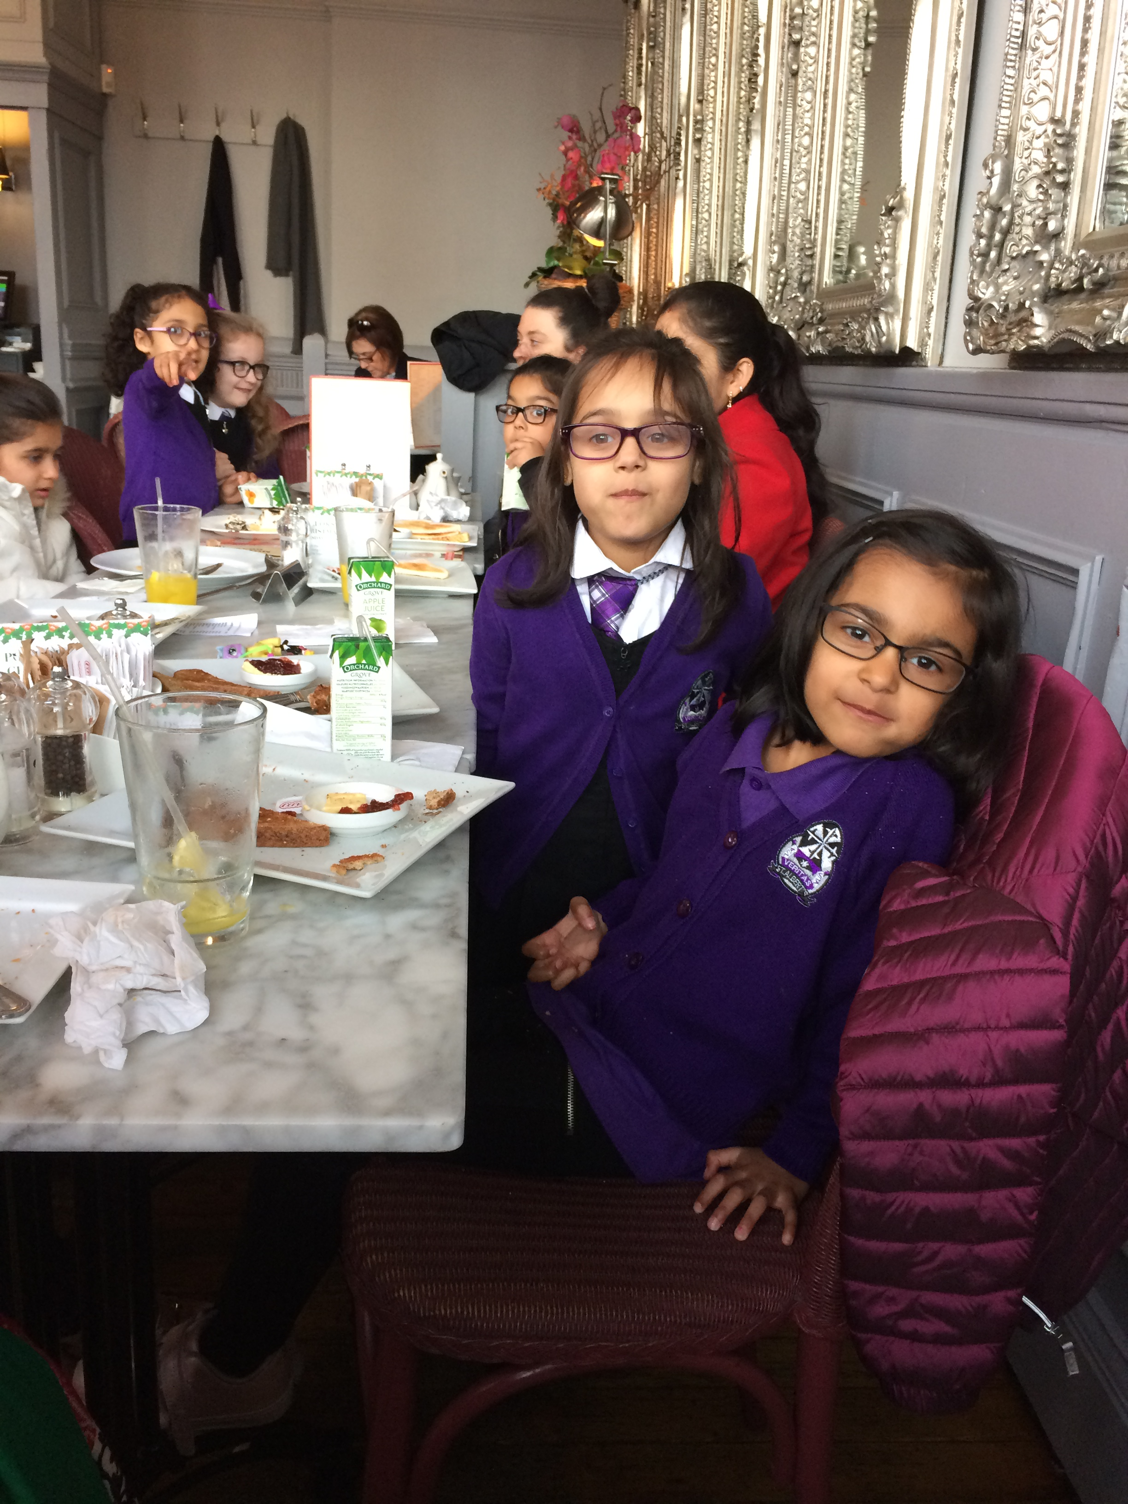

Slide 16
Any Questions?

