Slide 1
2012 Paper 2 Past paper
Worked Example
(circles)

Slide 2
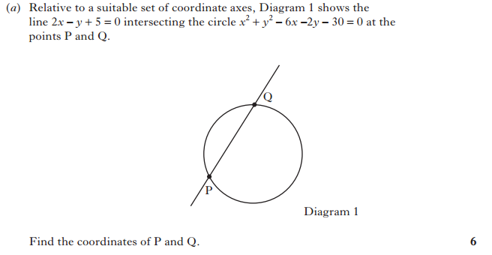

Slide 3
Steps
Solution
Rearrange straight line eq to y = 2x + 5
Substitute y into the circle eq
x² + (2x + 5)² - 6x - 2(2x + 5) - 30 = 0
Points of intersection
when y=y
Sub into circle eq
Expand brackets,
factorise and solve
Find x AND y coordinates!
x² + 4x² + 2-x + 25 - 6x - 4x - 10 -30 = 0
5x² + 10x - 15 = 0
5(x² + 2x - 3) = 0
(x - 1)(x + 3) = 0
x = 1 and x = -3
When x = 1, y = 2x1+5 = 7
When x = -3, y = 2x(-3)+5 = -1
P(-3,-1) and Q(1, 7)

Slide 4
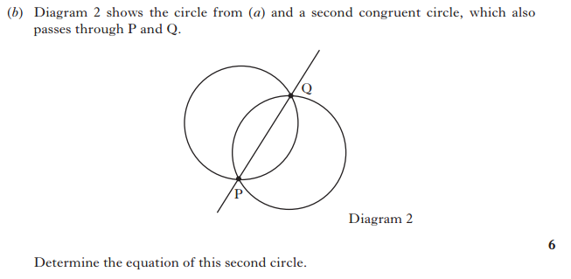

Slide 5
Steps
Solution
(x - 3)² - 9 + (y - 1)² - 1 - 30 = 0
(x - 3)² + (y - 1)² - 40 = 0
(x - 3)² + (y - 1)² = 40
C(3, 1) r = √40
Circle equation....
get centre and radius
Congruent => same size
Use “stepping out” method
Substitute centre and radius
into circle formula
Centre to Q = left 2, up 6
Q to 2nd centre = left 6, down 2
C2(-5, 5) r = 40
Eq: (x + 5)² + (y - 5)² = 40

