Slide 1
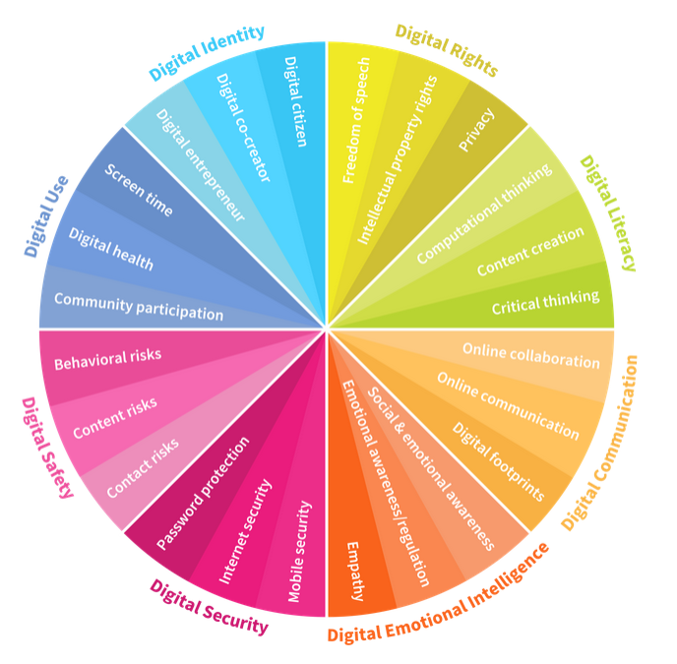
Shawlands Academy S1-S3 Digital Literacy Parents evening
Notes:
Welcome Screen

Slide 2
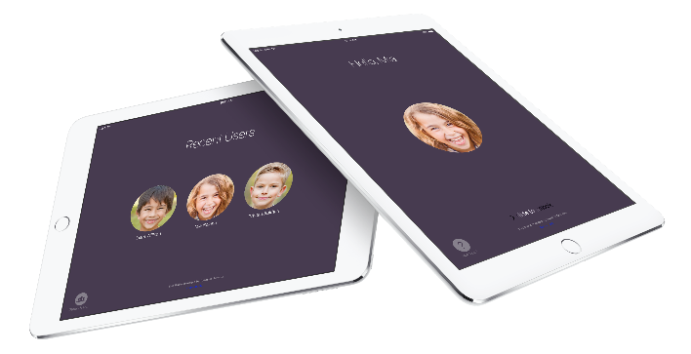
Welcome
Thank you for attending!
Today we will share:
Student expectations.
Digital learning
How Showbie works (S1-2)
Using Microsoft Teams (S3)

Slide 3
Student expectations
To be able to access your education pupils need to keep note of the following
Passcode for iPad (6 digit number) to unlock it.
Glow email username and password
PC username and password. (required on iPad if it requests you to input Proxy server update)
iPad software updates.

Slide 4
Student expectations
All reminders are emailed to pupils regularly along with the home use agreement
Can you have an agreed routine with your child about when it is charged and do not let them keep their iPad in their room at night.

Slide 5
Digital learning is here to stay
Digital Technology
Today, 84,400 people work in digital jobs in Scotland.
90% of jobs across the UK today already require the skills to use digital technologies confidently.
The digital sector alone contributes £4.5 billion to Scotland’s economy.
The number of digital businesses in Scotland increased almost twice as fast as across the UK as a whole.

Slide 6
Digital learning
Changes made to classrooms due to Covid-19.
Social Distancing in class.
Collecting in work from pupils.
Pupils self isolating at home.
Digital Learning is a tool that we are using to support and enhance the learning experience with our students.

Slide 7
Using Showbie
Used with S1-2 Pupils
All teachers are using this platform with their S1/2 classes.
We are working to standardise our school approach.
Platform allows:
Allows class discussions that everyone can see.
Instructions from teacher can be read back to pupils
Verbal feedback can be issued to pupils.
Staff can share their screen.
Pupils can upload hand written work.

Slide 8
Using Showbie
Time for an example.

Slide 9
Using Microsoft Teams
Used with S3 pupils.
S1/2 pupils have whole school year group teams.
All teachers are using this platform with their S3 classes.
Platform allows:
Upload materials and work,
Allows class discussions that everyone can see.
Pupils can upload hand written work.
Assignments issued to pupils.
Immersive reader supports pupils in Word documents.
Pupils can upload hand written work.
Use of One Note Classroom

Slide 10
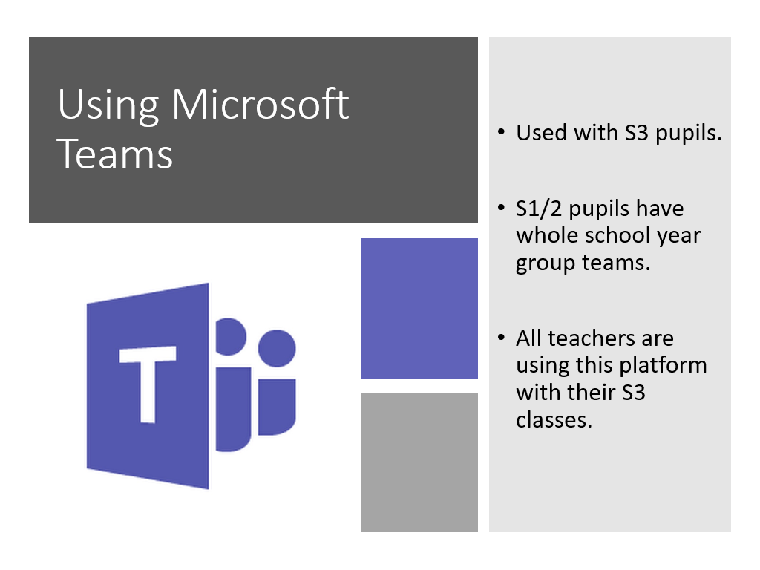
Introducing
PT Covid response Miss Ogdon.

Slide 11
Using Showbie
Time for an example.
Miss Ogdon is supporting pupils and parents who are affected by Covid 19 to support learning & teaching from home.

