Slide 1
Parental Study skills evening
Study techniques
Assessment Tips
Time Management and Organisation

Slide 2
QUALITY REVISION
“We don’t need students to be spending every waking hour revising, we just need them to be revising better for shorter periods”
“The key to effective revision isn't hours of cramming in the final few months, but regular, concentrated shorter periods”
TES ARTICLE
Short bursts of active study can be far more effective than just reading over notes for hours on end. Make sure that you're ACTIVELY involved in your study and then you TEST your understanding regularly.

Slide 3
Active Study
20% of what we READ
30% of what we HEAR
40% of what we SEE
50% of what we SAY
60% of what we DO
95% of what we TEACH someone else
So it is VERY important to use a VARIETY of techniques when studying

Slide 4
Feedback from former pupils
Should have started earlier with studying and review constantly throughout the year
Did well in prelims so thought I would be ok before final exam but did not do as well as did not keep up the same level of study
Should have asked for more clarification if unsure
Should have engaged with the support on offer
Social media is a big distraction – this has an impact on my study
More effort into my assignments as these make up a big chunk of my final exam
Should have attended more supported study.

Slide 5
Study Tips
Get rid of DISTRACTIONS – switch off mobile phone/social media sites – negotiate – take away temptations
Study sessions should focus entirely on the task – enjoyment and relaxation when on breaks
30 to 50 minute time slots – never more than an hour without a break
PLAN study and homework times – what is to be achieved in the study session/what activities are going to be completed – how will success be measured?

Slide 6
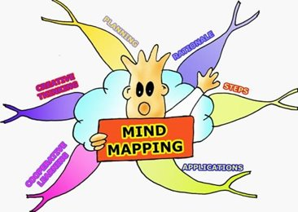
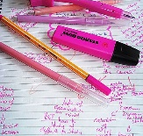
Study Skills
Memory techniques
Flashcards
Mind Maps
Note taking
recording

Slide 7
Useful Apps for studying
Book creator – Make up your own notes in the form of a book
BBC bitesize – good revision notes for most topics
Post it plus – Make up short hand notes
Quizlet – Make up revision cards on line
Make an IMOVIE or KEYNOTE presentation on a key topic and watch it back for revision
Teachers send out homework and revision notes through MICROSOFT TEAMS.
Create a study plan on your iPad with the SQA My Study Plan App

Slide 8
Effective note taking
Always write your notes in your own words. If you just copy, then the chances are that you will not understand as well
Techniques for taking notes
Less is more
Make your notes visual. Use symbols/drawings/illustrations
Be creative
Use different techniques
Use summary cards
Use a selection of coloured pens – make links with colour

Slide 9
Creating a ‘TWEET’
Select some revision notes or a newspaper article from bbc news to practise this technique.
If you can print it off and Highlight, underline or circle key points or read over the article several times
Using your own words write a ‘tweet’ summarising the article in 150 characters
Teach each other using only your tweet.

Slide 10
Revision Clock
A way of revising which can break a topic down into 12 (or fewer) sub-categories.
Student’s revise 12 different topics in 3-4 minute time periods.
They then have to fill each section with information, key words or pictures to represent what they can remember.

Slide 11
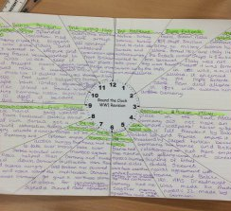
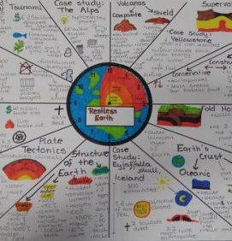
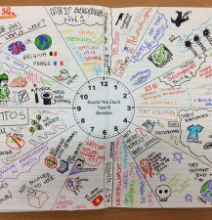
Examples of pupil revision clocks

Slide 12
Revision Cards
Revision cards are useful because they can be carried out – used anywhere
Help in planned study sessions when studying alone, with friends or parents
More interesting and motivating to work with summarised facts
rather than reading and writing out long passages
Summarise in bullet points – avoid long sentences
Use a question and answer format

Slide 13
Getting the most out of revision cards
Create
Create set cards throughout the year – so that they are ready when it is time to revise
Work
Work with friends/family – revision cards are an excellent way to test your understanding and for others to help with revision
Break
Use these cards as a way to break up studying by playing a quick revision game with the cards
GO
Use these on the go – through an app or with the cards

Slide 14
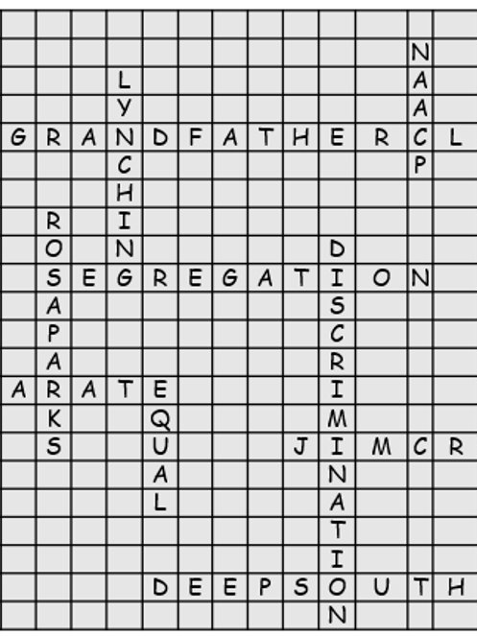
SCRABBLE
Think of a key word for a topic and write it in the middle of a grid
You have to fill as much of the grid as you can using other key words from the topic
You can only join them in a “Scrabble” way

Slide 15
Revision ideas
Mind maps – Create a mind map of a topic – linking ideas and information
Ever decreasing notes. Instead of just copying out notes endlessly, notes should be shorter each time you write them out.
Light-switch revision - A card template to go around the light-switch in bedrooms and be very effective in improving memory. Facts should be updated regularly
Test yourself Quiz - Series of questions about the topic including the answer underneath. Family/friends can help to test
Post-its – post its of key facts where they will be seen most
Teach what you have just learned to someone else
Record revision - 40% of what we hear is remembered and retained by our brains, therefore by repeating the recording we can remember even more
Timed questions – parents can help with this. This will be a massive help with time management
Look at feedback on a piece of work – apply all critical feedback to the current piece of work

Slide 16
Assessment Tips
Read instructions carefully.
Where possible do your best questions first
Look at the number of marks a question is worth
When tackling long questions, plan them first. A mind map is a good way to do this.
Underline the important words in a long question – this will help you break down the question and check that you have answered all parts to it

Slide 17
Assessment tips
Make sure you have all the equipment that you need
Don’t let one bad experience influence how you feel about yourself and the assessment
If you start to feel really stressed try some deep breathing exercises
Don't spend too long on one question – watch you timing
We LEARN from any mistakes that we make. What should we do differently next time

Slide 18
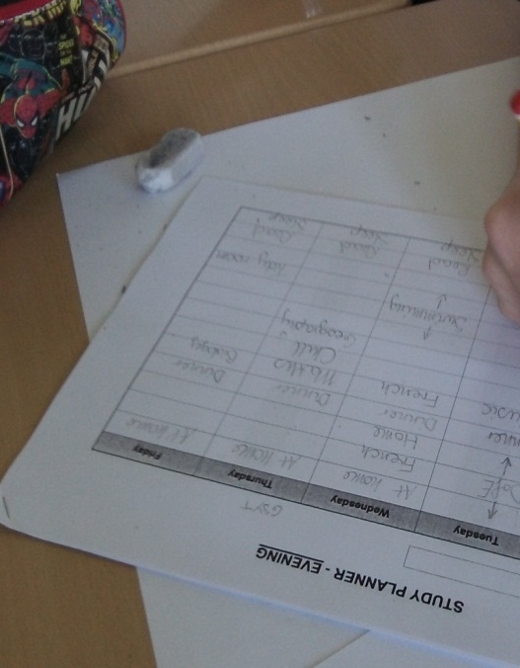
Organisation – creating your study plan
The secret to doing well in revision lies in planning. You can help your child to create a clear revision plan with methods of studying, a variety of subjects and suitable times. This will help them to feel in control of their work.
Block in all activities you have planned before study times
Be realistic – you want to keep to this study plan
When are you most effective study times – after school or after dinner?
What subjects need most revision? IMPORTANT TO HAVE A BALANCE OF SUBJECTS BUT SOME MAY NEED MORE STUDY THAN OTHERS

Slide 19
Thank you for listening
We will send out a form for your feedback and there will be an opportunity for you to ask any more questions that you have.

