Slide 1
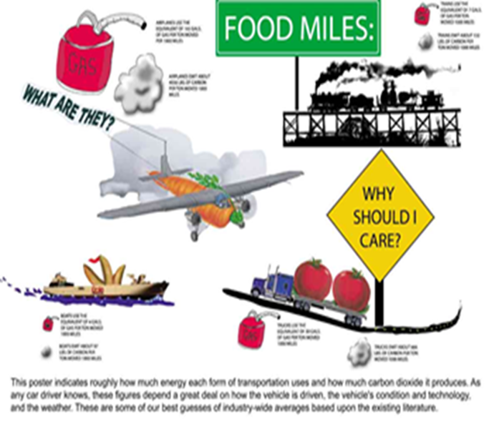
S3 Food Miles

Slide 2
Food Miles
Learning Intentions
Success Criteria
To learn about food miles and the advantages and disadvantages
I can explain the term ‘food miles’
I can identify advantages of transporting food from around the world
I can identify disadvantages of transporting food from around the world

Slide 3
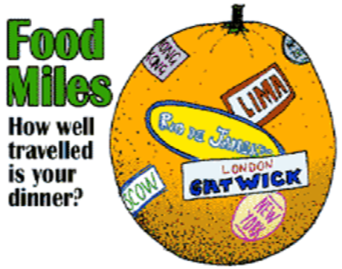
Food Miles
Today our food is travelling increasing distances by various methods of transport – air, sea, rail and road.
Food miles is the distance food is transported from the time of its making until it reaches the consumer.

Slide 4
Food Miles
Watch the 3 video clips about food waste and food miles
https://www.youtube.com/watch?v=t4VQ9pgWCFA&feature=fvwp&NR=1
https://www.youtube.com/watch?v=9Opt06QF9WY
https://www.truetube.co.uk/film/food-air-miles

Slide 5
Activity 1
Research the advantages and disadvantages of food miles
Create a PowerPoint presentation or poster showing the advantages and disadvantages of transporting foods from around the world. (Save document/Title as Food Miles Activity 1)
Include:
Title slide
Definition of food miles
Advantages
Disadvantages
Alternatives – seasonal foods/local produce
Examples of the distance food travels
Pictures
Use the food miles calculator to provide examples (see next slide for details on how to use the calculator)
Useful Website http://www.foodmiles.com/

Slide 6
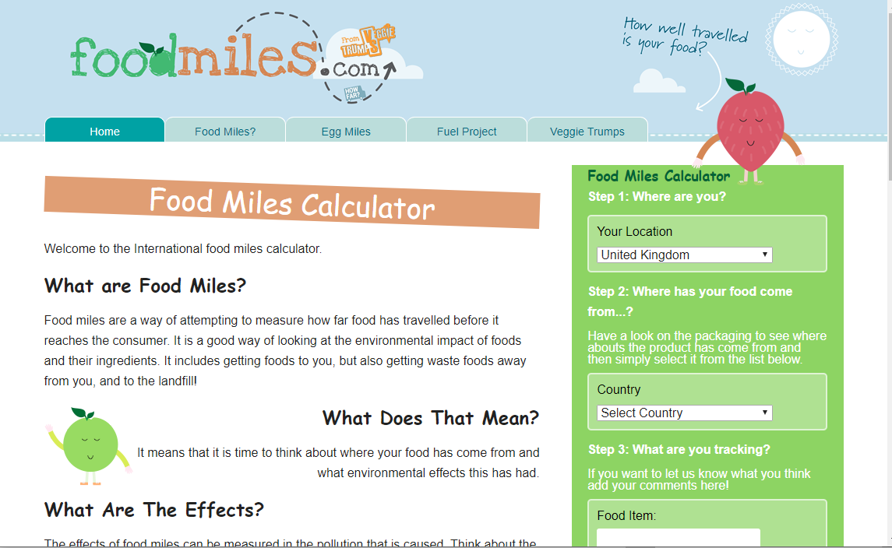

Slide 7
Activity 2
Task 1 Look at the list of foods below find out where the food come from.
Tomatoes Passion fruit
Lamb Oranges
Coconut Pineapple
Mango Banana
Beansprouts Sugar
Blueberries Prawns
Seabass New Zealand Lamb
Pick 4 other foods of your choice
Task 2 calculate how many miles it has to travel to the UK. (use the food miles calculator)
Write up your findings on paper or in a Word Document(Save document/Title Food Miles Activity 2)
REMEMBER TO PUT YOUR NAME ON YOUR WORK AND UPLOAD ONTO TEAMS OR
SEND VIA EMAIL TO YOUR CLASS TEACHER

