Slide 1
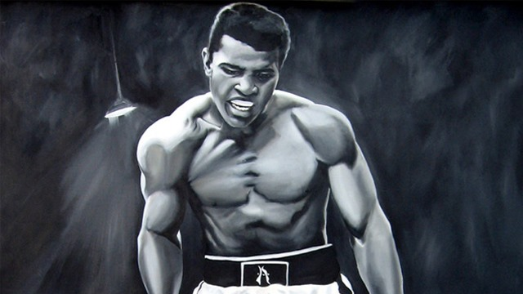
‘The Boxer’
Emma Payne

Slide 3
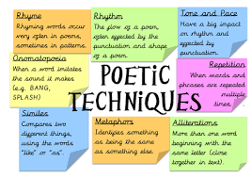
Learning Intentions
We will:
Learn how to analyse poetic techniques such as simile and metaphor.
Learn how to write a critical essay about poetry.
We will write an essay about ‘The Boxer’.

Slide 4
POETRY
Studying poems is a very important part of English.
This year, you will learn how to discuss, annotate and analyse poetry, and you will take these skills with you through school right up to National 5 and Higher English.
The poem we are going to look at today is called The Boxer.
First, though, we are going to discuss some common features of poetry that we need to know about.

Slide 5
POEMS
Poems are like very condensed, compressed stories.
They are usually fairly short, and have lots of poetic techniques in them to make them interesting to read.
Most poems contain an important theme or idea which should make you think.

Slide 6
Structure
Most poems are structured in a specific way. They will usually have different verses, known as stanzas.
When you refer to a particular section of a poem you can say which stanza it is in to make it clear which part of the poem you are talking about.

Slide 7
Poetic Techniques
Before we look at The Boxer, we are going to discuss some important poetic techniques that you should know about. These are:
Imagery
Metaphor
Simile
Personification
Alliteration
Repetition
Enjambment

Slide 8
Imagery
Phrases and sentences which create a particular image in a reader’s mind. Metaphors, similes, and personification are all examples of imagery.

Slide 9
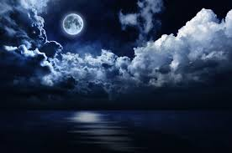
Simile and Metaphor
These are both examples of imagery which use a comparison.
A simile compares one thing to another using as or like, e.g. The moon was as bright as a spotlight.
A metaphor compares one thing saying it is something else e.g. The moon was a spotlight.

Slide 10
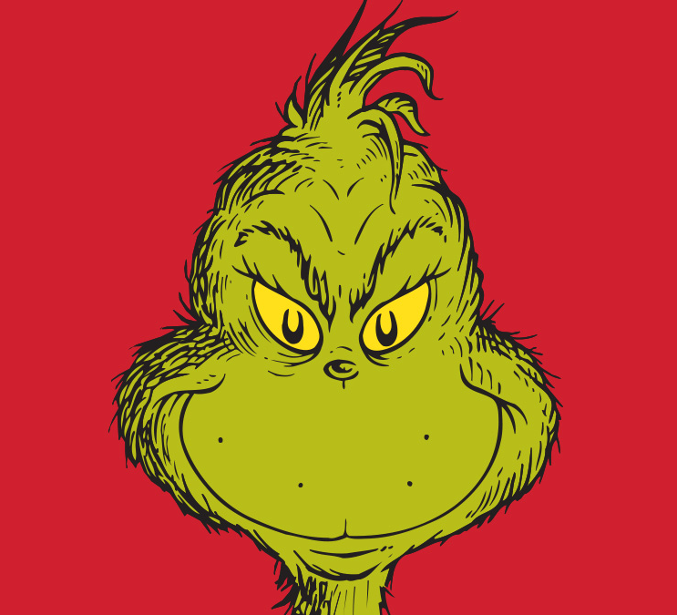
Lets look at simile and metaphor in more detail…

Slide 11
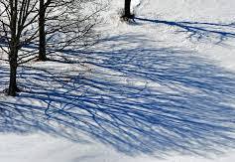
Personification
Personification is a technique which gives a non-living object living features. For example:
The shadows of the trees danced on the ground.
Trees’ shadows cannot literally dance, because they don’t have legs! However this kind of imagery helps us imagine the way things are happening – we can imagine how the trees’ shadows are moving here.

Slide 12
Alliteration
Alliteration is a technique where many of the words in a line all start with the same letter, creating a specific effect. For example:
The snake slithered softly on the soil.
This is usually used to draw attention to a specific phrase or sentence. What do you think the effect of the ‘s’ sound here is?

Slide 13
Repetition
Repetition is where words or phrases are repeated several times. For
example:
“In the swinging and the ringing
Of the bells, bells, bells.”
What do you think the effect of the repetition is here?

Slide 14
Enjambment
Enjambment is a technique where a sentence runs over from one line to the next, without punctuation. For example:
The flower unveils its colours, slowly Letting the shades reveal themselves to us.
Enjambment is used to draw attention to what is at the end of the line. What do you think the effect of the enjambment is here?

Slide 15
Task:
Write down the following sentences and identify the poetic techniques being used.
1. My living, laughing love.
2. The chair was a spinning world.
3. The stars twinkle like diamonds in the sky.
4. Let it snow, let it snow, let it snow.
5. We shouted shrilly in silhouette.
6. The hospital smell combs my nostrils.
We are now going to read the poem.

Slide 16
The Boxer
The great iron figure crouches, Scabs like flowers on his knees, And his chest is like a mountain And his legs are thick as a tree. He spits blood like a cherub In a fountain spouting foam, Ringed around by swing ropes And punters going home. Broken- knuckled, skinny eyed, Battered, bruised, and wet With droplets like cold rubies, And laced with bitter sweat. He crouches in a corner In his pool of sparkling red And dreads the jeers which soon fall Like blows upon his head.

Slide 17
Answer the following questions in your jotters.
What do you think this poem is about?
How do you know this?
What is the poem describing?
Choose three words from the poem which are interesting to you and explain why you find them interesting.
Choose three phrases which are memorable images and explain why you think they are memorable.

Slide 18
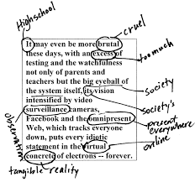
We are now going to annotate the poem.
Annotation is when we write comments, explanations and analysis on a poem to help us understand it.

Slide 19
Stanza 1
The first stanza gives the physical description of the Boxer, using a lot of imagery.
The man, who is very strong and has a good build, is described through images from nature to show that he is like a natural force , very tough and immovable (mountain simile, which also suggests that his chest is broad and muscular ).

Slide 20
Stanza 1
His legs are thick with muscle. His strength is displayed in his “great iron figure” (he is very hard to beat). But he is also hurt : he has “scabs like flowers” because they are bright red. This simile, which is creative and surprising, is the first hint of injury: the comparison between ugly, painful scabs and lovely soft flowers makes us think of the red symbols of his courage and perseverance)

Slide 21
Stanza 2
Here we learn that he is struggling, through the juxtaposition between the calm and gentle action of “a cherub” spouting water in a fountain and the vulgar, violent action of spitting blood. This emphasizes that the boxer is very badly injured and is losing a lot of blood, however, he is really determined because he carries on with his fight and is determined to finish it off.
“The punters going home” show that people now are giving up on him : the match has ended because the people who betted that he would win, are leaving.

Slide 22
Juxtaposition
The fact of two things being seen or placed close together with contrasting effect.

Slide 23
Stanza 3
This stanza gives another physical description of the boxer, which contrasts with the one in the first stanza.
He is depicted as broken and badly beaten up, and “the cold rubies” may refer both to his drops of blood and to the gemstones, meaning that is he losing the match and money. The “bitter sweat” can also represent the bitterness of defeat. This stanza draws further attention to the injuries sustained by the boxer: they seem to have dried up, which suggests he has already lost the fight.

Slide 24
Stanza 3
The poet uses a simile to describe the boxer’s exhaustion during the match: he is very tired as he is sweating profusely and is losing water, which is necessary in an exhausting sport like boxing. Therefore losing it is like losing rubies in the poem.

Slide 25
Stanza 4
At the beginning of this stanza the word “crouches” is used again, but with a different meaning: the man, once victorious, seems hiding in a corner, ashamed.
The poem ends with an effective image: the immovable boxer, crouching in a corner. It seems like he is refusing to lose.

Slide 26
Stanza 4
He has not fallen to the ground yet.
In “his pool of sparkling red”, he does not seem to fear all the physical blows on him but the comments of the audience - “the jeers which will soon fall/ like blows upon his head”.
But the simile shows that the boxer is brave enough to stay and receive the jeers without walking away like a coward.
Though he faces the crowd’s jeers if he were to lose the battle, which is very likely, he is determined to finish the fight, regardless of his loss: he is strong-willed, brave enough to continue although he is badly injured and in bad condition.

Slide 27
This poem focuses on the theme of never giving up and the message it conveys is that even if we are knocked down, or are beaten, we can refuse to give in because we can get back up again. The poem features many sound devices in this poem such as repetition and alliteration, imagery like powerful similes and metaphors.

Slide 28
Task:
You are now going to try writing your own poem about a person who does a job of your choice. They can be a baker, a teacher, or any other occupation you can think of.
You can make it rhyme if you want and should use the poetic techniques we have explored so far, including imagery (metaphors, similes, personification), alliteration and repetition.
Describe how they look and act in their job, and be as descriptive as possible.

Slide 29
This poem is very effective at creating an image in our heads of the character of the boxer.
Task: You are now going to try to draw the boxer based on the descriptions of him in the poem.

Slide 30
Poetic Techniques in ‘The Boxer’
Task:
Using different colours, highlight as many similes and metaphors as you can find in the poem.
Pick your favourite one and explain why it is your favourite. Why is it effective?

Slide 31
‘The Boxer’
The Great iron figure crouches, Scabs like flowers on his knees, And his chest is like a mountain And his legs are thick as a tree. He spits blood like a cherub In a fountain spouting foam, Ringed around by swing ropes And punters going home. Broken- knuckled, skinny eyed, Battered, bruised, and wet With droplets like cold rubies, And laced with bitter sweat. He crouches in a corner In his pool of sparkling red And dreads the jeers which soon fall Like blows upon his head.

Slide 32
Critical Essay Task
Task:
You are now going to write a critical essay about the poem The Boxer.
The Question:
Choose a poem which describes a person in a memorable way. By discussing poetic techniques (imagery, alliteration, etc.), show how the poet makes this person memorable.

Slide 33
Structure
Your essay will be structured like this:
Introduction
Summary
PEAR paragraph 1
PEAR paragraph 2
PEAR paragraph 3
Conclusion

Slide 34
Introduction
In your introduction, you simply rewrite the question, adding in the name of the poem and the poet. For example:
‘The Boxer’ by Emma Payne is a poem which describes a person in a memorable way.

Slide 35
Summary
After your introduction, give a brief summary of what the poem is about. For example:
The poem is about a boxer standing in a ring during a boxing match, and describes his appearance and his attitude towards the fight.

Slide 36
Summary
‘The Boxer’ is a descriptive poem about a boxer who fights in a brutal match. The boxer is fighting for victory however, it ends in bitter defeat. This poem describes his appearance, his attitude towards the fight and the struggles and pain he endures.

Slide 37
PEAR Paragraphs
What does PEAR stand for?
Point
Evidence
Analysis
Response

Slide 38
Point
For your point, you say one way the poet makes the boxer seem memorable. For example:
One way the poet makes the boxer seem memorable is through word choice.

Slide 39
Evidence
For your evidence, you give a quote which backs up your point. For example:
An example of this would be “cold rubies.”

Slide 40
Analysis
For your analysis, you show how your quote proves your
point. You should use your annotated poem to help you here.
For example:
The word choice is describing the blood on the floor of the boxing ring. It suggests that the boxer is losing both blood and money – ‘rubies’ are expensive, and red like blood.

Slide 41
Response
In your response, you give a personal response about your feelings. For example:
I think this makes the boxer seem like a memorable character because I can imagine the blood dripping off his wounds easily.

Slide 42
Pear Paragraph Exemplar
One way the poet makes the boxer seem memorable is through word choice. An example of this would be “cold rubies.” The word choice is describing the blood on the floor of the boxing ring. It suggests that the boxer is losing both blood and money – ‘rubies’ are expensive, and red like blood. I think this makes the boxer seem like a memorable character because I can imagine the blood dripping off his wounds easily.

Slide 43
Pear Paragraph Exemplar
One way the poet makes the boxer seem memorable is through word choice. An example of this would be “cold rubies.” The word choice is describing the blood on the floor of the boxing ring. It suggests that the boxer is losing both blood and money – ‘rubies’ are expensive, and red like blood. I think this makes the boxer seem like a memorable character because I can imagine the blood dripping off his wounds easily.

Slide 44
Pear Paragraph Exemplar
One way the poet makes the boxer seem memorable is through word choice. An example of this would be “cold rubies.” The word choice is describing the blood on the floor of the boxing ring. It suggests that the boxer is losing both blood and money – ‘rubies’ are expensive, and red like blood. I think this makes the boxer seem like a memorable character because I can imagine the blood dripping off his wounds easily.

Slide 45
Pear Paragraph Exemplar
One way the poet makes the boxer seem memorable is through word choice. An example of this would be “cold rubies.” The word choice is describing the blood on the floor of the boxing ring. It suggests that the boxer is losing both blood and money – ‘rubies’ are expensive, and red like blood. I think this makes the boxer seem like a memorable character because I can imagine the blood dripping off his wounds easily.

Slide 46
Pear Paragraph Exemplar
One way the poet makes the boxer seem memorable is through word choice. An example of this would be “cold rubies.” The word choice is describing the blood on the floor of the boxing ring. It suggests that the boxer is losing both blood and money – ‘rubies’ are expensive, and red like blood. I think this makes the boxer seem like a memorable character because I can imagine the blood dripping off his wounds easily.

Slide 47
Question
Choose a poem which describes a person in a memorable way. By discussing poetic techniques (imagery, alliteration, etc.), show how the poet makes this person memorable.
Copy this on to A4 lined paper.

Slide 48
Conclusion
In your conclusion, you briefly summarise what you have discussed in your essay, and then give a final comment about your opinion or thoughts about the poem.

Slide 49
‘The Boxer’ by Emma Payne is a poem which describes a person in a memorable way. ‘The Boxer’ is a descriptive poem about a boxer who fights in a brutal match. The boxer is fighting for victory however, it ends in bitter defeat. This poem describes his appearance, his attitude towards the fight and the struggles and pain he endures.

