Slide 1
SETTING

Slide 2
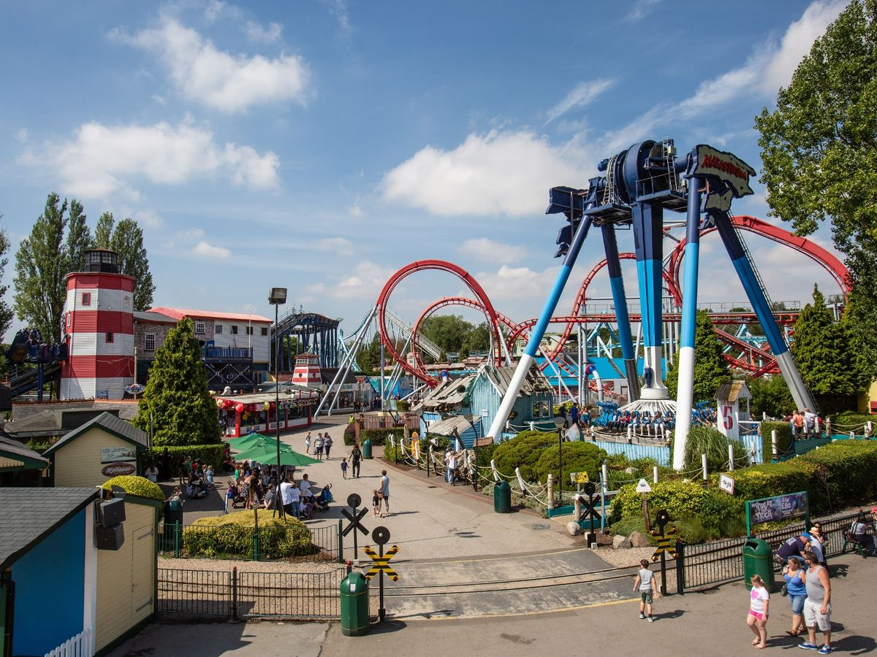
Task: Write 1-2 jotter pages which describe the setting.
Success Criteria
Powerful adjectives
Sensory description – See, Hear, Smell, Touch, Taste
TWO examples of imagery (minimum) – Simile/Metaphor
e.g. Simile – The sun was as hot as an oven
Metaphor – My heart was a hammer in my chest
Do NOT simply list I can smell, I can hear, I can feel…
Success Criteria
Powerful adjectives
Sensory description – See, Hear, Smell, Touch, Taste
TWO examples of imagery (minimum) – Simile/Metaphor
e.g. Simile – The sun was as hot as an oven
Metaphor – My heart was a hammer in my chest

Slide 3
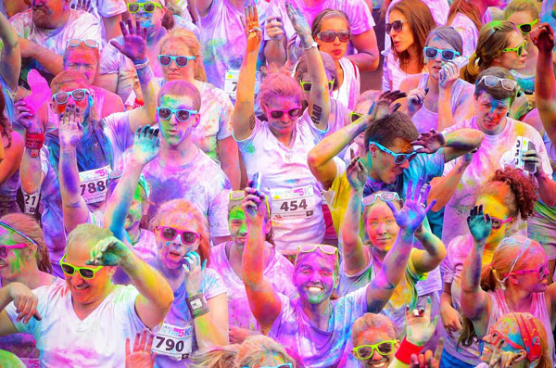
Task: Write 1-2 jotter pages which describe the setting.
Success Criteria
Powerful adjectives
Sensory description – See, Hear, Smell, Touch, Taste
TWO examples of imagery (minimum) – Simile/Metaphor
e.g. Simile – The sun was as hot as an oven
Metaphor – My heart was a hammer in my chest
Do NOT simply list I can smell, I can hear, I can feel…
Success Criteria
Powerful adjectives
Sensory description – See, Hear, Smell, Touch, Taste
TWO examples of imagery (minimum) – Simile/Metaphor
e.g. Simile – The sun was as hot as an oven
Metaphor – My heart was a hammer in my chest

Slide 4
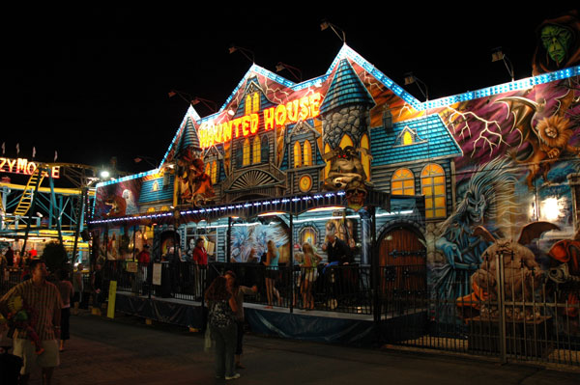
Task: Write 1-2 jotter pages which describe the setting.
Success Criteria
Powerful adjectives
Sensory description – See, Hear, Smell, Touch, Taste
TWO examples of imagery (minimum) – Simile/Metaphor
e.g. Simile – The sun was as hot as an oven
Metaphor – My heart was a hammer in my chest
Do NOT simply list I can smell, I can hear, I can feel…

Slide 5
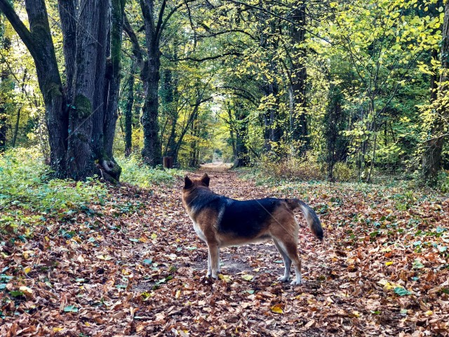
Task: Write 1-2 jotter pages which describe the setting.
Success Criteria
Powerful adjectives
Sensory description – See, Hear, Smell, Touch, Taste
TWO examples of imagery (minimum) – Simile/Metaphor
e.g. Simile – The sun was as hot as an oven
Metaphor – My heart was a hammer in my chest
Do NOT simply list I can smell, I can hear, I can feel…
Success Criteria
Powerful adjectives
Sensory description – See, Hear, Smell, Touch, Taste
TWO examples of imagery (minimum) – Simile/Metaphor
e.g. Simile – The sun was as hot as an oven
Metaphor – My heart was a hammer in my chest

Slide 6
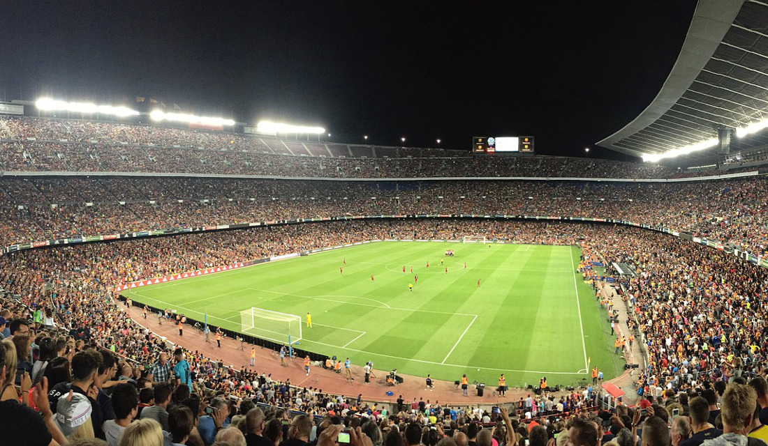
Task: Write 1-2 jotter pages which describe the setting.
Success Criteria
Powerful adjectives
Sensory description – See, Hear, Smell, Touch, Taste
TWO examples of imagery (minimum) – Simile/Metaphor
e.g. Simile – The sun was as hot as an oven
Metaphor – My heart was a hammer in my chest
Do NOT simply list I can smell, I can hear, I can feel…
Success Criteria
Powerful adjectives
Sensory description – See, Hear, Smell, Touch, Taste
TWO examples of imagery (minimum) – Simile/Metaphor
e.g. Simile – The sun was as hot as an oven
Metaphor – My heart was a hammer in my chest

Slide 7
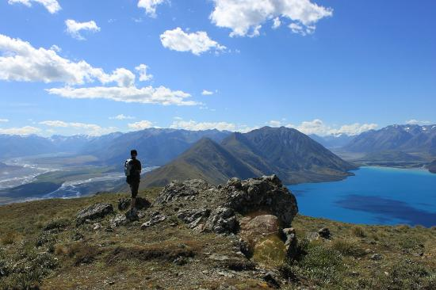
Task: Write 1-2 jotter pages which describe the setting.
Success Criteria
Powerful adjectives
Sensory description – See, Hear, Smell, Touch, Taste
TWO examples of imagery (minimum) – Simile/Metaphor
e.g. Simile – The sun was as hot as an oven
Metaphor – My heart was a hammer in my chest
Do NOT simply list I can smell, I can hear, I can feel…
Success Criteria
Powerful adjectives
Sensory description – See, Hear, Smell, Touch, Taste
TWO examples of imagery (minimum) – Simile/Metaphor
e.g. Simile – The sun was as hot as an oven
Metaphor – My heart was a hammer in my chest

Slide 8
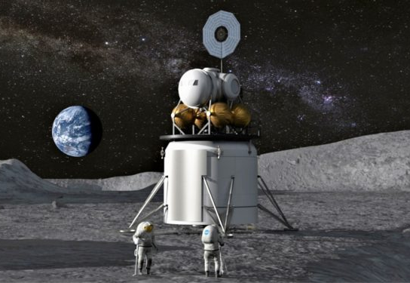
Task: Write 1-2 jotter pages which describe the setting.
Success Criteria
Powerful adjectives
Sensory description – See, Hear, Smell, Touch, Taste
TWO examples of imagery (minimum) – Simile/Metaphor
e.g. Simile – The sun was as hot as an oven
Metaphor – My heart was a hammer in my chest
Do NOT simply list I can smell, I can hear, I can feel…
Success Criteria
Powerful adjectives
Sensory description – See, Hear, Smell, Touch, Taste
TWO examples of imagery (minimum) – Simile/Metaphor
e.g. Simile – The sun was as hot as an oven
Metaphor – My heart was a hammer in my chest

Slide 9
CHARACTER

Slide 10
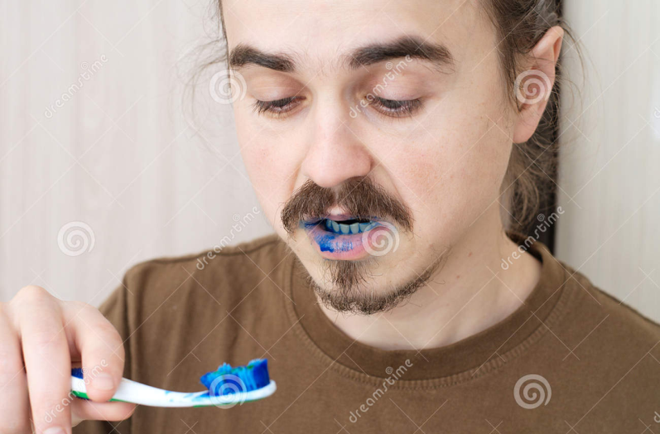
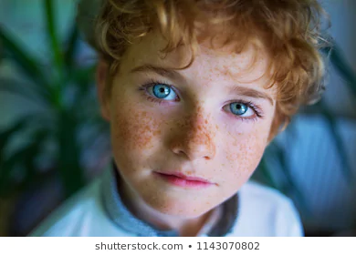
Task: Write 1-2 jotter pages which describe the character.
Success Criteria
Powerful adjectives – e.g. ginormous, flowing, lustrous
TWO examples of imagery (minimum) – Simile/Metaphor
THINK: Body type, interests, age, facial features, how they hold themselves, how they talk to other people etc.
SHOW DON’T TELL!
Success Criteria
Powerful adjectives
Sensory description – See, Hear, Smell, Touch, Taste
TWO examples of imagery (minimum) – Simile/Metaphor
e.g. Simile – The sun was as hot as an oven
Metaphor – My heart was a hammer in my chest

Slide 11
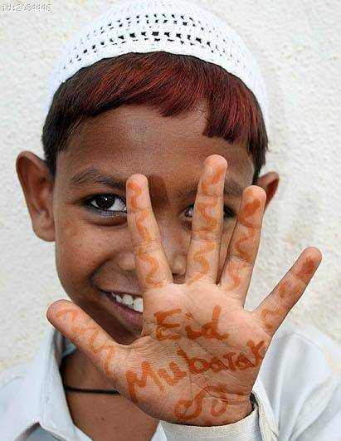
Task: Write 1-2 jotter pages which describe the character.
Success Criteria
Powerful adjectives – e.g. ginormous, flowing, lustrous
TWO examples of imagery (minimum) – Simile/Metaphor
THINK: Body type, interests, age, facial features, how they hold themselves, how they talk to other people etc.
SHOW DON’T TELL!
Success Criteria
Powerful adjectives
Sensory description – See, Hear, Smell, Touch, Taste
TWO examples of imagery (minimum) – Simile/Metaphor
e.g. Simile – The sun was as hot as an oven
Metaphor – My heart was a hammer in my chest

